Slide 1

The Barnes-Hut Algorithm:
A N-body Simulator
By:
Gabriel Balarezo
Advaced Programming
April 8, 2025

Slide 2
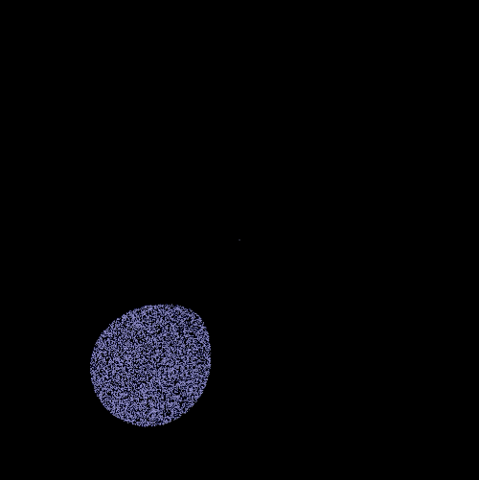
Agenda
Introduction: What is the N-body problem?
The Brute Force Method
The Barnes-Hut Approximation
C++ Implementation: early stage!
Preliminary Results

Slide 3
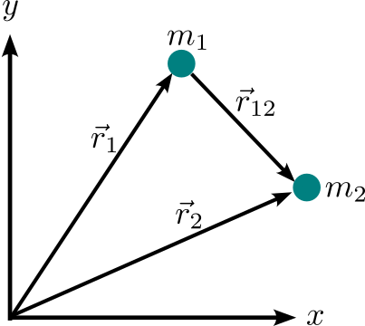
The N-body problem
Refers to the task of predicting the individual motions of a group of N interacting particles
under the influence of mutual forces, typically gravity.
Newton’s law of gravitation
General problem
Equations of motion
… so, where is the problem?

Slide 4
Solving the N-body problem
For N=1 and N=2 the equations of motion can be solved analytically.
Nevertheless, for N≥ 3 , there is no general analytical solution, and we
require numerical methods to approximate a solution.
For N=1 and N=2 the equations of motion can be solved analytically.
Nevertheless, for N≥ 3 , there is no general analytical solution, and we
require numerical methods to approximate a solution.
Direct method (Brute force)
💡
For each body we have to perform N −1
force calculations. A complete update of the
system requires N(N−1) calculations.
This is the most accurate method, however,
it is computationally expensive.
It has a time complexity of
… what can we do?

Slide 5
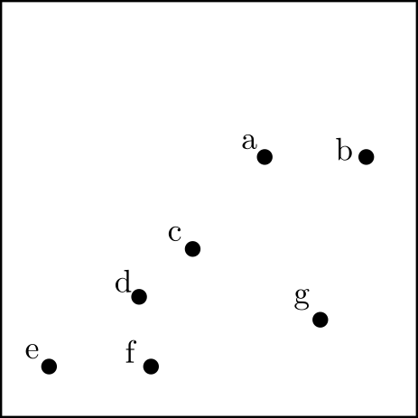
The Barnes-Hut Approximation
The Barnes-Hut algorithm is an approximation algorithm for performing
an N-body simulation with a time complexity of
How does it work?...
It approximates long-range forces by replacing a group of distant bodies with their centre of mass. It utilises a quadtree data structure to partition the simulation space into four equal quadrants recursively.

Slide 6
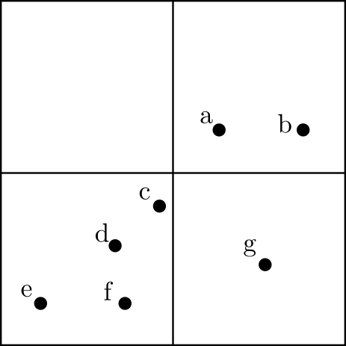
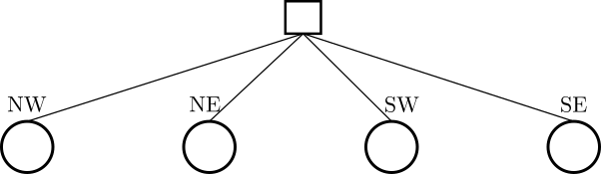
The Barnes-Hut Approximation
Implementation steps:
Divide the simulation space into 4 quadrants, each represented by a node in a tree.
If a node contains more than one body, it is subdivided into four child nodes, and redistribute the bodies.
Repeat the process recursively until each node contains at most one body.

Slide 7
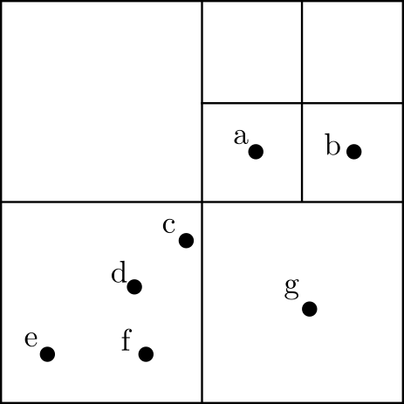
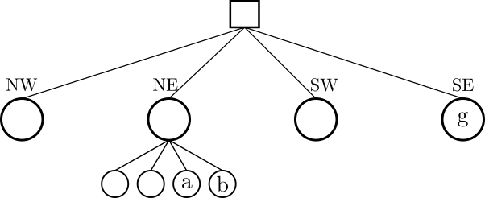
The Barnes-Hut Approximation
Implementation steps:
Divide the simulation space into 4 quadrants, each represented by a node in a tree.
If a node contains more than one body, it is subdivided into four child nodes, and redistribute the bodies.
Repeat the process recursively until each node contains at most one body.

Slide 8
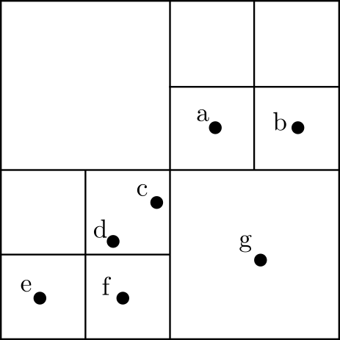
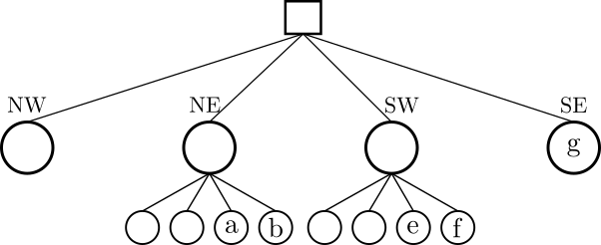
The Barnes-Hut Approximation
Implementation steps:
Divide the simulation space into 4 quadrants, each represented by a node in a tree.
If a node contains more than one body, it is subdivided into four child nodes, and redistribute the bodies.
Repeat the process recursively until each node contains at most one body.

Slide 9
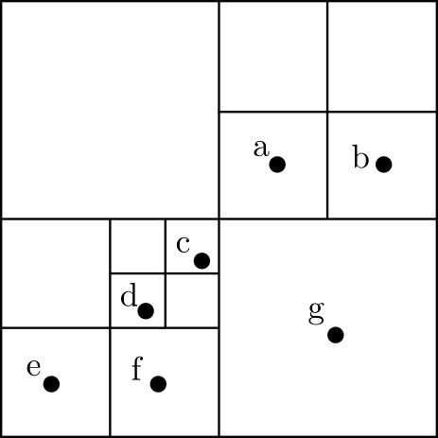
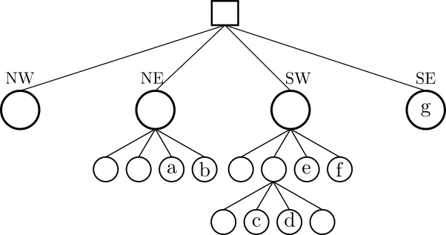
The Barnes-Hut Approximation
Implementation steps:
Divide the simulation space into 4 quadrants, each represented by a node in a tree.
If a node contains more than one body, it is subdivided into four child nodes, and redistribute the bodies.
Repeat the process recursively until each node contains at most one body.

Slide 10
The Barnes-Hut Approximation
Force calculation:
Each node stores the centre of mass and the total mass of the node.
We compute the distance d between mi and the centre of mass of the node, and the size D of the node.
Use the θ criterion to decide whether to compute the forces with the direct method or with the Barnes-Hut approximation.
Avoiding the summation...

Slide 11
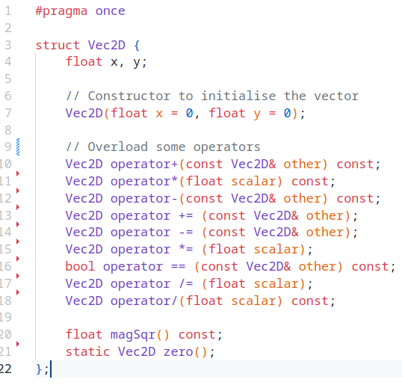
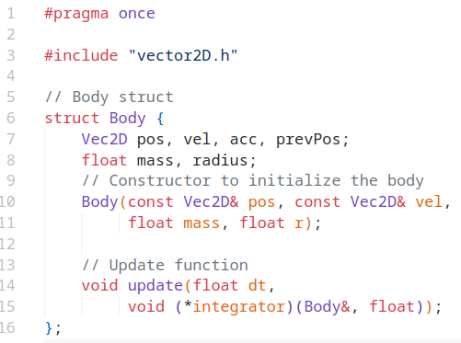
C++ Implementation: early stage
Body.h
vector2D.h

Slide 12
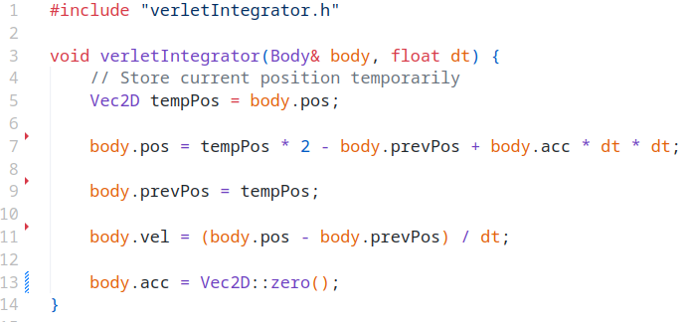
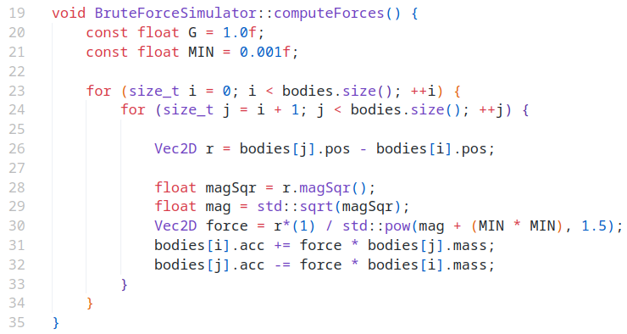
C++ Implementation: early stage
Verlet Integration
Force calculation

Slide 13
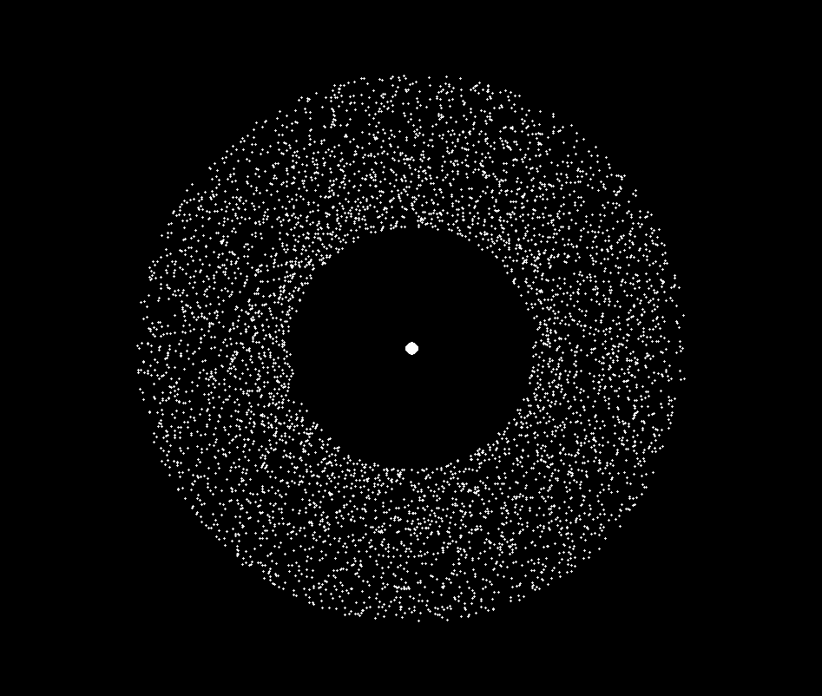
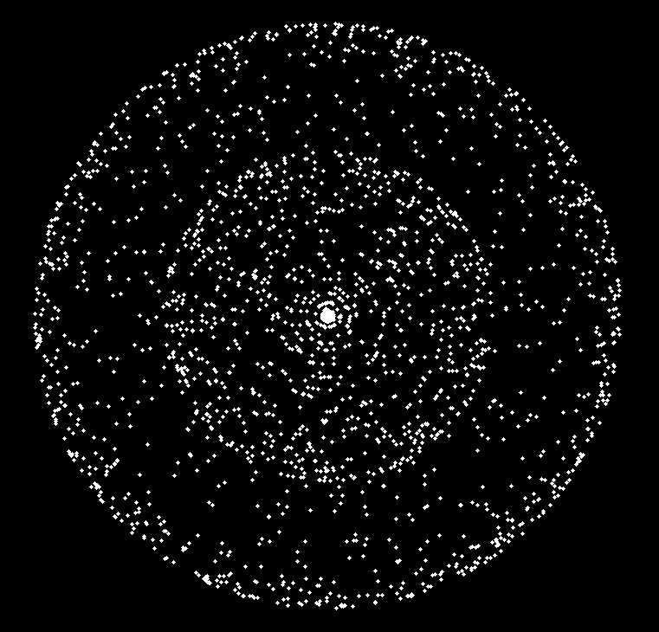
Preliminary results

Slide 14
Thanks for your attention!!
Any questions?

