Slide 1

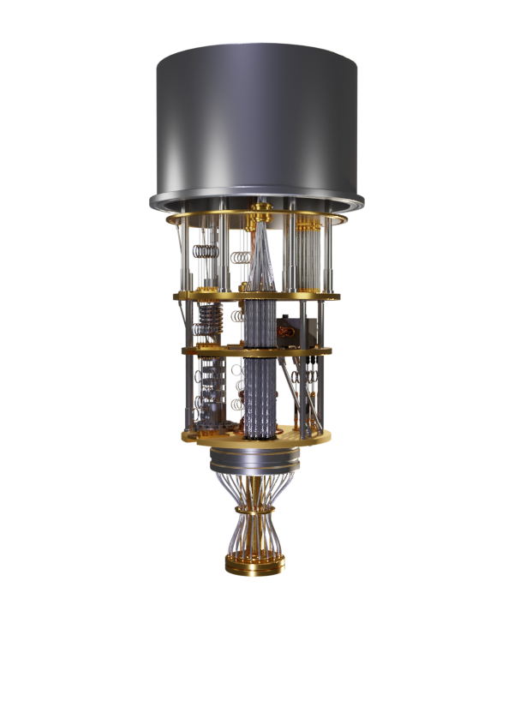
Introduction to Quantum Computing: From Qubits to Circuits
Quantum Computing Club Yachay Tech
By Gabriel Balarezo

Slide 2

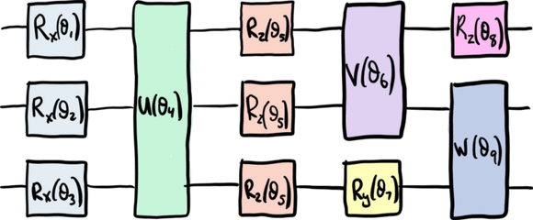
Overview
  Introduction to Quantum Computing
  Quantum Bits and Superposition
  Entanglement
  Quantum Gates and Circuits

Slide 3
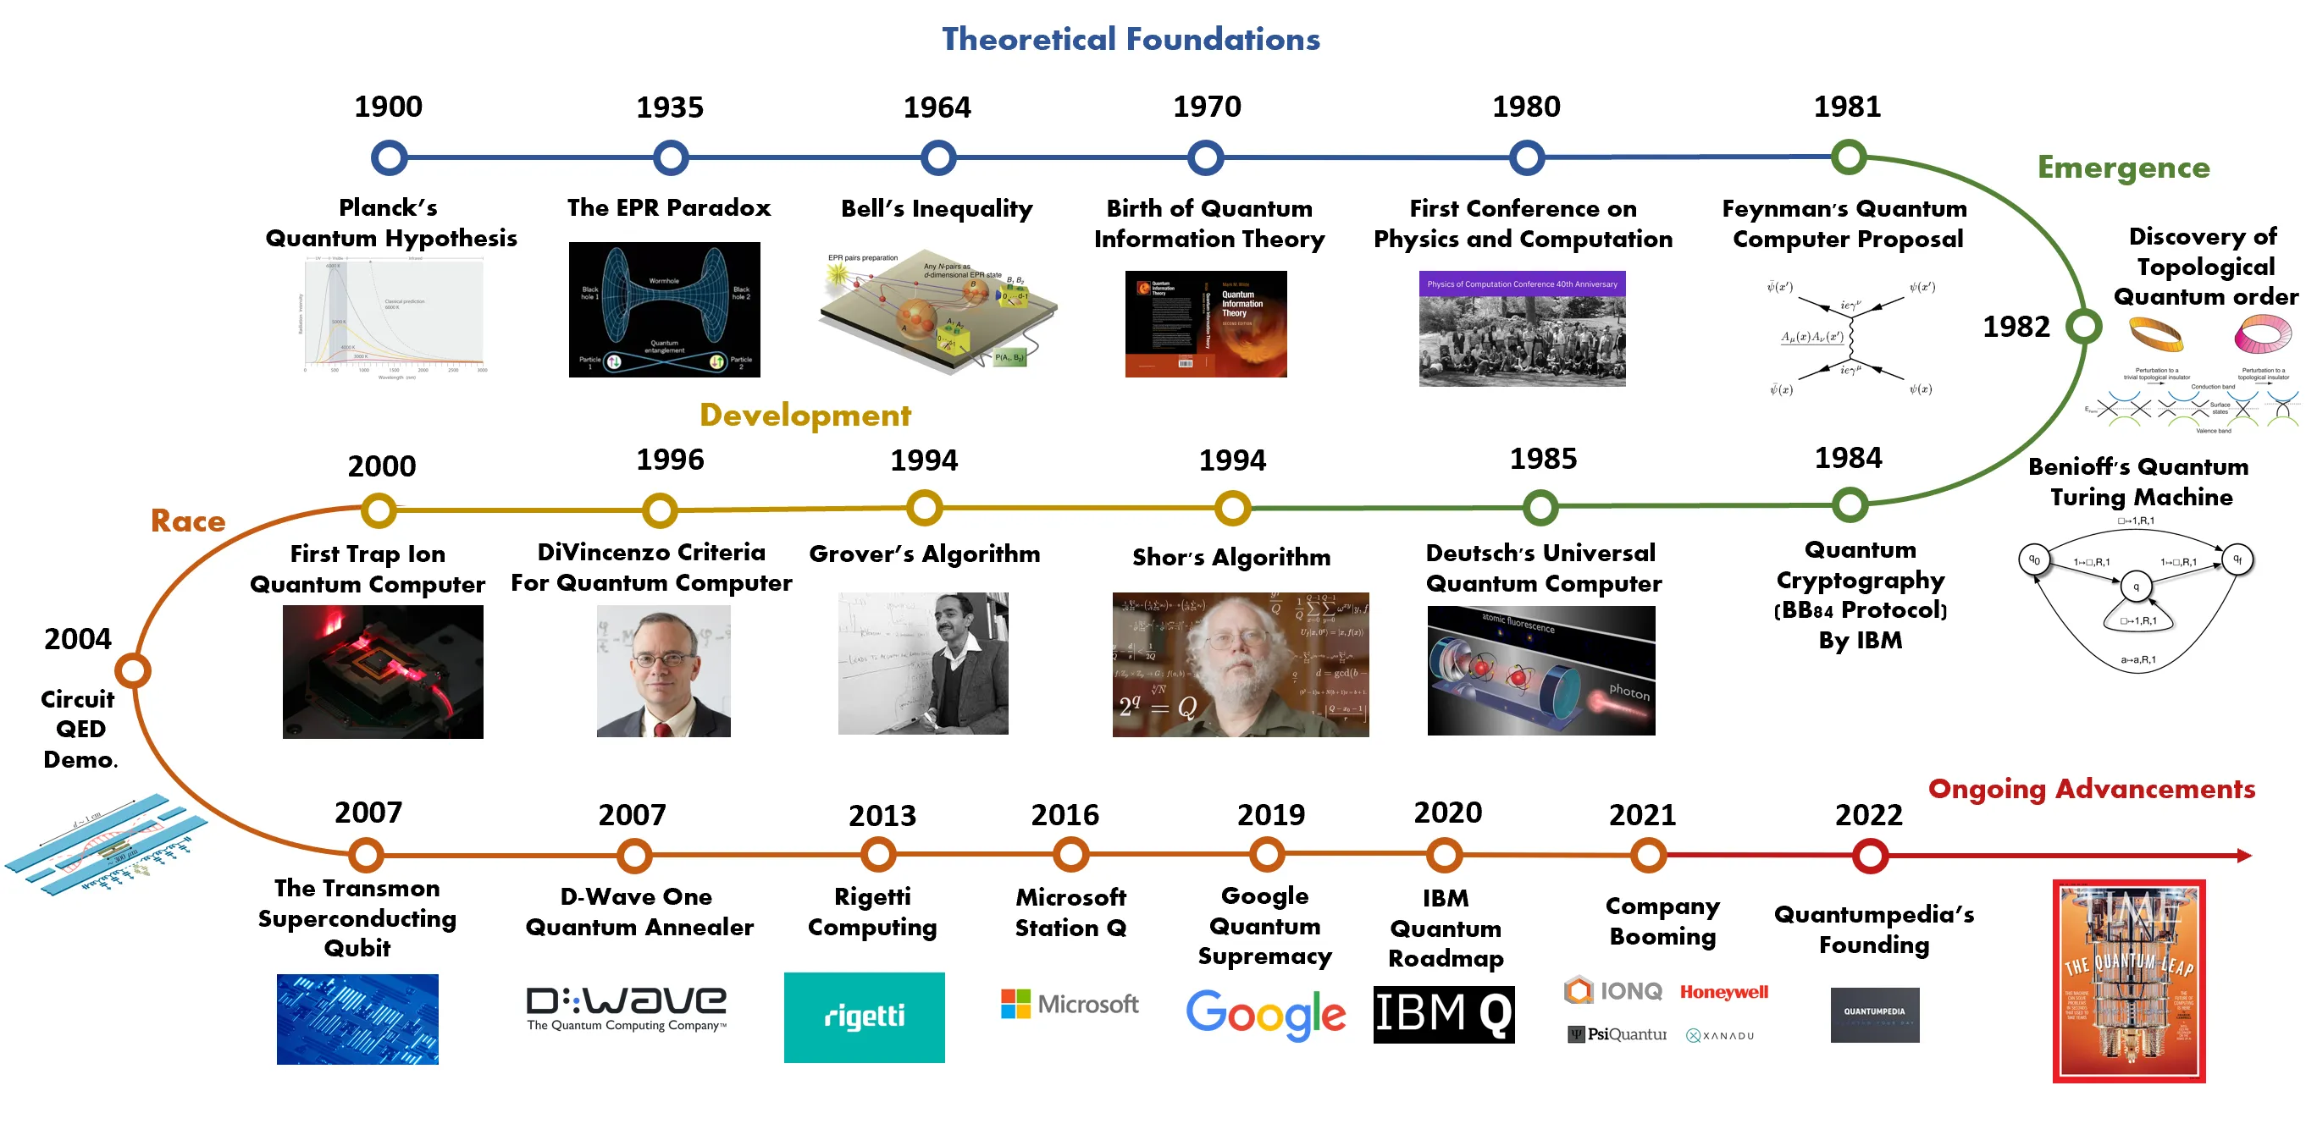
Roadmap

Slide 4
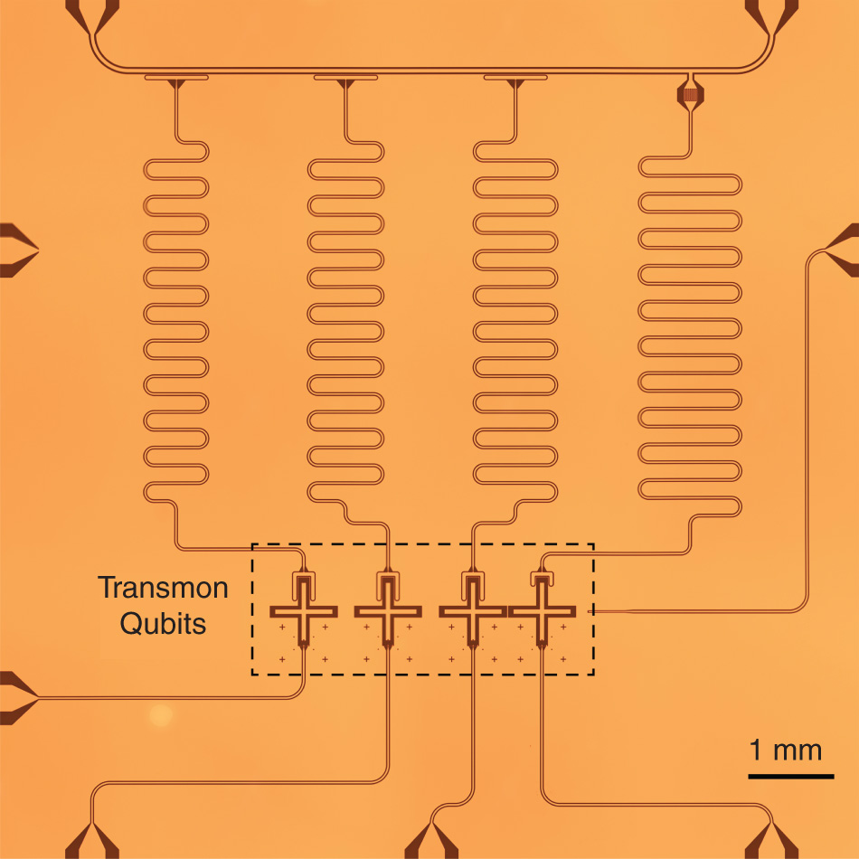


Introduction
What is quantum computing?
Quantum computing uses quantum mechanics to process information in ways classical computers cannot.
Classical vs. Quantum
Classical bits
Quantum bits (Qubit)
...superposition!!
How do we represent a Qubit?
Basis states
Quantum state
α and β can be complex!

Slide 5

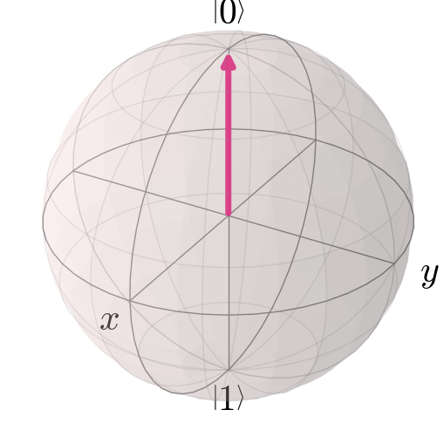
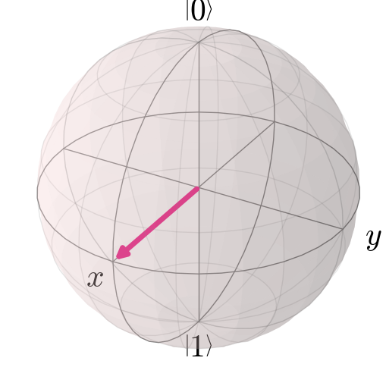
Superposition
Qubits and Superposition
Quantum superposition is a fundamental principle in quantum mechanics that describes how a quantum system can exist in multiple states simultaneously until it is observed!
Why is it important?
Parallelism: quantum computers can explore many possibilities at once. With n qubits, we can represent 2^{n} states simultaneusly.
Speedup: this allows quantum computers to outperform classical counterparts by exploiting all possible solutions in parallel.
Interference: works by boosting correct results and suppressing wrong ones.

Slide 6
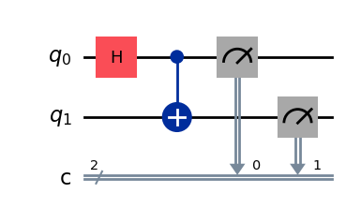
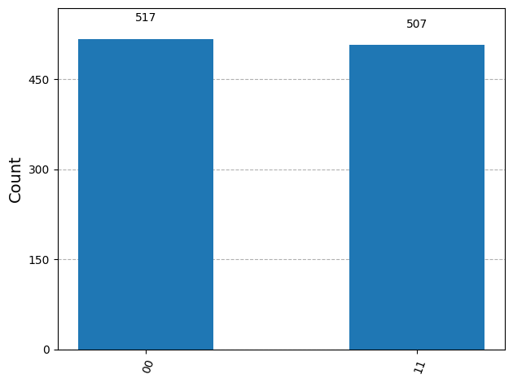
Entanglement
What is entanglement?
It is a quantum phenomenon where two or more qubits become linked. Measuring the state of one of them instantly determines the state of the other!
Why is it important?
Quantum Teleportation.
Quantum Error Correction
Parallelism
Quantum Cryptography
Bell states

Slide 7
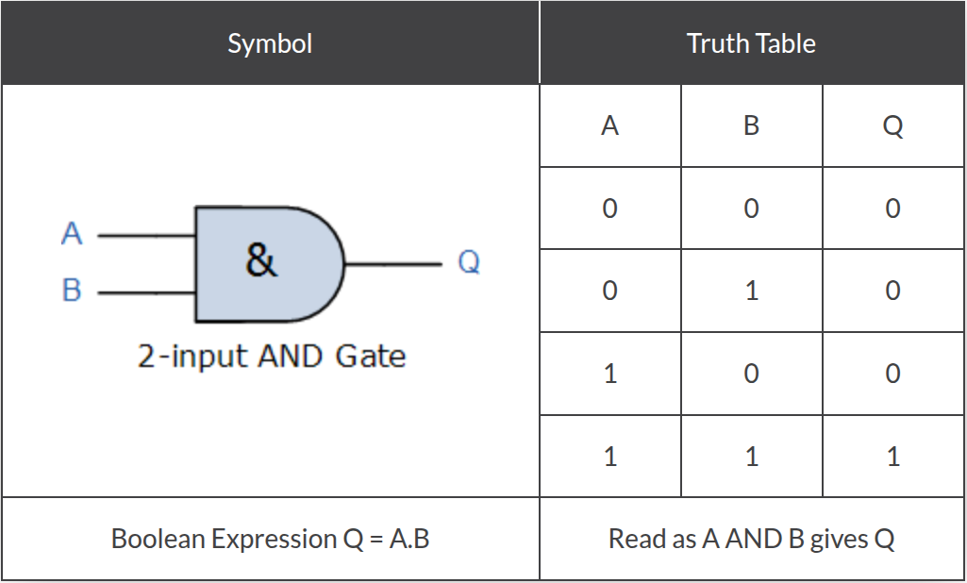
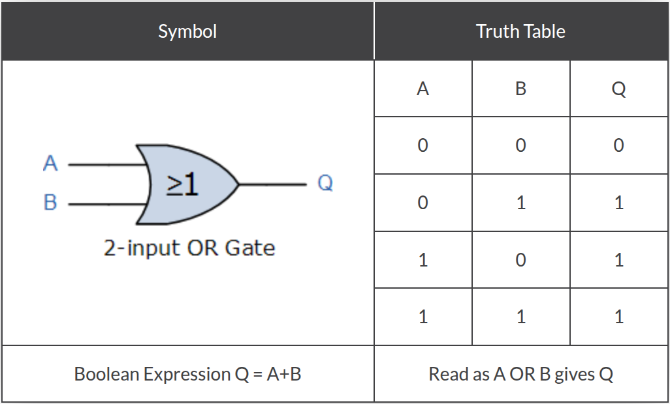
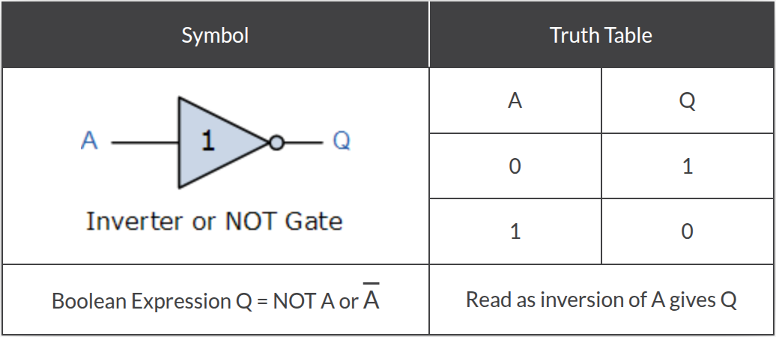
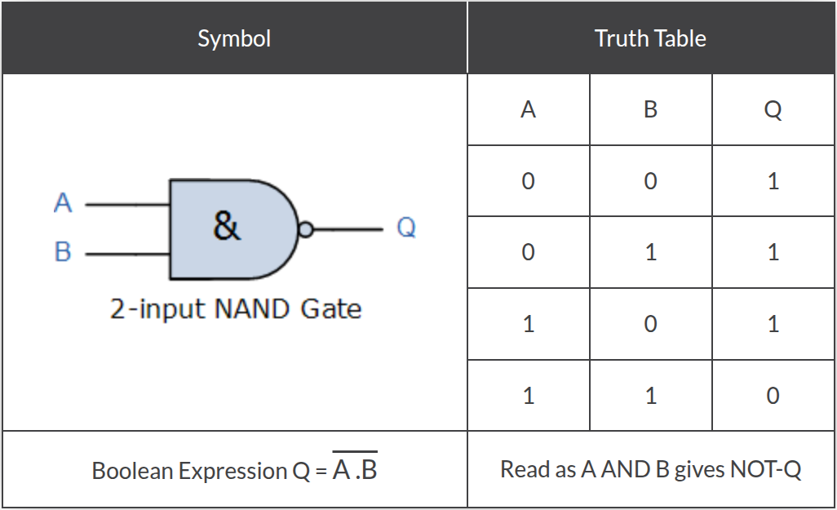
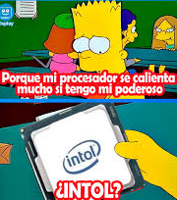
Quantum Gates
Classical Logic Gates

Slide 8
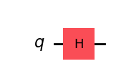

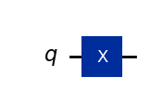

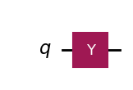

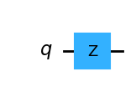

Quantum Gates
How to we manipulate Qubits?
Quantum Gates!
Represented by unitary matrices
Hadamard Gate
Pauli X Gate
Pauli Y Gate
Pauli Z Gate

Slide 9


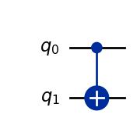

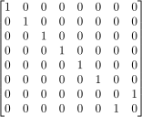
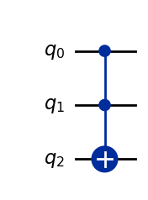
Quantum Gates
Wait… we have more of them!!
S Gate
Multi-qubit gates!
Flips the state of q1 if q0’s state is
1. Entanglement!!
CNOT Gate
Flips q2 only and if only q0 and q1 are in 1 state!
Universal gate!
Toffoli Gate

Slide 10
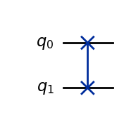

Quantum Gates
Wait… we have more of them!!
Multi-qubit gates!
SWAP Gate
Swaps q0 and q2 states.

Slide 11
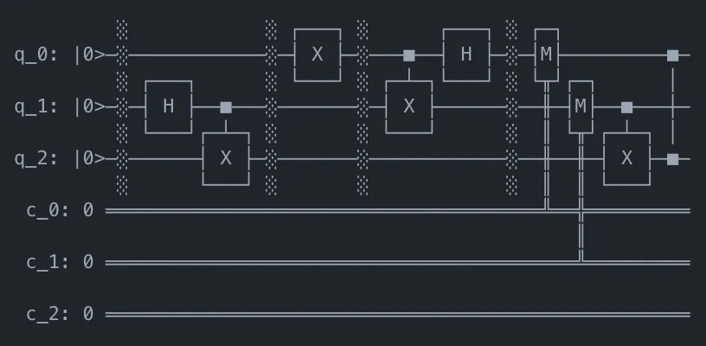
Quantum Circuits
What is a Quantum Circuit?
Sequence of building blocks that carry out elementary operations, called gates!
Key components
Qubits: wires that carry quantum information.
Gates: unitary operators.
Measurement: extract classical information.

Slide 12
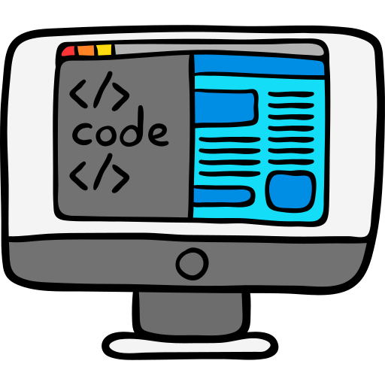
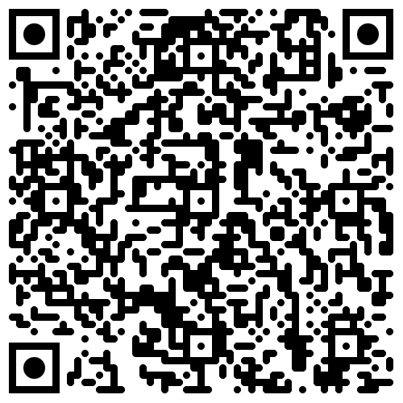
Coding time!!!

Slide 13









Resource
Page
Use these design resources in your Canva Presentation. Happy designing!
Don't forget to delete this page before presenting.

Slide 14
Resource
Page
Use these design resources in your Canva Presentation. Happy designing!
Don't forget to delete this page before presenting.

Slide 15
Resource
Page
B for blur
C for confetti
D for a drumroll
M for mic drop
Find the magic and fun
in presenting with Canva Presentations. Press the following keys while
on Present mode!
Delete this page
before presenting.
O for bubbles
Q for quiet
Any number from 0-9 for a timer
U for unveil

