Slide 1



First Principles and Machine Learning Investigations into the Atomic and Mechanical Properties of Cement Hydrates
Gabriel Balarezo, Henry Pinto
CompNano Reseach Group,
School of Physical Sciences and Nanotechnology,
Yachay Tech University, Ecuador
juan.balarezo@yachaytech.edu.ec
NSBC 2025
May 10, 2025

Slide 2

Presentation outline
Introduction
Aim and scope
Results
Conclusions

Slide 3
Introduction

Slide 4
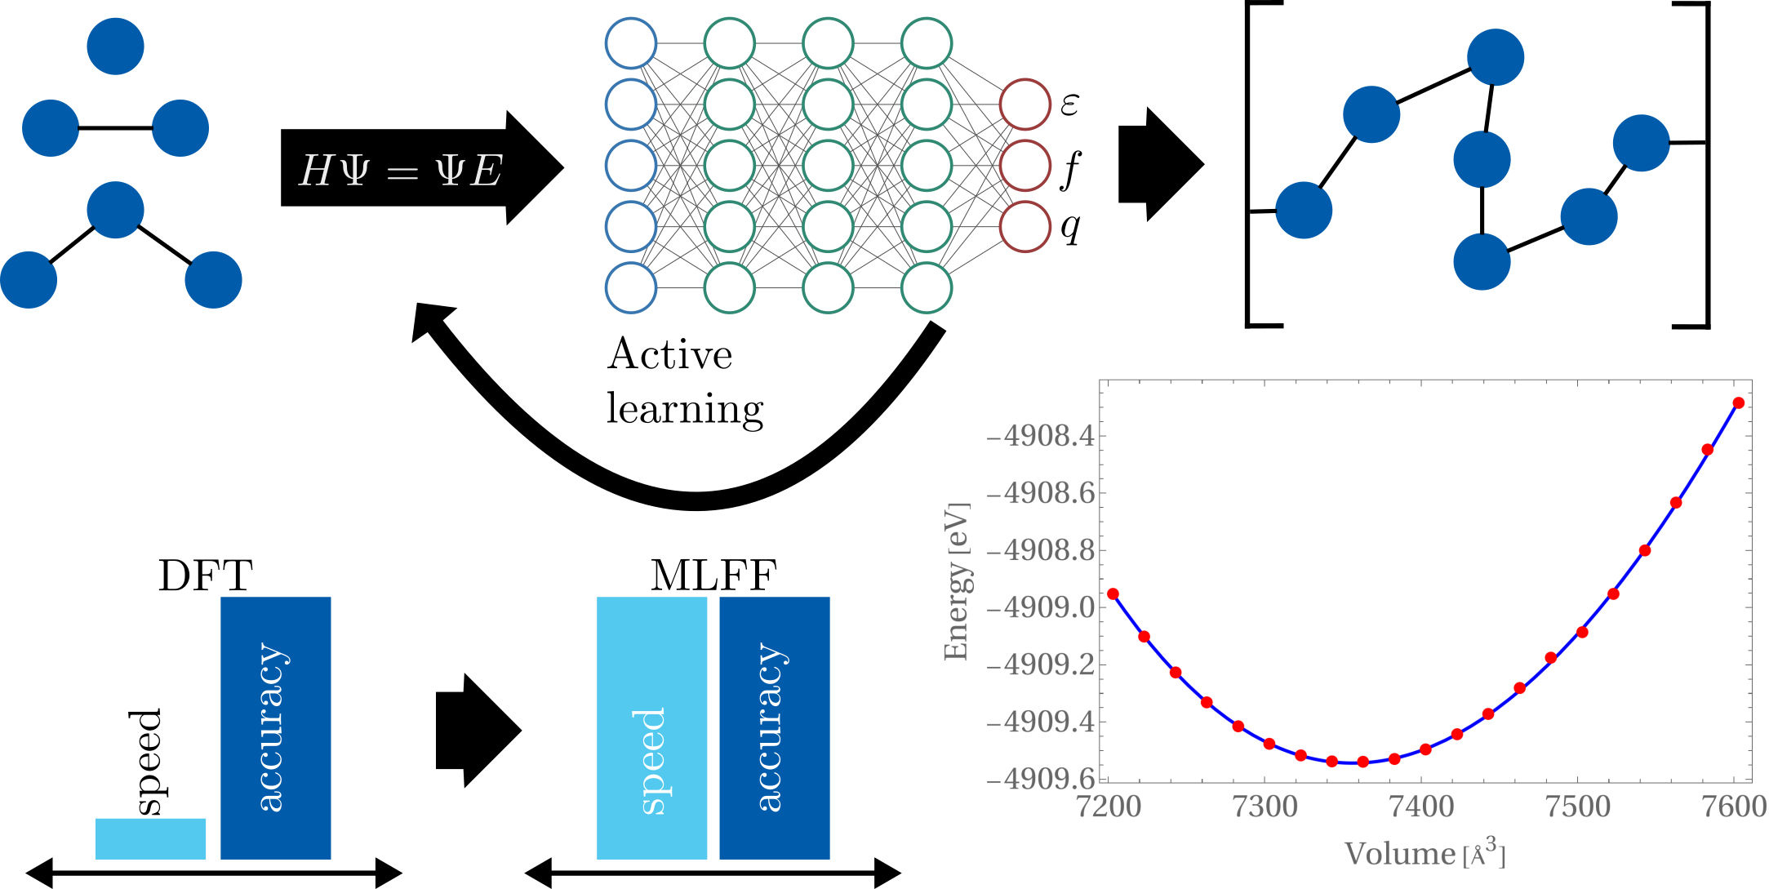
Aim and scope

