Slide 1


First Principles and Machine Learning Investigations into the Atomic and Mechanical Properties of Cement Hydrates C-S-H
By:
Gabriel Balarezo
Advisor:
Ph.D. Henry Pinto
Urcuqui, Ecuador
June 2025

Slide 2
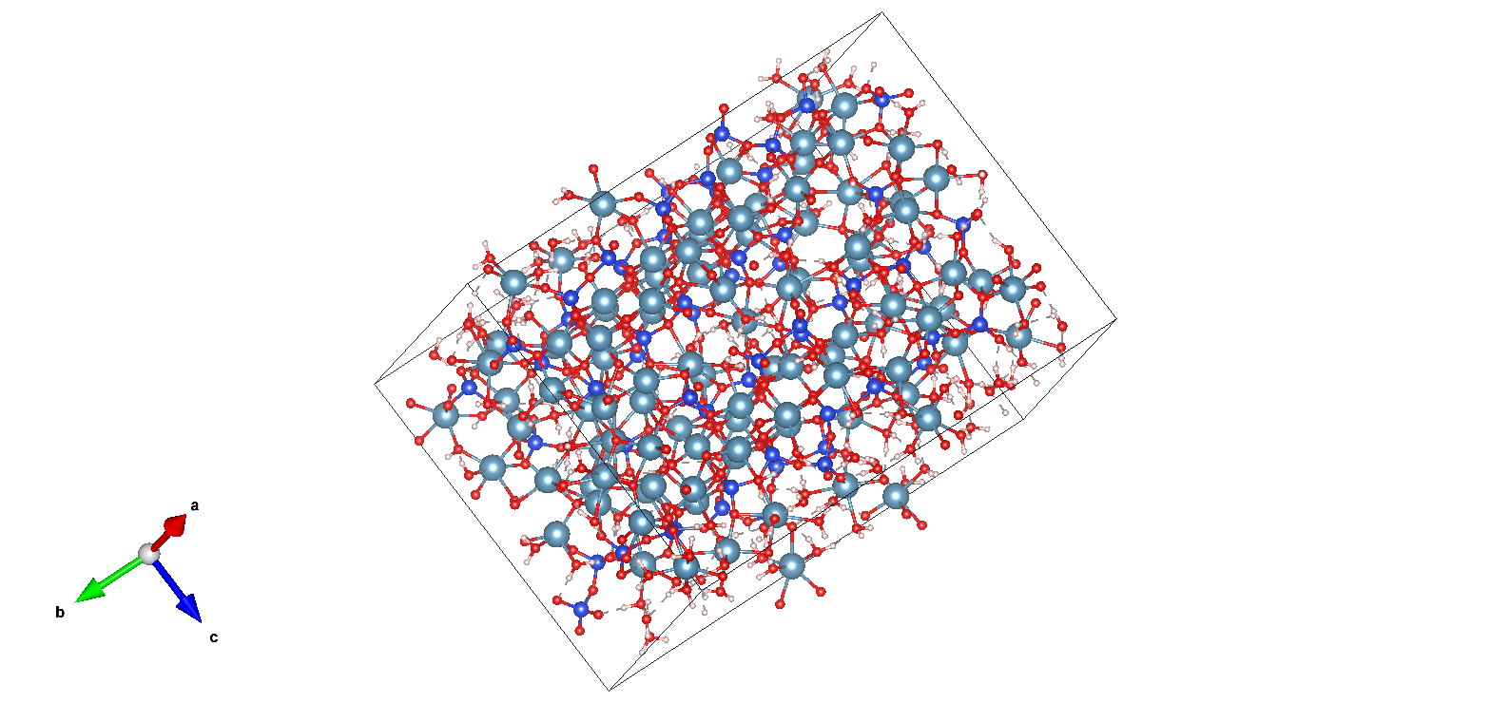
Table of Contents
Introduction
Theoretical Background
Methodology
Preliminar Results
Discussion
Conclusion

Slide 3
Introduction

Slide 4
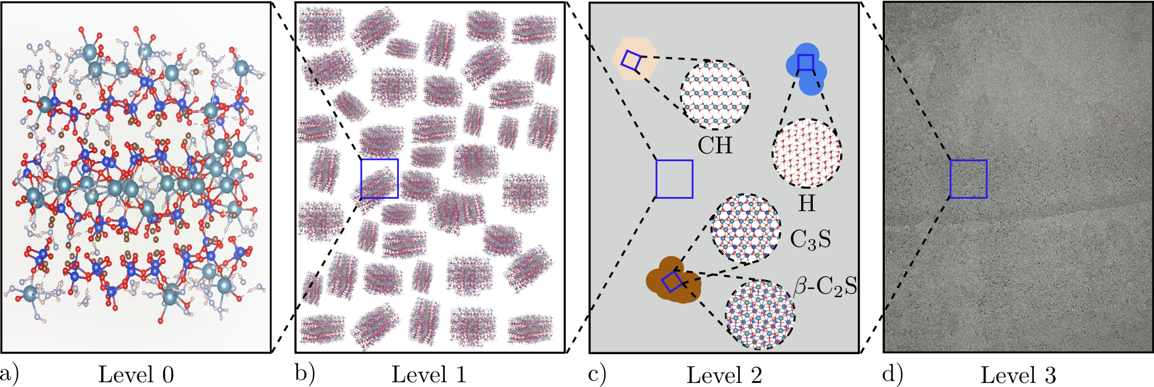
Introduction
Thesis Defence Introduction March 22nd 2025

Slide 5
Introduction
Thesis Defence Introduction March 22nd 2025

Slide 6
Introduction
Thesis Defence Methodology March 22nd 2025

Slide 7
Theoretical Background
Thesis Defence Theoretical Background March 22nd 2025

Slide 8
Methodology
Thesis Defence Methodology March 22nd 2025

Slide 9
C-S-H Structure
Thesis Defence Methodology March 22nd 2025

Slide 10
K-points
Thesis Defence Methodology March 22nd 2025
We sample k-point densities for:
...and we perform a convergency test so that the
total energy change of the k-point density is 1meV
Finally, choosing a k-point density of ∆ k = 0.06Å⁻¹ for the bulk C-S-H
(equivalent to a 1x1x1 k-point mesh) provides a fine enough mesh so that
the results converge within the criteria while keeping computational efficiency.

Slide 11
Cutoff energy
Thesis Defence Methodology March 22nd 2025
We sample cut-off energies for 300 ≤ Ecut ≤ 900 eV:

Slide 12
Structure relaxation
Thesis Defence Methodology March 22nd 2025

Slide 13
In the fly MLFF
Thesis Defence Methodology March 22nd 2025

Slide 14
MLFF validation
Thesis Defence Methodology March 22nd 2025

Slide 15
ML error analysis
Thesis Defence Methodology March 22nd 2025

Slide 16
Hyperparameters tunning
Thesis Defence Methodology March 22nd 2025

Slide 17
RCUT1 tunning
Thesis Defence Methodology March 22nd 2025
Refit the MLFF model for RCUT1 in [4, 45]

Slide 18
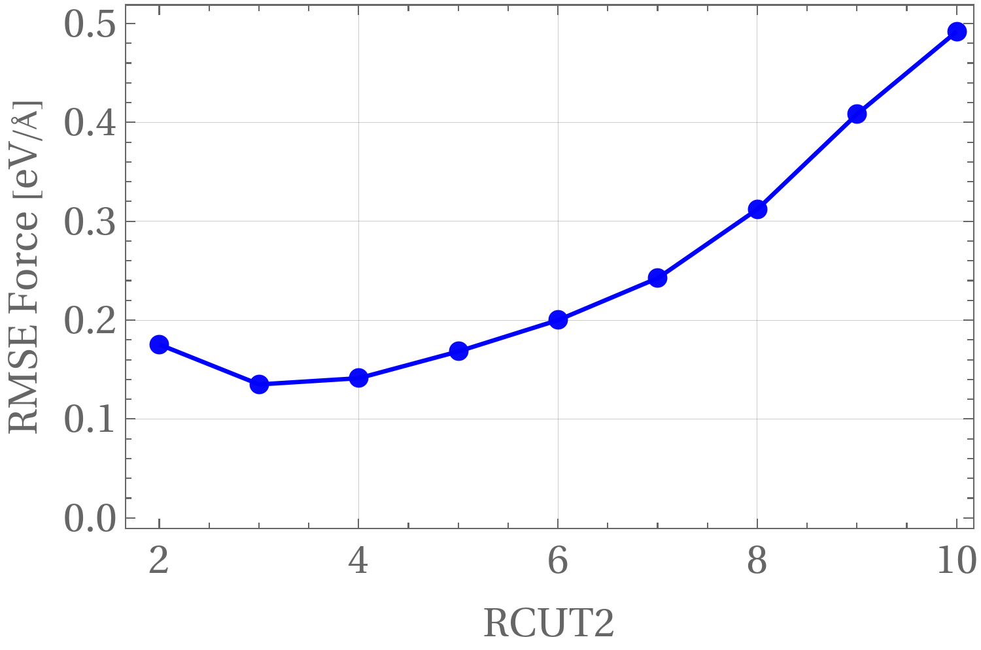
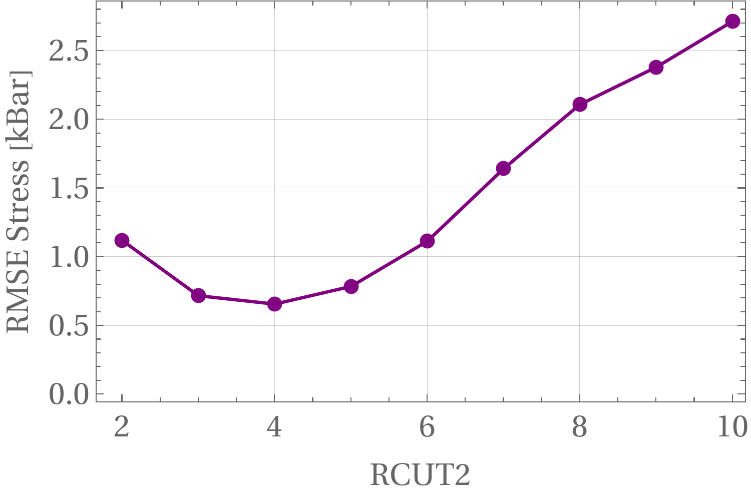
RCUT2 tunning
Thesis Defence Methodology March 22nd 2025
Refit the MLFF model for RCUT2 in [2, 10]

Slide 19
Preliminary Results
Thesis Defence Preliminary results March 22nd 2025

