Slide 1

Egyptian Air Quality Prediction Quantum Competition
Prof Ahmed El-Mahdy
Dean
3/8/2025

Slide 2
Agenda
Motivation
The Potential of Quantum Computing
The Problem of Air Pollution in Egypt
Competition Objectives and Phases
References

Slide 3
The Potential of Quantum Computing
The Quantum computing industry is evolving currently reaching 1,000 qubits and now with Majorana technology, it is expected to reach 1,000,000 qubits in a few years
Recently, quantum computing on a benchmark took 5min whereas a supercomputer would take 10²⁴ years to finish
Quantum Computing + Artificial Intelligence has strong potential

Slide 4
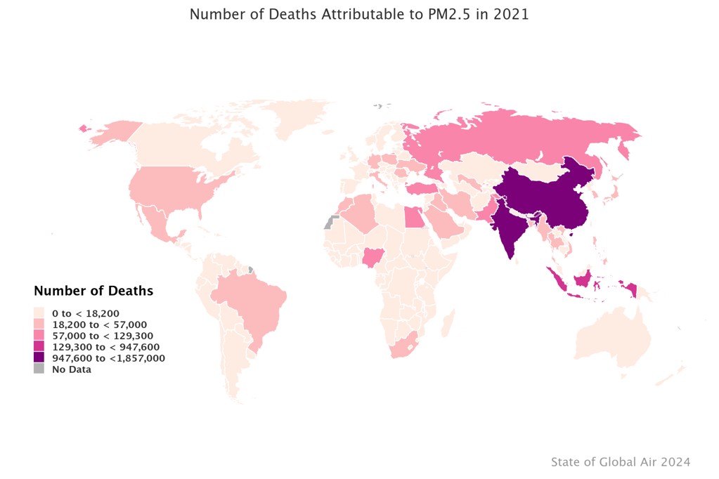
The Problem of Air Pollution in Egypt
Particulate Matter 2.5 is an important measure of air pollution
It is responsible for the death of 115700 in 2021 in Egypt
It is targeted in the UN SDGs
Good Health and Well Being (Goal 3)
Sustainable Cities (Goal 11)

Slide 5
Competition Objectives
Explore the potential of the emerging quantum AI technologies in the forecast operation in comparison to classical methods.
Use available satellite data (freely available from NASA) to predict future PM2.5 levels at the hourly and daily levels.
Provide national capacity building for the practical use of quantum technologies in this important topic.

Slide 6
Competition Phases
Phase 1: Sign Up (1 month)
Phase 2: Capacity Building (2 weeks)
Phase 3: Competition Stage-1 (Simulation) (6 weeks)
Phase 4: Competition Stage-2 (Physical) (4 weeks)

Slide 7
Stage 1: Signup
Joining Criteria:
Is currently enrolled in a postgraduate program into a related field of study
Have strong competencies demonstrated by his/her undergraduate achievements
Egyptian residency is a must.
3-5 members per team

Slide 8
Stage 2: Capacity Building
A two-week intensive course covering the following topics
Introduction to Quantum Mechanics and Quantum Computing (4 days)
Introduction to Quantum Machine Learning (3 days)
Introduction to Particulate Matter Estimation (1 day)

Slide 9
Tentative Schedule
Day 1: Introduction to Quantum Mechanics and Computing
09.00 - 10.30: The Two-Slit Experiment
11.00 - 12.30: Quantum Circuit Model
13.30 - 15.30: Qiskit lab
Day 2: Introduction to Quantum Mechanics and Computing
09.00 - 10.30: The Wave Equation
11.00 - 12.30: Quantum Systems Composition
14.00 - 15.30: Pennylane lab

Slide 10
Tentative Schedule
Day 3 Quantum Systems
09.00 – 10.30: Quantum Processors Technologies 1
Photonics
11.00 – 12.30: Quantum Processors Technologies 2
Superconductors
13.30 – 15.30: Physical QC lab (physical backends)
Day 4 Quantum Noise
09.00 – 10.30: Quantum Noise
11.00 – 12.30: Fault-Tolerant Quantum Computing
13.30 – 15.30: Pennylane with noise lab

Slide 11
Tentative Schedule
Day 5: Machine Learning
09.00 – 10.30: Machine Learning 1
11.00 – 12.30: Machine Learning 2
13.30 – 15.30: ML Lab
Day 6: Quantum Machine Learning
09.00 – 10.30: Variational Circuits 1
11.00 – 12.30: Variational Circuits 2
13.30 – 15.30: Pennylane Lab

Slide 12
Tentative Schedule
Day 7: Advanced Quantum Machine Learning
09.00 – 10.30: Quantum Machine Learning Issues 1
11.00 – 12.30: Quantum Machine Learning Issues 2
13.30 - 15.30: Pennylane Lab
Day 8: PM2.5 Estimation from Satellite
09.00 – 10.30: Satellite imaging and remote sensing
11.00 – 13.00: Data acquisition and preprocessing lab
14.00 – 16.30: Introduction to the competition problem.

Slide 13
Phase 3: Competition Stage-1; Quantum Simulation
The participants will form teams of a 3 to 5 members and participate in developing the required software. Results will be submitted and evaluated to the following criteria:
Accuracy
Execution Time
Evidence of Quantum Advantage over Classical.
Execution is to be done over quantum simulation.
By the end of this stage, 5 groups will be qualified for the next Phase

Slide 14
Phase 4: Competition Stage 2- Physical Quantum Backend
Successful groups will be given credit access to a real quantum processor on the cloud.
They then test their stage-1’s work on actual quantum processors.
Results will be submitted at the end of August 2025 on the same criteria as in Phase 2; successful candidates will be awarded prizes.

Slide 15
References
Dataset: https://disc.gsfc.nasa.gov/datasets?project=MERRA-2
PM2.5 Estimation formula: https://gmao.gsfc.nasa.gov/reanalysis/MERRA-2/FAQ

Slide 16

Thank You

