Slide 1

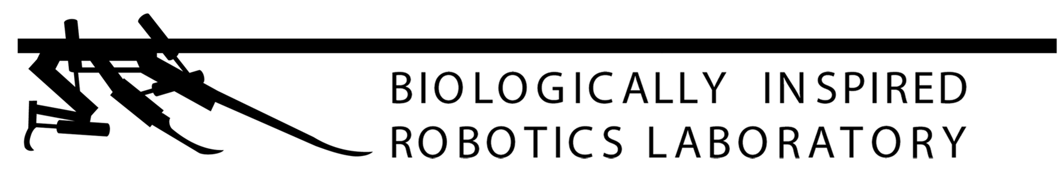

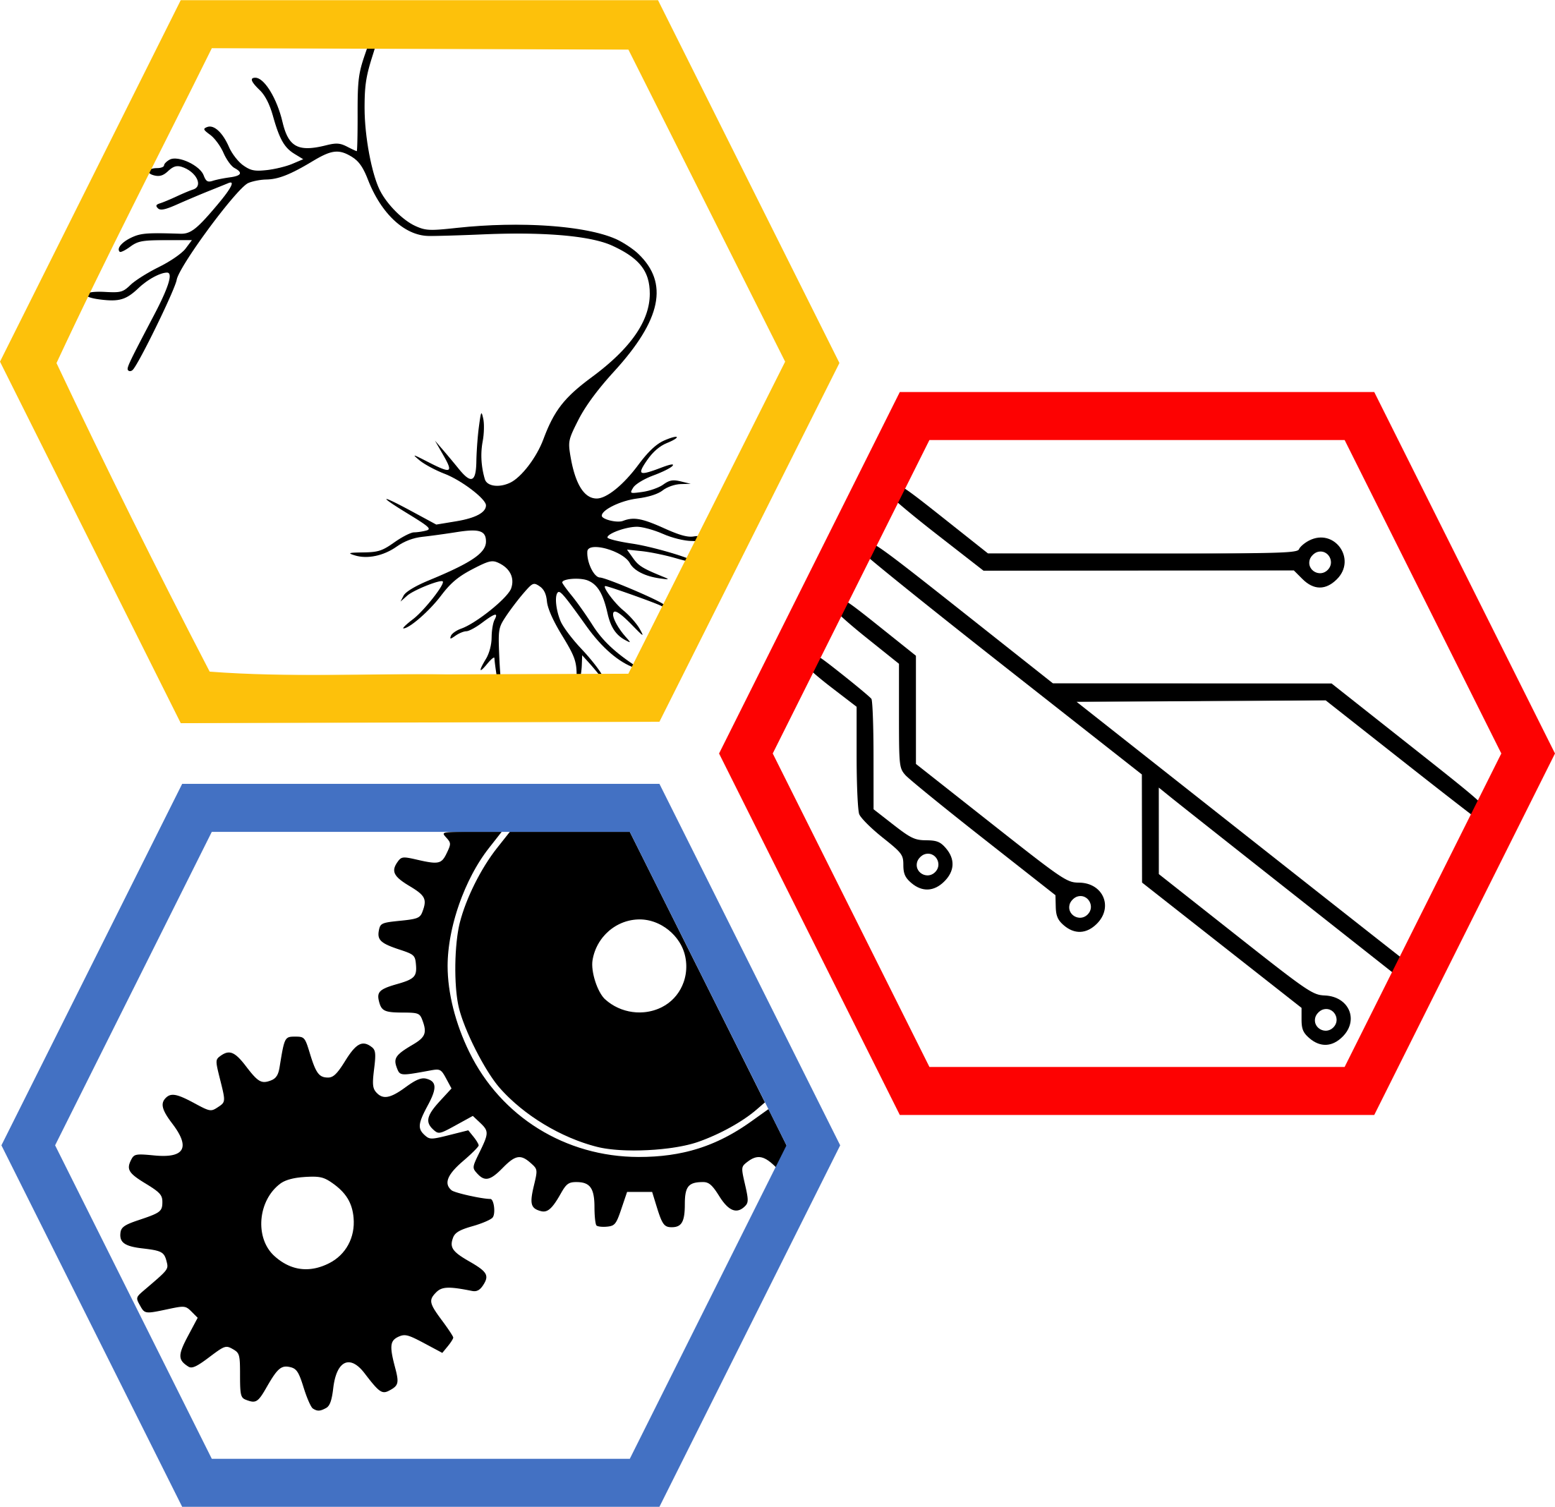
Data-Driven Control of a Soft Bioinspired Grasper
Sreeram Thirupathi, Helen Wang, Ravesh Sukhnandan, Nathan Zimmerer
Carnegie Mellon University: 1) Mechanical Engineering, 2) Robotics Institute
Biohybrid and Organic Robotics Group
Introduction
Methods
Results
Grasping and manipulating objects of various sizes, surface properties, and shapes remains challenging for robots.
Aplysia californica serves as inspiration for both the grasper’s physical morphology as well as the hierarchical neural controller
Fig. 4: (a) Eigenvalue plot (Re vs Imaginary of eigenvalues), (b) Quasistatic fit
Fig. 6: Simulation with PID for quasistatic and for Koopman. Add real hardware data with PID
Fig. 1:
Methods
Fig. 3: Block/flow chart for Koopman to PID and for quasistatic to PID
Conclusions
Results
Future Work
Fig. 2: Experimental Setup to gather data for fitting
Fig. 6:
Fig. 5: Koopman rollout vs real data. -> train and test.

