Slide 1

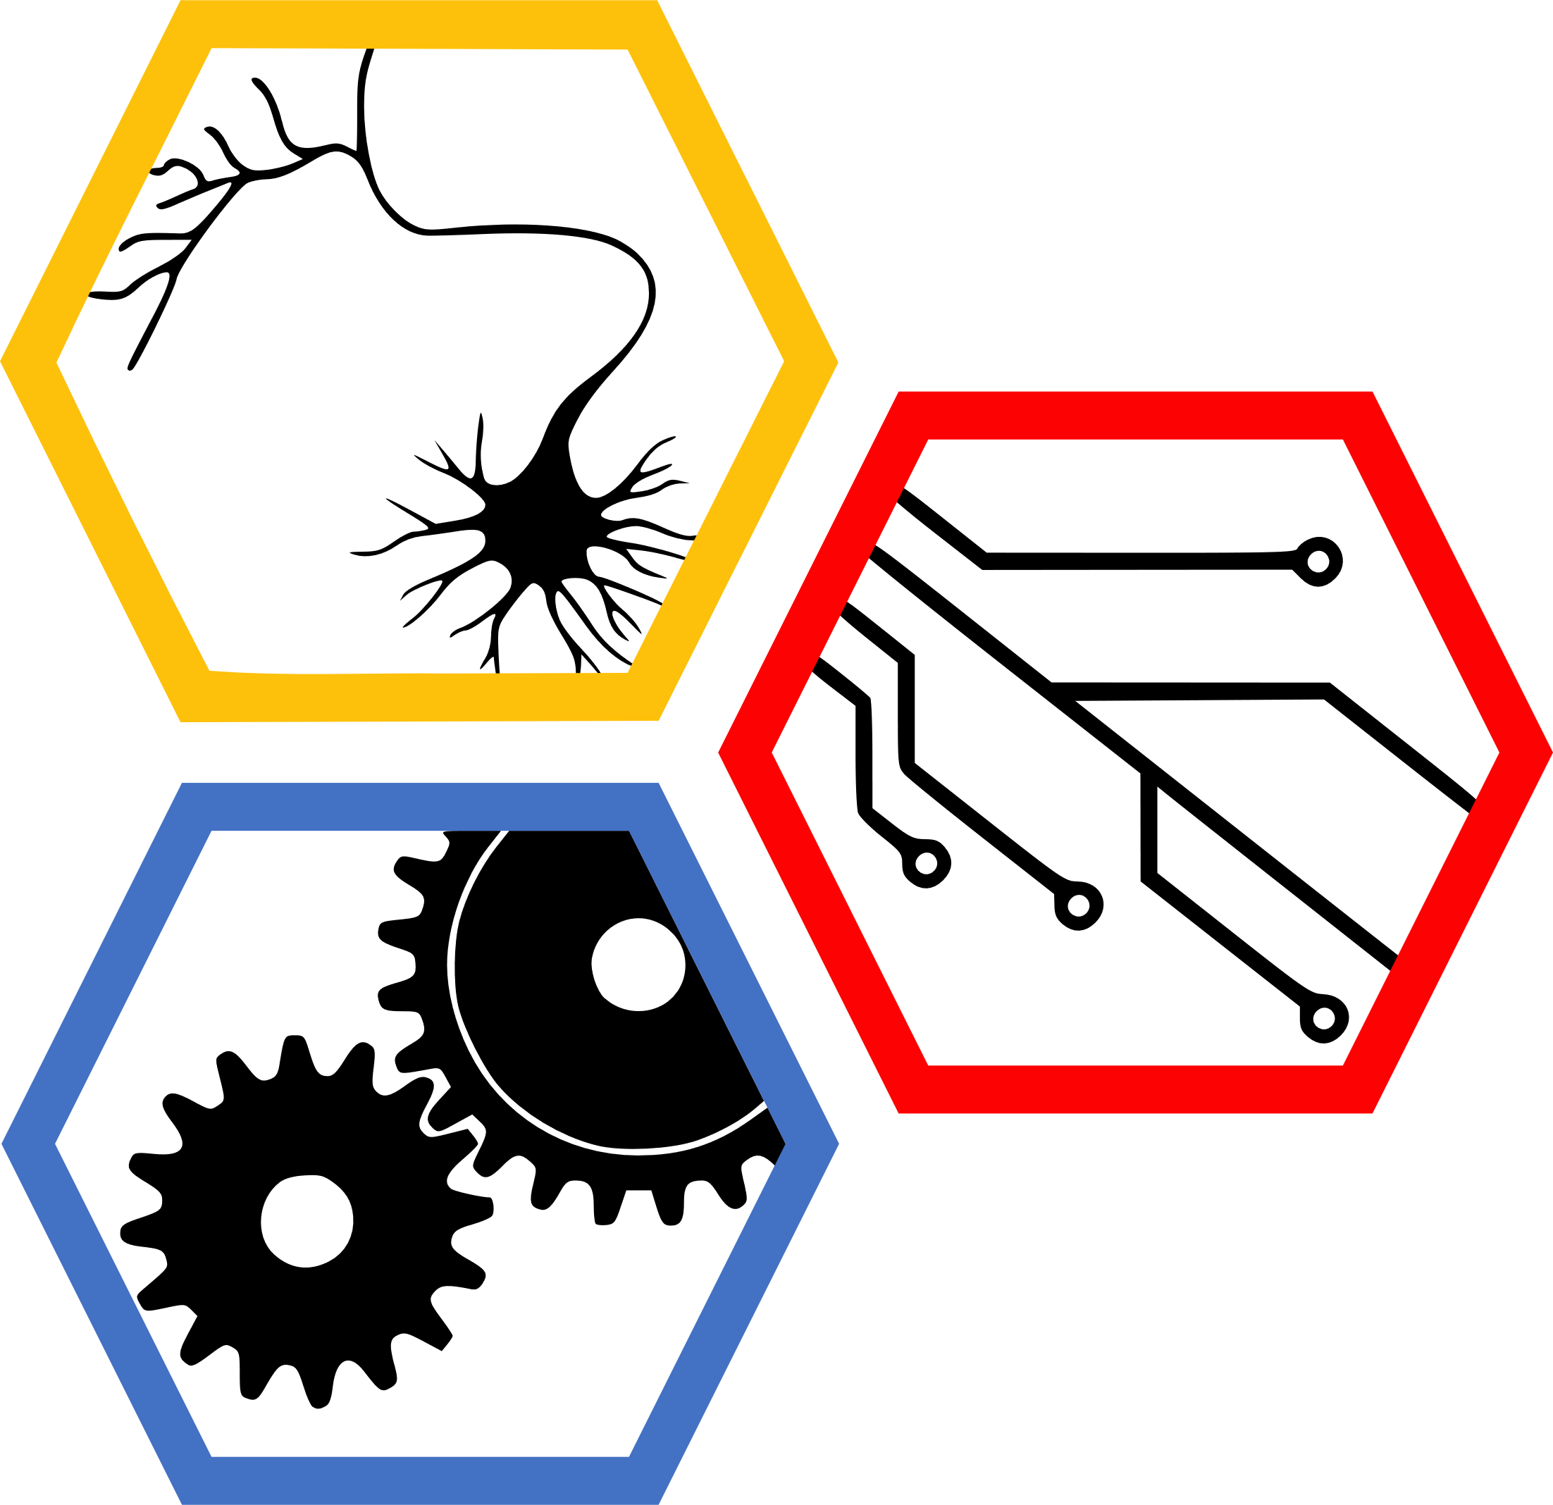
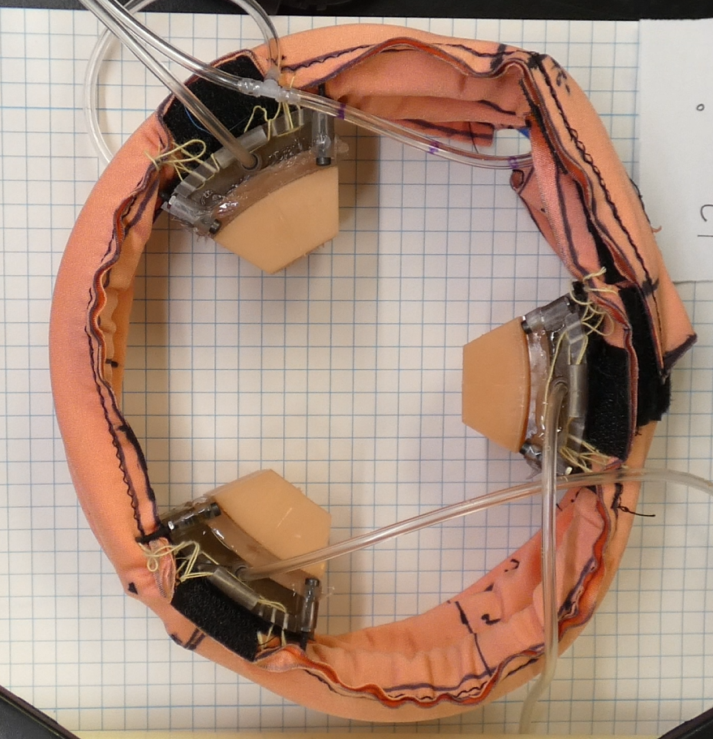
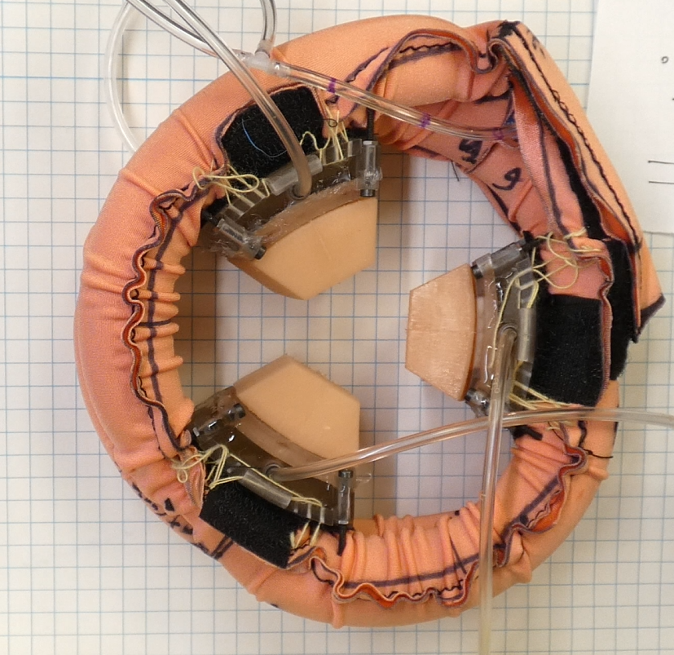
Data-Driven Control of a Soft Bioinspired Grasper
Ravesh Sukhnandan¹, Sreeram Thirupathi², Helen Wang¹, Nathan Zimmerer¹
Biohybrid and Organic Robotics Group
Carnegie Mellon University: 1) Mechanical Engineering, 2) Robotics Institute
Introduction
Methods
Results
G
A
B
Fig. 4: (a) Eigenvalue plot (Re vs Imaginary of eigenvalues), (b) Quasistatic fit
Fig. 6: Simulation with PID for quasistatic and for Koopman. Add real hardware data with PID
Fig. 1: Bio-inspired soft grasper with contact sensing via pneumatic jaws. The grasper decreases the enclosed area when moving from the rest state (A) to the actuated state (B).
Methods
Conclusions
Results
Future Work
Fig. 3: Block/flow chart for Koopman to PID and for quasistatic to PID
Fig. 6:
Fig. 5: Koopman rollout vs real data. -> train and test.
Fig. 2: Experimental Setup to gather data for fitting

