Slide 1
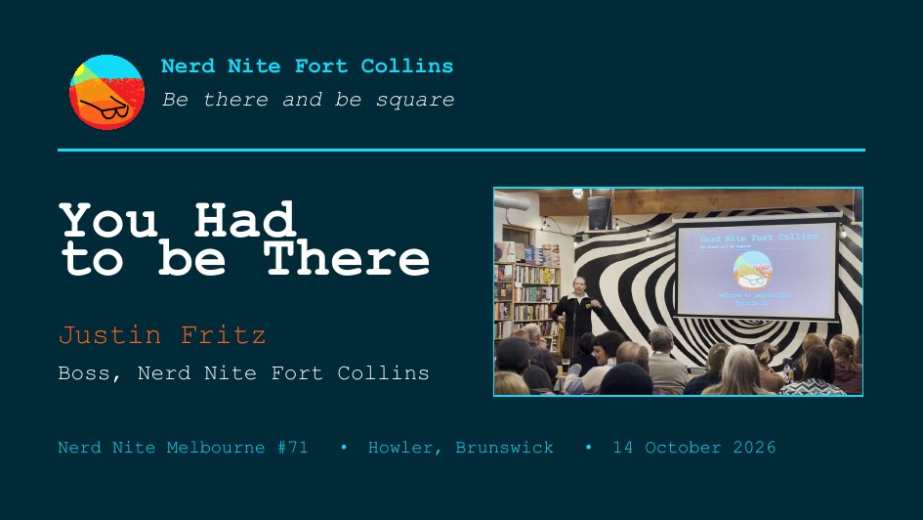
Notes:
TITLE 0:00
• Title. Then stop. Let it sit.
• Do NOT flip it yet — that is slide 7.
The tagline is already the close, on the wall, ten minutes early.
Nobody needs to notice.

Slide 2
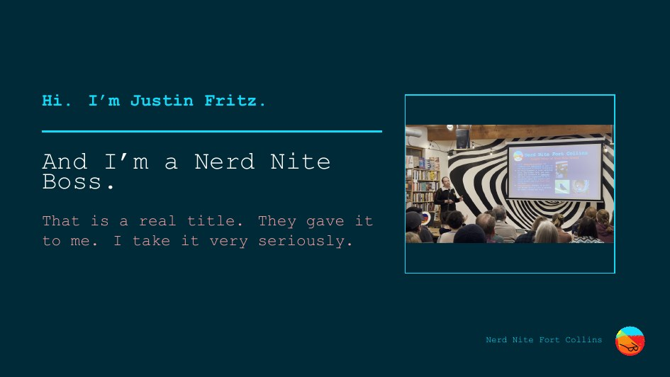
Notes:
WHO IS TALKING slides 2--5 share 2:30
• "Hi. I'm Justin Fritz. And I'm a Nerd Nite Boss."
• "That's a real title. They gave it to me. I take it very seriously."
• Fast and warm. Do not linger.

Slide 3
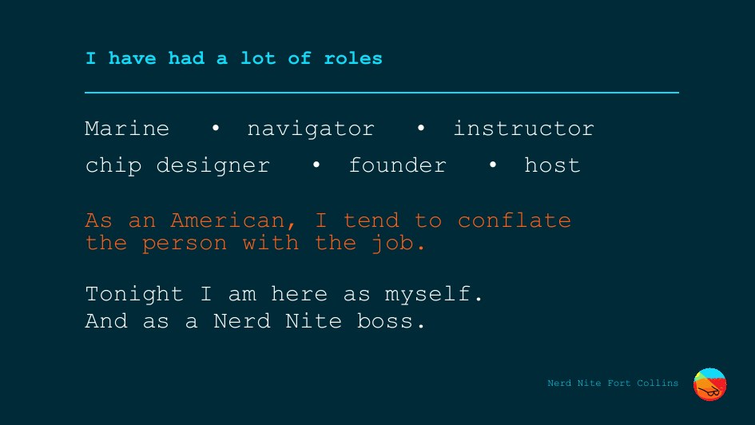
Notes:
THE ROLES
• Marine. Navigator. Instructor. Chip designer. Founder. Host.
• "As an American, I tend to conflate the person with the job." <- the laugh
• "Tonight I am here as myself. And as a Nerd Nite boss." — land it straight.
Past tense on the Marines. It is one item in a list that exists to be
undercut. Not a credential, not the opening.

Slide 4
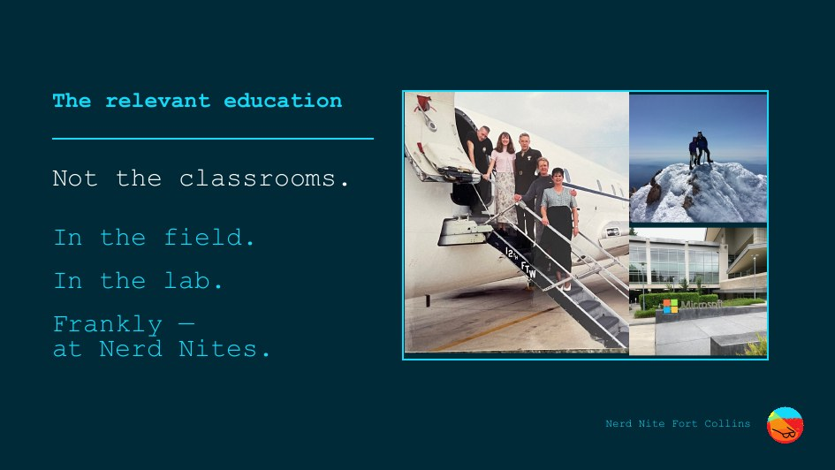
Notes:
THE RELEVANT EDUCATION
• "Not the classrooms."
• "In the field. In the lab. Frankly — at Nerd Nites."
• Gesture at the collage. Name one or two, no more: the flight line, the summit.
Do not inventory the career. Slide 3 already did it.

Slide 5
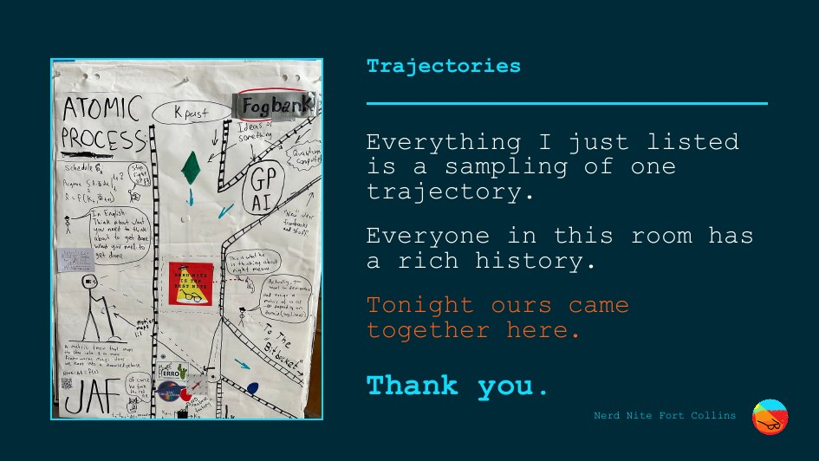
Notes:
TRAJECTORIES — end of the introduction
• "Everything I just listed is a sampling of one trajectory."
• "Everyone in this room has a rich history."
• "Tonight ours came together here."
• "Thank you." <- STOP. Let it land.
Grateful to all who share, all who facilitate, all who come. Rushing this costs
the rest of the talk.

Slide 6
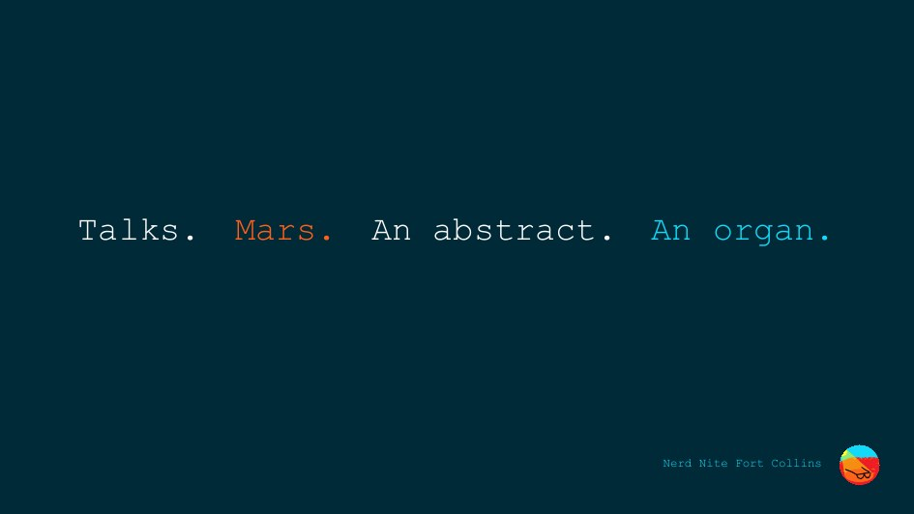
Notes:
WHAT THIS COVERS 0:45
• "Talks. Mars. An abstract. An organ."
• Fast. Do not expand any of them.
It is meant to make sense in retrospect, not now.

Slide 7
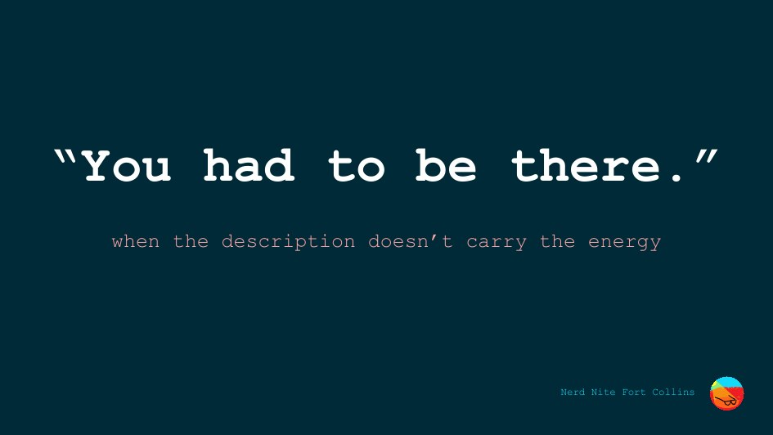
Notes:
THE FLIP 1:30
• "You had to be there" is what you say when the description didn't carry the energy.
• You told it right. Every fact was in there. It still died on the way over.
• Tonight it means something else too: you had to be at the talk about the thing.
NEEDS FROM YOU: the opening twenty seconds — one time the phrase
failed on you. Still open.

Slide 8
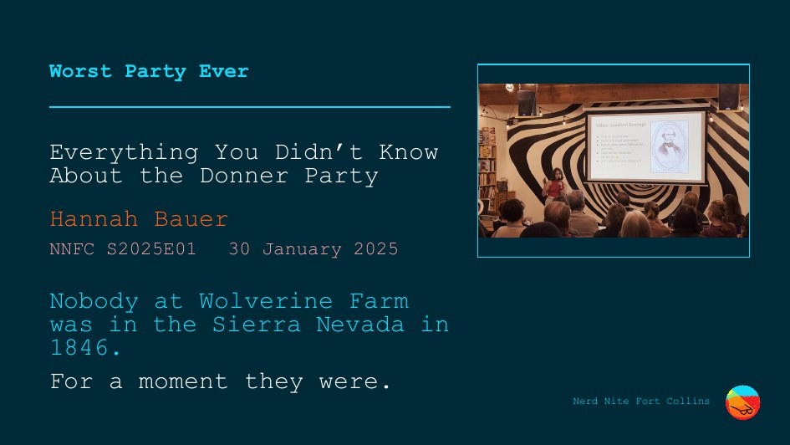
Notes:
HANNAH 2:30
• Worst Party Ever. Hannah Bauer. Jan 2025.
• "Most people hear Donner Party and think cannibalism. Valid — but that only scratches the surface."
• She put the room inside their heads. And we laughed. About the Donner Party.
• "Nobody at Wolverine Farm was in the Sierra Nevada in 1846. For a moment they were."
Wolverine Farm, never "a bar." Do not explain why it matters — that
is Mars.

Slide 9
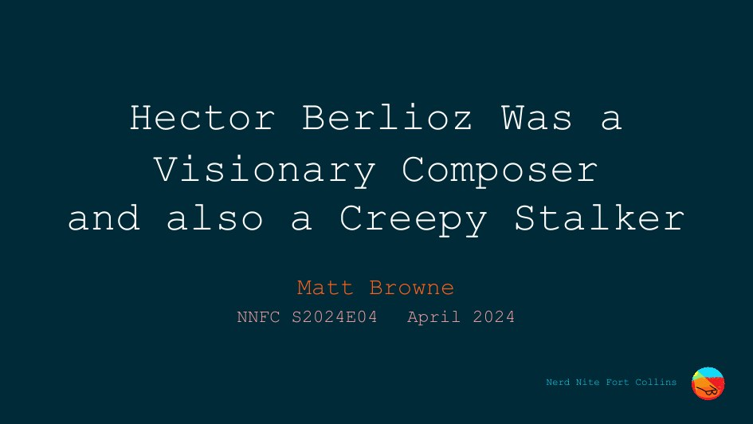
Notes:
BERLIOZ 0:30
• Read the title aloud. Stop. Add nothing.
• Matt Browne, April 2024.
FIRST CUT IF RUNNING LONG.

Slide 10
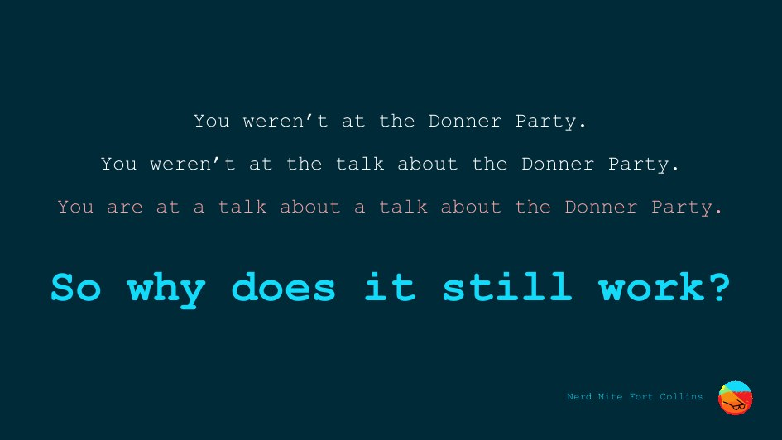
Notes:
THE LADDER 0:45 the hinge
• "You weren't at the Donner Party."
• "You weren't at the talk about the Donner Party."
• "You are at a talk about a talk about the Donner Party." <- the laugh
• Three rungs up, the most degraded copy in the chain — and it still works.
• "So why does it still work?"
ASK IT. DO NOT ANSWER IT. Pause, then move.

Slide 11
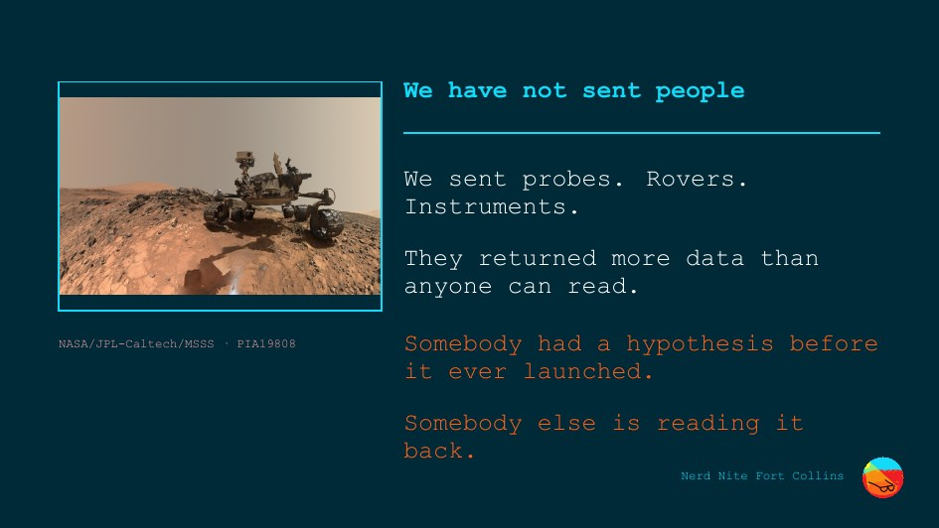
Notes:
MARS
• "We have never sent people. We sent probes, rovers, instruments."
• "They returned more data than anyone can read."
• "Somebody had a hypothesis before it ever launched."
• "Somebody else is reading it back."
• Neither is in the data stream.
Do not rush. This is the only abstract beat and it buys the next two.

Slide 12
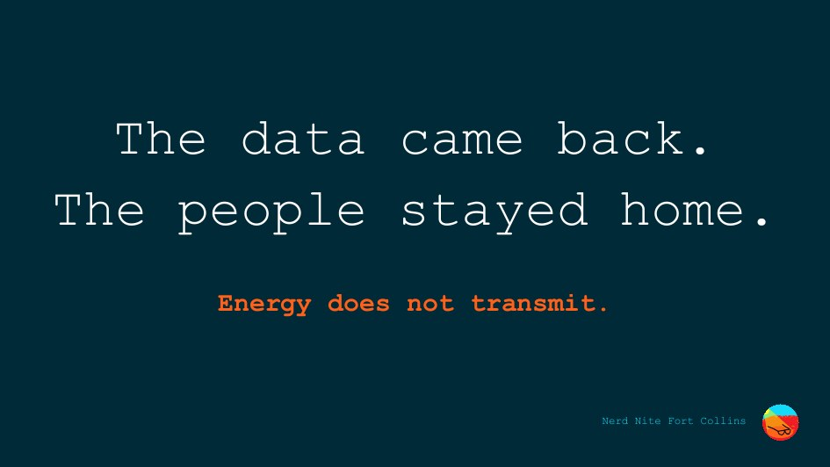
Notes:
THE LINE the answer
• "The data came back. The people stayed home."
• "Energy does not transmit."
• It has to be made again, in a room, by a person, every single time — or it is not there at all.
• That is why the ladder holds. Every rung has a human on it.
Once. Flat. Do not elaborate. Do not say "cognition."

Slide 13
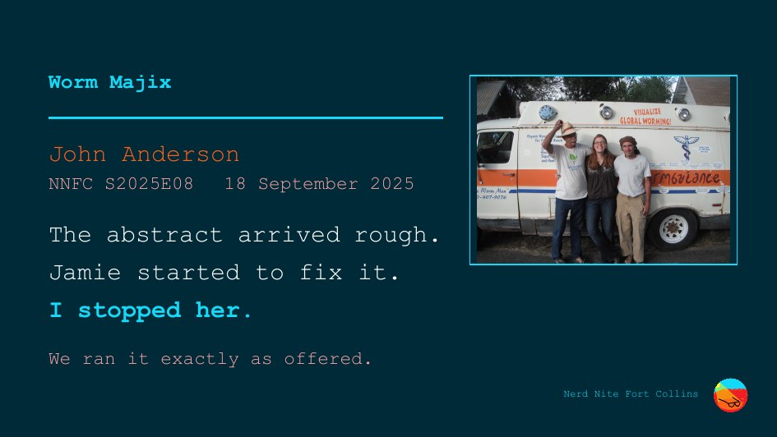
Notes:
JOHN 1:30
• Worm Majix. John Anderson. Sep 2025.
• Long-time friend of Wolverine Farm. Watched the crowd assemble. Asked Senne. Got a slot.
• "The abstract came in rough. Jamie started fixing it. I stopped her."
• "We platform people who want to talk. Connect speakers and audience — don't filter them."
• He gave it as himself, dressed how he dresses. Great talk.
DO NOT READ HIS ABSTRACT ALOUD. That makes John the joke in front of
other bosses.
Optional, one sentence, your call: same mechanism as the HoloLens spec
bug — a legible restatement silently becomes the reference.

Slide 14
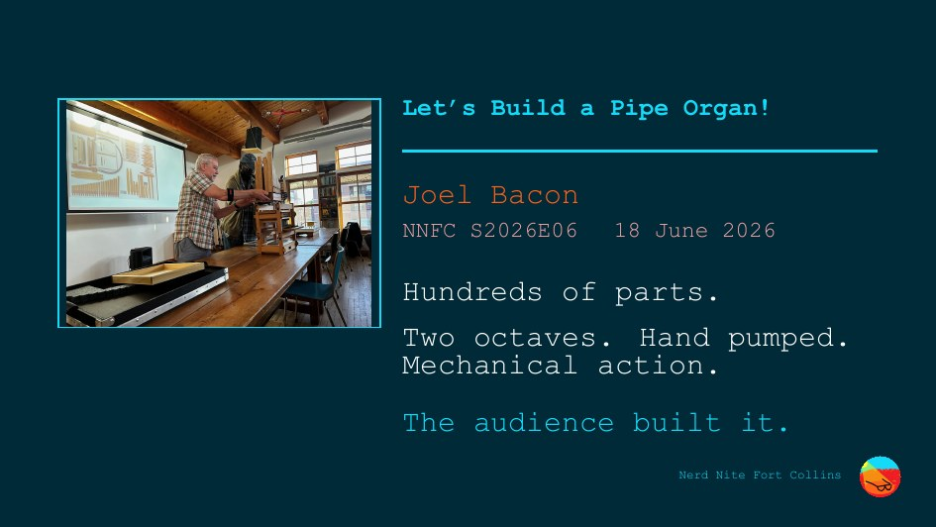
Notes:
THE BUILD
• Let's Build a Pipe Organ! Joel Bacon. June 2026.
• He talked through the parts — wind supply, keys, pipes.
• "Hundreds of parts. Two octaves, hand pumped, mechanical action."
• "And the audience built it."

Slide 15
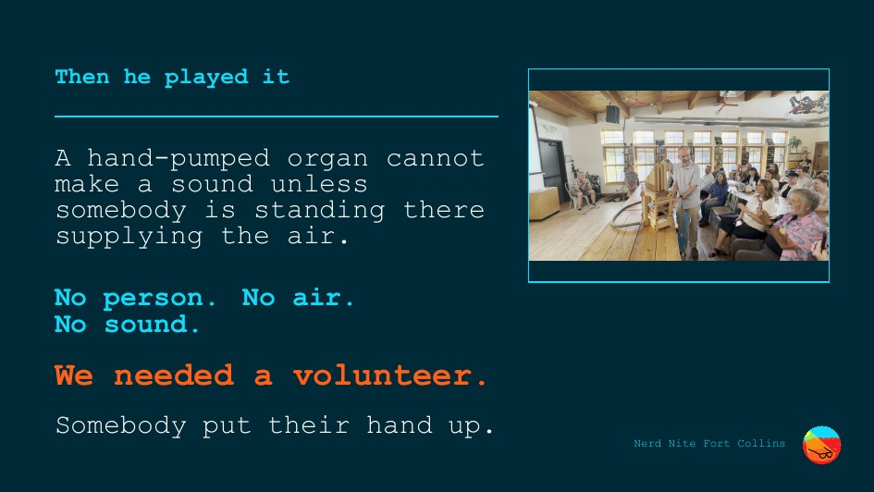
Notes:
THE LANDING the only real feeling in the talk
• "Then he played it." Professor, composer, working musician.
• "It connected me to the music in a way I had never felt before."
• <- ONE SENTENCE. THEN STOP. The pause does the work.
• "A hand-pumped organ cannot make a sound unless somebody is standing there supplying the air."
• "No person. No air. No sound." <- the thesis, in wood and leather
• "We needed a volunteer. Somebody put their hand up."
Air is the energy. Not an illustration of the argument — the argument,
running in front of them.
NO second sentence. NO "and that's what Nerd Nite does."
Say a volunteer, not "an audience member."

Slide 16

Notes:
THE CLOSE 0:30 screen is empty
• [twenty seconds — yours. Carry them from the organ to stillness.]
• "You had to be there."
• "You are."
NOTHING AFTER IT. No thank-you (that was slide 5). No call to action.
Stop talking.

Slide 17
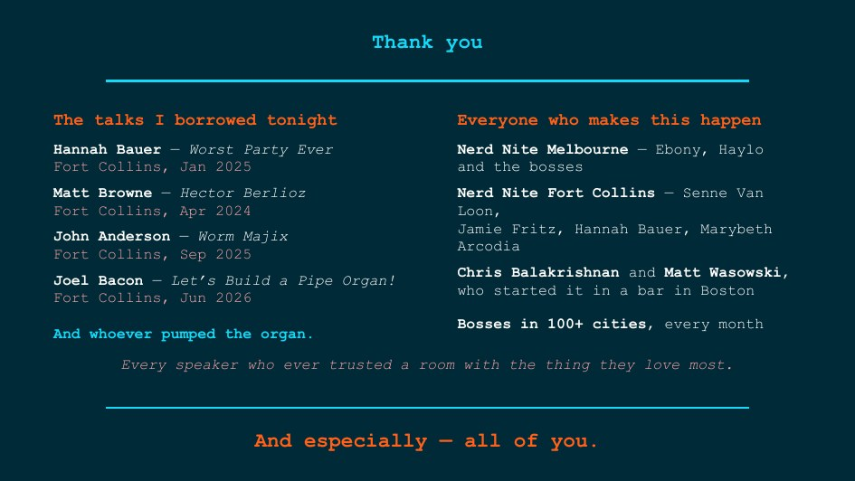
Notes:
CREDITS — questions only
• Advance here when the first question comes. Leave it up throughout.
• Do NOT show it during the talk.
If Berlioz got cut for time, Matt Browne stays on this slide anyway.

