Slide 1

Machine Learning for
Ultralow Vaccine Distribution
COLD-CHAIN MONITORING
An exploratory analysis of temperature behavior, sensor agreement, and alert proxies

Slide 2
Analysis roadmap
01 | Dataset & question scope
02 | What the data can support
03 | Linear regression findings
04 | Logistic regression findings
05 | K-means temperature patterns
06 | Interpretation & next steps

Slide 3
What the notebook can test
One temperature test is modeled with time, mean temperature, sensor spread, O₂, and CO₂. The analysis is exploratory—not a validated cold-chain alarm.
112,267
57
112,266
raw readings loaded
temperature channels
rows used for next-change models

Slide 4
What each ML question can answer today
The notebook answers some questions directly, others only through dataset-relative proxies, and several need additional labels or operational features.
Question | Model | Current answer | Evidence | Interpretation
Recovery time | Linear | Not answered | No labels | Add recovery data
Temperature rise | Linear | Weak support | R² = 0.003 | No reliable driver
Sensor validation | Linear | Yes | R² = 0.775 | Consistency check
Investigation | Logistic | Proxy only | Top 10% change | Triage proxy
Warm excursion | Logistic | Relative proxy | Top 10% warm | Relative only
Freezing exposure | Logistic | Not meaningful | No threshold | Add cutoff
Door / handling | Logistic | Proxy only | No labels | Label events
Pattern groups | K-means | Yes | 3 observed clusters | Descriptive, not causal

Slide 5
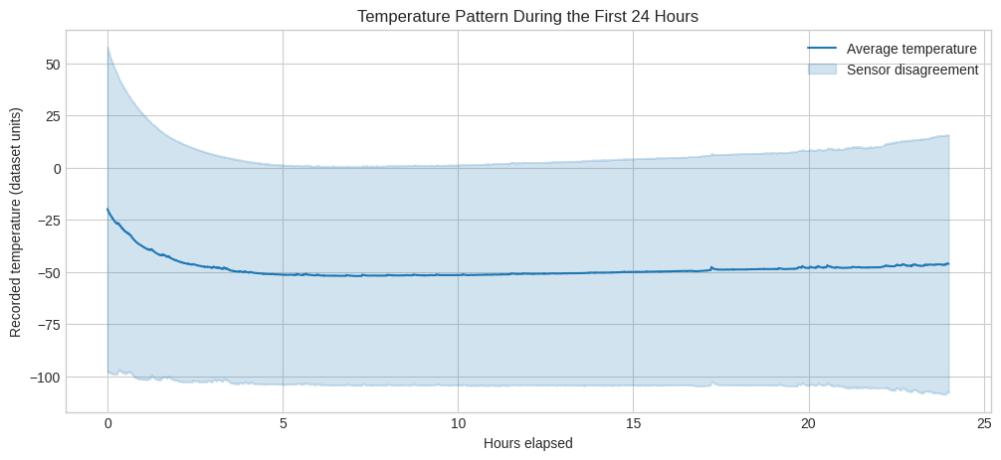
Temperature pattern during the first 24 hours
Average temperature and sensor spread reveal where channels diverge
The line averages 57 temperature channels; the shaded band shows their spread. Wider bands indicate more sensor disagreement.
Question link: this baseline supports monitoring, but it does not measure recovery time because excursions and acceptable-range labels are absent.

Slide 6
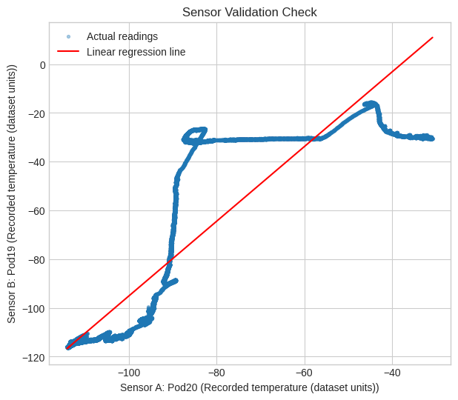
One sensor can help validate another
Sensor A predicts Sensor B with R² = 0.775
Readings follow a consistent linear relationship, so large deviations from the fitted line can flag disagreement or placement issues.
Question answered: yes—use sensor-to-sensor agreement as a validation screen, then investigate exceptions.

Slide 7
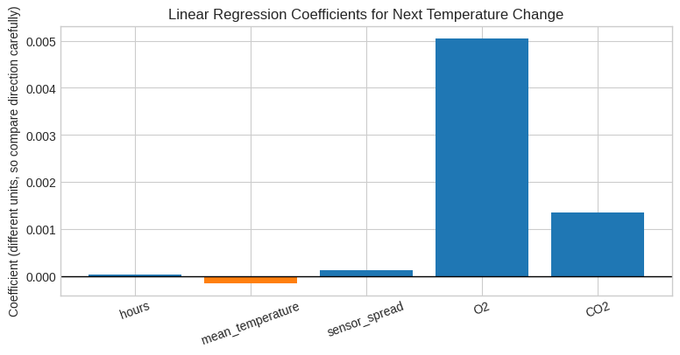
Available inputs barely explain the next temperature change
Linear model R² = 0.003
Coefficient directions are not comparable because the features use different units.
Result: R² = 0.003—the available proxies do not reliably explain next-reading change.

Slide 8
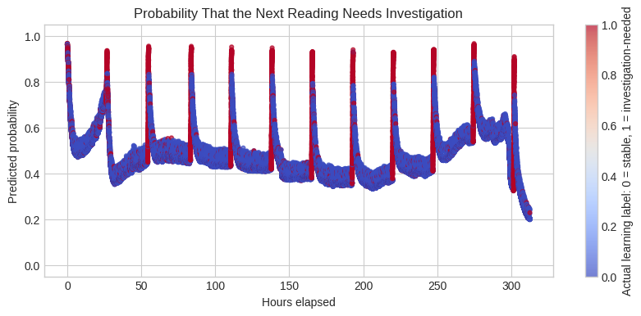
The investigation model identifies unusual changes—not verified failures
11,228 of 112,266 windows are labeled for review
Label = the top 10% of absolute next-temperature changes.
Result: useful for triage, not a confirmed normal-vs-failure classifier.

Slide 9
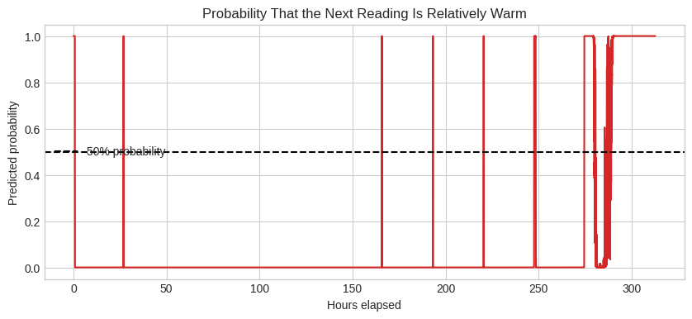
Warm probability is relative to this dataset
“Warm” means the warmest 10% of next readings
The line estimates membership in the dataset’s top decile; 50% is a model-probability reference.
Result: a relative signal, not a product-threshold probability.

Slide 10
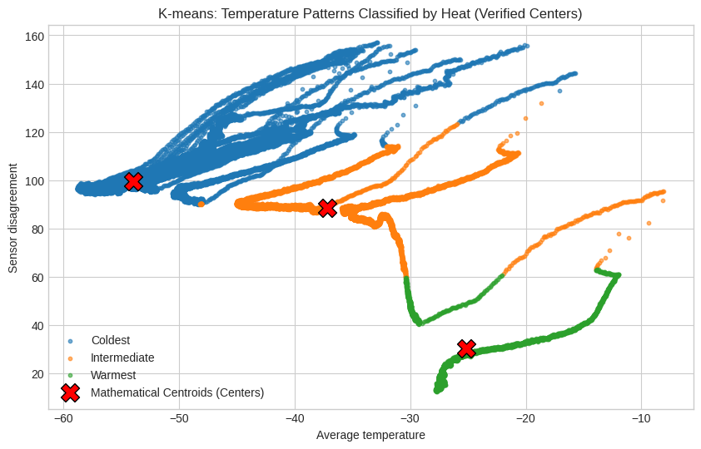
K-means groups three observed temperature behaviors
Clusters are descriptive pattern groups
Rows are grouped by mean temperature and sensor spread. The red X markers are calculated centers, ordered coldest to warmest.
Interpretation: clustering can surface distinct operating patterns, but it does not identify causes or events.

Slide 11
What the current notebook cannot claim
The supplied questions name humidity, location/hop, thresholds, and confirmed events. Those features or labels are not available in this notebook, so several use cases remain out of scope.
Recovery time
Needs excursion start/end times and the product’s acceptable temperature range.
Freezing exposure
Needs a product-specific freezing threshold and duration below it.
Door / handling events
Needs confirmed event labels before classification can be trusted.
Operational drivers
Humidity, location, and hop are not modeled in the available data.

Slide 12
A useful monitoring prototype needs verified operational context
The notebook demonstrates how linear regression, logistic regression, and K-means can turn sensor data into review signals. It does not yet validate decision-ready cold-chain alerts.
Keep
Sensor agreement and relative warm/change signals can prioritize review.
Add
Product limits, humidity, location/hop, and door/handling logs.
Validate
Test on held-out data with confirmed events before operational use.

