Slide 1

Ultralow Vaccine
Distribution Data
EXPLORATORY DATA ANALYSIS
Machine-learning questions, evidence,
and what the current data can support

Slide 2
Which ML questions can this dataset answer?
01 | Can sensors validate one another?
02 | What relates to next temperature change?
03 | Which windows need investigation?
04 | Which readings are relatively warm?
05 | Which temperature patterns look similar?
06 | What cannot be concluded without labels?

Slide 3
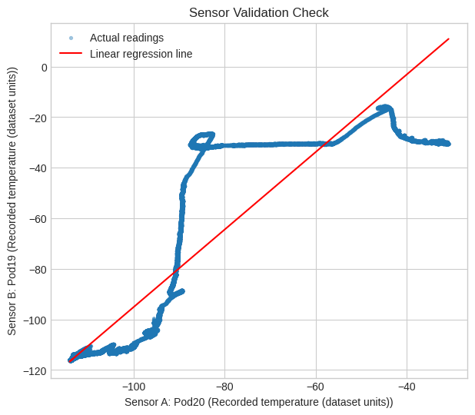
Can one temperature sensor help validate another?
Answer: yes, as a consistency check.
The first two temperature channels have a linear relationship of R² = 0.775. Most points sit near the fitted line, so a large departure can flag sensor disagreement or placement issues.
Interpretation: this validates consistency—not absolute accuracy.

Slide 4
Which available factors are associated with temperature rise?
Answer: the tested features explain very little of the next reading’s change. R² = 0.003, so this is not a usable next-reading predictor.
Model inputs
Time, mean temperature, sensor spread, O₂, and CO₂
Coefficient view
Direction only; the feature units differ
Interpretation
Add operational context before decisions

Slide 5
Can the system classify normal vs. investigation-needed windows?
Answer: it can rank a proxy for unusual short-term change—not confirm a failure.
The learning label marks the 10% largest absolute next-temperature changes. The visualization shows model probability across time, colored by this relative label.
Learning label
Largest 10% of absolute next-reading changes
Scale
11,228 of 112,266 model windows
Interpretation
Review queue, not a verified incident alarm

Slide 6
Can the system predict the probability of a warm excursion?
Answer: it estimates relative warmth within this dataset—not a product-limit excursion.
Learning label
Warmest 10% of next readings
Probability
A relative model score over time
Interpretation
The 0.5 reference is not a temperature limit

Slide 7
Can K-means reveal recurring temperature behavior?
Answer: yes. K-means groups observed readings by mean temperature and sensor spread; the groups are descriptive, not incident types.
Method
K-means with three clusters
Features
Mean temperature + sensor spread
Interpretation
Clusters reveal recurring patterns, not quality grades

Slide 8
What the current dataset supports—and what it does not
The analysis is useful for exploratory monitoring. Its limits are as important as its model outputs.
Supported
Sensor consistency checks and grouping of observed temperature behavior.
Proxy-only labels
“Investigation-needed” and “warm” are relative 10% cutoffs.
Not supported yet
Recovery time, freezing exposure, and door events lack verified labels or thresholds.
Next step
Add product limits, confirmed excursions, and event logs before operational deployment.

Slide 9
The clearest takeaway: use these models to prioritize review, not automate decisions
The data supports sensor cross-checking and pattern discovery today. Reliable operational alerts require domain thresholds and verified outcomes.
112,267
57
0.775
readings analyzed
temperature channels
sensor-validation R²

