Slide 1
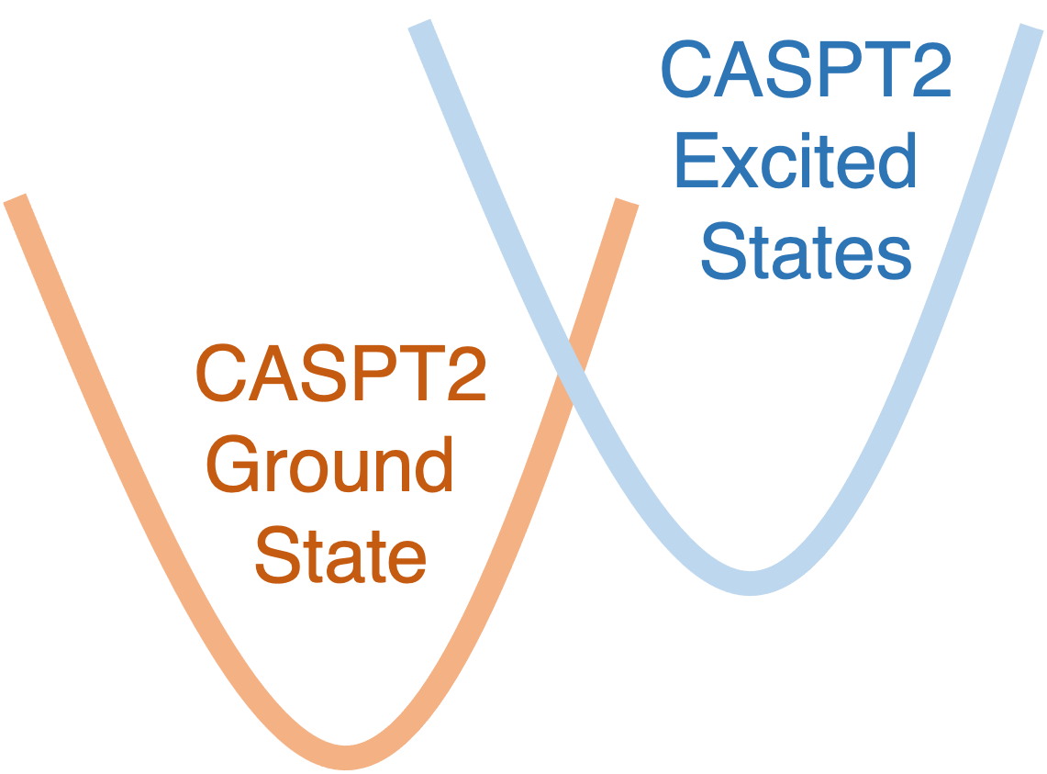
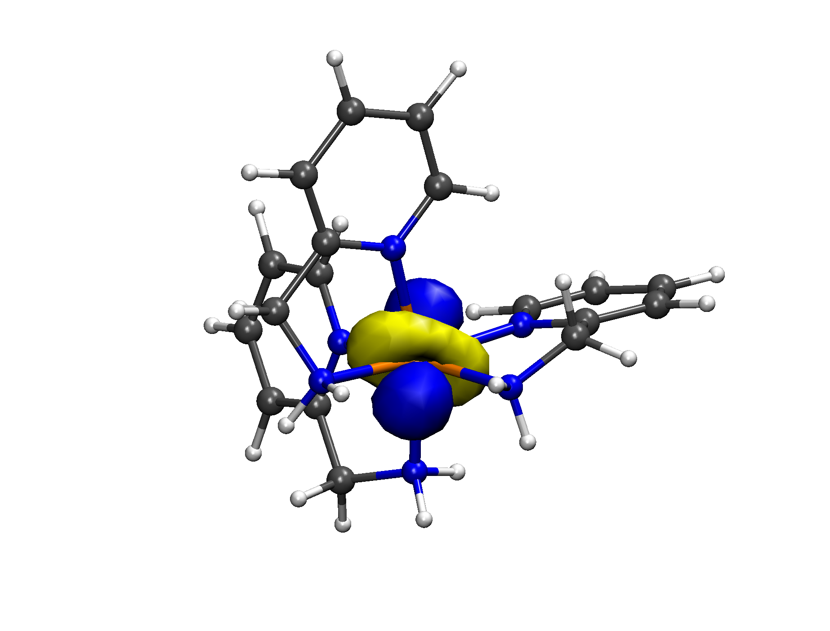
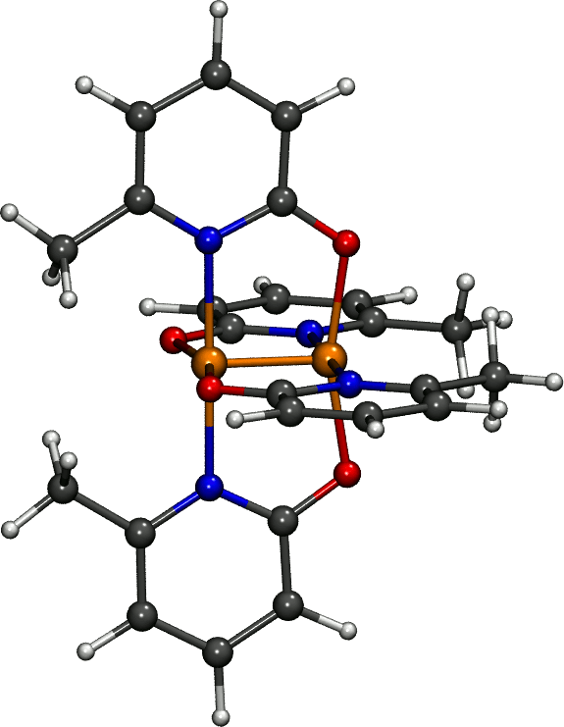
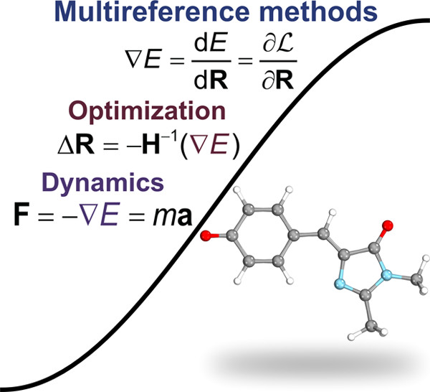
Not limited to the ground state
Fe(II) Spin-Crossover Complexes
Cr–Cr Vibrational
Modes
Recent Chem. Rev.

Slide 2
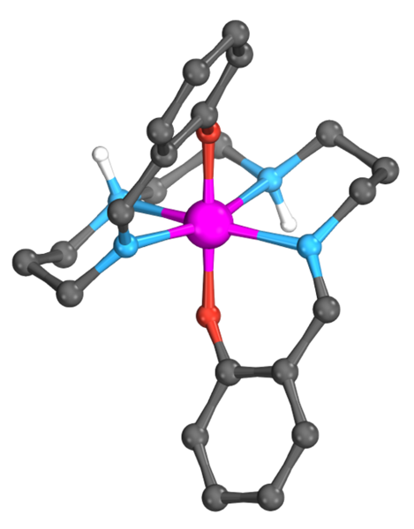
Not limited to the ground state
Fe(II) Spin-Crossover Complexes
Cr–Cr Vibrational
Modes
Mn(III) Spin-Crossover Complexes

Slide 3
Mn(III) Spin-Crossover Complexes

Slide 4
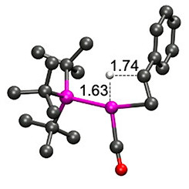
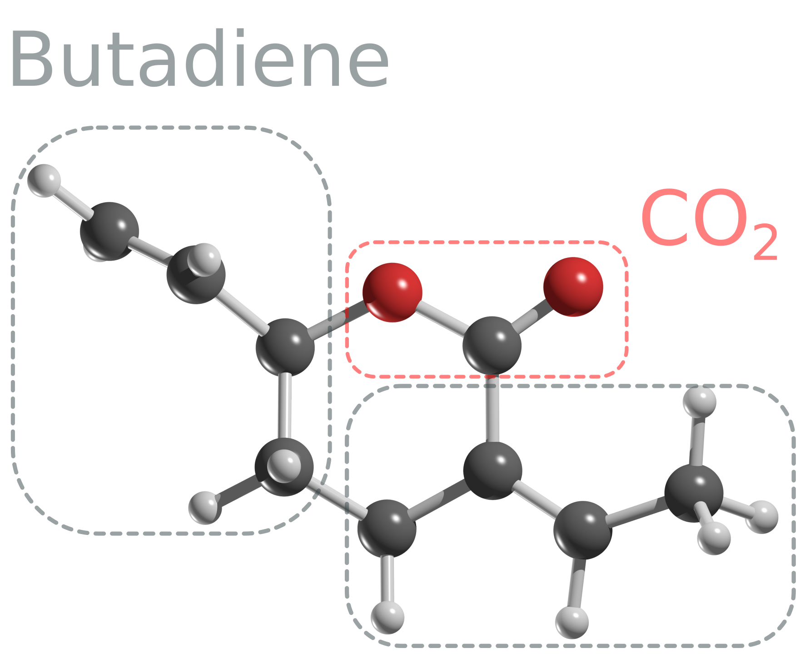
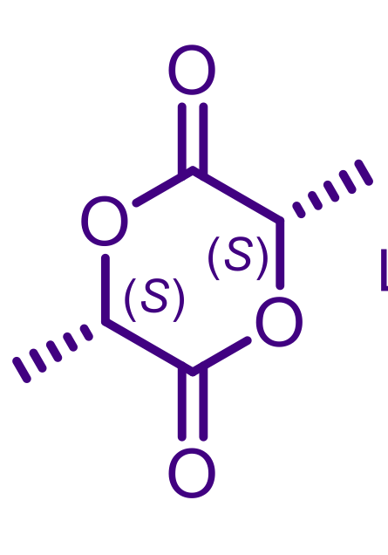
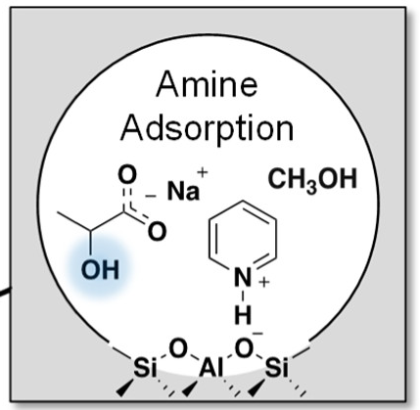
Pd Catalysts Decarbonylation
Pd-catalyzed
δ-lactones
Al Catalysts for Ring Opening Lactones
Co-Fe Amines for Selective Dehydration

Slide 5
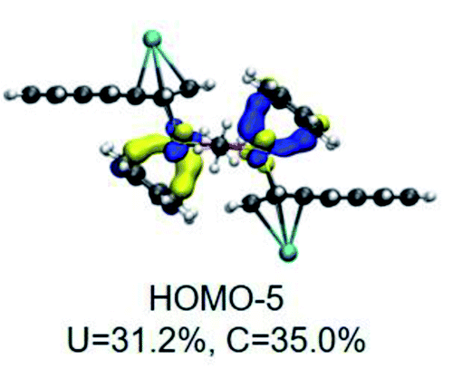
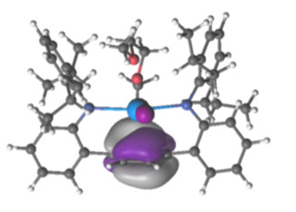
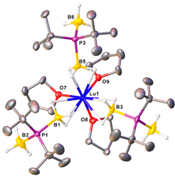
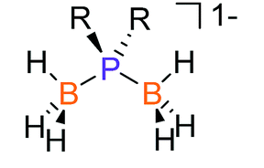
Uranium Arenide Sandwich Complex
N-Tethered Uranium Arene Complex
An and Ln Phosphindiboranates
Homoleptic U and Ln Phosphinodiboranates

