Slide 1
Microsoft
AURA
Agentic Retargeting Framework
LangGraph Implementation Update
Students: Yunbo Wang
Company Liaisons: Joe Tostenrude, Yousef Iskander, Ph.D., Richard Paw
Faculty Advisor: Dr. Farzad Ahmadkhanlou
Date: May 08, 2026
UCI Samueli
School of Engineering
Yunbo
1 / 16
M.Eng Capstone Project

Slide 2
This Deck: Agentic Framework Only
Built the core LangGraph orchestration for analog netlist migration.
Focus: agent roles, routing logic, Cadence/Ocean tool wrappers, run artifacts.
Not covering model training, GNN decoder, or GLA experiments in this update.
Default mode runs locally without UCI server; Cadence mode is enabled by environment variables.
Input .scs + specs CSV + prompt
LangGraph multi-agent loop
Output final .scs + .ocn + report
UCI Samueli
School of Engineering
Yunbo
2 / 16
M.Eng Capstone Project

Slide 3
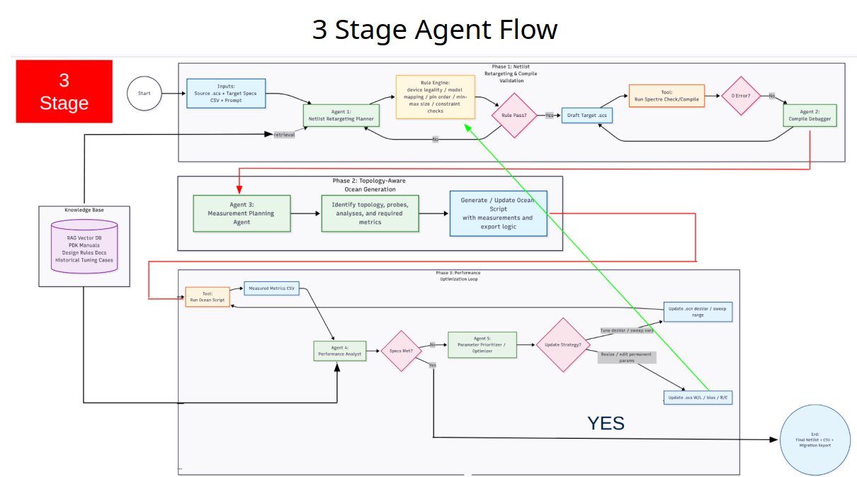
UCI Samueli
School of Engineering
Yunbo
3 / 16
M.Eng Capstone Project

Slide 4
LangGraph Runtime
load_inputs
retrieve_kb
retarget_planner
rule_engine
spectre_compile
measure / ocean
compile_debugger if Spectre errors
performance_analyst
optimizer
finalize_outputs
UCI Samueli
School of Engineering
Yunbo
4 / 16
M.Eng Capstone Project

Slide 5
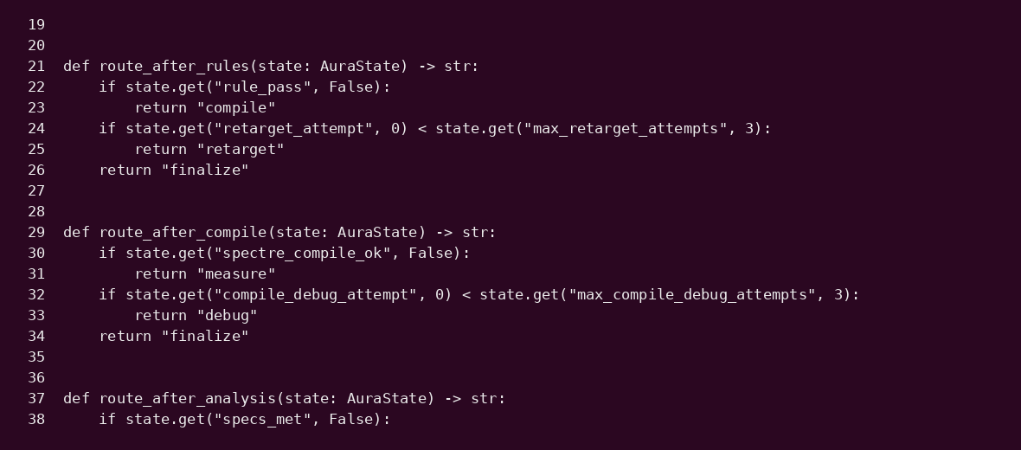
Graph Code: Explicit Routing
UCI Samueli
School of Engineering
Yunbo
5 / 16
M.Eng Capstone Project

Slide 6
State Contract
Inputs
Retargeting
Tools
Optimization
source_scs_path
target_specs_csv_path
target_pdk
user_prompt
retarget_plan
draft_scs_path
rule_violations
rule_pass
spectre_compile_ok
ocean_script_path
measured_csv_path
compile_errors
specs_met
failed_specs
optimization_actions
final_scs_path
The graph passes one TypedDict state across every agent and tool node.
All generated files are also registered in `artifacts` for reporting.
UCI Samueli
School of Engineering
Yunbo
6 / 16
M.Eng Capstone Project

Slide 7
Phase 1: Netlist Retargeting
Reads source Spectre netlist and target specs CSV.
Builds a first-pass retarget plan from local PDK presets and examples.
Rewrites model include, MOS model names, default bias variables, and target L/W constraints.
Rule engine checks model mapping, MOS pin count, min length/width, and required design parameters.
45nm source nmos / pmos 5V bias
Target PDK preset ptm22_lp / gpdk045 / asap7
Draft .scs 22n L new include safe bias defaults
UCI Samueli
School of Engineering
Yunbo
7 / 16
M.Eng Capstone Project

Slide 8
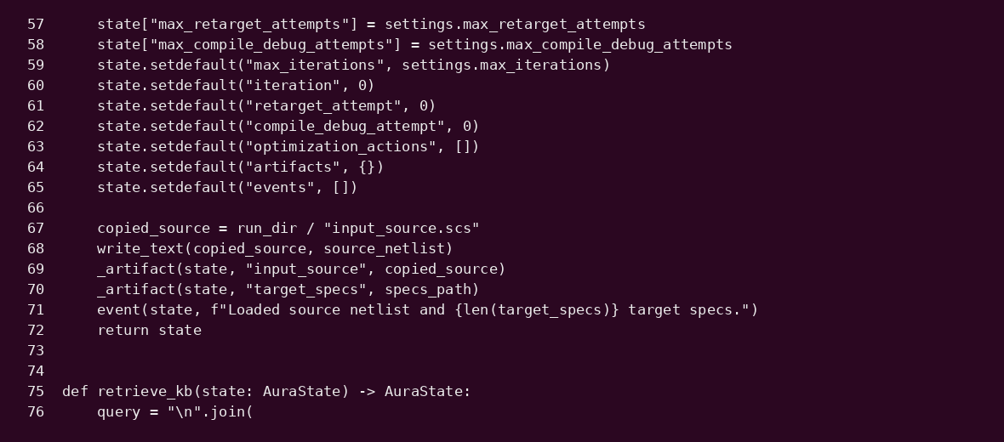
Phase 1 Code: Planner and Rule Gate
UCI Samueli
School of Engineering
Yunbo
8 / 16
M.Eng Capstone Project

Slide 9
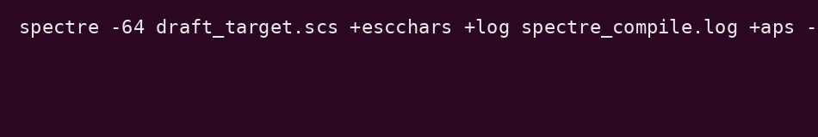
Tool Node: Spectre Compile / Debugger
`run_spectre_compile` prepares the real Cadence command and parses logs.
`AURA_DRY_RUN=true` skips external binaries for local development.
When connected to UCI server, set `AURA_DRY_RUN=false` and source Cadence profile.
Compile debugger keeps edits conservative: fix missing params, then route back to rule engine.
No SSH inside the agent Run locally on UCI Linux/Cadence host
UCI Samueli
School of Engineering
Yunbo
9 / 16
M.Eng Capstone Project

Slide 10
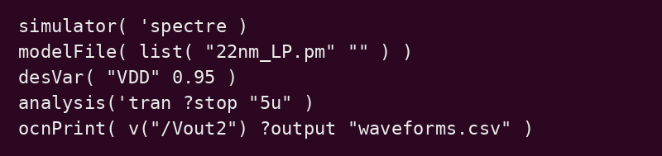
Phase 2: Topology-Aware Ocean Generation
Infers differential amplifier probes: Vin+, Vin-, Vout1, Vout2, VDD, ground.
Chooses analyses from requested metrics: dcOp, ac, transient.
Generates `.ocn` with simulator, modelFile, desVar, analysis, resultsDir, ocnPrint.
Normalizes Spectre values like `10uA`, `0.95V`, `10mV` into Ocean-friendly literals.
Topology Detector
Analysis Planner
Ocean Writer
UCI Samueli
School of Engineering
Yunbo
10 / 16
M.Eng Capstone Project

Slide 11
Phase 3: Performance Optimization Loop
measured_metrics.csv
Performance Analyst compare specs
Specs Met?
Final Report
Optimizer prioritize failed metrics
Update .scs W/L, bias, R/C
Gain or bandwidth failures tune Rg/Rm.
Power failures reduce ISS/Ibtail.
Output common-mode failures tune Aref/Vb3.
UCI Samueli
School of Engineering
Yunbo
11 / 16
M.Eng Capstone Project

Slide 12
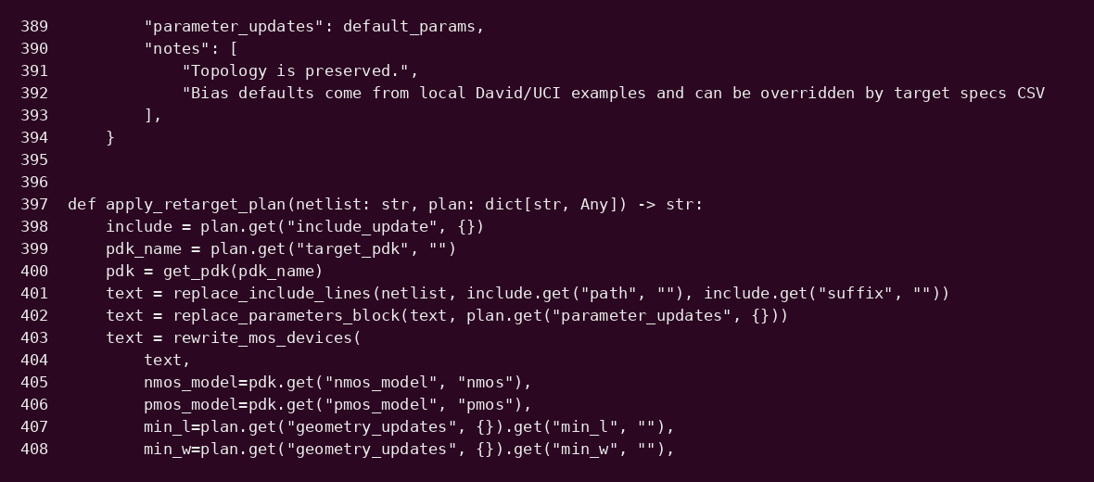
Tooling Code: Metrics and Optimization
UCI Samueli
School of Engineering
Yunbo
12 / 16
M.Eng Capstone Project

Slide 13
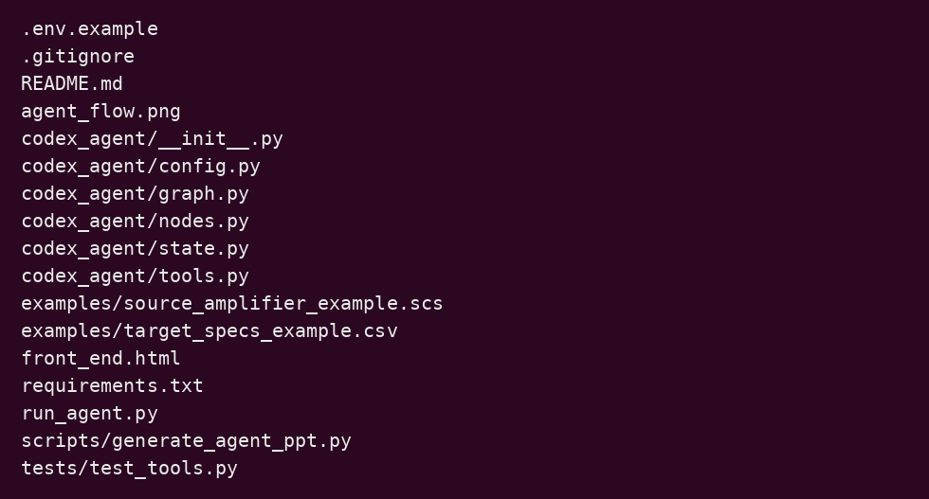
Agent Code Files
- graph.py: LangGraph topology and conditional routers.
- nodes.py: agent/tool nodes matching the three-stage flow.
- tools.py: netlist parser, PDK presets, rule checks, runner wrappers.
- state.py: shared state contract.
- run_agent.py: reproducible CLI entrypoint.
UCI Samueli
School of Engineering
Yunbo
13 / 16
M.Eng Capstone Project

Slide 14
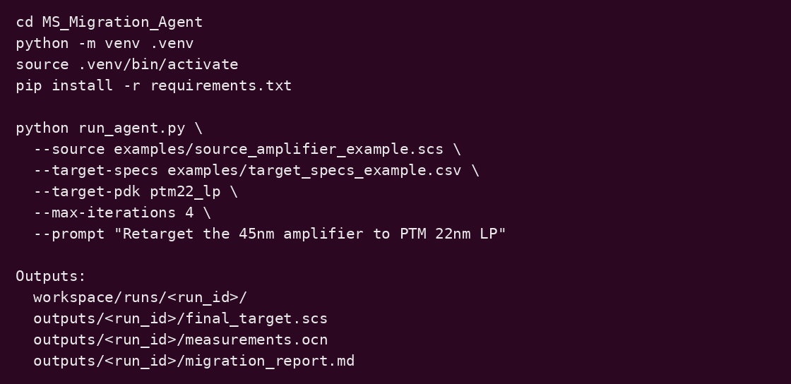
How To Run The Agent
UCI Samueli
School of Engineering
Yunbo
14 / 16
M.Eng Capstone Project

Slide 15
Current Technical Features
Local KB Retrieval
Reads david / csc / TPM / mother_code examples for relevant snippets.
PDK Presets
ptm22_lp, gpdk045, asap7 model names, min geometry, include paths.
Dry Run First
Develop and demo without Cadence connection; no SSH required.
Cadence Ready
Spectre/Ocean wrappers use environment variables for UCI server mode.
Artifact Tracking
Every run writes draft .scs, .ocn, logs, metrics CSV, final report.
Loop Routing
Optimizer sends updates back to rule checks or Ocean generation.
UCI Samueli
School of Engineering
Yunbo
15 / 16
M.Eng Capstone Project

Slide 16
Next Steps
Run `AURA_DRY_RUN=false` on the UCI Cadence Linux host and validate Spectre/Ocean logs.
Replace heuristic retarget planner with LLM + structured RAG over PDK manuals and tuning cases.
Add stronger analog metric extraction: gain, bandwidth, phase margin, power, settling, swing.
Connect Skillbridge/Virtuoso path for schematic-level desVar tuning.
Later stage: log trajectories for Agent Lightning style policy/router improvement.
UCI Samueli
School of Engineering
Yunbo
16 / 16
M.Eng Capstone Project

