Slide 1
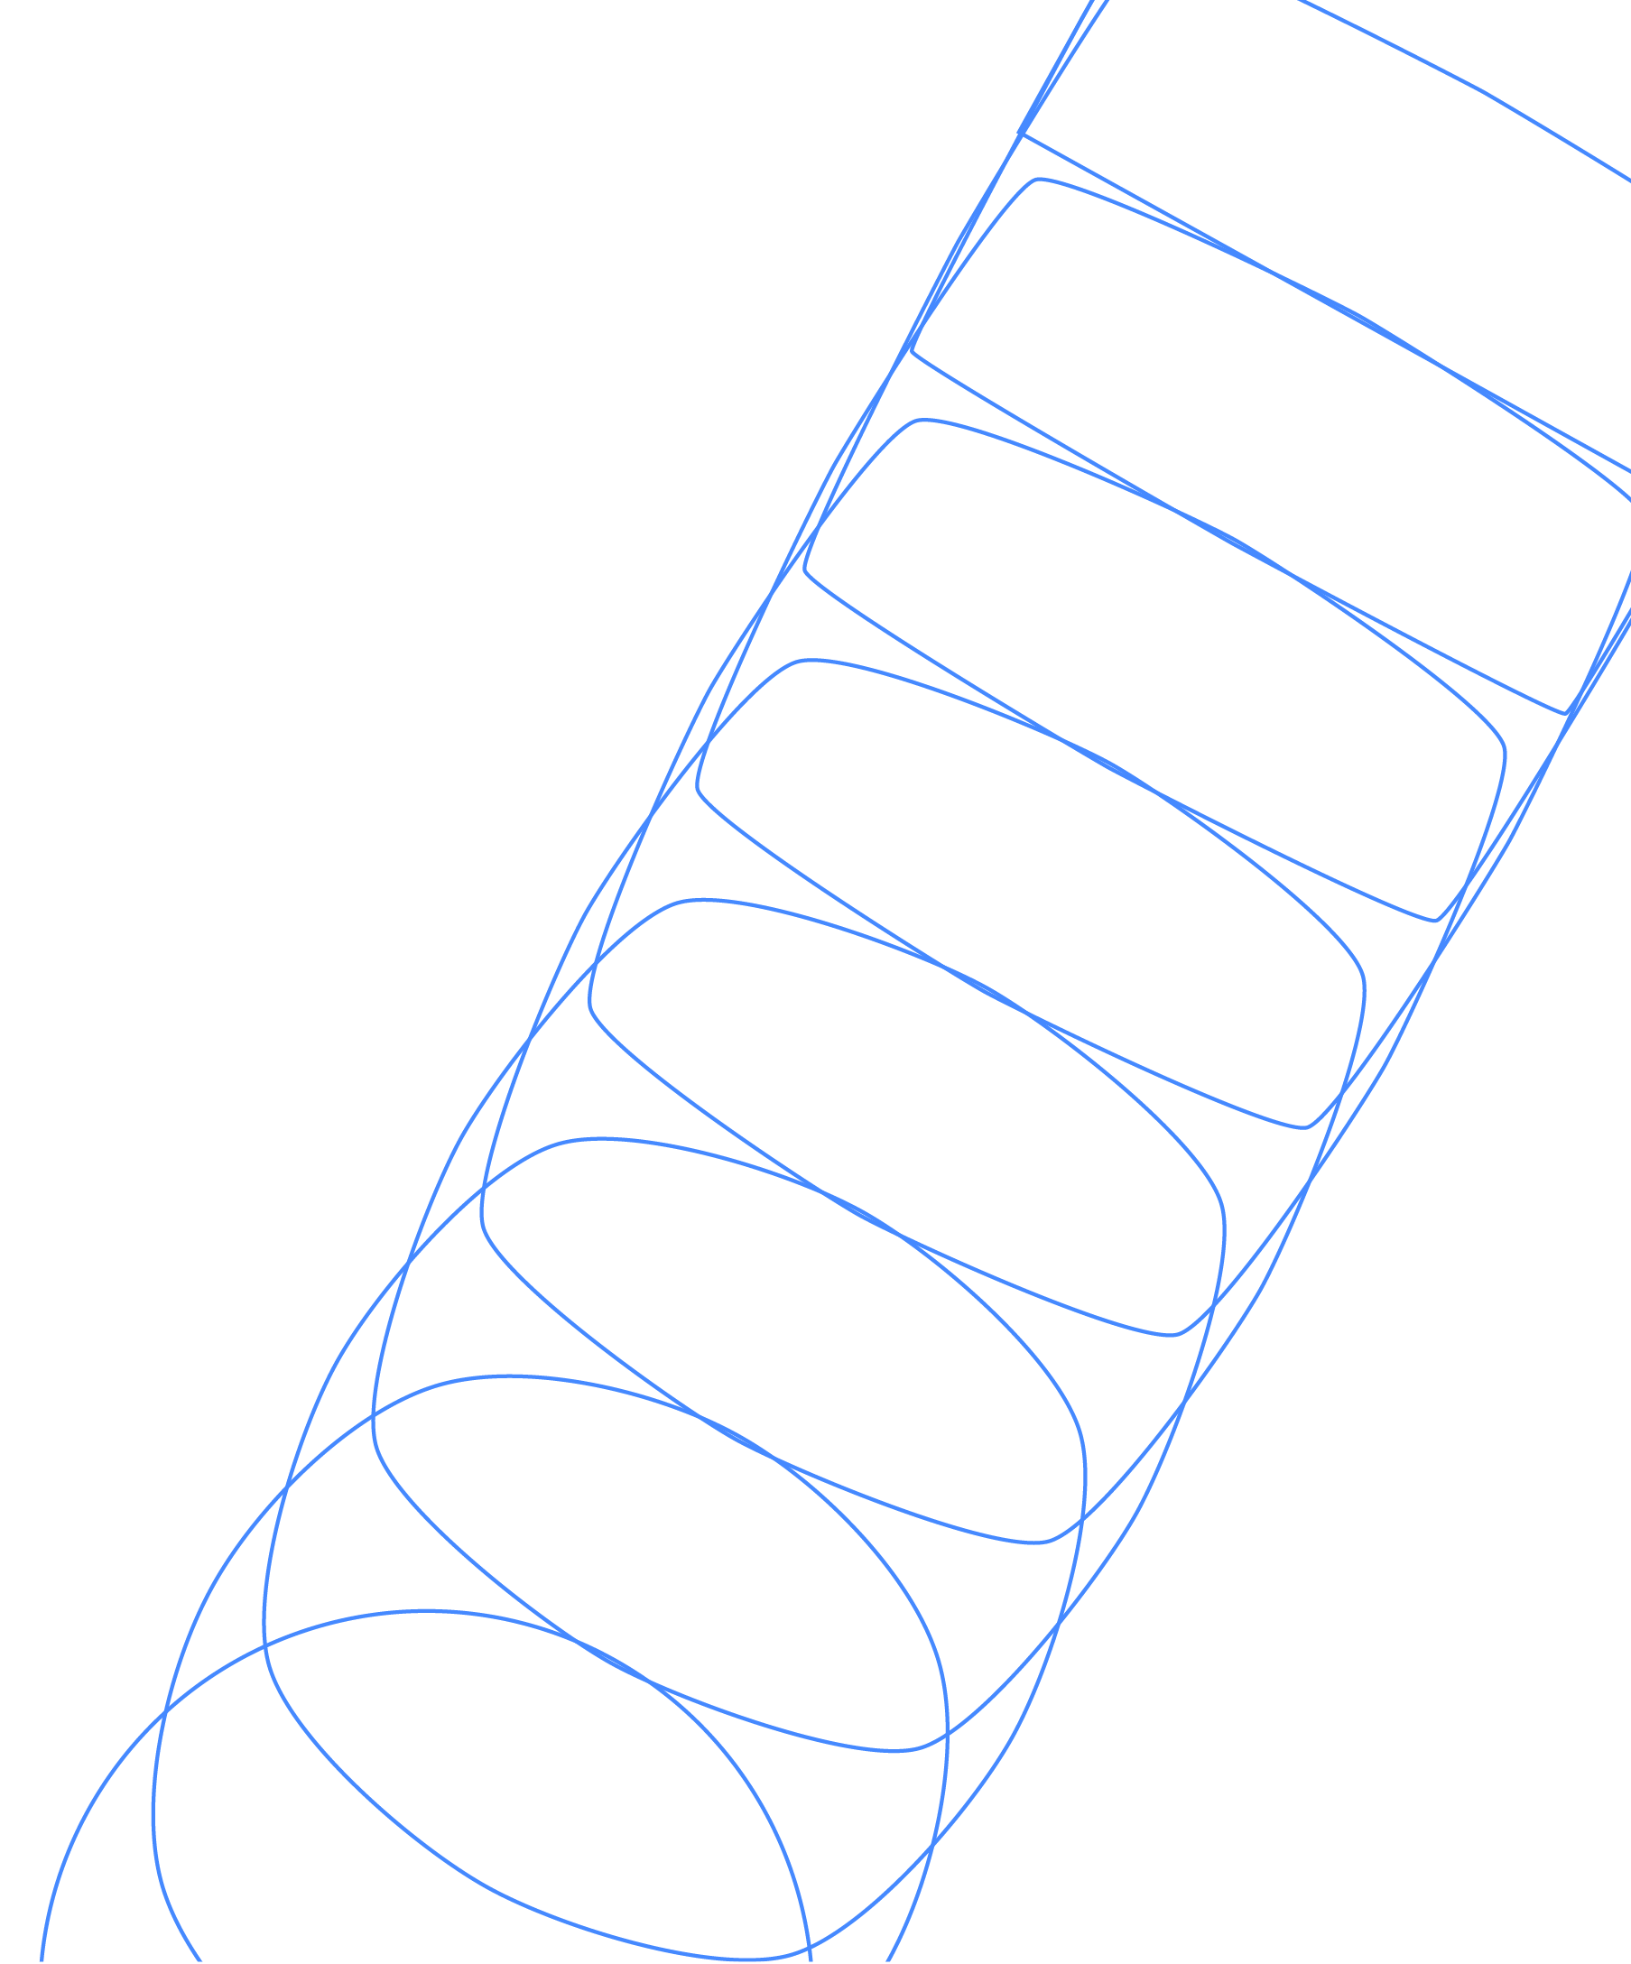
Introduction to the Surface Code
James R. Wootton
IBM Quantum

Slide 2
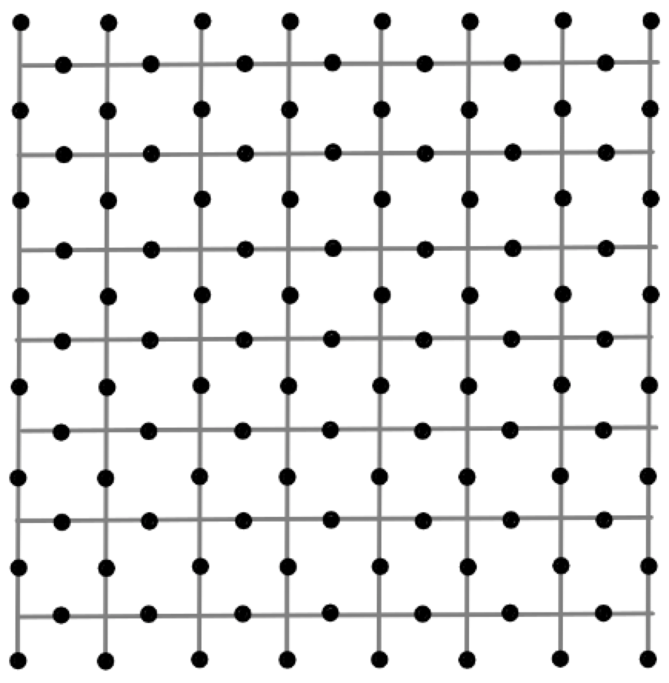
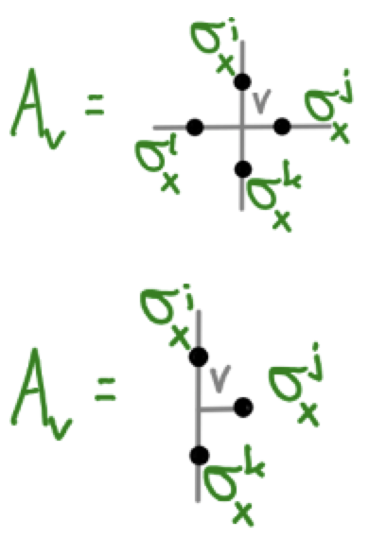
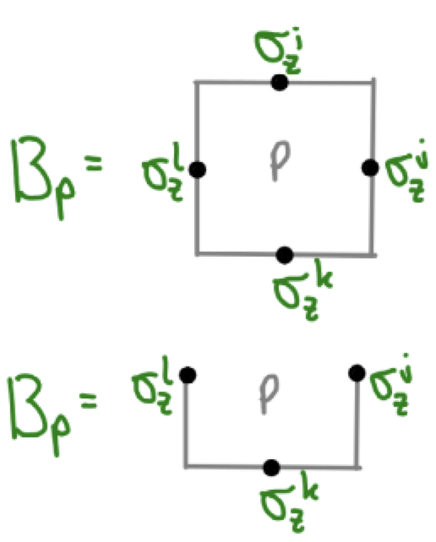
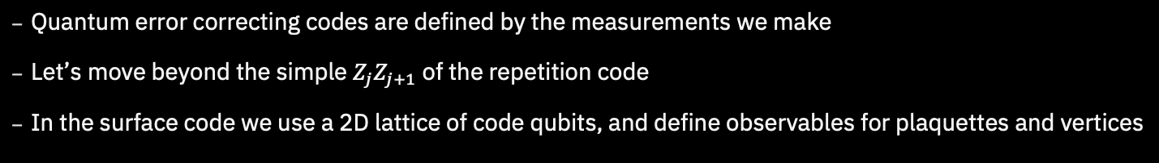
The Surface Code
  Quantum error correcting codes are defined by the measurements we make
  Let’s move beyond the simple $Z_{j}Z_{j+1}$ of the repetition code
  In the surface code we use a 2D lattice of code qubits, and define observables for plaquettes and vertices

Slide 3
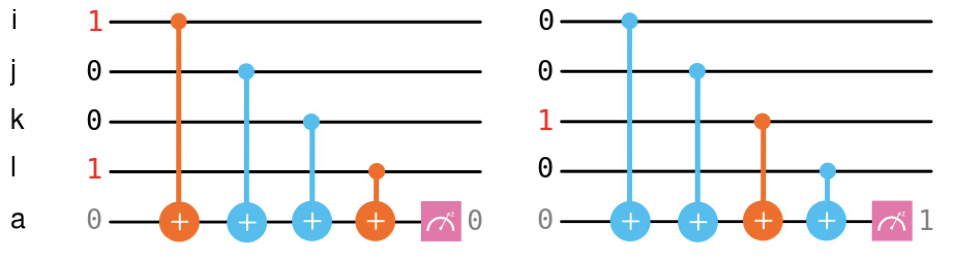
Plaquette Syndrome
  First let’s focus on the plaquette syndrome
  These are similar to the two qubit measurements in the repetition code
  Instead we measure the parity around plaquettes in the lattice
  Can again be done with CX gates and an extra qubit

Slide 4
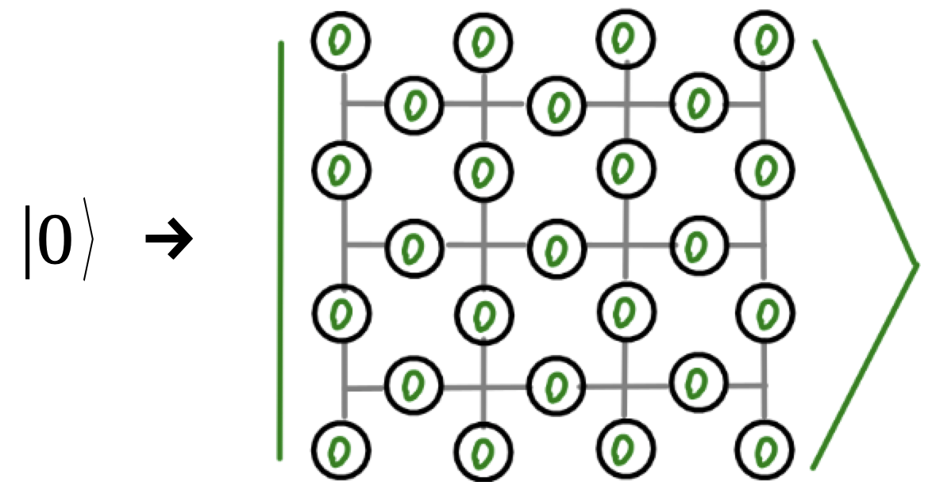
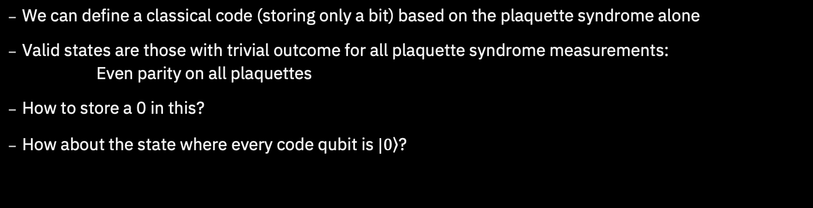
Plaquette Syndrome
  We can define a classical code (storing only a bit) based on the plaquette syndrome alone
  Valid states are those with trivial outcome for all plaquette syndrome measurements:
  Even parity on all plaquettes
  How to store a 0 in this?
  How about the state where every code qubit is $|\left.0\right\rangle$?

Slide 5
Plaquette Syndrome
  We can define a classical code (storing only a bit) based on the plaquette syndrome alone
  Valid states are those with trivial outcome for all plaquette syndrome measurements:
  Even parity on all plaquettes
  How to store a 0 in this?
  How about the state where every code qubit is $|\left.0\right\rangle$?

Slide 6
Plaquette Syndrome
  We can define a classical code (storing only a bit) based on the plaquette syndrome alone
  Valid states are those with trivial outcome for all plaquette syndrome measurements:
  Even parity on all plaquettes
  How to store a 0 in this?
  How about the state where every code qubit is $|\left.0\right\rangle$?

Slide 7
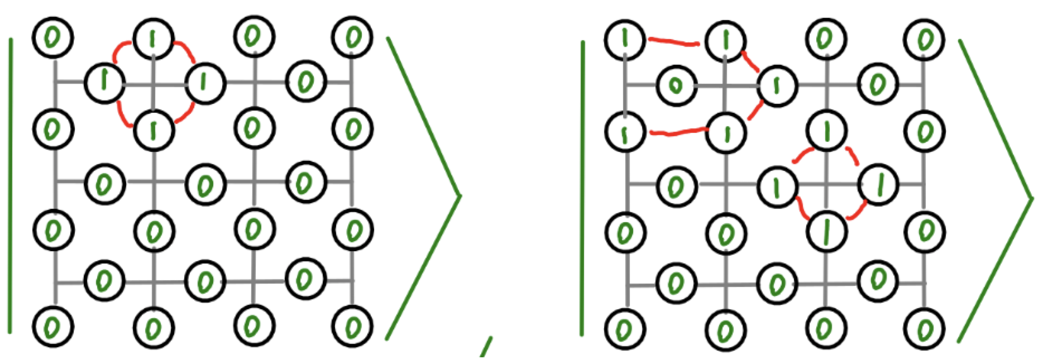
Plaquette Syndrome
  There are ‘nearby’ states that also have even parity on all plaquettes
  These can’t be a different encoded state: they are only a few bit flips away from our encoded 0 state
  We’ll treat them as alternative ways to store a 0

Slide 8
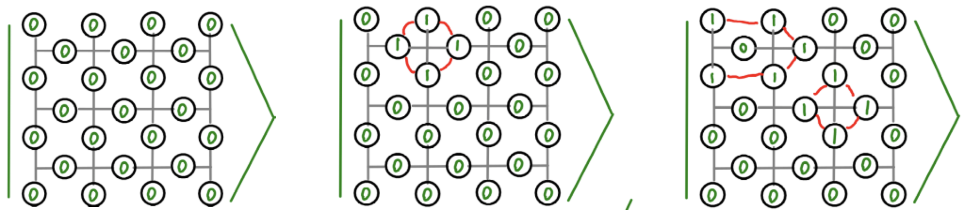
Plaquette Syndrome
  Given any state for an encoded 0
    Pick a vertex
    Apply bit flips around that vertex
  Now you have another valid state for 0
  This generates an exponentially large family

Slide 9
Plaquette Syndrome
  The states in this family can be very different
  But they all share a common feature
    Any line from top to bottom (passing along edges) has even parity
  This is how we can identify an encoded 0
  And it gives us a clue about how to encode a 1

Slide 10
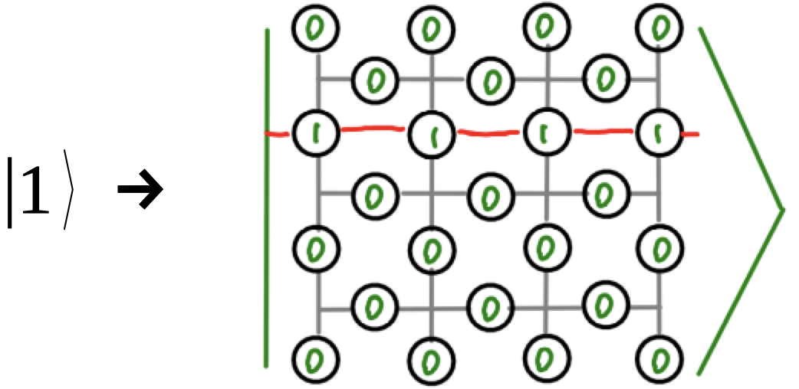
Plaquette Syndrome
  For our basic encoded 1, we use a bunch of 0s with a line from left to right (passing through plaquettes)
  This also spawns an exponentially large family
  All have odd parity for a line from top to bottom
  Unlike the repetition code, distinguishing encoded 0 and 1 requires some effort (which is good!)

Slide 11
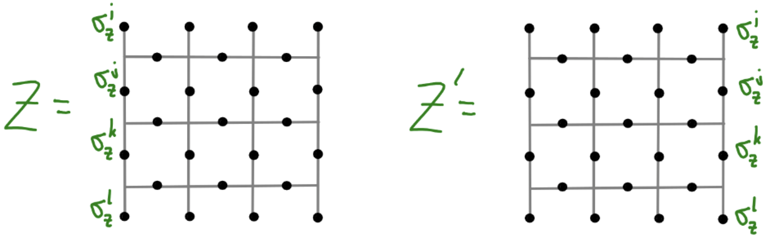
Logical X and Z
  Distinguishing 0 and 1 corresponds to measuring Z on the physical qubit
  The following observables detect what we need
  Or the same on any line from top to bottom
  Uses the edges has a nice advantage: we can think of them as large (unenforced) plaquettes

Slide 12
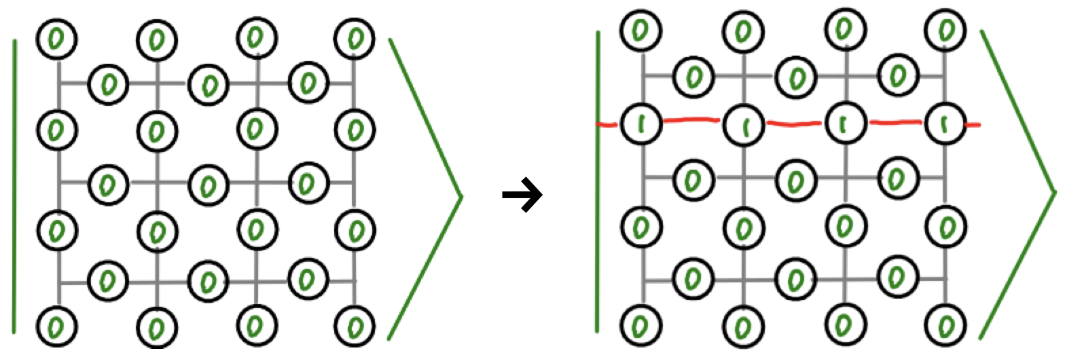
Logical X and Z
  To flip between 0 and 1, we can flip a line of qubits
  Such lines of flips act as an X on the logical qubit

Slide 13
Effects of Errors
  Applying an X to any code qubit changes the parity of its two plaquettes
  An isolated X creates a pair of defects
  Further Xs can be move a defect, or annihilate pairs of them
  A logical X requires many errors to stretch across the lattice
  With the plaquette operators, we can encode and protect a bit

Slide 14
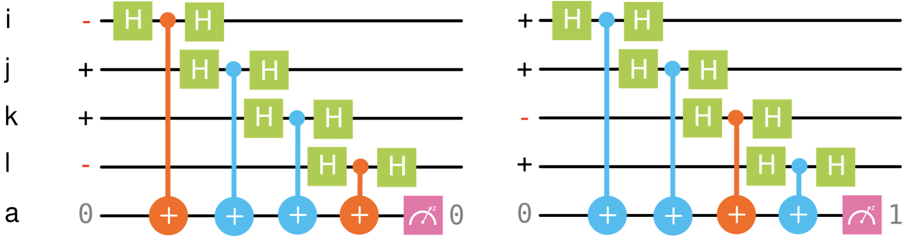
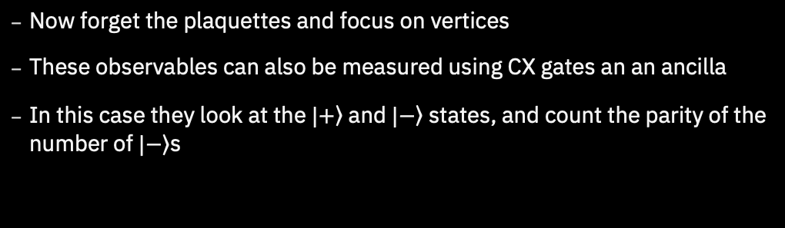
Vertex Syndrome
  Now forget the plaquettes and focus on vertices
  These observables can also be measured using CX gates an an ancilla
  In this case they look at the $|\left.+\right\rangle$ and $|\left.−\right\rangle$ states, and count the parity of the number of $|\left.−\right\rangle$s

Slide 15
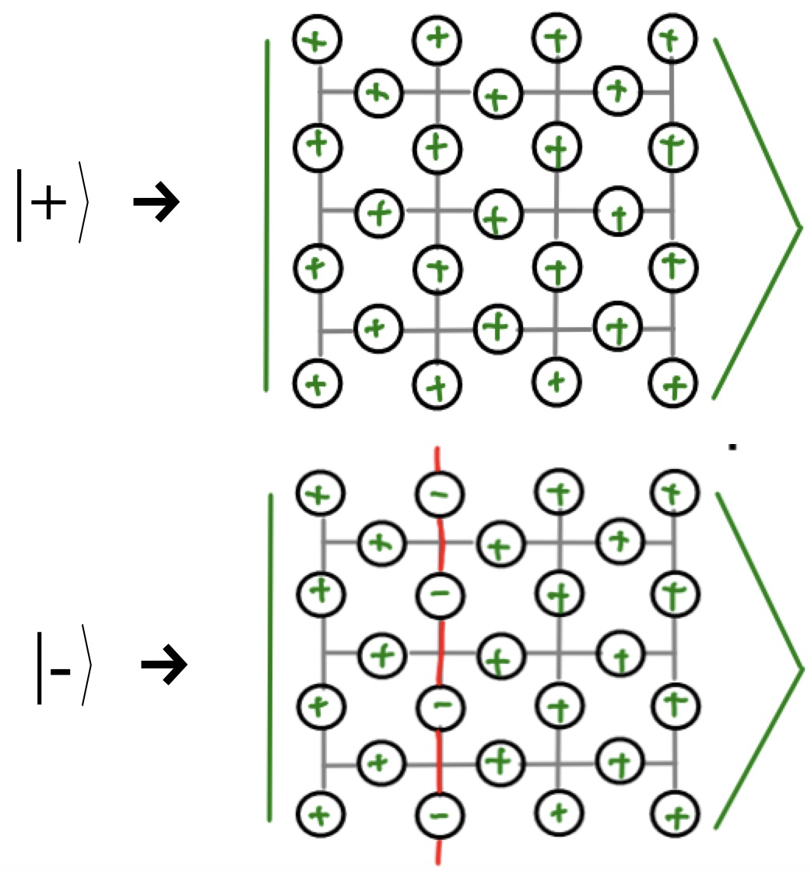
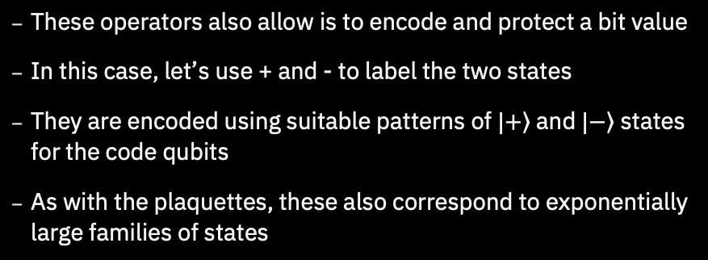
Vertex Syndrome
  These operators also allow is to encode and protect a bit value
  In this case, let’s use + and - to label the two states
  They are encoded using suitable patterns of $|\left.+\right\rangle$ and $|\left.−\right\rangle$ states for the code qubits
  As with the plaquettes, these also correspond to exponentially large families of states

Slide 16
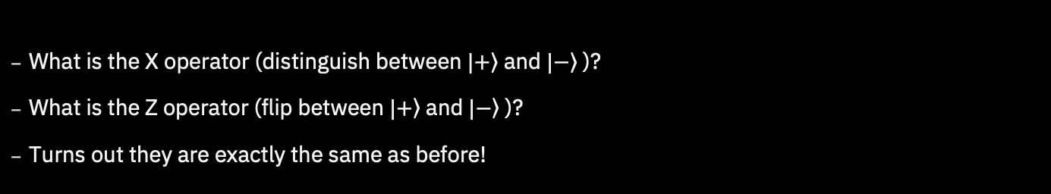
Logical X and Z
  What is the X operator (distinguish between $|\left.+\right\rangle$ and $|\left.−\right\rangle$ )?
  What is the Z operator (flip between $|\left.+\right\rangle$ and $|\left.−\right\rangle$ )?
  Turns out they are exactly the same as before!

Slide 17
Effects of Errors
  Applying a Z to any code qubit changes the X parity of its two vertices
  An isolated Z creates a pair of defects
  Further Zs can be move a defect, or annihilate pairs of them
  A logical Z requires many errors to stretch across the lattice
  With the vertex operators, we can encode and protect a bit

Slide 18
Putting it all Together
  The plaquette and vertex operators commute
  This allows us to detect both X and Z errors
  Since Y~XZ, we can detect Y errors too

Slide 19
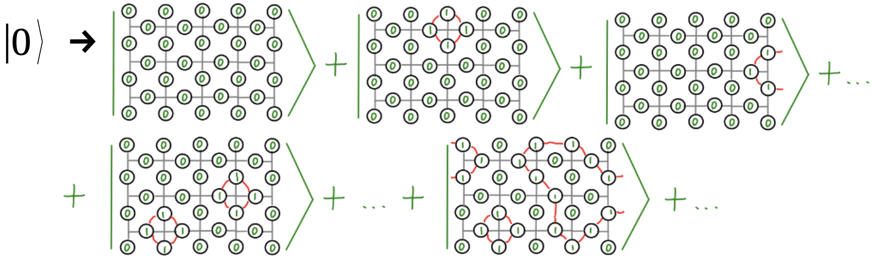
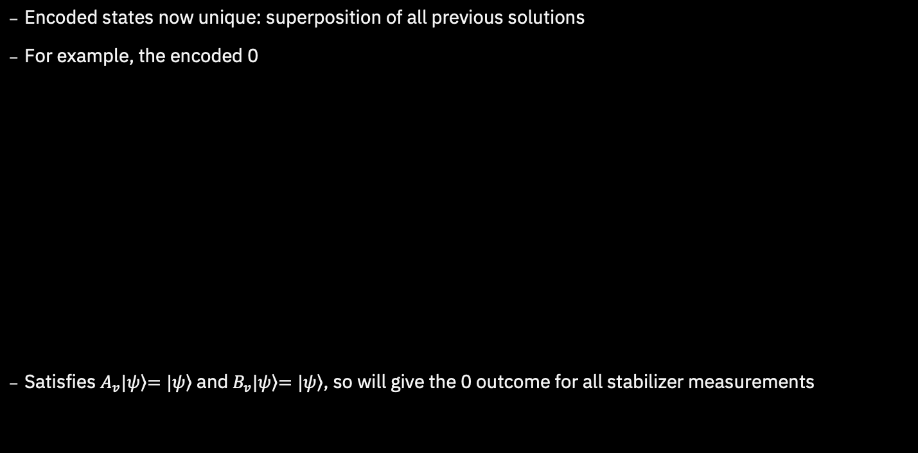
Putting it all Together
  Encoded states now unique: superposition of all previous solutions
  For example, the encoded 0
  Satisfies $A_{v}|\left.ψ\right\rangle \left.=|ψ\right\rangle$ and $B_{v}|\left.ψ\right\rangle \left.=|ψ\right\rangle$, so will give the 0 outcome for all stabilizer measurements

Slide 20
Putting it all Together
  The Z and X operators on the encoded qubit are exactly the same as before
  These, and the Hadamard, can be performed fault-tolerantly

Slide 21
Putting it all Together
  The states we need are highly entangled quantum states
  They are examples of topologically ordered states
  Though such things can be hard to make, we create and protect them with the syndrome measurements

Slide 22
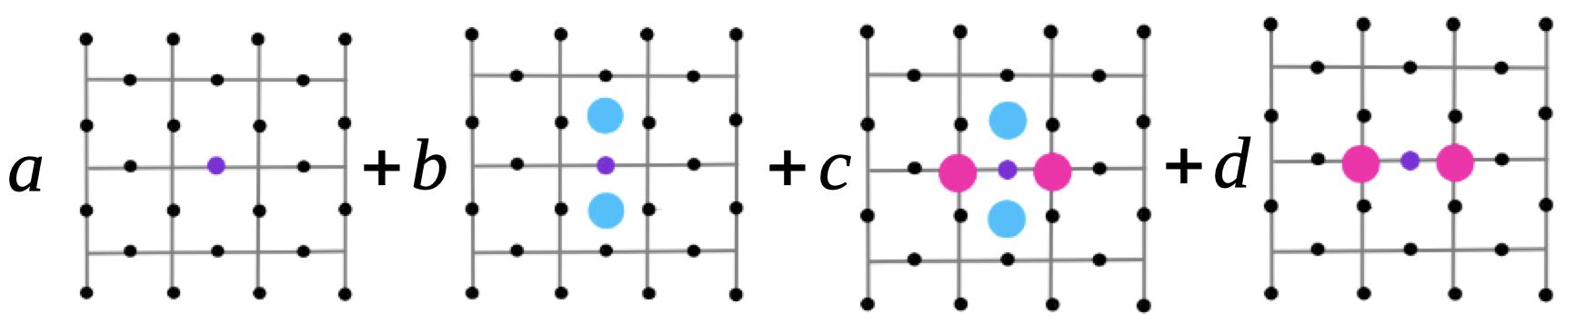
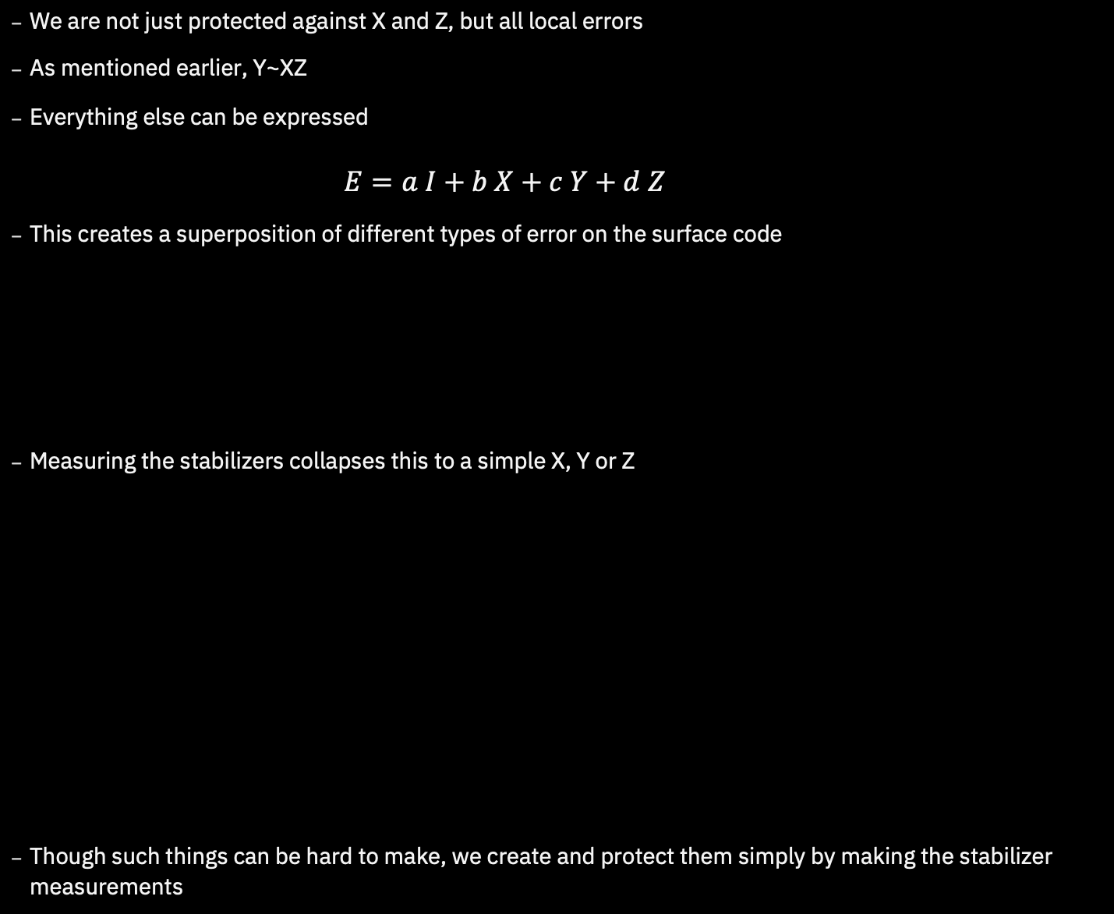
Putting it all Together
  We are not just protected against X and Z, but all local errors
  As mentioned earlier, Y~XZ
  Everything else can be expressed
        $$E=a I+b X+c Y+d Z$$
  This creates a superposition of different types of error on the surface code
  Measuring the stabilizers collapses this to a simple X, Y or Z
  Though such things can be hard to make, we create and protect them simply by making the stabilizer measurements

Slide 23
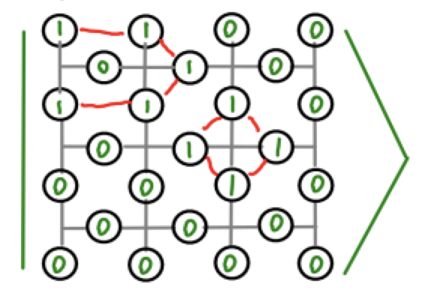
Final Readout
  The logical operators are many-body observables
  So how do we read them out fault-tolerantly
  When you decide on a basis for final measurement, you stop caring about some errors
  You can then measurement in a product basis
  Final readout and final stabilizer measurement can be constructed from the result
  Measurement errors are effectively the same as errors before measurement

Slide 24
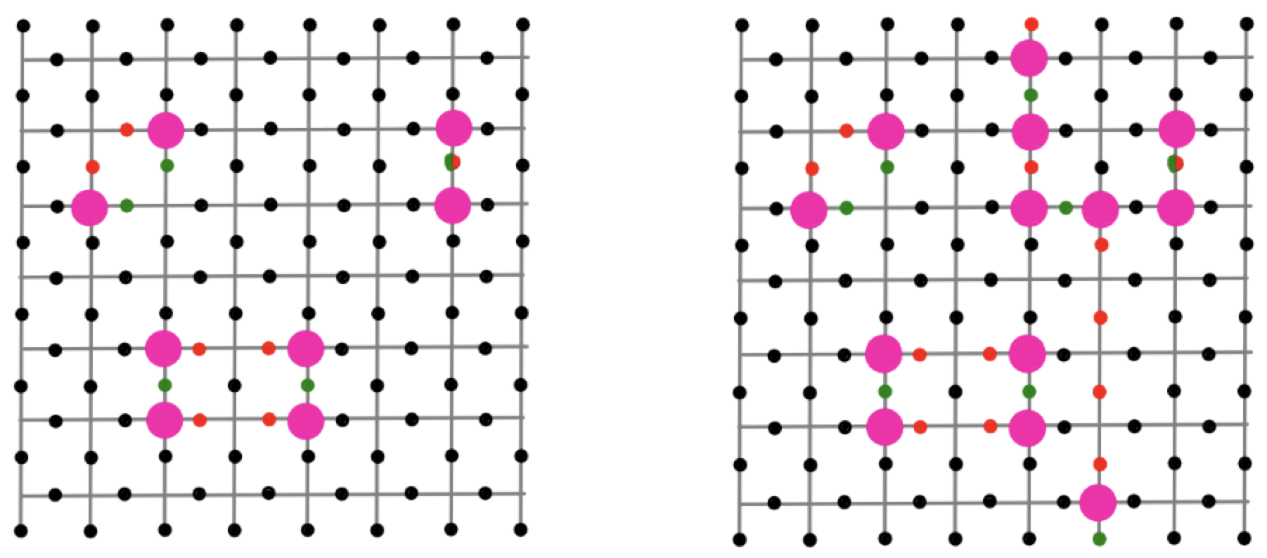
Decoding
  Given the measurement results, we need to work out what errors happened
  More specifically, the ‘equivalence class’ of errors
  This is the job of the decoding algorithm

Slide 25
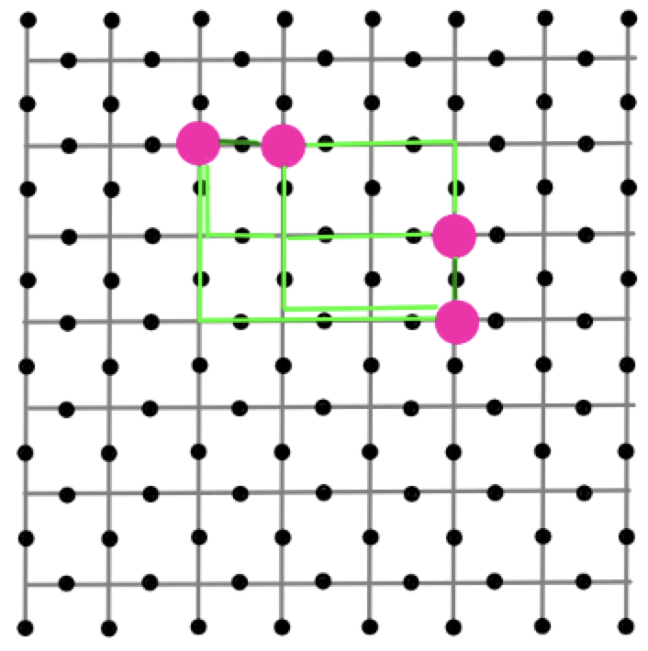
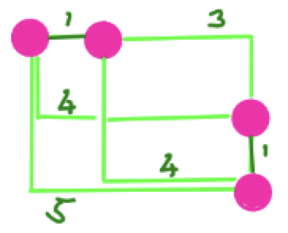
Decoding with MWPM
  A good option is MWPM
  Just as we considered for the repetition code
  Again we start with the simple and unrealistic case: errors only between measurement
  Each round can be decoded separately, corresponding to MWPM on a 2D graph
  Decoding for X and Z errors can also be done independently

Slide 26
Decoding
  We need to be careful to account for the effects of the edges
  This is done by introducing extra ‘virtual nodes’
  (also required for the repetition code, but we ignored it earlier)

Slide 27
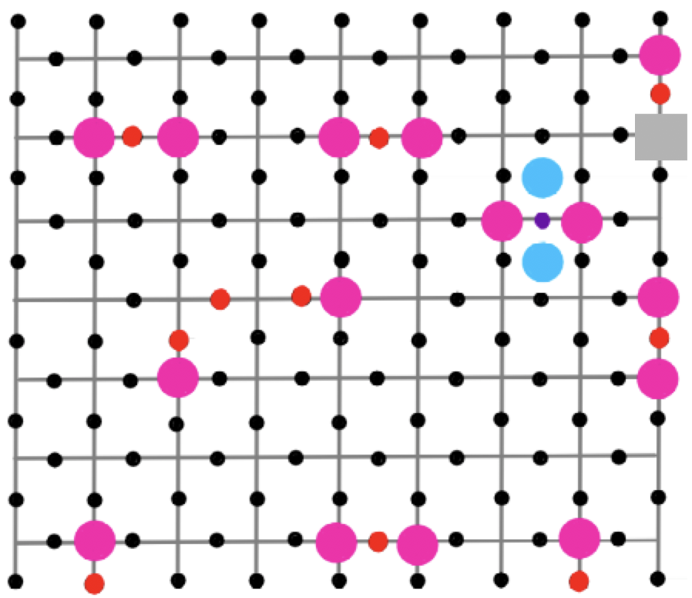
Imperfect Measurements
  Again, we have the problem of imperfect measurements
    The measurements might lie
    Errors on the additional qubit
    Errors in the CX gates
  We base the decoding using syndrome changes
  This leads to a 3D MWPM problem (2D space + time)

Slide 28
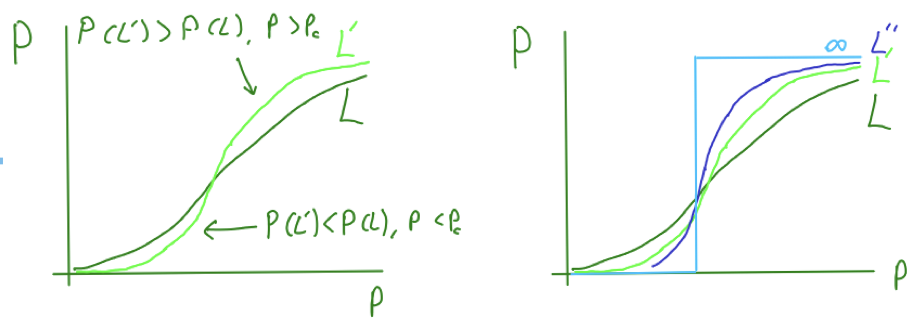
Threshold
  Correcting according to the right class removes the effects of errors
  Correcting according to the wrong class causes an operation on the encoded qubit (without our knowing)
  What is the probability of such an error, P, given the probability on the qubits of the code, p?
  We find a phase transition as L is increased (for an LxL grid)

Slide 29
More Logical Gates
  We’ve seen how to do logical X and Z
  A logical CX can be done without much trouble
  A logical H requires the lattice to be rotated, but that can be done
  Other logical Clifford gates can be done with some crazy tricks
  But that’s all! No other logical operations can be done fault-tolerantly.
  A solution is magic state distillation, using the logical gates we have to clean up the one we don’t
  But that’s beyond today’s lecture…

Slide 30
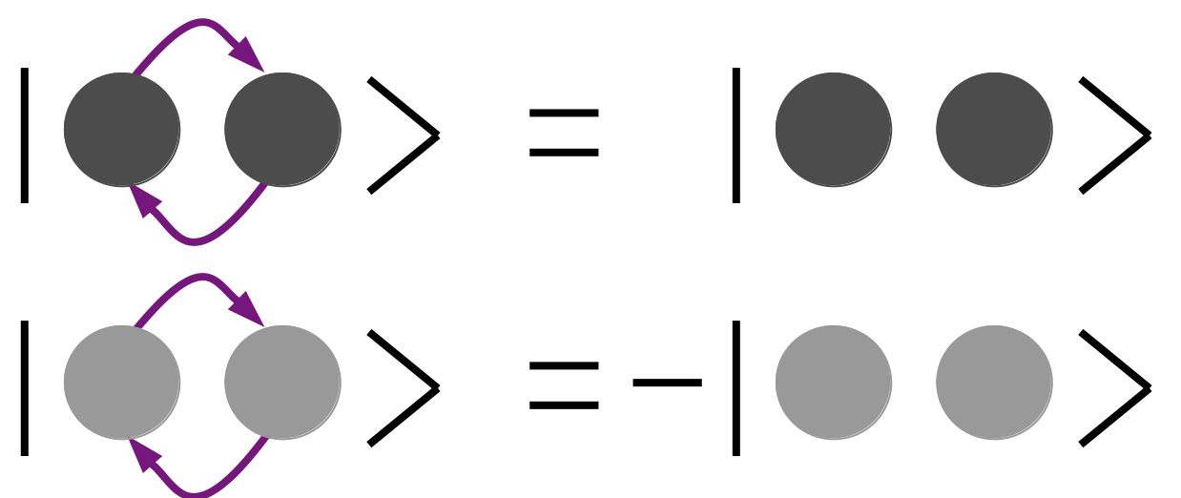
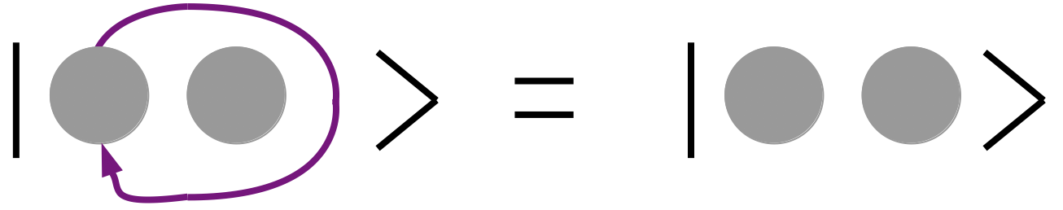
Anyons in the Surface Code
  There are many variants on how qubits can be encoded and manipulated in the surface code
  They all depend on the unique topological nature
  The ‘defects’ created by errors in the surface code behave like particles
  All particles in our universe are either bosons or fermions
  This due to topological restrictions in a 3D universe

Slide 31
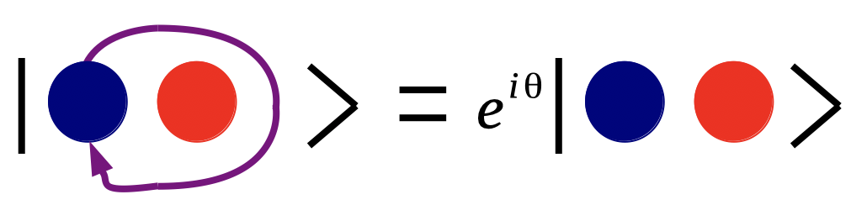
Anyons in the Surface Code
  The surface code is only a 2D ‘universe’, so doesn’t have these restrictions
  How do these particles behave?

Slide 32
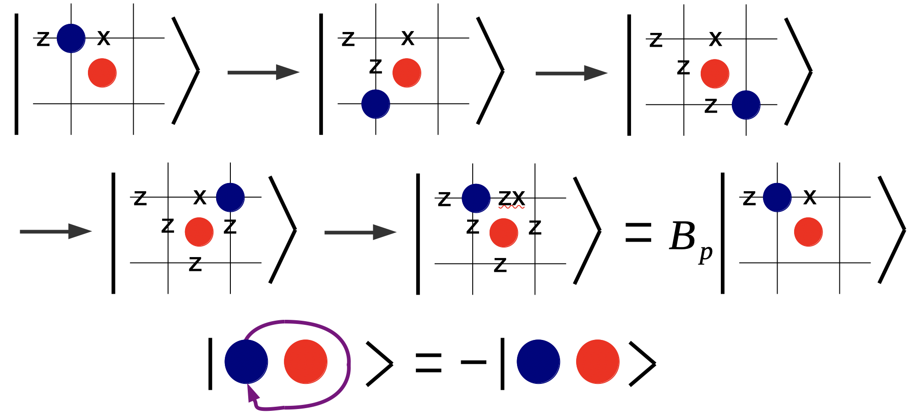
Anyons in the Surface Code
  Braiding a particle corresponds to applying a stabilizer
  Their eigenstates defines the braiding phase
  Neither bosons nor fermions, but anyons!

