Slide 1
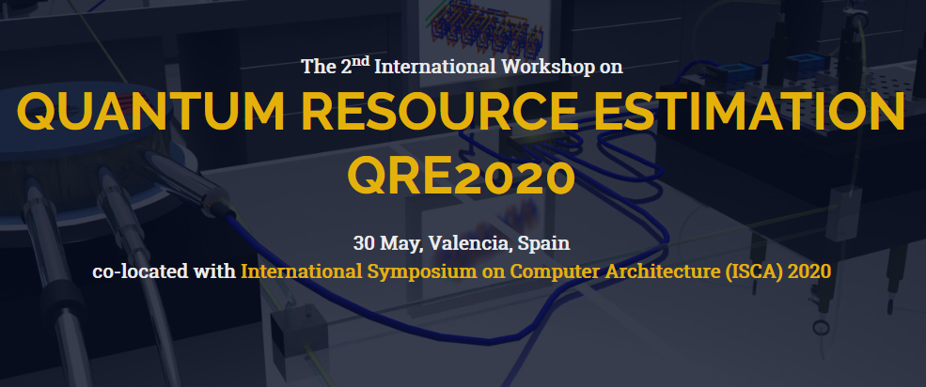

www.quantumresource.org
Quantum computation has a growing number of promising application areas such as quantum chemistry, quantum optimisation and finance. However, the first industrially relevant and scalable quantum computer seems to be at least a decade away. Therefore, one of the most pressing questions is "How many physical qubits and how much time is necessary to execute a quantum algorithm on a selected hardware platform where the algorithmic output is more important than the fact a quantum computer was used to calculate it?”
The workshop will bring together researchers to discuss new methods and directions needed to develop the tools to:
accurately analyze and benchmark complex quantum algorithms
adapt error-correction techniques
refine classical control and hardware microarchitectures
enable scientifically and commercially relevant quantum applications
Research papers, tutorials, software and other demonstrations, and work-in-progress reports are within the scope of the workshop. Invited talks by leading international experts will complete the program. Contributions on areas of quantum performance analytics are welcome:
High level quantum circuit analytics.
Fault-tolerant quantum circuit analytics.
Clifford+T optimisation strategies.
Resource efficient surface code implementations.
Surface code decoders.
Practical quantitative analysis of surface code alternatives.
Noisy Intermediate Scale Quantum (NISQ) evaluation.
Initial submission for QRE2020 will consist of an extended abstract, limited to 2+epsilon-pages (including figures and references, please don't go nuts with the epsilon!). Contributions must be written in English and report on original, unpublished work, not submitted for publication elsewhere. Upon acceptance, researchers are invited to submit full research papers (maximum 12 pages), as well as work-in-progress or tool demonstration papers (maximum 6 pages). The best papers will be selected to appear in IEEE Transactions on Quantum Engineering.
Extended Abstract Submission: 15 March April 2020
Notification Extended Abstract: 1 May 2020
Workshop Date: 30 May 2020
Full Paper Submission: 1 August 2019
Alexandru Paler
Linz Institute of Technology, Linz, Austria
Simon Devitt
University of Technology, Sydney, Australia
Daniel Herr
d-fine, Zurich, Switzerland

