Slide 1
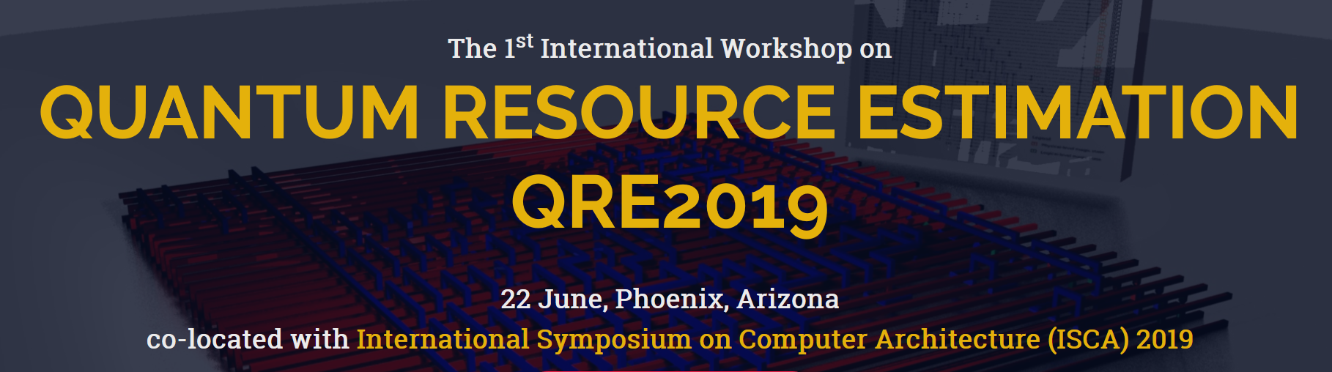

www.quantumresource.org
CALL FOR PAPERS
Quantum computation has a growing number of promising application areas such as quantum chemistry, quantum optimisation and finance. However, the first industrially relevant and scalable quantum computer seems to be at least a decade away. Therefore, one of the most pressing questions is "How many physical qubits and how much time is necessary to execute a quantum algorithm on a selected hardware platform where the algorithmic output is more important than the fact a quantum computer was used to calculate it?”
The workshop will bring together researchers to discuss new methods and directions needed to develop the tools to:
accurately analyze and benchmark complex quantum algorithms
adapt error-correction techniques
refine classical control and hardware microarchitectures
enable scientifically and commercially relevant quantum applications
Research papers, tutorials, software and other demonstrations, and work-in-progress reports are within the scope of the workshop. Invited talks by leading international experts will complete the program. Contributions on areas of quantum performance analytics are welcome:
High level quantum circuit analytics.
Fault-tolerant quantum circuit analytics.
Clifford+T optimisation strategies.
Resource efficient surface code implementations.
Surface code decoders.
Practical quantitative analysis of surface code alternatives.
Noisy Intermediate Scale Quantum (NISQ) evaluation.
Upon acceptance of an extended abstract (approx. 2 pages), researchers are invited to submit full research papers (maximum 12 pages), as well as work-in-progress or tool demonstration papers (maximum 6 pages). Accepted full papers will be published in a journal (subject to the journal being approved - IEEE Transactions on Quantum Engineering; a backup TBD exists).
Extended Abstract Submission: 21 April 2019
Notification Extended Abstract: 12 May 2019
Workshop Date: 22 June 2019
Full Paper Submission: 1 August 2019
Notification of Full Paper: (tentative) 1 November 2019
Publication of Full Paper: (tentative) 1 January 2020
Invited Speakers:
Naomi Nickerson, PsiQuantum
Joseph Fitzsimons, Horizon Quantum
Michael Bremner, University of Technology Sydney
Craig Gidney, Google
Daniel Litinski, Free University, Berlin
Christian Gogolin, Covestro
Scott Aaronson, UT Austin
Alexandru Paler, Linz Institute of Technology, Linz, Austria
Simon Devitt, University of Technology, Sydney, Australia
Daniel Herr, RIKEN, Wako-shi, Japan

