Slide 1
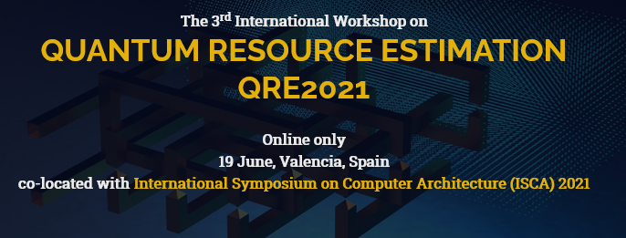
www.quantumresource.org
This is the third international workshop on the emerging field of Quantum Resource Estimation (QRE), benchmarking and performance analytics. We hope to encourage participation from those working in quantum algorithm optimization, error-correction, architecture design, quantum compilation, classical control and resource benchmarking.
The workshop is focused around developing techniques and tools that aid quantum software and algorithm design, informed by the realities of the hardware architectures. QRE shifts the perspective from complexity theoretic arguments to quantitative computer architecture arguments.
The goal is to reduce the physical resource costs for interesting quantum algorithms as quickly as possible. Small-scale, cloud-based NISQ machines sparked the interest of exact, realistic and non asymptotic resource estimations. It is still uncertain if any valuable quantum algorithm is possible without incorporating costly error-correction protocols that make estimation, benchmarking and optimization far more complex.
Research papers, tutorials, software and other demonstrations, and work-in-progress reports are within the scope of the workshop. Invited talks by leading international experts will complete the program. Contributions on areas of quantum performance analytics are welcome:
High level quantum circuit analytics.
Fault-tolerant quantum circuit analytics.
Clifford+T optimisation strategies.
Resource efficient surface code implementations.
Surface code decoders.
Practical quantitative analysis of surface code alternatives.
Noisy Intermediate Scale Quantum (NISQ) evaluation.
Initial submission for will consist of an extended abstract, limited to 2+epsilon-pages. Contributions must be written in English and report on original, unpublished work, not submitted for publication elsewhere. Upon acceptance, researchers are invited to submit full research papers (maximum 12 pages), as well as work-in-progress or tool demonstration papers (maximum 6 pages).
The best papers will be selected to appear in IEEE Transactions on Quantum Engineering.
Extended Abstract Submission: 24 April 2021
Notification Extended Abstract: 15 May 2021
Workshop Date: 19 June 2021
Full Paper Submission: 1 October 2021
Organisers:
Alexandru Paler, Johannes Kepler University, Linz, Austria
Simon Devitt, University of Technology, Sydney, Australia
Daniel Herr, d-fine, Zurich, Switzerland

