Slide 1
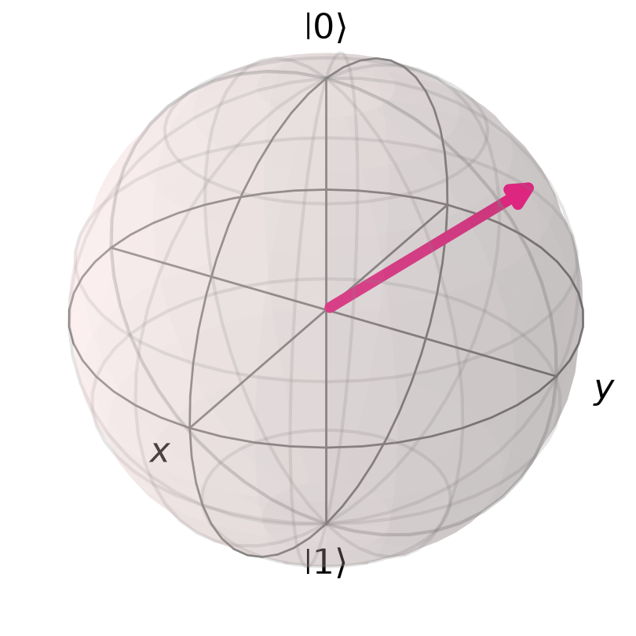
QUANTUM TECHNOLOGIES CLUB WORKSHOP
Qiskit from Zero
Build, see and run quantum circuits:
from your laptop to a real IBM quantum computer.
10 November 2026
Notes:
Welcome! Informal session. By the end everyone will have run a quantum program, and have a free IBM account to keep going at home.

Slide 2
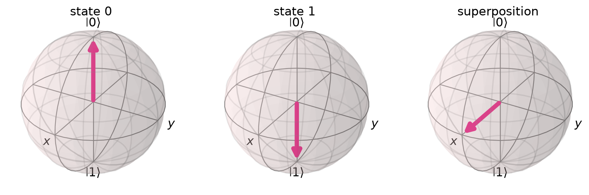
Bits vs. qubits
A bit is a light switch. A qubit is an arrow on a sphere.
💡 Bit
Either 0 or 1
Reading it changes nothing
⚛️ Qubit
0, 1, or a superposition
Measuring it gives a random 0 or 1 and erases the superposition
The Bloch sphere: up = |0⟩, down = |1⟩, equator = 50/50
Notes:
|0> and |1> are just name tags. Every qubit starts pointing up. Gates rotate the arrow.

Slide 3
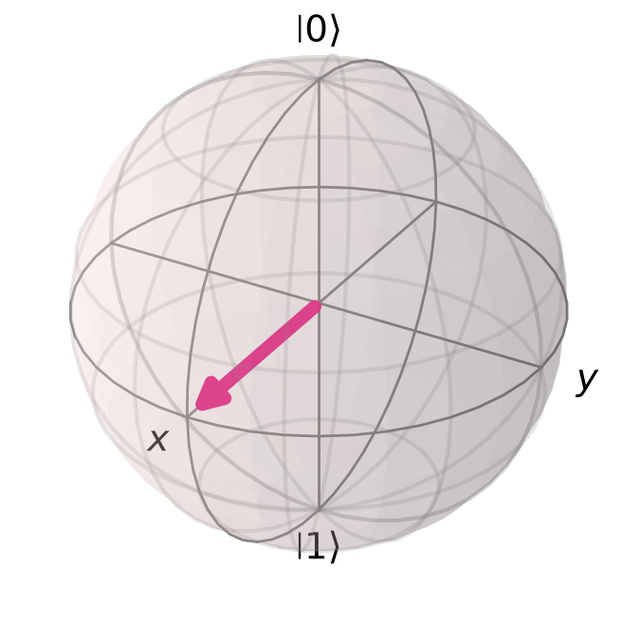
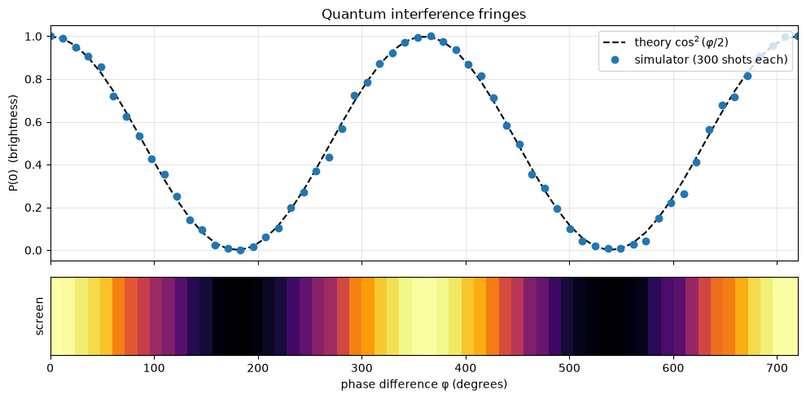
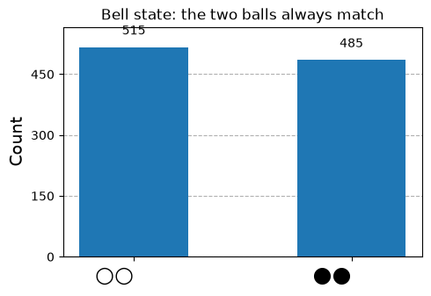
Three quantum ideas we'll see today
Superposition
Interference
Entanglement
A qubit can be a mix of 0 and 1, like a coin spinning in the air.
Possibilities can add up… or cancel out. This is what powers quantum algorithms.
Two qubits, each random, that always agree. Einstein called it 'spooky'.
Notes:
Don't explain deeply; just name them. Each notebook will show one of these with plots.

Slide 4
What is Qiskit?
IBM's free, open-source Python toolkit for programming quantum computers
🧱 Build
🛠️ Optimize
▶️ Run
📊 Analyze
circuits (qubits + gates)
translate for a real chip
simulator or real QPU
histograms & plots
from qiskit import QuantumCircuit
qc = QuantumCircuit(2)
qc.h(0) # superposition
qc.cx(0, 1) # entanglement
qc.measure_all()
Sampler().run([qc]).result()
Today's plan
💻 On a simulator (no account needed)
01 · Meet the qubit
02 · Measure & simulate
03 · Q is for Quantum
⚛️ On a real quantum computer
04 · Free IBM account + real hardware
Notes:
Four steps = IBM's 'Qiskit patterns'. The code on the left is the whole Bell-state program; by notebook 03 everyone will be able to explain each line. Notebooks 01 to 03 run on a simulator and need no account; the IBM account only comes in for notebook 04.

Slide 5
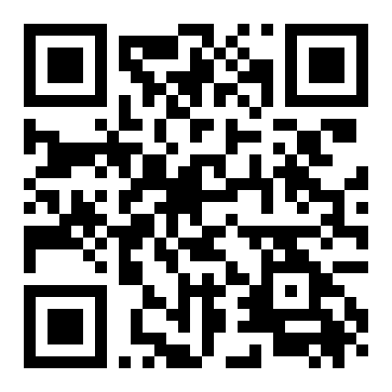
Get set up: do this now 🚀
No account needed: everything up to notebook 04 runs on a simulator
1 Open Google Colab
2 Get the notebooks
Zero install.
File → Open notebook → GitHub tab → Run cell.
From the club's GitHub repo:
github.com/quantumtechcluburi/workshops
Start with
01_meet_the_qubit.ipynb
Run the first cell (Shift + Enter). It installs Qiskit for you.
colab.research.google.com
Notes:
Nobody needs an IBM account yet. While people open Colab, submit your own real-hardware job from notebook 04 so the result is back by the end of the session.

Slide 6
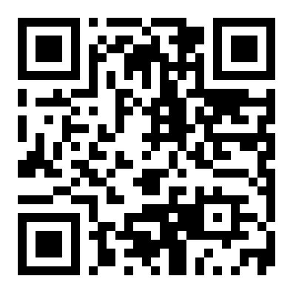
Your turn: a real quantum computer ⚛️
Notebook 04 runs on real IBM hardware with a free account
1 Sign in with an IBMid or Google account
2 Set the region to us-east (top of the page)
3 Instances → Create instance → Open Plan (free)
4 Dashboard → Create API key (keep it safe)
5 Notebook 04: set USE_REAL_HARDWARE = True
quantum.cloud.ibm.com/registration
Scan with your phone to sign up
Free Open Plan: 10 minutes of real quantum time every 28 days. A small circuit uses a few seconds.
🔐 Your API key is a password: never paste it in a shared notebook.
Notes:
No account yet or slow e-mail verification? Leave USE_REAL_HARDWARE = False: the notebook uses a noisy copy of a real IBM chip. Full steps in SETUP_AND_SIGNUP.md.

Slide 7
Where to go next
You've programmed a quantum computer. Keep going!
IBM Quantum Composer
IBM Quantum Learning
Drag-and-drop circuits in the browser, no code
Free courses (try Basics of Quantum Information)
quantum.cloud.ibm.com/composer
quantum.cloud.ibm.com/learning
Qiskit docs
Your notebooks
Guides, tutorials and API reference
Do the 🏆 challenges at the end of each one
quantum.cloud.ibm.com/docs
github.com/quantumtechcluburi/workshops
Notes:
Remind: never share your API key; send many circuits in one job to save free minutes.

Slide 8
Thanks for coming! ⚛️

