Slide 1

Quan Wei | WEEK 1

Slide 2
Summer Intern Project Update
RESEARCH INTERNSHIP
Quan Wei | June 1 – August 7, 2026

Slide 3
Summer Intern Project Update
RESEARCH INTERNSHIP
Quan Wei | Week 1

Slide 4
Project Overview
Research Direction
Goals
LLM-based multi-agent system
Agent harness: scaffolding around the LLM that manages the reasoning loop, tool invocation, and state across turns
Decentralized coordination: agents self-organize and reach consensus without a central orchestrator
Effective agent workflows: robust task decomposition and recovery that hold up on long-horizon tasks
Token efficiency: cut inter-agent communication and context overhead without losing accuracy
Research output: identify challenging, high-impact problems, solve them, and consolidate the findings into a paper submission
Quan Wei | WEEK 1

Slide 5
Project Proposal
Large–Small Model Collaboration — each tier does the work it is best suited for
 | Large model (LLM) | Small model (SLM)
Role | Planner / orchestrator | Executor / specialist
Handles | Complex reasoning, decomposition | Routine, latency-sensitive subtasks
Cost/Latency | High | Low
Bilevel Collaboration
Task-level — cost-efficient: route simple subtasks to small models, sparing large-model calls.
Token-level — token-efficient: small models draft tokens via speculative decoding, verified in one pass.
Unified, the two levels make end-to-end inference both cost- and token-efficient—without sacrificing quality.
Quan Wei | WEEK 1

Slide 6
Project Plan
Models
Closed-source (API): Claude
Open-source: Qwen series
Tasks
Deep Search: multi-step retrieval across sources
Deep Research: synthesis of findings into structured reports
Code Generation: end-to-end code writing and execution
Metrics
Quality: task accuracy and answer correctness
Efficiency: token cost and latency
Quan Wei | WEEK 1

Slide 7
Summer Intern Project Update
RESEARCH INTERNSHIP
Quan Wei | Week 2

Slide 8
OrchestrateAnything: Project Overview
Goal: unified orchestration of tasks, models, and resources across heterogeneous multi-agent systems.
RQ1 — Build a hierarchical MAS
How can a hierarchical multi-agent system reliably complete complex tasks?
Approach: pair a centralized orchestrator with decentralized, autonomous subagents.
RQ2 — Orchestrate it efficiently
Given a mixed pool of closed- and open-source models, how to stay efficient without losing accuracy?
Approach: jointly optimize accuracy against model, token, communication, API, and latency cost.
Quan Wei | WEEK 2

Slide 9
Hierarchical MAS Architecture
Agent = Model + Harness — model reasons; harness handles prompts, tool routing, memory, and execution.
Agent Context = Profile + Memory + Communication + Tools
Two-layer control
Centralized — orchestrator holds the global view and drives high-level decisions.
Decentralized — subagents execute locally and autonomously, without central intervention.
Subagent roles
Executor — carries out assigned subtasks.
Verifier — validates outputs for correctness.
Responder — synthesizes and delivers the final response.
Memory Manager — maintains persistent and working memory.
Quan Wei | WEEK 2

Slide 10
Orchestrator Responsibilities
The orchestrator coordinates the system across three levels.
Task orchestration — decompose the input into a subtask DAG and assign subtasks to subagents.
Model orchestration — match each subagent to a model based on task demands and model capability.
Resource orchestration — govern shared memory and communication channels for coordinated execution.
Why it matters
Prior work covers task and model orchestration; resource orchestration is the gap we target.
Quan Wei | WEEK 2

Slide 11
Efficiency: Costs & Resource Allocation
Five cost dimensions to optimize jointly
Model — scales with tier: closed-source > open large > open small.
Token — scales with prompt and completion tokens per call.
Communication — message frequency and payload size between agents.
API — each tool call (retrieval, code execution) adds cost.
Latency — delay from inference and inter-agent messaging.
Three allocation levers
Model allocation — which model runs each subtask; controls model cost & accuracy.
Token allocation — budget per agent or subtask; controls token cost.
Communication allocation — routing and frequency; controls comm and latency cost.
Quan Wei | WEEK 2

Slide 12
Experimental Design
Baselines
Single agent — one model, no decomposition
Homogeneous MAS — AgentFlow, AORCHESTRA
Heterogeneous MAS — MAS-Orchestra
Public vs. Ours — pre-trained vs. trained
Model pool
Closed-source — Claude, GPT, Gemini
Open-source — gpt-oss-120B / 20B
Task-specific — CodeLlama
Tasks & datasets
Search — HotpotQA
Deep research — GAIA, BrowseComp+
Math — AIME, AMC
Science — GPQA
Code — SWE-bench, Terminal-bench
Metrics
Accuracy — task completion quality
Cost — model + token + communication
References: AgentFlow · AORCHESTRA · MAS-Orchestra
Quan Wei | WEEK 2

Slide 13
References
AgentFlow In-the-Flow Agentic System Optimization for Effective Planning and Tool Use. arXiv:2510.05592, 2025.
AORCHESTRA AOrchestra: Automating Sub-Agent Creation for Agentic Orchestration. arXiv:2602.03786, 2026.
MAS-Orchestra Understanding and Improving Multi-Agent Reasoning Through Holistic Orchestration and Controlled Benchmarks. arXiv:2601.14652, 2026.
Quan Wei | WEEK 2

Slide 14
To-Do List
1. Build the heterogeneous MAS codebase on top of MAS-Orchestra
2. Implement our proposed approach: prompt, SFT, RL
3. Conduct experiments and evaluation
Quan Wei | WEEK 2

Slide 15
Overview: MAS Co-Evolution
Motivation
Centralized MAS: a single controller becomes a scalability bottleneck and a single point of failure
Decentralized MAS: local-only views block knowledge sharing, capping collective performance
Novelty: Neighborhood Learning
No controller: fully decentralized — scales and avoids a single point of failure
Hierarchical memory: fuses local state with top-K peer signals for global context
Co-evolution: act on neighbor consensus and improve together, faster convergence
Methodology
Neighbor selection: each agent scores peers and keeps its top-K
Graph evolution: edges rewire toward higher-value neighbors
Agent co-evolution: behavior adapts to neighbor consensus
Experiments — Tasks
Collaborative Reasoning: jointly solving hard problems
Multi-Hop QA: multi-step, shared-evidence questions
Code & Tool Use: cooperative, tool-assisted coding
Quan Wei | WEEK 2

Slide 16
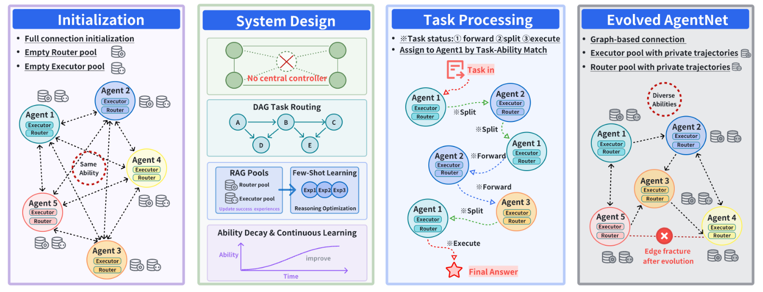
Example
Source: Liu et al., “AgentNet: Decentralized Evolutionary Coordination for LLM-based Multi-Agent Systems,” arXiv:2504.00587, 2025.
Quan Wei | WEEK 2

Slide 17
To-Do List
To-Do List
1. Reproduce AgentNet results
2. Implement our idea on top of the AgentNet codebase
3. Run extensive experiments on performance gain and convergence speed
Reference
Liu et al., “AgentNet: Decentralized Evolutionary Coordination for LLM-based Multi-Agent Systems,” arXiv:2504.00587, 2025
Quan Wei | WEEK 2

