Slide 1
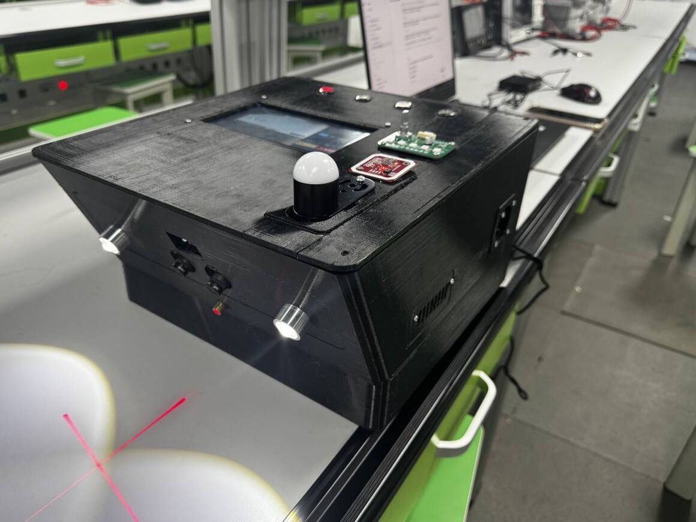

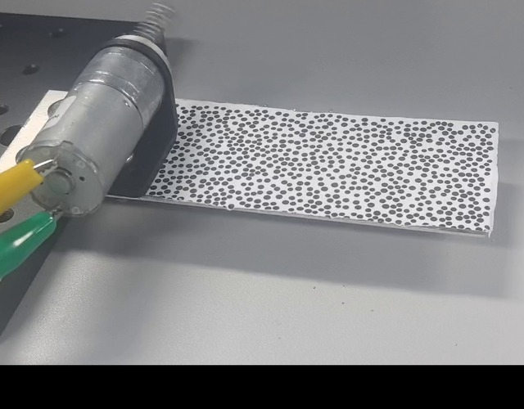
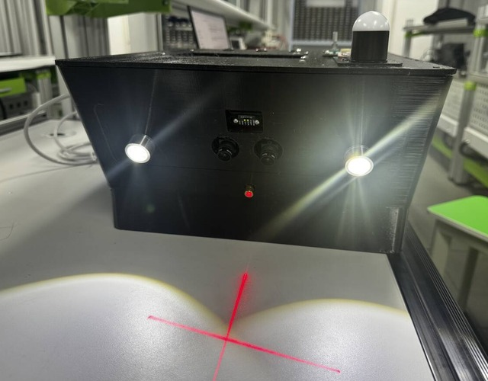
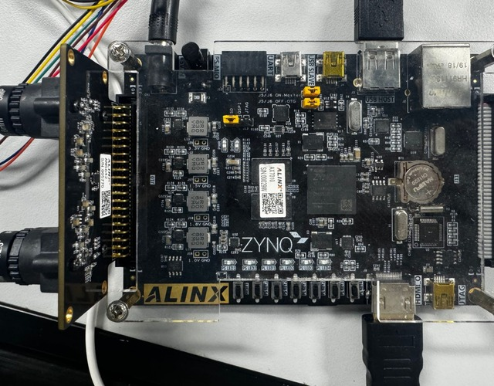
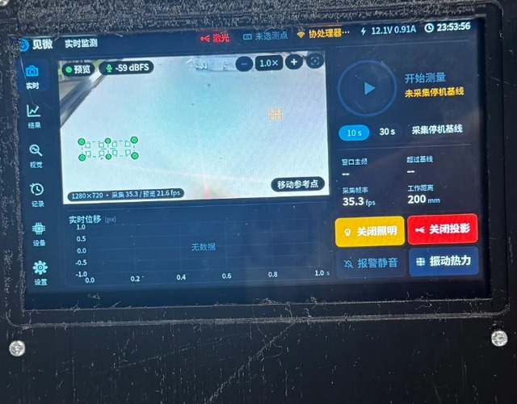

JianWei: Non-contact Multi-point
Vision Vibrometer on AMD Zynq-7010
INTRODUCTION
AMD Zynq-7010 (ALINX AX7010)
Early faults can cause vibration too small to see. Contact sensors require mounting and wiring at each point. JianWei measures multiple points without contact and reports abnormal vibration directly on site.
Dual camera
AN5642
PL
PS
On board test by AMD Zynq-7010
Dual-camera capture
Multi-point tracking
7-inch screen
HDMI display
FFT and baseline gate
Alarm light
Signal-to-baseline ratio per point
PDM mic receiver
Stereo ranging
C
R
19.95 Hz
visual frequency
Printer
R
E
100
Light and printer I/O
UI, records, alarm
E
19.93 Hz
microphone check
UART
LAN
A
S
Vibrating
target
JianWei
unit
Zynq-7010
analysis
Screen, alarm,
printer
Phone and
PC app
Carrier board
sensors, lights, laser
Nano ESP32
NFC, voice, Wi-Fi
Phone and PC app
LAN or hotspot
T
U
0.209 mm
peak-to-peak, trial scale
50
I
L
Measurement chain
System Architecture
V
T
An ALINX AX7010 board (AMD Zynq-7010) is the core, with an AN5642 dual camera, a self-designed carrier board and front panel, and an Arduino Nano ESP32 coprocessor, all in a 3D-printed enclosure.
E
12 / 12
points above baseline
3×
1
2
3
4
5
6
7
8
9
10
11
12
Key innovations:
One camera, many points: no contact, no wiring on the machine.
Background references cancel camera shake; a 3× motor-off baseline gate stops false alarms.
A PDM microphone received in PL checks the frequency from sound alone.
PL runs video and I/O timing, PS runs analysis and UI, ESP32 serves NFC, voice and Wi-Fi.
Board test, 2026-11-04
D
Board test. A gear motor shakes a speckle-printed plate. After a 15 s motor-off baseline, a 10 s run captured 452 frames at 45 fps with no drops or tracking loss. All 12 points passed the 3× gate; 0.209 mm peak-to-peak (trial scale) exceeded the 0.02 mm threshold and set off the alarm light, buzzer and app.
Microphone check. The PDM microphone heard 19.93 Hz, 0.02 Hz from the visual 19.95 Hz.
Performance. Capture at 45.05 fps with 0.42 ms frame jitter. PL: 50.8% LUT, 41.0% FF, 50.8% BRAM, +0.756 ns slack. About 9.3 W from 12 V.
Outlook. Move sub-pixel tracking to PL using the bit-verified LK accumulator to increase multi-point throughput. Quantify displacement error through checkerboard calibration and tests at known vibration amplitudes.
Key technical issues addressed:
Video front end in PL: dual-camera capture, frame buffering and HDMI display.
Multi-point tracking on PS: up to 12 points with 25×25 templates; 4 background references remove camera shake.
Decision: 128-frame Hann FFT for frequency and amplitude, gated at 3× a motor-off baseline before alarm.
Peripheral interfaces: PDM microphone, light PWM, cross laser, printer UART, plus IMU, ToF, accelerometer and SHT40 ports.
E
S
I
G
N
Self-designed hardware:
100×100 mm carrier board: 12 V power, power monitor, RTC, I/O expander, all connectors.
60×40 mm front panel: rotary encoder, key, five WS2812 LEDs.
3D-printed enclosure for cameras, lights, laser and printer.

