Slide 1
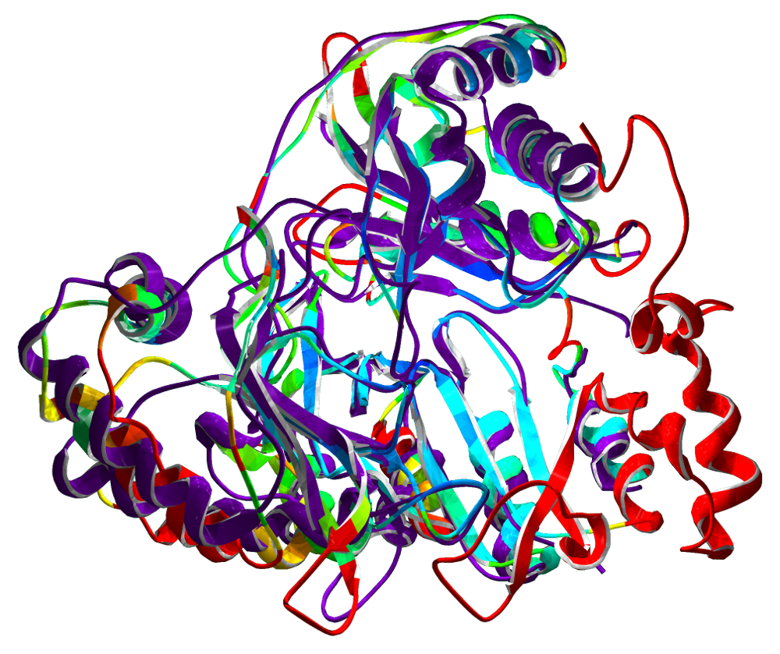
Protein BLAST
Basic Local Alignment Search Tool
Blastp: Protein vs Protein
Quan Tran
Department of Computer Science

Slide 2

Table of Contents
BLAST Algorithm
Word Search Method
Word Match Method
Extension Method
Overview Feature
BLAST MVC
DATA FLOW
Reference

Slide 3
Attempt to Implement blastp which is protein vs protein
Search | Query | Database
Blastn | Nucleotide | Nucleotide
Blastx | translated nucleotide in all six frames | Protein
Tblastx | translated nucleotide in all six frames | translated nucleotide in all six frames
Blastp | Protein | Protein

Slide 4
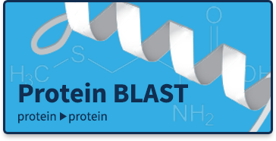
BLAST algorithm
Implement with 3 step process:
Word search method
Identification of exact word match method
Maximum segment pair alignment method – extends the possible match alignment in both direction going left and right that result with a maximum score.
Return to Table of Contents

Slide 5
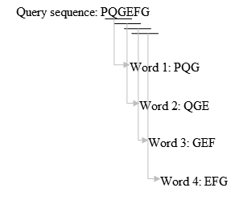
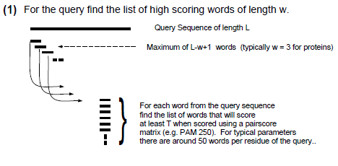
Word Search Method
Break the sequences into WORD.
Protein sequences are chains of letters drawn from a 22-letter alphabet of amino acids (20 standard plus 2 unusual ones
Example: Protein word limit is 3
So the maximum of words is length – 3 + 1
Protein Sequence Alignment.pdf
https://en.wikipedia.org/wiki/BLAST
Return to Table of Contents

Slide 6
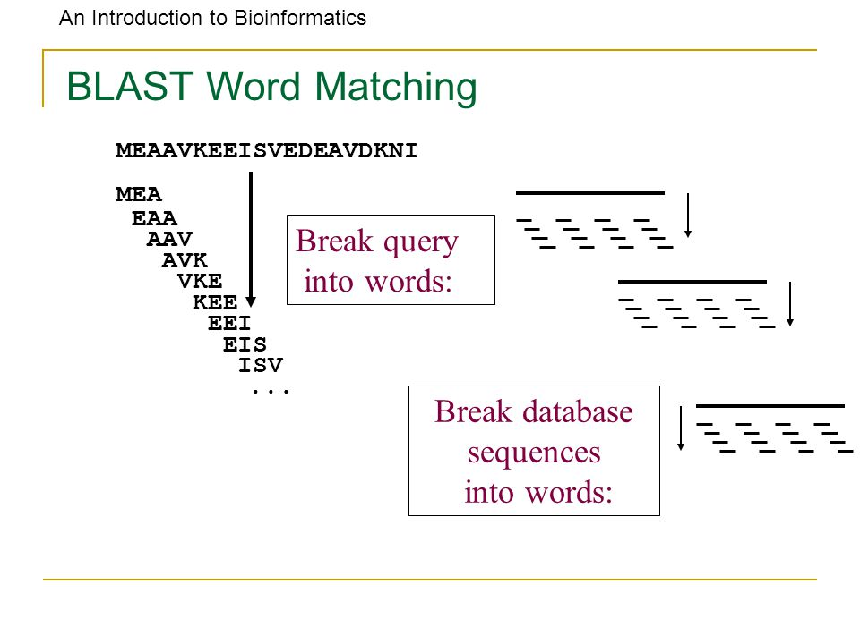
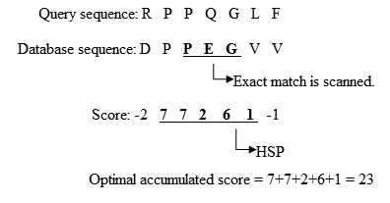
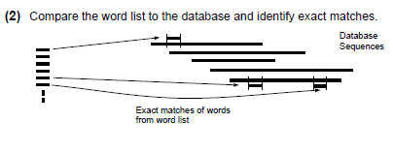
Identification Of Exact Word Match Method
Search the database word that match with query word
Save both indices
https://en.wikipedia.org/wiki/BLAST
Protein Sequence Alignment.pdf

Slide 7
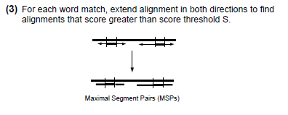
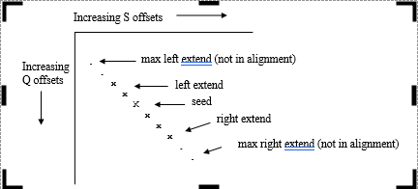
Extension Process
Start from the seed
Extends the possible match alignment in both direction
Going left and right that result with a maximum score.
Global alignment over the whole sequence
Return to Table of Contents

Slide 8
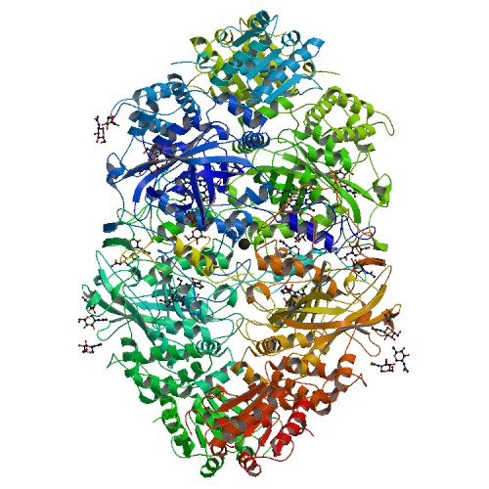
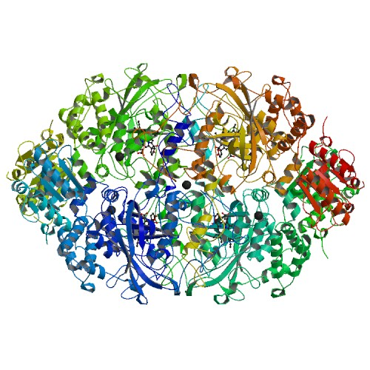
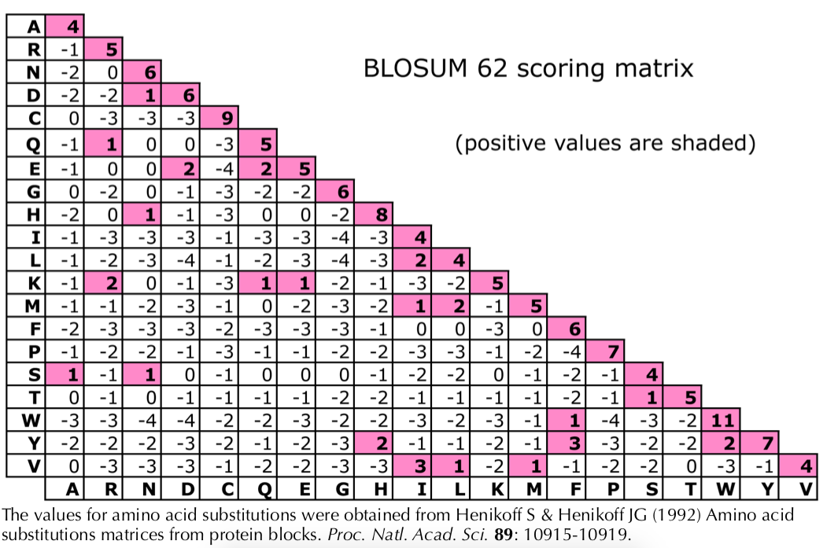
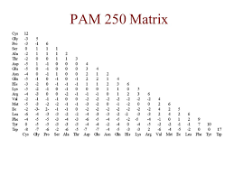
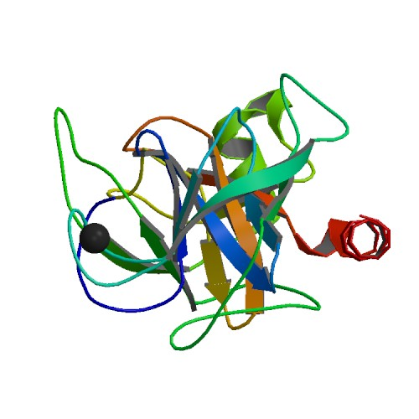
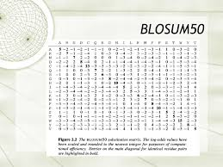
Overview of Features
Sample Features
Using Needleman-Wunsch algorithm for sequence global alignment
Protein Subject:
4AUE
4B31
Scoring Matrix:
2PTN
Return to Table of Contents

Slide 9
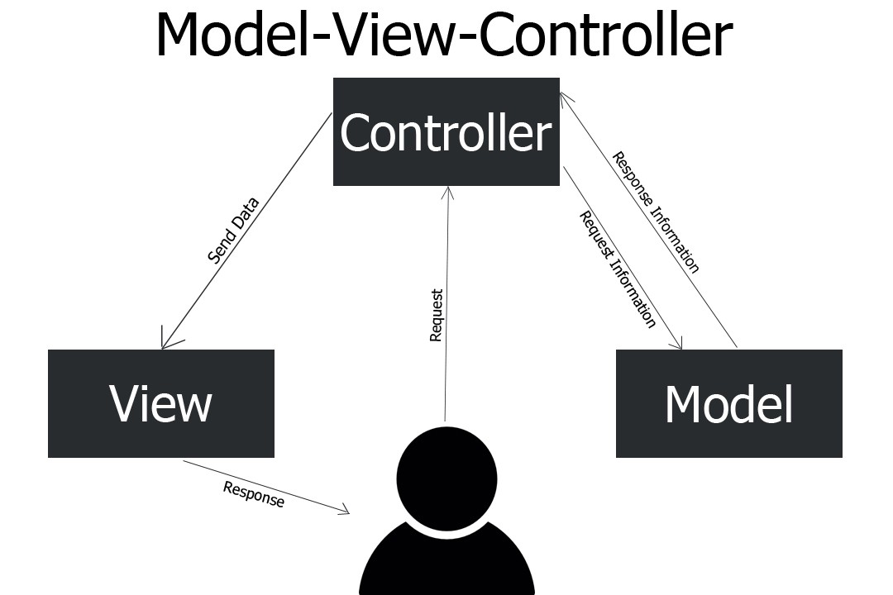
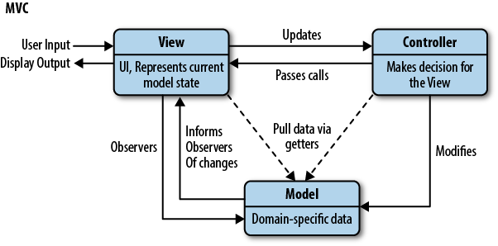
Implementation
MVC

Slide 10

Blastp MVC
DATABASE
MODEL
BLOSUM50.txt
BLOSUM62.txt
PAM250.txt
2PTN_A.txt
4AUE_A.txt
4B31_A.txt
AlignmentClass.php
NeedlemanClass.php
Global_alignment.php
Response Information
Response Information
Request Information
Request Information
VIEW
blastp_welcome.php
alignments._view.php
Header.php
Footer.php
Main.css
Index.php
CONTROLLER
Send Data
Response / Display
Request
START
Return to Table of Contents

Slide 11
Data Flow Representation
Call method or functions
to get Optimal Global
Alignments
Index.php
$alignments = global_alignment($query_seq_upper, $protein_subject, $matching_words_indices, $score_threshold, $word_size, $matrix, $gap_costs);
Global_alignment_db.php
AlignmentClass.php
$needleman_optimal_alignment = $needlemanAlgorithm->get_needleman_opt_alignments();
NeedlemanClass.php
public function get_needleman_opt_alignments() { return $this->alignments; }
$sequence_alignments = $alignments->get_global_alignments()
$needlemanAlgorithm->get_optimal_alignment($query_seed, $db_seed);
alignments_view.php
Show global alignments
Blasp_welcome.php
User input query sequence
Select features
Return to Table of Contents

Slide 12
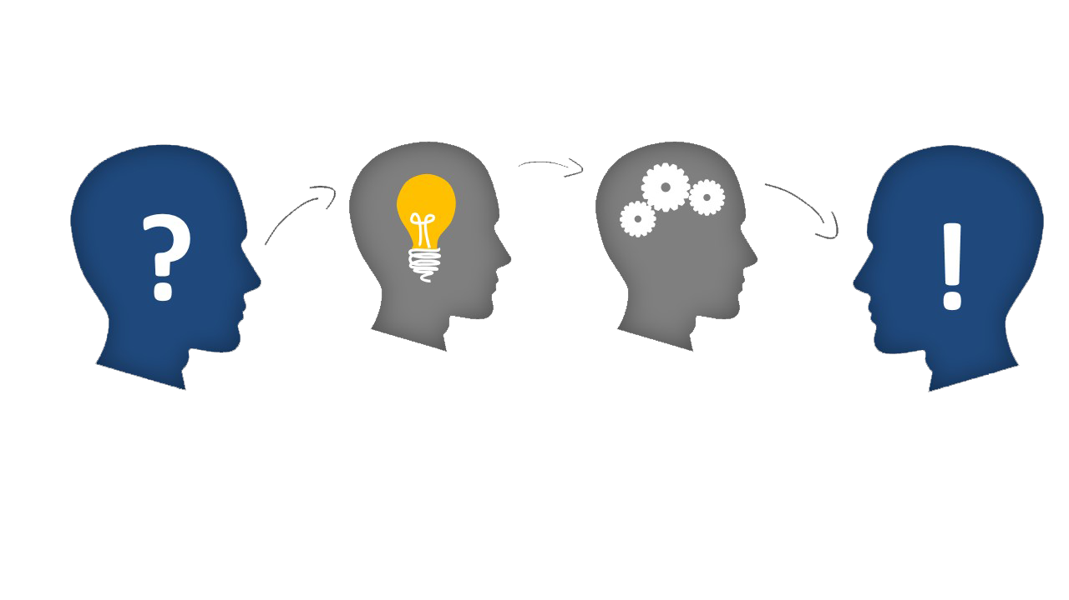
Requirements to Run the Program
NetBeans IDE 8.2
Web browser: Google Chrome Version 74.0.3729.131
XAMPP v3.2.3: Apache
Project directory need to be in xampp/htdocs directory
Return to Table of Contents

Slide 13

Reference
BLAST blastp suite: https://blast.ncbi.nlm.nih.gov/Blast.cgi?PROGRAM=blastp&PAGE_TYPE=BlastSearch&LINK_LOC=blasthome
BLAST(basic local alignment search tool) wiki: https://en.wikipedia.org/wiki/BLAST
Bioinformatics part 6 BLAST algorithm: https://www.youtube.com/watch?v=LlnMtI2Sg4g
BLOSUM wiki: https://en.wikipedia.org/wiki/BLOSUM
Needleman-Wunsch :http://etutorials.org/Misc/blast/Part+II+Theory/Chapter+3.+Sequence+Alignment/3.1+Global+Alignment+Needleman-Wunsch/
Needle-Wunsch algorithm - https://en.wikipedia.org/wiki/Needleman%E2%80%93Wunsch_algorithm
The Blast Algorithm - http://etutorials.org/Misc/blast/Part+III+Practice/Chapter+5.+BLAST/5.2+The+BLAST+Algorithm/
https://www.cs.sjsu.edu/~aid/cs152/NeedlemanWunsch.pdf
https://github.com/aebruno/needleman-wunsch
http://www.compbio.dundee.ac.uk/ftp/preprints/review93/review93.pdf
https://github.com/jdenozi/NeedlemanWunsh-Algorithme/blob/master/needleman_wunsh.py
https://www.ncbi.nlm.nih.gov/IEB/ToolBox/C_DOC/lxr/source/data/
http://web.mit.edu/~r/current/arch/i386_linux26/lib/R/library/Biostrings/html/substitution_matrices.html
ftp://ftp.ncbi.nih.gov/blast/matrices/
.
Return to Table of Contents

Slide 14


DEMO
Return to Table of Contents

