Slide 1
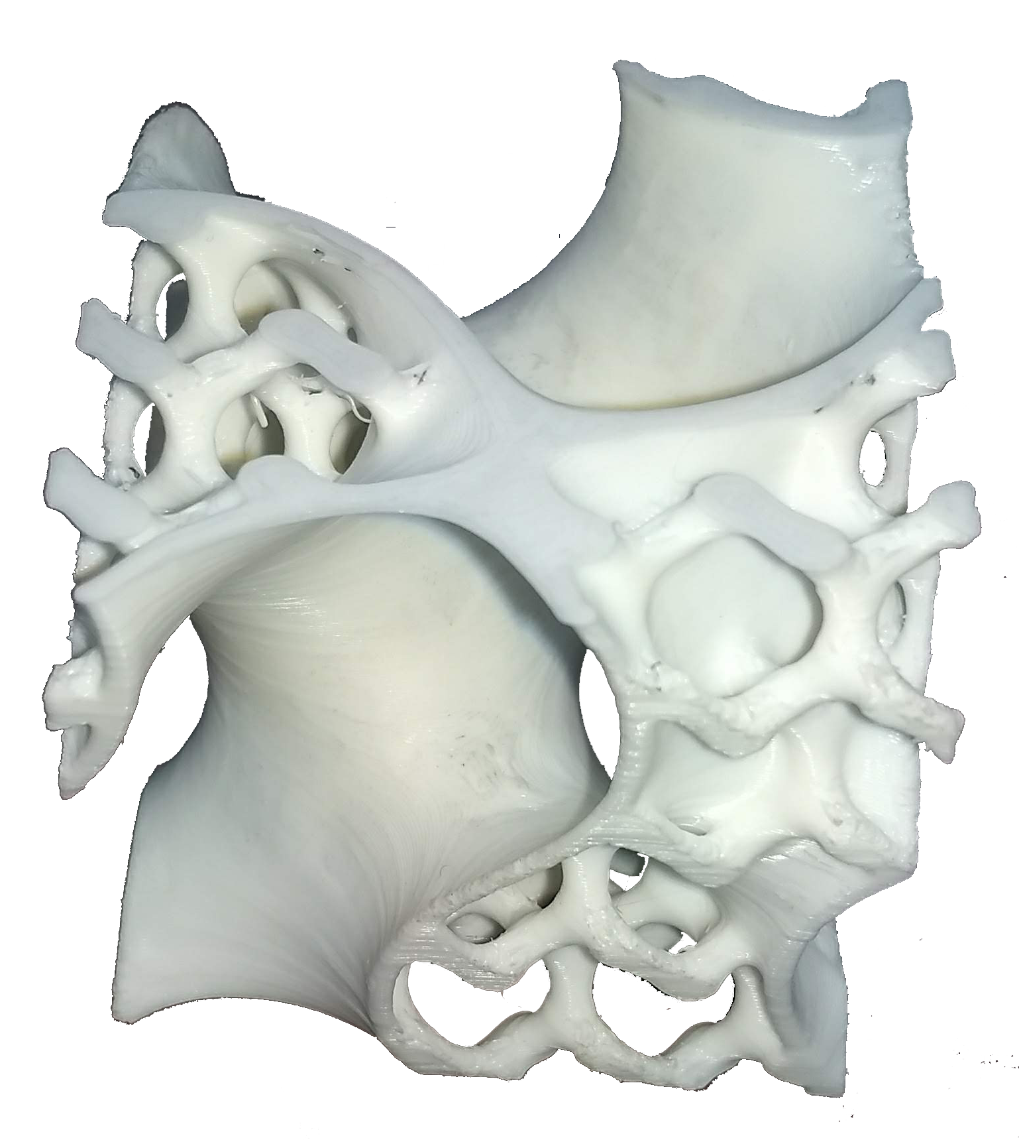
Memory Efficient Voxel Processing Library
Department of Computer Science
Notes:
I am going to present a brief walkthrough on my Payroll Bi-Weekly and show some samples screenshot.

Slide 2
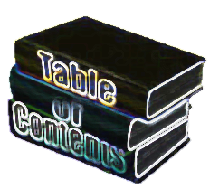
Table of Contents
Introduction
Problem
Analysis
Design
Solution
Progess Challenges
Test
Results
Notes:
In General, I am responsible for any FCG and Windstar entry. And these are the process of FCG

Slide 3
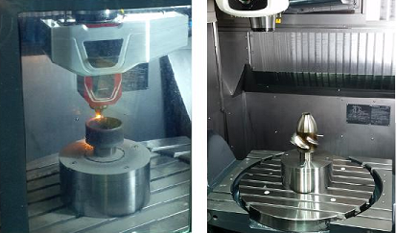
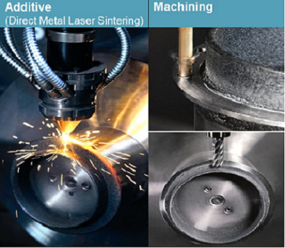
Client Background
Focus on software and consulting services in 3-D Rapid Prototyping and 3-D Rapid Manufacturing.
Design and Integrate System for Hybrid Machines
Such as Integrate the CNC Machine, Laser, Sensors, with PINE's Multi-Axis Planning Software for Additive Manufacturing Machines
Return to Table of Contents

Slide 4
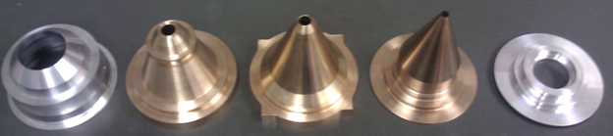
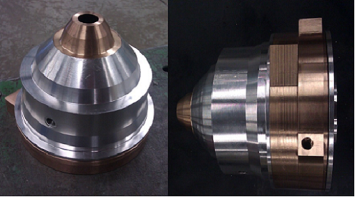
Client Servies
One of many services: Custom Designed Powder Feeders, Nozzles, etc.
PINE's CNC Machined Co-Axial Nozzle For Metal Deposition
Return to Table of Contents

Slide 5

Problem Analysis Slides
So what is the problem? Why they need our help?
Voxel based geometry allows for simple and robust morphological processing. However, the memory footprint scales with the cell size of the volume being described. This tends to occupy considerably more memory than something like a tessellated surface model.
Out Of Memory?
They need a compressed voxel data structure (think three dimensional JPG or PNG) for storing float or int data (not just boolean) that I can use for morphological operations (e.g. erode, dilate, marching cubes), math operations.
Problem
Return to Table of Contents

Slide 6
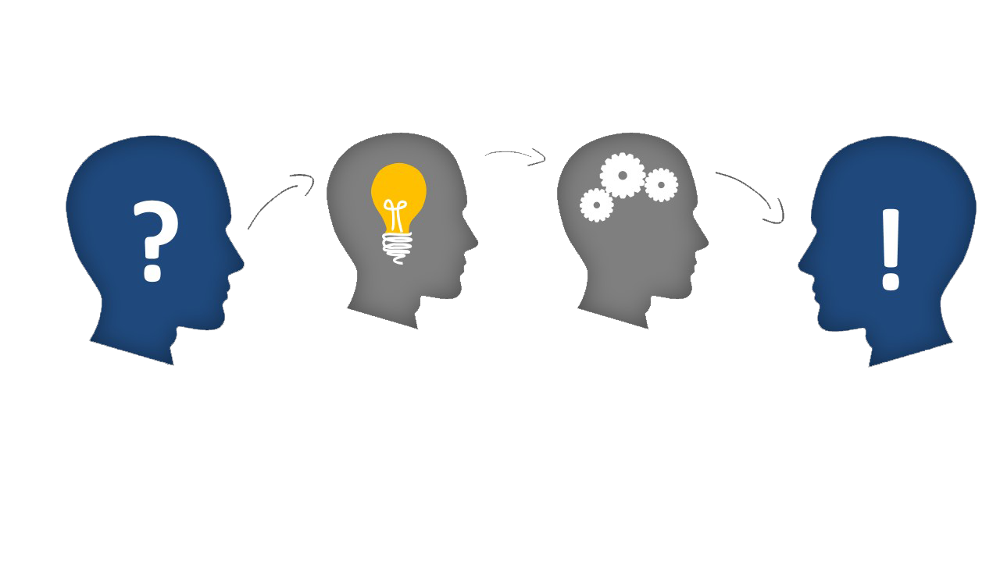
Problem Analysis Slides
Features:
• Compressed 3d array data structure
• Castable to and from a numpy.array instance in Python 3.6
• Addressable similar to a numpy array
• Morpological operations such as erode and dilate
• Math operations (per-element add/subtract/divide)
• Isosurface computation (e.g. marching cubes)
Analysis
Design
Problem
Solution
Our approach to the problem:
Analysis:
Design:
Solution:
Return to Table of Contents

Slide 7
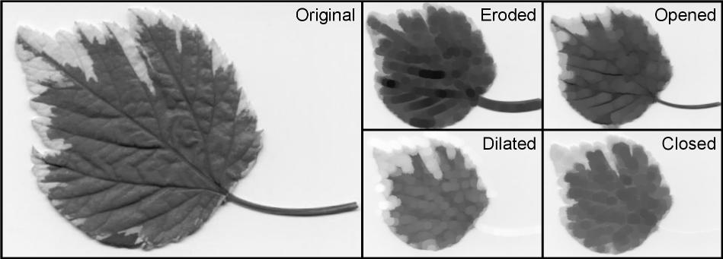
Morphology Operation
http://rsb.info.nih.gov/ij/plugins/images/gray-morphology.jpg
Return to Table of Contents
Notes:
In addition to FCG, I also take care of Windstar

Slide 8
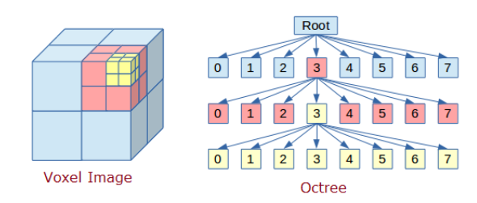
Progress Challenges
We tried the Octree Data Structure.
Return to Table of Contents

Slide 9
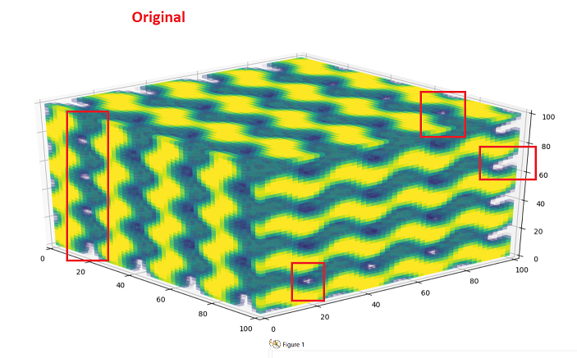
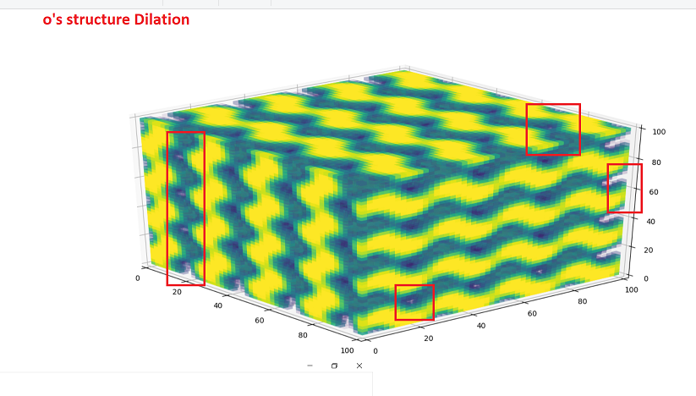
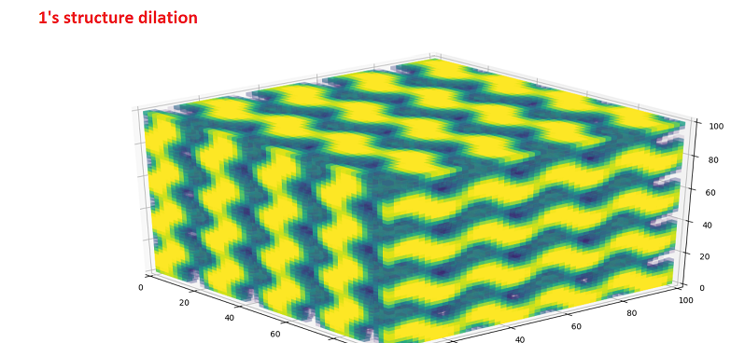
Testing
Return to Table of Contents

Slide 10
Testing
Testing
Testing
AMY_PY_ALL_EXPENSE_NOT_ACTIVE2
AMY_PY_PAYROLL_ERRORS
BCO_UMB_ADDITIONAL_PAY
PY_ALL_BLANK_MAIL_DR
AMY_PY_ALL_RETRO_UNPROCESSED
PY_ALL_LESS_THAN_1_DOLLAROP
PY_ALL_NEGATIV_DED_OR_TAX
TL_ALL_INACTIVE_TL_EMPL
CA_ALL_FUND_END_DATES_MAX
CA_BUDGET_SEQ_2
HR_TER_WITH_PAY_JS_REV
BN_ALL_ORP_MISSING_LIFE_ADD
BN_ALL_SERS_WITH_ORPLIFE_ADD
ZBOS_BEN_EE_WITHOUT_RET
HR_TERM_EE_OVERPAYMENT
JS_EF_AUD_LATE_ACTIONS
HPCA010
PAY034
PAY035
PAY011
PAY036
PAY008
PAY010
Return to Table of Contents
Notes:
In addition to FCG, I also take care of Windstar

Slide 11
Testing
Testing
Testing
Testing
Testing
Testing
Testing
Testing
Testing
Testing
Testing
Testing
Return to Table of Contents

Slide 12
Testing
Testing
Testing
Testing
Testing
Testing
Testing
Testing
Testing
Testing
Flow
Testing
Flow 2
Testing
Testing
Return to Table of Contents
Notes:
In addition to FCG, I also take care of Windstar

Slide 13
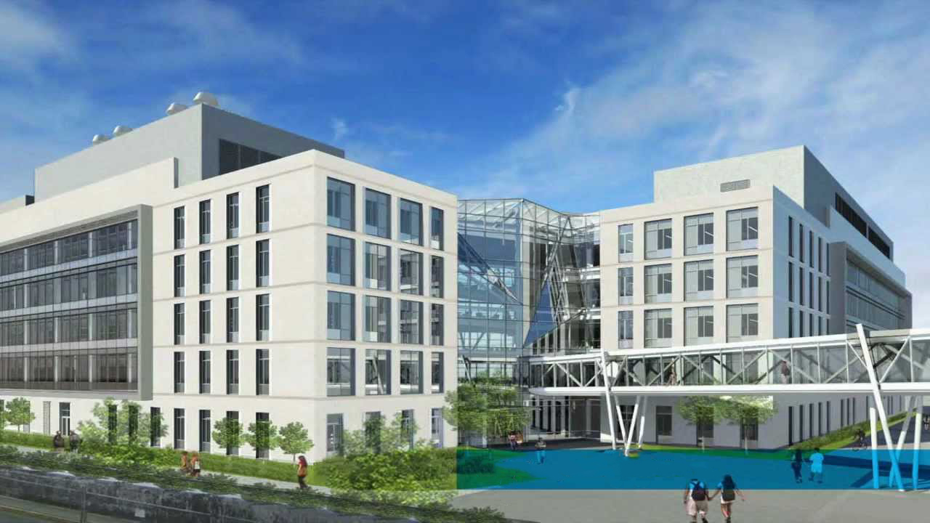
Testing
Testing
FRIDAY – Testing
MONDAY – Testing
TUESDAY – Testing
Return to Table of Contents
Notes:
In addition to FCG, I also take care of Windstar

Slide 14

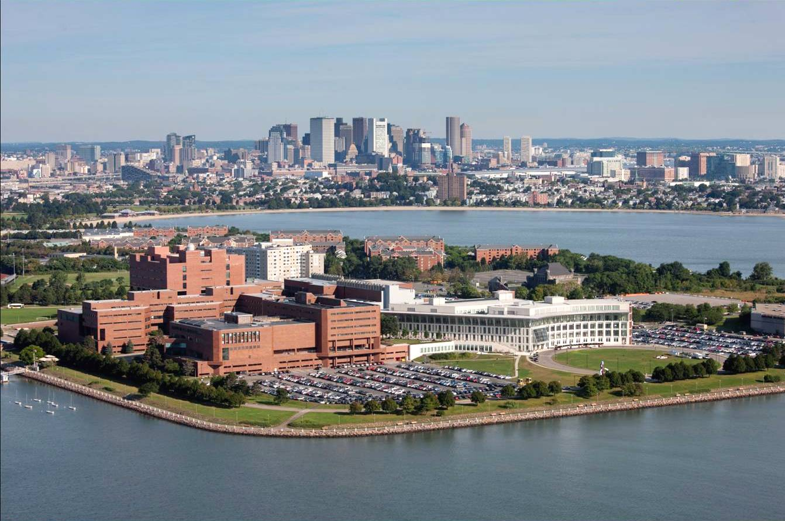
Return to Table of Contents
Notes:
And that is ALL

