Slide 1
Multi-Agent Reinforcement Learning with Parameterized Action Spaces for Event-Driven Decision Processes with a case study for Bus Bunching Problem

Slide 2
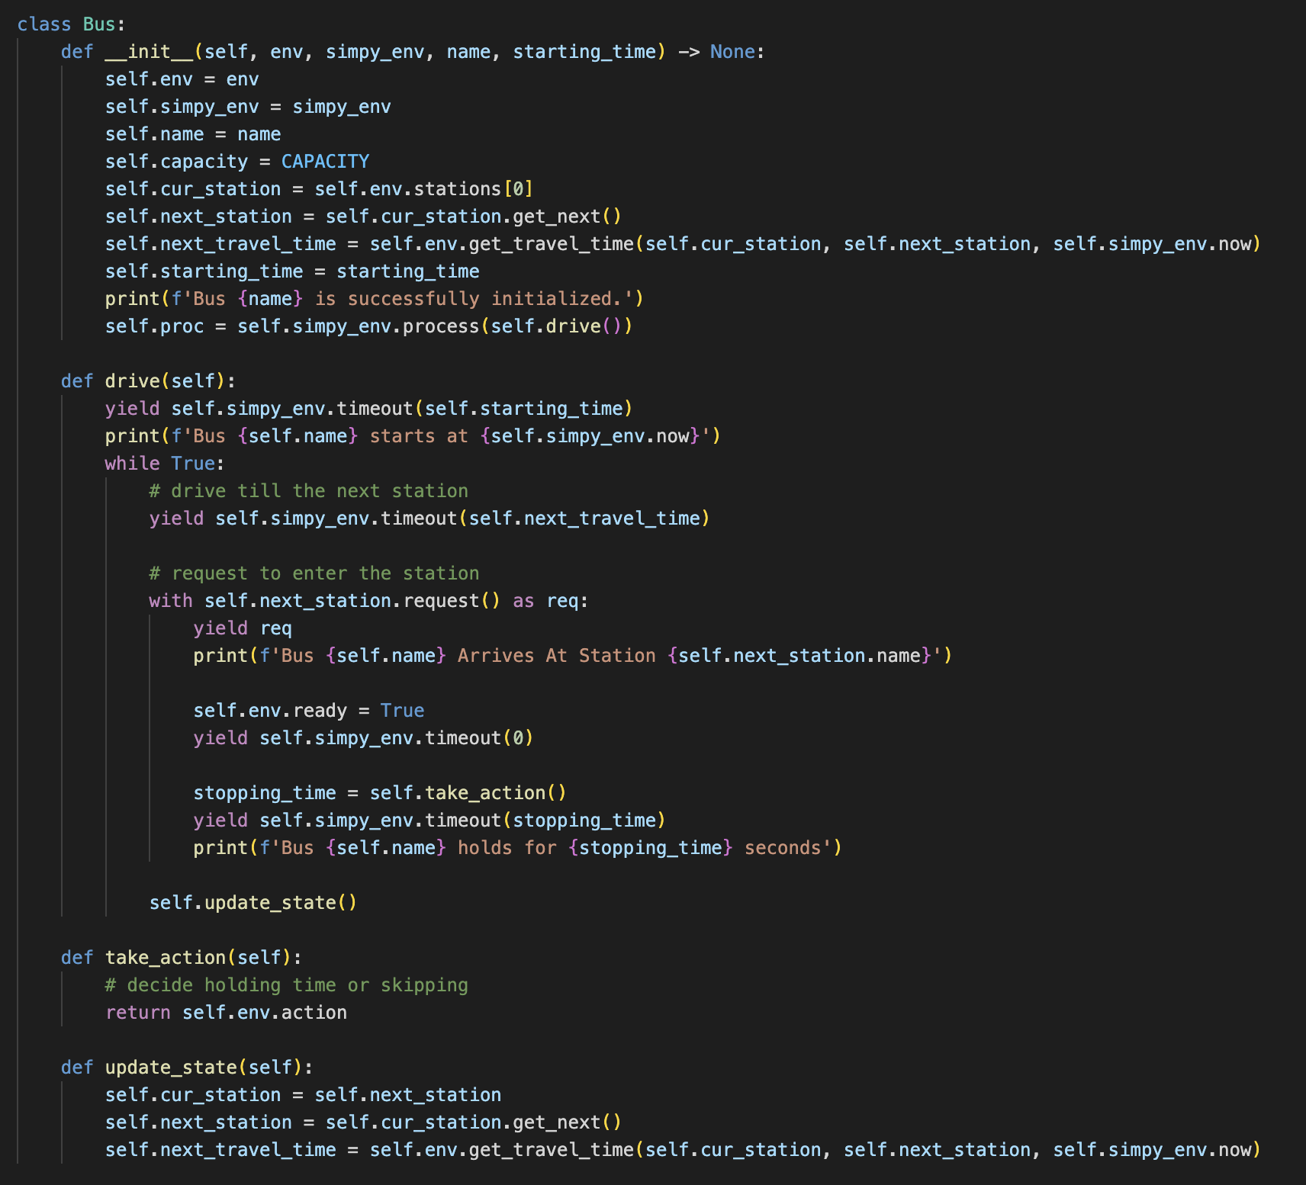
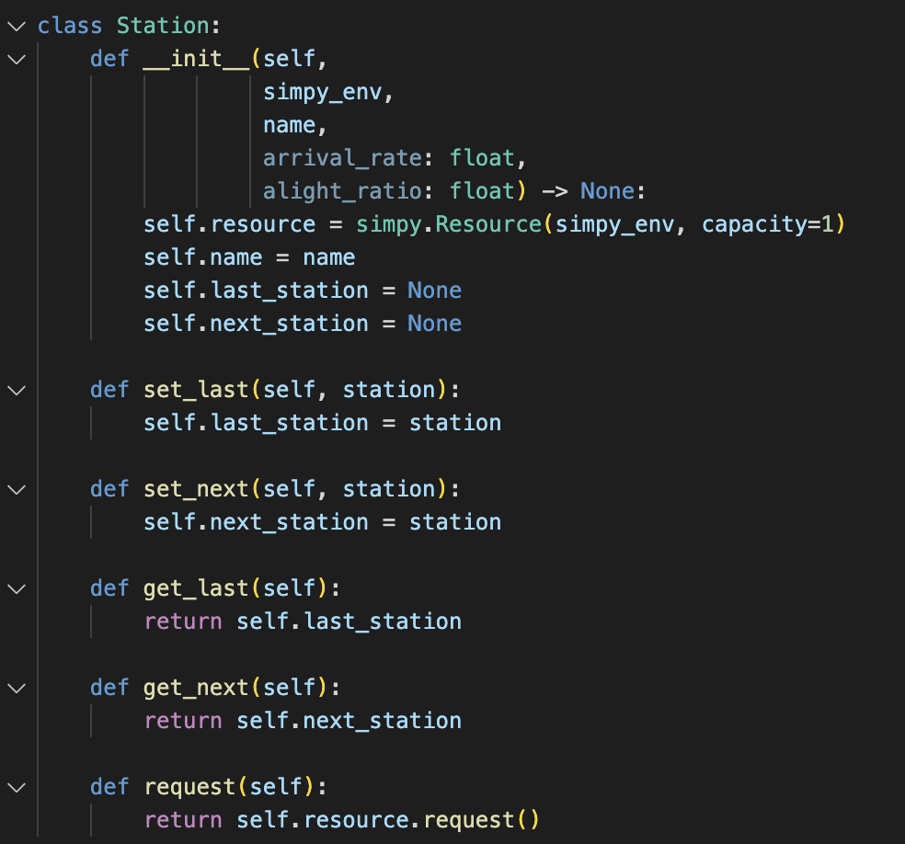
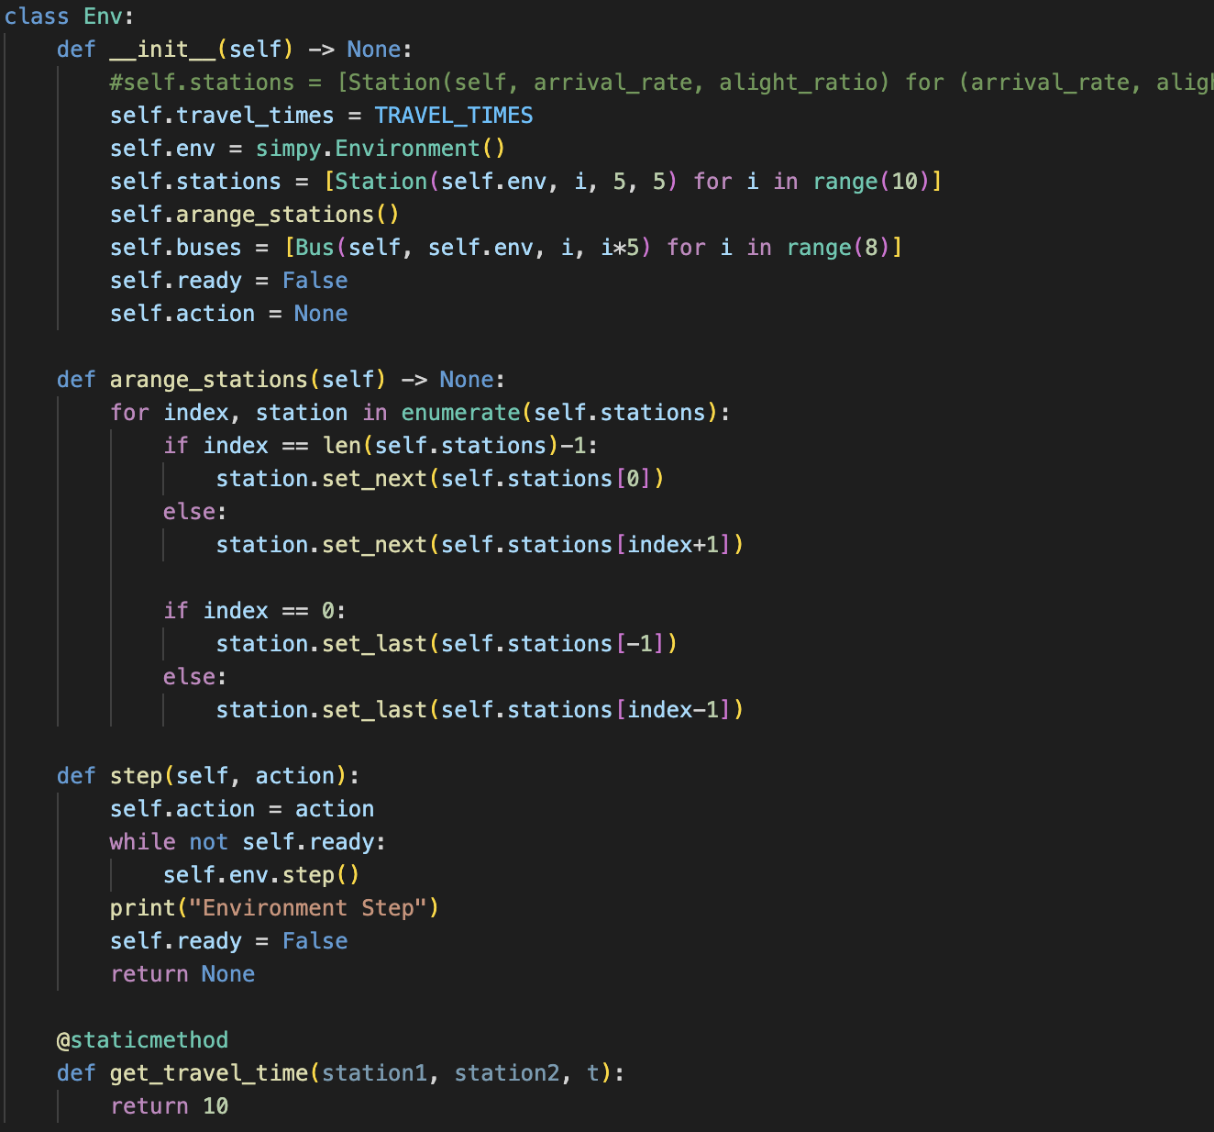
New Simulator – Event-driven with less than 150 lines of code
Environment
Bus:
Drive(): next travel time -> request for stop -> stopping time
Station

Slide 3
New Problem Formulation
hold
skip
turnaround
1, penalty for turnaround (people who are on the bus & people who are waiting at downstream stations)
2, turnaround will make sense in very strict condition

Slide 4
New Methodology
Challenge 1: State representation that differentiates ego-bus
query
key
value
num_pax,
location
Ego
Other1
key
value
Transformer
(self-attention)
State Encoding
Other2
key
value
…
OtherN-1
key
value

Slide 5
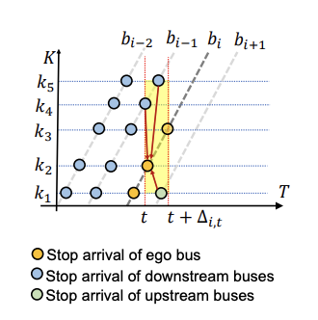
New Methodology
Challenge 2: Encode other on-going events and events that affect the final reward.
For each event:
state
action
Relative time

Slide 6
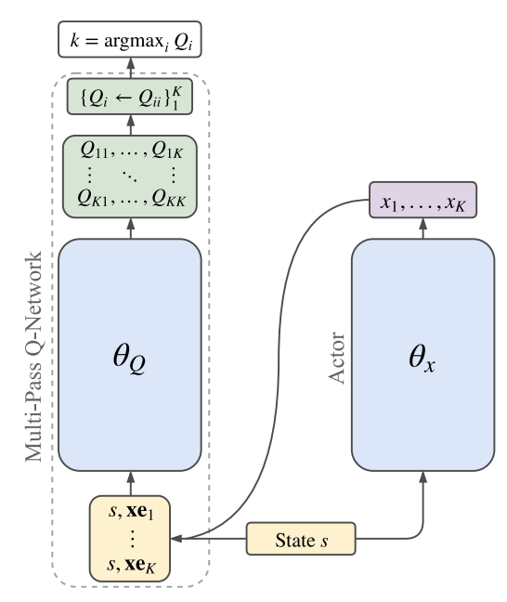
New Methodology
Challenge 3: Discrete-Continuous Hybrid Action Space
Use (k, x_k) to represent an action where k is the discrete part and x_k is the continuous part.

Slide 7
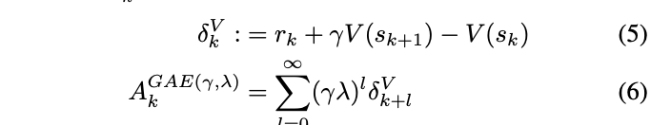
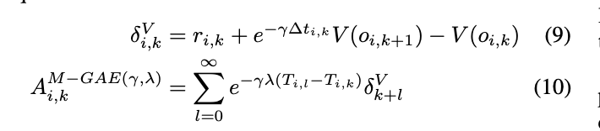
New Methodology
Challenge 4: Reward Assignment (credit assignment)

