Slide 1
Hardware design basics
as viewed by a software person
(part 2)
This presentation (along with the sample code) lives on github: https://github.com/quarck/vhdl_intro

Slide 2
VHDL – a bit more formal introduction
Strictly typed language
Types of VHDL objects:
constant
variable
signal
file (we would ignore this one)
Object definition:
<Object type> <name> : <data type> [:= Initial value];

Slide 3
VHDL: example object definitions
constant MATH_PI : real := 3.1415927;
variable ctr : integer :=0;
signal Q : bit := ‘0’;
Note: signal assignment is different between variables and signals (on purpose, we would cover it later):
Q <= not Q;
ctr := ctr + 1;

Slide 4
VHDL – a bit more formal: basic types
type bit is (‘0’, ‘1’);
type boolean is (false, true);
type character is (NUL, SOH, … ‘ ’, ‘!’, … ‘A’, ‘B’, … ‘a’, ‘b’, …);
type integer is range -2.147.483.647 to 2.147.483.647; -- particular implementations may extend this range
type real is range -1.0e38 to 1.0e38; -- particular implementations may extend this range

Slide 5
VHDL – a bit more formal: basic types
subtype natural is integer range 0 to integer'high;
subtype positive is integer range 1 to integer'high;
type string is array (positive range <>) of character;
type bit_vector is array (natural range <>) of bit;

Slide 6
VHDL – a bit more formal: types
std_logic is a library defined type:
type std_logic is (
‘U’, -- Uninitialized
‘X’, -- Forcing unknown
‘0’, -- Forcing 0
‘1’, -- Forcing 1
‘Z’, -- High impedance
‘W’, -- Weak unknown
‘L’, -- Weak 0
‘H’, -- Weak 1
‘-’ -- Don’t care
};

Slide 7
VHDL – a bit more formal: physical types
By example, system time type:
type time is range 0 to 1e20
units
fs;
ps = 1000 fs;
ns = 1000 ps;
us = 1000 ns;
ms = 1000 us;
sec = 1000 ms;
min = 60 sec;
hr = 60 min;
end units time;

Slide 8
VHDL: arrays, example
type ram_t is array (0 to 255)
of std_logic_vector(7 downto 0);
signal ram : ram_t :=
(others => (others => '0’));
type bit_vector is array (natural range <>)
of bit;

Slide 9
VHDL: arrays, example
type ram_t is array (0 to 255) of std_logic_vector(7 downto 0);
signal ram : ram_t := (others => (others => '0'));
-- Xilinx-specific: can be also peppered with:
attribute ram_style: string;
attribute ram_style of ram : signal is "distributed";
-- or
attribute ram_style of ram : signal is “block";
-- or
attribute ram_style of ram : signal is “auto";

Slide 10
VHDL: records (structs), example
type t_TO_FIFO is record
wr_en : std_logic;
wr_data : std_logic_vector(7 downto 0);
rd_en : std_logic;
end record t_TO_FIFO;

Slide 11
VHDL: operations: relational
Operation | Comment
=
/= | Not equal
<
<=
>
>=

Slide 12
VHDL: operations: logic
Operation | Comment
and
or
nand | a nand b = not (a and b)
nor | a nor b = not (a or b)
xor | exclusive or
not

Slide 13
VHDL: operations: Arithmetic
Operation | Comment
+
-
*
/
** | Power
mod
rem
abs

Slide 14
VHDL: operations: Concatenation
Operation | Comment
&
signal a : std_logic_vector (7 downto 0) := “00000000”;
signal b : std_logic_vector (8 downto 0);
…
b <= ‘0’ & a; -- makes 8-bit signal into 9-bit

Slide 15
VHDL: design units
Entity
Architecture
Package
Configuration (we would skip this one for now)

Slide 16
VHDL: entity, formal syntax
entity <id> is
[<generic>];
[<ports>];
[<declarations>];
[begin <sentences>];
end [entity] [<id>];

Slide 17
VHDL: entity - example
entity MUX21 is
port(
A : in bit;
B : in bit;
Ctrl : in bit;
Z : out bit;
end MUX21;

Slide 18
VHDL: entity, example with generics
entity MUX21n is
generic( n : integer := 2);
port( A : in bit_vector(n-1 downto 0);
B : in bit_vector(n-1 downto 0);
Ctrl : in bit;
Z : out bit_vector(n-1 downto 0));
end MUX21;

Slide 19
VHDL: architecture, formal syntax
architecture <id> of <id_entity> is
[<declarations>];
begin
<concurrent sentences>;
end [architecture] [<id>];

Slide 20
VHDL: architecture, code example:
architecture Behaviour of MUX21n is
begin
process(A, B, Ctrl)
begin
if Ctrl = ‘0’ then
Z <= A;
else
Z <= B;
end if;
end process;
end Behaviour;

Slide 21
VHDL: package
Declaration:
package <identifier>
[<declarations>];
end [package] [<identifier>]
Body:
package body <identifier>
[<Assignments and Detailed definitions>];
end [package body] [<identifier>]

Slide 22
VHDL: package usage
Usage:
use <library>.<package name>.[<identifier> | all];
Example standard packages:
std_logic_1164
std_logic_arith
Used as follows:
library ieee;
use ieee.std_logic_1164.all;
use ieee.std_logic_arith.all;

Slide 23
VHDL: concurrent & sequential statements
Two types of code statemtns:
Concurrent
Sequential
All the VHDL code is concurrent by default
Unless it resides inside the “process” statement (also applies to “procedure” and “function” declarations)
Anything inside “process” statement is sequential

Slide 24
VHDL: concurrent statements
All the lines of code are “executed” simultaneously
Example:
signal a : std_logic := ‘1’;
signal b : std_logic := ‘0’;
begin
-- code below swaps bit values between a and b
a <= b when rising_edge(clk);
b <= a when rising_edge(clk);
end …;

Slide 25
VHDL: sequential statements
Code inside the “process” statement behaves as if it was just a regular software thread, “executing” line by line
Each “process” is executing in parallel with other processes
Synthesis tool would analyse the behaviour and produce the netlist that implements the required behaviour
A lot of sequential code statements cannot be synthesised, but can be used in testbenches, for example:
wait for 20ns;

Slide 26
VHDL: process (sequential statements):
Syntax:
[label:]
process [(<sensitivity list>)]
begin
<sequential sentences>
[<wait statements>;]
end process;
Either sensitivity list or at least one wait statement must be present.

Slide 27
VHDL: process, sensitivity list:
Sequential statements inside “process” block are re-run each time any signal in the sensitivity list changes its value
(Process statement is executed once unconditionally at “start”)
Example:
process (clk, x)
begin
if rising_edge(clk) then
z <= x;
end if;
end process;

Slide 28
VHDL: process, wait statement:
“Wait” statement suspends execution of the process until the wait condition is met
Can have simply a list of signals, in such case it is an equivalent to a sensitivity list Example:
process
begin
if rising_edge(clk) then
z <= x;
end if;
wait on clk, x;
end process;

Slide 29
VHDL: process, wait statement:
Formal syntax:
[label:] wait [on <signal> {, ...}]
[until <boolean_expresion>]
[for <time_expresion>];
Examples:
wait on clk, x;
wait for 10 ns;
wait until clk = ‘1’;
wait; -- “terminates” the process

Slide 30
VHDL: process, signals vs variables
Both “signals” and “variables” can be used inside the process statement
Variable assignment has an immediate effect
Signal assignment only “applies” when process is suspended

Slide 31
VHDL: process, signals vs variables, example:
process (clk, x, y, z)
variable a : std_logic = ‘0’;
signal b : std_logic = ‘1’;
begin
if rising_edge(clk) then
a := y; -- value of ‘a’ is changed immediately
b <= y; -- value of ‘b’ is ‘cached’
if x = ‘1’ then
a := z; -- value of ‘a’ is changed again
b <= z; -- ‘b’ is still cached
end if;
end if;
wait on (clk, x, y, z); -- here ‘b’ is finally applied
end process;

Slide 32
VHDL: process, signals vs variables
“signal” translates directly into a wire of flip-flop
“variable” gives some flexibility for the tool to analyse the behaviour and produce netlist that implements it, might as well get translated into the wire of flip-flo
“signal” can be viewed in the simulation waveform, while “variable” is usually not

Slide 33
VHDL: Variable assignment (process only)
[label:] <variable name> := <expression>;

Slide 34
VHDL: signal assignment
[label:] <signal_name> <= [delay_type] <expression> {after <delay>};
Can take quite complicated form, but these can be only used in testbenches:
A <= ‘0’, ‘1’ after 10 ns, ‘0’ after 15 ns, ‘1’ after 20 ns, ‘0’ after 30 ns, ‘1’ after 50 ns, ‘0’ after 70 ns;
B1 <= transport A after 10 ns;
B2 <= A after 10 ns;
B3 <= reject 5 ns A after 10 ns;
We would skip these ones

Slide 35
VHDL: conditional signal assignment
[<label>:] <signal> <= [delay_type]
{<expression|waveform> when <boolean expression> else}
< expression|waveform> [when <boolean expression>];
Example:
z <= a when s = “00” else
b when s = “11” else
unnafected when others;

Slide 36
VHDL: selective signal assignment
[<label>:]
with <expression> select
<signal> <= [delay_type]
{<expression|waveform> when <value>,}
<expression|waveform> when <value>;
Example:
with opcode select
res <= A + B when “00”,
A - B when “01”,
A and B when “10”,
A or B when “11”;
WOW! We’ve just implemented a very basic ALU (arithmetic logic unit) by accident!

Slide 37
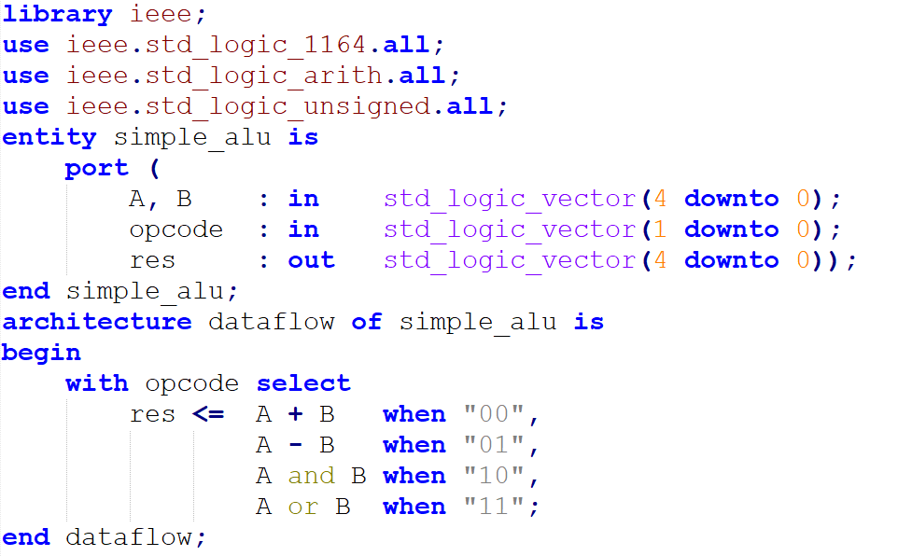
Side note: simple ALU, let’s see some code and netlists

Slide 38
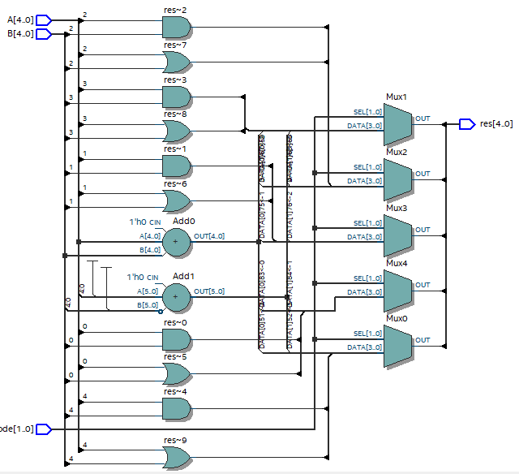
Side note: simple ALU, let’s see some code and netlists

Slide 39
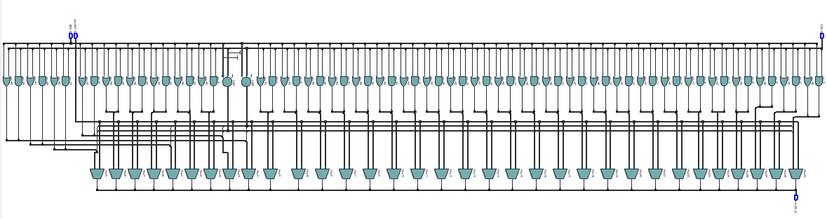
32 bit? Behold!

Slide 40
VHDL: sequential stm, if-statements, formal syntax
[label:] if <condicion> then
<sentencias secuenciales>
{elsif <condicion> then
<sentencias secuenciales}
[else
<sentencias secuenciales>]
end if [label];

Slide 41
VHDL: sequential stm, case-statements, formal syntax
[label:] case <expresion> is
{when <value1> =>
<sequential sentences>;}
{when <value2> =>
<sequential sentences>;}
[when others =>
<sequential sentences>;]
end case [label];

Slide 42
VHDL: sequential stm, while loops
[label:] while <boolean_condition>
loop
<sequential sentences>
end loop [label];

Slide 43
VHDL: sequential stm, for loops
[label:] for <repetition_control>
loop
<sequential sentences>
end loop [label];
example:
for i in 1 to 10 loop
<statements>;
end loop example;
Loop variable should not be declared in advance, its lifetime is limited to the loop body
‘to’ can be changed to ‘downto’ for going down instead of going up.

Slide 44
VHDL: generate statements, ‘if’
Conditionally generate or skip a piece of definition, syntax:
<label>: if <condition>
generate
{<concurrent sentences>}
end generate;

Slide 45
VHDL: generate statements, ‘if’
Example:
if_32_bit: if n = 32
generate
a: ALU_32_bit port map (…);
end generate;
if_lt32_bit: if n < 32
generate
a: ALU_simple port map (…);
end generate;
-- to ensure we’ve covered all cases, let’s assert a bit:
assert n <= 32 report “Only 1-32 bits are supported”
severity failure;

Slide 46
VHDL: generate statements, “for”
Generates repeating blocks. Syntax:
<label>: for <range specification>
generate
{<concurrent sentences>}
end generate;

Slide 47
VHDL: generate statements, ‘for’
Example:
gen_adder: for i in 0 to 31
generate
adder: full_adder
port map(
a => a(i), b => b(i),
c_in => carry(i),
S => res(i),
c_out => carry(i + 1));
end generate;

Slide 48
VHDL: function, just a syntax
Declaration:
function <name> [(<parameters list>)] return <data_type>;
Definition:
function <name> [(<parameters list>)] return <data_type> is
{<declarative part>}
begin
{<sequential sentences>}
end [function] [<name>];
One or more “return [expression];” in here

Slide 49
VHDL: procedure, just a syntax
Declaration:
procedure <name> [(<parameters list>)];
Definition:
procedure <name> [(<parameters list>)] is
{<declarative part>}
begin
{<sequential sentences>}
end [procedure] [<name>];

Slide 50
FPGAs
First, let’s recall our state machines that we did already in the part 1

Slide 51
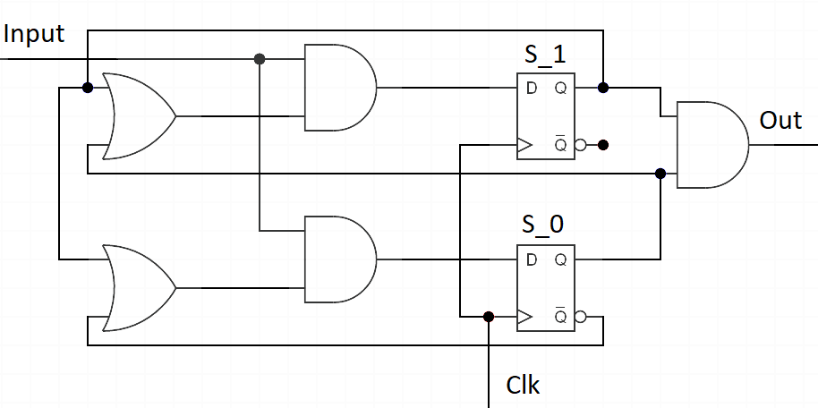
Sequence 111 detection FSM

Slide 52
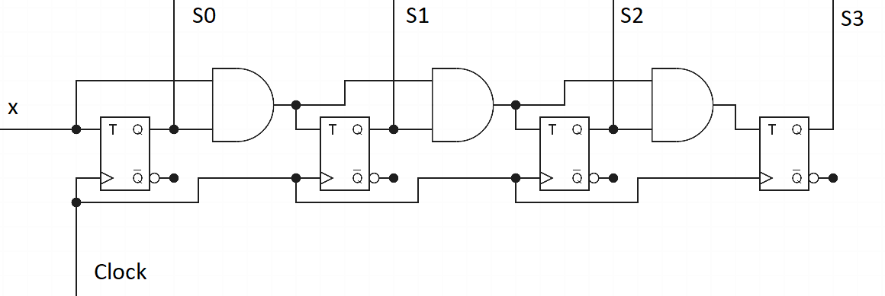
Sync counter FSM

Slide 53
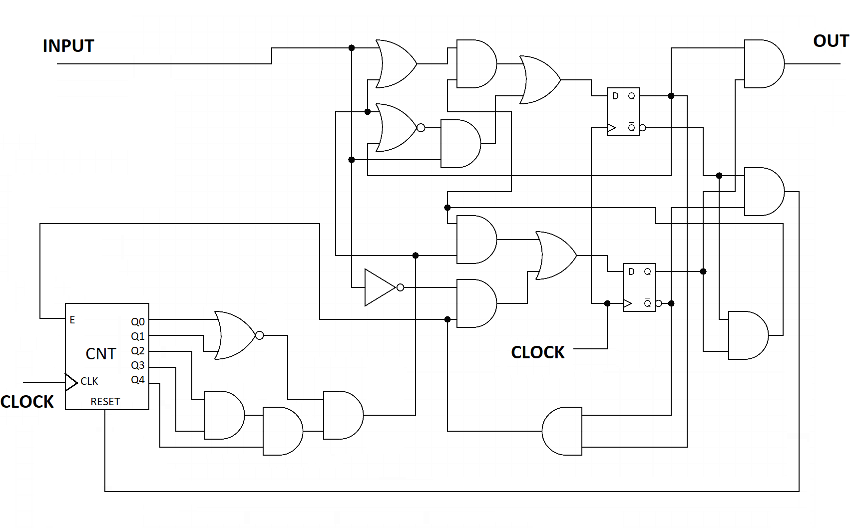
Ethernet preamble detection FSM

Slide 54
FPGAs..
Notice a pattern in all our state machines:
In consists of flip-flops paired with some combinatory circuit that defines the next state of the flip flop
Inputs into the combinatory circuit could be either current circuit’s input or the current value of the circuit flipflop(s) or both.
If we denote our combinatory circuits as black boxes, we can draw these state machines as (next slides):

Slide 55
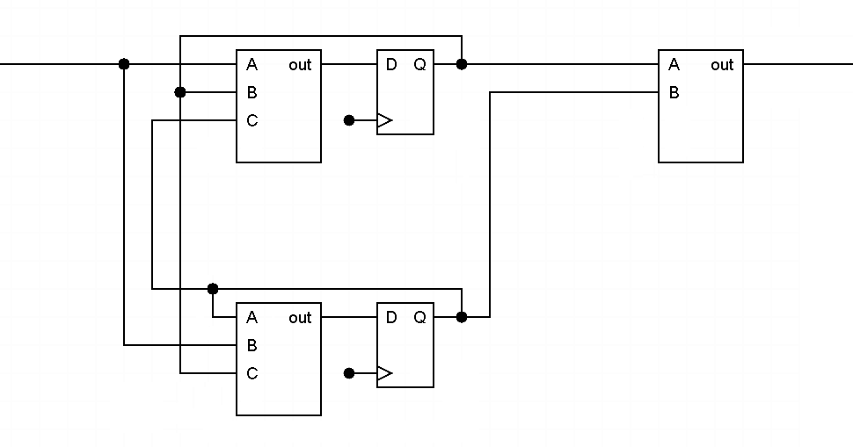
Sequence 111 detection, generalized

Slide 56
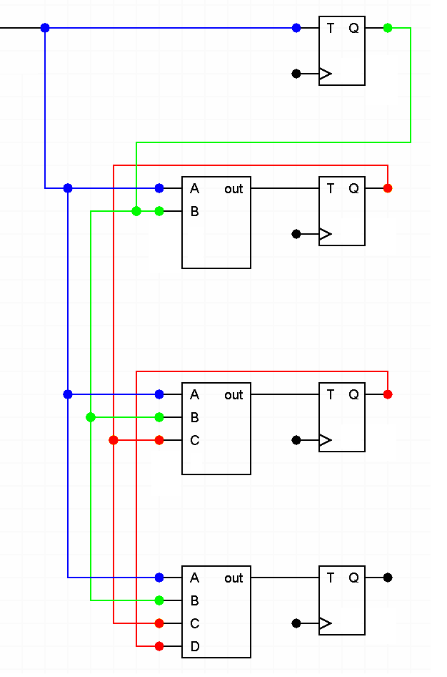
Sync counter:

Slide 57
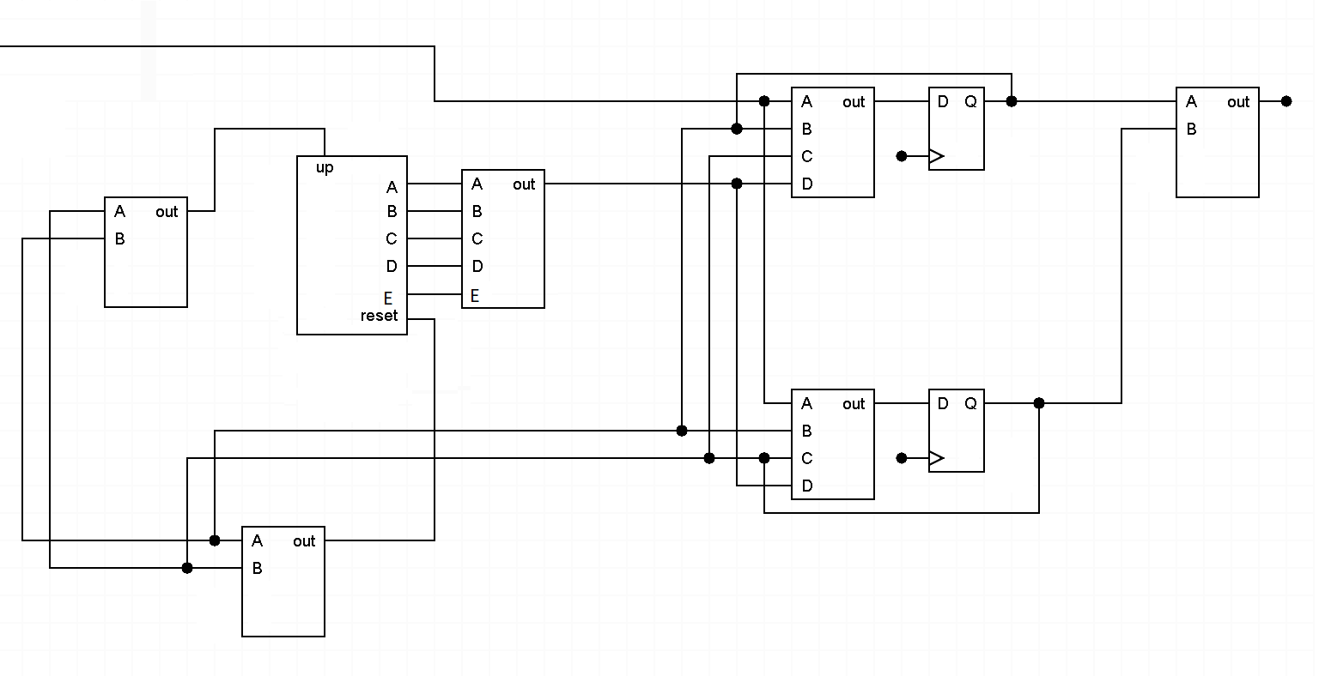
Ethernet preamble detection

Slide 58
FPGA
The pair of configurable logical function coupled with the flip-flop is basically an elementary construction of any FPGA, called “System Logic Cell” or “Configurable Logic Block” – CLB for short.
Configurable logical function is called LUT, implemented as a simple lookup table, can have between 3 and 6 inputs and 1 or several bits of output.
FPGA cell can be configured to bypass either LUT or flip-flop, acting as just a LUT on its own or as a D flip-flop
CLB might contain additional logic to accelerate addition operation, etc.
These CLBs are arranged into a huge arrays with configurable interconnects
NOTE: FPGAs are not the only programmable logic devices that do exist, but the most capable ones

Slide 59
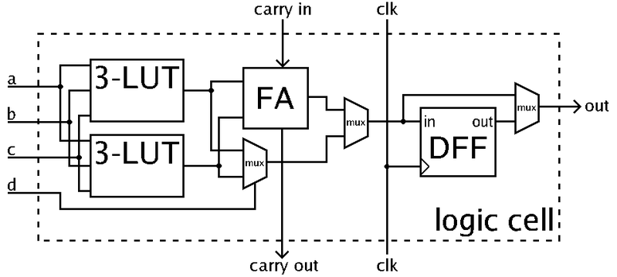
FPGA, simplified configurable logic block

Slide 60
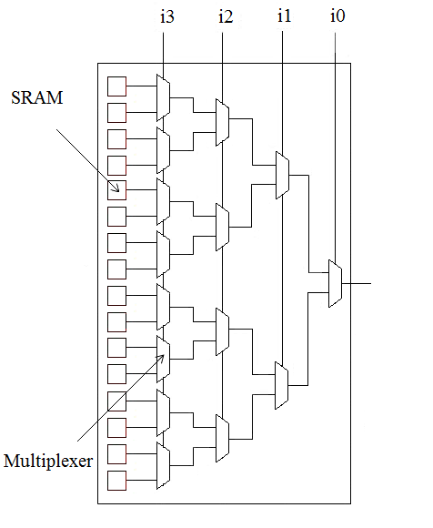
LUT structure

Slide 61
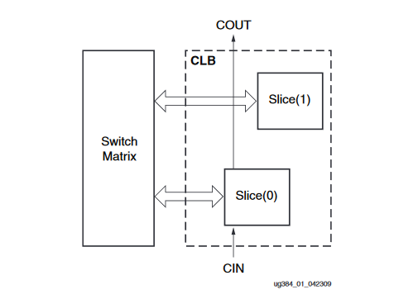
FPGA: CLBs in a real world, Spartan 6 example
Xilinx Spartan 6, each CLB contains two “slices”
Each slice is approximately identical and includes actual programmable logic
There are three slice types on Spartan 6: SLICEM, SLICEL, SLICEX
Each type of slice contains a set of 6-input LUTs and 8 Flip-Flops
SLICEL and SLICEM also contain carry logic and wide multiplexers
SLCIEM also has Distributed RAM and Shift Registers on board.
Image, Source: https://www.xilinx.com/support/documentation/user_guides/ug384.pdf

Slide 62
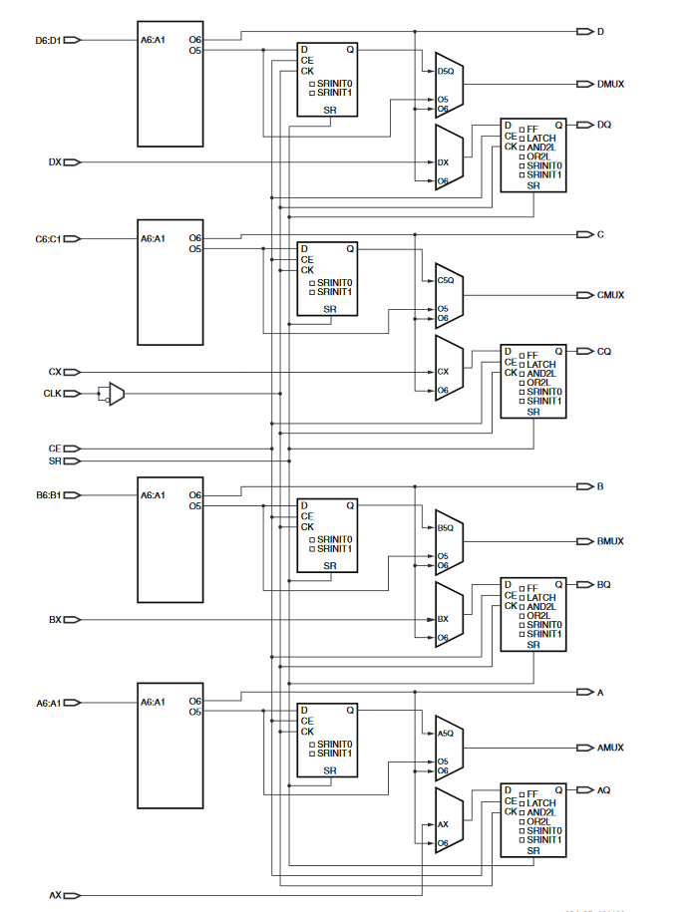
FPGA: Xilinx Spartan 6, SLICEX:
© Xilinx, Source: https://www.xilinx.com/support/documentation/user_guides/ug384.pdf

Slide 63
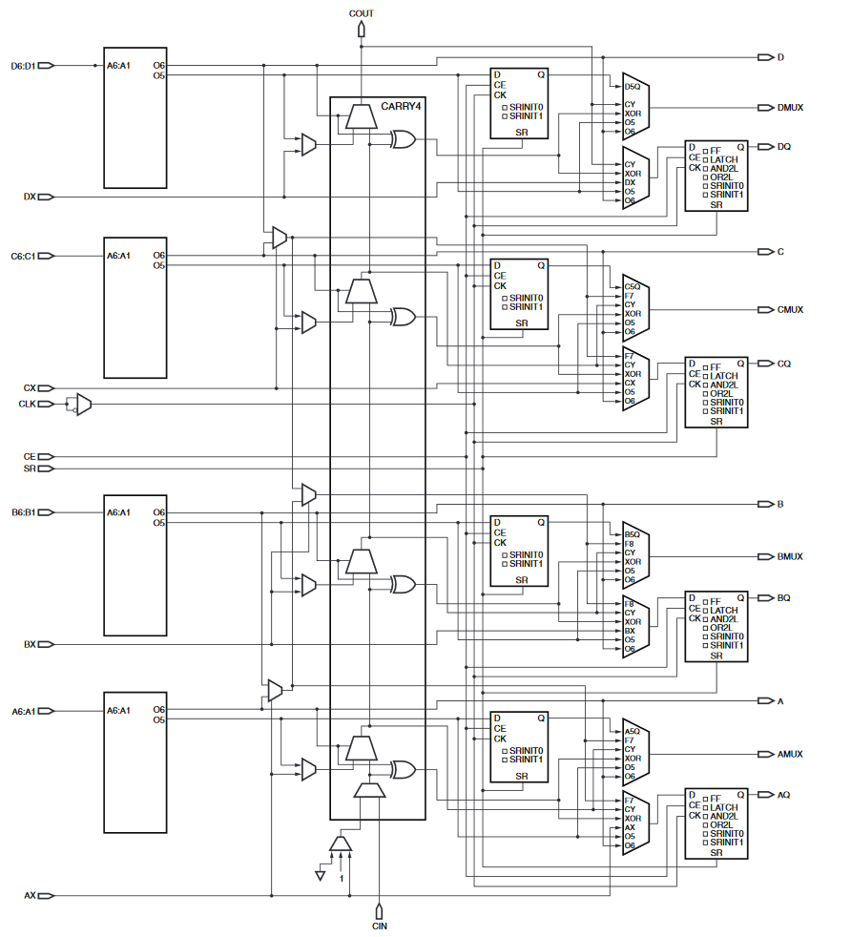
FPGA: Xilinx Spartan 6, SLICEL:
© Xilinx, Source: https://www.xilinx.com/support/documentation/user_guides/ug384.pdf

Slide 64
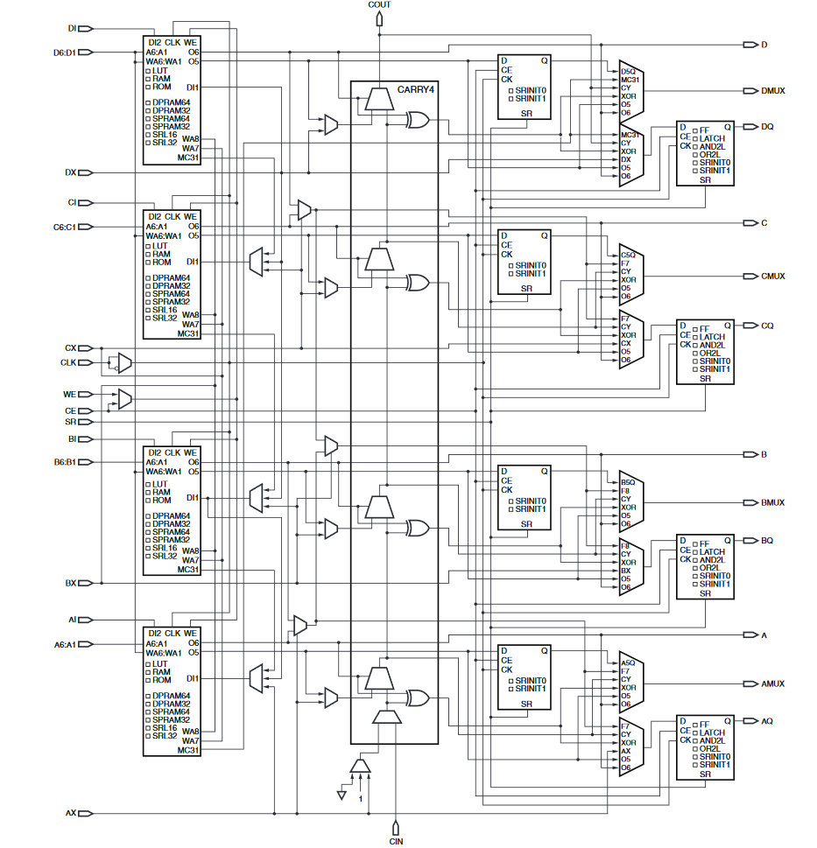
FPGA: Xilinx Spartan 6, SLICEM:
© Xilinx, Source: https://www.xilinx.com/support/documentation/user_guides/ug384.pdf

Slide 65
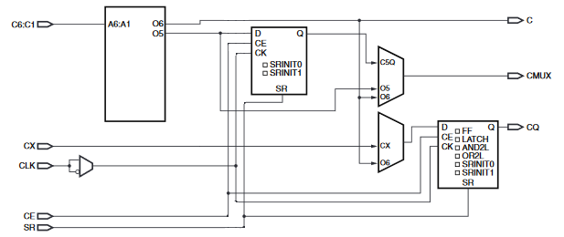
Spartan 6, ¼ of SLICEX, configuration variants
Two pre-programmable muxes (ignore the clock one), 6 combinations all together
Let’s review these combinations

Slide 66
Spartan 6, ¼ of SLICEX config., variant 1
One isolated FF with CX as input and CQ as output
LUT output O5 paired with FF into CMUX output
LUT output O6 connected directly to the slice output C

Slide 67
Spartan 6, ¼ of SLICEX config., variant 2
One isolated FF with CX as input and CQ as output
LUT output O6 connected directly to output C
LUT output O5 connected directly to output CMUX
Another FF is unused

Slide 68
Spartan 6, ¼ of SLICEX config., variant 3
One isolated FF with CX as input and CQ as output
LUT output O6 connected directly to both output C and CMUX
LUT output O5 is not used (perhaps this config. can help with routing in some cases)
Another FF is unused

Slide 69
Spartan 6, ¼ of SLICEX config., variant 4
Both LUT outputs are fed through FF I
LUT output O5 paired with FF into CMUX output
LUT output O6 paired with FF into CQ output
LUT output O6 also connected directly into C (may be unused)

Slide 70
Spartan 6, ¼ of SLICEX config., variant 5
LUT output O5 is now goes directly into CMUX
LUT output O6 paired with FF into CQ output
LUT output O6 also connected directly into C (may be unused)
One FF is unused

Slide 71
Spartan 6, ¼ of SLICEX config., variant 6
LUT output O6 paired with FF into CQ output
LUT output O6 also connected directly into C, and into CMUX
One FF is unused, as well as LUT O5
Not sure if this combination is used and if so - how

Slide 72

FPGA interconnects
A very generic FPGA architecture:
An ocean (sea, lake, puddle) of configurable logic blocks
Connected by programmable interconnects

Slide 73
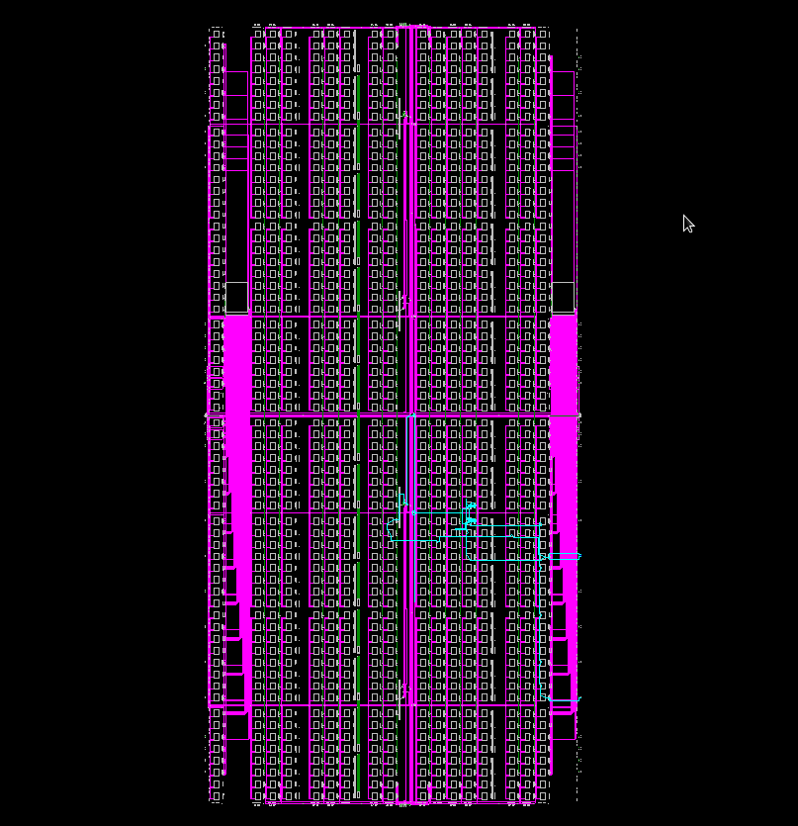
FPGA interconnects In the real world
This
Is Spartan! (Spartan 6, XC6SLX9,
1430 slices, 5720 luts, 11440 FFs)
Displaying:
Long lines (magenta)
Pin lines (green)
Switch matrixes (‘big’ squares)
Slices (tiny dots)
Local slice-level lines are not displayed

Slide 74
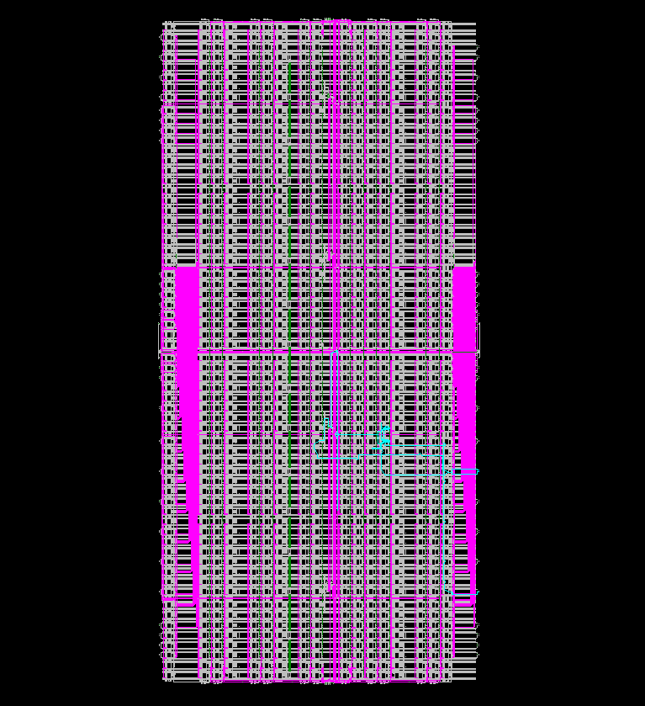
FPGA interconnects In the real world
This Is Spartan! (Spartan 6, XC6SLX9,
1430 slices, 5720 luts, 11440 FFs)
Displaying:
Long lines (magenta)
Pin lines (green)
Switch matrixes (‘big’ squares)
Slices (tiny dots)
Local slice-level lines (white mess)

Slide 75
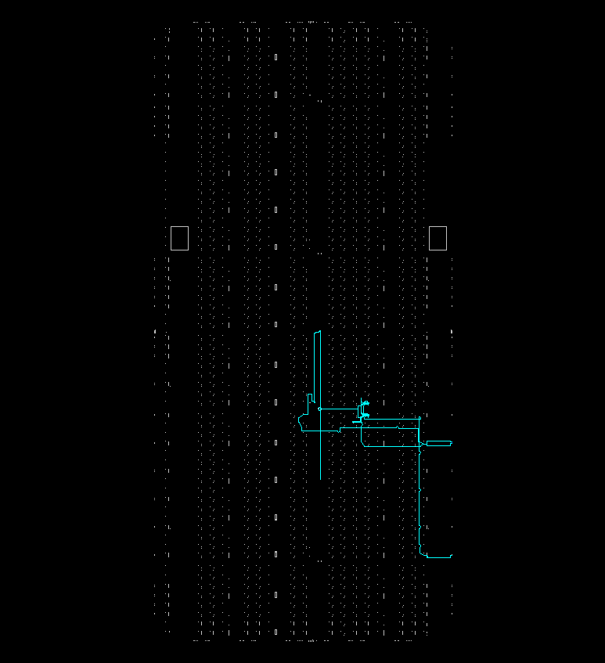
Spartan 6 XC6SLX9 structure, only slices
Only CLBS and the “eth preamble” bitstream routes are displayed
Key point: in the FPGA, most of the space is taken by the configurable routing / interconnects, and not by the logic cells

Slide 76
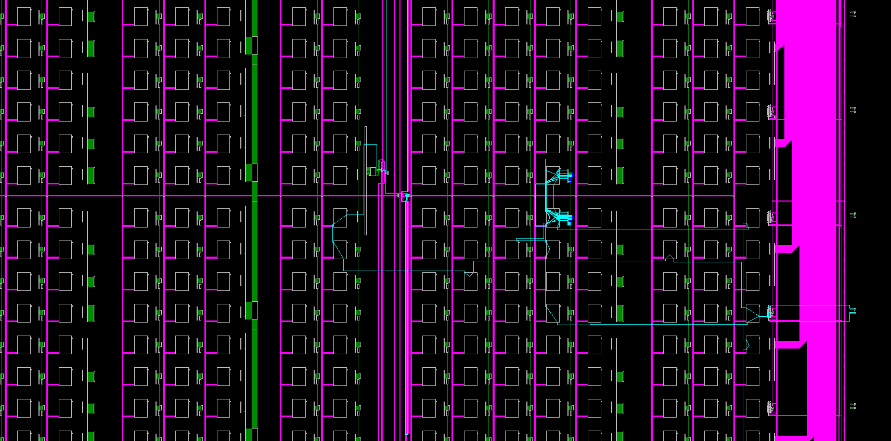
Spartan 6 XC6SLX9, zoom in, local lines not displayed
CLBs are too small to see here
Switch matrixes
Pin lines
Long lines

Slide 77
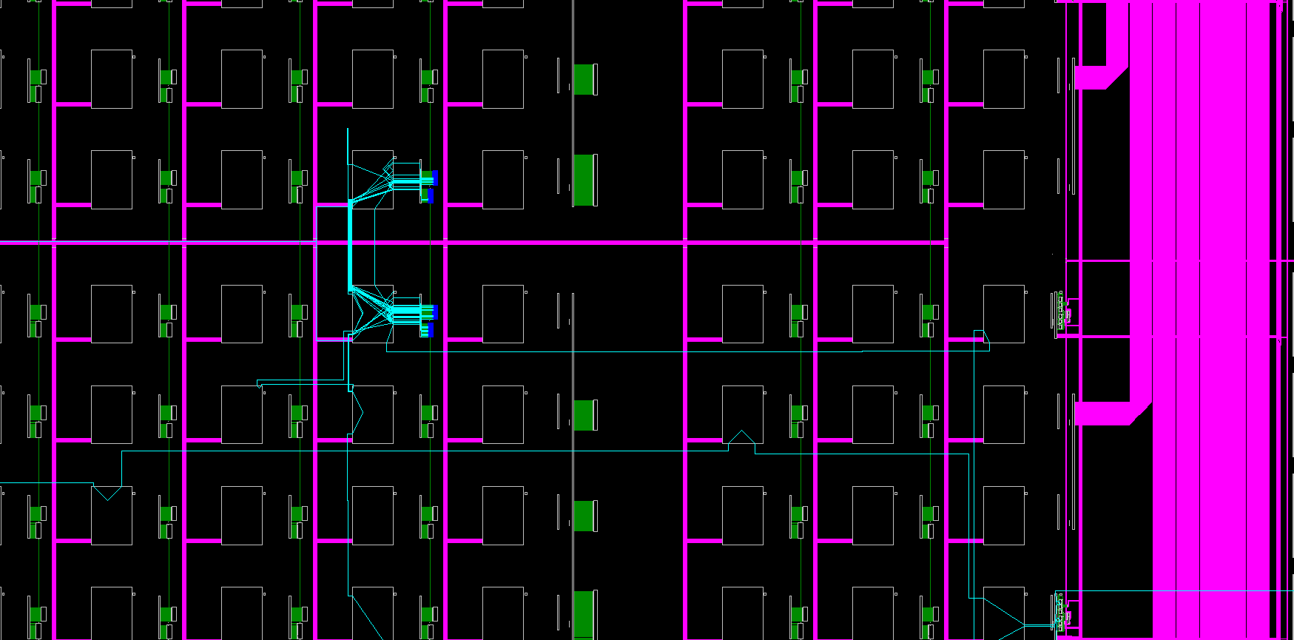
Spartan 6 XC6SLX9, further zoom in, no local lines
Slices (of CLB)
Switch matrixes

Slide 78
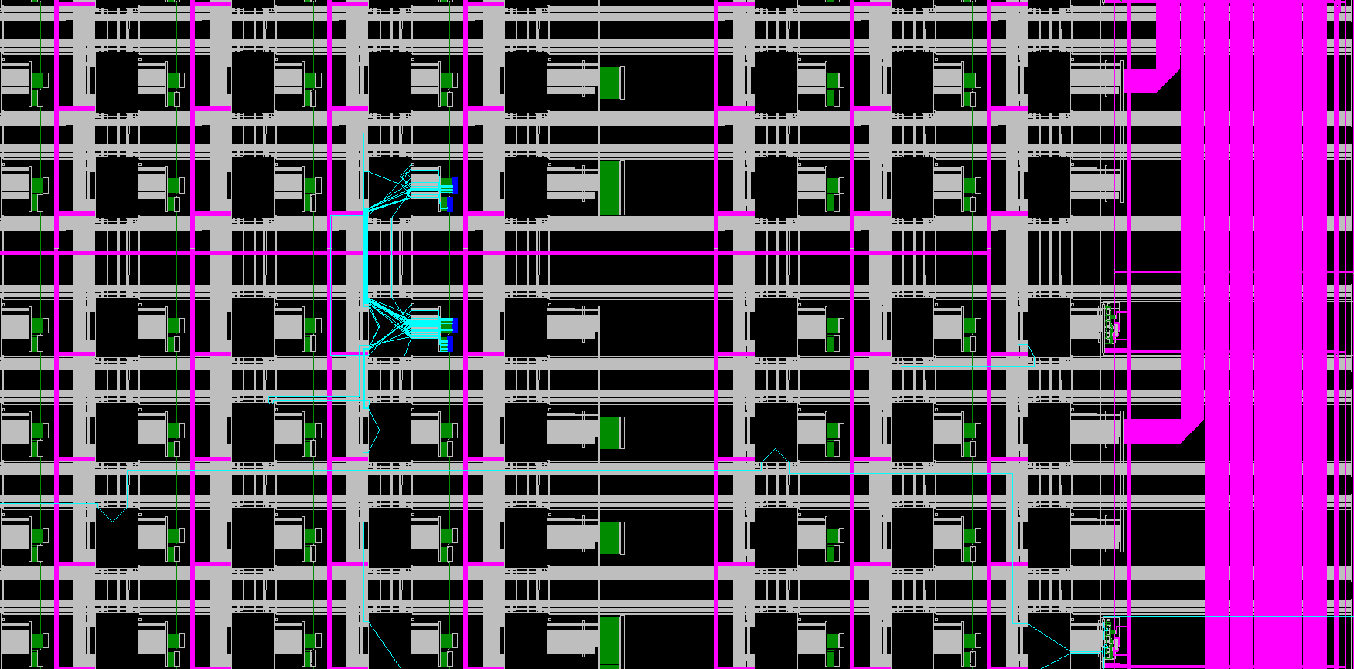
Spartan 6 XC6SLX9, local lines displayed

Slide 79
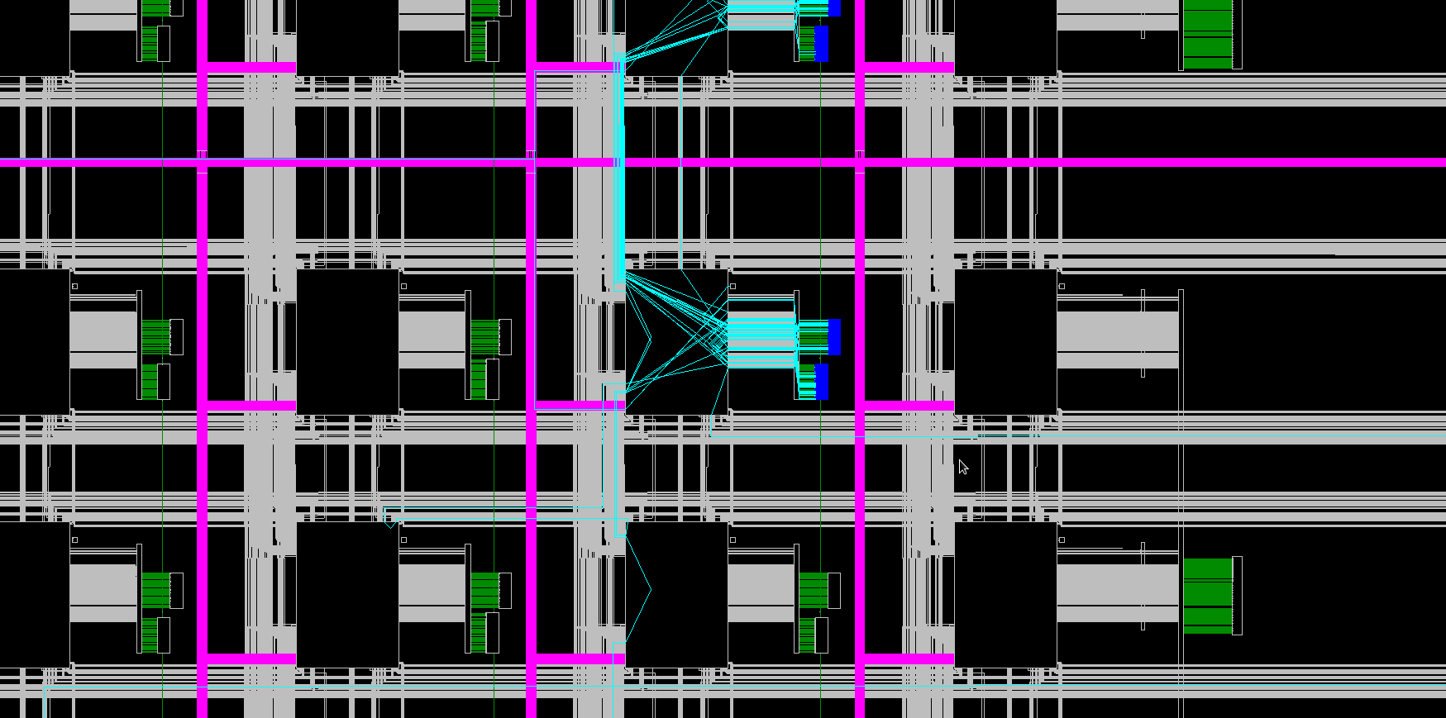
Spartan 6 XC6SLX9, further zoom in

Slide 80
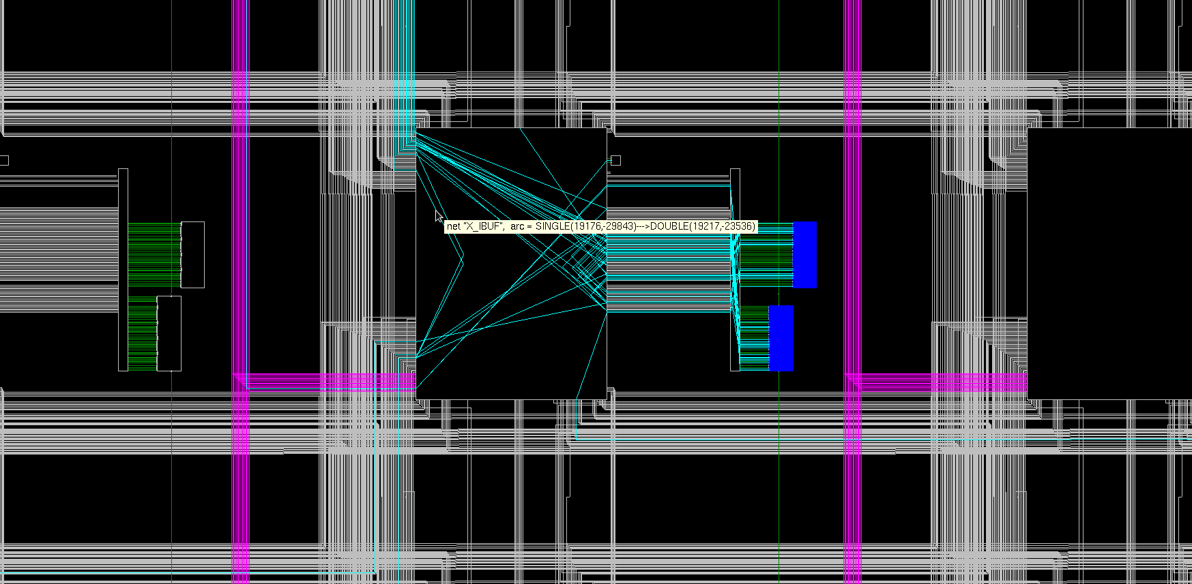
Spartan 6 XC6SLX9, further zoom in

Slide 81
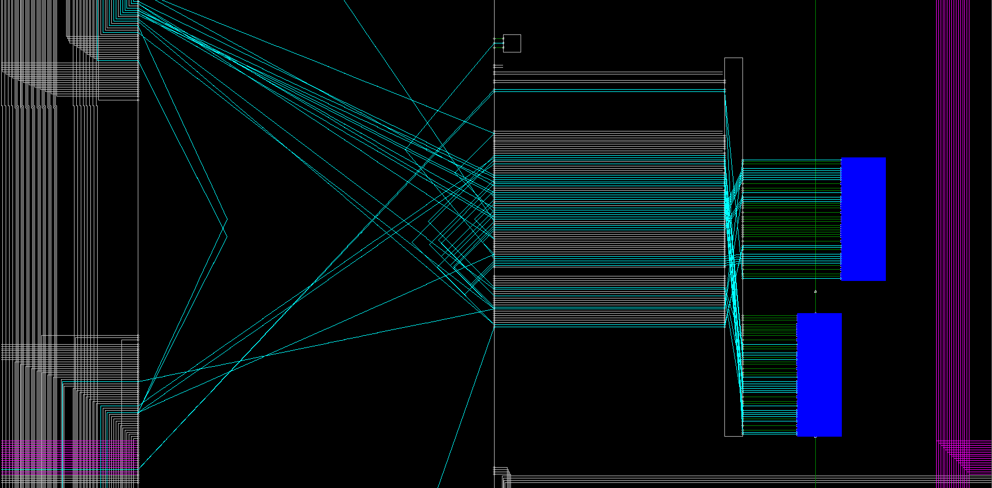
Spartan 6 XC6SLX9, at a max zoom
Two slices
Short Lines
Switch matrixes
Long Lines

Slide 82
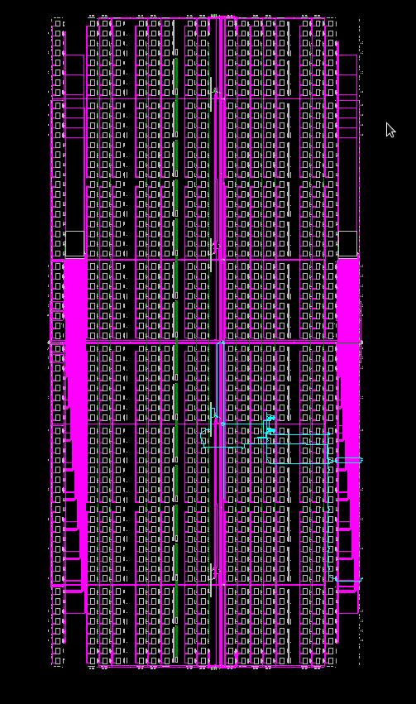
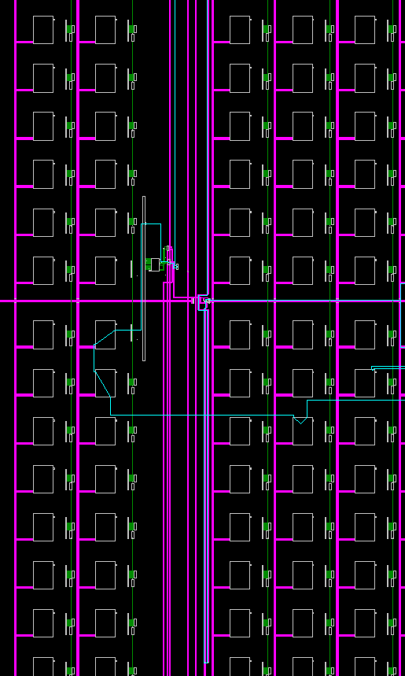
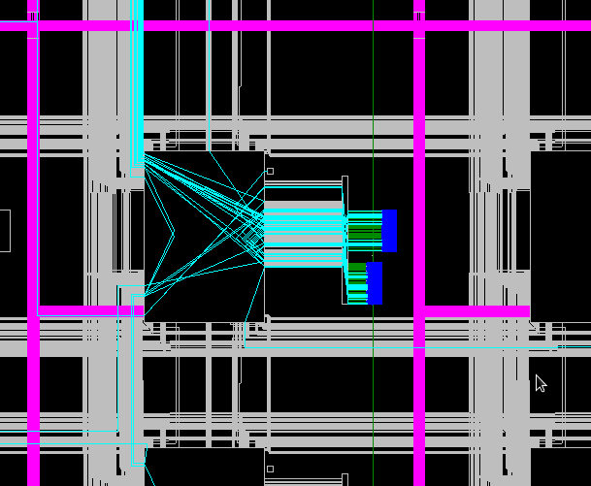
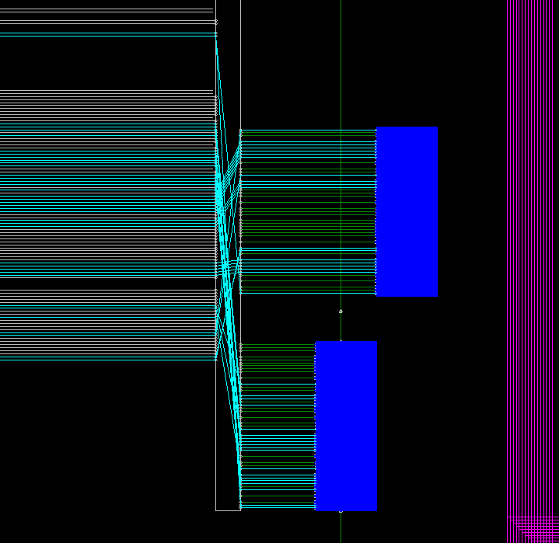

Slide 85
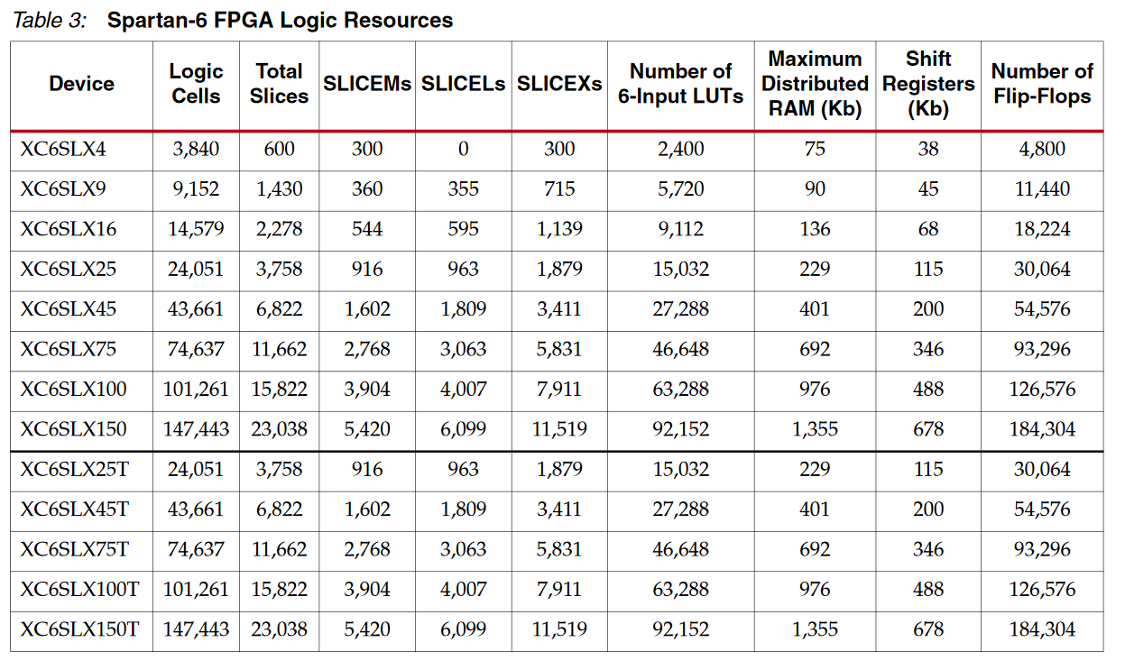
Appendix A. Xilinx Spartan 6 family summary
© Xilinx, Source: https://www.xilinx.com/support/documentation/user_guides/ug384.pdf

Slide 86
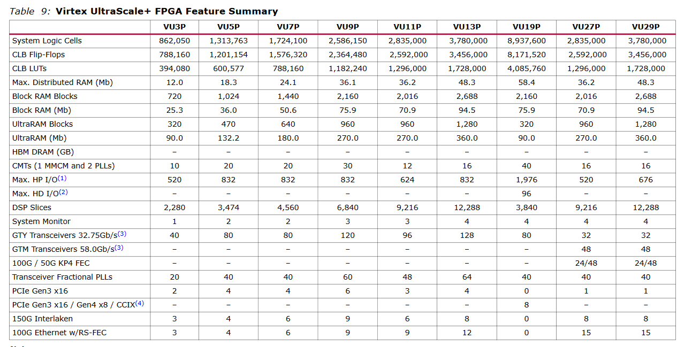
Appendix B. Xilinx Virtex Ultrascale family summary
© Xilinx, Source: https://www.xilinx.com/support/documentation/data_sheets/ds890-ultrascale-overview.pdf

