Slide 1



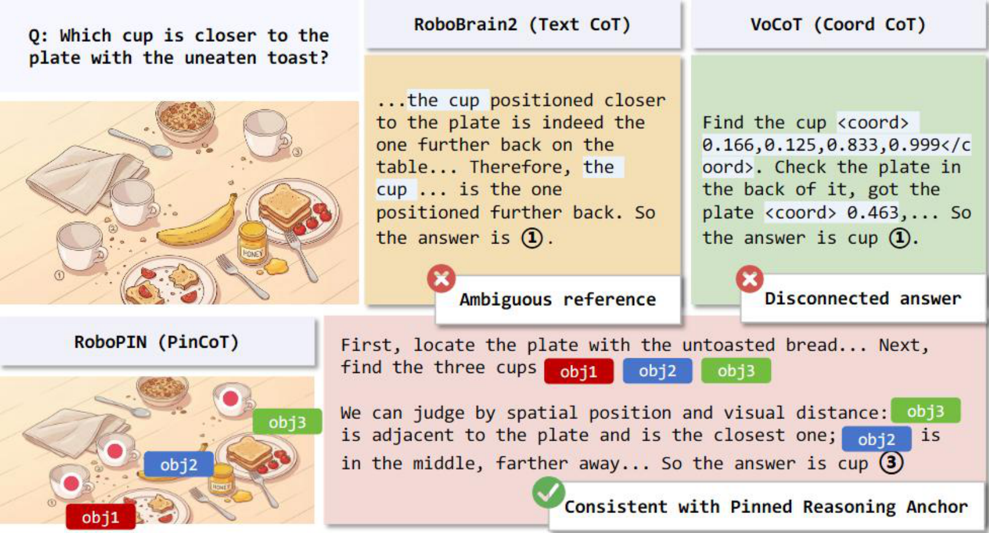
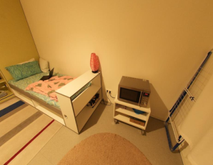
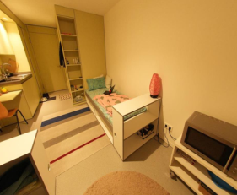
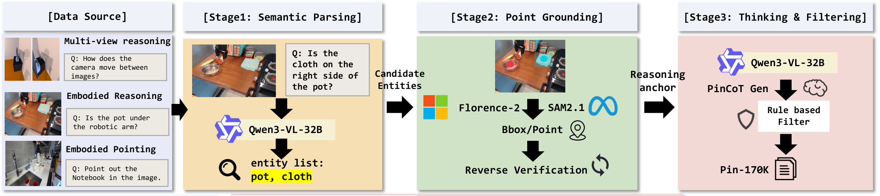
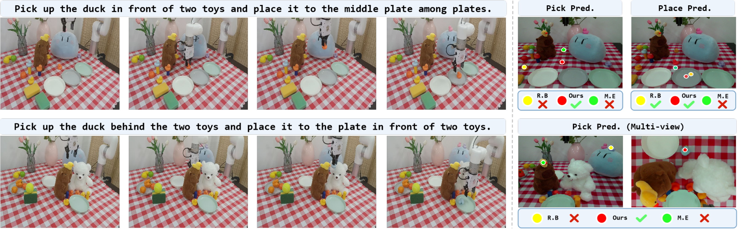
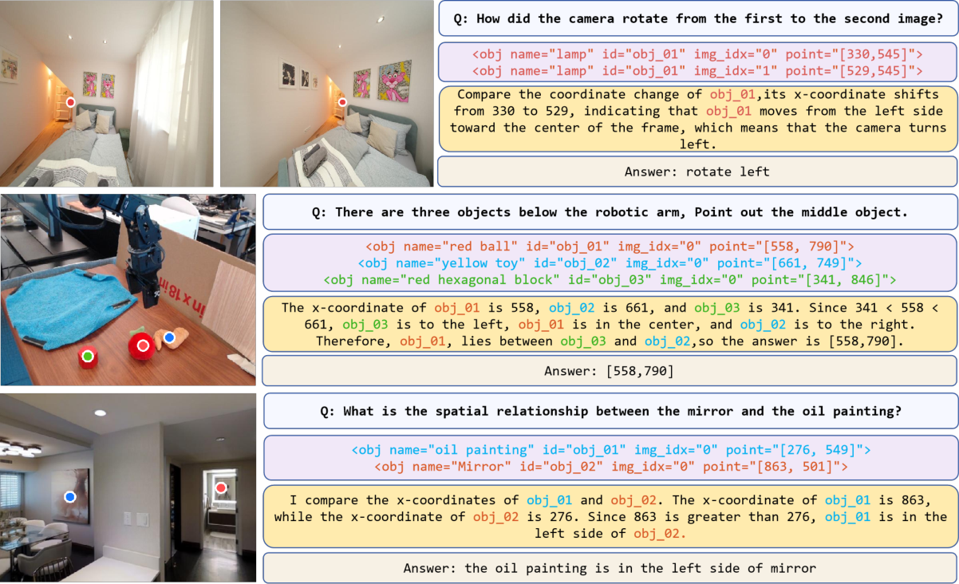
RoboPIN
Grounded Embodied Reasoning
via Pinned Chain-of-Thought
Yaoting Huang* · Yifu Yuan*† · Linqi Han · Chengwen Li · Shuoheng Zhang
Tianjin University
Xianze Yao · Hongyao Tang · Yan Zheng · Jianye Hao†
Tianjin University · ACM Multimedia 2026 · Rio de Janeiro, Brazil
quark404@tju.edu.cn · yuanyf@tju.edu.cn | * Equal contribution † Corresponding authors
Motivation
Key Insight: Persistent Identity
VIEW 0
VIEW 1
obj_01
obj_01
Same entity. Same ID. Different views.
Reasoning anchor = name + ID + view + point.
Introduce the anchor; reuse its identity throughout the reasoning chain.
1
Reference drift
Our insight
QR
PLACEHOLDER
Textual references can switch between similar objects during multi-step reasoning.
Persistent IDs connect visual grounding, intermediate
steps and the final answer.
2
Reasoning–answer misalignment
A correct intermediate analysis can still end on the wrong object, especially across views.
PAPER / CODE
Our Method: RoboPIN / PinCoT
Three-stage
post-training
SFT
CoT-SFT
RFT / GRPO
Embodied knowledge
Structured reasoning
Process alignment
PinCoT binds visual evidence to persistent identities. PIN-170K supplies structured traces; process rewards supervise grounding and identity consistency.
Experimental Results
Qualitative Results
Embodied-R1 (3B)
RoboBrain2.0 (7B)
Mimo-Embodied (7B)
RoboPIN (4B)
Spatial
Pointing
Robot
100
68.0
100
65.6
62.1
67.9
100
75.0
50
52.4
55.1
58.7
50
51.8
50
30.0
16.7
Zero-shot xArm
0
0
0
n/a
Spatial
Scores (%) · Spatial: 13-column mean; pointing: 5-benchmark mean; robot: success over 60 trials.
20 / 20
Multi-view
14 / 20
18.8% → 99.9% cross-step ID coverage
Long-horizon
Without RFT → RoboPIN · EmbSpatial
11 / 20
Successes per task
Persistent visual anchors make embodied reasoning traceable.
Notes:
A0 portrait 841 × 1189 mm. Module refinement variant: clean. The clean variant reduces decorative load; balanced expands evidence and qualitative examples; mechanism adds source-published anchor coordinates and the four reward components. Scientific figures and text remain grounded in the paper. The external API-based PosterAgent generator was not run. Original Figure 1 comparison and Figure 2 pipeline are preserved. The qualitative panel adds the original Figure 4 reasoning examples. Three grouped bar charts reproduce paper Figure 1 and Tables 1–3: spatial mean over 13 capability columns, pointing mean over 5 benchmarks, robot successes over 60 trials. Missing robot baseline is n/a. Compact variants include three explicitly selected benchmark comparisons: CrossPoint, BLINK multi-view and EmbSpatial; these do not assert universal superiority. The robot trial-count caption conflict in the source paper still requires author confirmation. Logos are original official images; paper/code QR remains an intentional placeholder. Chart bars, values, axes, text and training nodes are editable; source figures are replaceable images.

