Slide 1



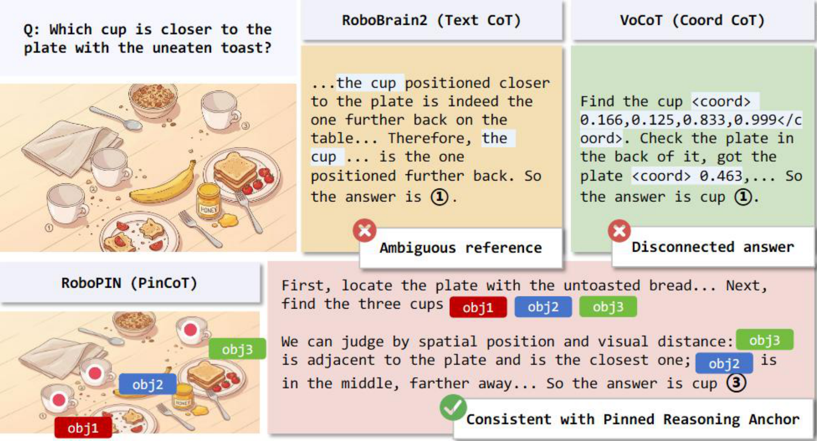
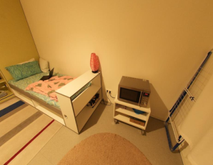
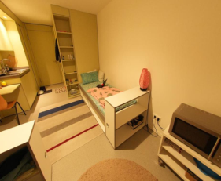
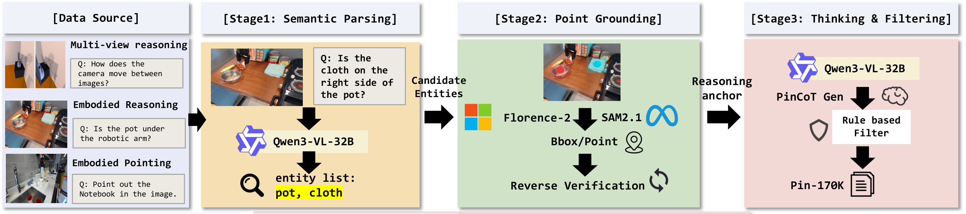
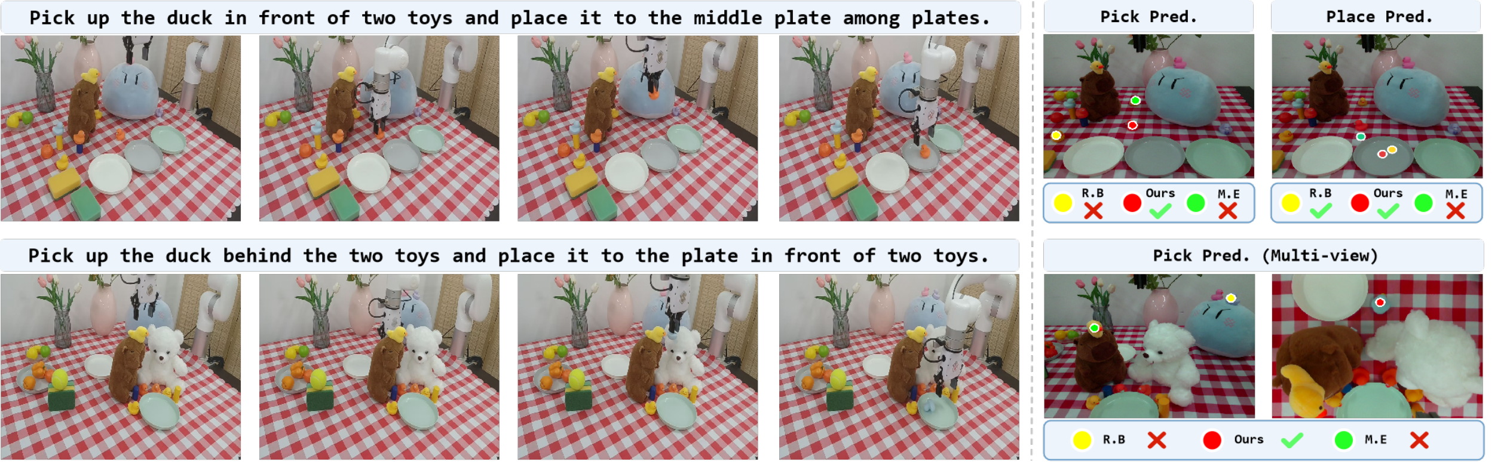
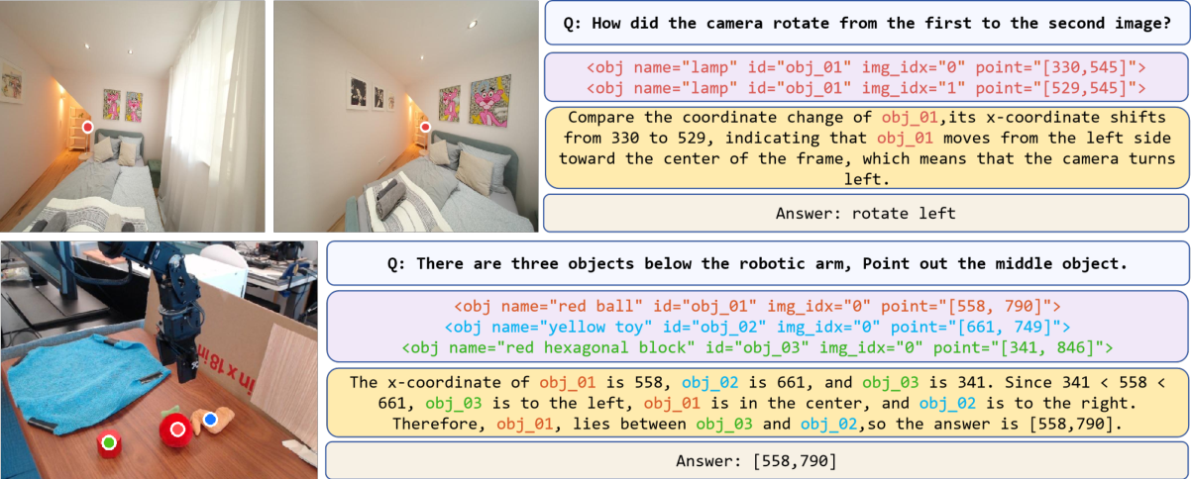
RoboPIN
Grounded Embodied Reasoning
via Pinned Chain-of-Thought
Yaoting Huang* · Yifu Yuan*† · Linqi Han · Chengwen Li · Shuoheng Zhang
Tianjin University
Xianze Yao · Hongyao Tang · Yan Zheng · Jianye Hao†
Tianjin University · ACM Multimedia 2026 · Rio de Janeiro, Brazil
quark404@tju.edu.cn · yuanyf@tju.edu.cn | * Equal contribution † Corresponding authors
Motivation
Key Insight: Persistent Identity
VIEW 0
VIEW 1
obj_01
obj_01
Same entity. Same ID. Different views.
Anchor = name + ID + view + point.
Keep identity stable across steps and viewpoints.
1
Reference drift
Our insight
Entity references can switch between similar objects across reasoning steps.
Persistent IDs connect visual evidence, intermediate steps
and the final answer.
QR
PLACEHOLDER
2
Reasoning–answer misalignment
The final answer can point to a different entity from the one analyzed.
PAPER / CODE
Our Method: RoboPIN / PinCoT
Three-stage
post-training
SFT
CoT-SFT
RFT / GRPO
Embodied knowledge
Structured reasoning
Process alignment
PIN-170K supplies grounded reasoning traces; progressive training couples visual evidence to the final answer.
Experimental Results
Qualitative Results
Embodied-R1 (3B)
RoboBrain2.0 (7B)
Mimo-Embodied (7B)
RoboPIN (4B)
100
Spatial
100
Pointing
100
Robot
55.1
58.7
68.0
65.6
62.1
67.9
75.0
50
52.4
50
51.8
50
Zero-shot xArm · successful executions / 20
30.0
16.7
20 / 20
14 / 20
11 / 20
0
0
0
n/a
Spatial
Multi-view
Long-horizon
Scores (%): spatial mean over 13 columns; pointing mean over 5 benchmarks; robot success over 60 trials.
Selected benchmarks · score (%)
Benchmark
Mimo-7B
RoboPIN
Δ pp
CrossPoint
36.8
72.2
+35.4
BLINK multi-view
26.3
72.9
+46.6
EmbSpatial
76.2
83.1
+6.9
18.8% → 99.9% cross-step ID coverage
Without RFT → RoboPIN · EmbSpatial
Persistent visual anchors make embodied reasoning traceable.
Notes:
A0 portrait 841 × 1189 mm. Module refinement variant: balanced. The clean variant reduces decorative load; balanced expands evidence and qualitative examples; mechanism adds source-published anchor coordinates and the four reward components. Scientific figures and text remain grounded in the paper. The external API-based PosterAgent generator was not run. Original Figure 1 comparison and Figure 2 pipeline are preserved. The qualitative panel adds the original Figure 4 reasoning examples. Three grouped bar charts reproduce paper Figure 1 and Tables 1–3: spatial mean over 13 capability columns, pointing mean over 5 benchmarks, robot successes over 60 trials. Missing robot baseline is n/a. Compact variants include three explicitly selected benchmark comparisons: CrossPoint, BLINK multi-view and EmbSpatial; these do not assert universal superiority. The robot trial-count caption conflict in the source paper still requires author confirmation. Logos are original official images; paper/code QR remains an intentional placeholder. Chart bars, values, axes, text and training nodes are editable; source figures are replaceable images.

