Slide 1


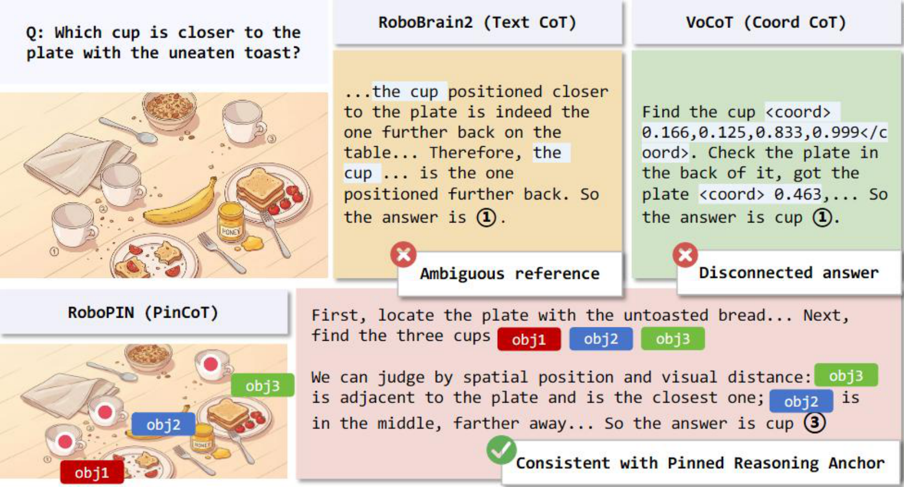
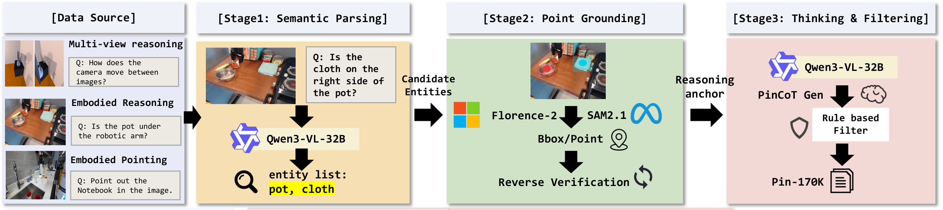
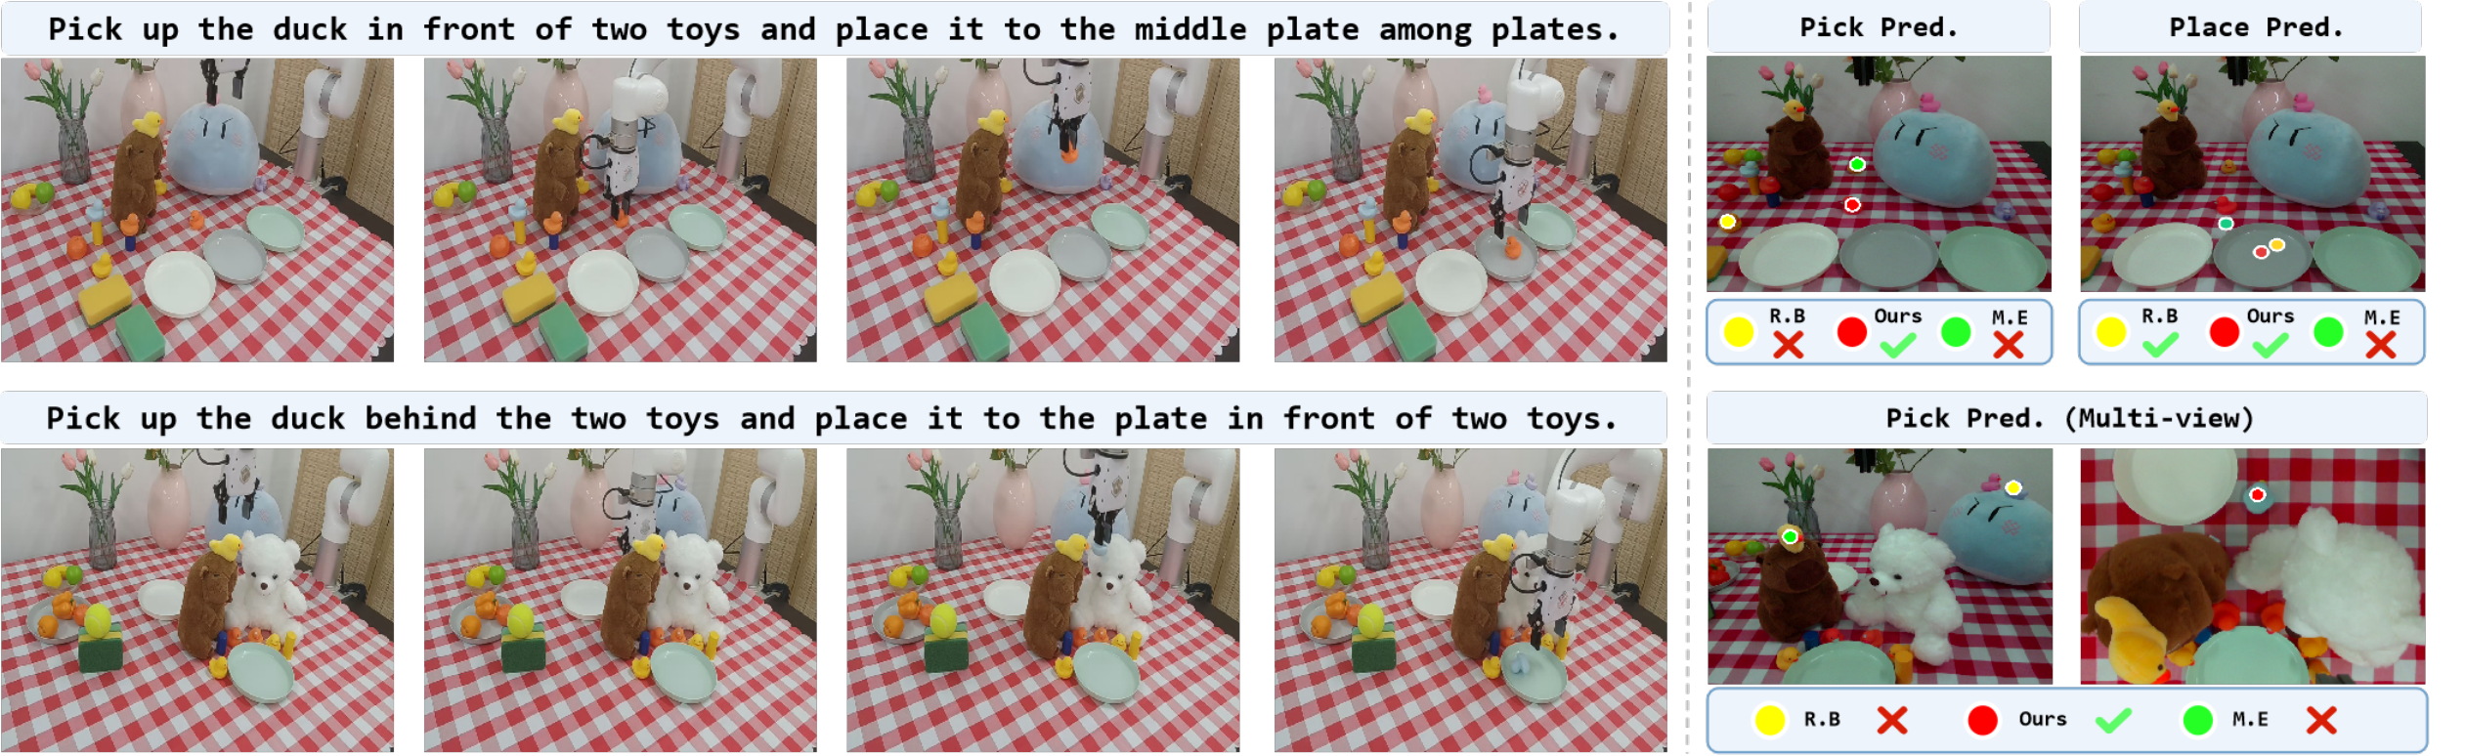
ACM MULTIMEDIA 2026 / EMBODIED REASONING
RoboPIN
Grounded Embodied Reasoning
via Pinned Chain-of-Thought
Yaoting Huang* · Yifu Yuan*† · Linqi Han · Chengwen Li · Shuoheng Zhang
Xianze Yao · Hongyao Tang · Yan Zheng · Jianye Hao†
Tianjin University · Rio de Janeiro, Brazil · 10–14 November 2026
01
Reason with a persistent visual anchor
THE CORE IDEA
One entity.
One persistent ID.
a = (name, id, view, point)
Introduce anchor
name · ID · view · point
Reuse identity
across steps and views
Visual evidence stays traceable.
02
How RoboPIN learns to stay grounded
Three-stage
post-training
SFT
CoT-SFT
RFT / GRPO
Embodied knowledge
Structured reasoning
Process alignment
03
Grounding improves embodied reasoning
Embodied-R1 (3B)
RoboBrain2.0 (7B)
Mimo-Embodied (7B)
RoboPIN (4B)
Spatial reasoning
Pointing
Real-world robots
100
13 capability columns · 9 benchmarks
100
5 benchmark mean
100
60 executions · 3 tasks
52.4
55.1
58.7
68.0
65.6
51.8
62.1
67.9
75.0
50
50
50
30.0
16.7
0
0
0
n/a
Scores (%) · Tables 1–3 / Figure 1. Spatial and pointing: arithmetic means. Robot: overall execution success.
04
Reliable execution and consistent entity tracking
Successful executions / 20 per task
PAPER / CODE
20 / 20
14 / 20
11 / 20
Spatial
Multi-view
Long-horizon
QR
PLACEHOLDER
18.8% → 99.9%
Zero-shot xArm execution · Figure 3
Cross-step ID coverage · w/o RFT → RoboPIN
quark404@tju.edu.cn · yuanyf@tju.edu.cn
* Equal contribution † Corresponding authors
Notes:
A0 portrait 841 × 1189 mm. Iterated using the upstream Paper2Poster lightweight skill and visual review. The external API-based PosterAgent generator was not run. The original Figure 1 comparison is the main visual; Figure 2 upper pipeline is preserved. Three grouped bar charts reproduce paper Figure 1 and Tables 1–3: spatial mean over 13 capability columns, pointing mean over 5 benchmarks, robot successes over 60 trials. Missing robot baseline is n/a. The detailed selected-benchmark table is retained in the source notes rather than repeated on this poster. The robot trial-count caption conflict in the source paper still requires author confirmation. Logos are original official images; paper/code QR remains an intentional placeholder. Chart bars, values, axes, text and training nodes are editable; source figures are replaceable images.

