Slide 1
Teaching AI Agents to Speak Quarkus
quarkus-agent-mcp
Phillip Kruger
Red Hat
Notes:
0:00. Skip the intro and go straight to the terminal. Paste Prompt 1 (demo-script.md) into Claude Code and press enter. Say: 'I'll come back to this in a few minutes. Let's see what it builds.'

Slide 2
Demo 1 · Build it
A Sydney ferry departures board, built live by Claude Code
Notes:
Show this while the prompt runs. Prompt 1:
Create a Quarkus app in ~/demo/ferries for a Sydney ferry departures board. A departure has a route (like F1 Manly), wharf, destination, departure time and trip duration. REST API to list departures, filter by wharf and route, and mark departures as favourites. Use PostgreSQL. Seed it with a timetable from Circular Quay wharves 2 to 6, with departures every 10 to 20 minutes from 6am to 10pm (make the times up). Add a simple web page that shows it as a departures board. Write tests and make sure they pass.

Slide 3
AI agents already write Quarkus. Mostly last year’s Quarkus.
Training data is a snapshot. Quarkus ships every month.
Notes:
2:00. Let this sit for a second. Agents learned Quarkus from old data and don't know they're out of date. Glance at the terminal.

Slide 4
Why agents get Quarkus wrong
What it knows
javax.*, RESTEasy Classic, old config keys
REST clients built by hand
Blog posts from Quarkus 1.x
What it can’t see
The running app and its test results
Dev Services, config, endpoints
The crash that just happened
Notes:
Left: knowledge. Use an example from rehearsal if you have one (javax.ws.rs imports, a REST client built by hand). Right: Dev MCP already exposes Dev UI to agents, but it runs inside the app, so it's gone at exactly the moment the agent needs it most: after a crash.

Slide 5
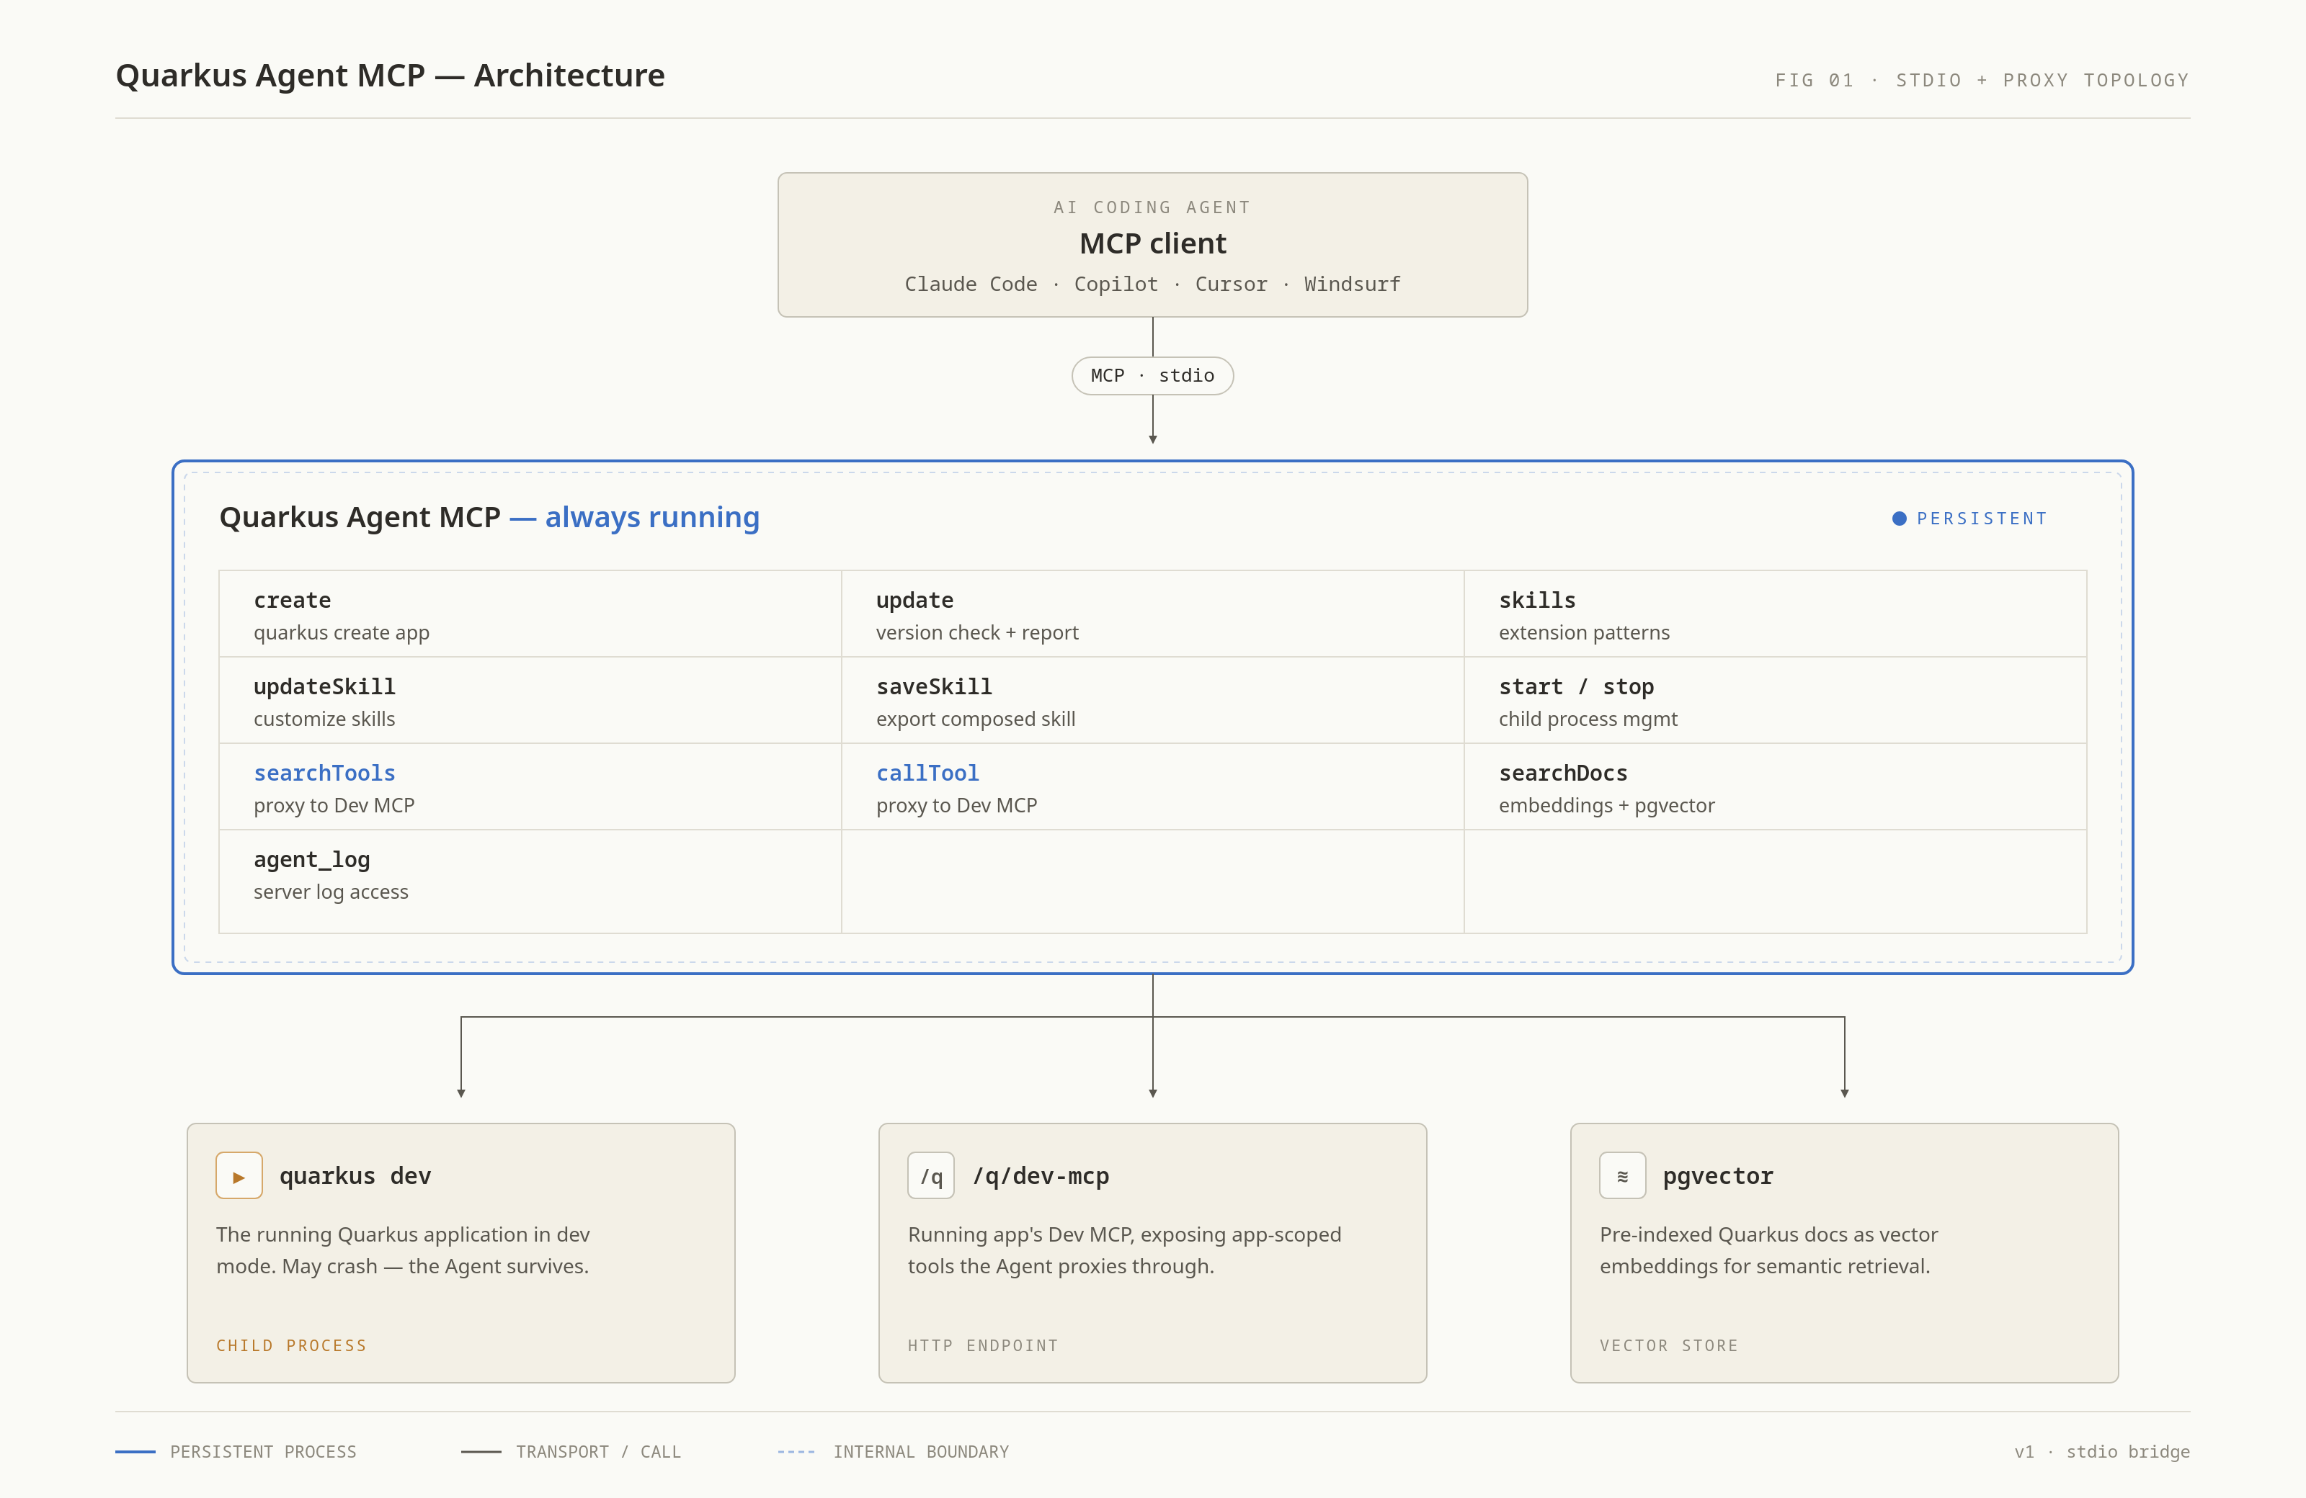
Quarkus Agent MCP
Separate from your app
It runs quarkus dev as a child process, so it stays up when the app crashes.
It proxies the app’s Dev MCP tools and adds skills and doc search.
Notes:
A standalone MCP server. Works in Claude Code, VS Code/Copilot, Cursor, Windsurf, JetBrains, IBM Bob and ACP agents.

Slide 6
What the agent gets
Create and run: quarkus_create, start, attach, browser
Skills: how to use each extension, from its authors
Docs: semantic search, matched to your Quarkus version
Your running app: tests, config, endpoints, exceptions
Upgrades: quarkus_update, with a dry run
Notes:
Don't read the list aloud. Pick one example from each line. The running-app tools come from Dev MCP (quarkus_searchTools / quarkus_callTool) and change as you add extensions. Glance at the terminal: it has probably called quarkus_create and quarkus_skills by now.

Slide 7
Skills before code
Each extension ships a skill: patterns, tests, pitfalls
  “Use @Transactional for writes with Panache”
Layered, and the most specific wins:
  extension JAR → bundled → ~/.quarkus/skills → .agent/skills
Every new project also gets an AGENTS.md
Notes:
This is the 'teaching' in the title. ~/.quarkus/skills (yours) and .agent/skills (your project's, commit it) are where you teach it your team's rules; that's Demo 3. ~9:00: go back to the terminal.

Slide 8
Back to the demo
What did it build, and how did it get there?
Notes:
Scroll the transcript and point at: quarkus_create (scaffold + auto start), AGENTS.md, quarkus_skills, quarkus_searchDocs, then tests via quarkus_callTool → devui-testing_runTests. Ask it to open the app and the Dev UI (quarkus_browser). Add a departure with curl and show it on the board. If it's stuck after 60 s, switch to the finished branch or the recording.

Slide 9
Demo 2 · Break it
The app crashes. The agent keeps going.
Notes:
17:00. Prompt 2: Add an endpoint that returns the next departure and the one after it from each wharf, from now or from an optional time parameter.
Apply your prepared bad edit (e.g. remove @Transactional or break an entity field). The app fails but the MCP server stays up. Point at devui-exceptions_getLastException: exception class, message and the line in your code. The agent fixes it and reruns the tests.

Slide 10
Demo 3 · Teach it
Your team’s rules, as a skill
Notes:
22:00. Prompt 3: Our team rule: REST errors must use RFC 7807 Problem Details, and resources return Java records, never entities. Remember this as a skill for quarkus-rest.
Show the quarkus_updateSkill call, then the next slide.
Start with an empty ~/.quarkus/skills!

Slide 11
A skill is just Markdown
# ~/.quarkus/skills/quarkus-rest/SKILL.md
---
name: quarkus-rest
description: Our team's REST conventions
mode: enhance
---
- Resources return Java records, never entities
- Errors use RFC 7807 Problem Details
Notes:
Illustrative: show the real file the agent just wrote. 'enhance' appends to the extension's own skill instead of replacing it.
Prompt 4: Add a POST endpoint to rate a departure from 1 to 5, rejecting invalid input. Point out records and Problem Details, without being told again. Then quarkus_saveSkill → .agent/skills/: 'commit this and your whole team's agent gets the rule'.

Slide 12
For extension authors
Ship META-INF/quarkus-skill.md in your deployment JAR
Write it by watching an agent use your extension
  Every time you had to help it, that's a line in the skill
Ship doc embeddings so quarkus_searchDocs finds your docs
Dev UI tools you add show up for agents automatically
Notes:
30:00. Works for core, Quarkiverse and your own internal extensions. docs/creating-extension-skills.md describes the loop: a Worker session (Opus) and a Tester session (Sonnet). Run a realistic prompt, note every intervention, turn them into the skill, and test again.

Slide 13
Fits how you already work
App already running in your terminal? quarkus_attach
Upgrading? quarkus_update with dryRun=true first
Claude Code, VS Code, Cursor, Windsurf, JetBrains, Bob, ACP
JVM via JBang, or a native binary for Linux and macOS
Notes:
Optional quick show: start a Quarkus app by hand in a second terminal and ask the agent to attach to it. Skip it if you're behind time.

Slide 14
Try it
# Claude Code
claude plugin marketplace add quarkusio/quarkus-agent-mcp
claude plugin install quarkus-agent@quarkus-tools
# Any other MCP client: run the server with JBang
jbang quarkus-agent-mcp@quarkusio
# github.com/quarkusio/quarkus-agent-mcp
Notes:
34:00. Part of the DevStar working group: github.com/quarkusio/quarkus/discussions/53093. Then go to the closing slide (QR code to the repo) and leave it up during Q&A.

Slide 15
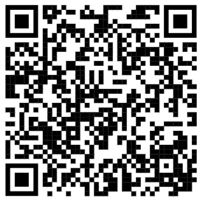
Thank you
Phillip Kruger
phillip.kruger@redhat.com
Notes:
36:00. Keep about 4 minutes for questions.

