Slide 1
Start
Latitude band
List storing mass of CO_2 condensed per m^2
Current and predicted temperature
False
There is non-zero CO_2 at this latitude
End
True
False
Temperature will increase (without CO_2 presence)
True
Find mass of CO_2 that freezes from temperature difference
Find mass of CO_2 that sublimes from temperature difference
Add mass of frozen CO_2 to latitudinal inventory
Mass of CO_2 that will sublime is less than surface CO_2 mass
Find heat required to sublime total mass of surface CO_2
False
Remove mass of frozen CO_2 from atmospheric inventory
Remove all mass of CO_2 from latitudinal inventory
True
Set latitudinal temperature to freezing point
Subtract used heat (to sublime CO_2) from total heat added to atmosphere
Remove sublimed mass of CO_2 from latitudinal inventory
Find temperature difference from remaining heat added to atmosphere
Add sublimed mass of CO_2 to atmospheric inventory
Set latitudinal temperature to freezing point

Slide 2
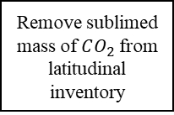
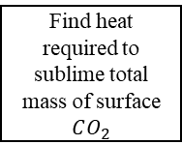
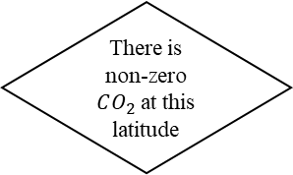
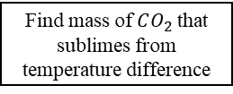
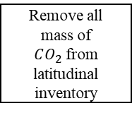
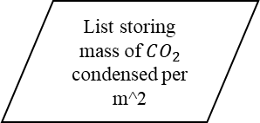
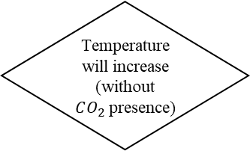
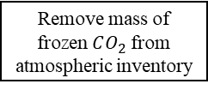
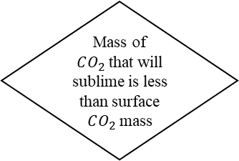
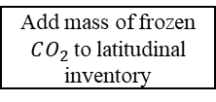
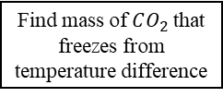
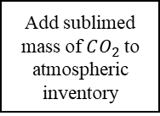
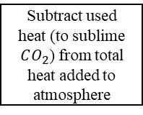
End
Find mass of $CO_{2}$that freezes from temperature difference
Add mass of frozen $CO_{2}$to latitudinal inventory
Remove mass of frozen $CO_{2}$from atmospheric inventory
Set latitudinal temperature to freezing point
Latitude band
False
False
End
There is non-zero $CO_{2}$at this latitude
Temperature will increase (without $CO_{2}$presence)
List storing mass of $CO_{2}$ condensed per m^2
Start
Current and predicted temperature
True
End
Find mass of $CO_{2}$that sublimes from temperature difference
Find heat required to sublime total mass of surface $CO_{2}$
Remove all mass of $CO_{2}$from latitudinal inventory
Subtract used heat (to sublime $CO_{2}$) from total heat added to atmosphere
Find temperature difference from remaining heat added to atmosphere
False
Mass of $CO_{2}$that will sublime is less than surface $CO_{2}$mass
Remove sublimed mass of $CO_{2}$from latitudinal inventory
Add sublimed mass of $CO_{2}$to atmospheric inventory
Set latitudinal temperature to freezing point
End
True

