Slide 1
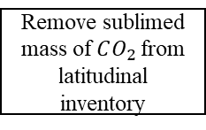
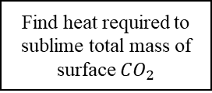
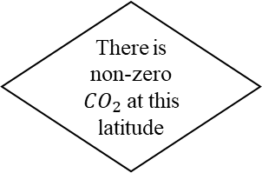
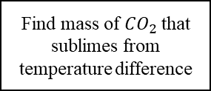
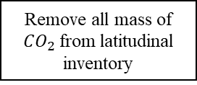
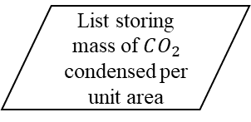
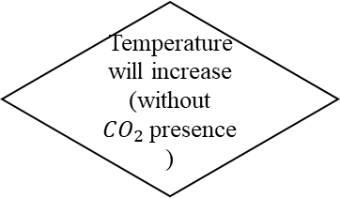
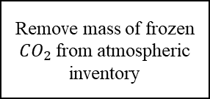
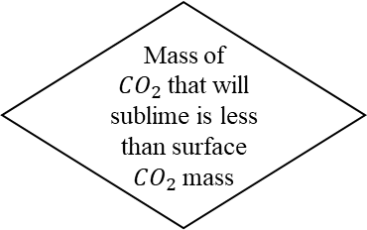
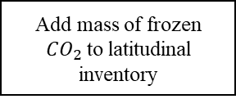
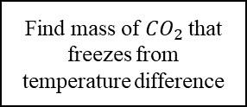
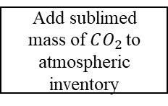
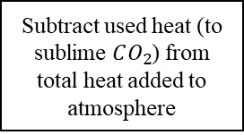
Start
Current and predicted temperature
List storing mass of $CO_{2}$ condensed per unit area
Latitude band
There is non-zero $CO_{2}$at this latitude
False
End
Temperature will increase (without $CO_{2}$presence)
Find mass of $CO_{2}$that sublimes from temperature difference
True
False
Find mass of $CO_{2}$that freezes from temperature difference
Mass of $CO_{2}$that will sublime is less than surface $CO_{2}$mass
Add mass of frozen $CO_{2}$to latitudinal inventory
False
Find heat required to sublime total mass of surface $CO_{2}$
True
Remove mass of frozen $CO_{2}$from atmospheric inventory
Remove sublimed mass of $CO_{2}$from latitudinal inventory
Remove all mass of $CO_{2}$from latitudinal inventory
Subtract used heat (to sublime $CO_{2}$) from total heat added to atmosphere
Set latitudinal temperature to freezing point
Add sublimed mass of $CO_{2}$to atmospheric inventory
Find temperature difference from remaining heat added to atmosphere
End
Set latitudinal temperature to freezing point
End
End

Slide 2
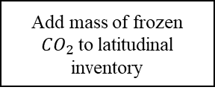
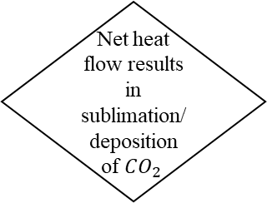
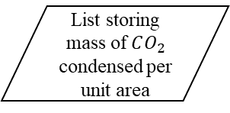
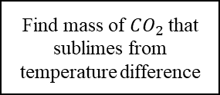
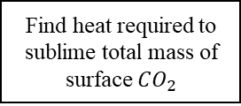
Start
Current and predicted temperature
List storing mass of $CO_{2}$ condensed per unit area
Latitude band
Net heat flow results in sublimation/deposition of $CO_{2}$
False
End
True
Find mass of $CO_{2}$that sublimes from temperature difference
True
There is positive net heat flow
True
There is non-zero $CO_{2}$at this latitude
False
Mass of $CO_{2}$that will sublime is less than surface $CO_{2}$mass
False
Find heat required to sublime total mass of surface $CO_{2}$
Find mass of $CO_{2}$that freezes from temperature difference
True
Remove all mass of $CO_{2}$from latitudinal inventory
Remove sublimed mass of $CO_{2}$from latitudinal inventory
Add mass of frozen $CO_{2}$to latitudinal inventory
Subtract used heat (to sublime $CO_{2}$) from total heat added to atmosphere
Add sublimed mass of $CO_{2}$to atmospheric inventory
Remove mass of frozen $CO_{2}$from atmospheric inventory
Set latitudinal temperature to freezing point
Find temperature difference from remaining heat added to atmosphere
Set latitudinal temperature to freezing point
End
End
End

Slide 3
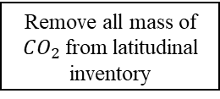
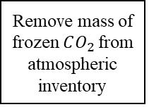

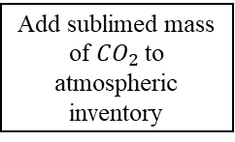
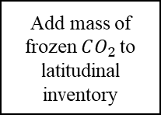
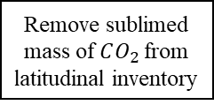
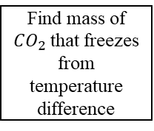
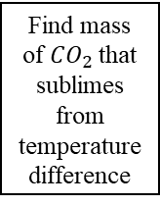
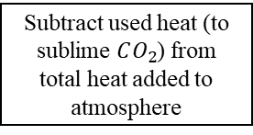
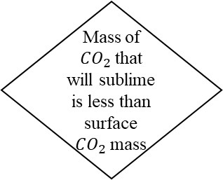
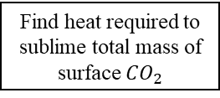
Start
Relevant parameters
Net heat flow results in sublimation/deposition of $CO_{2}$
False
End
True
Find mass of $CO_{2}$that sublimes from temperature difference
True
There is positive net heat flow
There is non-zero $CO_{2}$at this latitude
True
False
False
Mass of $CO_{2}$that will sublime is less than surface $CO_{2}$mass
True
False
Find mass of $CO_{2}$that freezes from temperature difference
Remove sublimed mass of $CO_{2}$from latitudinal inventory
Find heat required to sublime total mass of surface $CO_{2}$
Add mass of frozen $CO_{2}$to latitudinal inventory
Add sublimed mass of $CO_{2}$to atmospheric inventory
Remove all mass of $CO_{2}$from latitudinal inventory
Subtract used heat (to sublime $CO_{2}$) from total heat added to atmosphere
Remove mass of frozen $CO_{2}$from atmospheric inventory
Set latitudinal temperature to freezing point
End
Find temperature difference from remaining heat added to atmosphere
Set latitudinal temperature to freezing point
End
End

Slide 4

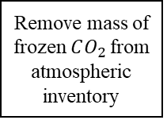
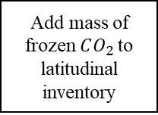
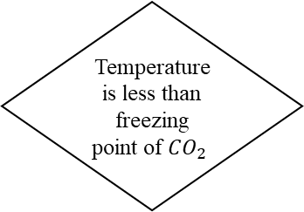
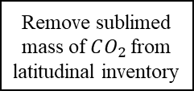
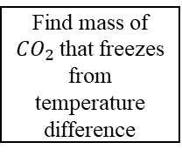
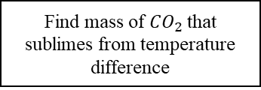

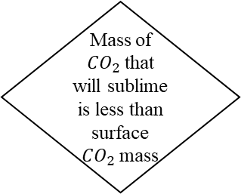
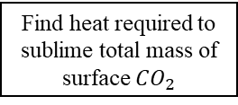
Start
Relevant parameters
Calculate temperature at next timestep
There is non-zero $CO_{2}$at this latitude
Temperature is less than freezing point of $CO_{2}$
False
False
True
Find mass of $CO_{2}$that freezes from temperature difference
End
True
Find mass of $CO_{2}$that sublimes from temperature difference
Add mass of frozen $CO_{2}$to latitudinal inventory
Mass of $CO_{2}$that will sublime is less than surface $CO_{2}$mass
True
False
Remove mass of frozen $CO_{2}$from atmospheric inventory
Find heat required to sublime total mass of surface $CO_{2}$
Remove sublimed mass of $CO_{2}$from latitudinal inventory
Set latitudinal temperature to freezing point
Remove all mass of $CO_{2}$from latitudinal inventory
Add sublimed mass of $CO_{2}$to atmospheric inventory
Return
Subtract used heat (to sublime $CO_{2}$) from total heat added to atmosphere
Set latitudinal temperature to freezing point
Find temperature difference from remaining heat added to atmosphere
Return
Return

