Slide 1
Crossref Test

Slide 2
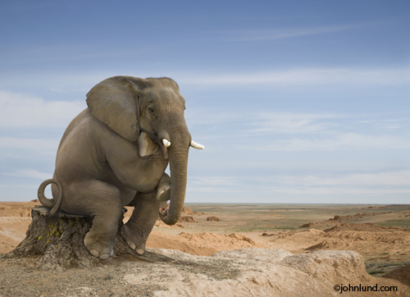
Simple Figure
Figure 1: Elephant

Slide 3
See Figure 1 for an illustration

Slide 4
Simple Crossref Table
See Table 1.

Slide 5
Math
Theorem 1 (Line) The equation of any straight line, called a linear equation, can be written as:
$$y=mx+b$$
See Theorem 1.

