Slide 1
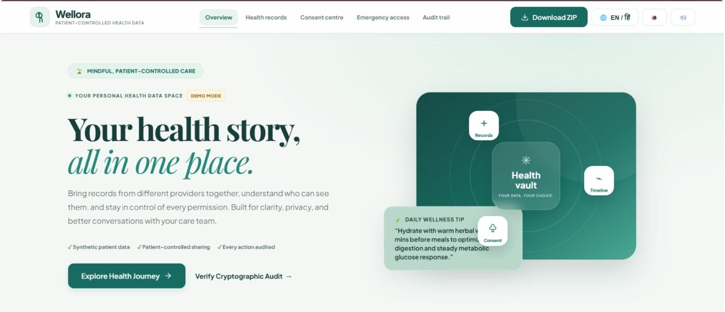
PATIENT-CONTROLLED HEALTH DATA
WELLORA
“Your health story,
all in one place.”
IMPACTX 2026 | Challenge 07
A Better Digital Health Journey
An existing interactive prototype, shown with synthetic data.

Slide 2
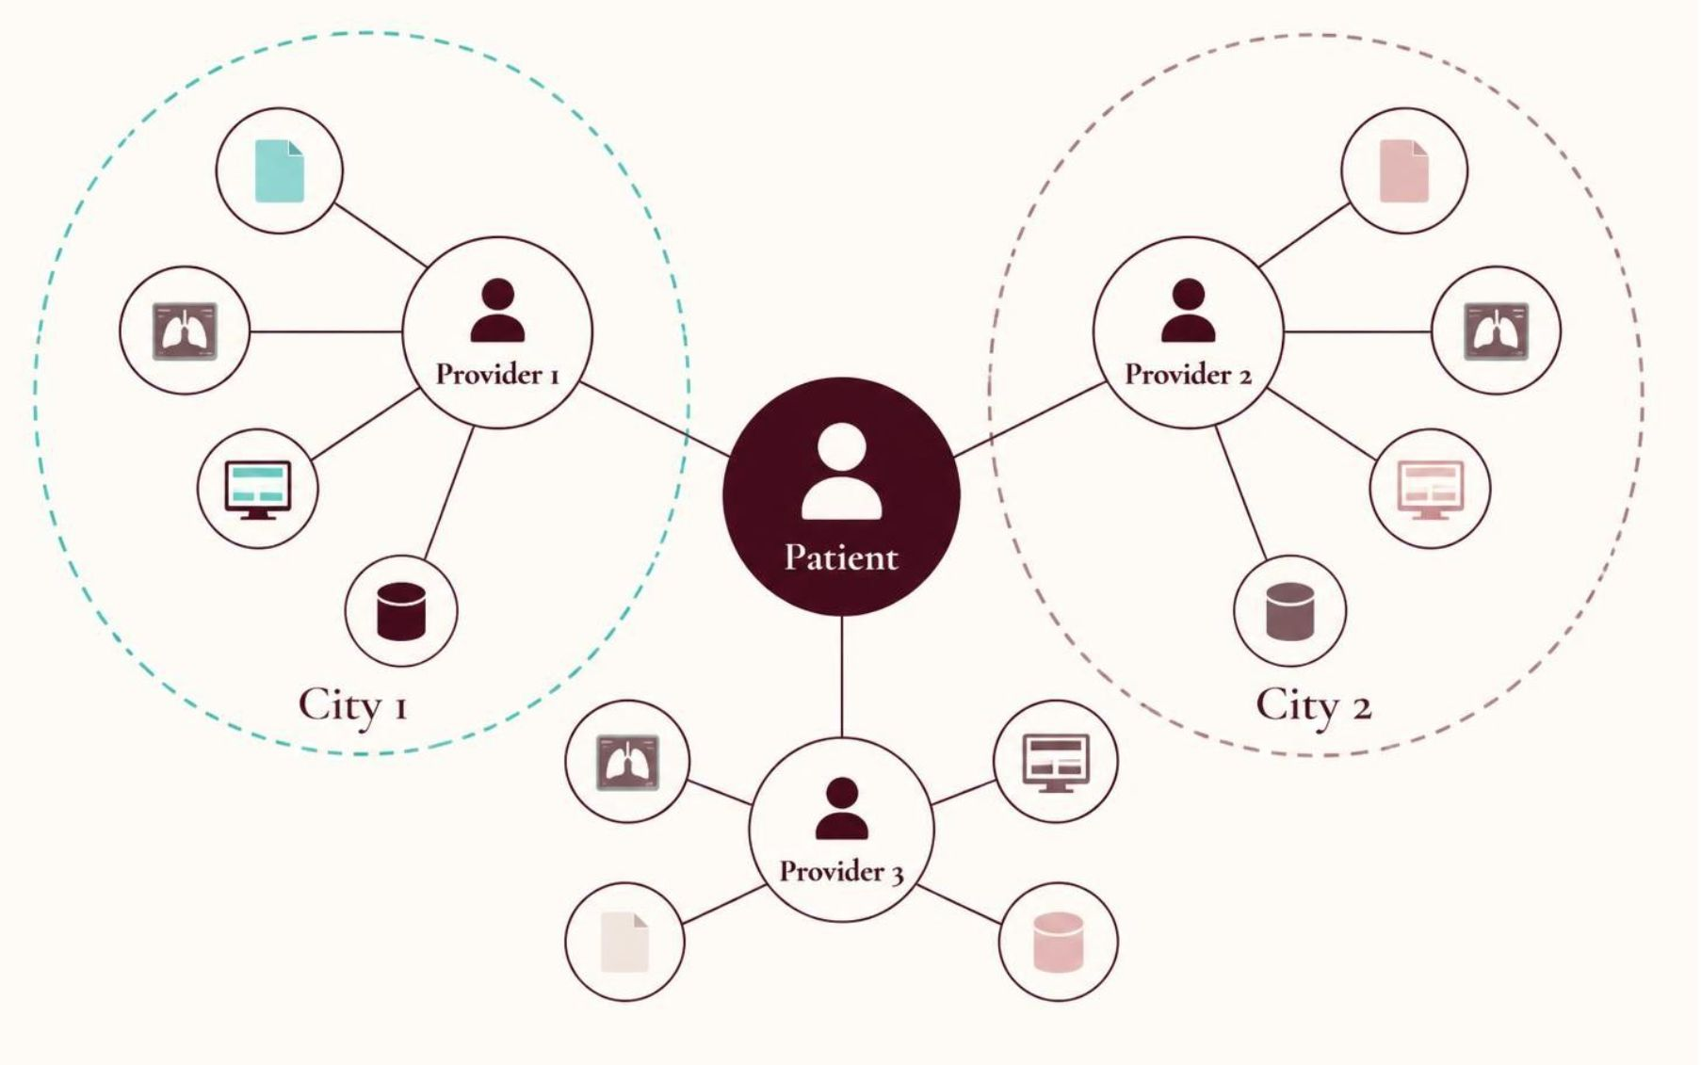
A fragmented patient journey
Records scattered across paper files, scans, portals and provider systems
Duplicates and conflicting dates blur the original
Handwritten prescriptions and imperfect OCR leave doses uncertain
Sharing can expose more than intended
Patients struggle to organize history; clinicians reconcile documents; sensitive data is shared without clear boundaries.

Slide 3
Storing documents is not the same as organizing a health history
Conceptual comparison, not a claim about every existing app.
Conventional storage
Wellora’s approach
Stores uploaded files
Dates and sources hard to compare
Little context on suspected duplicates
Access scope and duration unclear
Corrections and past shares uncertain
Preserves source and separate dates
Flags conflicts; links duplicates; keeps originals
Shows recipient, purpose, permissions and duration
Tracks access and supersession
Prepares clinician questions without diagnosing

Slide 4
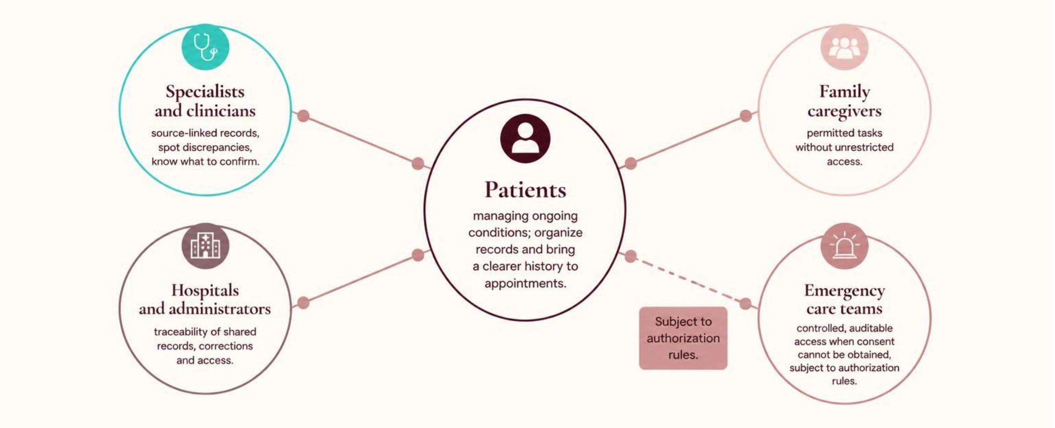
Who benefits, with the patient at the center
Wellora does not replace EHR systems or clinical judgment.

Slide 5
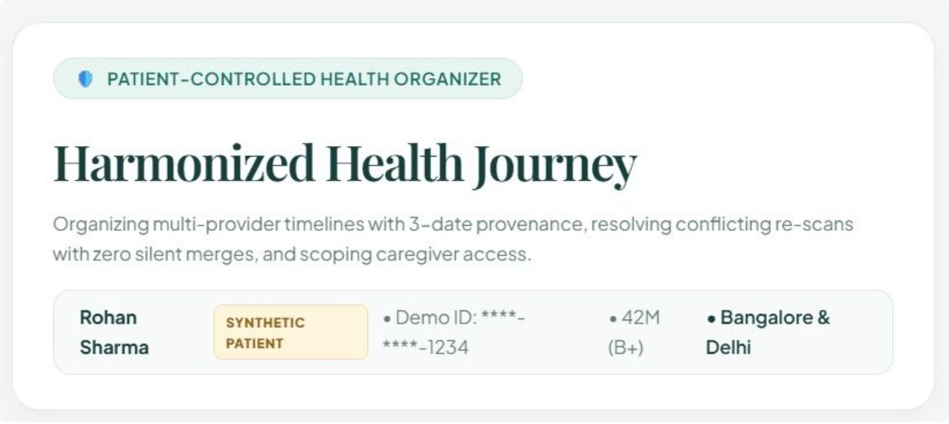
Meet Rohan: one health history, three providers
Synthetic patient. Demonstration records only, not real data. Providers in Delhi and Bengaluru.
1
Care from three providers
2
Two reports for one test show inconsistent report dates; one is a re-uploaded scan
3
A handwritten prescription has an uncertain dosage
4
A specialist requests selected records for seven days
5
An older relative helps as a limited-permission caregiver
6
Simulated emergency access for an unconscious patient
7
A provider corrects a previously shared report

Slide 6
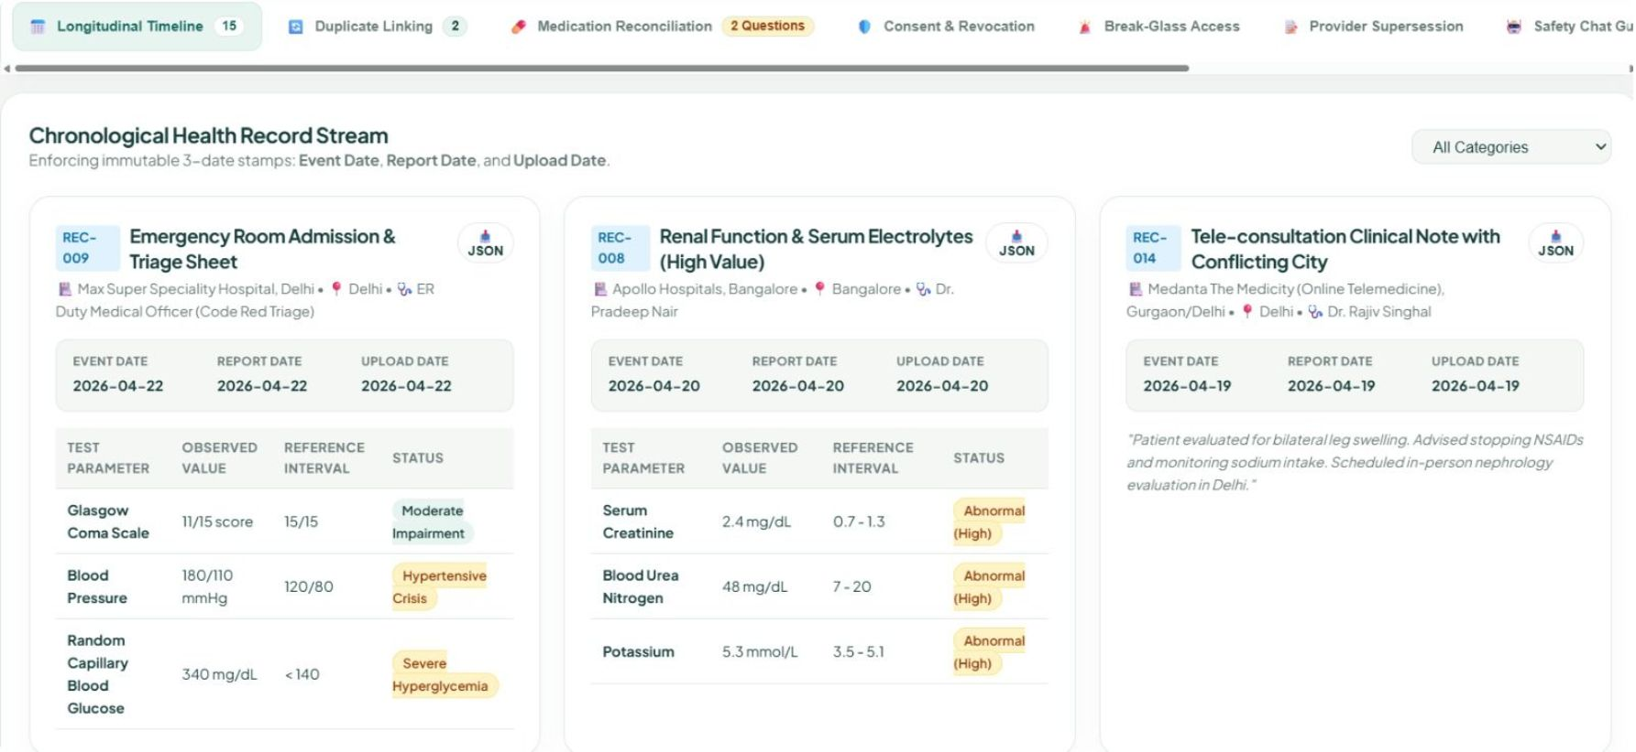
A clearer timeline without rewriting the medical history
Event date
When the medical event occurred
Report date
When the provider issued or recorded the report
Upload date
When the document entered Wellora
Provider, source and location shown where available. Conflicts stay visible until reviewed; originals remain accessible.
A re-uploaded scan never silently changes the historical event date.

Slide 7
Wellora identifies uncertainty; it does not invent certainty
Synthetic lab report
Similar synthetic lab report
Test names · report identifiers
Dates · text
Similarity evidence shown
Conflicting fields identified
01
02
03
04
05
Detect
Compare
Flag
Review
Preserve
Possible duplicate or near-duplicate
Show similarity evidence
Identify conflicting fields
Reviewer chooses “Keep both and link”
Originals and provenance
Uncertain prescription OCR stays marked uncertain. The patient gets a clinician question, never a guessed dose.

Slide 8
Consent that is understandable, specific, time-limited and revocable
CONSENT RECEIPT
Reviewable access history
Seven days
Revoking stops future access through Wellora.
Copies already retained
“Selected laboratory reports shared with Dr. Mehta for a medical consultation until the stated expiry date.”
Revocation cannot guarantee deletion of copies already downloaded or retained.
Sensitive categories
Excluded from shared views and notifications by default unless explicitly authorized.
Patient sets records, recipient, purpose and duration; sees whether access expired or was revoked.

Slide 9
Care when needed, accountability at every step
Caregivers see only explicitly permitted records or tasks. Patients see their actions; sensitive categories require extra confirmation. No automatic full history.
1
Authorized emergency user authenticates
2
Supplies a reason; requests predefined scope
3
Authorization rules decide
4
Time-limited, audit-logged access
5
Patient notified afterward when possible
Emergency access is not unrestricted. Simulated in the prototype; no production hospital integration.

Slide 10
Organize the information. Preserve the evidence. Empower the patient. Leave diagnosis to the clinician.
WELLORA: Your health story, all in one place.

