Slide 1
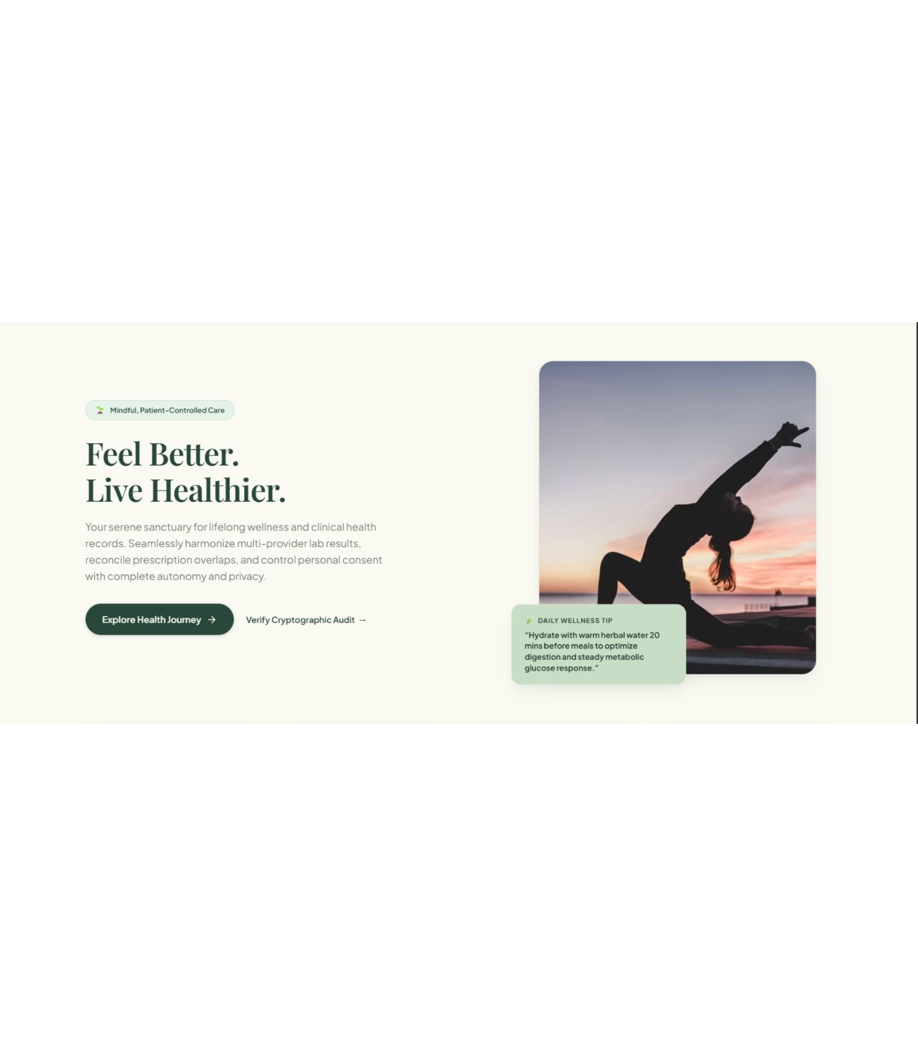
IMPACTX 2026 | Challenge 07
A Better Digital Health Journey
Patient-Controlled, Consent-Aware Medical Record Organizer
ABDM / ABHA Ecosystem

Slide 2

The burden today
Health records are scattered, and patients carry the burden
Hospitals
Laboratories
Paper documents
↓
One fragmented patient record
Across cities: duplicate reports, conflicting dates, uncertain prescription text and fragmented histories.
Consent and sharing permissions are hard for patients to understand.

Slide 3
Synthetic patient journey
One patient, three providers, two cities
01
02
03
Conflicting reports
Uncertain dosage
Time-bound sharing
Two reports for the same test show different dates; one is a re-uploaded scan.
A handwritten prescription has an uncertain OCR dosage.
Records shared with a specialist for seven days, then revoked.
04
05
06
Caregiver permissions
Emergency request
Provider correction
An older relative holds limited caregiver permissions.
A hospital requests emergency access while the patient is unconscious.
A provider later corrects an already shared report.

Slide 4

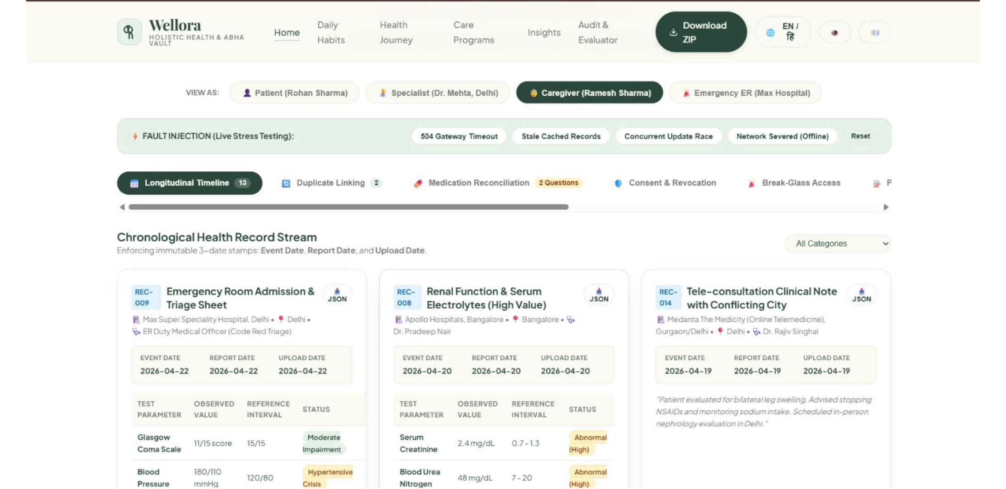




The organizer
A patient-controlled organizer with one longitudinal timeline
Original records and their sources stay intact.
Patient control
Transparent provenance
Explainable conflict detection
Explicit consent
Prototype dashboard · Synthetic data
Non-diagnostic assistance

Slide 5
Synthetic comparison · Original evidence preserved
Provenance-aware timeline flags conflicts, never resolves them
Separate dates. Visible sources.
Duplicates and medication differences become questions, not merges
Every item names its provider and original source. Separate event date, report date and upload date.
Document hashes, text similarity and image similarity catch exact and near-duplicates, including re-scans. Reasons for a suspected match are displayed.
Lab reports | Original | Re-scan
Provider / source | Shown | Shown
Event date | Both shown and flagged
Report / upload dates | Separate | Separate
Keep both and link
User chooses; nothing is silently merged or deleted.
Medication discrepancy
Prescription differences are flagged as questions for a clinician, with no medication advice.
Date conflict
Original stays retrievable.

Slide 6
Consent · Synthetic example
Consent that is granular, readable and revocable
Plain-language consent receipt
01
02
Permission | Selected scope
Record / category | Selected records
Recipient | Specialist
Purpose | Explicitly scoped
Time window | Seven days
Seven-day access
Revoked
Selected records shared with a specialist.
Future access through the app is blocked.
Revocation cannot guarantee deletion of copies already retained.
Patient-visible access log
Sensitive categories are excluded from shared views and notifications by default.

Slide 7
Accountable access · Synthetic workflows
Caregiver and emergency access with full accountability
Caregiver permissions
Simulated break-glass
Scoped caregiver delegation; caregiver actions visible to the patient. Extra confirmation for sensitive records.
Authenticated user → predefined authorization → restricted records → time limit → stated reason.
Comprehensive audit log and follow-up patient notification.
Corrections keep history; notifications keep secrets
01
02
Neutral lock-screen text
Superseded
Corrected report
“Your health records have an update. Open the app to review it.”
Older version marked; history retained.
Affected authorized recipients notified.

Slide 8
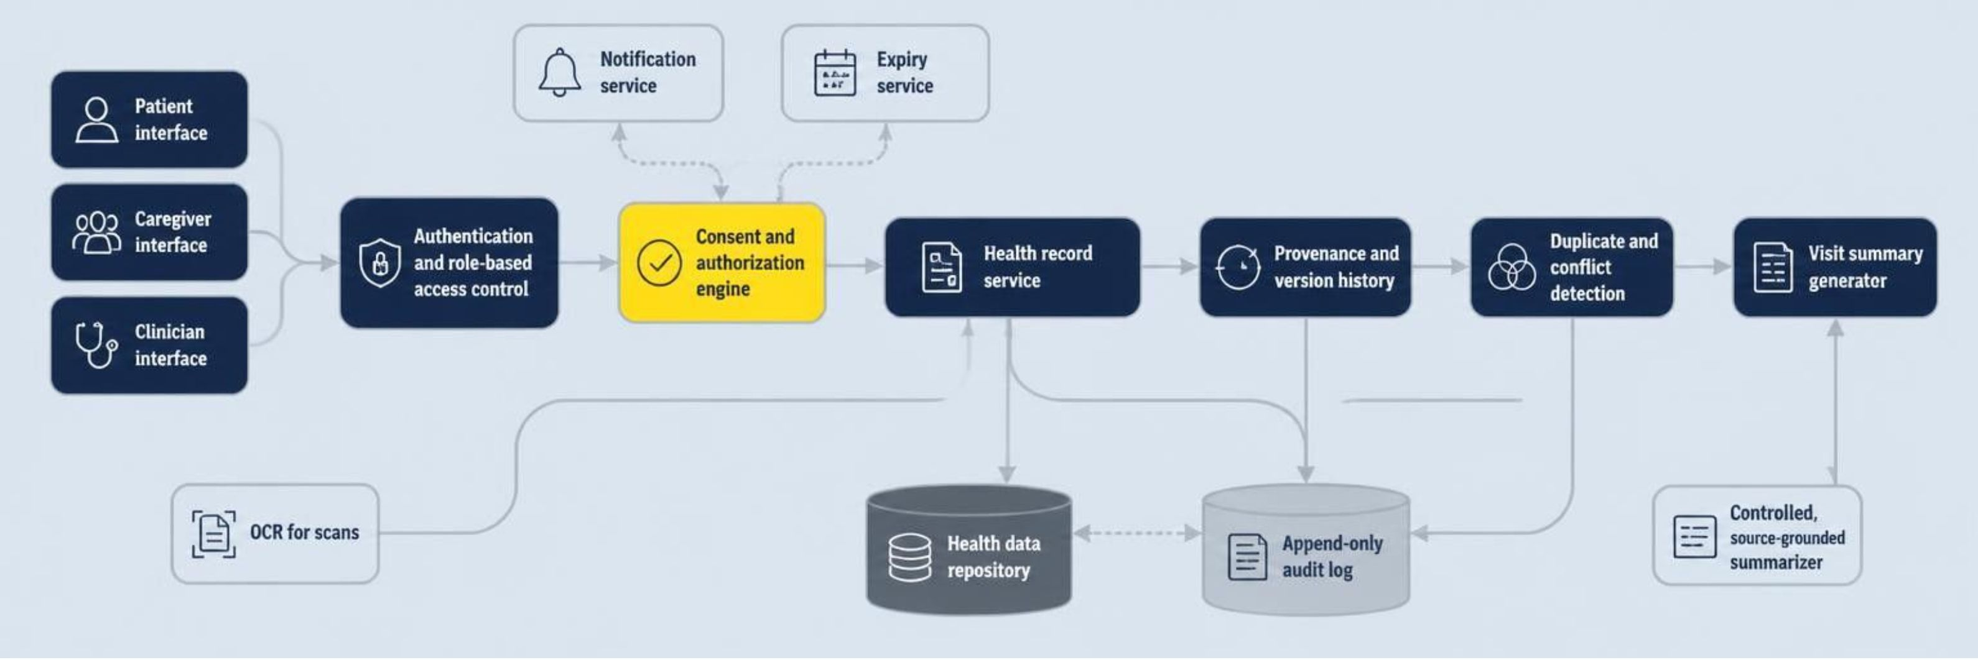
Working prototype · Synthetic records only
A feasible architecture for a working prototype
Prototype stack
Integration boundary
React · Python FastAPI · PostgreSQL or SQLite · Tesseract OCR · hashing and text similarity · secure authentication
ABDM/ABHA integration is future work.

Slide 9
Safety boundaries and evaluation
Safe by design: not a diagnostic tool
Assistance stays source-grounded
Success targets
To be measured during testing. No results claimed.
“Do I have X?”
Duplicate detection precision and recall on a seeded test set
Zero silent merges; all originals retrievable
Revocation tests: later access blocked, attempts logged
Consent comprehension: share of non-technical users correctly identifying what, with whom, until when
Declines and prepares clinician questions, cited to source records.
Abnormal flags
Shown exactly as the source states them.
Uncertain OCR text
Marked uncertain, never guessed.

Slide 10

Expected impact
Expected impact
Longitudinal records
Visible evidence
Better-organized longitudinal records.
Transparent provenance and fewer unnoticed conflicts.
Accountable access
Prepared consultations
Understandable consent and accountable access.
Safer caregiver workflows and better-prepared consultations.
“Organize the information. Preserve the evidence. Empower the patient. Leave diagnosis to the clinician.”

