Slide 1
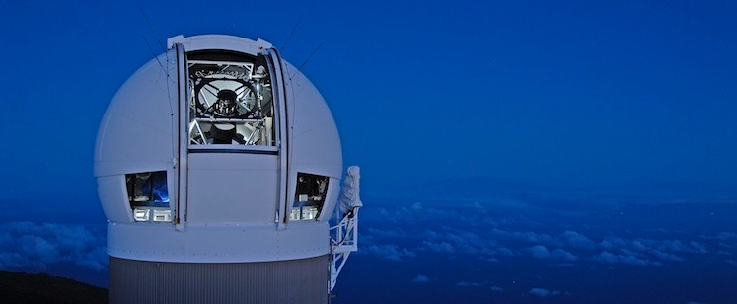
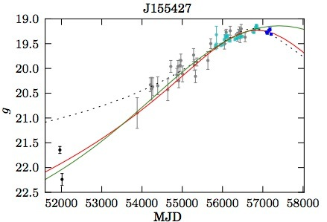
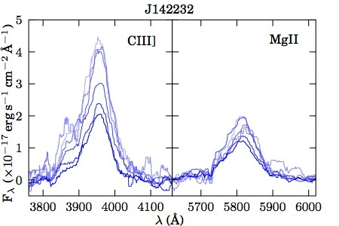
A.Stronomer
Application of cabalistic techniques to AGN hypervariables
1/3
We did a huge survey
with our favourite telescope. It was about a squillion times bigger than anything before, although only a tad deeper than Brand X. We were able to compare to the earlier survey in 2012 and find things wot changed a lot.
PS1
CRTS
SDSS
We followed up 37 of these objects with WHT spectra and found some lines changed and some didn’t. La Palma is even nicer than Hawaii.
We found a whole bunch of things that changed a lot, and quite smoothly. This one is our favourite, which we will pretend is typical. We tried fitting Whifftofski’s model and a couple of others, but nothing really fits.
The differential line variability has very important implications, which we modelled on a 56-core machine using magic and extreme optimism.
The main conclusions are:
There is a bunch of weird stuff going on
The accretion disc is seven times smaller than you thought
The BLR is made entirely of Germanium
Quasars in crisis Edinburgh August 2019

Slide 2
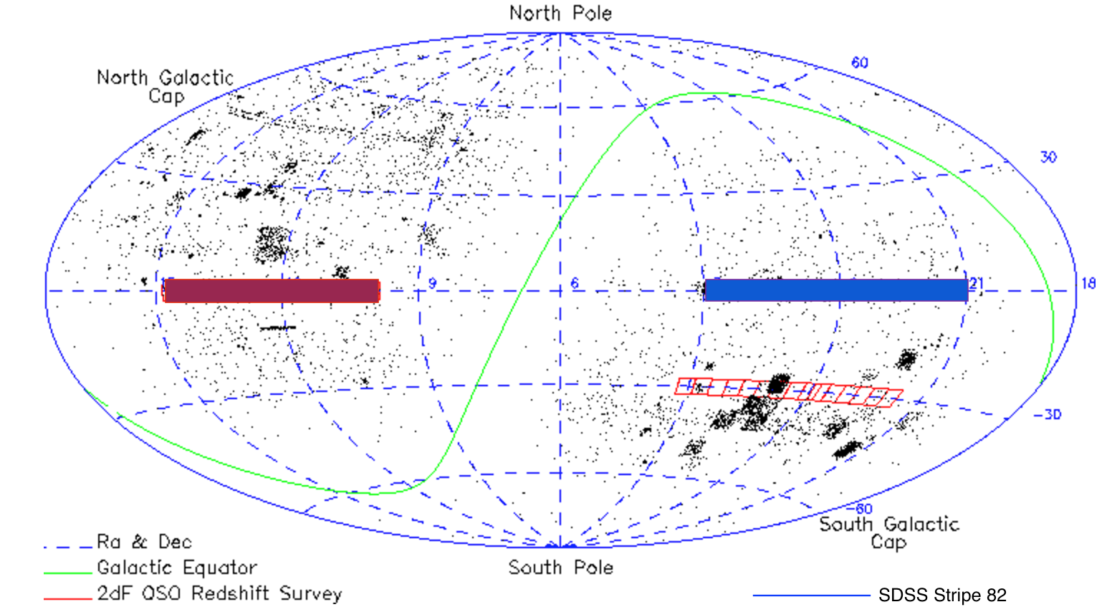
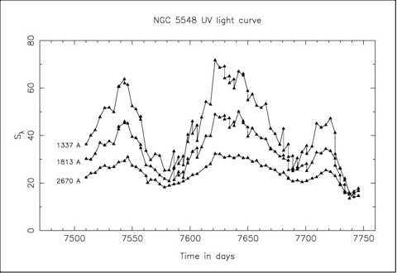

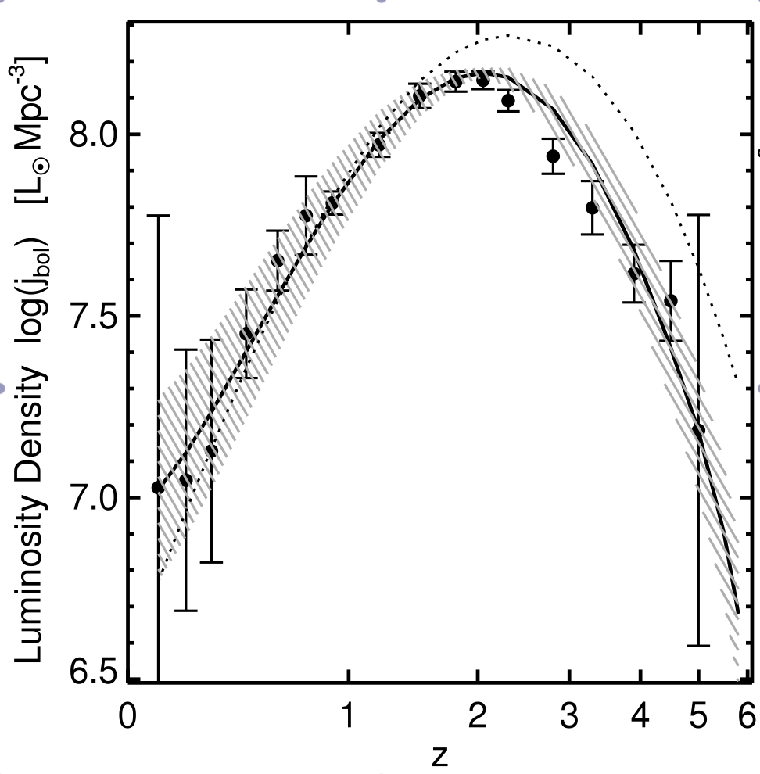
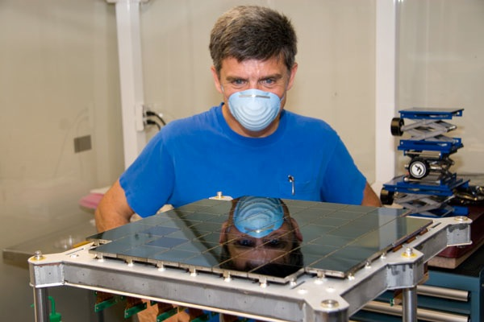
A.Stronomer
Application of cabalistic techniques to AGN hypervariables
2/3
More detail part-I
Blah de blah de blah and rhubarb and more rhubarb and some custard as well.Blah de blah de blah and rhubarb and more rhubarb and some custard as well.
obviously
seven
Blah de blah de blah and rhubarb and more rhubarb and some custard as well.Blah de blah de blah and rhubarb and more rhubarb and some custard as well.
whereas
twelve
Blah de blah de blah and rhubarb and more rhubarb and some custard as well.Blah de blah de blah and rhubarb and more rhubarb and some custard as well.
our fearless leader
Quasars in crisis Edinburgh August 2019

Slide 3
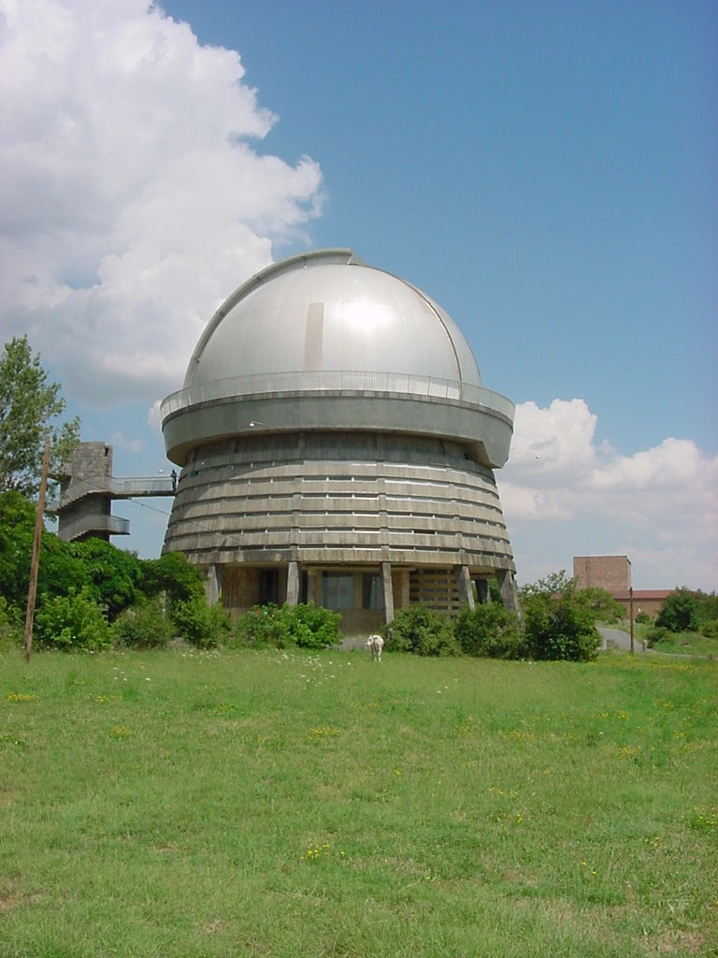

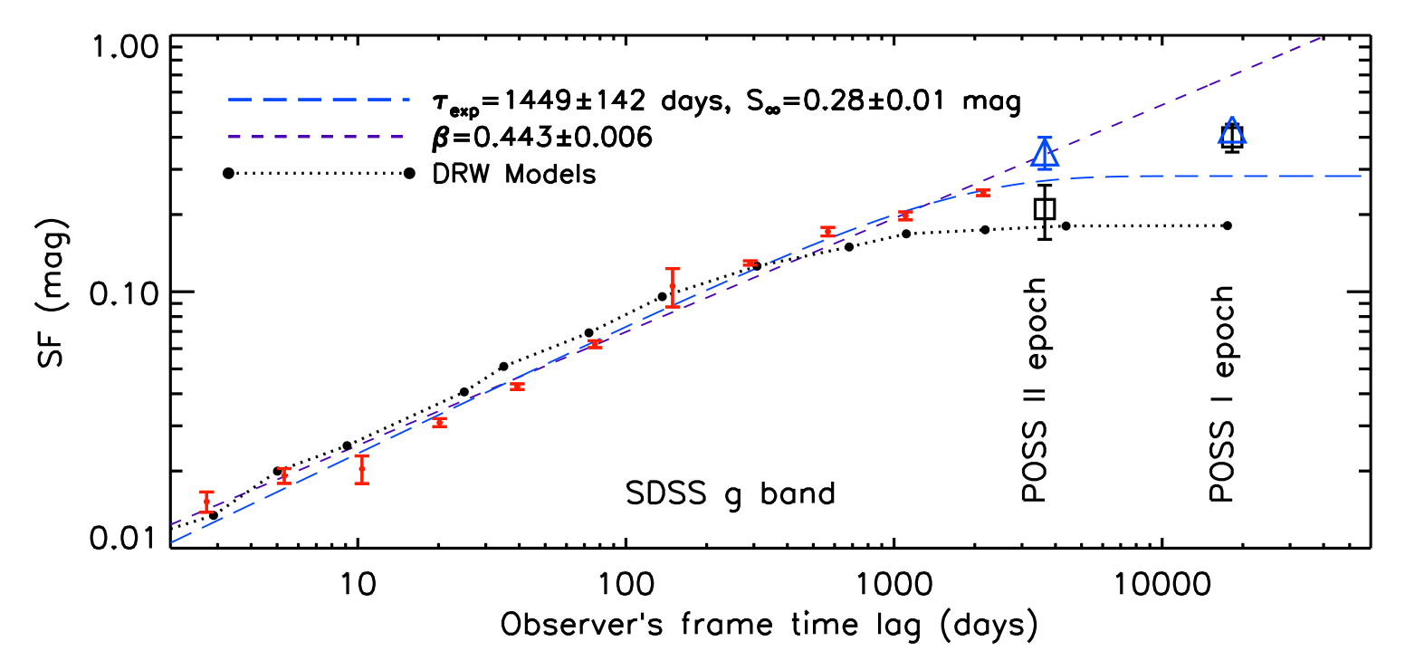
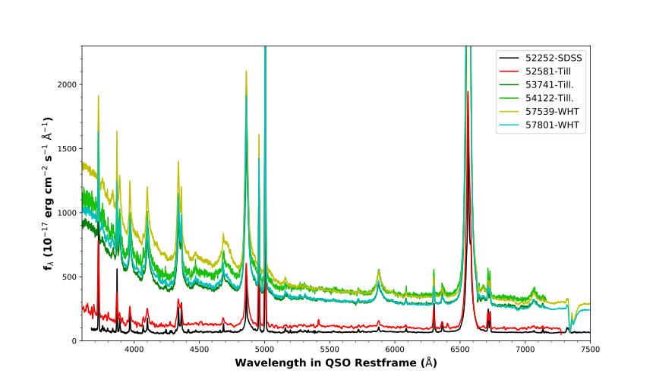
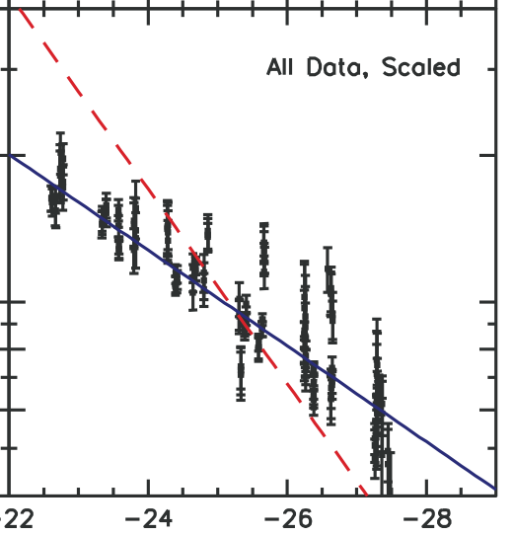
A.Stronomer
Application of cabalistic techniques to AGN hypervariables
3/3
More detail part-II
which has never been pointed out before
As was already demonstrated by MacLeod 2012
Blah de blah de blah and rhubarb and more rhubarb and some custard as well.Blah de blah de blah and rhubarb and more rhubarb and some custard as well.
Blah de blah de blah and rhubarb and more rhubarb and some custard as well.Blah de blah de blah and rhubarb and more rhubarb and some custard as well.
Which may seem puzzling, but we carefully considered all the systematic effects, and did a blind test on various grad students, who we paid in pizza.
Quasars in crisis Edinburgh August 2019

