Slide 1

Does demographical factors (age, gender, health score, test preparedness, and family relationship) effect overall test scores?
DSC 530
Bellevue University
Professor: Neerja Sahu
Qua Tran

Slide 2

Dataset & Variables
To analyze the following dataset the below variables were chosen;
Age
Gender (M/F and/or 0/1)
Health Score (0 – 5)
Absences (0 – 93)
Study Time (0 – 5)
G1, G2, G3 = Test Scores (Sum)
Source: https://www.kaggle.com/ramontanoeiro/student-performance

Slide 3

Dataset & Variables Part II
The main variable component that will be utilize for correlation is age and how it relates to test scores.
These six variables were chosen from the data set to analyze if there are any correlation between them with student test scores. The following variables are categorical; Gender, Study Time, Health Score while the following care continuous; Age, Absences, and Test Scores.
The next few slides will be histogram charts of all the variables. I decided that the end goal would be to keep all the outliers and not omit them in the dataset. The purpose of this is that we do want to measure if age plays a factor in lower test scores so if we omit that ones with low score, it will heavily influence the result.

Slide 4
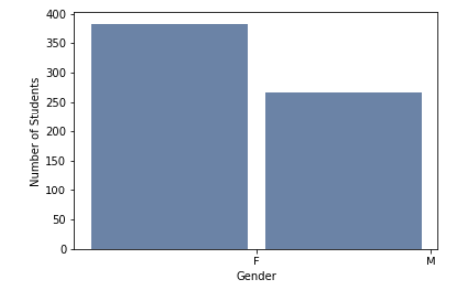
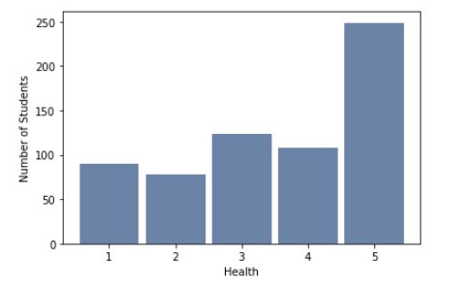
Gender and Student Count
Health Score and Student Count
Total: 649 Students. No outliers, spread amongst student seems normalization. Predictable that more students are rated a 5 for good health.

Slide 5
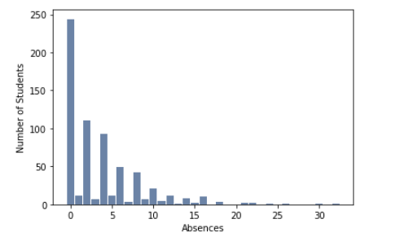
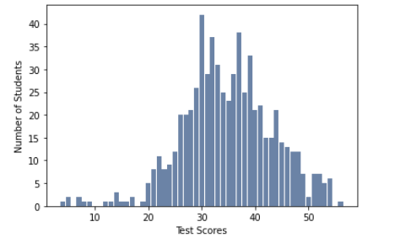
Absences and Student Count
Total Test Scores and Student Count
There are outliers throughout this dataset. For absences and student count, there are <10 students who has over 20 absences. For total test scores, it seems roughly a normal distribution with the bell curve being around ~low 30s which is technically half of the highest score.

Slide 6
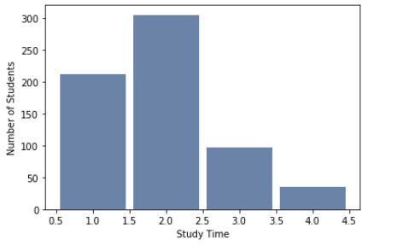
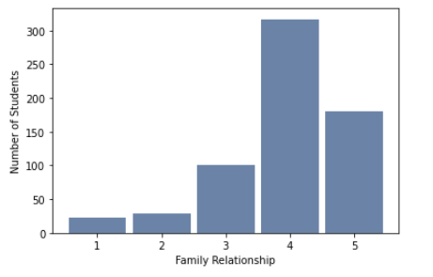
Study Time and Student Count
Family Relationship and Student Count
Variation of data set seems normal without any outliers

Slide 7
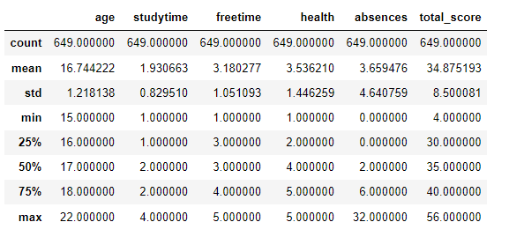
Count, Mean, STD, MIN, Percentile, MAX

Slide 8
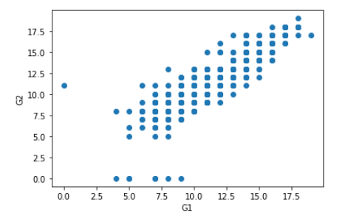
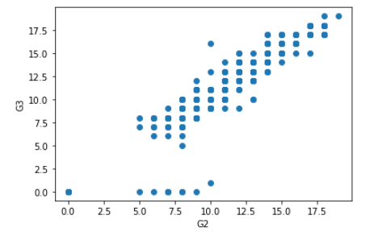
G1 Grades Vs G2 Grades
G2 Grades Vs G3 Grades

Slide 9
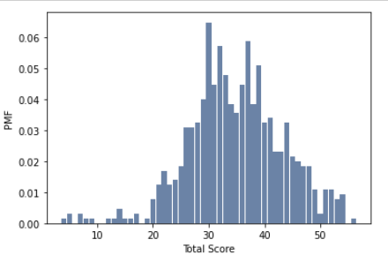
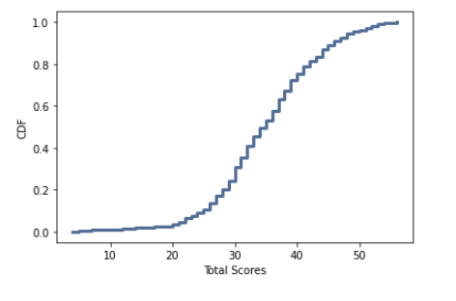
Test Score PMF
Test Score CDF

Slide 10
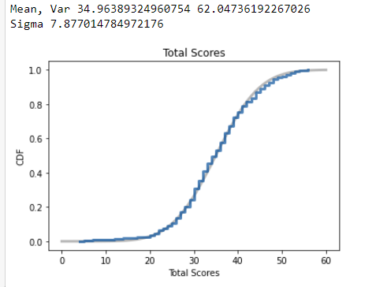
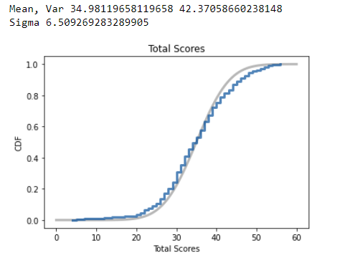
Distribution at p= 0.01
Distribution at p= 0.05

Slide 11
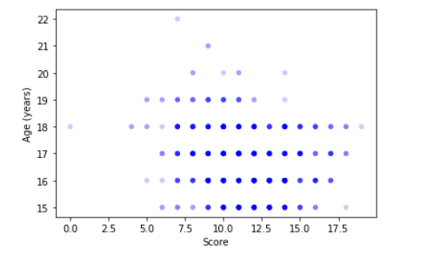
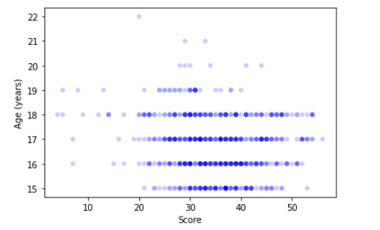
G1 Grades Vs. Age
Total Score Vs. Age
With ages ranging from 16 to 22, the darkening scatters on both sides reflects and correlates to the PMF and CDF. Students tends to score roughly high 30s (half of max score of 60) through the 3 tests (G1, G2 and G3)

Slide 12
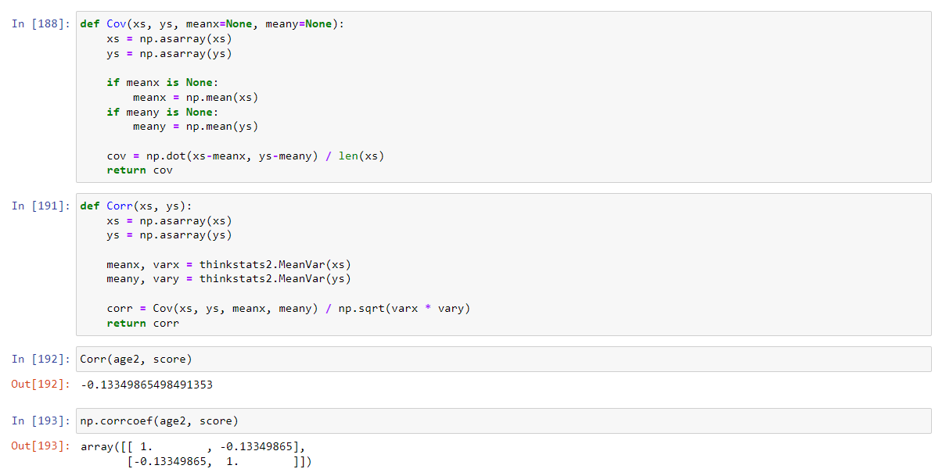
Covariance and Correlation

Slide 13
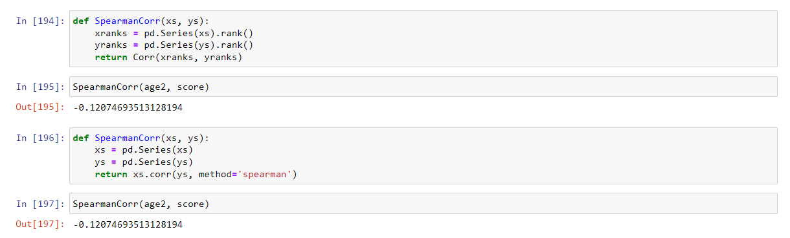
Spearman Correlation
Negative spearman corr value indicates that when one variable increases, the other tends to decrease. As age increases, total score decreases which has been shown in our previous graphs.

Slide 14
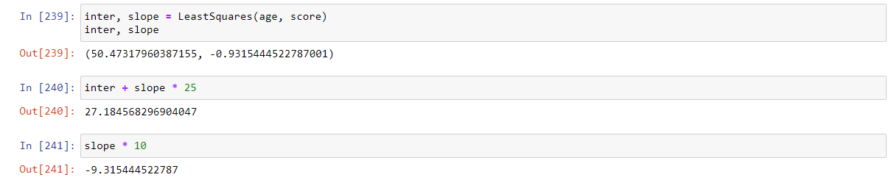
Inter and Slope

Slide 15
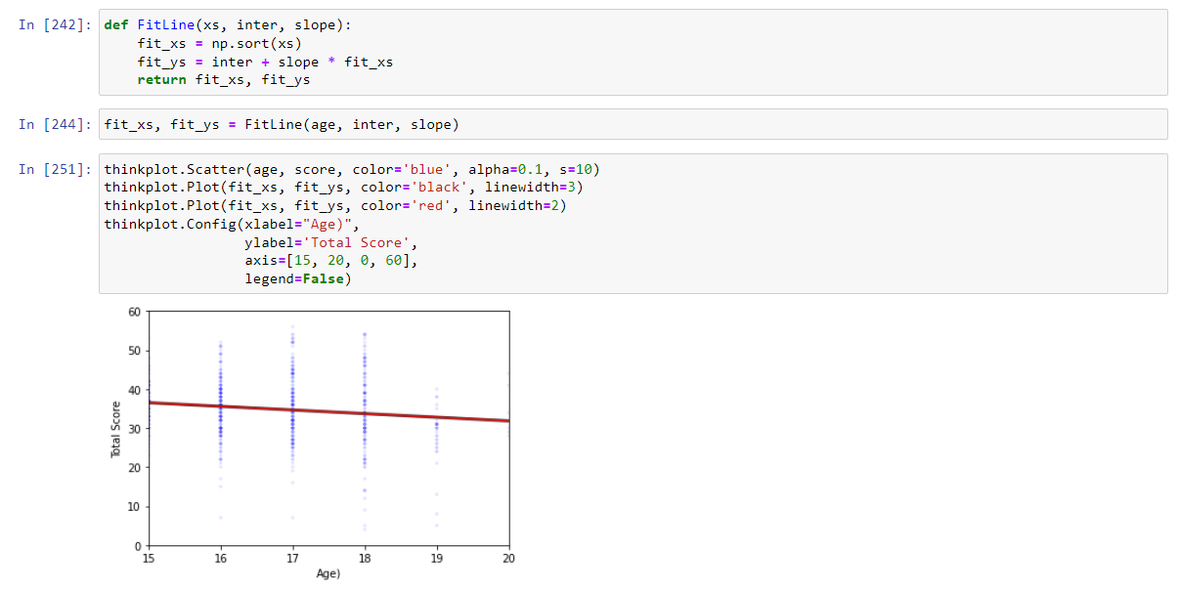
Best Fit Line

Slide 16
The End Thank You

