Slide 1
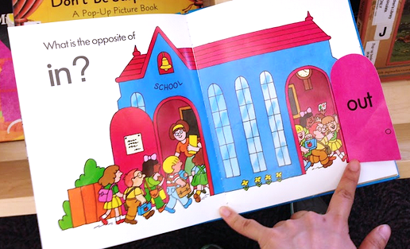

Slide 2
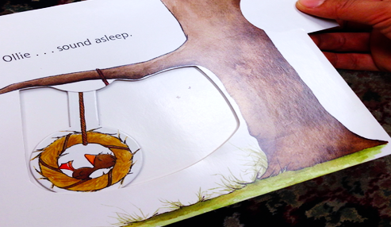

Slide 3
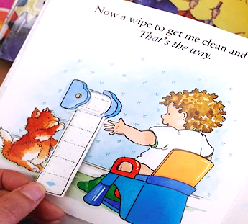

Slide 4






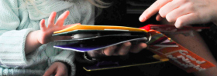
Two Pictures of Children Book
3D Warehouse
Moving Primitives
2nd layer with the flap
1st layer with objects
Customize
hinge pulley spinner
Movable Tactile Picture

Slide 5
Sail
Hinge
fit
Hinge cover
Boat
Page back

Slide 6
Roller
pucker
stretch back
Axe
Page back
Page back

Slide 7
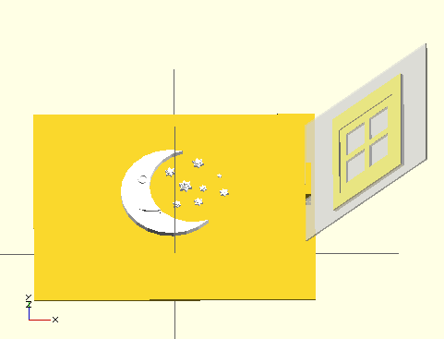


Y X

Slide 8
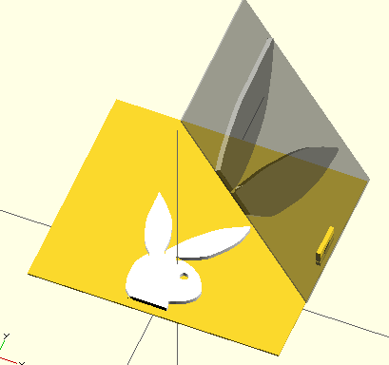
X₁
X₂
Y

Slide 9
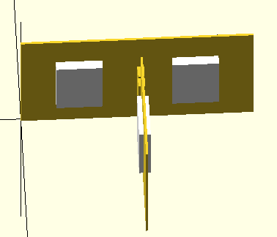
X₁
X₂
Y₁
Y₂

