Slide 1
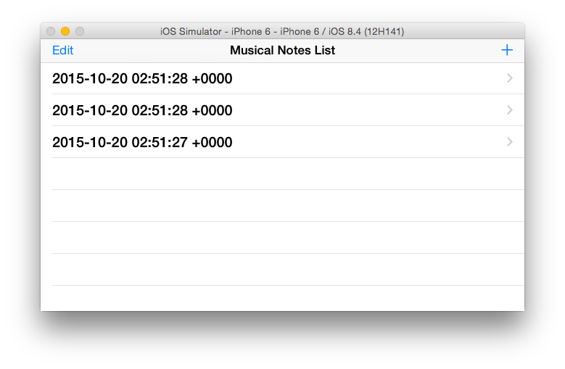
Salut D’mour
Memory (Musical CATS OST)
Grandfather’s Clock

Slide 2
