Slide 1




Live online course
Cohort Fall 2026
AI & Machine
Learning for Civil
Engineers
Session 01 · Python as a tool, not a barrier
From Engineering Problems to Data &
Machine Learning
Python & Google Colab: a practical, no-installation starting point for engineering
data and machine learning.
Dr. Abdul Waris
Research Associate · Universität Siegen, Germany
Technology partner

Slide 2
AI & ML for Civil Engineers
Session 01
02 / 44
Welcome to the cohort
Machine learning, taught the way
engineers think.
8
90min
4weeks
8
1
live, instructor-led sessions
each, about half of it coding
together
from first cell to uncertainty
analysis
hands-on Colab notebooks,
one per session
real engineering dataset in
every session
In the room
B.Tech students
M.Tech students
Ph.D. scholars
Faculty
Practising engineers
No coding experience needed

Slide 3





AI & ML for Civil Engineers
Session 01
03 / 44
Your instructor
Dr. Abdul Waris
Research Associate · Universität Siegen, Germany
Ph.D. in Geotechnical Engineering
Indian Institute of Technology (IIT) Hyderabad
Former Prime Minister’s Research Fellow
PMRF, Government of India
Research in explainable ML & reliability
The basis for sessions 07 and 08 of this course
Invited talks
Oregon State University · DY Patil · NIT Srinagar

Slide 4


AI & ML for Civil Engineers
Session 01
Course overview
04 / 44
The course at a glance
Eight sessions. One engineering workflow.
Part 1 · Foundations
Part 2 · Prediction to decision
01
From Engineering Problems to Python
Today
05
From Prediction to Engineering Decision:
Classification
AI/ML basics, Google Colab, NumPy & pandas
Logistic regression, confusion matrix, precision & recall
02
From Raw Engineering Data to an ML-Ready Dataset
EDA, data quality, outliers, train/test split, leakage
06
Artificial Neural Networks
Architecture, activations, training, overfitting
03
Your First Engineering Prediction Model
Linear regression, error metrics, cross-validation
07
Can We Trust Our ML Model?
Feature importance, SHAP, engineering judgement
Nonlinear Engineering Problems: Trees & Ensembles
Instructor’s research area
04
Decision trees, Random Forest, boosting
From Prediction to Probability
08
Monte Carlo, ML surrogates, probability of failure
Instructor’s research area
Notes:
[Clicks on this slide: 2]

Slide 5




AI & ML for Civil Engineers
Session 01
Course overview
05 / 44
How every session runs
Concept, then code, then judgement.
Concept & engineering context
Live code-along in Colab
Interpretation
Q&A
Why the method exists
Real civil engineering data
Does it make sense?
Your questions
0 min
90 min
One notebook per
session
Real engineering data
Recordings
Engineering judgement
Materials, structures, buildings &
energy, transport, water &
environment, geotechnics.
Shared after each session;
available until two weeks after the
course ends.
Validation, limitations and
physical plausibility, not just
accuracy.
Structured Colab notebooks you
keep and revisit.
Notes:
[Clicks on this slide: 1]

Slide 6







AI & ML for Civil Engineers
Session 01
Course overview
06 / 44
Today · Session 01
From engineering problems to Python
By the end of today you can
01
From engineering problems to machine learning
AI, ML and DL · supervised and unsupervised learning · one workflow
Place AI, ML and deep learning on one
map
Tell regression, classification and
unsupervised problems apart
02
Python & Google Colab
Describe the ML workflow for a civil
engineering problem
Why Python · notebooks · Colab vs alternatives · our toolkit
Open, run and save a Colab notebook
03
Hands-on: our first cells
Open the notebook · run code · load data · first plot
Notes:
[Clicks on this slide: 4]

Slide 7


AI & ML for Civil Engineers
Session 01
07 / 44
01
a
A problem we already know
b
AI, ML and deep learning
c
Supervised & unsupervised
d
From training to prediction
e
One ML workflow
Part 01
From engineering
problems to machine
learning

Slide 8

AI & ML for Civil Engineers
Session 01
Part 01 · Problems to ML
08 / 44
Start with an engineering problem
Can we predict concrete strength from its mix and
age?
X
inputs: mix and age
We already understand this problem. We
have the ingredients, we have age, and we
measure a response.
Cement
Water
Fly ash
Slag
102–540 kg/m³
122–247 kg/m³
0–200 kg/m³
0–359 kg/m³
Aggregates
Super­plasticizer
Age
The question is
Can we use historical
examples to learn the
relationship?
coarse 801–1145 · fine 594–993 kg/m³
0–32 kg/m³
1–365 days
We measure a response
y Compressive strength
2–83 MPa
Ranges from the Concrete Compressive Strength dataset, UCI Machine Learning Repository (Yeh, 1998): 1,030 laboratory mixes.
Notes:
Slide 2 — Start with an engineering problem
They are not learning an alien computer problem.
They are solving an engineering problem with another tool.
[Clicks on this slide: 2]

Slide 9
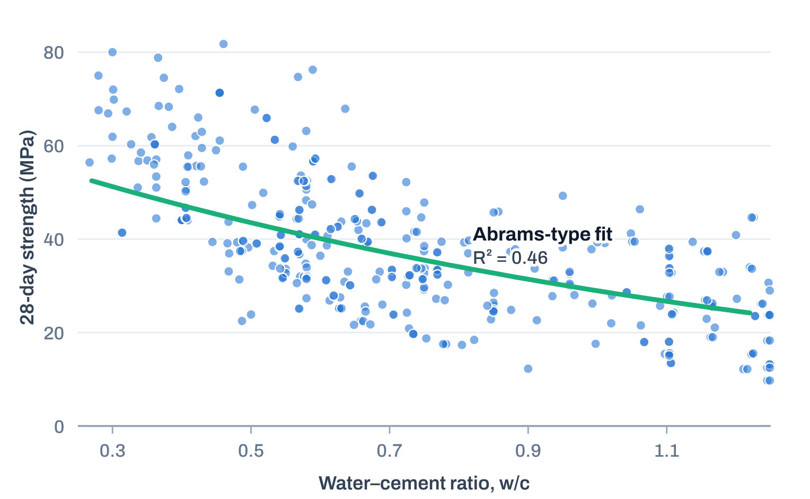
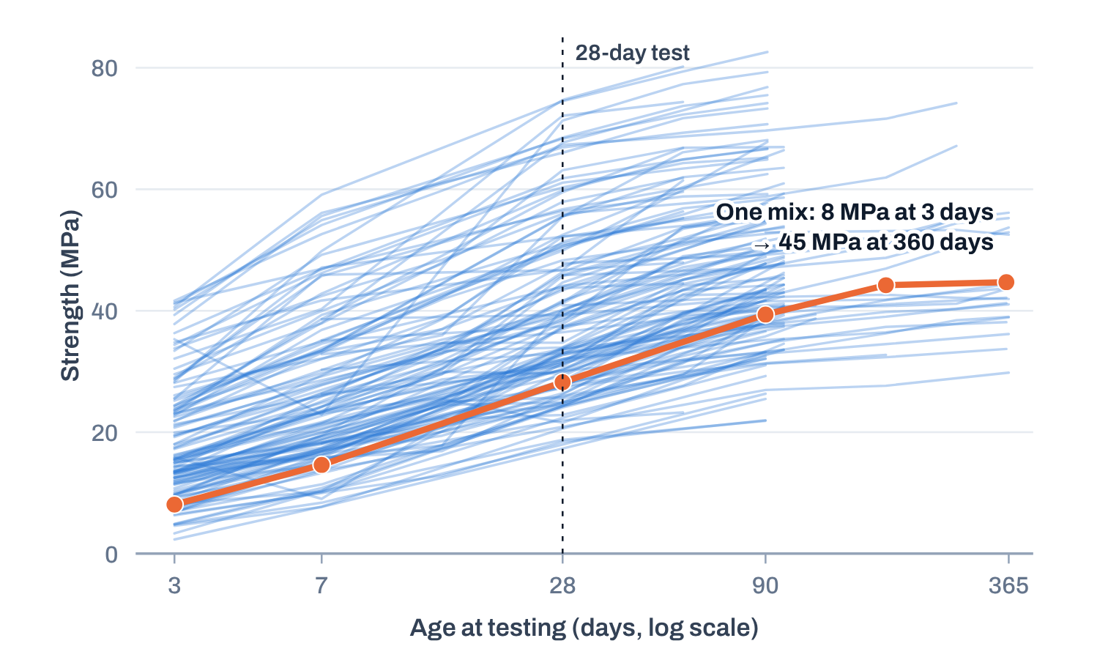

AI & ML for Civil Engineers
Session 01
Part 01 · Problems to ML
09 / 44
What 1,030 laboratory tests show
Each input tells part of the story
Strength keeps growing with age
Lower water–cement ratio, higher strength
132 mixes tested at four or more ages. Highlighted: one mix went from 8 MPa at 3
days to 45 MPa at 360 days.
An Abrams-type curve on 425 mixes at 28 days explains only 46% of the variation.
One variable at a time leaves most of the story untold. Machine learning can use all the inputs together.
Data: UCI Concrete Compressive Strength (Yeh, 1998). Curve: f_{c} = A / B^{w/c} fitted to 28-day mixes, A = 65.4 MPa, B = 2.26.
Notes:
[Added] Real data: 1,030 laboratory mixes (UCI Concrete Compressive Strength, Yeh 1998). Left: 132 mixes tested at four or more ages; one slag mix went from 8 MPa at 3 days to 45 MPa at 360 days. Right: an Abrams-type curve fitted to 425 mixes at 28 days explains only 46% of the variation (R² = 0.46). Message: one input at a time leaves much unexplained; ML can use all the inputs together.
[Clicks on this slide: 3]

Slide 10






AI & ML for Civil Engineers
Session 01
Part 01 · Problems to ML
10 / 44
Civil engineers already build models
ML is another engineering modelling tool.
Machine learning learns relationships
from examples in data.
Theory & mechanics
first principles
We already build models. We use equations, correlations, numerical
models, experiments and design standards.
Empirical correlations
e.g. Abrams’ law (1918)
Machine learning doesn’t suddenly replace engineering thinking. It
gives us another way to represent relationships when we have
sufficient data.
Numerical models
FEM · FDM
Machine learning is another modelling approach
Laboratory / field data
cube, cylinder & field tests
The important difference is that instead of
prescribing the relationship ourselves, we allow an
algorithm to learn a relationship from examples in
data.
Data-driven models
learned from examples
Notes:
Slide 3 — Civil Engineers already use models
Speaker point
"We already build models. We use equations, correlations, numerical models, experiments and design standards. Machine learning doesn't suddenly replace engineering thinking. It gives us another way to represent relationships when we have sufficient data."
[Clicks on this slide: 3]

Slide 11

AI & ML for Civil Engineers
Session 01
Part 01 · Problems to ML
11 / 44
The vocabulary · you will hear these terms constantly
Artificial intelligence is the broad idea.
Artificial Intelligence
Our focus
The broader field of building systems that perform tasks
associated with human intelligence.
Machine learning is the focus of
this course. We meet deep learning
with artificial neural networks.
Machine Learning
Other AI approaches
1956
“Artificial intelligence” becomes a field at
the Dartmouth summer workshop
A subset of AI: a way of building systems that learn
patterns from data.
e.g. rule-based expert systems, search and
planning
1959
Arthur Samuel popularises the term
“machine learning”
Traditional ML
Deep Learning (DL)
2012
Deep neural networks break through in
image recognition
regression, trees, ensembles
A family of ML methods based on
multi-layer neural networks.
sessions 03–05
session 06
Notes:
Slide — Why are we talking about AI?
What you say
"You will hear these three terms constantly, so let's establish the vocabulary first.
Artificial Intelligence is the broadest term.
Machine Learning is one approach within AI, where algorithms learn patterns from data.
Deep Learning is a family of machine-learning methods based on neural networks with multiple layers."
Then immediately:
"For this workshop, ML is our main focus. We will touch deep learning later when we reach Artificial Neural Networks."
That is enough.
[Clicks on this slide: 3]

Slide 12

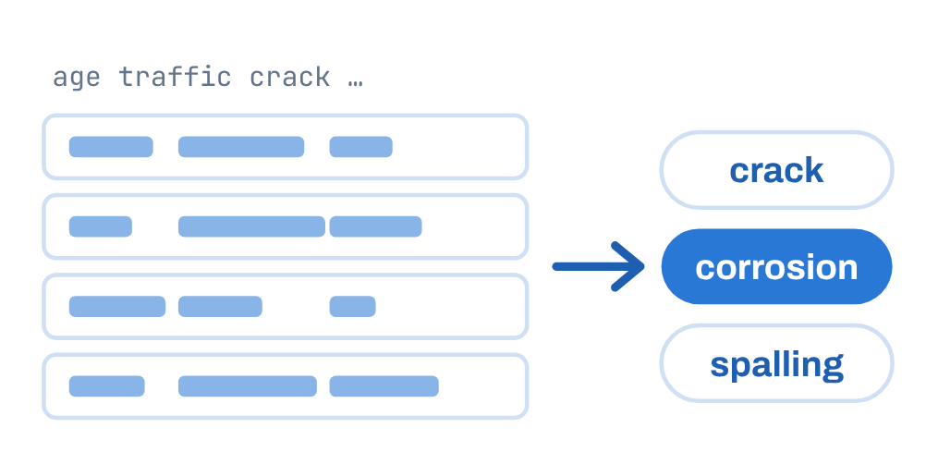
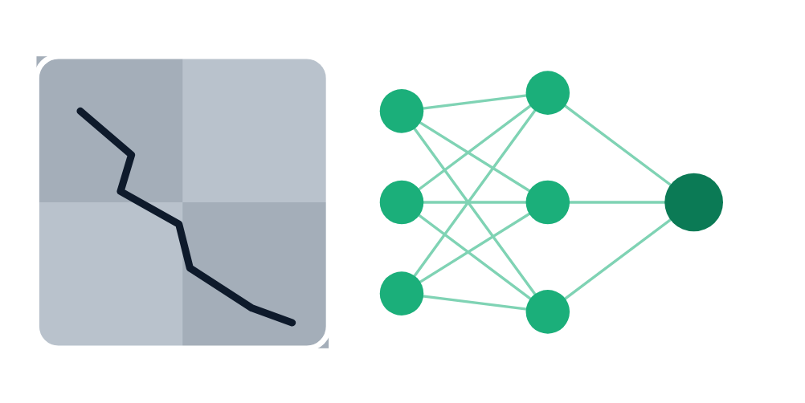
AI & ML for Civil Engineers
Session 01
Part 01 · Problems to ML
12 / 44
One engineering example · structural inspection
Same engineering world. Different levels.
Level 1 · Artificial Intelligence (AI)
Level 2 · Machine Learning (ML)
Level 3 · Deep Learning (DL)
Can a system assist an engineer in
deciding whether a structure
requires attention?
Can we learn from historical
inspection data to classify defects?
Can a neural network learn complex
patterns directly from images of
structural defects?
AI = the broader goal
ML = learning from data
DL = neural-network-based ML
Notes:
Slide — AI, ML and DL: one engineering example
[Clicks on this slide: 3]

Slide 13
AI & ML for Civil Engineers
Session 01
Part 01 · Problems to ML
13 / 44
Machine learning, defined
“
Field of study that gives computers the
ability to learn without being explicitly
programmed.
Arthur Samuel
1959
IBM pioneer of the self-learning checkers program
Notes:
Arthur Samuel's 1959 definition. Samuel worked at IBM; his checkers program improved by playing against itself.

Slide 14
AI & ML for Civil Engineers
Session 01
Part 01 · Problems to ML
14 / 44
Machine learning algorithms
Two families we will use
Supervised learning
Unsupervised learning
Learns from the “right answers”
Finds structure on its own
Every example comes with its label y.
Data only comes from inputs X, with no output label.
X₁
X₂
X₃
y · label
X₁
X₂
X₃
no label
Regression
Classification
Clustering
Anomaly detection
Dimensionality reduction
Notes:
[Layout added] From the original slide 6: 'Machine learning algorithms: Supervised / Unsupervised'. Supervised: every example has its label y. Unsupervised: only X, no label.
[Clicks on this slide: 2]

Slide 15


AI & ML for Civil Engineers
Session 01
Part 01 · Problems to ML
15 / 44
Supervised learning · examples
Input X → output Y
Input (X)
Output (Y)
Application
Email
Spam? (0/1)
Spam filtering
Audio
Text transcripts
Speech recognition
English
Arabic, Urdu, Spanish, etc.
Machine translation
Ad, user info
Click? (0/1)
Online advertising
Mix design + age
Strength (MPa)
Concrete mix design
Photo of a concrete surface
Crack? (0/1)
Visual inspection
DeepLearning.AI. Phoon, K. K., Ching, J. & Cao, Z. (2022). Unpacking data-centric geotechnics. Underground Space 7(6), 967–989. doi:10.1016/j.undsp.2022.04.001. Highlighted rows: civil engineering examples added for this course.
Notes:
Table from the original slide 6. Two civil engineering rows added at the bottom for this course.
[Clicks on this slide: 1]

Slide 16

AI & ML for Civil Engineers
Session 01
Part 01 · Problems to ML
16 / 44
Supervised learning · learns from being given the “right answers”
Regression or classification?
34.7MPa
Stable
Unstable
Regression problem
Classification problem
Predict a number
Predict a category
from infinitely many possible outputs.
from a small number of possible outcomes.
Civil engineering examples
Civil engineering examples
Concrete strength
Settlement
Traffic volume
Stable / unstable
Defect type
Soil class
Energy demand
Factor of safety
Damage category
The target determines the ML problem.
DeepLearning.AI.
Notes:
[Clicks on this slide: 3]

Slide 17
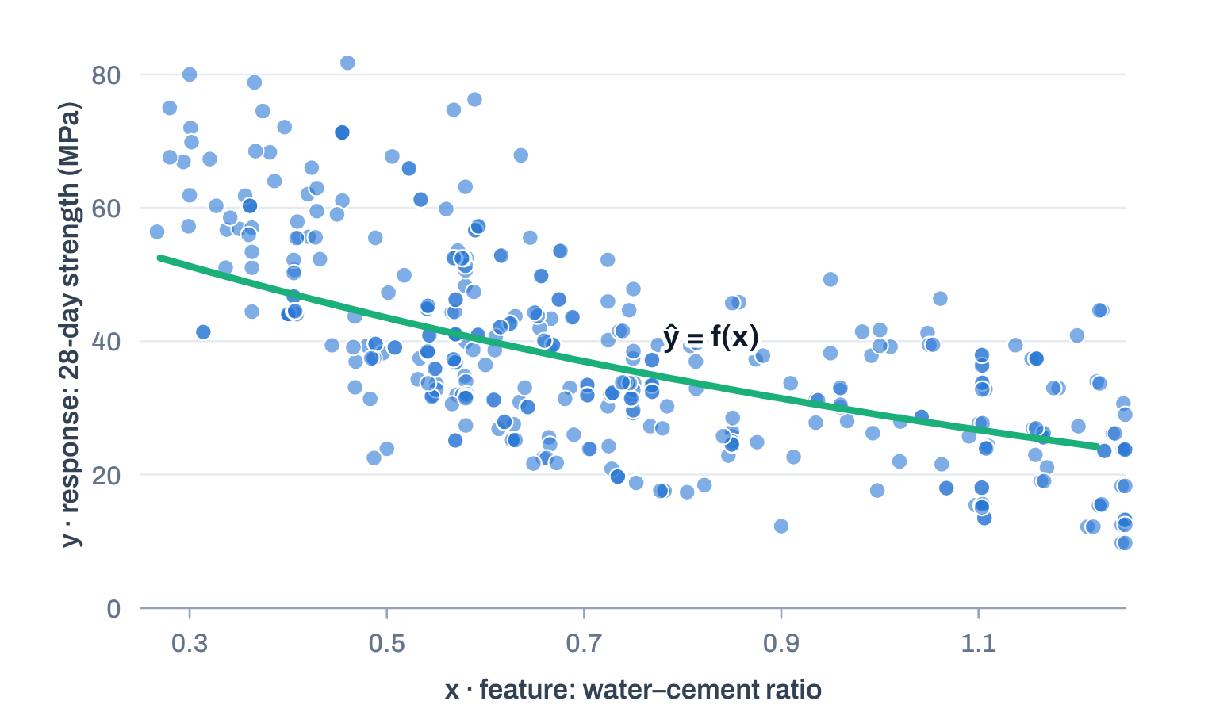
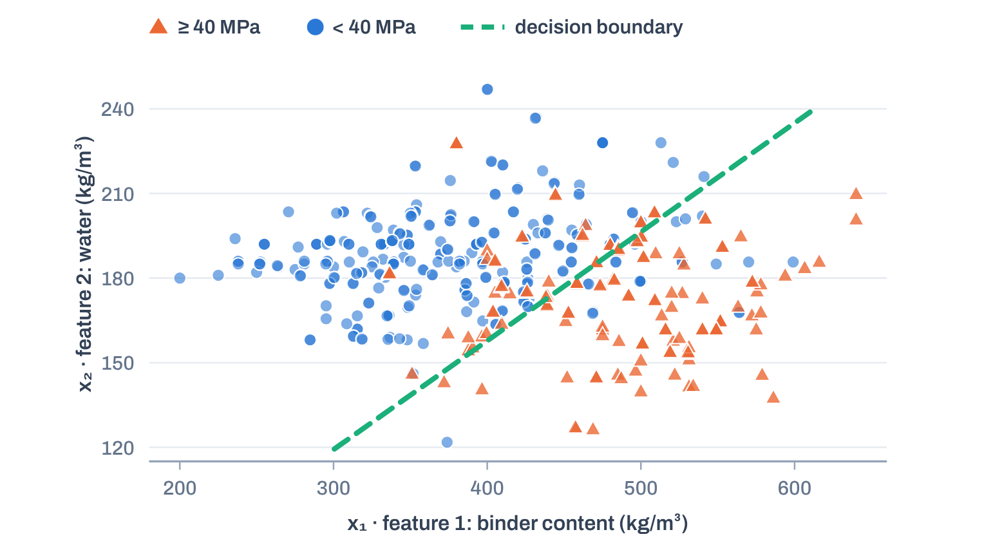

AI & ML for Civil Engineers
Session 01
Part 01 · Problems to ML
17 / 44
Supervised learning · what the model learns
Fit a curve, or draw a boundary
Regression problem
Classification problem
Predict the strength itself
Will the mix reach 40 MPa?
One feature x, response variable y, model output ŷ.
Two features x₁, x₂. A simple model is right 84% of the time (always guessing
“below”: 66%).
Same 425 mixes at 28 days. Change the target, and the problem changes.
Data: UCI Concrete Compressive Strength (Yeh, 1998). Binder = cement + slag + fly ash. Boundary from logistic regression. Concept after DeepLearning.AI.
Notes:
[Real data] Left: regression, 28-day strength against water-cement ratio with the Abrams-type fit. Right: the same 425 mixes with the target changed to 'does the mix reach 40 MPa?'. A logistic regression on binder content and water is right 84% of the time, against 66% for always guessing 'below 40'. The boundary roughly follows a constant water-binder ratio: engineering knowledge is visible in the model.
[Clicks on this slide: 3]

Slide 18
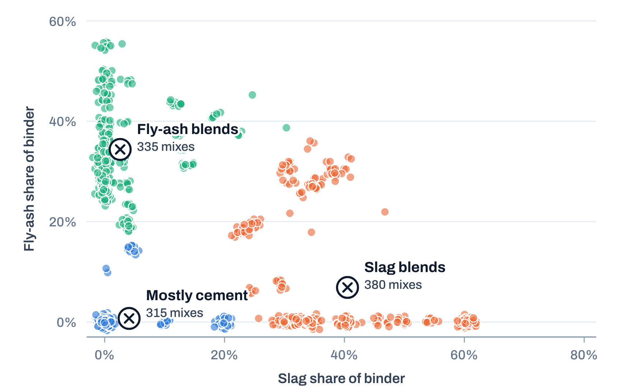



AI & ML for Civil Engineers
Session 01
Part 01 · Problems to ML
18 / 44
Unsupervised learning
Takes data without labels and tries to automatically
group them into clusters.
No strength labels. Three binder families emerge.
Data only comes from Input (X) but not output label (Y).
Algorithm has to find structure in the data.
k-means on 1,030 mixes, using only how the binder is made up.
Clustering
Group similar datapoints together.
Anomaly detection
Finds unusual data points, e.g. a faulty sensor reading.
Dimensionality reduction
Compress data into fewer variables while keeping its structure.
DeepLearning.AI. Phoon, K. K., Ching, J. & Cao, Z. (2022). Unpacking data-centric geotechnics. Underground Space 7(6), 967–989. Chart data: UCI Concrete Compressive Strength (Yeh, 1998).
Notes:
[Real data] k-means with three groups on the slag share and fly-ash share of the binder; no strength labels used. Groups found: Mostly cement 315 mixes, Slag blends 380 mixes, Fly-ash blends 335 mixes. Dimensionality reduction compresses data into fewer variables (dimensions).
[Clicks on this slide: 2]

Slide 19



AI & ML for Civil Engineers
Session 01
Part 01 · Problems to ML
19 / 44
A simple supervised-learning picture · it follows us all course
X is what we give the model. y is what we want it to
predict.
Cement
Slag
Fly ash
Water
SP
Coarse
Fine
Age
Strength
540.0
0.0
0.0
162
2.5
1040
676
28
79.99
1
332.5
142.5
0.0
228
0.0
932
594
270
40.27
ML algorithm
Training
198.6
132.4
0.0
192
0.0
978
826
360
44.30
learns a relationship f so that
f(X) ≈ y
… 1,030 mixes · inputs (X) in kg/m³ and days · output (y) in MPa
Provide this dataset to an ML model for training.
2
Cement
Slag
Fly ash
Water
SP
Coarse
Fine
Age
Strength
ŷ
350.0
0.0
0.0
180
0.0
1000
800
28
?
Trained model f
Predicted compressive
strength (MPa)
Prediction
applies what it learned
A new mix: we know X, but not y yet.
Training rows from the UCI Concrete Compressive Strength dataset (Yeh, 1998). The prediction row is an illustrative new mix.
Notes:
Speaker point
"This little diagram is going to follow us throughout the course. X is the information we give the model. y is what we want it to predict."
Then give the Energy and Steel examples verbally.
[Clicks on this slide: 2]

Slide 20


AI & ML for Civil Engineers
Session 01
Part 01 · Problems to ML
20 / 44
Words we will use all course
A small vocabulary goes a long way
X
Features
y
Target
ŷ
Prediction
The inputs we give the model. Also called
variables.
The response we want to predict. In a training
table it is the label.
The model’s estimate of y for a new input.
cement, water, age …
compressive strength (MPa)
ŷ = f(X)
f
Model
Dataset
Training
The relationship learned from the examples.
Rows are examples; columns are features and
the target.
Fitting the model to examples where y is
known.
a curve, a tree, a network …
1,030 rows × 9 columns
model.fit(X, y)
Notes:
[Added] Vocabulary for the whole course: X features, y target/label, ŷ prediction, f model, dataset, training.
[Clicks on this slide: 2]

Slide 21








AI & ML for Civil Engineers
Session 01
Part 01 · Problems to ML
21 / 44
The signature of this course
One ML workflow. Multiple civil engineering
applications.
01
02
03
04
05
Engineering
problem
Data
Python
ML model
Decision
Measurements, simulations or
records
Inspect, prepare, analyse
Learn patterns from examples
Interpret with domain
knowledge
What do we need to estimate?
Engineering problem
Target
ML problem
Concrete
Strength
Regression
Buildings
Energy load
Regression
Steel inspection
Fault class
Classification
Structural health
Stability class
Classification
Notes:
Slide 6 — One workflow. Many engineering problems.
This should be one of the signature slides of the course.
The engineering problem changes. The dataset changes. The target changes. But the basic workflow survives.
[Clicks on this slide: 6]

Slide 22
AI & ML for Civil Engineers
Session 01
Part 01 · Problems to ML
22 / 44
Quick check · two minutes
Regression, classification or unsupervised?
01
02
03
Predict the settlement of a shallow
footing in millimetres
Label a soil sample as clay, silt or
sand from its lab tests
Group traffic sensors that show
similar daily patterns
Regression
Classification
Unsupervised
Regression
Classification
Unsupervised
Regression
Classification
Unsupervised
04
05
06
Flag strain-gauge readings on a
bridge that look unusual
Estimate a building’s heating load
from its geometry
Decide whether a slope is stable or
unstable
Regression
Classification
Unsupervised
Regression
Classification
Unsupervised
Regression
Classification
Unsupervised
Notes:
[Added] Give the cohort two minutes and ask them to vote in the chat. Answers on the next slide.

Slide 23
AI & ML for Civil Engineers
Session 01
Part 01 · Problems to ML
23 / 44
Quick check · answers
The target decides, every time
01
02
03
Predict the settlement of a shallow
footing in millimetres
Label a soil sample as clay, silt or
sand from its lab tests
Group traffic sensors that show
similar daily patterns
Regression
Classification
Unsupervised · clustering
A number on a continuous scale.
Three possible categories.
No labels; we look for groups.
04
05
06
Flag strain-gauge readings on a
bridge that look unusual
Estimate a building’s heating load
from its geometry
Decide whether a slope is stable or
unstable
Unsupervised · anomaly detection
Regression
Classification
We look for points unlike the rest.
An energy quantity: a number.
Two possible categories.
Notes:
[Added] Answers: 1 regression, 2 classification, 3 clustering (unsupervised), 4 anomaly detection (unsupervised), 5 regression, 6 classification.
[Clicks on this slide: 6]

Slide 24








AI & ML for Civil Engineers
Session 01
24 / 44
02
a
Why Python
b
Google Colab & notebooks
c
Colab, Anaconda and MATLAB
d
Our Python toolkit
Part 02
Python & Google Colab

Slide 25








AI & ML for Civil Engineers
Session 01
Part 02 · Python & Colab
25 / 44
Python
Why are we using Python?
Open-source
Easy to learn
No paid language licence is required.
An easy to learn programming language.
Our principle
We are not learning
Python for its own sake.
We are learning enough Python to ask
better engineering questions and build
data-driven models.
Scientific ecosystem
Useful across disciplines
A huge ecosystem of libraries: NumPy,
pandas, Matplotlib, scikit-learn and more.
Data analysis, visualisation, ML and
scientific computing.
Notes:
[Clicks on this slide: 3]

Slide 26

AI & ML for Civil Engineers
Session 01
Part 02 · Python & Colab
26 / 44
What is it with the name? · Why is it called Python?
Named after a comedy show, not a snake.
The name Python doesn’t come from the snake, even though the logo
and community themes often use snake imagery.
Fun fact
Python was named after the British comedy group “Monty Python’s
Flying Circus”, a favourite of Python’s creator, Guido van Rossum.
He wanted a name that was short, unique, and a little mysterious or
fun, and “Python” felt just right.
Python · Guido van Rossum

Slide 27





AI & ML for Civil Engineers
Session 01
Part 02 · Python & Colab
27 / 44
Where Python fits
Python supports the engineering workflow
01
02
03
04
05
Engineering
problem
Data
Python
ML model
Decision
Measurements, simulations or
records
Inspect, prepare, analyse
Learn patterns from examples
Interpret with domain
knowledge
What do we need to estimate?
Python supports the workflow
Engineering knowledge supplies the meaning
Inspect, prepare and analyse the data.
Fit and evaluate the model.
Is this result physically plausible? Is it
safe to act on?
Load 1,030 test results in one line
Is 80 MPa realistic for this mix?
Plot strength against age
Are we extrapolating beyond the data?
Fit a model and score its error
Is the error acceptable for design?
Notes:
Python supports the workflow; engineering knowledge supplies the meaning.
[Clicks on this slide: 2]

Slide 28






AI & ML for Civil Engineers
Session 01
Part 02 · Python & Colab
28 / 44
Our environment
What is Google Colab?
Hosted notebook environment
Write and run Python in a web browser.
Google Colaboratory
Interactive
Combine code, text, equations and plots.
For this workshop
Open the link → run a cell →
inspect the output.
Low setup burden
No local Python installation is needed to begin.
We can focus on engineering ideas rather than
installation and environment setup.
Shareable
Notebooks can be shared and revisited online.
Open: https://colab.research.google.com
Notes:
[Clicks on this slide: 5]

Slide 29

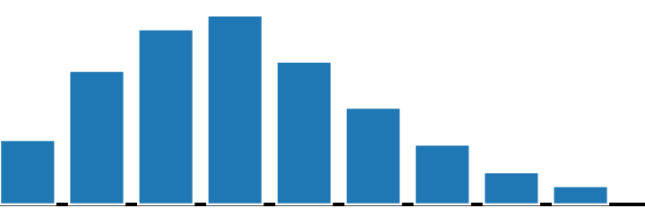

AI & ML for Civil Engineers
Session 01
Part 02 · Python & Colab
29 / 44
Anatomy of a notebook
What is a notebook?
Session01_first_steps.ipynb
Share
Code cells
File
Edit
View
Insert
Runtime
Tools
Help
+ Code
+ Text
● Connected
Run Python instructions and see the result beneath
the cell.
Water–cement ratio
Text cell
Assumption: quantities in kg/m³. A lower w/c generally gives higher strength.
Text / Markdown cells
Explain the engineering question, assumptions,
equations and interpretation.
import pandas as pd
df = pd.read_csv("concrete.csv")
df["w_c"] = df["water"] / df["cement"] # new feature
df["w_c"].hist()
Code cell
Outputs
Display numbers, tables, charts and model
diagnostics in one place.
Output
A notebook is a record of code, results and reasoning, not just a place to type code.
Notes:
[Clicks on this slide: 3]

Slide 30







AI & ML for Civil Engineers
Session 01
Part 02 · Python & Colab
30 / 44
The choice we made
Why Google Colab for this workshop?
Shared workflow
Easy to share
No installation
Everyone follows the same notebook
sequence.
Links make distributing notebooks
straightforward.
Start in a browser.
Live demonstrations
Engineering-focused
Beginner-friendly
Run cells and inspect results together.
More time for data and interpretation.
No environment management at the outset.
We choose Colab to reduce setup friction, not because it is best for every project.
Notes:
[Clicks on this slide: 3]

Slide 31





AI & ML for Civil Engineers
Session 01
Part 02 · Python & Colab
31 / 44
Alternatives
Google Colab, Anaconda and MATLAB
Feature
Google Colab
Anaconda + Jupyter
MATLAB
Initial setup
Browser; no local install to start
Install and manage a local
distribution
Installation and licence access
may be required
Language
Python
Python (with R tools available)
MATLAB
Packages / tools
Common libraries available; some setup
may be needed
Flexible packages and environments
MATLAB toolboxes and add-ons
Best fit here
Shared, low-friction workshop
Local work and controlled
environments
Existing MATLAB workflows
All can support technical work; this workshop prioritises accessibility and shared hands-on learning.
Notes:
[Clicks on this slide: 5]

Slide 32






AI & ML for Civil Engineers
Session 01
Part 02 · Python & Colab
32 / 44
Good to know
What should we know about Colab?
Internet access is needed
Sessions are temporary
Colab runs in the browser.
Save notebooks and important outputs.
Files and packages may need setup
Compute resources can vary
Upload data or mount cloud storage when required.
Hardware and usage limits are not guaranteed.
Protect sensitive data
Follow institutional data-protection rules before uploading data.
Use Colab as a practical workshop environment, not as a promise of unlimited compute.
Notes:
[Clicks on this slide: 4]

Slide 33





AI & ML for Civil Engineers
Session 01
Part 02 · Python & Colab
33 / 44
Tools, introduced when we need them
Our Python toolkit
We introduce tools when an
engineering question calls for
them.
Python
Language and logic
w_c = water / cement
The goal is not to memorise every
function. It is to understand what
each step does and whether its
result makes engineering
sense.
NumPy
Numerical arrays and calculations
np.mean(strength)
pandas
Tables and data preparation
pd.read_csv("concrete.csv")
Matplotlib
Plots and visual diagnostics
plt.scatter(df.age, df.strength)
scikit-learn
Machine-learning models and
evaluation
model.fit(X, y)
Notes:
[Clicks on this slide: 6]

Slide 34


AI & ML for Civil Engineers
Session 01
34 / 44
03
a
Open and run the notebook
b
Our first cell
c
Read the output like an engineer
d
Working with notebooks
Part 03 · Hands-on
Let’s get started with
Python in Google Colab.
Dr. Abdul Waris · Research Associate, Universität Siegen

Slide 35






AI & ML for Civil Engineers
Session 01
Part 03 · Hands-on
35 / 44
Hands-on · step by step
How to open and run the workshop notebook
STEP 1
STEP 2
STEP 3
STEP 4
STEP 5
Open the shared
Colab link
Sign in to Google if
prompted
Open the provided
notebook
Run a cell
Read the output
before moving on
Click Run, or press Shift +
Enter
https://
colab.research.google.com
Any Google account works.
An .ipynb file, one per session.
Does it make engineering
sense?
If a cell fails, read the error and check the preceding steps before rerunning everything.
Notes:
[Clicks on this slide: 6]

Slide 36

AI & ML for Civil Engineers
Session 01
Part 03 · Hands-on
36 / 44
An engineering-flavoured example
Let’s run our first cell
Session01_first_steps.ipynb
[1] · Python 3
Who does what?
cement = 350 # kg/m³
water = 180 # kg/m³
water_cement_ratio = water / cement
print(water_cement_ratio)
The computer performs arithmetic; the
engineer interprets what the ratio
means.
Try it
Change the water content. Observe what
changes, and what the calculation alone
cannot tell you.
Expected output
0.5142857…
Notes:
[Clicks on this slide: 3]

Slide 37


AI & ML for Civil Engineers
Session 01
Part 03 · Hands-on
37 / 44
From one mix to 1,030 mixes
Load the whole dataset with pandas
Session01_first_steps.ipynb
[2]
pandas reads the whole lab record into a
table we can inspect, filter and plot.
import pandas as pd
df = pd.read_csv("concrete.csv")
df.shape
1,030 rows: one row is one mix tested in the lab. 9
columns: eight inputs and the strength.
X
8 inputs
y
strength (MPa)
Output
(1030, 9)
[3]
df.head()
cement
slag
ash
water
superplastic
coarseagg
fineagg
age
strength
0
540.0
0.0
0.0
162.0
2.5
1040.0
676.0
28
79.99
1
540.0
0.0
0.0
162.0
2.5
1055.0
676.0
28
61.89
2
332.5
142.5
0.0
228.0
0.0
932.0
594.0
270
40.27
3
332.5
142.5
0.0
228.0
0.0
932.0
594.0
365
41.05
4
198.6
132.4
0.0
192.0
0.0
978.4
825.5
360
44.30
Data: Concrete Compressive Strength, UCI Machine Learning Repository (Yeh, 1998). Column names follow a common CSV release of the dataset.
Notes:
[Added, real data] Session 01 covers pandas: load the whole lab record in one line. df.shape gives (1030, 9): one row per mix, eight inputs and the strength. The table shows the real first five rows. Column names follow a common CSV release of the UCI dataset; match them to the workshop notebook.
[Clicks on this slide: 2]

Slide 38

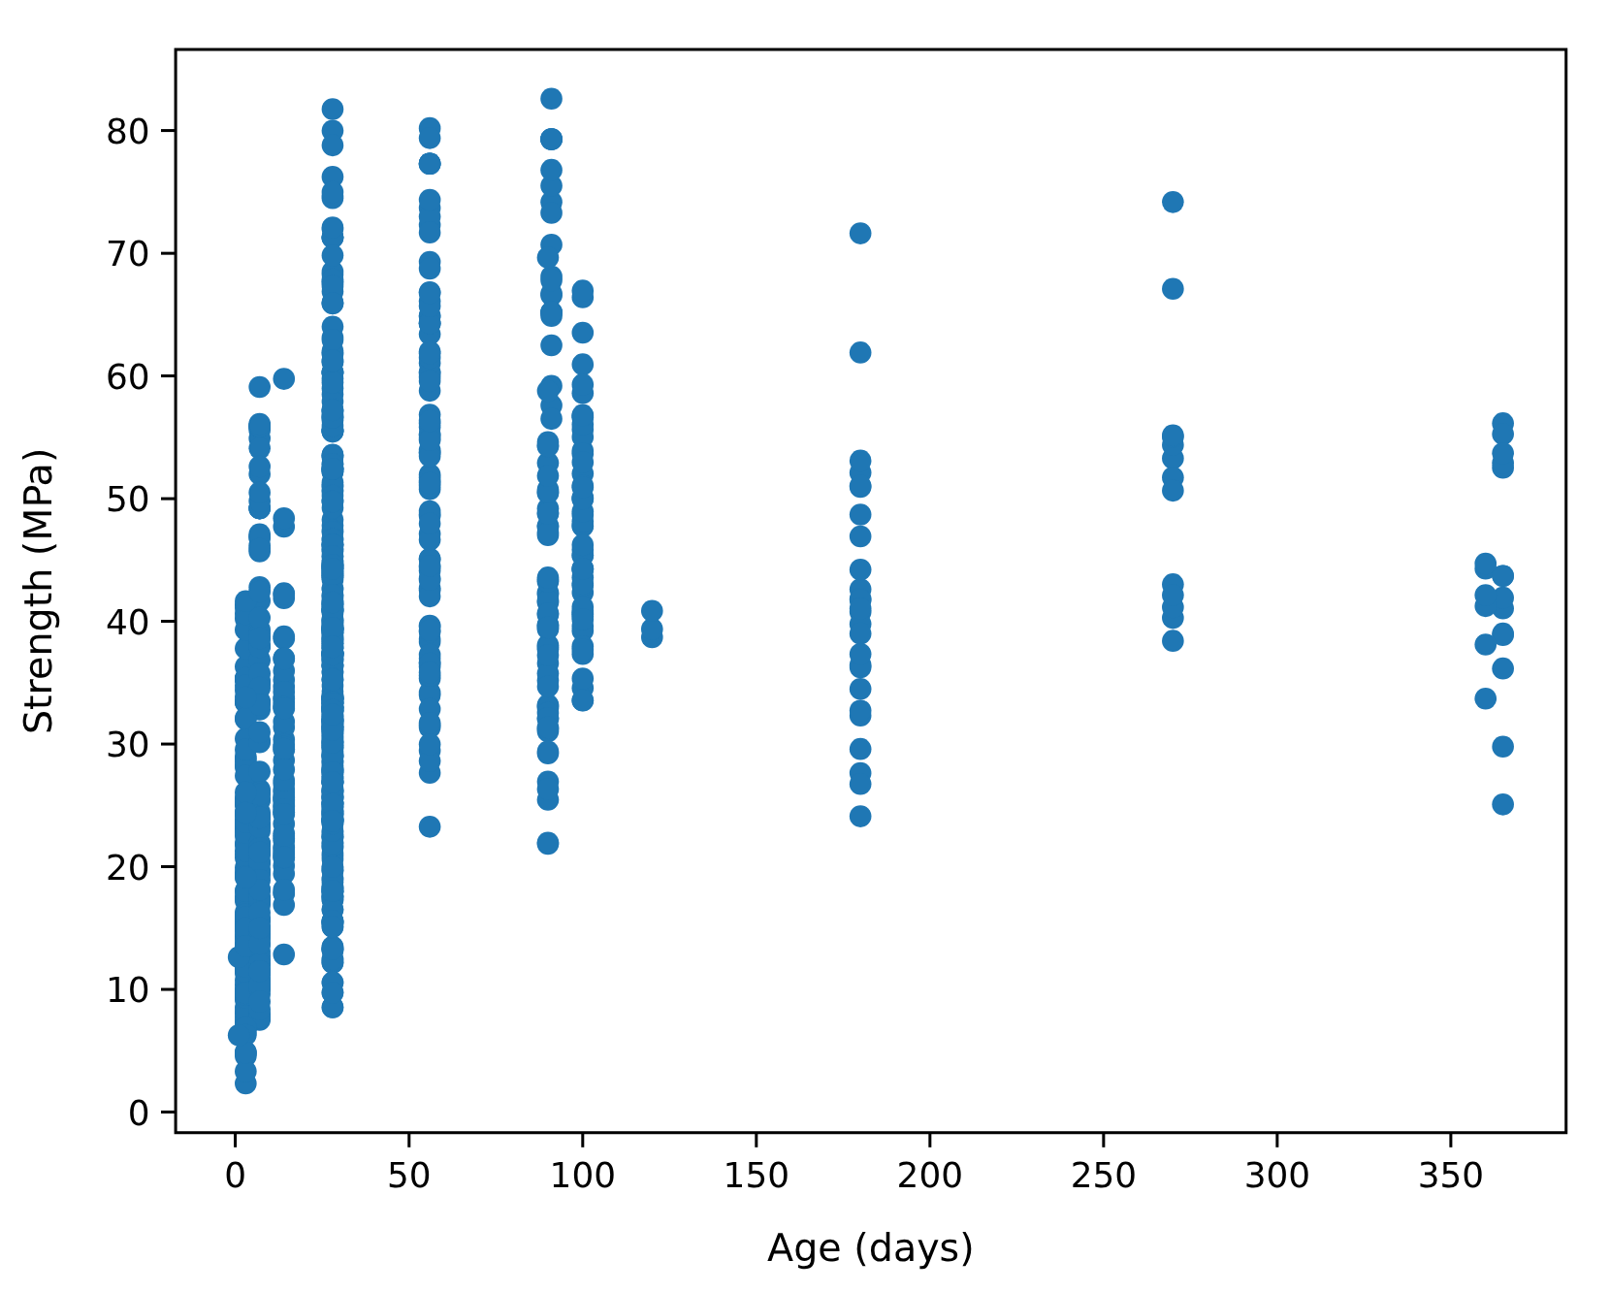

AI & ML for Civil Engineers
Session 01
Part 03 · Hands-on
38 / 44
Our first plot
One line of Matplotlib, 1,030 tests on screen
Session01_first_steps.ipynb
[4]
Output
import matplotlib.pyplot as plt
plt.scatter(df["age"], df["strength"])
plt.xlabel("Age (days)")
plt.ylabel("Strength (MPa)")
plt.show()
What do you notice? Tests happen at fixed ages, strength
rises with age, and the spread at every age is wide.
Data: UCI Concrete Compressive Strength (Yeh, 1998). The output is drawn in Matplotlib’s default style.
Notes:
[Added, real data] First plot with Matplotlib. Ask the cohort what they notice: tests happen at fixed ages (3, 7, 28, 56, 90 days ...), strength rises with age, and at every age the spread is wide. Age alone cannot predict strength.
[Clicks on this slide: 2]

Slide 39
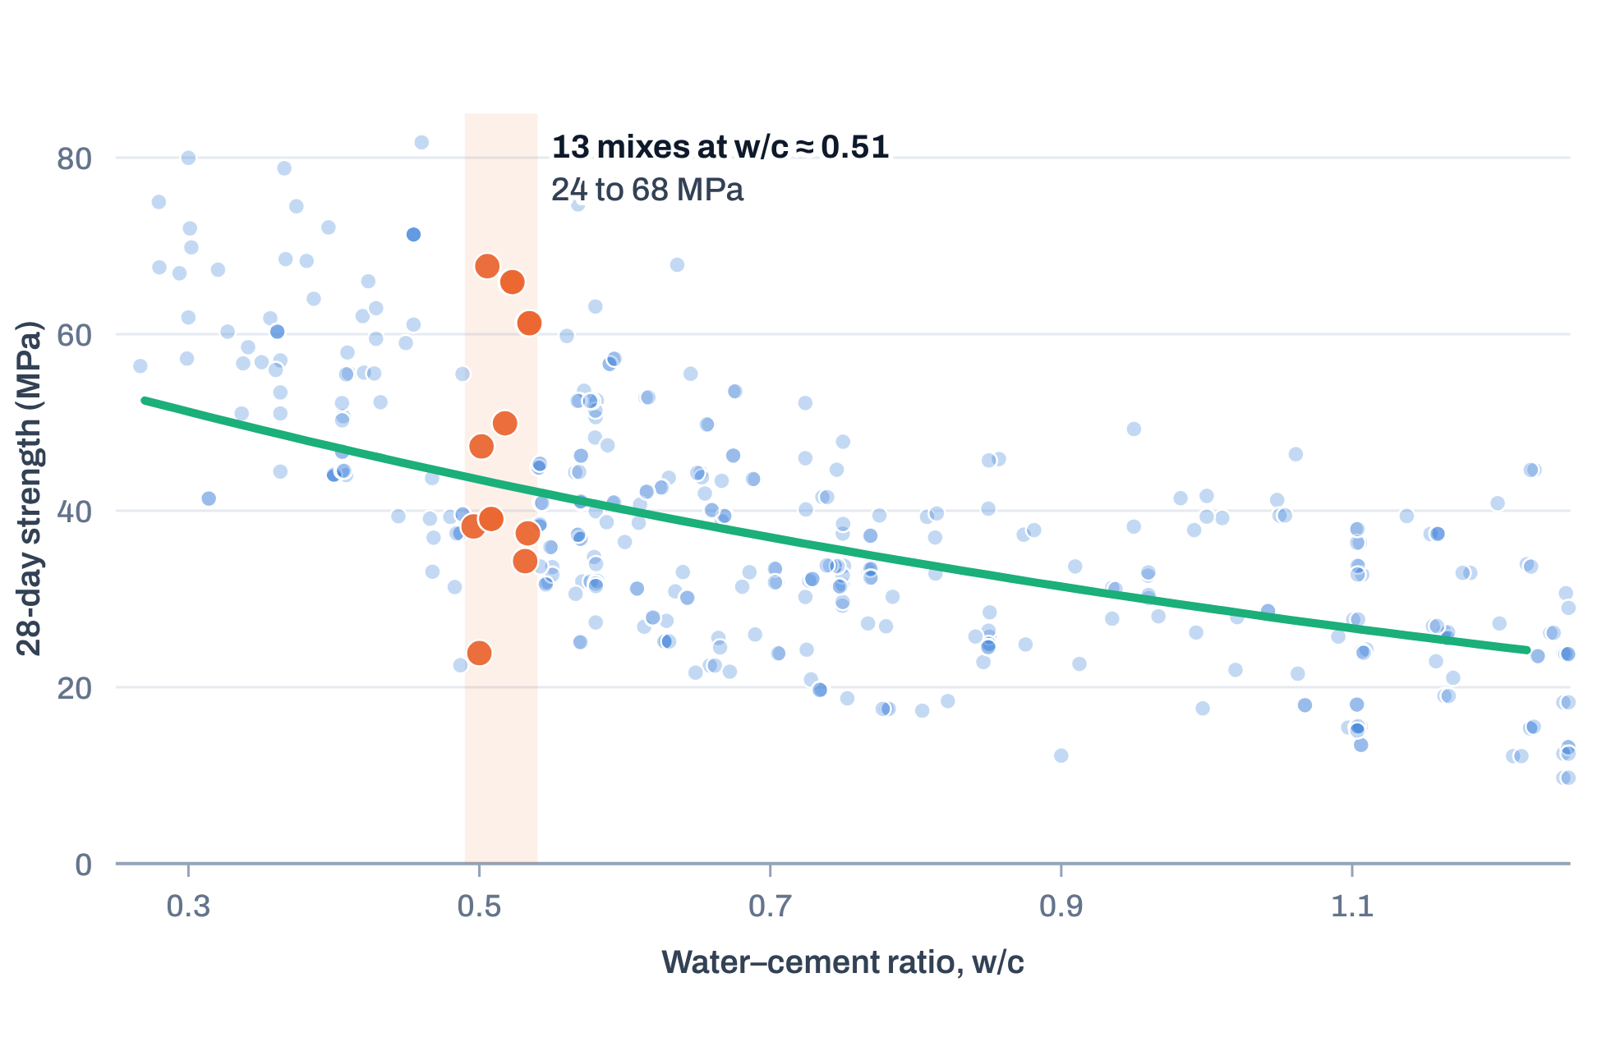
AI & ML for Civil Engineers
Session 01
Part 03 · Hands-on
39 / 44
Read the output like an engineer
0.51 is a number. Is it a good mix?
Our w/c of 0.51 among 425 real mixes at 28 days
df["w_c"] = df["water"] / df["cement"]
24–68MPa
13 mixes in the dataset share a w/c of about 0.51.
Their 28-day strengths range from 24 to 68 MPa.
What the calculation cannot tell you
Slag, fly ash, superplasticizer and aggregates
matter too. Bringing all the inputs together is
exactly what ML will help us do.
Data: UCI Concrete Compressive Strength (Yeh, 1998). Highlighted: 28-day mixes with 0.49 < w/c < 0.54. Curve: the Abrams-type fit from Part 01.
Notes:
[Added, real data] After the first cell. 13 mixes at 28 days have a w/c between 0.49 and 0.54; their strengths range from 24 to 68 MPa. The ratio alone does not fix the strength: slag, fly ash, superplasticizer and aggregates matter too. That is why we bring all the inputs together with ML.
[Clicks on this slide: 2]

Slide 40

AI & ML for Civil Engineers
Session 01
Part 03 · Hands-on
40 / 44
Good habits from day one
Working with workshop notebooks
01
Open the shared link
Use the notebook for the relevant session.
Workshop notebook link
02
Keep your own copy
Open today’s notebook and
make your own copy.
Use File → Save a copy in Drive when appropriate.
03
Work in sequence
Run cells from top to bottom unless instructed otherwise.
04
Keep the analysis reproducible
Record assumptions and note any changes to evaluation steps.
Link shared in the session chat
Notes:
Replace 'Link shared in the session chat' with the real notebook link if you want it on the slide.
[Clicks on this slide: 5]

Slide 41



AI & ML for Civil Engineers
Session 01
Part 03 · Hands-on
41 / 44
Summary
Why this setup?
Python
Google Colab
Engineering judgement
An accessible, widely used language for
scientific computing and ML.
A browser-based notebook environment
with minimal setup.
The goal is meaningful analysis, not
merely code that runs.
We chose Colab to reduce installation barriers and keep the cohort focused on real Civil Engineering
problems.
Next
Load a dataset, inspect its structure, and ask our first engineering questions.
Notes:
[Clicks on this slide: 4]

Slide 42
AI & ML for Civil Engineers
Session 01
Part 03 · Hands-on
42 / 44
Before session 02
Three small things to try
1
2
3
Run it all
Change the water
Bring a question
Open today’s notebook, save your own
copy, and run every cell from top to bottom.
Try 160 and 200 kg/m³. Note the new w/c,
and what it still cannot tell you.
Write down one quantity from your own field
you would like to predict, and the inputs you
would need.
File → Save a copy in Drive
water = 160
y = ? · X = ?
02
From Raw Engineering Data to an ML-Ready Dataset
Explore, clean, visualise and split engineering data.
Notes:
[Added] Optional practice before session 02.
[Clicks on this slide: 4]

Slide 43
AI & ML for Civil Engineers
Session 01
43 / 44
?
Questions
Unmute, or drop your question in the chat.
Concepts
Python & Colab
Your own engineering data
Dr. Abdul Waris
Research Associate · Universität Siegen, Germany

Slide 44



End of session 01
Thank you.
See you in session 02: From Raw Engineering Data to an
ML-Ready Dataset.
Dr. Abdul Waris
Research Associate · Universität Siegen, Germany
Course page
qudeltastudios.com/courses
Technology partner

