Slide 1

Notes:
Instructor note (draft): "Today we are going to build our first actual prediction model. We have already learned how to prepare the data. Now we ask: can a machine-learning model learn a useful relationship from this data?"

Slide 2
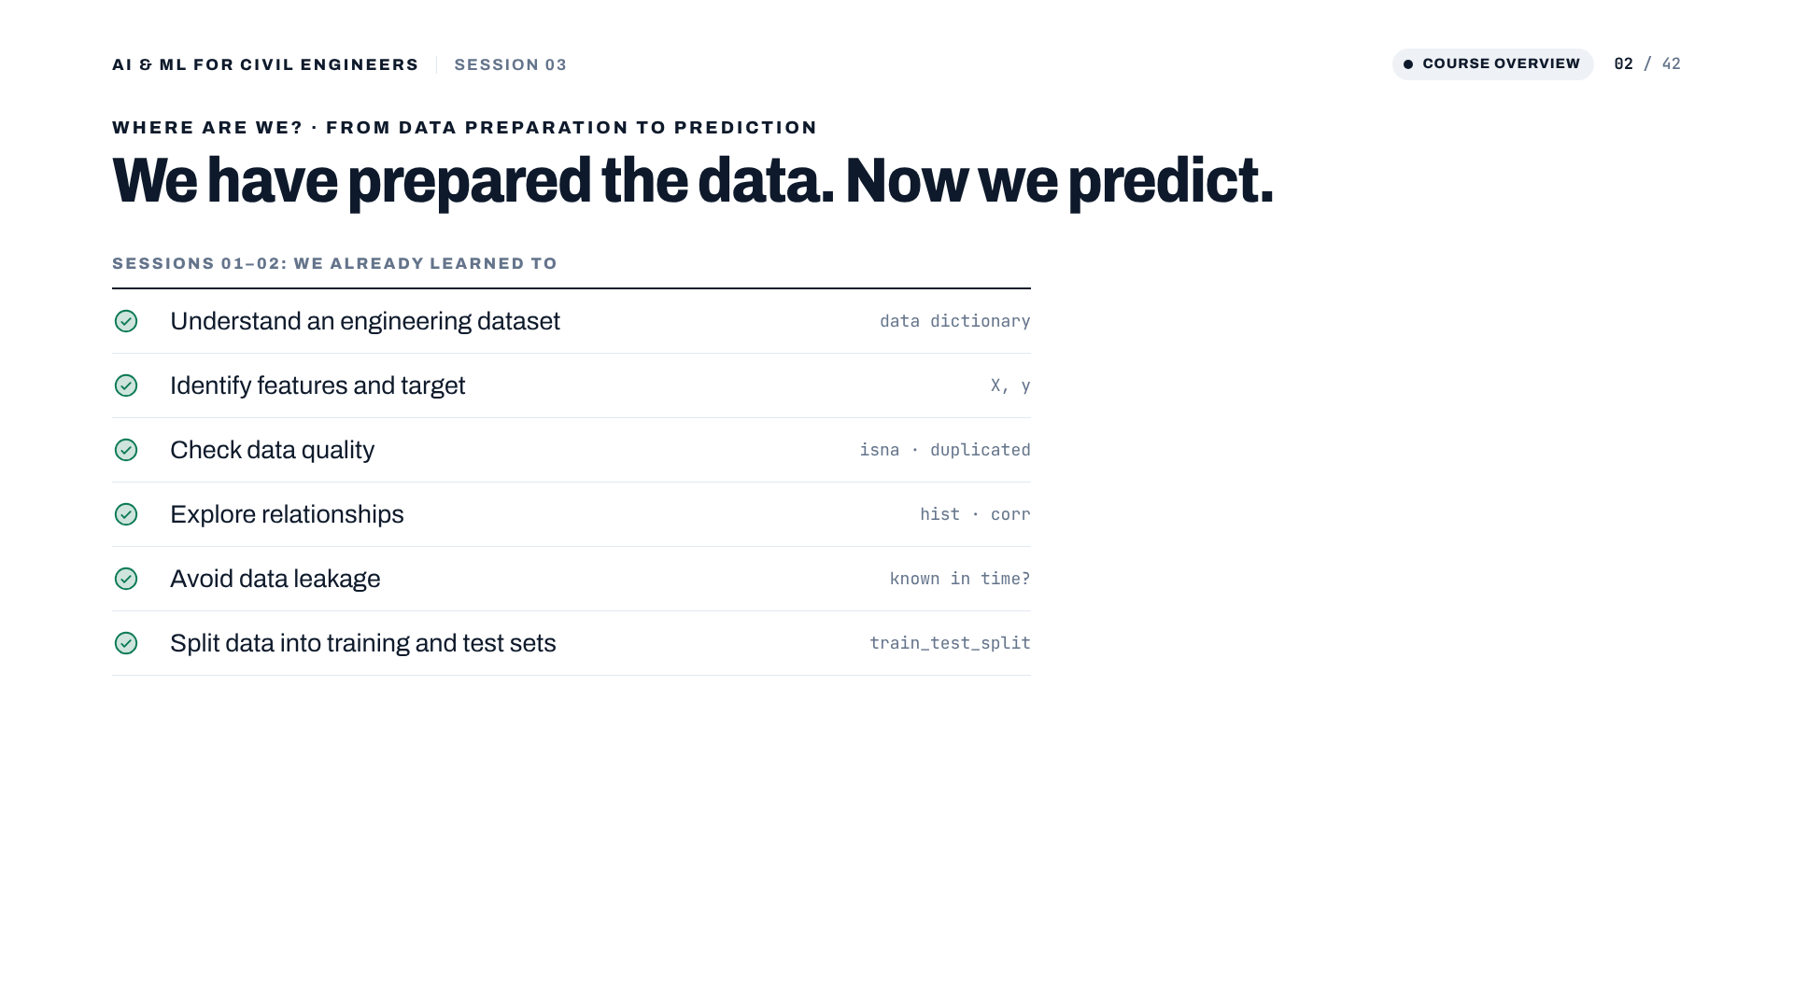
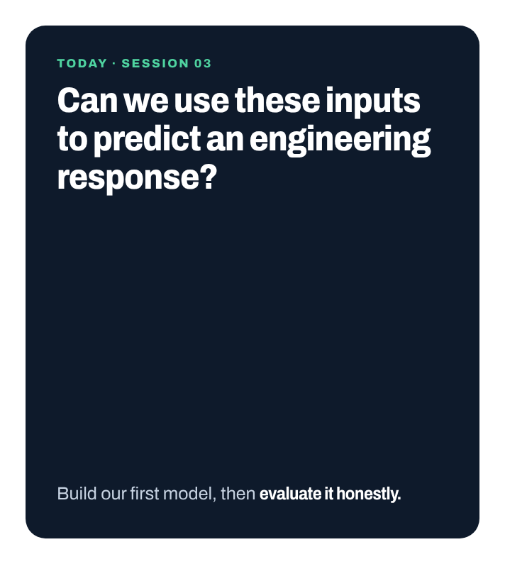
Notes:
Recap of sessions 01 and 02 in one minute. Everything on the left is what made the data ready. Today: can we use these inputs to predict an engineering response, and how would we know if the prediction is any good?
[Clicks on this slide: 1]

Slide 3
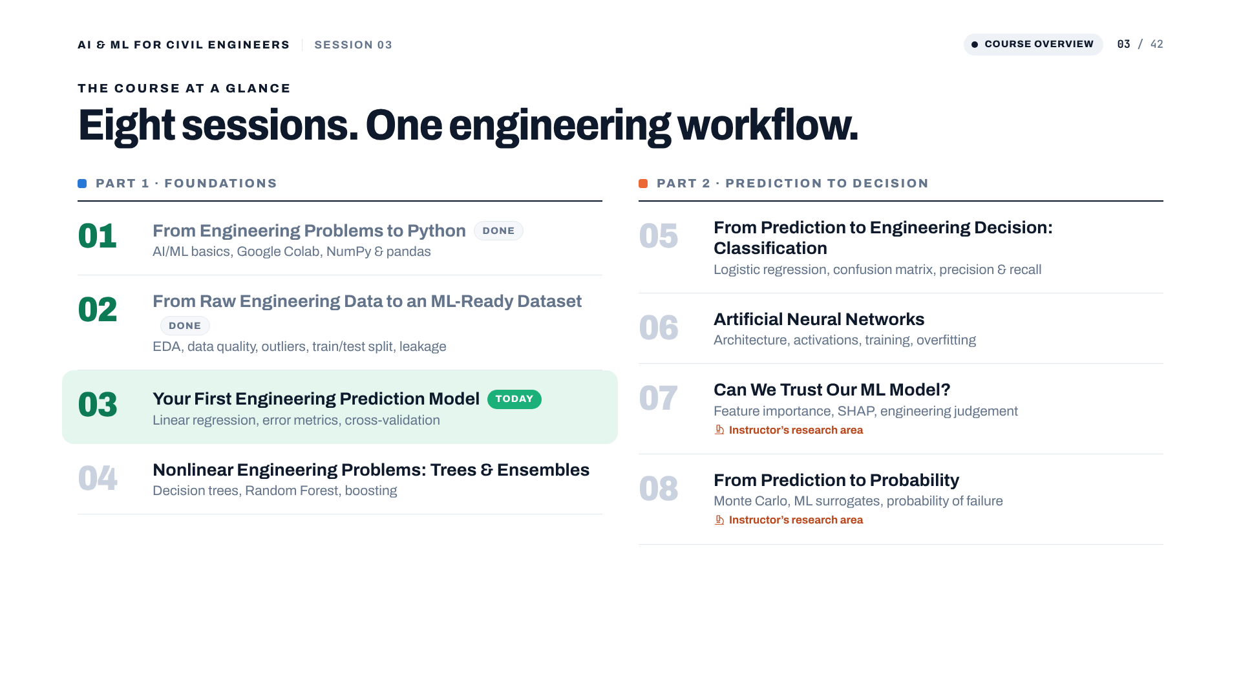
Notes:
Session 03 of 8. After today we have a complete, honest modelling workflow that every later session reuses.

Slide 4
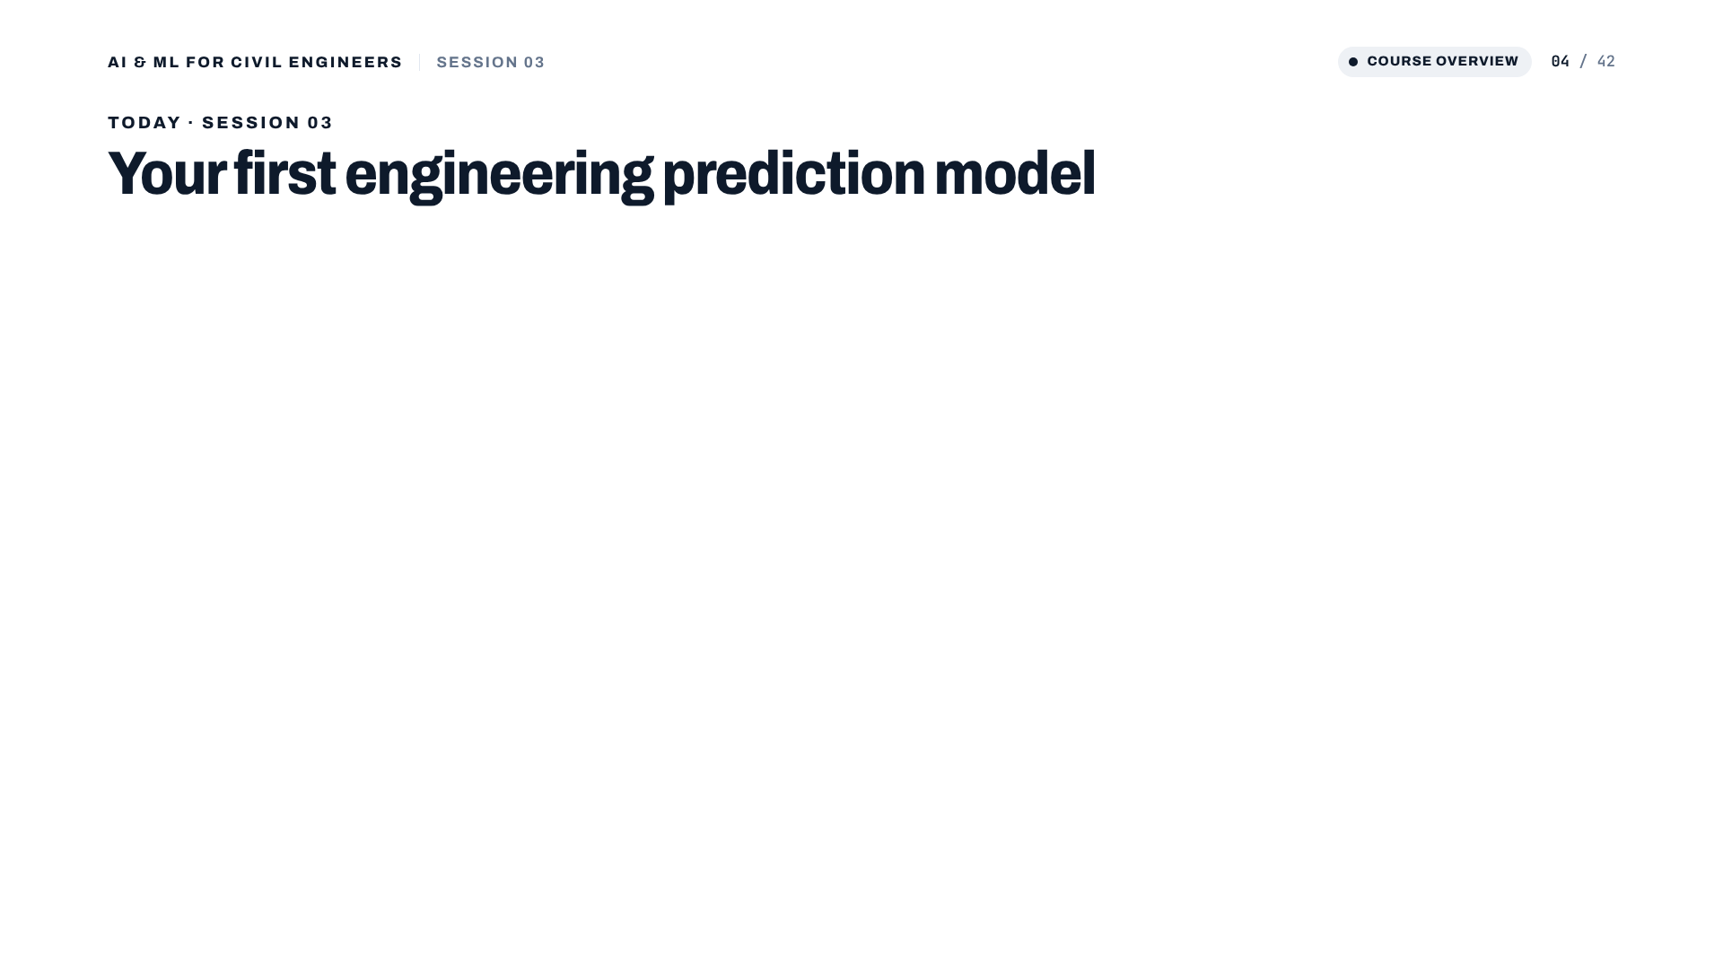
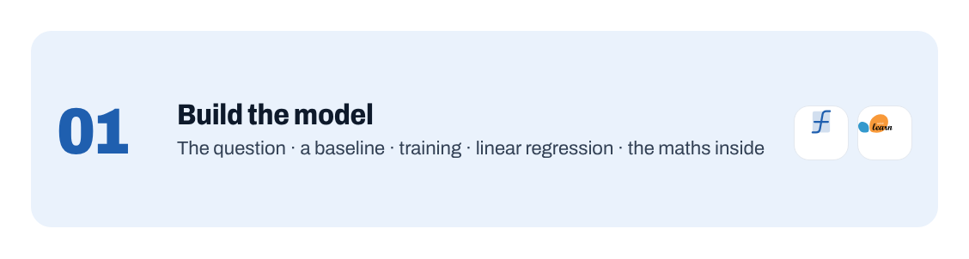
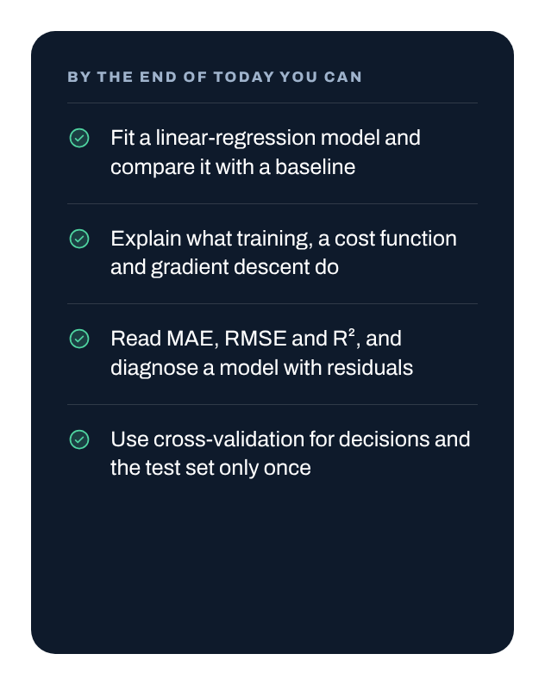
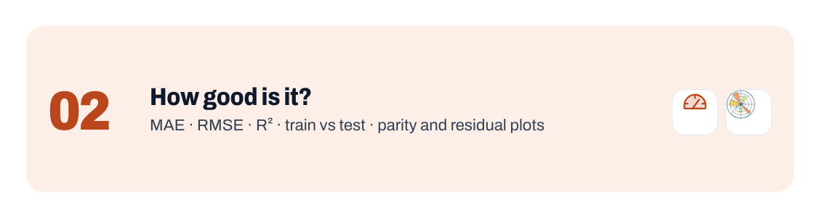
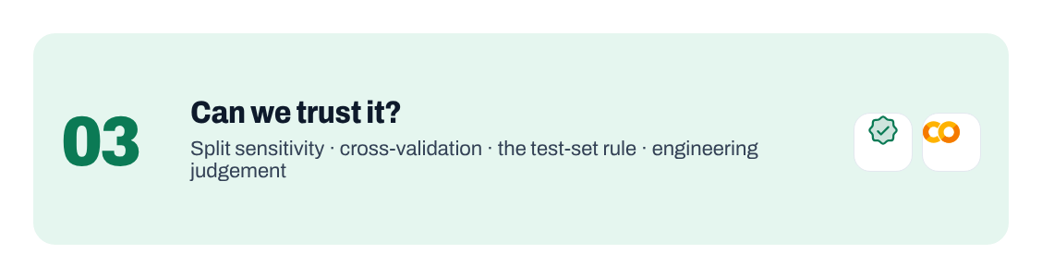
Notes:
Three parts: build the model (including the maths behind it), evaluate it, and check whether we can trust it. Read the four outcomes; we return to them in the summary.
[Clicks on this slide: 4]

Slide 5
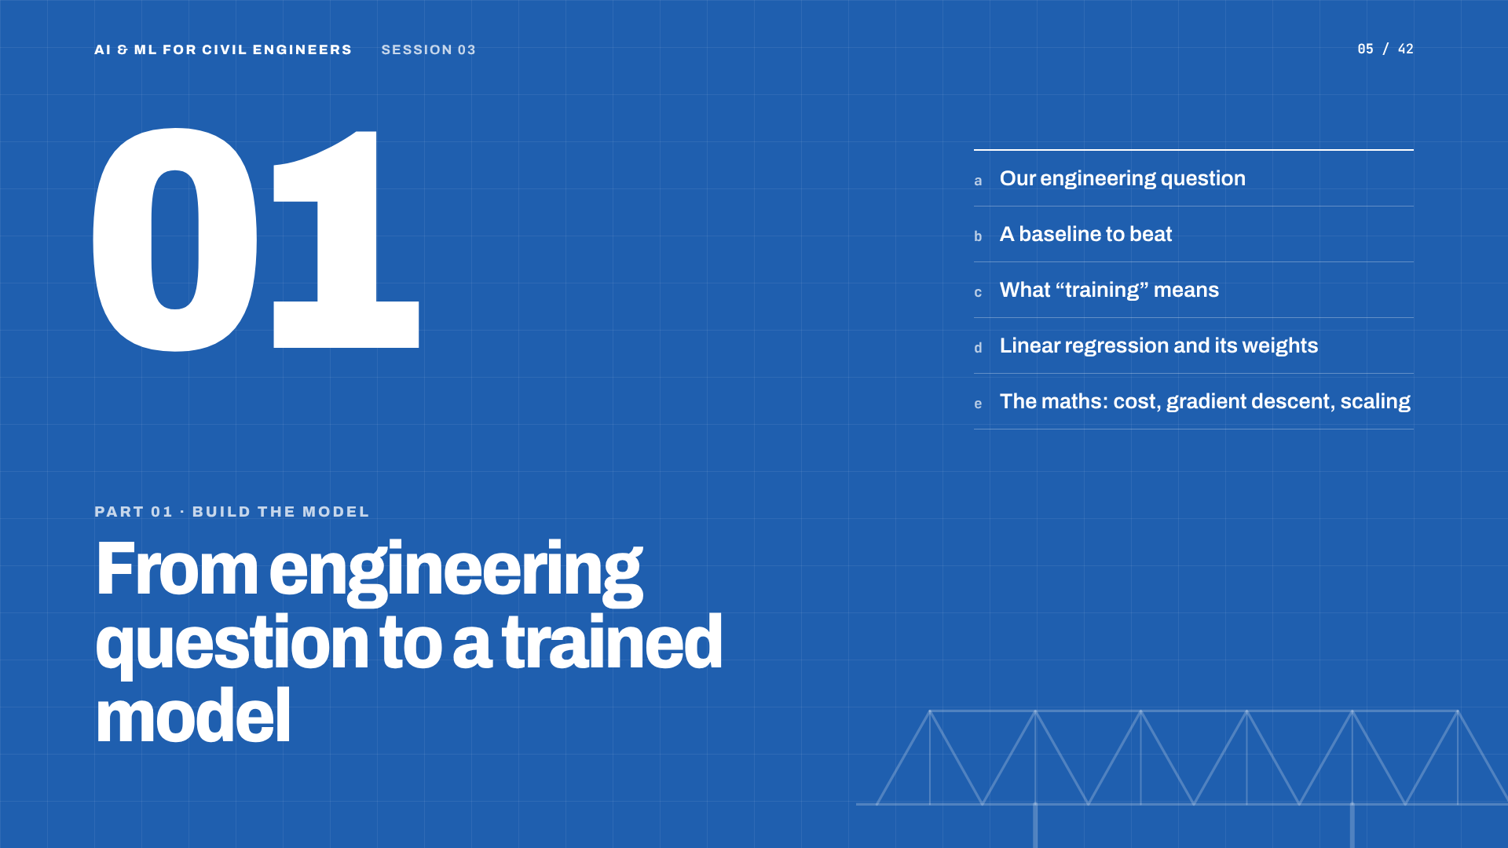
Notes:
Part 01: from engineering question to a trained model.

Slide 6
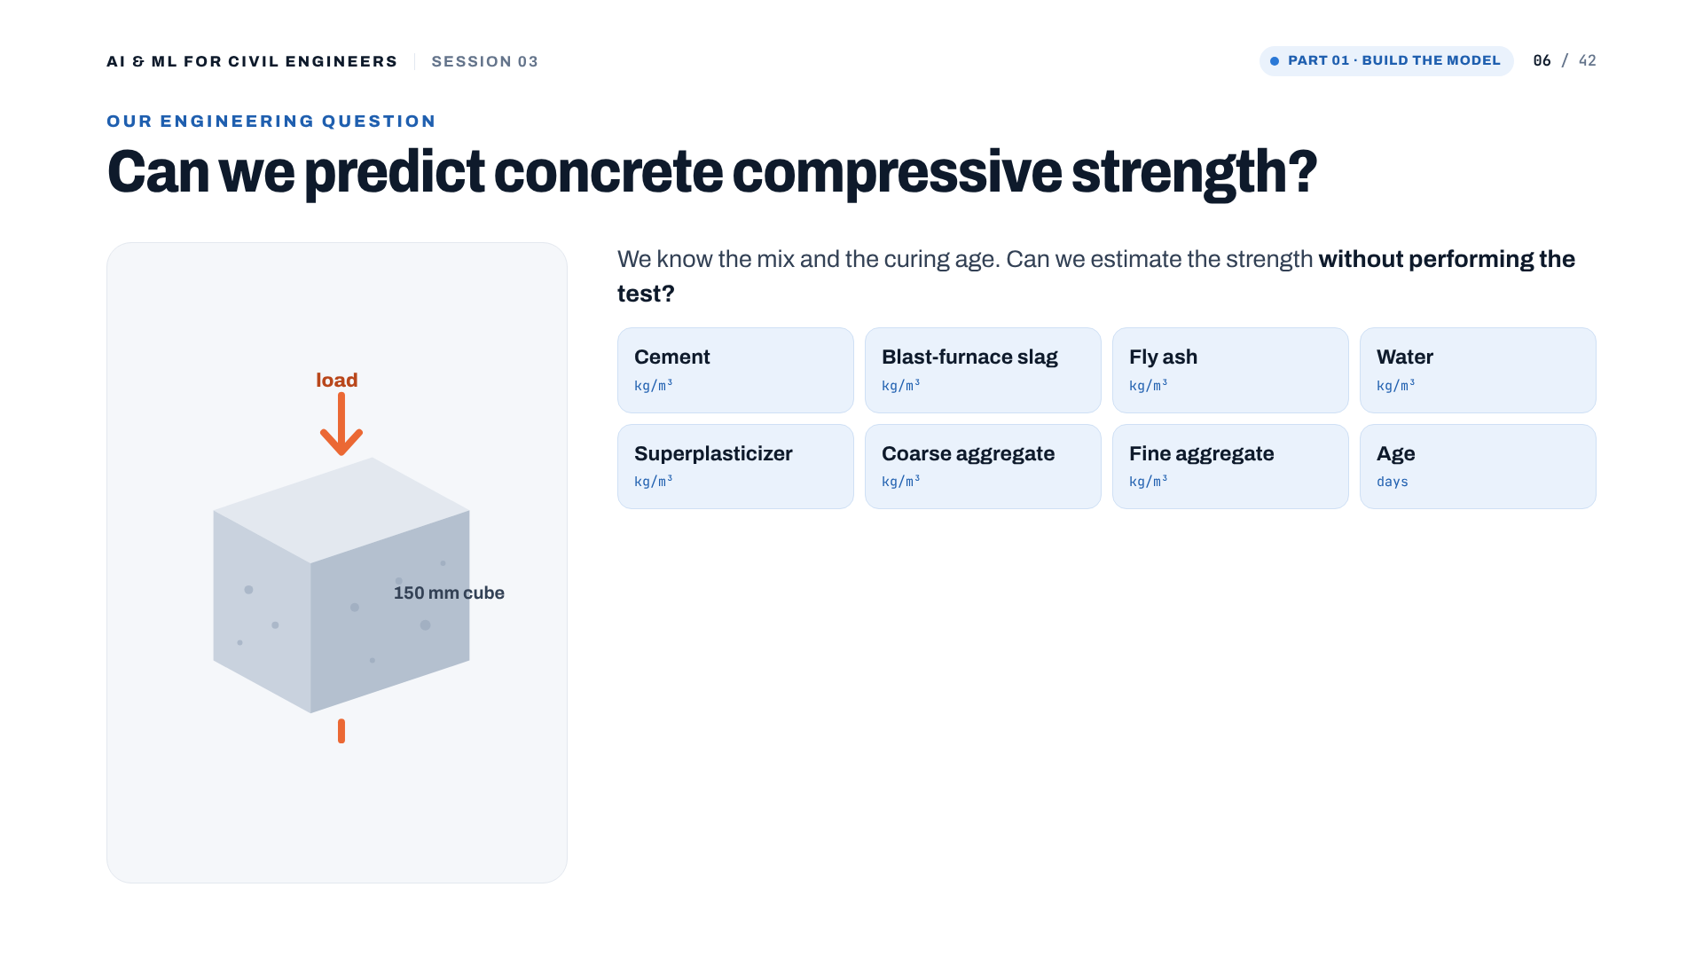
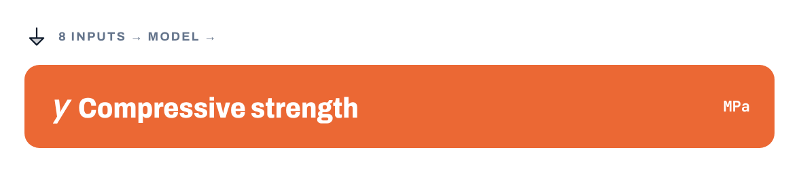
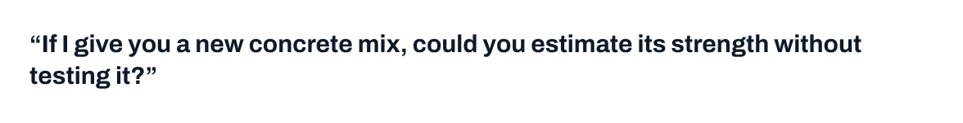
Notes:
Instructor prompt (draft): "If I give you a new concrete mix, could you estimate its compressive strength without performing the test?" Eight inputs, one numeric target.
[Clicks on this slide: 2]

Slide 7
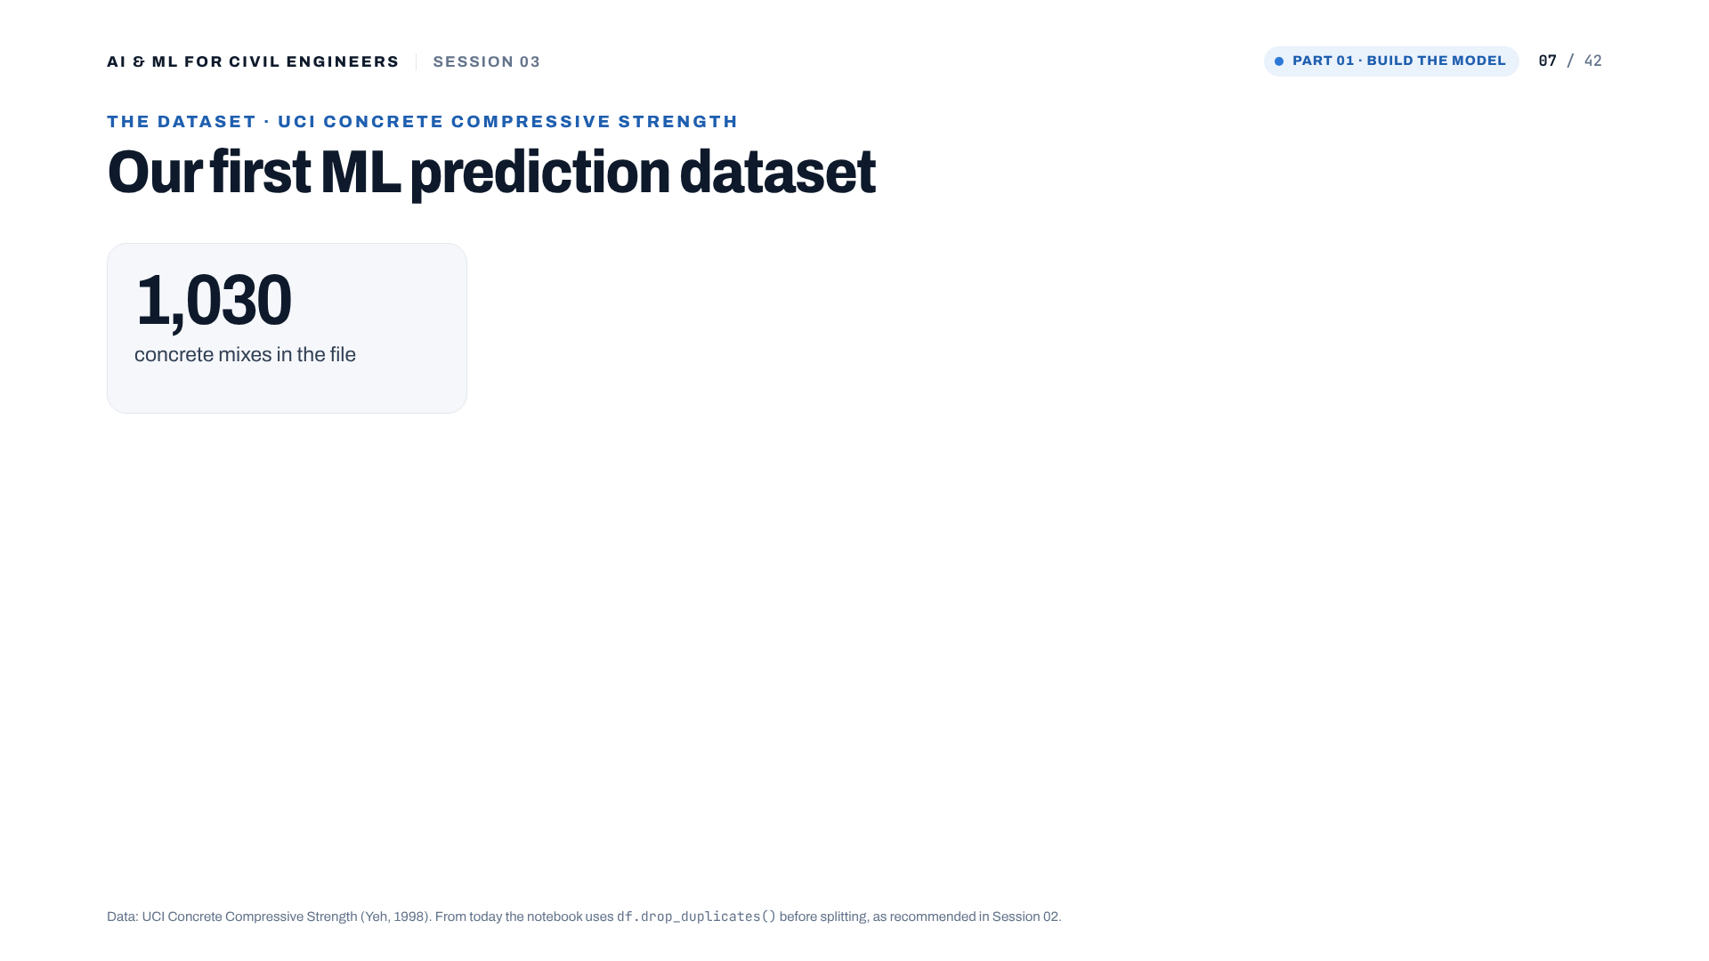
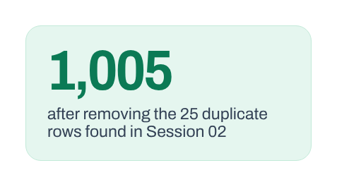
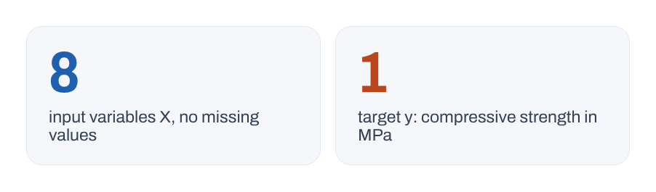
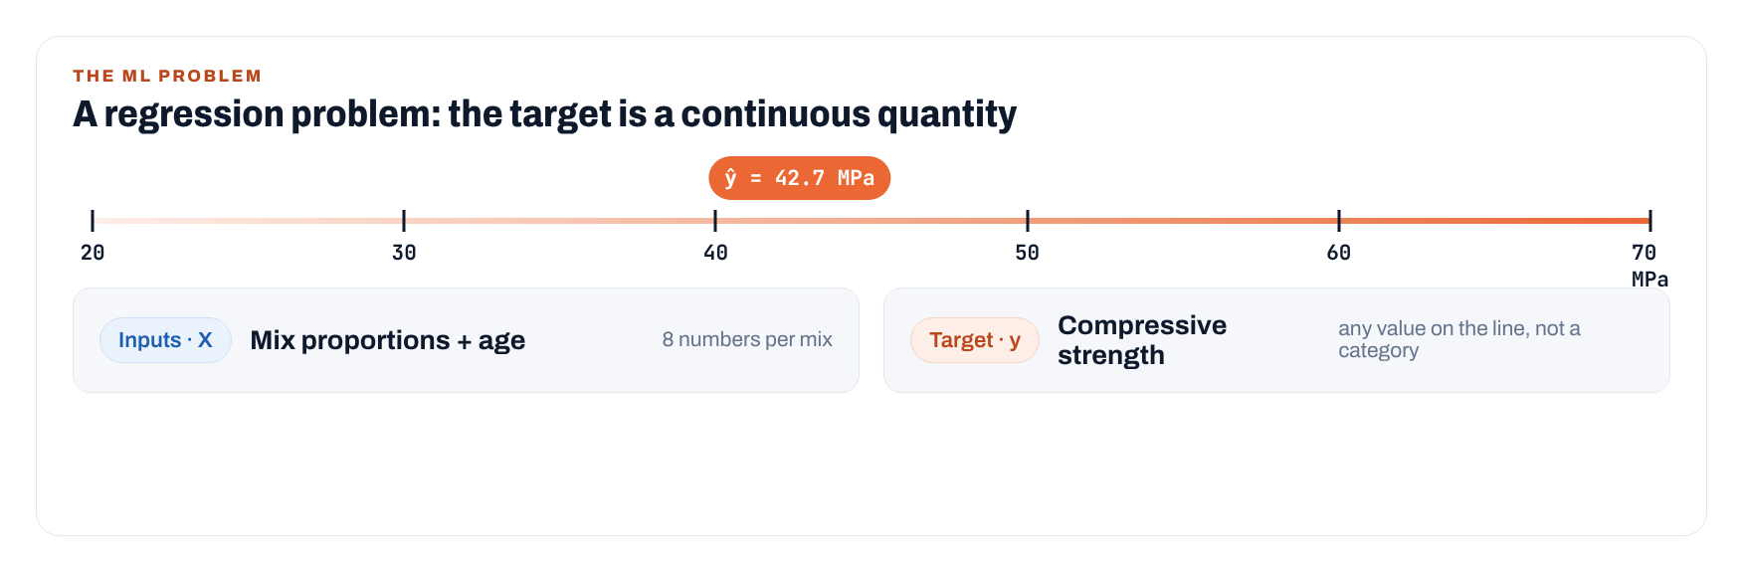
Notes:
The file has 1,030 mixes. In Session 02 we found 25 duplicated rows; from today the notebook drops them, leaving 1,005. Eight inputs, no missing values, one continuous target in MPa: a regression problem. The 42.7 MPa marker just illustrates that a prediction can be any value on the line.
[Clicks on this slide: 3]

Slide 8
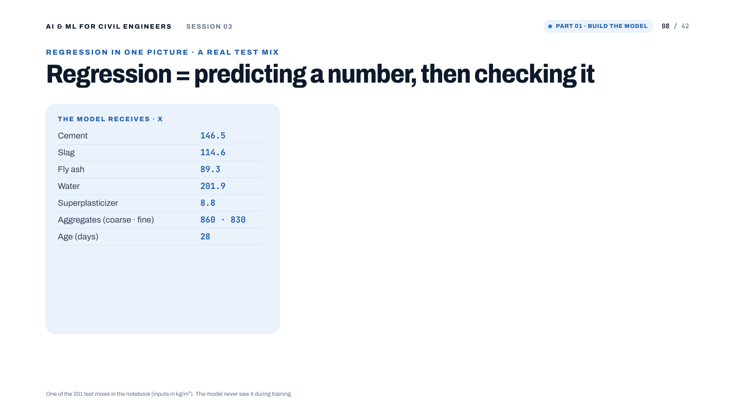
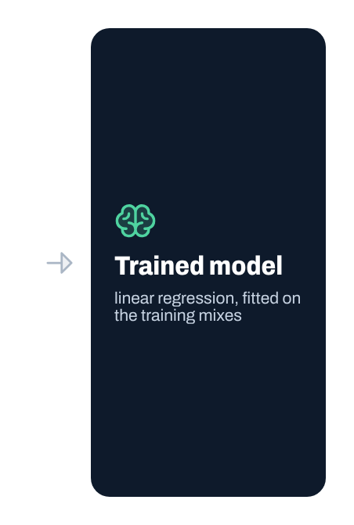
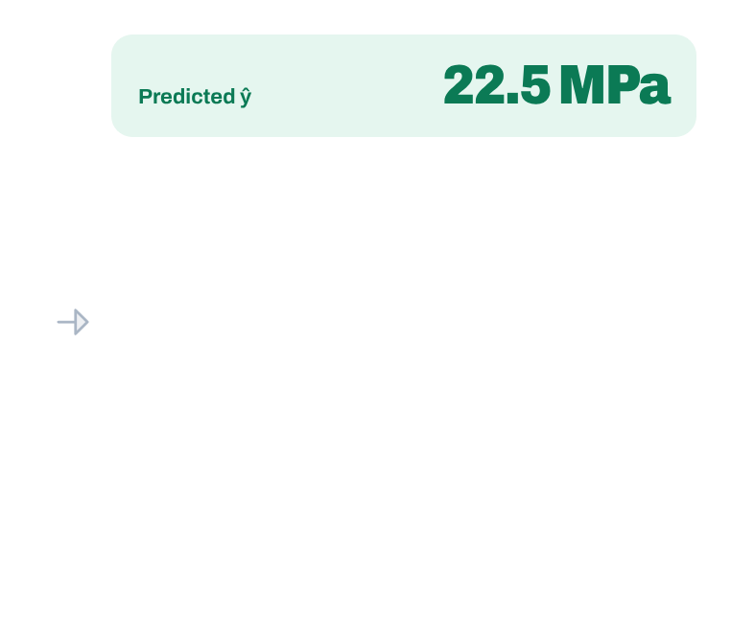
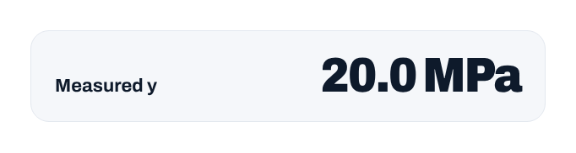
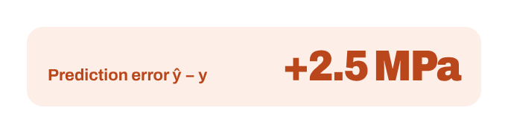
Notes:
A real test mix from the notebook: the model predicts 22.5 MPa, the lab measured 20.0 MPa, so the error is +2.5 MPa. Instructor note (draft): "Every regression model we build today ultimately produces predictions that we need to compare against observations."
[Clicks on this slide: 5]

Slide 9
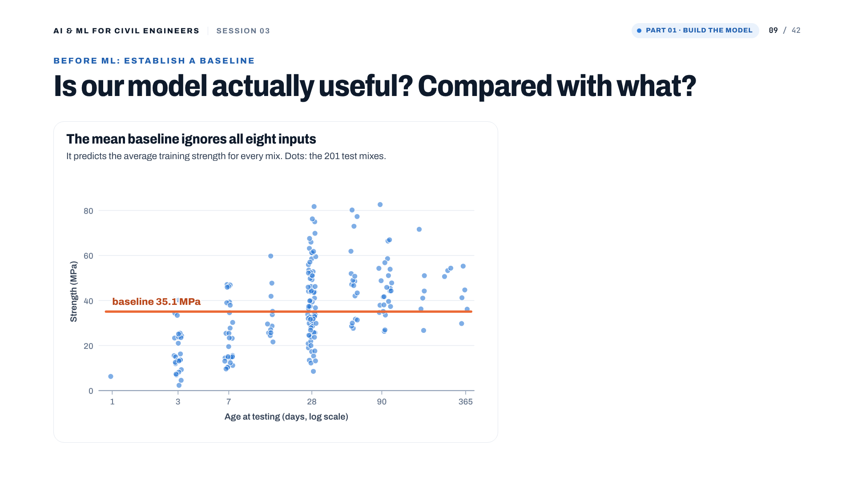
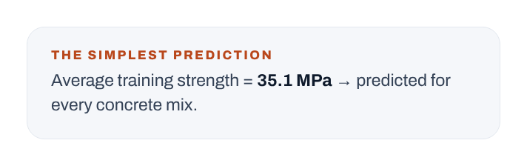
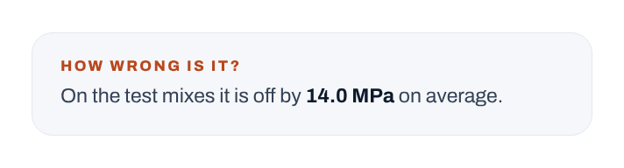
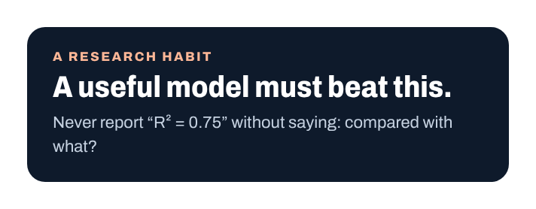
Notes:
The mean baseline: predict the average training strength, 35.1 MPa, for every mix. It ignores all eight inputs. On the test mixes it is off by 14.0 MPa on average. Instructor note (draft): this is a very important research habit. Don't simply report that an ML model gives an R² of 0.75. Ask: compared with what?
[Clicks on this slide: 3]

Slide 10
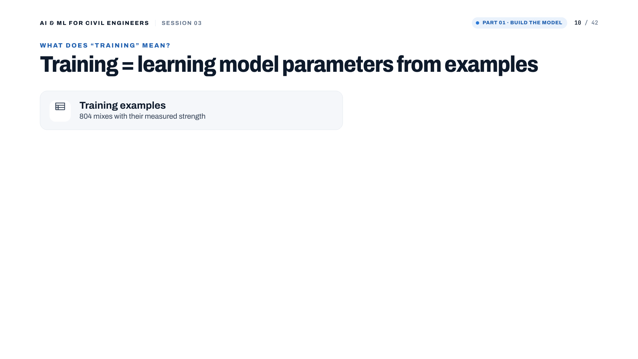
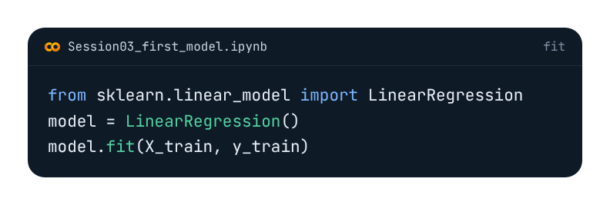
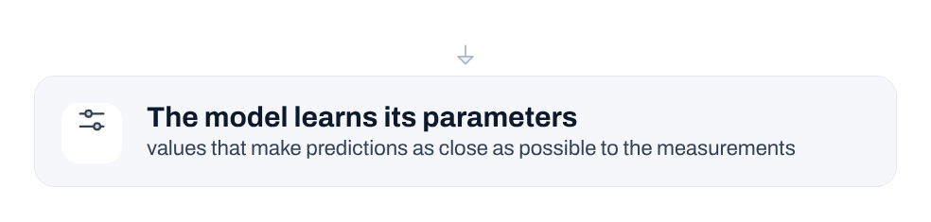
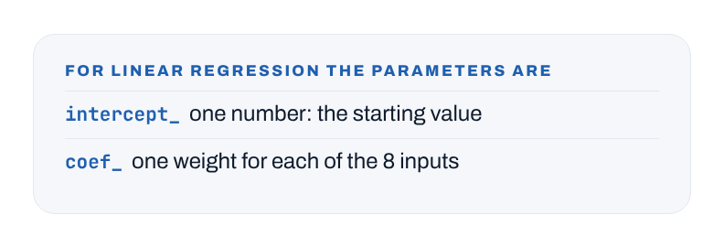

Notes:
Training = learning parameters from examples. For linear regression: one intercept and one coefficient per input. fit() chooses them so that the predictions are as close as possible to the training measurements. (The draft said 'do not introduce gradient descent here'; it comes on slides 15-19.)
[Clicks on this slide: 4]

Slide 11

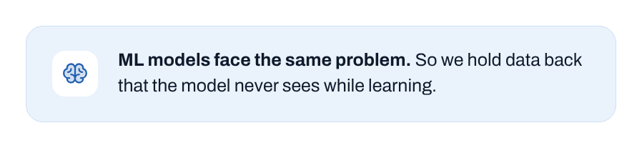
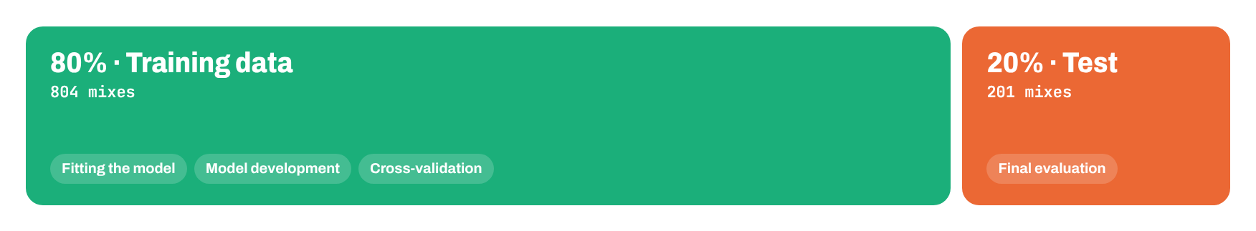
Notes:
Why hold data back: the exam analogy. 80% (804 mixes) for fitting, development and cross-validation; 20% (201 mixes) kept for the final evaluation only.
[Clicks on this slide: 3]

Slide 12
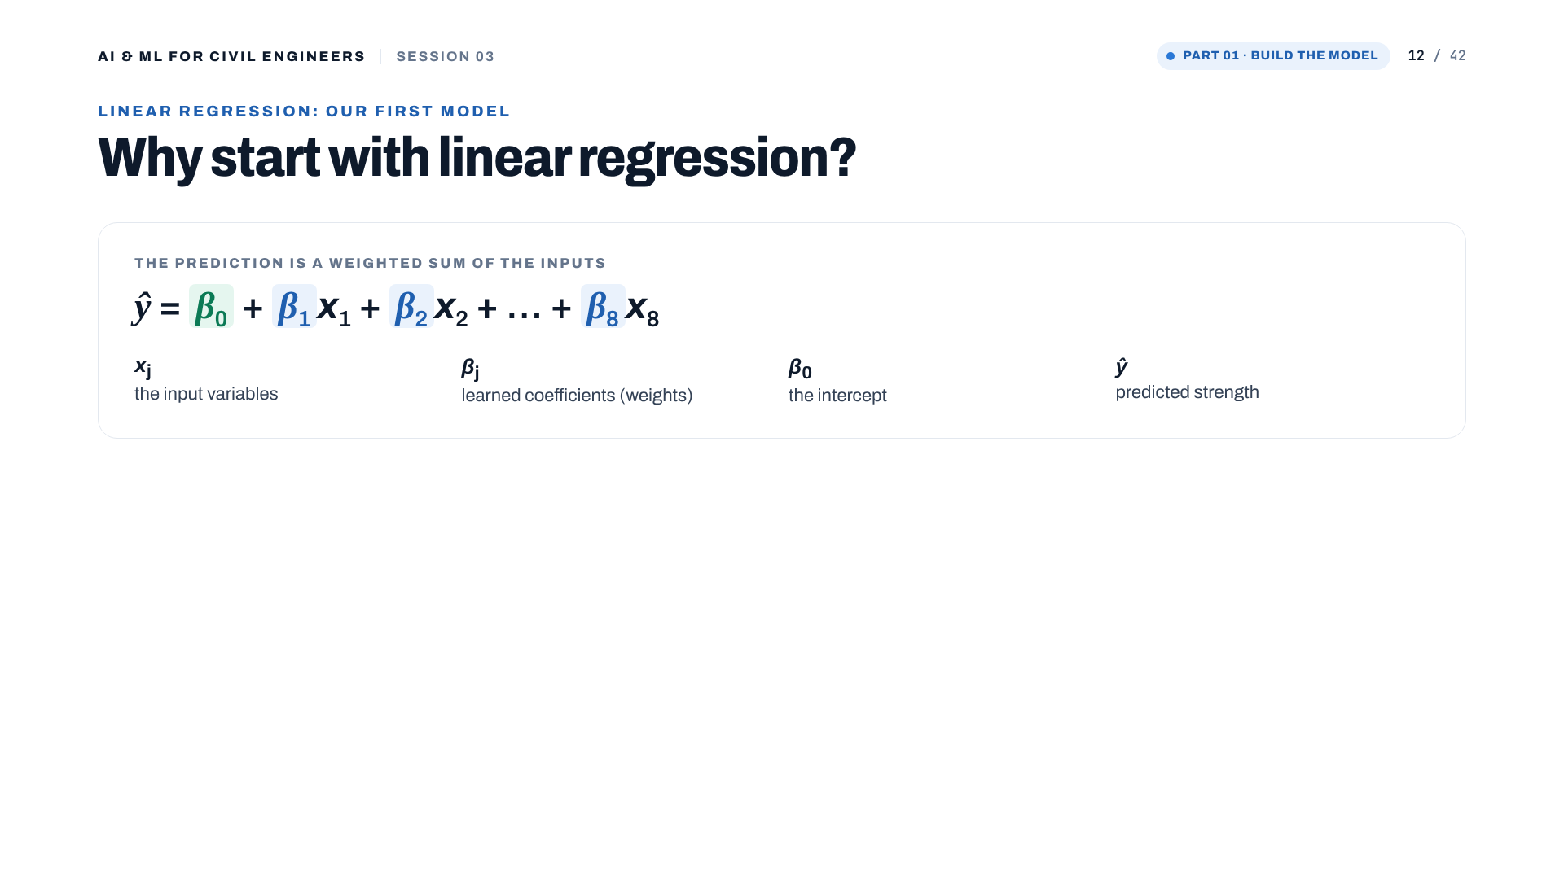
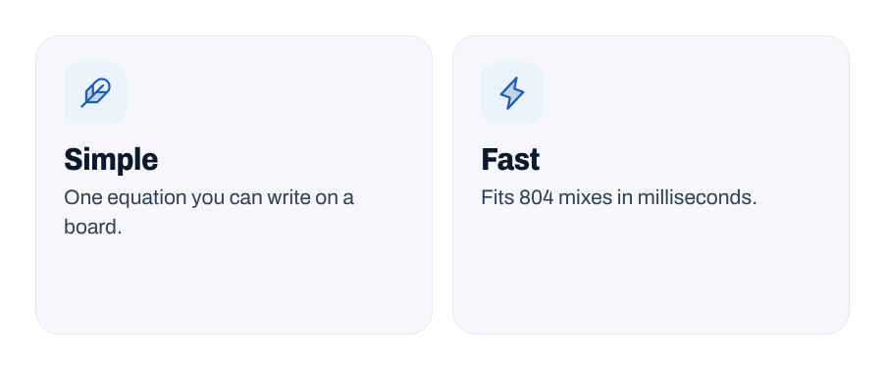
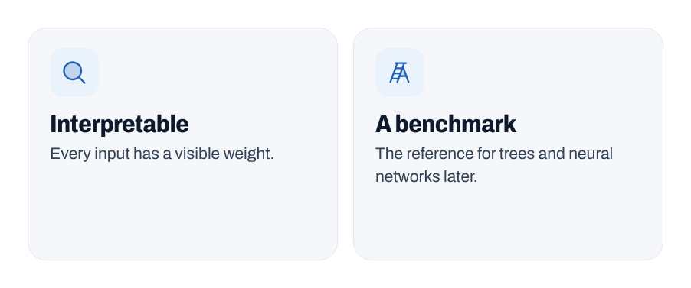
Notes:
Linear regression: the prediction is a weighted sum of the inputs plus an intercept. Simple, fast, interpretable, and the baseline for every more complex model later. Simple does not mean useless.
[Clicks on this slide: 3]

Slide 13
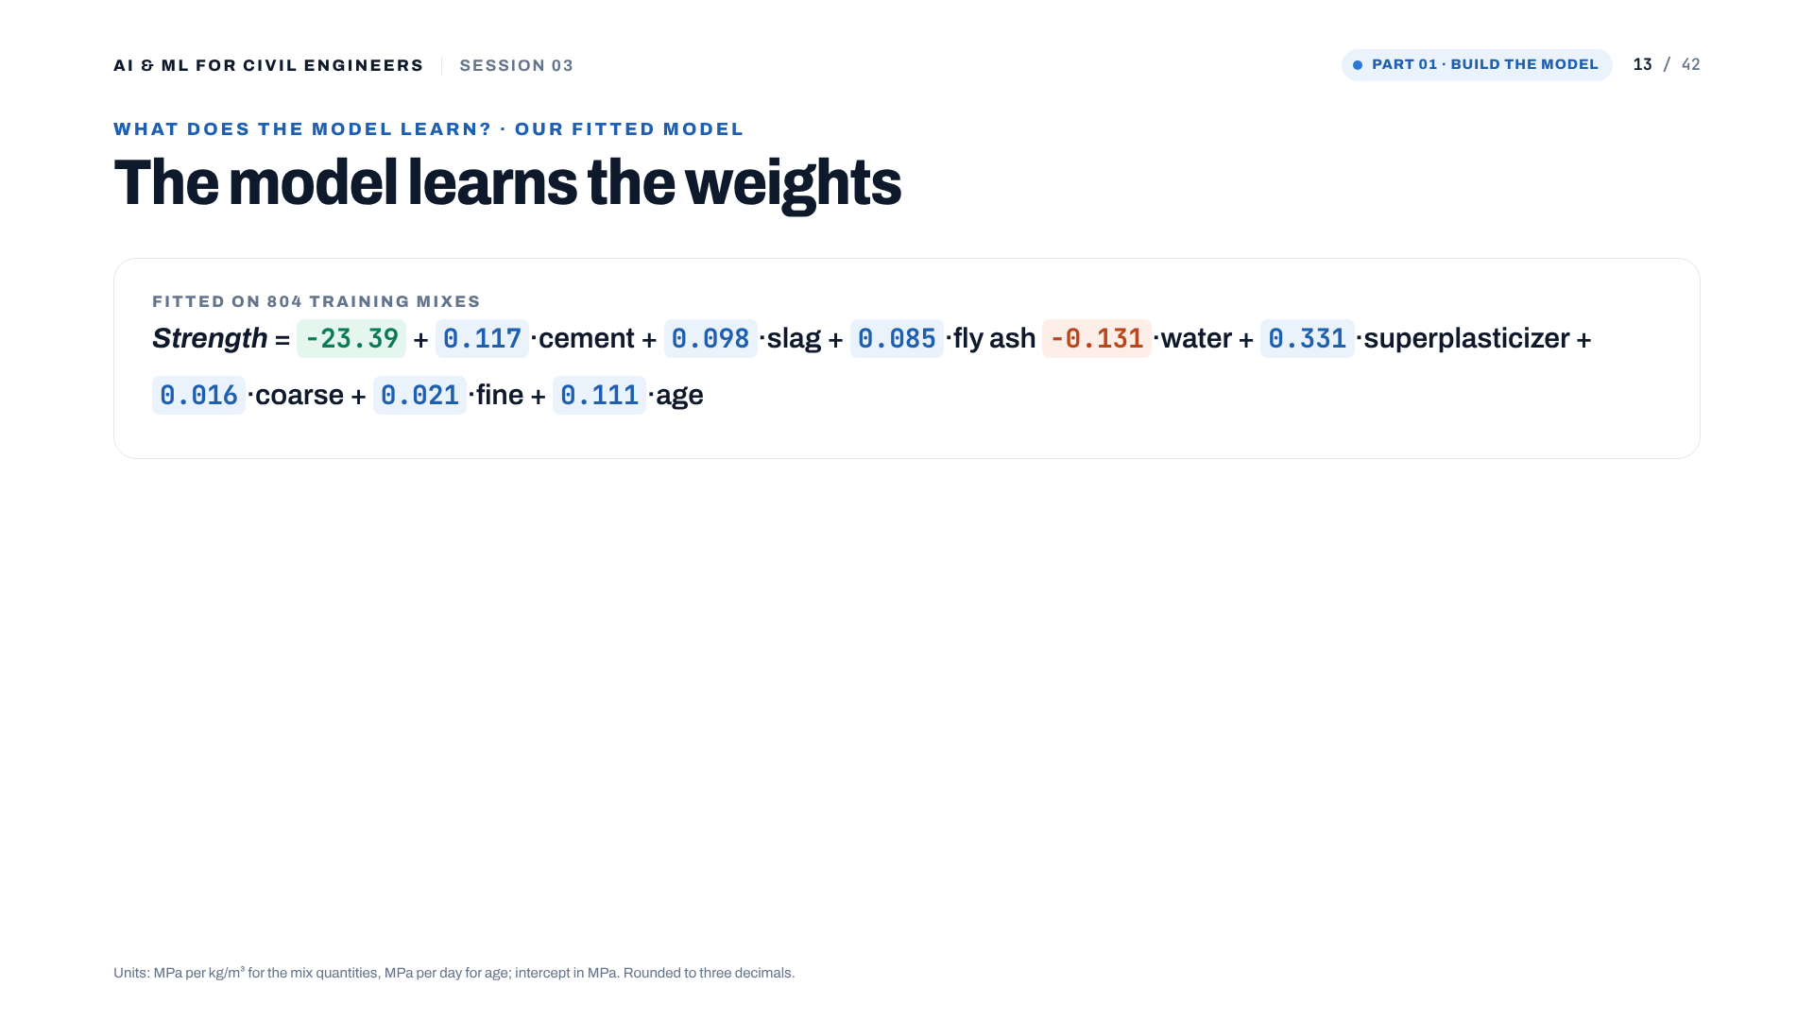
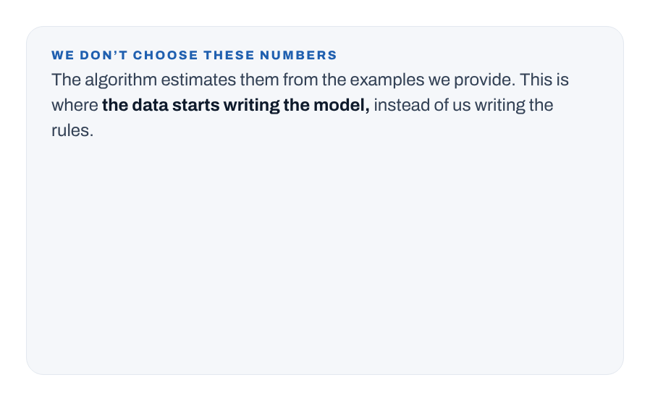
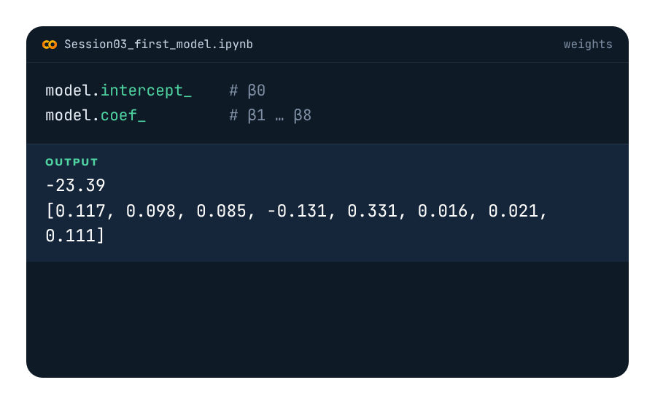
Notes:
The real fitted equation. Intercept -23.39 MPa; for example cement +0.117 and age +0.111. Instructor note (draft): "This is the point where the data starts determining the model rather than us writing engineering rules manually."
[Clicks on this slide: 2]

Slide 14
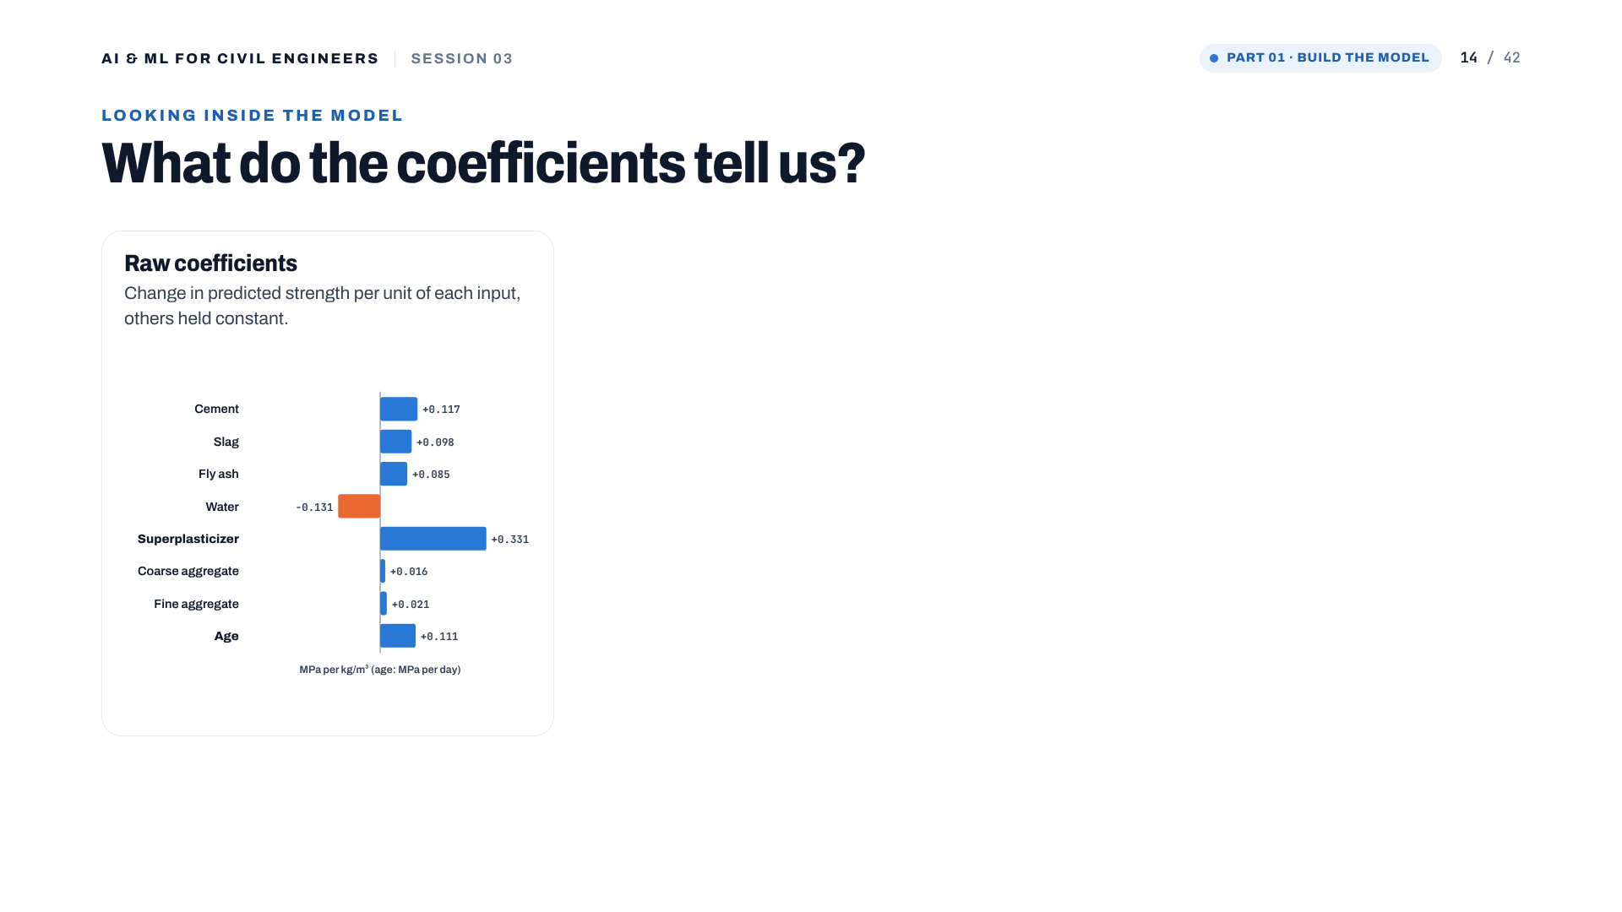
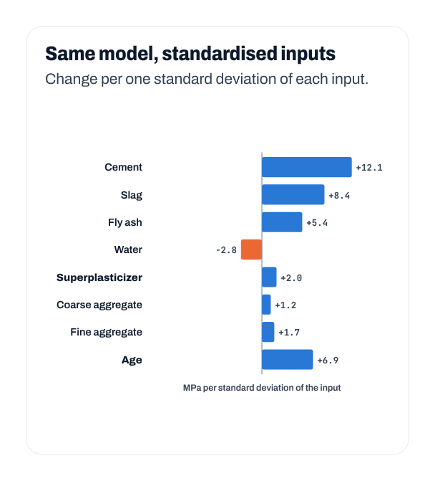
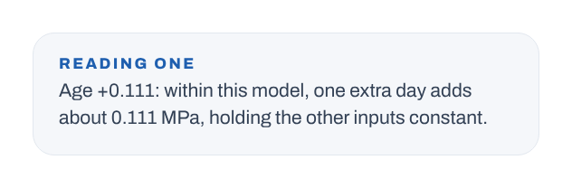
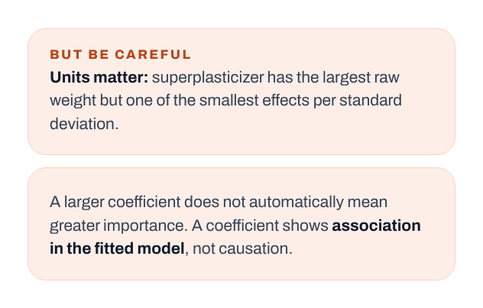
Notes:
Reading coefficients. Raw: superplasticizer has the largest weight (+0.331 per kg/m³) but it only varies by a few kg/m³. Per standard deviation, cement (+12.1) and slag dominate and superplasticizer is small (+2.0). Units matter; a coefficient is an association in the fitted model, not a cause.
[Clicks on this slide: 4]

Slide 15
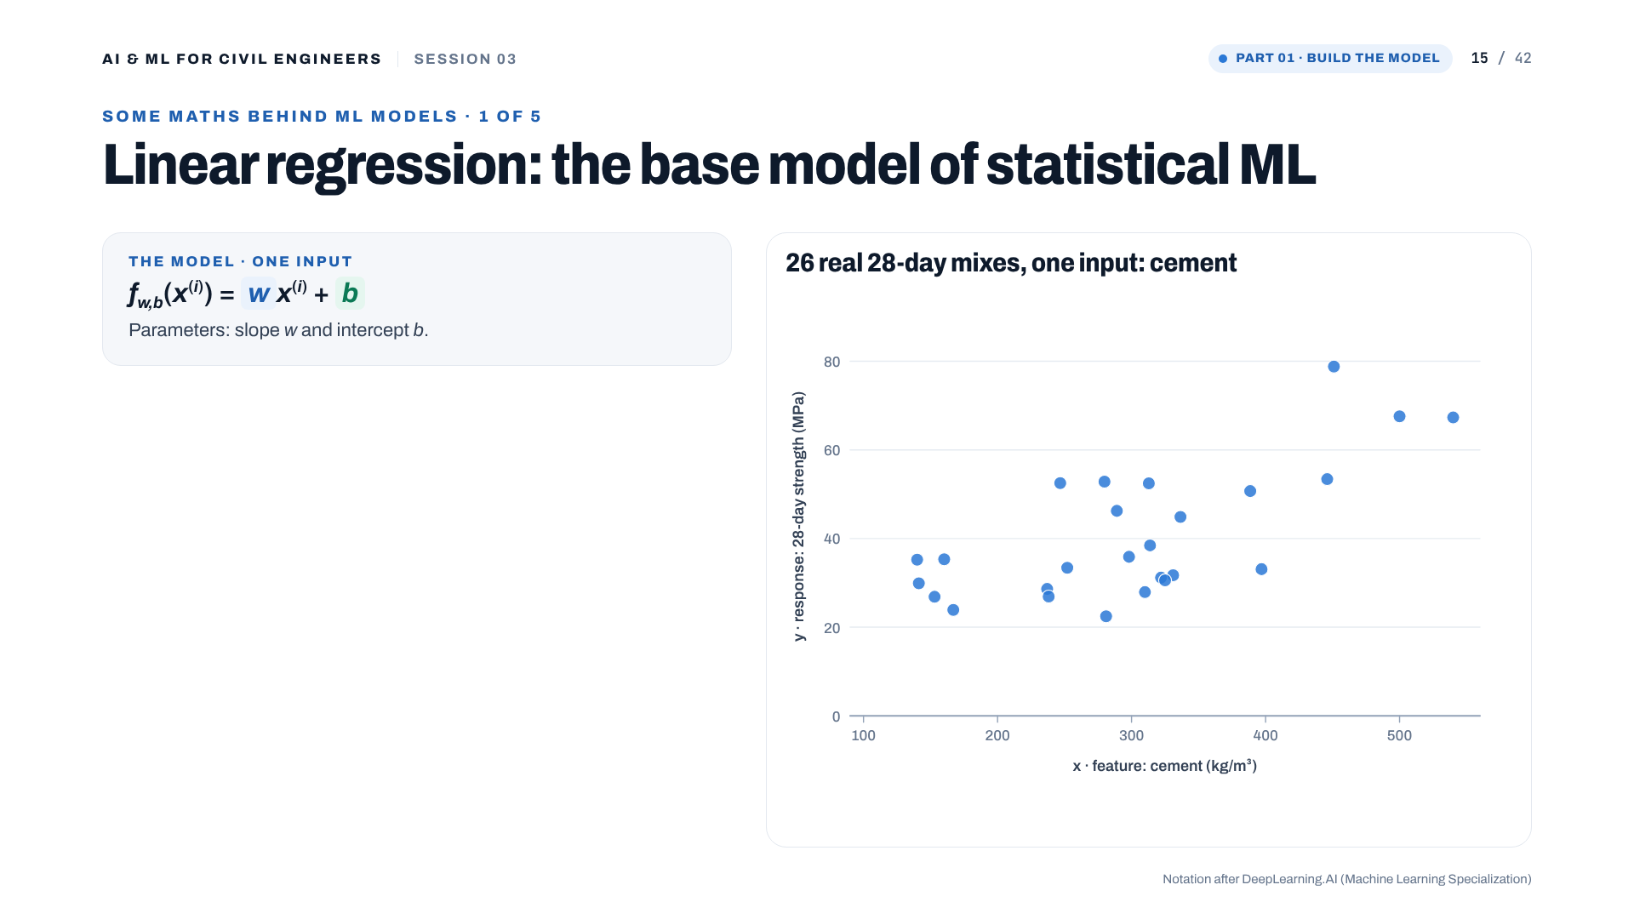
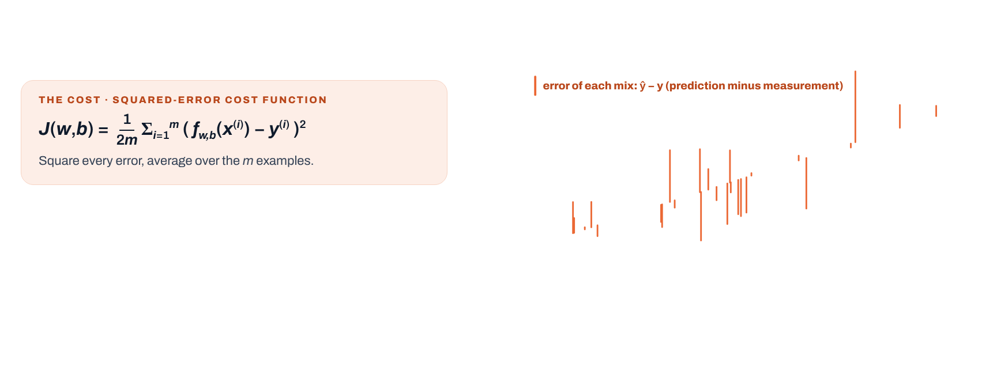
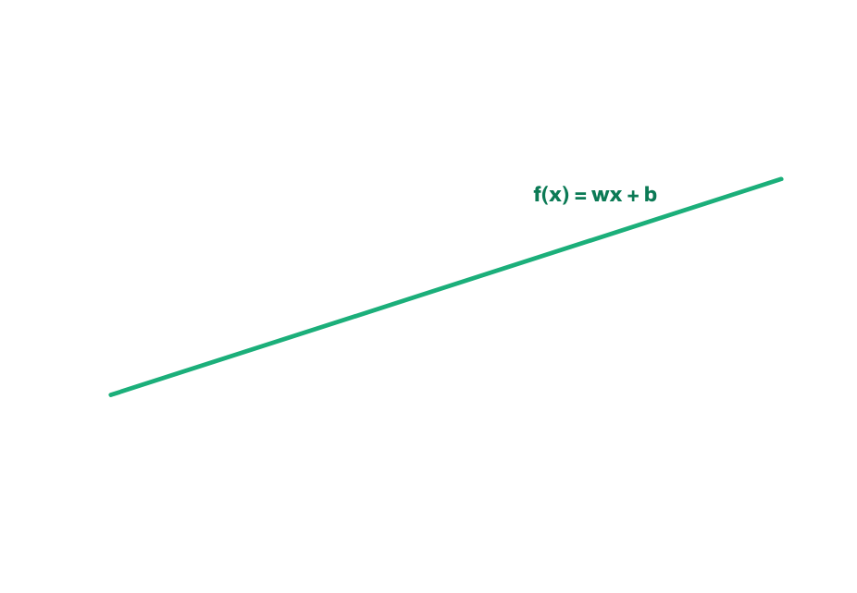
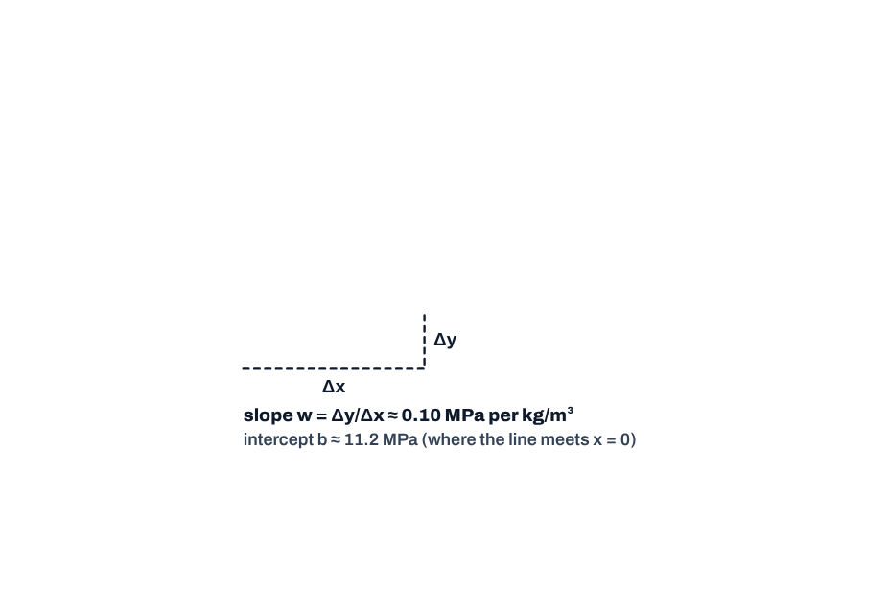
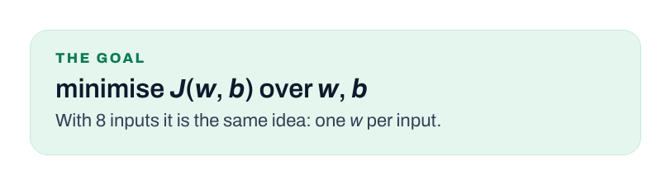
Notes:
Some maths behind ML models (1 of 5). One input to keep it visible: 26 real 28-day mixes, strength against cement. Click 1: the line f(x) = wx + b. Click 2: the vertical errors, and the squared-error cost J(w, b) that adds them up. Click 3: slope and intercept. Click 4: the goal, find w and b that make J smallest.
[Clicks on this slide: 4]

Slide 16
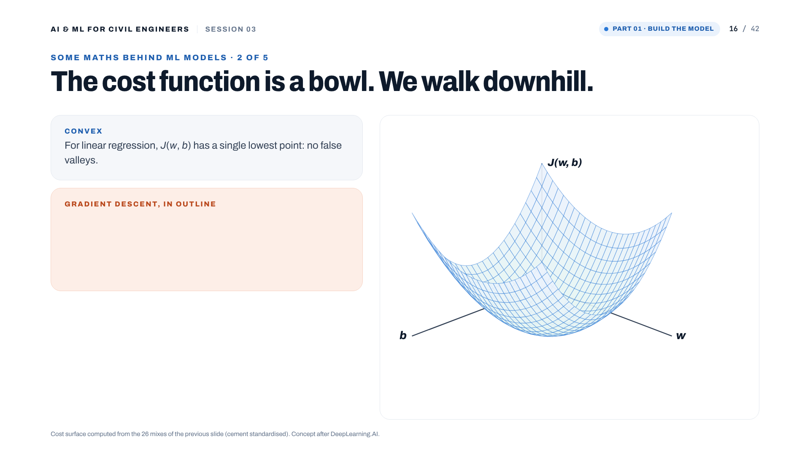
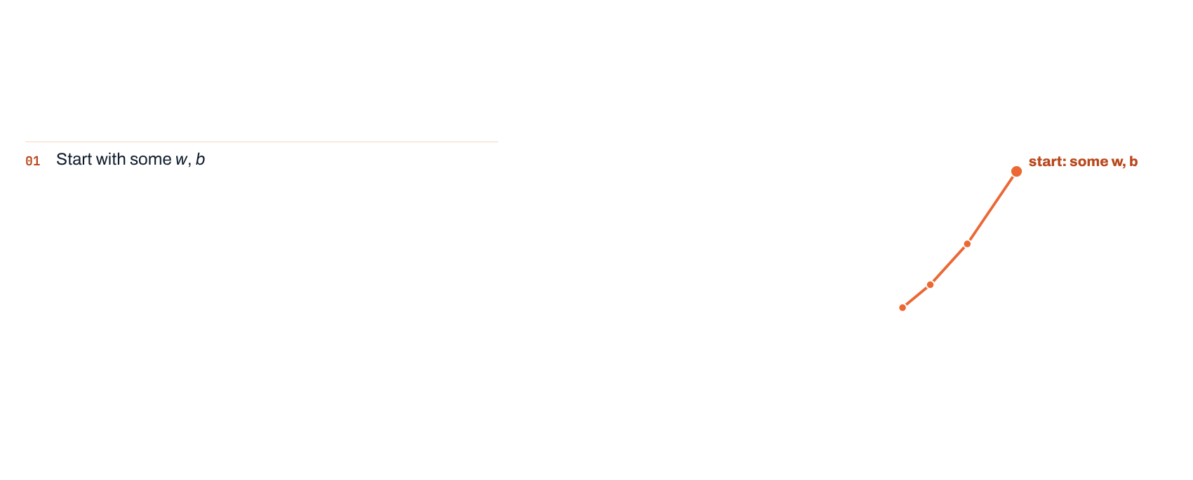
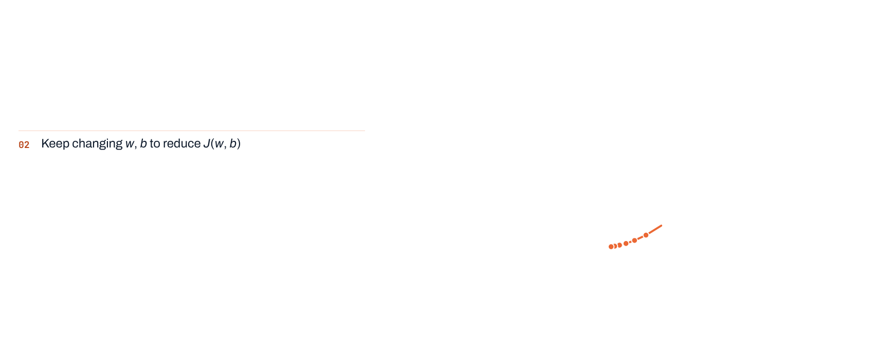
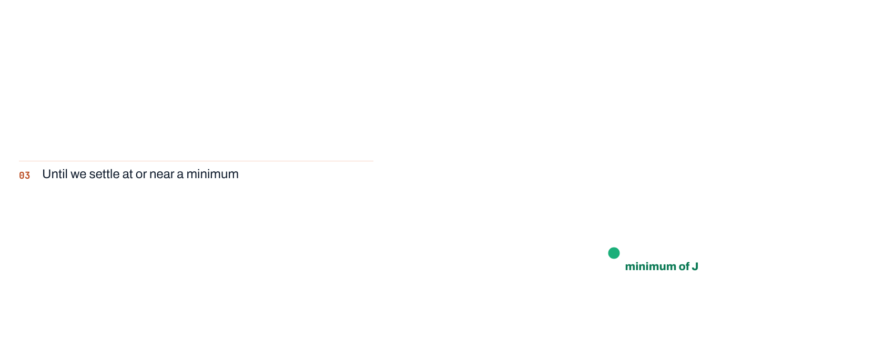


Notes:
(2 of 5) Plot J for every pair (w, b) and you get a bowl: convex, one minimum. Gradient descent starts somewhere and walks downhill. The clicks show the real path in three stages; 40 steps reduce J from 1,103 to 54 MPa², its minimum.
[Clicks on this slide: 5]

Slide 17








Notes:
(3 of 5) The update rule: new w = old w minus learning rate times slope. Clicks 1-2: on the left the slope is negative, so w increases; on the right it is positive, so w decreases. Clicks 4-6: the ball steps down, with steps shrinking as the slope flattens. w and b are updated together.
[Clicks on this slide: 7]

Slide 18





Notes:
(4 of 5) Learning rate: too small (0.03) crawls; about right (0.3) converges in about ten steps; too large (2.06) overshoots and diverges. α is a hyperparameter. scikit-learn's LinearRegression solves for the weights directly, so we do not tune α today; it returns with neural networks in Session 06.
[Clicks on this slide: 4]

Slide 19




Notes:
(5 of 5) Feature scaling. Cement varies about 17 times more than superplasticizer, so the cost contours are long and narrow and gradient descent needs 984 iterations. After standardising (mean 0, sd 1) the contours are nearly round: 2 iterations. Note: standardising gives mean 0 and sd 1; it does not force values into -1 to 1 (that is min-max scaling). Fit the scaler on the training data only.
[Clicks on this slide: 3]

Slide 20

Notes:
Part 02: how good is our model?

Slide 21




Notes:
We need a scorecard. Three metrics, three slightly different questions.
[Clicks on this slide: 4]

Slide 22



Notes:
MAE: the average absolute error, in MPa. Our model: 8.9 MPa on the test set, against 14.0 MPa for the mean baseline. 'Our predictions are off by about 8.9 MPa on average.'
[Clicks on this slide: 2]

Slide 23



Notes:
RMSE squares errors first, so big misses count more. The toy example: same MAE, double the RMSE. Ours: 11.2 MPa (baseline 17.3). The gap between RMSE and MAE hints at a few large misses.
[Clicks on this slide: 2]

Slide 24




Notes:
R² compares our squared error with the mean baseline's. 1 is perfect, 0 is no better than the mean, negative is worse. Ours: 0.58. R² is not accuracy: 0.58 does not mean 58% of predictions are correct.
[Clicks on this slide: 3]

Slide 25


Notes:
The scorecard side by side. A metric is evidence, not engineering judgement: is an average error of about 9 MPa acceptable for the decision you have to make?
[Clicks on this slide: 4]

Slide 26





Notes:
Train R² 0.61, test R² 0.58: similar. No sign of overfitting, but modest on both: the model is probably too simple. Good training performance alone is never enough.
[Clicks on this slide: 5]

Slide 27



Notes:
Parity plot: perfect predictions lie on the 45-degree line. Here high-strength mixes fall below the line: the model under-predicts strong concrete. Look for ranges where it behaves differently.
[Clicks on this slide: 2]

Slide 28




Notes:
Residuals = actual minus predicted. Against the prediction they look roughly centred. Against age they curve: median residual about -13 MPa at 3 days, +12 at 56 days and -10 at a year. Strength gain with age is not a straight line, the same lesson as the correlation slide in Session 02. This is the evidence that a linear model is too simple.
[Clicks on this slide: 4]

Slide 29

Notes:
Part 03: is it consistent, and can we trust it?

Slide 30




Notes:
Same model, same data, different random split: test R² from 0.53 to 0.66 across 50 seeds (42: 0.58, 7: 0.64, 21: 0.66). One split is one estimate.
[Clicks on this slide: 4]

Slide 31









Notes:
5-fold cross-validation on the training data only; the test set stays locked. Each fold takes one turn as validation. Average the five scores. (This replaces the draft's 4-fold / 10% test diagram from another study, so it matches the 80/20 split and 5-fold CV used in the notebook.)
[Clicks on this slide: 8]

Slide 32



Notes:
Our model: fold R² from 0.55 to 0.64, mean 0.59 ± 0.03: consistent. Models A and B are an illustration: same mean, very different spread. Note that the 1.02 in the draft's Model B example is impossible for R² (maximum 1); it is kept here, marked, as a talking point about sanity checks. Instructor note (draft): large variation may indicate that the model behaves very differently for different subsets.
[Clicks on this slide: 3]

Slide 33



Notes:
The most important rule from today. Do not use the test set to choose models, features, hyperparameters or pre-processing. Every peek leaks the test set into development.
[Clicks on this slide: 3]

Slide 34







Notes:
The workflow: cross-validation for decisions, the test set for the final assessment, once. This matters more in Sessions 04 to 06 when we compare several algorithms.
[Clicks on this slide: 6]

Slide 35







Notes:
Five questions before trusting any prediction, each answered for today's model at the bottom of its card. Machine learning gives us a model; engineering judgement tells us whether to trust it.
[Clicks on this slide: 6]

Slide 36




Notes:
Live exercise in the notebook, about 10 minutes. A: change the seed. B: compare with the baseline (DummyRegressor). C: inspect the residuals. Close with the engineering question: is there evidence that the linear model is too simple? (Yes: the residuals curve with age.)
[Clicks on this slide: 4]

Slide 37




Notes:
The complete first modelling workflow in twelve steps. The central lesson: a prediction is not enough.
[Clicks on this slide: 3]

Slide 38


Notes:
Bridge to Session 04: our residuals curve, civil engineering relationships are often nonlinear, so next we try decision trees, Random Forest and boosting on the same data, compared with today's workflow.
[Clicks on this slide: 1]

Slide 39





Notes:
Optional practice. Exercise 2 (log of age) previews the idea that better features can fix some nonlinearity.
[Clicks on this slide: 4]

Slide 40

Notes:
Questions.

Slide 41

Notes:
Thank you. See you in Session 04.

Slide 42

Notes:
Appendix for the instructor: recommended timing, updated to this deck's slide numbers. Hide this slide when presenting if you prefer (right-click, Hide Slide).

