Slide 1







Live online course
Cohort Fall 2026
AI & Machine
Learning for Civil
Engineers
Session 03 · Linear regression, error metrics & cross-validation
Your First Engineering Prediction Model
Can a model learn a useful relationship from the data we prepared, and how would we
know?
Data
Model
Prediction
Evaluation
Decision
Dr. Abdul Waris
Research Associate · Universität Siegen, Germany
Technology partner
Notes:
Instructor note (draft): "Today we are going to build our first actual prediction model. We have already learned how to prepare the data. Now we ask: can a machine-learning model learn a useful relationship from this data?"

Slide 2



AI & ML for Civil Engineers
Session 03
Course overview
02 / 42
Where are we? · from data preparation to prediction
We have prepared the data. Now we predict.
Sessions 01–02: we already learned to
Understand an engineering dataset
data dictionary
Today · Session 03
Can we use these inputs
to predict an engineering
response?
Identify features and target
X, y
Check data quality
isna · duplicated
Explore relationships
hist · corr
Avoid data leakage
known in time?
Split data into training and test sets
train_test_split
Build our first model, then evaluate it honestly.
Notes:
Recap of sessions 01 and 02 in one minute. Everything on the left is what made the data ready. Today: can we use these inputs to predict an engineering response, and how would we know if the prediction is any good?
[Clicks on this slide: 1]

Slide 3


AI & ML for Civil Engineers
Session 03
Course overview
03 / 42
The course at a glance
Eight sessions. One engineering workflow.
Part 1 · Foundations
Part 2 · Prediction to decision
01
From Engineering Problems to Python
Done
05
From Prediction to Engineering Decision:
Classification
AI/ML basics, Google Colab, NumPy & pandas
Logistic regression, confusion matrix, precision & recall
02
From Raw Engineering Data to an ML-Ready Dataset
Done
06
Artificial Neural Networks
EDA, data quality, outliers, train/test split, leakage
Architecture, activations, training, overfitting
Your First Engineering Prediction Model
Today
07
Can We Trust Our ML Model?
03
Feature importance, SHAP, engineering judgement
Linear regression, error metrics, cross-validation
Instructor’s research area
04
Nonlinear Engineering Problems: Trees & Ensembles
From Prediction to Probability
Decision trees, Random Forest, boosting
08
Monte Carlo, ML surrogates, probability of failure
Instructor’s research area
Notes:
Session 03 of 8. After today we have a complete, honest modelling workflow that every later session reuses.

Slide 4









AI & ML for Civil Engineers
Session 03
Course overview
04 / 42
Today · Session 03
Your first engineering prediction model
By the end of today you can
01
Build the model
The question · a baseline · training · linear regression · the maths inside
Fit a linear-regression model and
compare it with a baseline
Explain what training, a cost function
and gradient descent do
02
How good is it?
Read MAE, RMSE and R², and
diagnose a model with residuals
MAE · RMSE · R² · train vs test · parity and residual plots
Use cross-validation for decisions and
the test set only once
Can we trust it?
03
Split sensitivity · cross-validation · the test-set rule · engineering
judgement
Notes:
Three parts: build the model (including the maths behind it), evaluate it, and check whether we can trust it. Read the four outcomes; we return to them in the summary.
[Clicks on this slide: 4]

Slide 5


AI & ML for Civil Engineers
Session 03
05 / 42
01
a
Our engineering question
b
A baseline to beat
c
What “training” means
d
Linear regression and its weights
e
The maths: cost, gradient descent, scaling
Part 01 · Build the model
From engineering
question to a trained
model
Notes:
Part 01: from engineering question to a trained model.

Slide 6
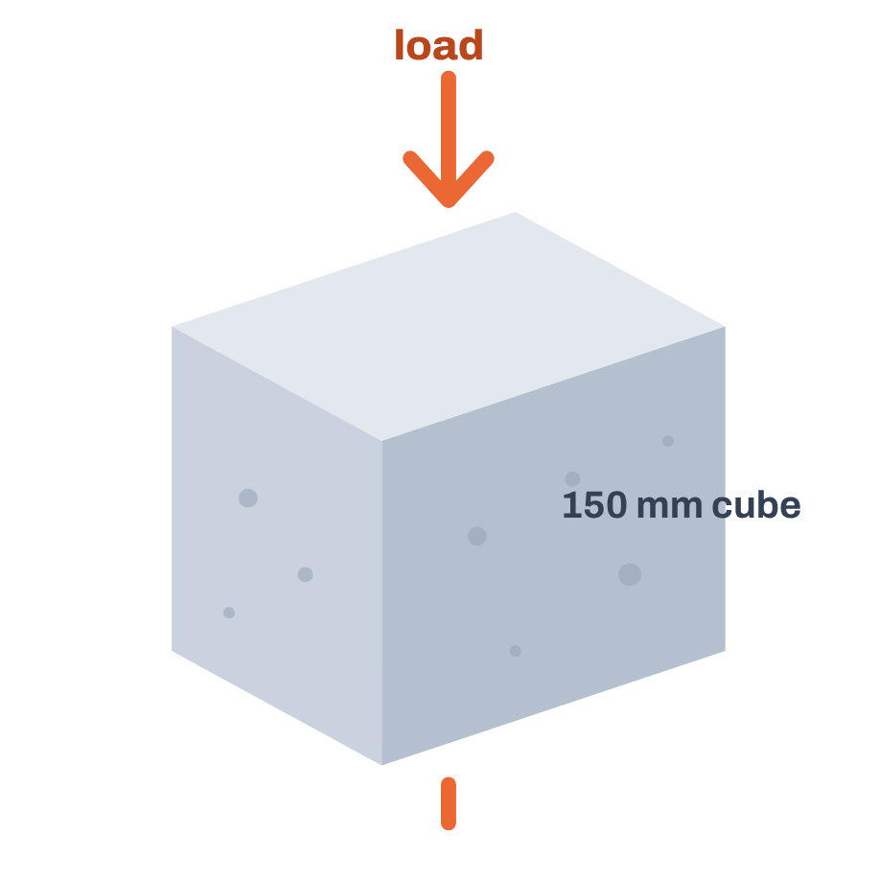

AI & ML for Civil Engineers
Session 03
Part 01 · Build the model
06 / 42
Our engineering question
Can we predict concrete compressive strength?
We know the mix and the curing age. Can we estimate the strength without performing the
test?
Cement
Blast-furnace slag
Fly ash
Water
kg/m³
kg/m³
kg/m³
kg/m³
Super­plasticizer
Coarse aggregate
Fine aggregate
Age
kg/m³
kg/m³
kg/m³
days
8 inputs → model →
y Compressive strength
MPa
“If I give you a new concrete mix, could you estimate its strength without
testing it?”
Notes:
Instructor prompt (draft): "If I give you a new concrete mix, could you estimate its compressive strength without performing the test?" Eight inputs, one numeric target.
[Clicks on this slide: 2]

Slide 7







AI & ML for Civil Engineers
Session 03
Part 01 · Build the model
07 / 42
The dataset · UCI Concrete Compressive Strength
Our first ML prediction dataset
1,030
1,005
8
1
concrete mixes in the file
after removing the 25 duplicate
rows found in Session 02
input variables X, no missing
values
target y: compressive strength in
MPa
The ML problem
A regression problem: the target is a continuous quantity
Inputs · X
Mix proportions + age
8 numbers per mix
Target · y
Compressive
strength
any value on the line, not a
category
Data: UCI Concrete Compressive Strength (Yeh, 1998). From today the notebook uses df.drop_duplicates() before splitting, as recommended in Session 02.
Notes:
The file has 1,030 mixes. In Session 02 we found 25 duplicated rows; from today the notebook drops them, leaving 1,005. Eight inputs, no missing values, one continuous target in MPa: a regression problem. The 42.7 MPa marker just illustrates that a prediction can be any value on the line.
[Clicks on this slide: 3]

Slide 8



AI & ML for Civil Engineers
Session 03
Part 01 · Build the model
08 / 42
Regression in one picture · a real test mix
Regression = predicting a number, then checking it
The model receives · X
22.5 MPa
Cement
146.5
Predicted ŷ
Slag
114.6
Fly ash
89.3
20.0 MPa
Measured y
Water
201.9
Superplasticizer
8.8
+2.5 MPa
Aggregates (coarse · fine)
860 · 830
Trained model
Prediction error ŷ − y
Age (days)
28
linear regression, fitted on
the training mixes
Every regression model produces predictions that we must compare against observations.
One of the 201 test mixes in the notebook (inputs in kg/m³). The model never saw it during training.
Notes:
A real test mix from the notebook: the model predicts 22.5 MPa, the lab measured 20.0 MPa, so the error is +2.5 MPa. Instructor note (draft): "Every regression model we build today ultimately produces predictions that we need to compare against observations."
[Clicks on this slide: 5]

Slide 9
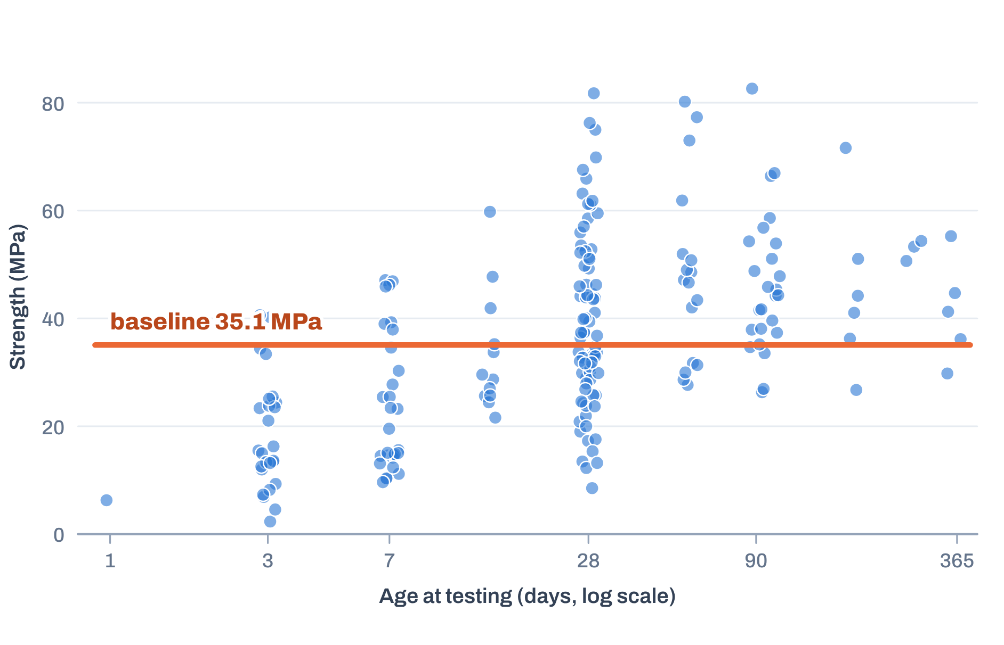
AI & ML for Civil Engineers
Session 03
Part 01 · Build the model
09 / 42
Before ML: establish a baseline
Is our model actually useful? Compared with what?
The mean baseline ignores all eight inputs
The simplest prediction
It predicts the average training strength for every mix. Dots: the 201 test mixes.
Average training strength = 35.1 MPa → predicted for
every concrete mix.
How wrong is it?
On the test mixes it is off by 14.0 MPa on average.
A research habit
A useful model must beat this.
Never report “R² = 0.75” without saying: compared with
what?
Notes:
The mean baseline: predict the average training strength, 35.1 MPa, for every mix. It ignores all eight inputs. On the test mixes it is off by 14.0 MPa on average. Instructor note (draft): this is a very important research habit. Don't simply report that an ML model gives an R² of 0.75. Ask: compared with what?
[Clicks on this slide: 3]

Slide 10






AI & ML for Civil Engineers
Session 03
Part 01 · Build the model
10 / 42
What does “training” mean?
Training = learning model parameters from examples
Training examples
Session03_first_model.ipynb
fit
804 mixes with their measured strength
from sklearn.linear_model import LinearRegression
model = LinearRegression()
model.fit(X_train, y_train)
The model learns its parameters
values that make predictions as close as possible to the measurements
For linear regression the parameters are
intercept_ one number: the starting value
A fitted model
coef_ one weight for each of the 8 inputs
ready to predict a mix it has never seen
Notes:
Training = learning parameters from examples. For linear regression: one intercept and one coefficient per input. fit() chooses them so that the predictions are as close as possible to the training measurements. (The draft said 'do not introduce gradient descent here'; it comes on slides 15-19.)
[Clicks on this slide: 4]

Slide 11



AI & ML for Civil Engineers
Session 03
Part 01 · Build the model
11 / 42
Our first protection against overconfidence
Why don’t we train on everything?
Studying with the exact questions that will appear in the
exam gives a high score that says little about new questions.
ML models face the same problem. So we hold data back
that the model never sees while learning.
80% · Training data
20% · Test
804 mixes
201 mixes
Fitting the model
Model development
Cross-validation
Final evaluation
The test set represents new data from the model’s perspective.
Notes:
Why hold data back: the exam analogy. 80% (804 mixes) for fitting, development and cross-validation; 20% (201 mixes) kept for the final evaluation only.
[Clicks on this slide: 3]

Slide 12





AI & ML for Civil Engineers
Session 03
Part 01 · Build the model
12 / 42
Linear regression: our first model
Why start with linear regression?
The prediction is a weighted sum of the inputs
ŷ = β₀ + β₁x₁ + β₂x₂ + … + β₈x₈
x_{j}
β_{j}
β₀
ŷ
the input variables
learned coefficients (weights)
the intercept
predicted strength
Simple
Fast
Interpretable
A benchmark
One equation you can write on a
board.
Fits 804 mixes in milliseconds.
Every input has a visible weight.
The reference for trees and neural
networks later.
Simple does not mean useless.
Notes:
Linear regression: the prediction is a weighted sum of the inputs plus an intercept. Simple, fast, interpretable, and the baseline for every more complex model later. Simple does not mean useless.
[Clicks on this slide: 3]

Slide 13
AI & ML for Civil Engineers
Session 03
Part 01 · Build the model
13 / 42
What does the model learn? · our fitted model
The model learns the weights
Fitted on 804 training mixes
Strength = −23.39 + 0.117·cement + 0.098·slag + 0.085·fly ash −0.131·water + 0.331·superplasticizer +
0.016·coarse + 0.021·fine + 0.111·age
We don’t choose these numbers
Session03_first_model.ipynb
weights
The algorithm estimates them from the examples we provide. This is
where the data starts writing the model, instead of us writing the
rules.
model.intercept_ # β0
model.coef_ # β1 … β8
Output
−23.39
[0.117, 0.098, 0.085, −0.131, 0.331, 0.016, 0.021,
0.111]
Units: MPa per kg/m³ for the mix quantities, MPa per day for age; intercept in MPa. Rounded to three decimals.
Notes:
The real fitted equation. Intercept -23.39 MPa; for example cement +0.117 and age +0.111. Instructor note (draft): "This is the point where the data starts determining the model rather than us writing engineering rules manually."
[Clicks on this slide: 2]

Slide 14
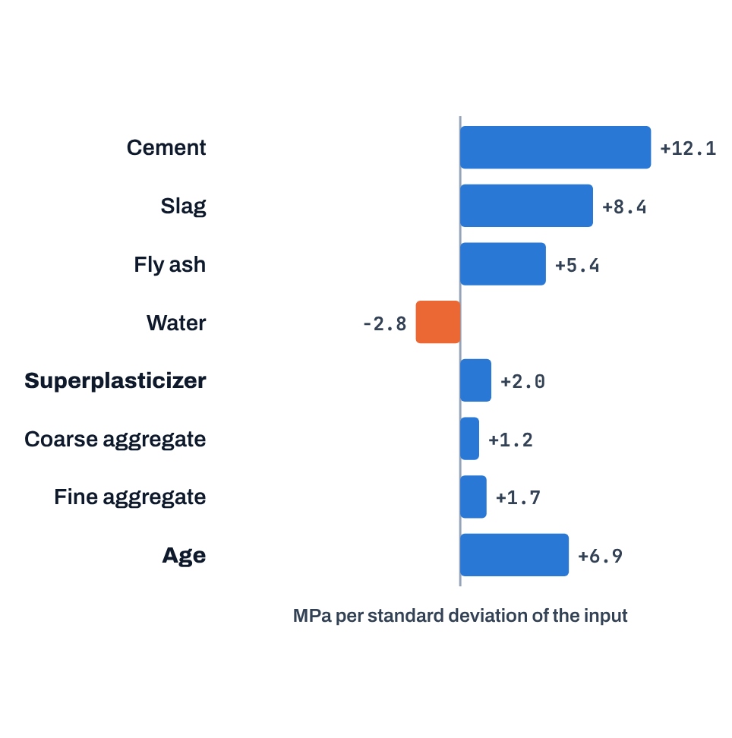
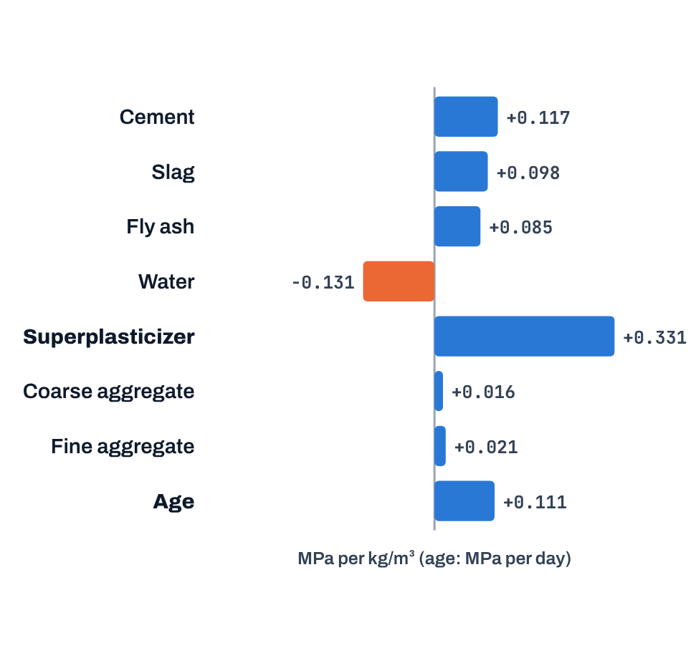

AI & ML for Civil Engineers
Session 03
Part 01 · Build the model
14 / 42
Looking inside the model
What do the coefficients tell us?
Raw coefficients
Same model, standardised inputs
Reading one
Change in predicted strength per unit of each input,
others held constant.
Change per one standard deviation of each input.
Age +0.111: within this model, one extra day adds
about 0.111 MPa, holding the other inputs constant.
But be careful
Units matter: superplasticizer has the largest raw
weight but one of the smallest effects per standard
deviation.
A larger coefficient does not automatically mean
greater importance. A coefficient shows association
in the fitted model, not causation.
This is an important engineering judgement point. More in Session 07.
Notes:
Reading coefficients. Raw: superplasticizer has the largest weight (+0.331 per kg/m³) but it only varies by a few kg/m³. Per standard deviation, cement (+12.1) and slag dominate and superplasticizer is small (+2.0). Units matter; a coefficient is an association in the fitted model, not a cause.
[Clicks on this slide: 4]

Slide 15
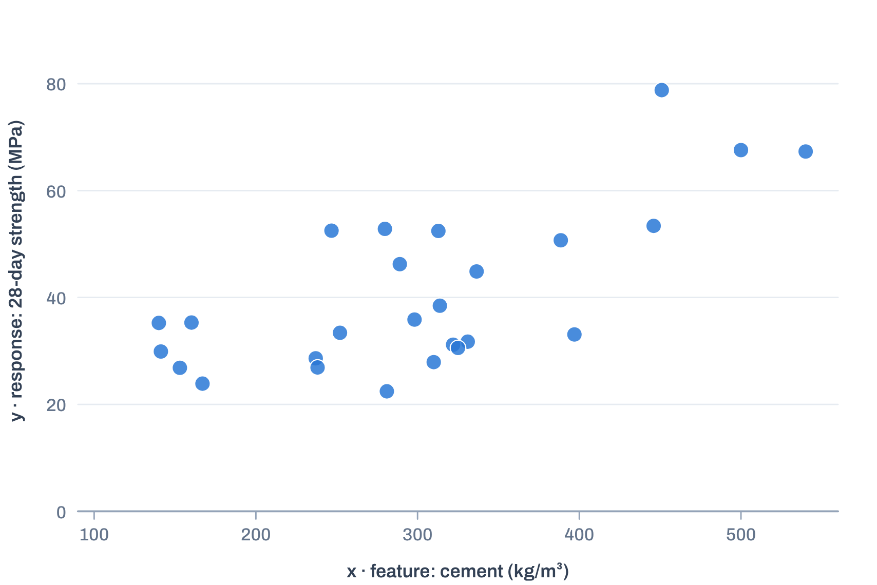
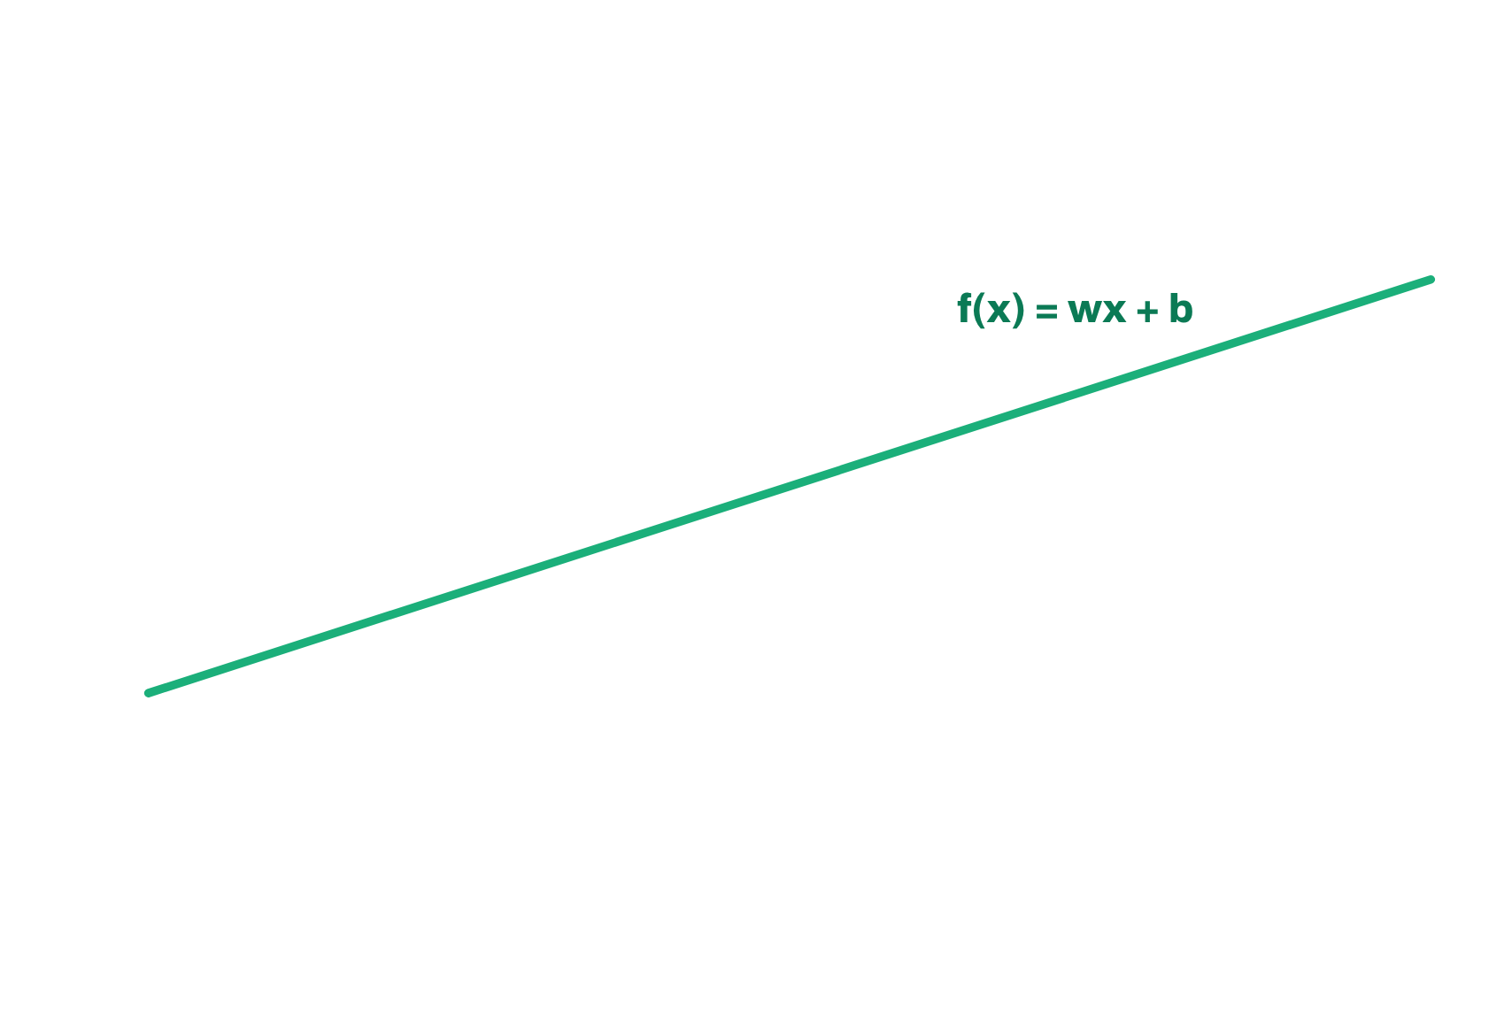
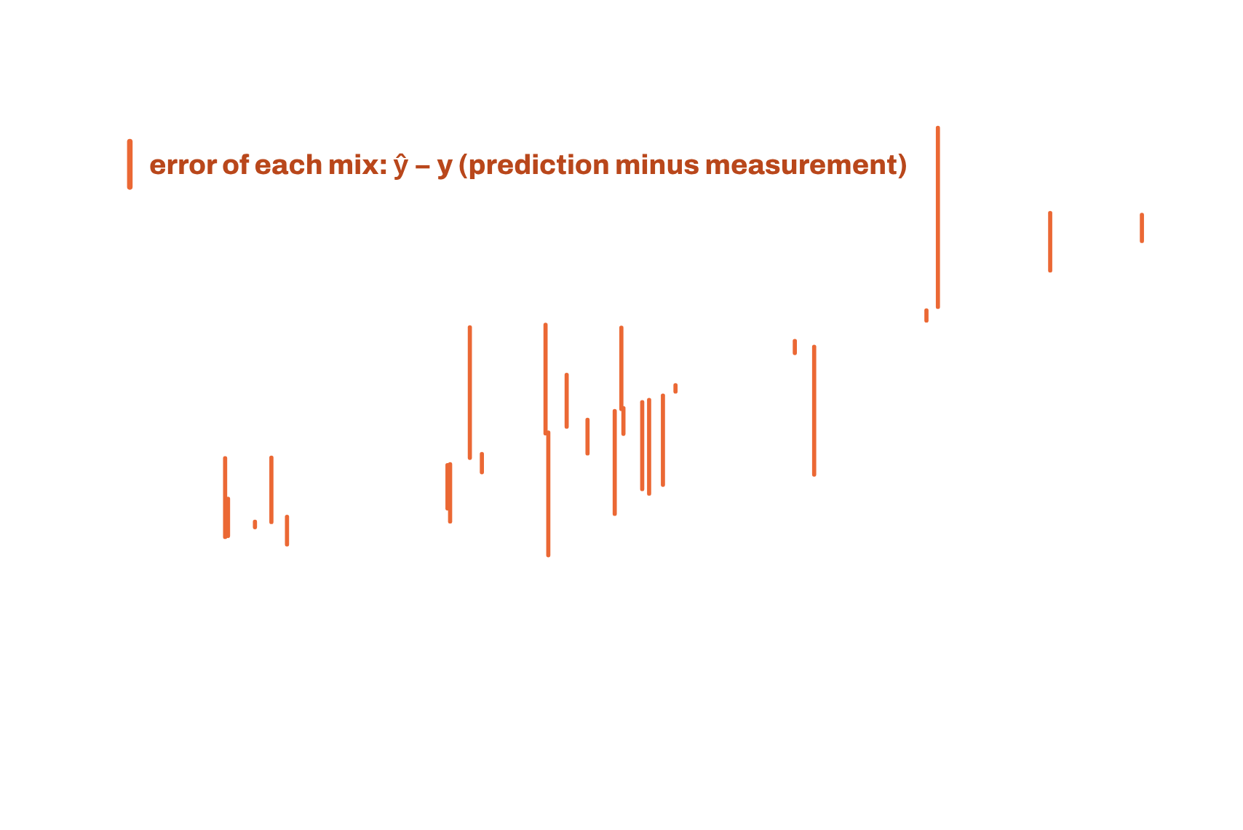
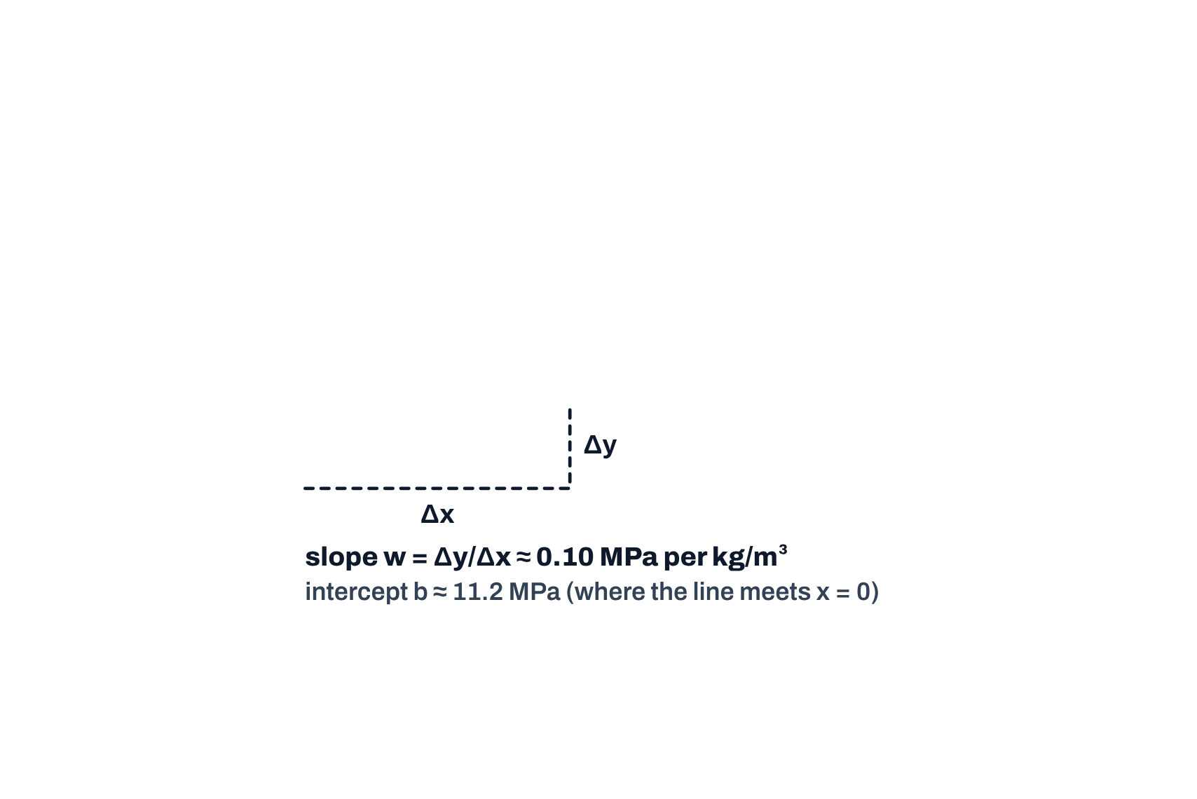
AI & ML for Civil Engineers
Session 03
Part 01 · Build the model
15 / 42
Some maths behind ML models · 1 of 5
Linear regression: the base model of statistical ML
The model · one input
26 real 28-day mixes, one input: cement
f_{w,b}(x^{(i)}) = wx^{(i)} + b
Parameters: slope w and intercept b.
The cost · squared-error cost function
J(w,b) =
1
Σ_{i=1}^{m} ( f_{w,b}(x^{(i)}) − y^{(i)} )²
2m
Square every error, average over the m examples.
The goal
minimise J(w, b) over w, b
With 8 inputs it is the same idea: one w per input.
Notation after DeepLearning.AI (Machine Learning Specialization)
Notes:
Some maths behind ML models (1 of 5). One input to keep it visible: 26 real 28-day mixes, strength against cement. Click 1: the line f(x) = wx + b. Click 2: the vertical errors, and the squared-error cost J(w, b) that adds them up. Click 3: slope and intercept. Click 4: the goal, find w and b that make J smallest.
[Clicks on this slide: 4]

Slide 16
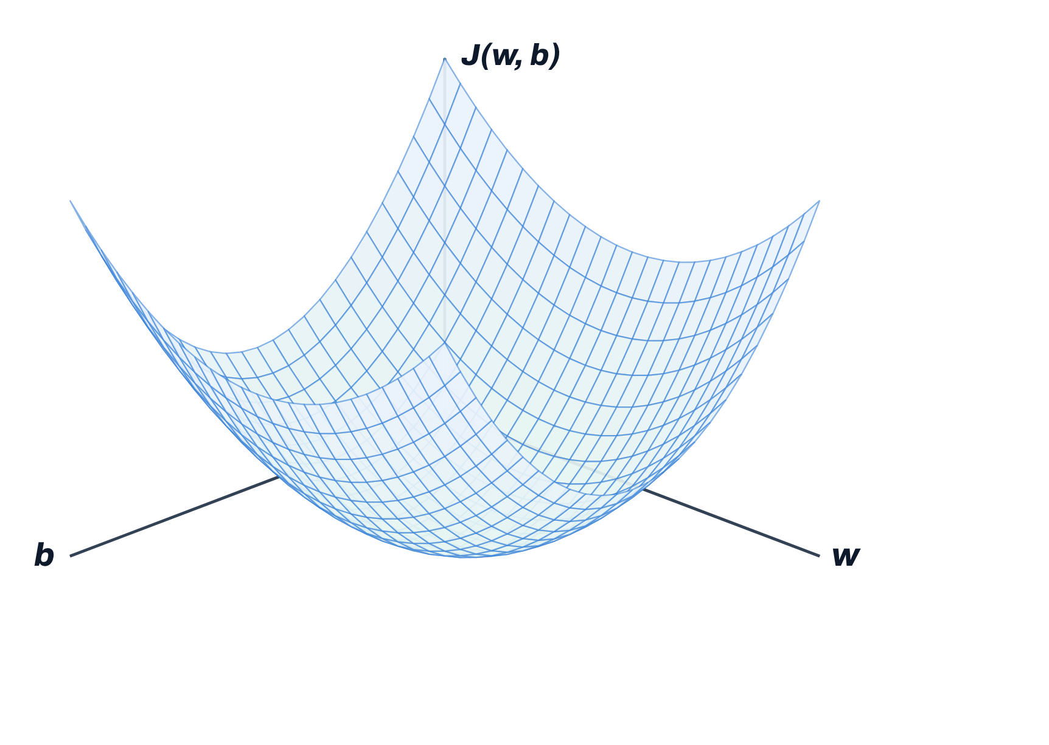
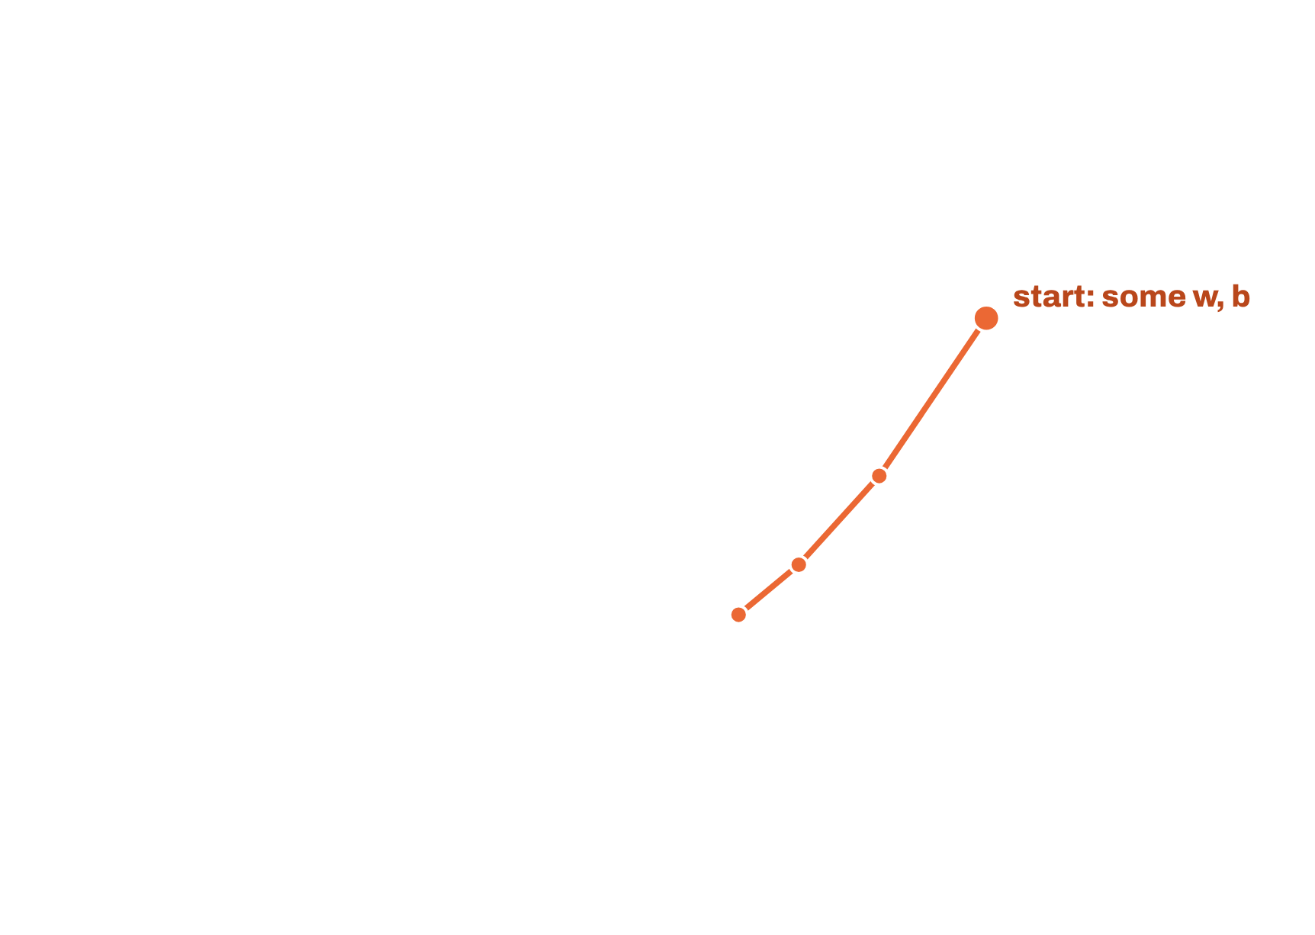
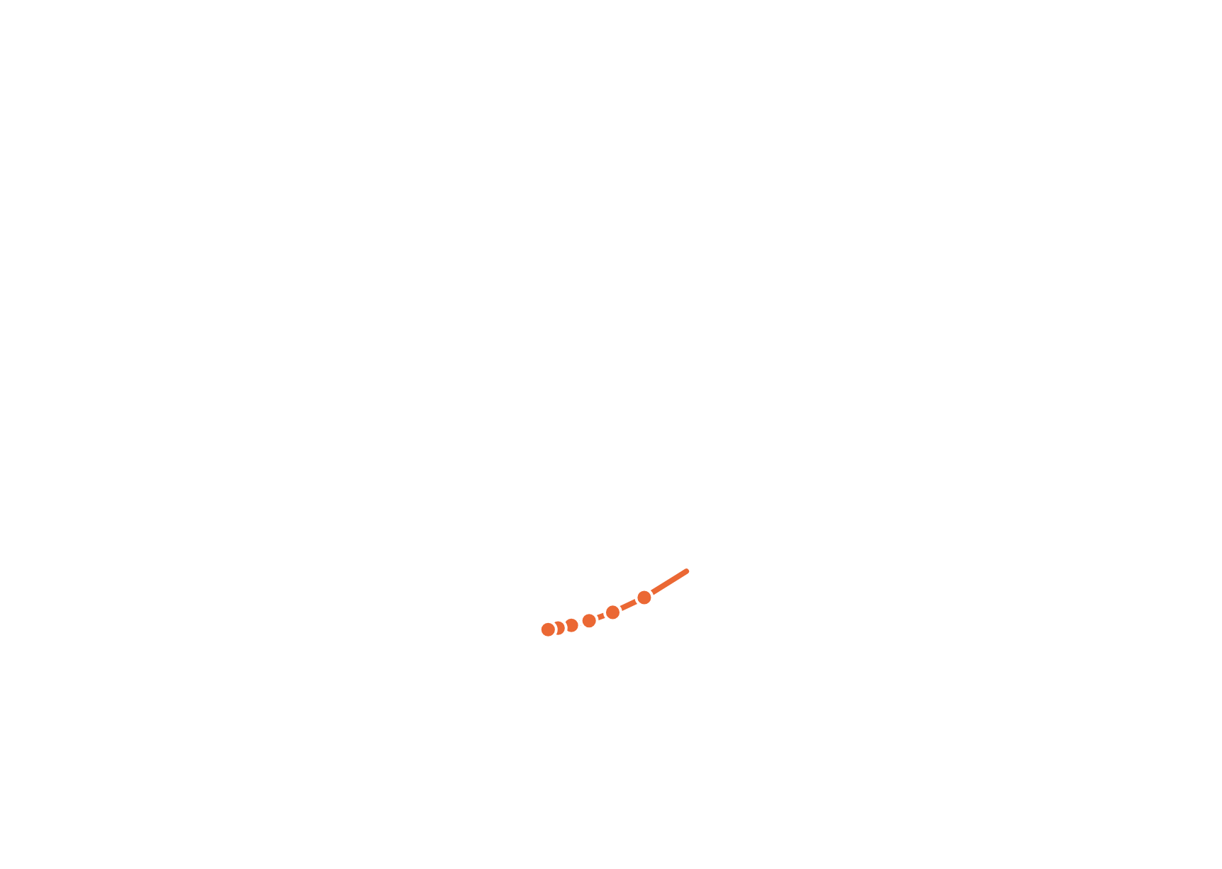

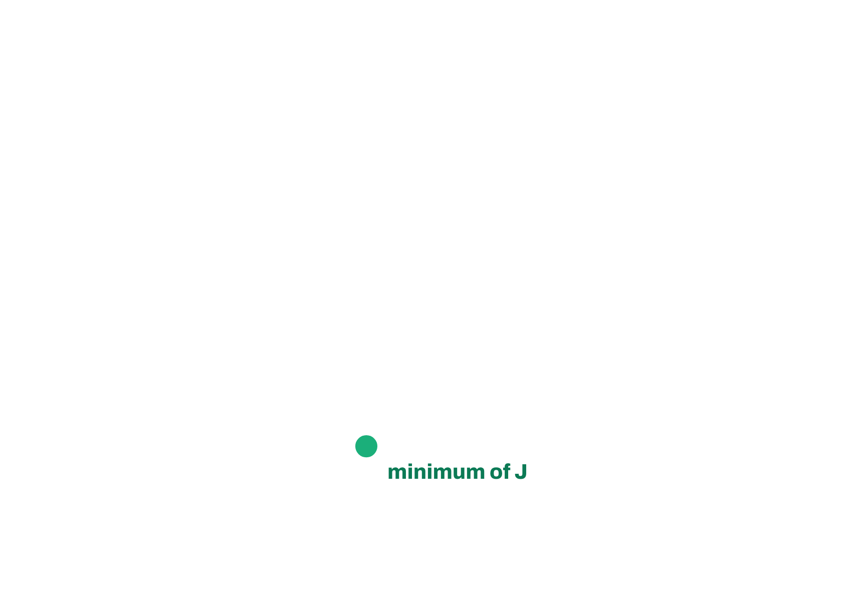
AI & ML for Civil Engineers
Session 03
Part 01 · Build the model
16 / 42
Some maths behind ML models · 2 of 5
The cost function is a bowl. We walk downhill.
Convex
For linear regression, J(w, b) has a single lowest point: no false
valleys.
Gradient descent, in outline
01
Start with some w, b
02
Keep changing w, b to reduce J(w, b)
03
Until we settle at or near a minimum
Here: 40 steps take the cost from 1,103 to 54 MPa².
Cost surface computed from the 26 mixes of the previous slide (cement standardised). Concept after DeepLearning.AI.
Notes:
(2 of 5) Plot J for every pair (w, b) and you get a bowl: convex, one minimum. Gradient descent starts somewhere and walks downhill. The clicks show the real path in three stages; 40 steps reduce J from 1,103 to 54 MPa², its minimum.
[Clicks on this slide: 5]

Slide 17
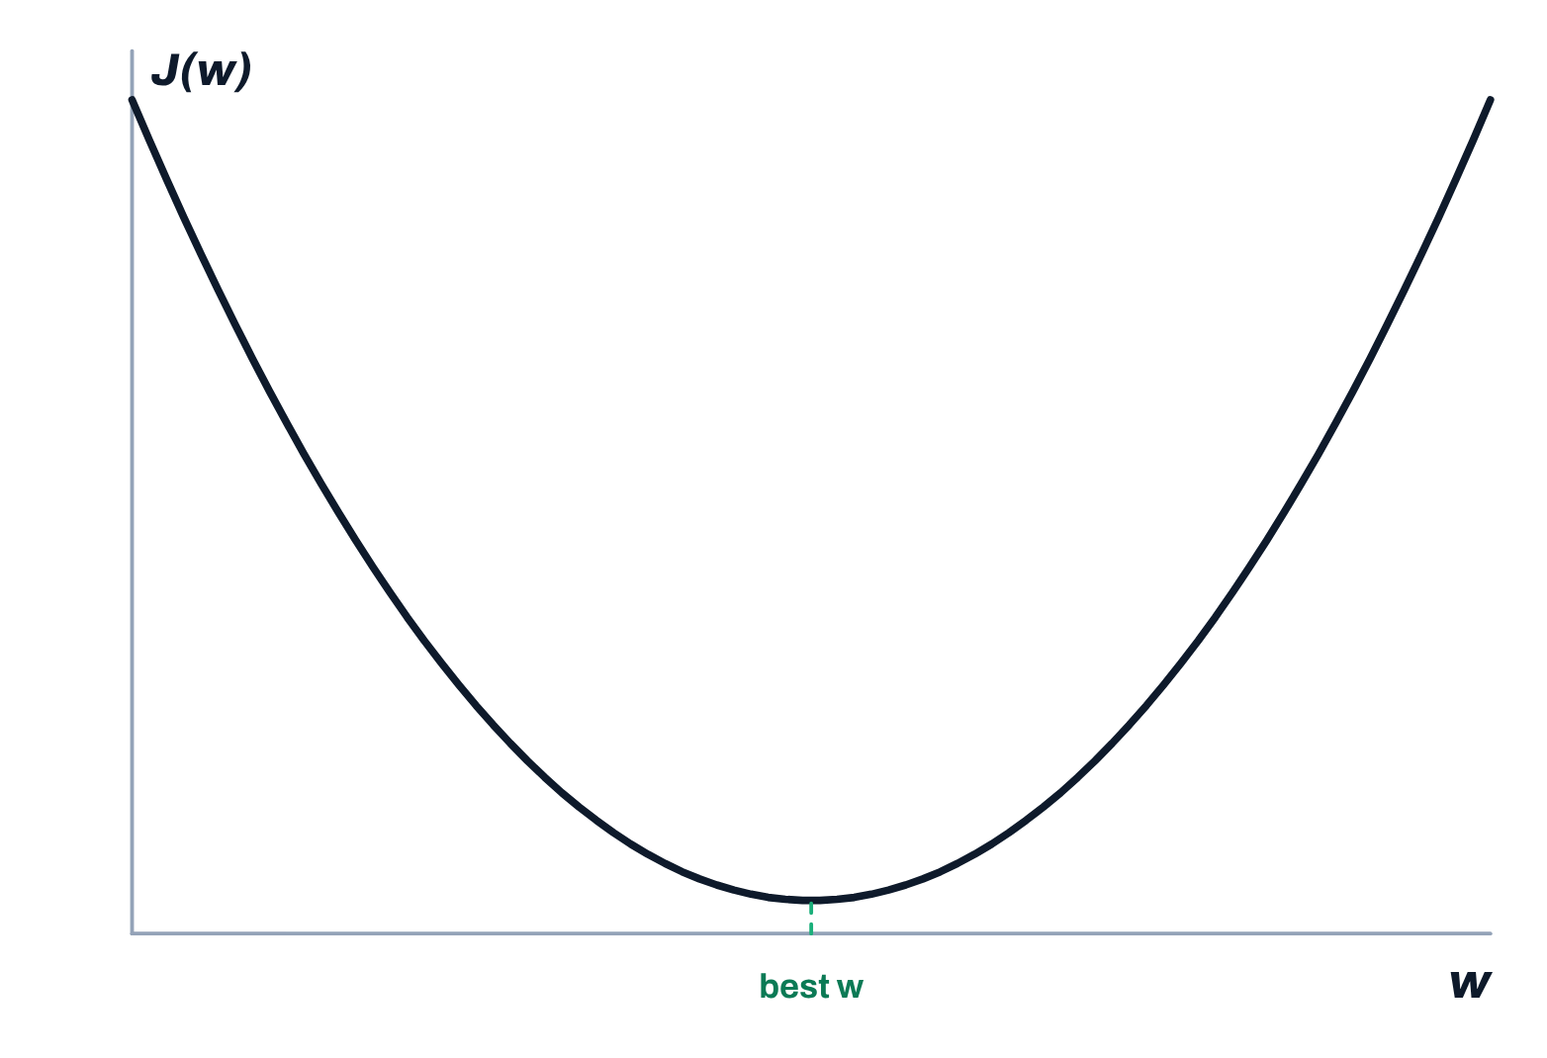
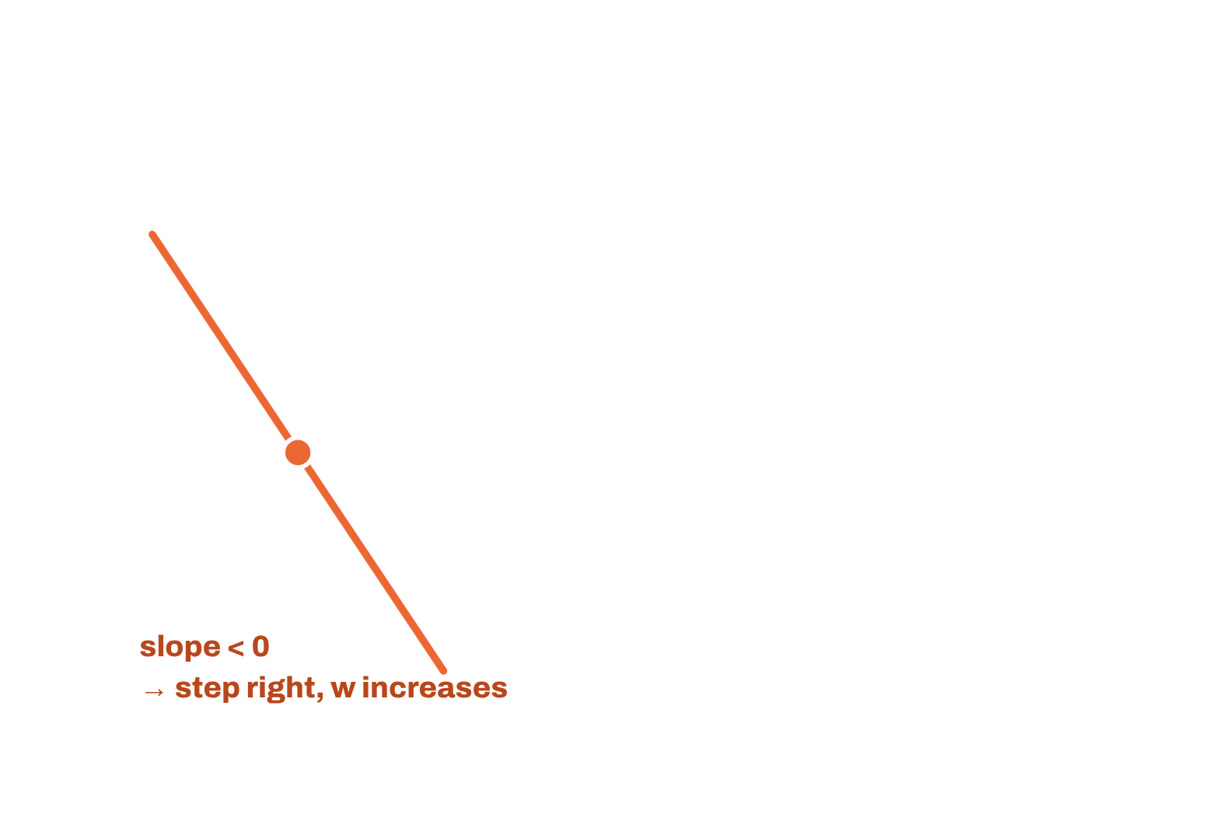
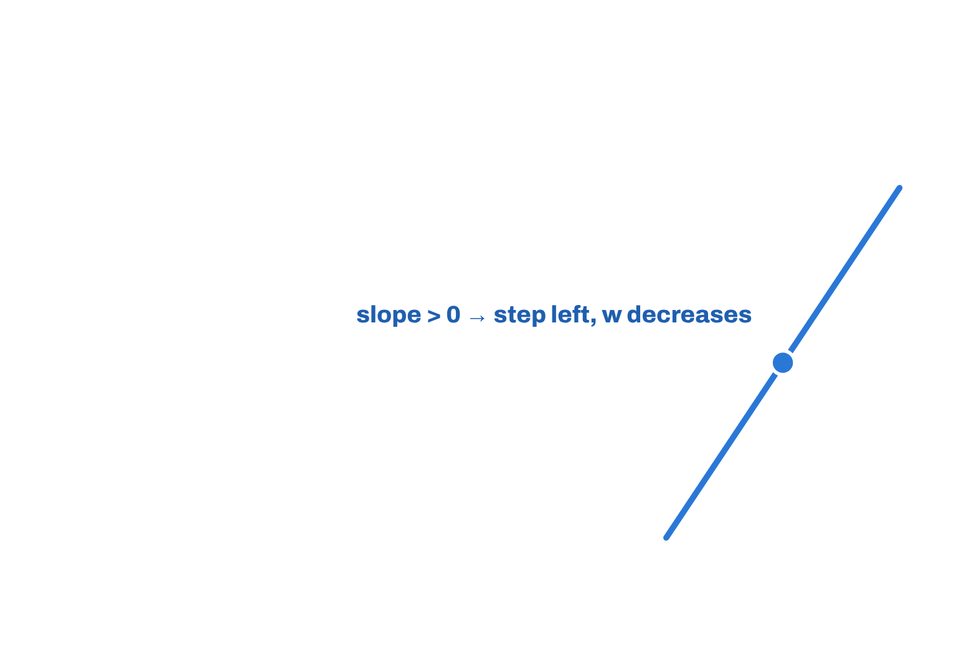
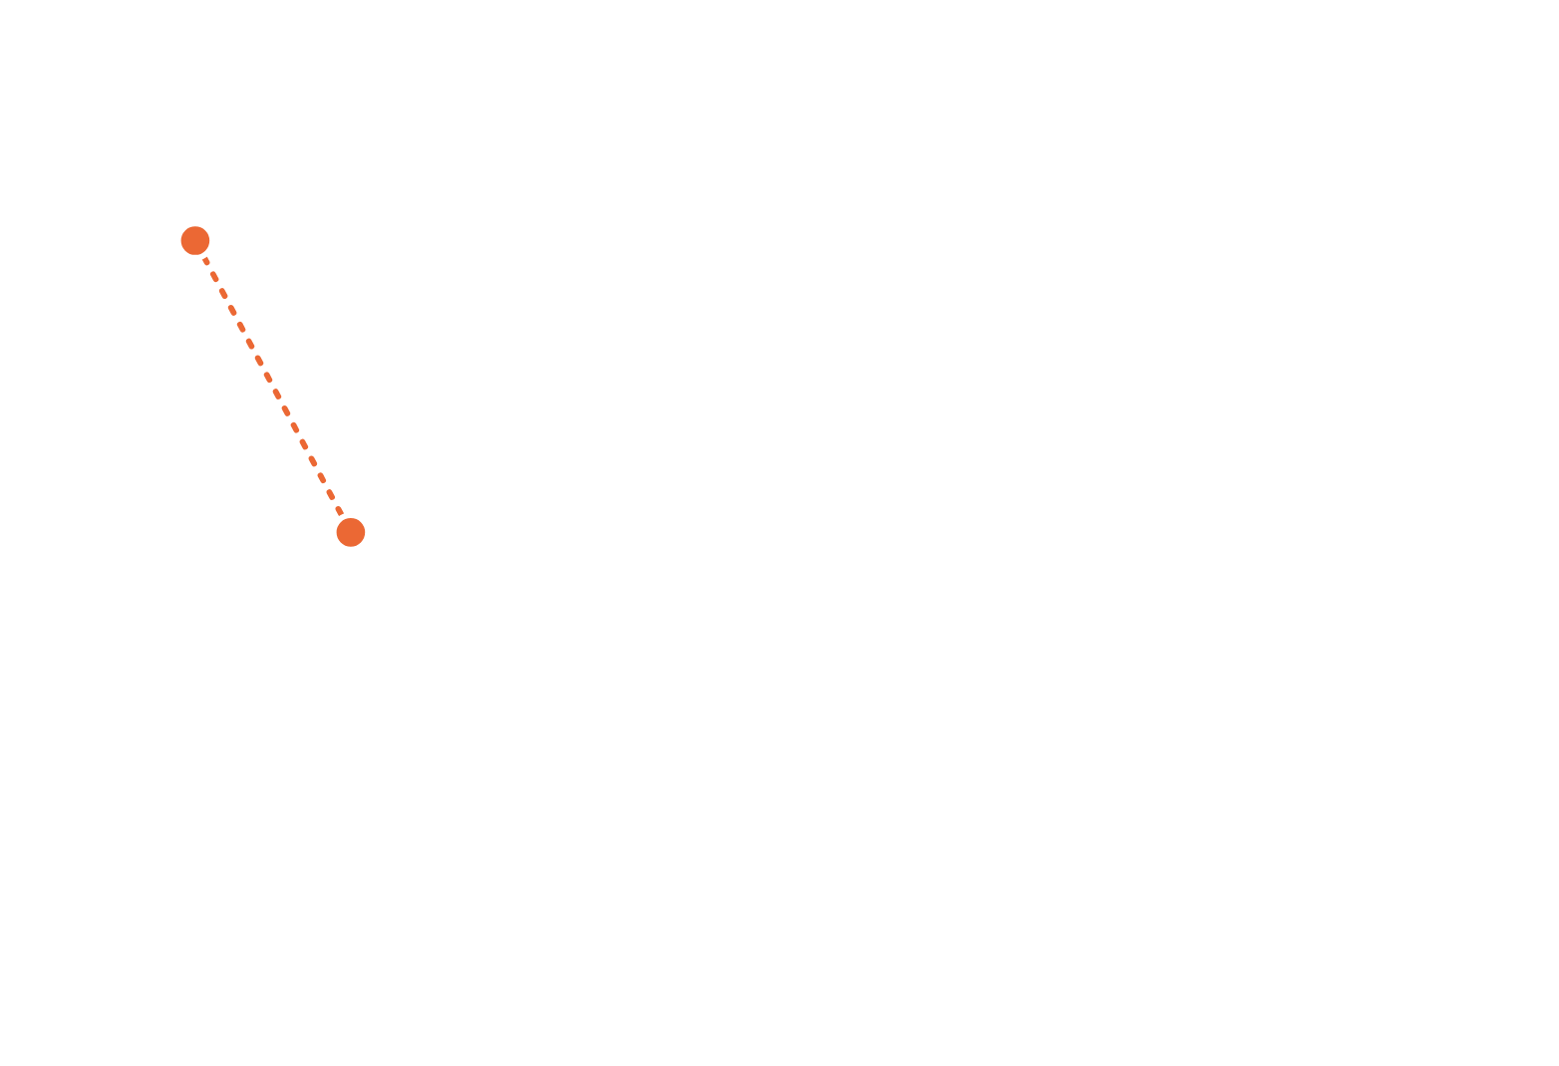
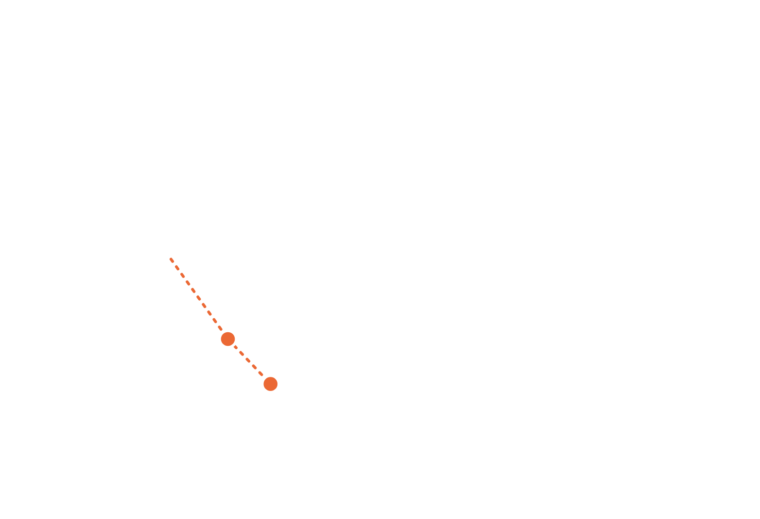

AI & ML for Civil Engineers
Session 03
Part 01 · Build the model
17 / 42
Some maths behind ML models · 3 of 5
Gradient descent: follow the slope downhill
Repeat until convergence:
J(w) with b at its best value
w = w − α
∂
J(w,b)
∂w
b = b − α
∂
J(w,b)
∂b
α
learning rate: step size
derivative: slope of
J
Why it works
A negative slope makes w grow; a positive slope makes it shrink. Steps get
smaller as the slope flattens near the minimum.
Update w and b together, using the slope at the current point.
Notation after DeepLearning.AI; concept also in CS771, IIT Kanpur
Notes:
(3 of 5) The update rule: new w = old w minus learning rate times slope. Clicks 1-2: on the left the slope is negative, so w increases; on the right it is positive, so w decreases. Clicks 4-6: the ball steps down, with steps shrinking as the slope flattens. w and b are updated together.
[Clicks on this slide: 7]

Slide 18
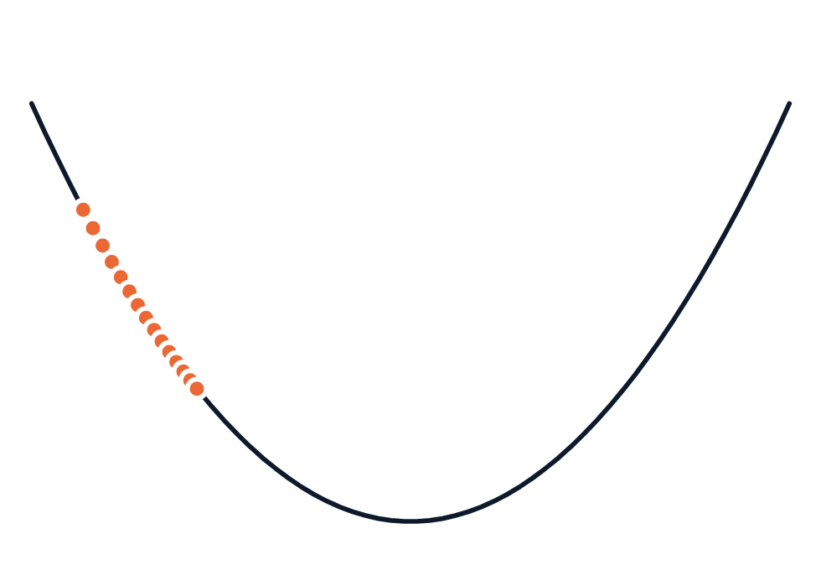
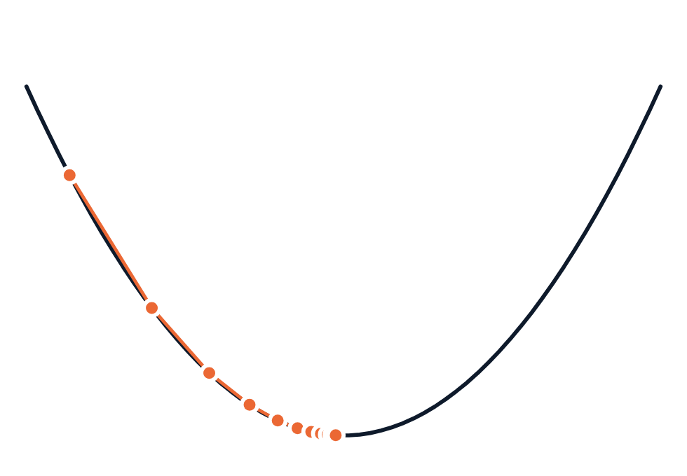
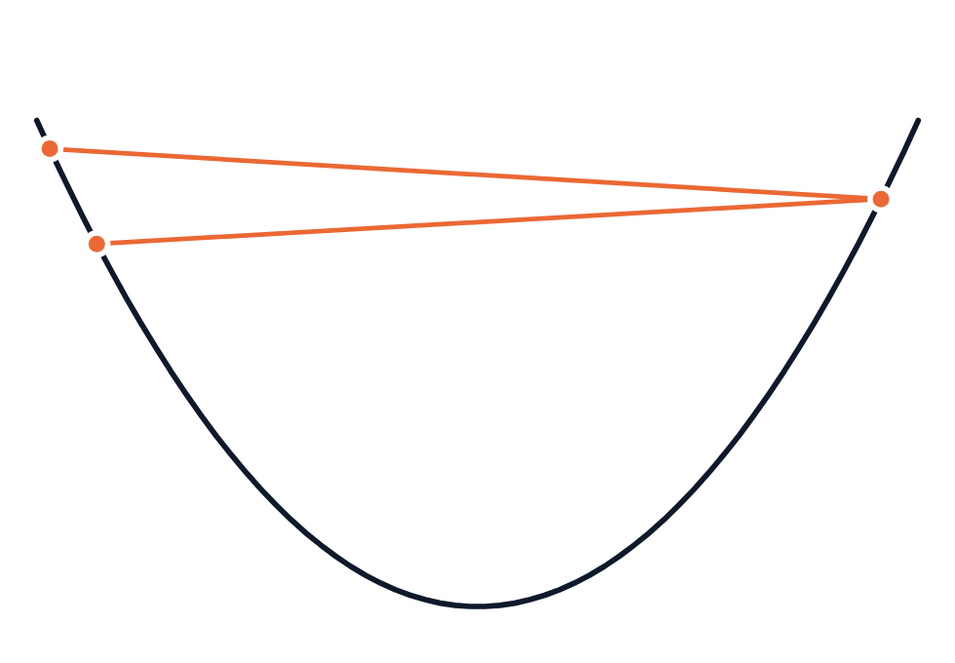

AI & ML for Civil Engineers
Session 03
Part 01 · Build the model
18 / 42
Some maths behind ML models · 4 of 5 · hyperparameter tuning
The learning rate α decides whether we arrive
α = 0.03 · too small
α = 0.3 · about right
α = 2.06 · too large
Slow
Efficient
Overshoots
Tiny steps: after 14 steps we have covered only 35%
of the way.
Large steps far away, small steps near the minimum:
there in about 10 steps.
Each step jumps past the minimum and lands higher
up the other side.
Converges, eventually
Converges quickly
Fails to converge
α is a hyperparameter: we choose it; the model does not learn it. scikit-learn’s LinearRegression solves for the weights
directly, so today we do not tune α.
All three runs start from the same point on the same cost curve as the previous slide.
Notes:
(4 of 5) Learning rate: too small (0.03) crawls; about right (0.3) converges in about ten steps; too large (2.06) overshoots and diverges. α is a hyperparameter. scikit-learn's LinearRegression solves for the weights directly, so we do not tune α today; it returns with neural networks in Session 06.
[Clicks on this slide: 4]

Slide 19
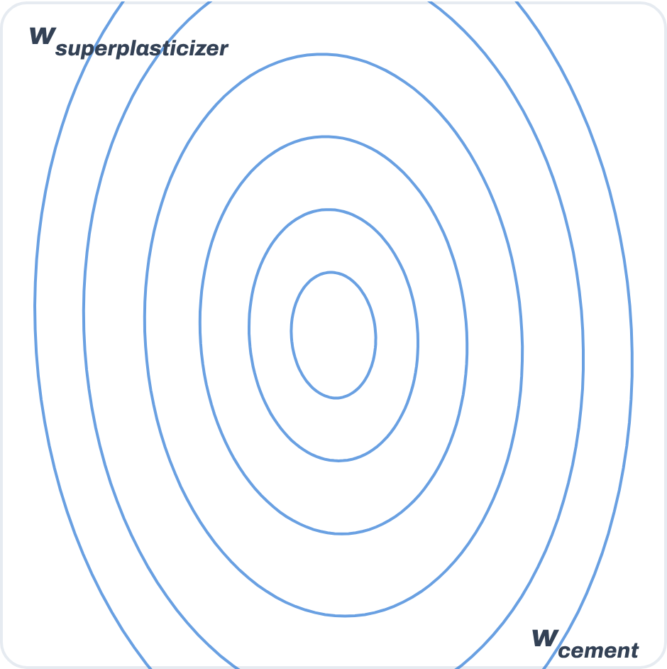
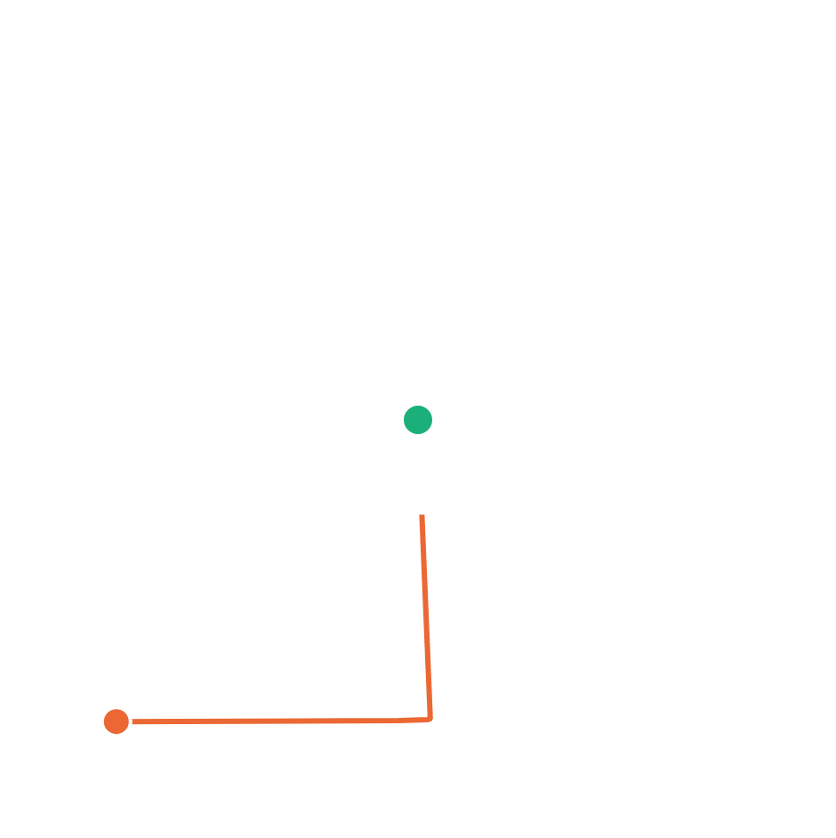

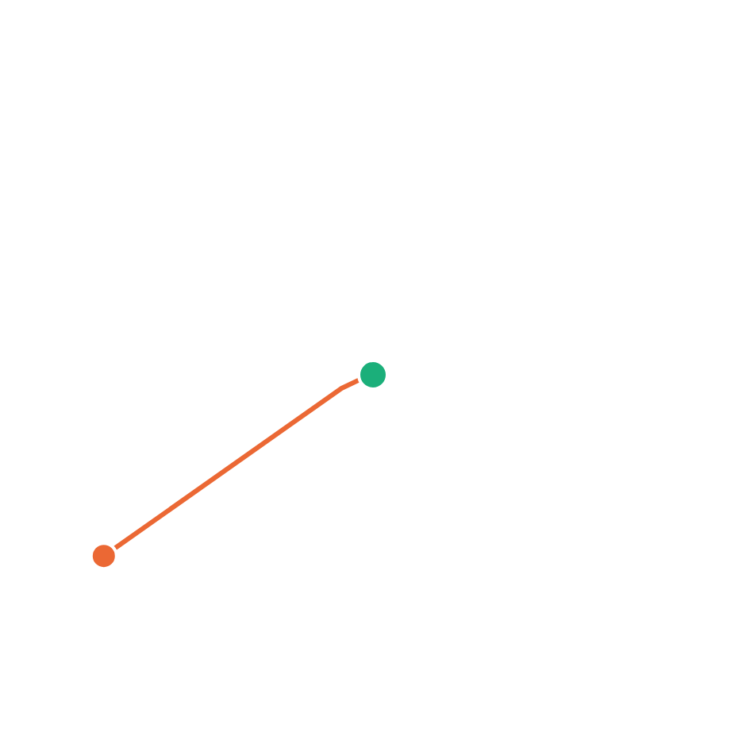
AI & ML for Civil Engineers
Session 03
Part 01 · Build the model
19 / 42
Some maths behind ML models · 5 of 5 · data pre-processing
Feature scaling: make the bowl round
Once the features are selected, they may not
be on the same scale: cement varies by about
104 kg/m³, superplasticizer by about 6.
Gradient descent without scaling
Gradient descent after scaling
Raw kg/m³
Standardised
Problematic
Features with larger scales can dominate
comparisons, and gradient descent crawls
along a long, narrow valley.
Therefore, standardise
Mean 0, standard deviation 1 for every feature.
It stabilises the optimisation used in ML
algorithms.
StandardScaler().fit(X_train)
984 iterations
2 iterations
Real cost contours for predicting strength from cement and superplasticizer (1,005 mixes), same safe learning rate rule, stopping at 0.1% of the starting cost. Idea after Virginia Tech ECE 5424 (Lec. 03) and DeepLearning.AI.
Notes:
(5 of 5) Feature scaling. Cement varies about 17 times more than superplasticizer, so the cost contours are long and narrow and gradient descent needs 984 iterations. After standardising (mean 0, sd 1) the contours are nearly round: 2 iterations. Note: standardising gives mean 0 and sd 1; it does not force values into -1 to 1 (that is min-max scaling). Fit the scaler on the training data only.
[Clicks on this slide: 3]

Slide 20



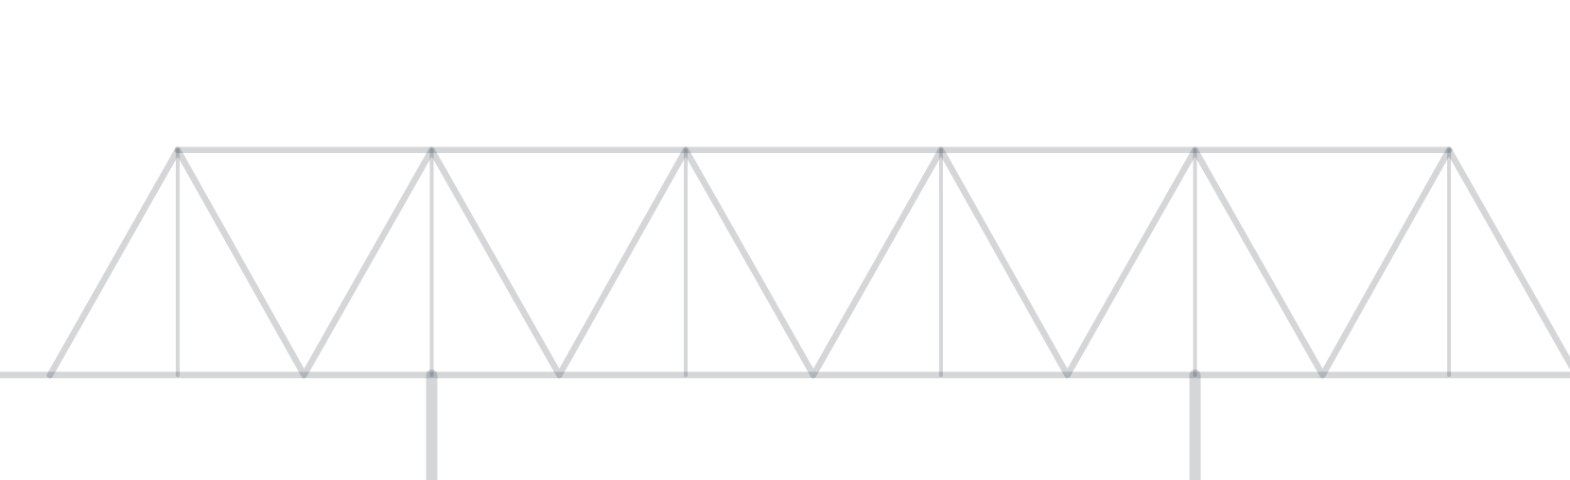
AI & ML for Civil Engineers
Session 03
20 / 42
02
a
A scorecard: MAE, RMSE, R²
b
Which metric should we trust?
c
Train vs test performance
d
Parity plot
e
Residuals: where is it wrong?
Part 02 · Evaluation
How good is our model?
Notes:
Part 02: how good is our model?

Slide 21

AI & ML for Civil Engineers
Session 03
Part 02 · Evaluation
21 / 42
Prediction is not enough
A model can make predictions. How good are they?
We need a scorecard. Today: three regression metrics.
MAE
RMSE
R²
Mean Absolute Error
Root Mean Squared Error
Coefficient of Determination
unit: MPa · lower is better
unit: MPa · lower is better
no unit · higher is better, max 1
How large is the error, with big misses
counting more?
On average, how large is the error?
How much better than predicting the mean?
Different metrics answer slightly different questions.
Notes:
We need a scorecard. Three metrics, three slightly different questions.
[Clicks on this slide: 4]

Slide 22
AI & ML for Civil Engineers
Session 03
Part 02 · Evaluation
22 / 42
Metric 1 · on our 201 test mixes
MAE: Mean Absolute Error
Question · on average, how large is our prediction error?
Linear regression · test set
MAE =
1
Σ_{i=1}^{m} | y_{i} − ŷ_{i} |
8.9MPa
m
actual target value · predicted target
“Our predictions are off by about 8.9 MPa on
average.”
Why engineers like MAE
Same units as the target: MPa
Easy to interpret
Every error contributes in proportion to its size
Mean baseline: 14.0 MPa. The model cuts the
average error by 36%.
Notes:
MAE: the average absolute error, in MPa. Our model: 8.9 MPa on the test set, against 14.0 MPa for the mean baseline. 'Our predictions are off by about 8.9 MPa on average.'
[Clicks on this slide: 2]

Slide 23
AI & ML for Civil Engineers
Session 03
Part 02 · Evaluation
23 / 42
Metric 2 · large errors are penalised more strongly
RMSE: Root Mean Squared Error
Squares the errors before averaging
Linear regression · test set
RMSE = √
1
Σ_{i=1}^{m} ( y_{i} − ŷ_{i} )²
11.2MPa
m
RMSE ≥ MAE always. Here the gap (11.2 vs
8.9) says some mixes are missed by a lot.
Why squaring matters · errors of two models on 4 mixes
A
3
3
3
3
→ MAE 3.0 · RMSE 3.0
B
0
0
0
12
→ MAE 3.0 · RMSE 6.0
MAE → average error size
RMSE → average error with a greater penalty for large misses
Mean baseline: 17.3 MPa. Lower is better.
Notes:
RMSE squares errors first, so big misses count more. The toy example: same MAE, double the RMSE. Ours: 11.2 MPa (baseline 17.3). The gap between RMSE and MAE hints at a few large misses.
[Clicks on this slide: 2]

Slide 24
AI & ML for Civil Engineers
Session 03
Part 02 · Evaluation
24 / 42
Metric 3 · how much variation does the model explain?
R²: compared with the mean baseline
Model error relative to baseline error
Linear regression · test set
R² = 1 −
Σ ( y_{i} − ŷ_{i} )²
0.58
Σ ( y_{i} − ȳ )²
ȳ arithmetic mean of y = the baseline
The model explains well over half the variation
in strength that the mean leaves unexplained.
R² = 1
R² = 0
R² < 0
perfect predictions
no better than the mean
worse than the mean, possible
on unseen data
Important · R² is NOT accuracy
R² = 0.58 does not mean “58% of predictions are correct”. It means the squared error is 58%
smaller than the mean baseline’s.
Mean baseline: 0.00, by construction.
Notes:
R² compares our squared error with the mean baseline's. 1 is perfect, 0 is no better than the mean, negative is worse. Ours: 0.58. R² is not accuracy: 0.58 does not mean 58% of predictions are correct.
[Clicks on this slide: 3]

Slide 25
AI & ML for Civil Engineers
Session 03
Part 02 · Evaluation
25 / 42
Don’t ask “which metric is best?” · ask what each one tells us
Which metric should we trust?
Metric
What it tells us
Mean baseline
Linear
regression
MAE
Typical size of the errors
14.0 MPa
8.9 MPa
RMSE
Errors, with greater emphasis on large misses
17.3 MPa
11.2 MPa
R²
Variation explained, relative to the mean baseline
0.00
0.58
Engineering judgement
A good R² can still hide errors too large for the application. Is ±8.9 MPa acceptable for your
design decision?
A metric is evidence, not judgement.
All values on the 201 test mixes (random_state = 42).
Notes:
The scorecard side by side. A metric is evidence, not engineering judgement: is an average error of about 9 MPa acceptable for the decision you have to make?
[Clicks on this slide: 4]

Slide 26

AI & ML for Civil Engineers
Session 03
Part 02 · Evaluation
26 / 42
Training performance ≠ generalisation
Does the model work on new data?
Evaluated on
MAE
RMSE
R²
Similar performance
Training data · seen
8.0
10.0
0.61
→ encouraging
Much better on training than test
Test data · never seen
8.9
11.2
0.58
→ possible overfitting / poor generalisation
Poor or modest on both
Our model: similar on both, and modest on both. Not overfitting; more
likely too simple for this problem.
→ model may be too simple, data insufficient, or the problem difficult
Good training performance alone is not enough.
MAE and RMSE in MPa. Training: 804 mixes; test: 201 mixes.
Notes:
Train R² 0.61, test R² 0.58: similar. No sign of overfitting, but modest on both: the model is probably too simple. Good training performance alone is never enough.
[Clicks on this slide: 5]

Slide 27
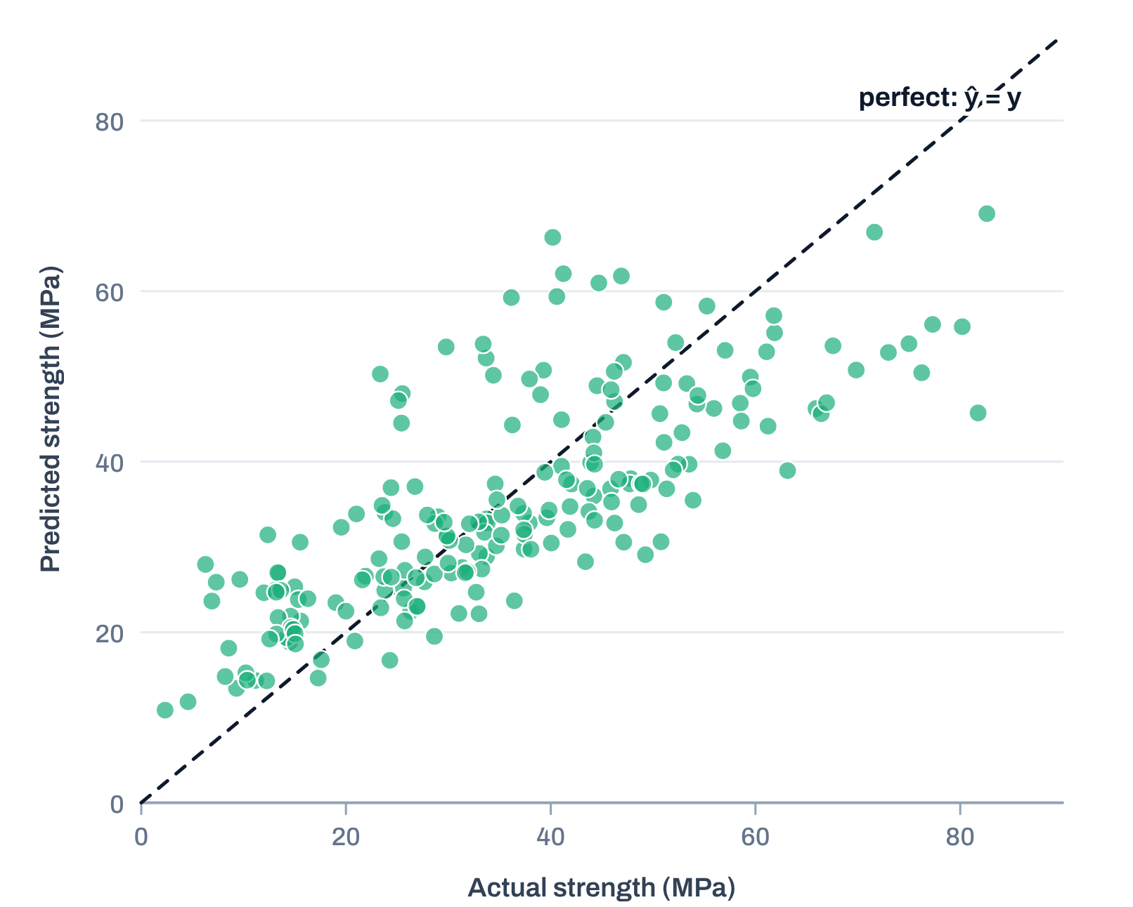
AI & ML for Civil Engineers
Session 03
Part 02 · Evaluation
27 / 42
Visualising predictions
Parity plot: actual vs predicted
201 test mixes
If predictions were perfect
Every point would lie on the 45° line.
Look for
How close points are to the line
Systematic deviations
Extreme errors
Different behaviour in different ranges
Here
Strong mixes above 60 MPa sit below the line: the model under-
predicts high strength.
Notes:
Parity plot: perfect predictions lie on the 45-degree line. Here high-strength mixes fall below the line: the model under-predicts strong concrete. Look for ranges where it behaves differently.
[Clicks on this slide: 2]

Slide 28
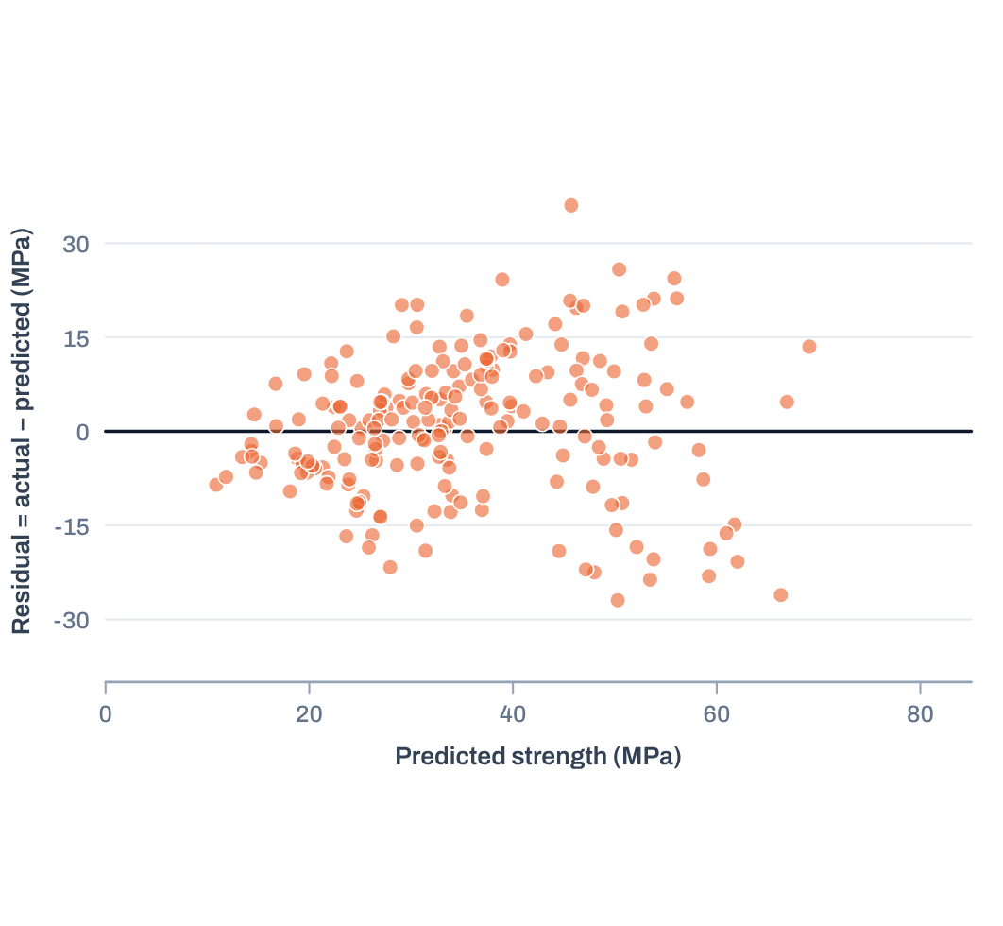
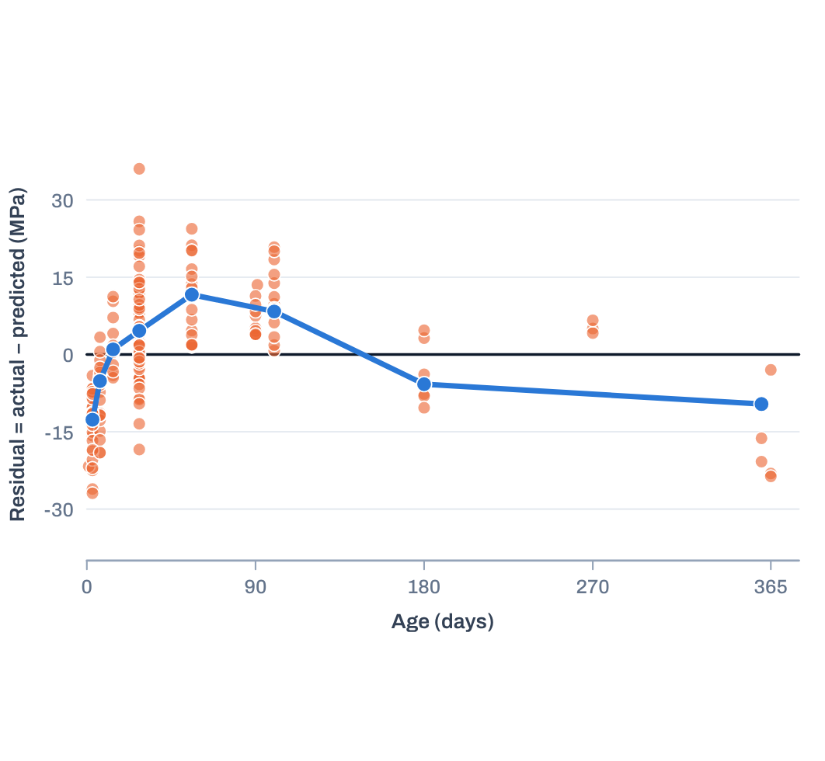

AI & ML for Civil Engineers
Session 03
Part 02 · Evaluation
28 / 42
Residual = actual − predicted · where and why is the model wrong?
Residuals help us diagnose the model
Against the prediction
Against age: a clear curve
Warning signs
Ideally: centred on zero, no pattern.
Blue: median residual at each test age.
Curvature
→ the linear model misses nonlinear behaviour.
Here: −12.7 MPa at 3 days, +11.6 at 56, −9.6 at
a year.
Increasing spread
→ the error changes with the target or input
range
Large isolated residuals
→ unusual observations or difficult cases
Don’t just ask “how good is the score?” Ask “where and why is the model wrong?”
Notes:
Residuals = actual minus predicted. Against the prediction they look roughly centred. Against age they curve: median residual about -13 MPa at 3 days, +12 at 56 days and -10 at a year. Strength gain with age is not a straight line, the same lesson as the correlation slide in Session 02. This is the evidence that a linear model is too simple.
[Clicks on this slide: 4]

Slide 29


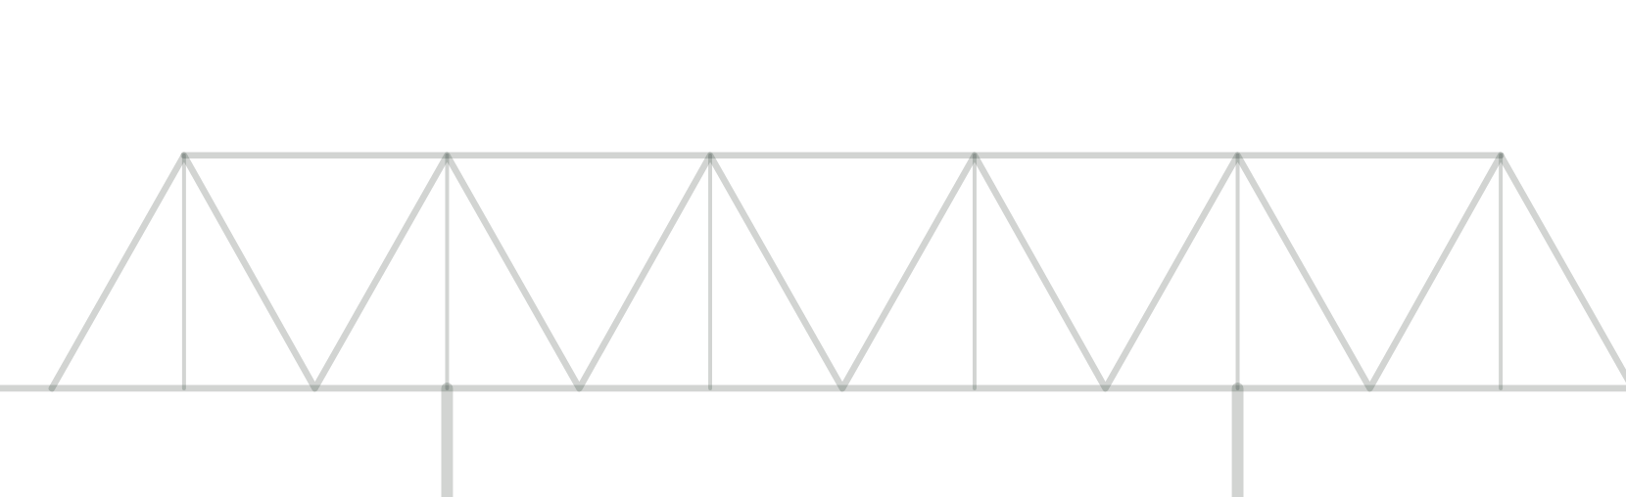
AI & ML for Civil Engineers
Session 03
29 / 42
03
a
One split is only one split
b
K-fold cross-validation
c
Look beyond the mean
d
The test-set rule
e
From performance to engineering
judgement
f
Your turn: diagnose the model
Part 03 · Validation & judgement
Is it consistent, and can
we trust it?
Notes:
Part 03: is it consistent, and can we trust it?

Slide 30
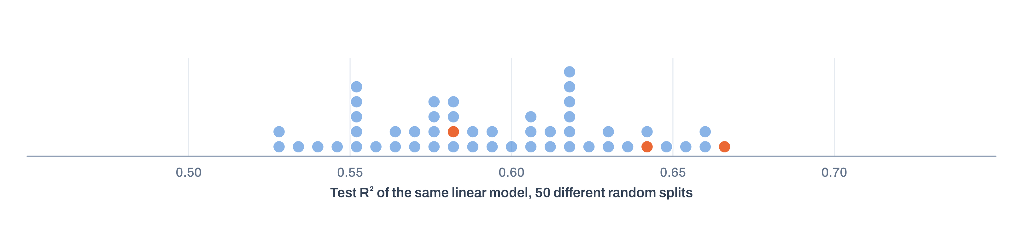

AI & ML for Civil Engineers
Session 03
Part 03 · Validation
30 / 42
One split is only one split
What if we change the split? Same model, same data.
random_state = 42
R² 0.58
random_state = 7
R² 0.64
random_state = 21
R² 0.66
Test R² from 50 different random splits: 0.53 to 0.66
Which mixes land in the test set changes the score. A single split gives one estimate of performance.
Notes:
Same model, same data, different random split: test R² from 0.53 to 0.66 across 50 seeds (42: 0.58, 7: 0.64, 21: 0.66). One split is one estimate.
[Clicks on this slide: 4]

Slide 31



AI & ML for Civil Engineers
Session 03
Part 03 · Validation
31 / 42
A more systematic view
K-fold cross-validation
1,005 mixes
80% training: 804
20% test: locked
Each mix gets one turn
Every training observation is validated exactly
once, by a model that did not see it.
5-fold CV on the training data only
Fold 1
validate
train
train
train
train
Session03_first_model.ipynb
cv
Fold 2
train
validate
train
train
train
from sklearn.model_selection import \
cross_val_score, KFold
cv = KFold(5, shuffle=True, random_state=42)
scores = cross_val_score(model, X_train,
y_train, cv=cv, scoring="r2")
Fold 3
train
train
validate
train
train
Fold 4
train
train
train
validate
train
Fold 5
train
train
train
train
validate
Average performance metric =
(1/K) Σ score_{k}
Notes:
5-fold cross-validation on the training data only; the test set stays locked. Each fold takes one turn as validation. Average the five scores. (This replaces the draft's 4-fold / 10% test diagram from another study, so it matches the 80/20 split and 5-fold CV used in the notebook.)
[Clicks on this slide: 8]

Slide 32
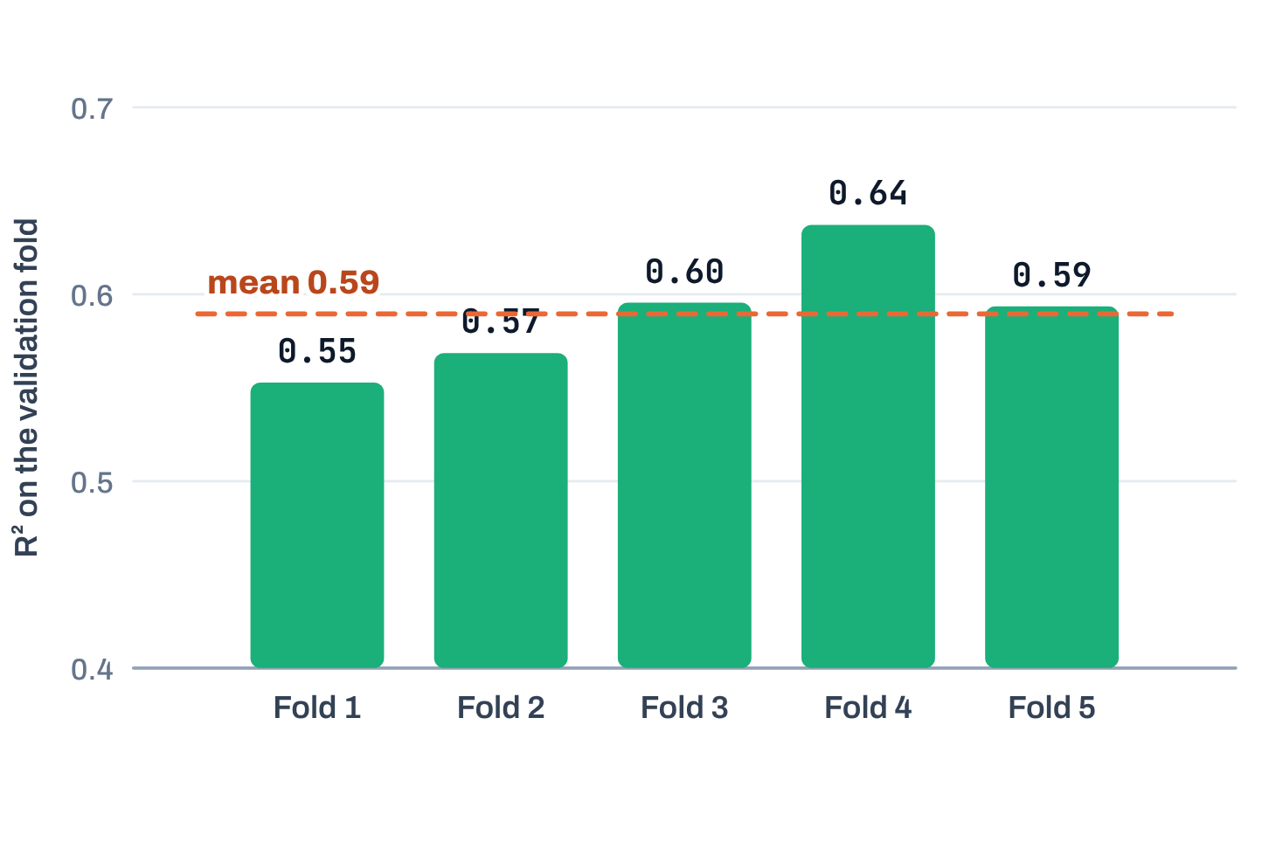

AI & ML for Civil Engineers
Session 03
Part 03 · Validation
32 / 42
What does cross-validation tell us? · look beyond the mean
Average and spread both matter
Our linear regression: R² 0.59 ± 0.03
An illustration with two hypothetical models:
Five validation folds of the training data.
Model A
mean ≈ 0.90 · consistent
0.89
0.91
0.90
0.92
0.88
Model B
mean ≈ 0.90 · much more variable
0.60
0.97
0.91
1.00
1.02*
* An R² above 1 is impossible: a value like this signals a bug in the evaluation.
Similar average, much larger fold-to-fold variation: Model B deserves more investigation.
Notes:
Our model: fold R² from 0.55 to 0.64, mean 0.59 ± 0.03: consistent. Models A and B are an illustration: same mean, very different spread. Note that the 1.02 in the draft's Model B example is impossible for R² (maximum 1); it is kept here, marked, as a talking point about sanity checks. Instructor note (draft): large variation may indicate that the model behaves very differently for different subsets.
[Clicks on this slide: 3]

Slide 33




AI & ML for Civil Engineers
Session 03
Part 03 · Validation
33 / 42
The most important rule from today
Keep the test set untouched during development
Do not use test performance to decide which
Model
Features
Hyperparameters
Pre-processing approach
is better. Every peek turns the test set into training data.
The test set is for the
final evaluation.
Use it once, at the end.
Notes:
The most important rule from today. Do not use the test set to choose models, features, hyperparameters or pre-processing. Every peek leaks the test set into development.
[Clicks on this slide: 3]

Slide 34



AI & ML for Civil Engineers
Session 03
Part 03 · Validation
34 / 42
Separate development from final assessment
The better workflow
01
Training data
Decisions
Use cross-validation to make
decisions.
02
Cross-validation
Assessment
03
Model development and comparison
Use the test set to make the final
assessment.
04
Choose the final approach
This becomes increasingly important when we
compare several algorithms in Sessions 04–06.
05
Train the final model on all training data
06
Evaluate once on the untouched test set
07
Report the final test performance
Notes:
The workflow: cross-validation for decisions, the test set for the final assessment, once. This matters more in Sessions 04 to 06 when we compare several algorithms.
[Clicks on this slide: 6]

Slide 35
AI & ML for Civil Engineers
Session 03
Part 03 · Validation
35 / 42
From model performance to engineering judgement
Accuracy is only part of the story
1
2
3
4
5
Does it generalise?
Is the error
acceptable?
Physically
plausible?
Where does it fail?
Are we
extrapolating?
Was it evaluated on unseen
data?
Are errors concentrated in
certain regions?
What do MAE and RMSE
mean in engineering terms?
Does the model produce
sensible results?
Is the new mix outside the
training range?
Test R² 0.58, CV 0.59
±8.9 MPa on average
Straight-line age effect: no
Early ages, high strength
Check against df.describe()
Machine learning gives us a model. Engineering judgement tells us whether to
trust it.
Notes:
Five questions before trusting any prediction, each answered for today's model at the bottom of its card. Machine learning gives us a model; engineering judgement tells us whether to trust it.
[Clicks on this slide: 6]

Slide 36
AI & ML for Civil Engineers
Session 03
Part 03 · Validation
36 / 42
Live exercise · in the notebook
Your turn: diagnose the model
A
B
C
Change the random seed
Baseline vs model
Inspect the residuals
Does the test performance change? By how
much?
Did linear regression actually improve on the
mean prediction? On which metric, by how
much?
Centred around zero?
Any curvature?
Does the spread change?
Unusually large residuals?
random_state = 7, 21, …
DummyRegressor()
plt.scatter(X_test.age, res)
Engineering question
Is there evidence that our linear model is too simple for this problem?
Notes:
Live exercise in the notebook, about 10 minutes. A: change the seed. B: compare with the baseline (DummyRegressor). C: inspect the residuals. Close with the engineering question: is there evidence that the linear model is too simple? (Yes: the residuals curve with age.)
[Clicks on this slide: 4]

Slide 37
AI & ML for Civil Engineers
Session 03
Course overview
37 / 42
What we learned today · from engineering data to a validated prediction
The complete first modelling workflow
01
02
03
04
05
06
Engineering
question
Features + target
Train / test split
Baseline
Linear regression
Predictions
07
08
09
10
11
12
Residual
diagnostics
Final test
assessment
Engineering
judgement
MAE · RMSE · R²
Split sensitivity
Cross-validation
The central lesson
A prediction is not enough.
We need to know how well it works, how consistently it works, and whether the result makes engineering sense.
Notes:
The complete first modelling workflow in twelve steps. The central lesson: a prediction is not enough.
[Clicks on this slide: 3]

Slide 38

AI & ML for Civil Engineers
Session 03
Course overview
38 / 42
Where do we go next?
What if the relationship is not linear?
Today’s evidence
Next · Session 04
Linear regression assumes a simple, straight-line relationship. Our
residuals curve with age. Civil engineering problems are often:
Trees & ensemble models
Nonlinear
Interactive
Threshold-dependent
Decision trees
Random Forest
Boosting
Highly coupled
Same engineering problem. Same data.
A different modelling approach.
So what happens when a straight-line model is not
enough?
Compared properly, with today’s workflow.
Notes:
Bridge to Session 04: our residuals curve, civil engineering relationships are often nonlinear, so next we try decision trees, Random Forest and boosting on the same data, compared with today's workflow.
[Clicks on this slide: 1]

Slide 39
AI & ML for Civil Engineers
Session 03
Part 03 · Validation
39 / 42
Before session 04
Three small things to try
1
2
3
Ten seeds
Add log(age)
Your acceptable error
Repeat the split with ten random seeds.
Record the test MAE each time: what is the
range?
Add a feature log(age). Does cross-
validated R² improve? Do the residuals still
curve?
For one decision in your field, write the error
you could accept. Compare it with today’s
MAE.
for s in range(10): …
np.log(df["age"])
MAE ≤ ? MPa
04
Nonlinear Engineering Problems: Trees & Ensembles
Decision trees, Random Forest and boosting on the same
data.
Notes:
Optional practice. Exercise 2 (log of age) previews the idea that better features can fix some nonlinearity.
[Clicks on this slide: 4]

Slide 40
AI & ML for Civil Engineers
Session 03
40 / 42
?
Questions
Unmute, or drop your question in the chat.
Linear regression
Gradient descent
Metrics & residuals
Cross-validation
Dr. Abdul Waris
Research Associate · Universität Siegen, Germany
Notes:
Questions.

Slide 41



End of session 03
Thank you.
See you in session 04: Nonlinear Engineering Problems:
Trees & Ensembles.
Dr. Abdul Waris
Research Associate · Universität Siegen, Germany
Course page
qudeltastudios.com/courses
Technology partner
Notes:
Thank you. See you in Session 04.

Slide 42
AI & ML for Civil Engineers
Session 03
Course overview
42 / 42
Appendix · for the instructor
Recommended timing for the 90-minute session
Part
Slides
Approx. time
Problem, dataset, baseline, training, linear regression
1–14
12 min
Notebook
load · drop duplicates · split · baseline · fit
—
15 min
The maths: cost function, gradient descent, learning rate, scaling
15–19
10 min
Metrics and train vs test
21–26
8 min
Notebook
predictions · MAE · RMSE · R² · parity and residual plots
27–28
15 min
Split sensitivity, cross-validation, test-set rule, workflow
30–34
10 min
Notebook
cross-validation · live exercise
36
12 min
Engineering judgement, summary, next session, questions
35, 37–41
8 min
Total
90 min
Notes:
Appendix for the instructor: recommended timing, updated to this deck's slide numbers. Hide this slide when presenting if you prefer (right-click, Hide Slide).

