Slide 1

Notes:
Welcome to Session 06: artificial neural networks for engineering prediction. Today we go from a single neuron to a trained network, and then ask the engineering question: is the extra flexibility worth it on our concrete data?

Slide 2
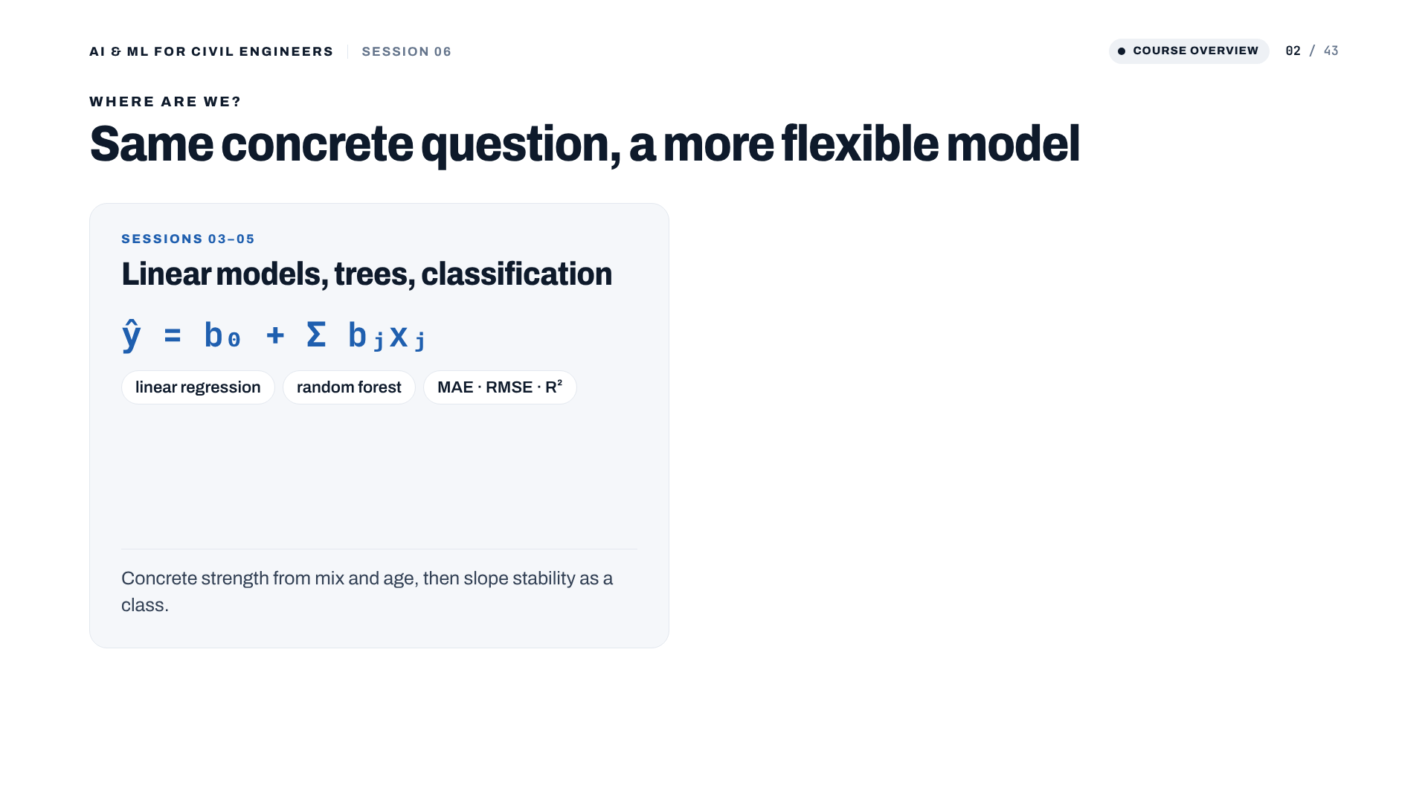
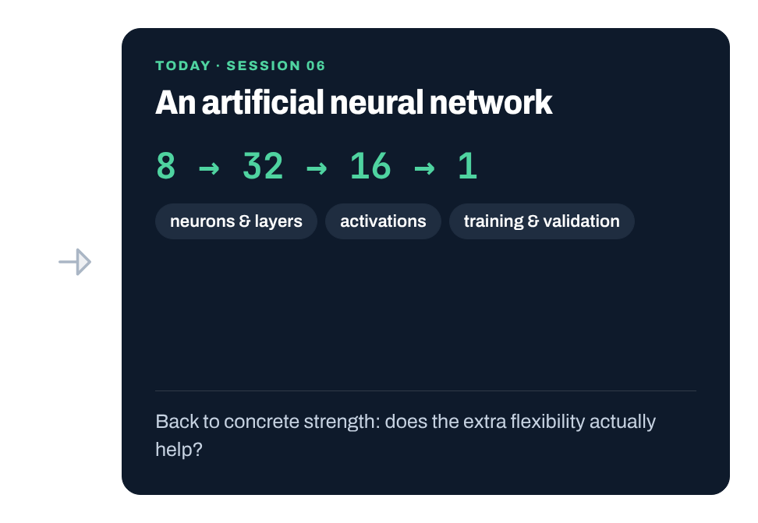
Notes:
Bridge from Sessions 03 to 05. We predicted concrete strength with linear regression and trees, and last time classified slopes. Today: the same concrete regression problem with an ANN of 8 inputs, hidden layers of 32 and 16 neurons, and one output. It is one more candidate model and must earn its place on the same test set.
[Clicks on this slide: 2]

Slide 3
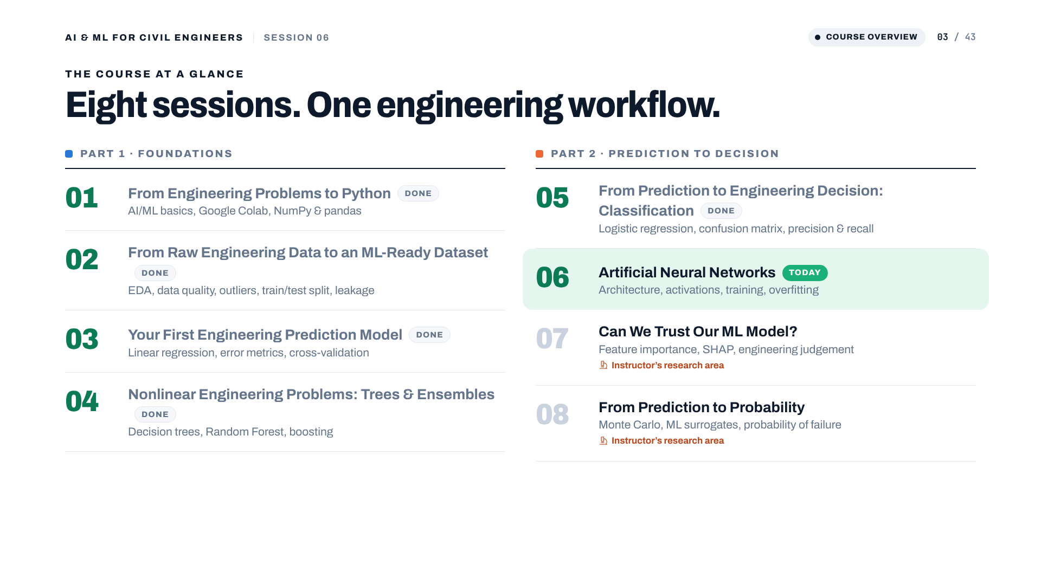
Notes:
Session 06 of 8, in Part 2: from prediction to decision.

Slide 4
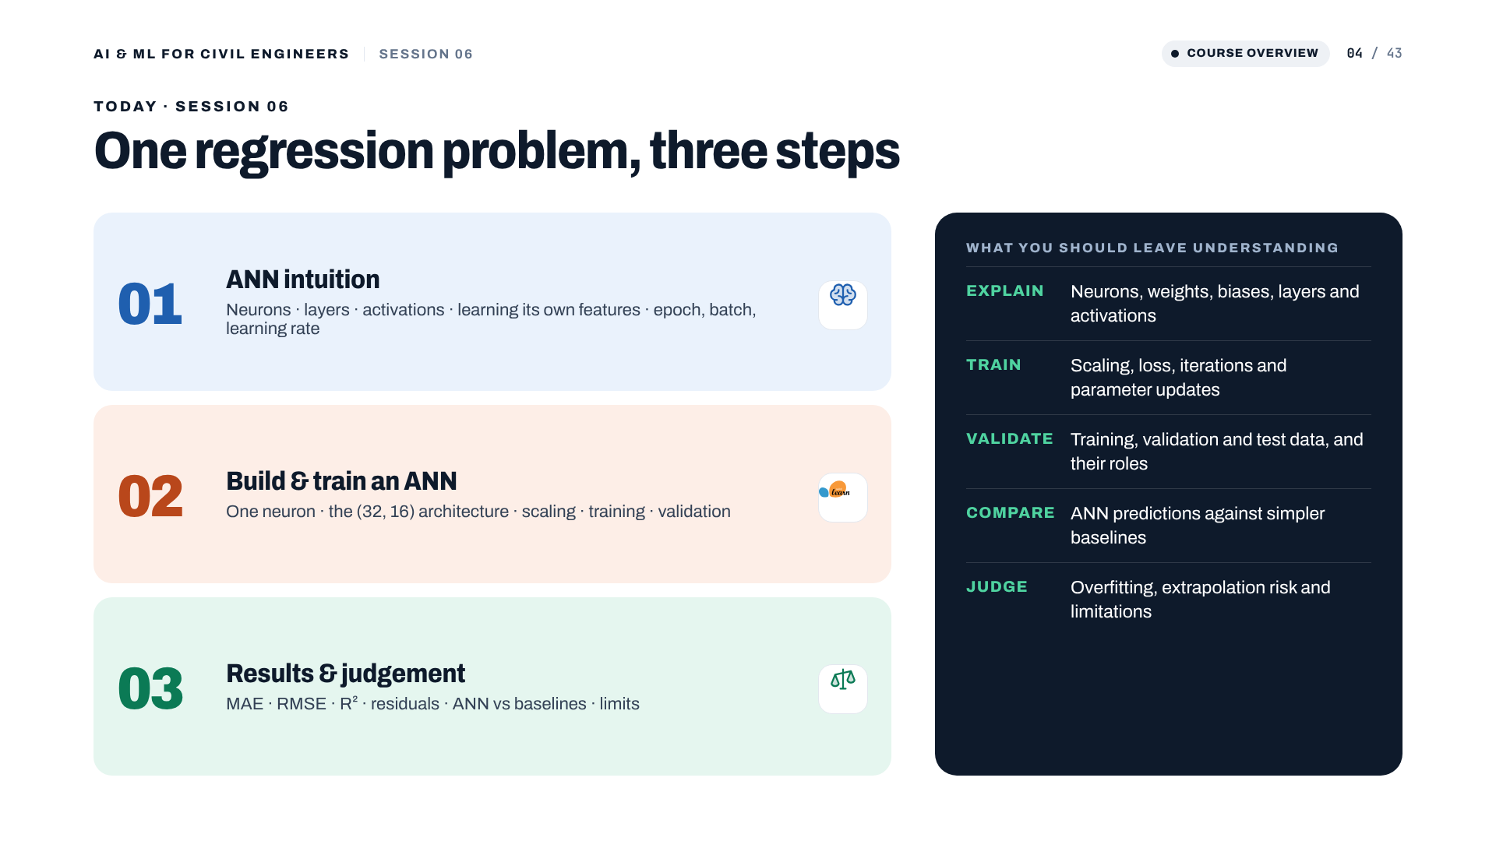
Notes:
Three parts: the intuition behind neural networks, then building and training one for concrete strength, then reading the results honestly. On the right, the five things participants should leave understanding: explain, train, validate, compare, judge.

Slide 5
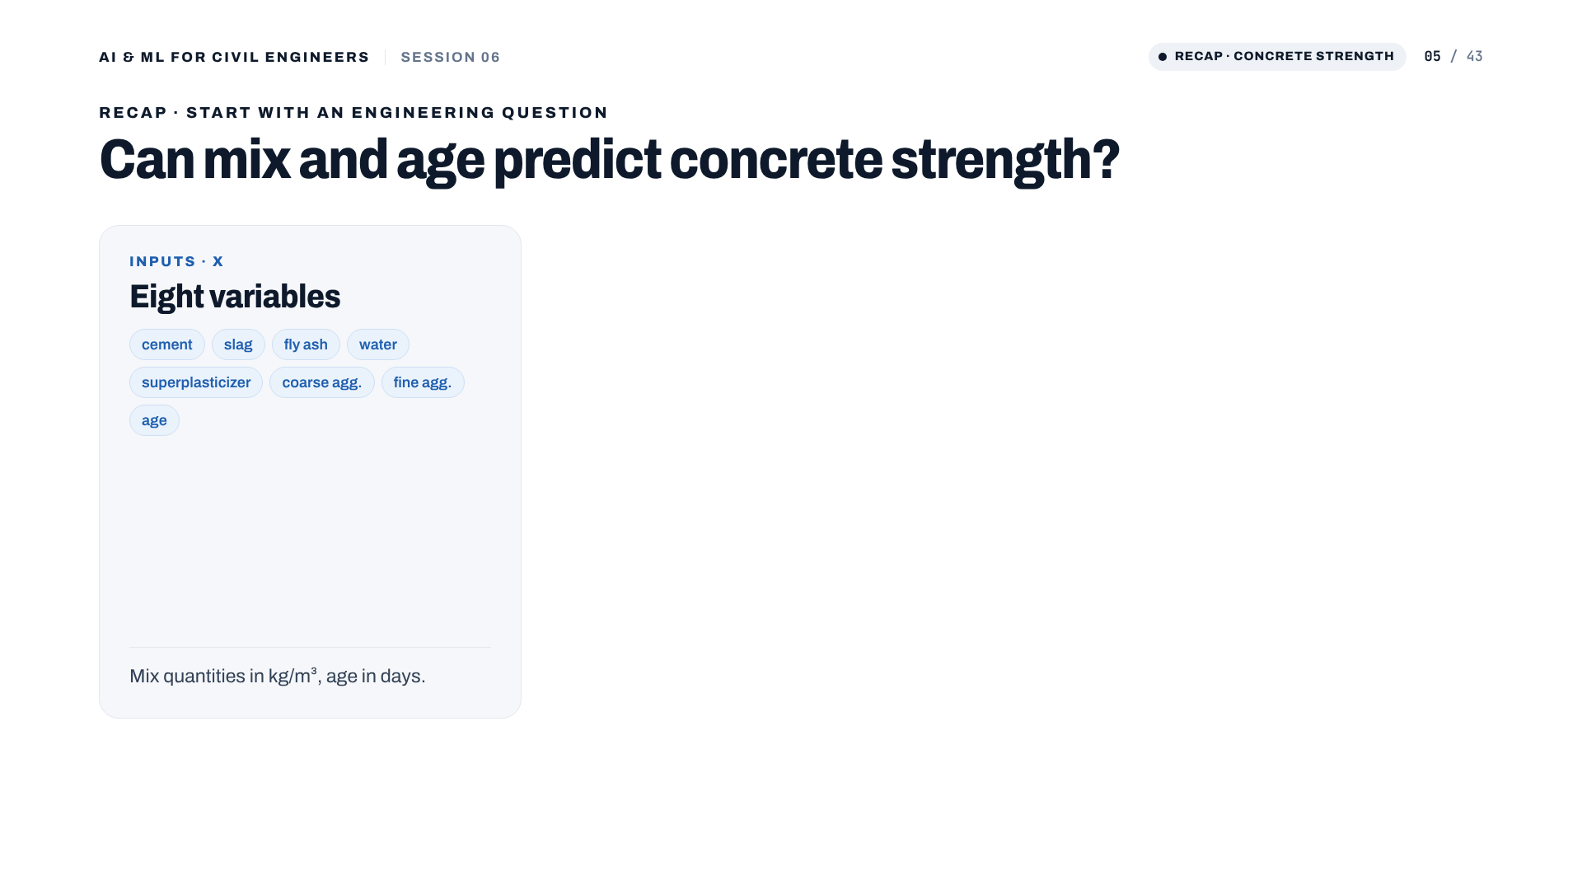
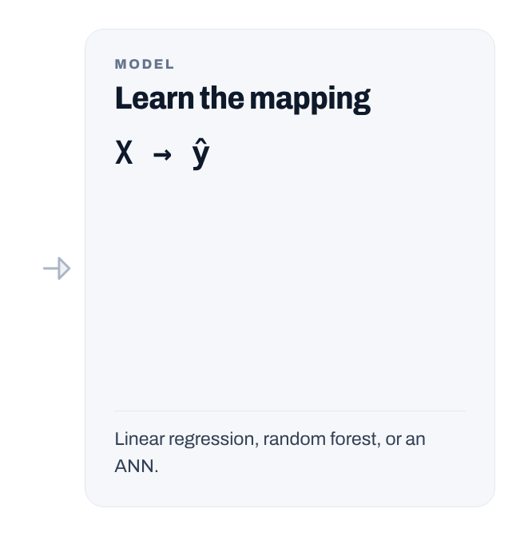
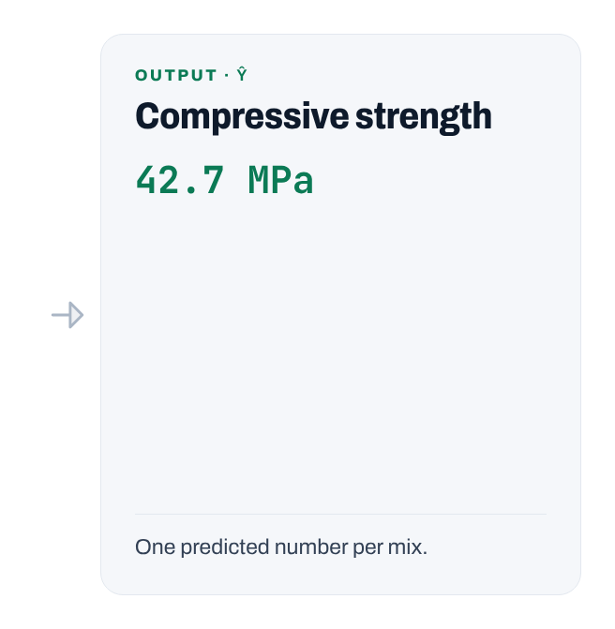
Notes:
Recap. Eight mix and age variables in, one continuous strength out: a regression problem.
[Clicks on this slide: 3]

Slide 6
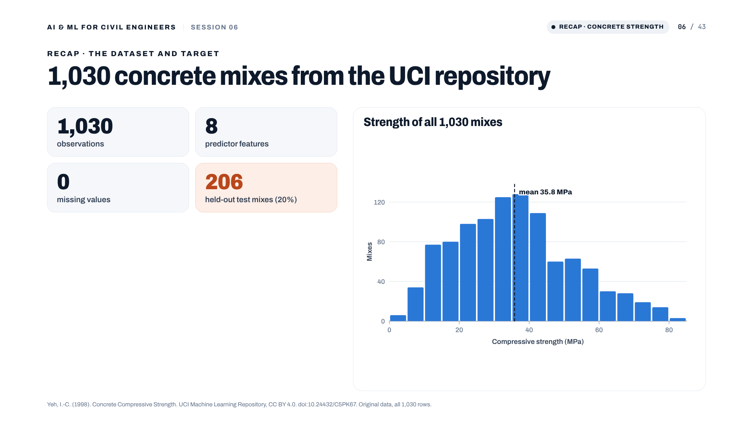
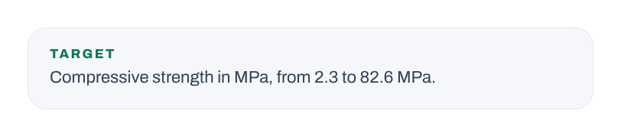
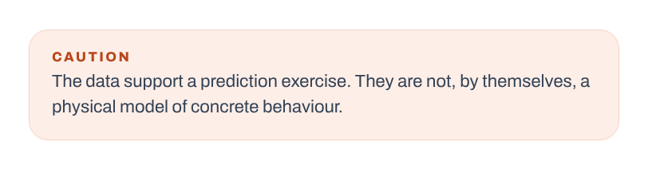
Notes:
Recap of the data: 1,030 mixes, 8 features, no missing values in the original UCI file. One fixed 80/20 split gives 824 training and 206 test mixes. Strength ranges from 2.3 to 82.6 MPa, mean 35.8. The data support a prediction exercise; they are not a physical model of concrete.
[Clicks on this slide: 2]

Slide 7
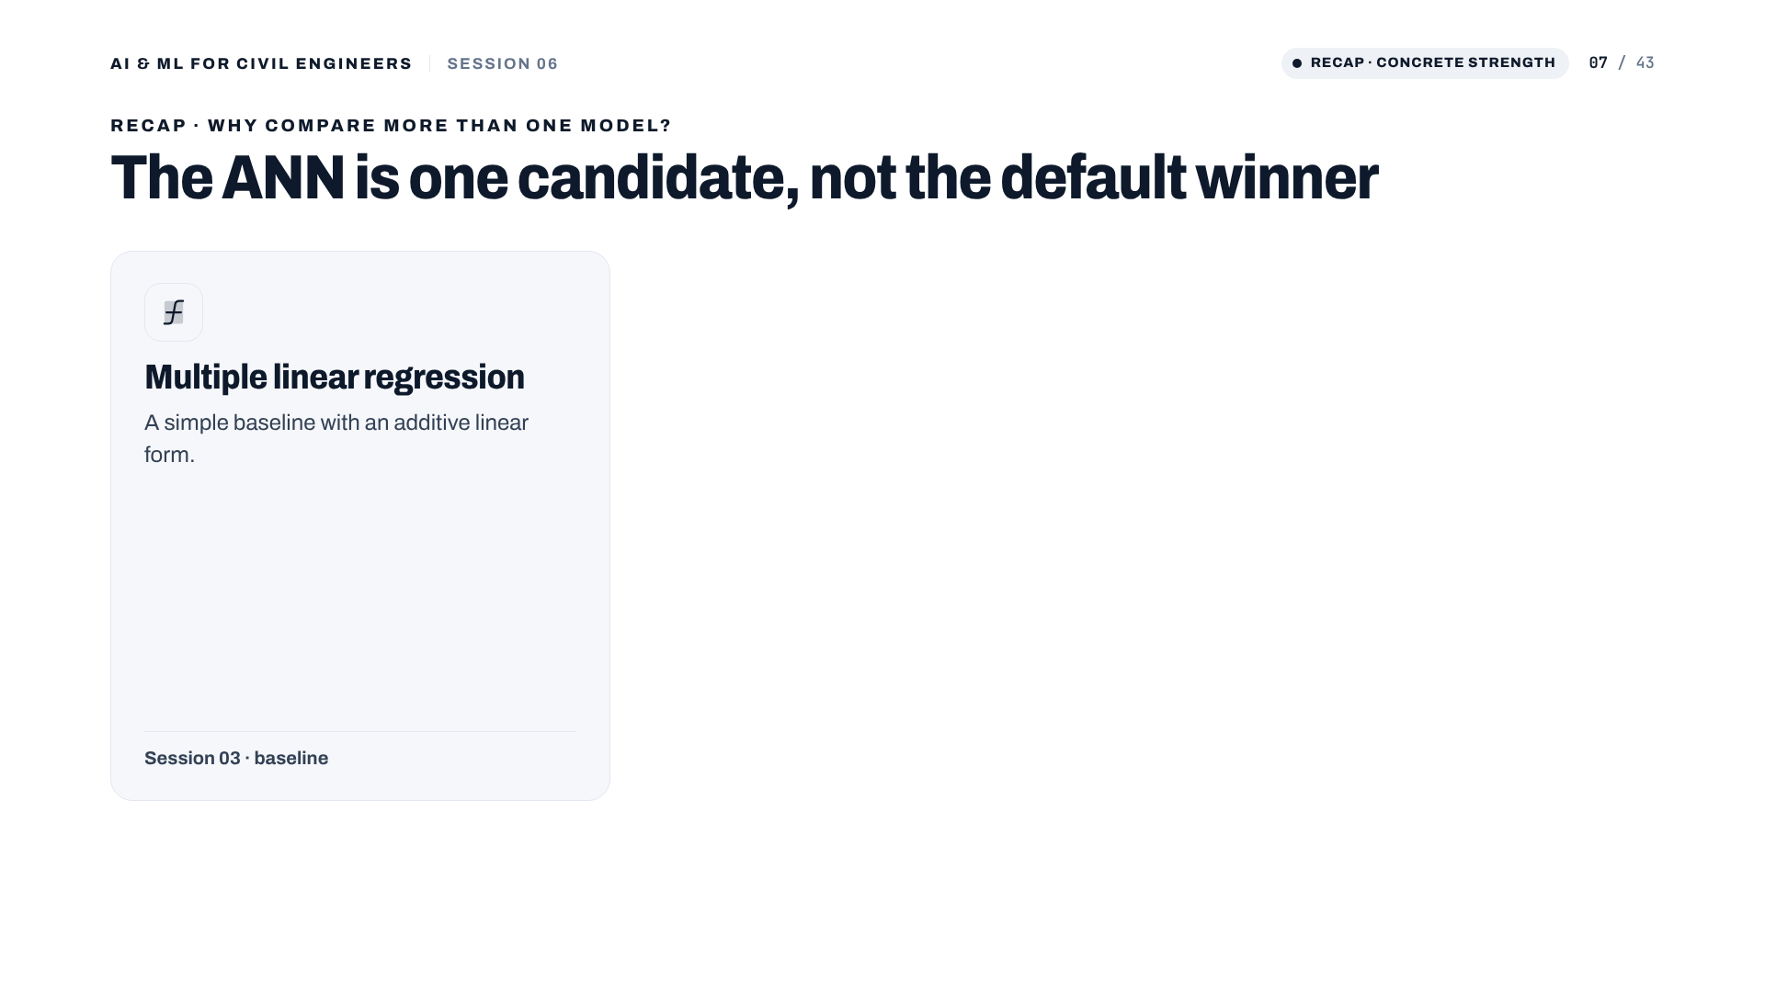
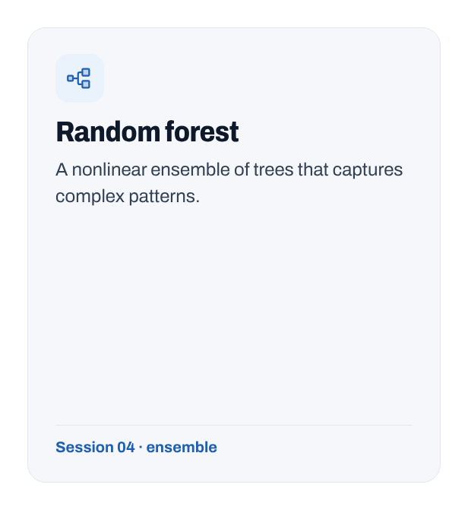
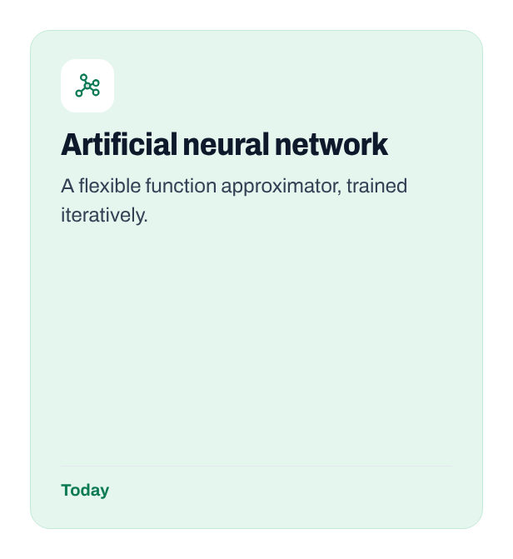
Notes:
Three candidates: linear regression as the baseline, random forest as the nonlinear ensemble from Session 04, and the ANN. All are compared on the same held-out test set. The baselines are not exhaustively tuned.
[Clicks on this slide: 3]

Slide 8
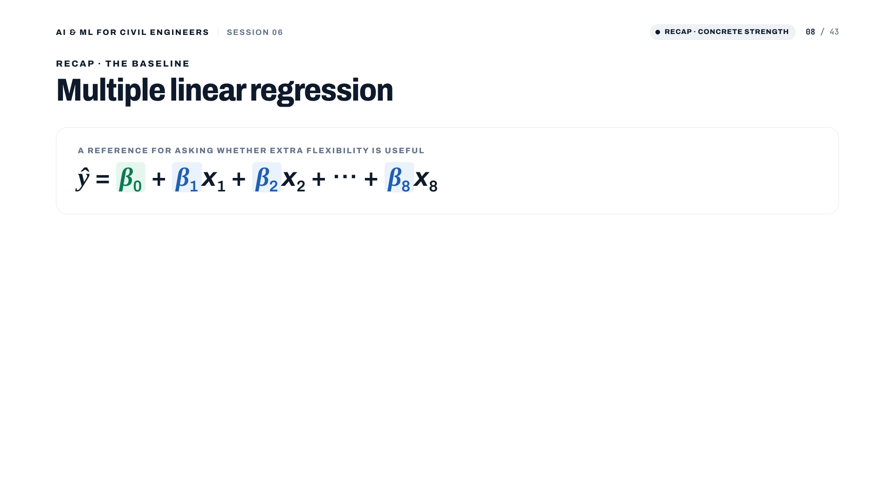
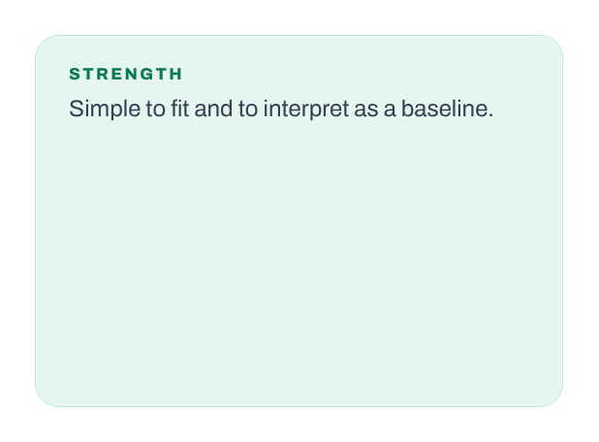
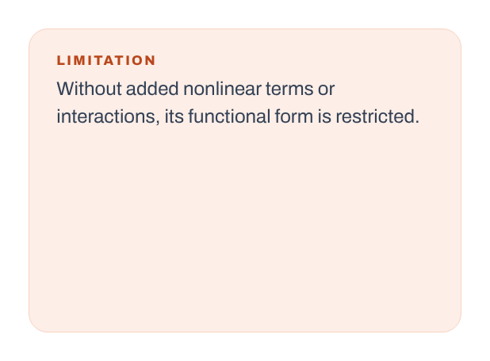
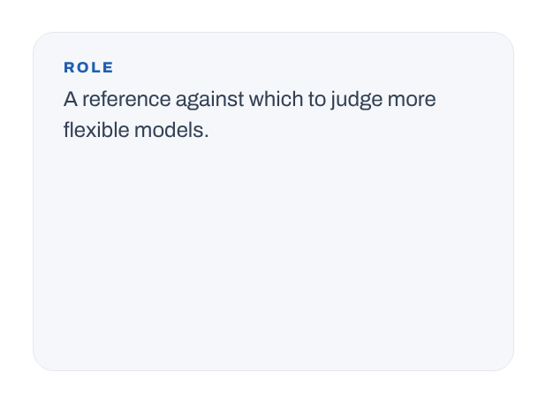
Notes:
The baseline: an additive linear form. Simple and interpretable, but restricted without interactions or nonlinear terms. On today's test mixes it reaches R² = 0.628, RMSE 9.80 MPa. That is the bar to beat.
[Clicks on this slide: 4]

Slide 9

Notes:
Done with the recap. Here comes the ANN. Part 01 builds the intuition.

Slide 10
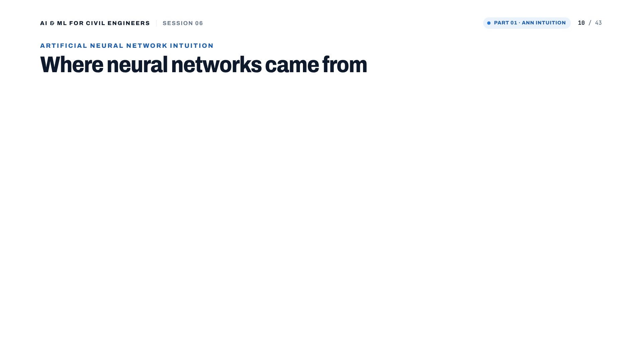
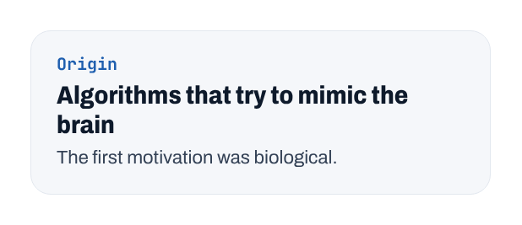
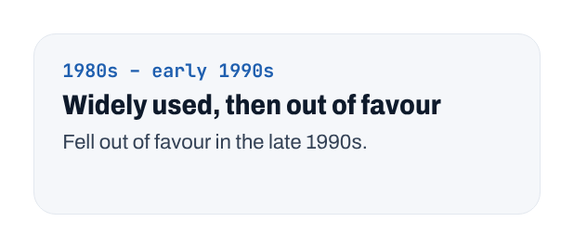
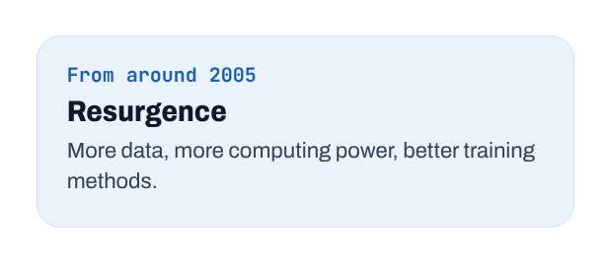
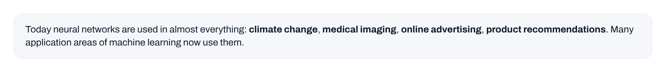
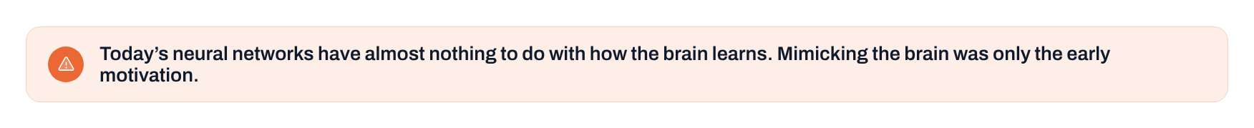
Notes:
Click through the history. Origin: algorithms that try to mimic the brain. Used in the 1980s and early 1990s, out of favour in the late 1990s. Resurgence from around 2005. Applications came in waves: speech recognition, then image recognition (computer vision), then text (natural language processing). Today: everything from climate change to medical imaging, advertising and product recommendations. Last click: today's networks have almost nothing to do with how the brain learns; the brain was only the early motivation.
[Clicks on this slide: 6]

Slide 11
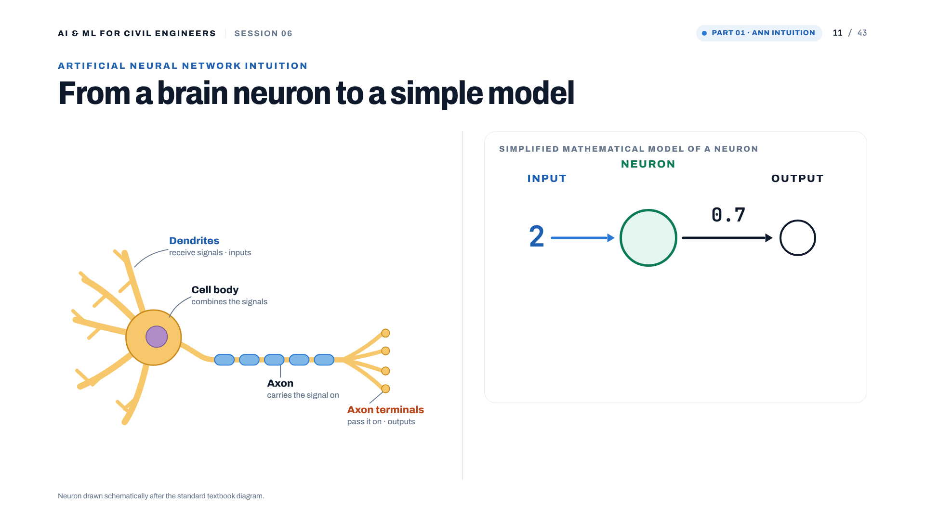
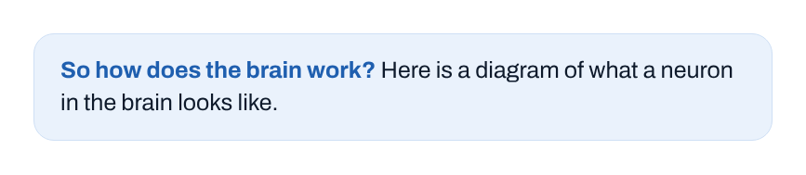
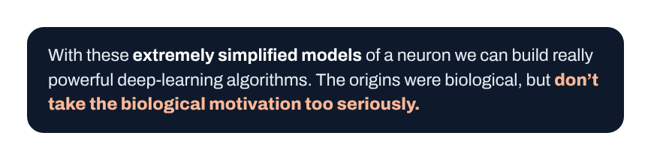
Notes:
All of human thought comes from neurons like this, sending electrical impulses and sometimes forming new connections with other neurons. Dendrites receive the inputs, the cell body combines them, the axon carries the signal, and the axon terminals pass it on. Click 2: the simplified mathematical model takes a number in, here 2, and outputs a number, here 0.7. With such extremely simplified models we build powerful algorithms. Don't take the biology too seriously.
[Clicks on this slide: 2]

Slide 12
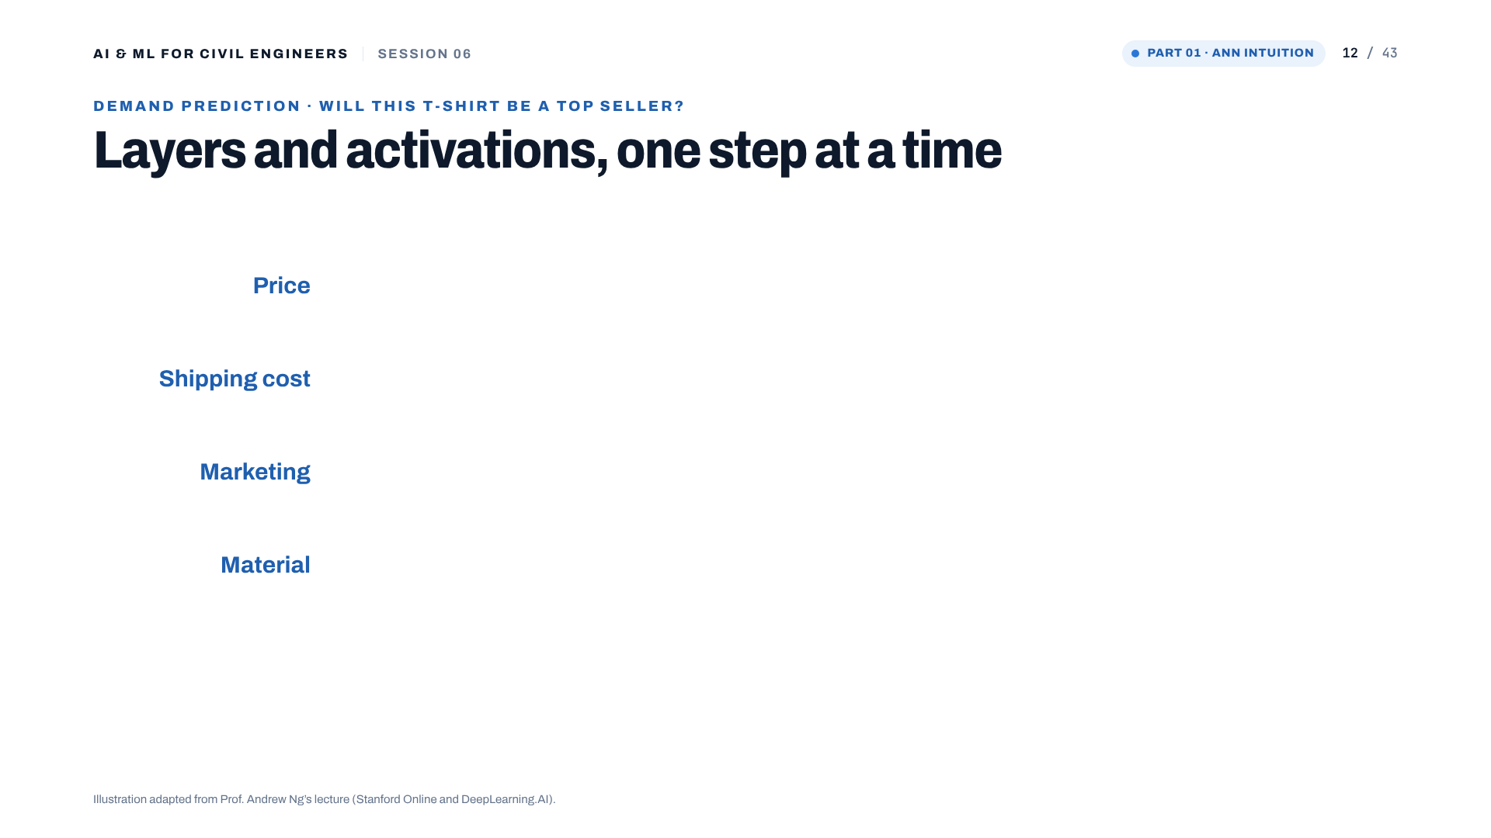
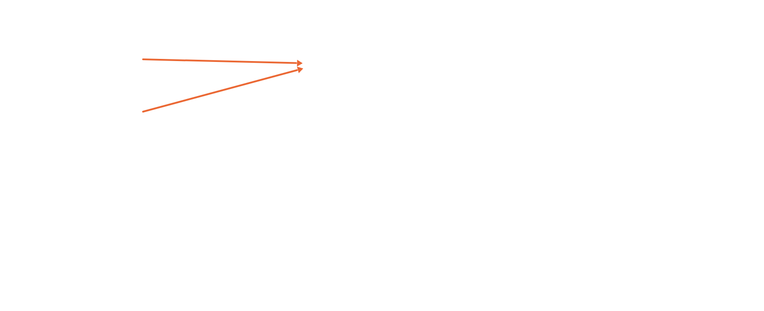
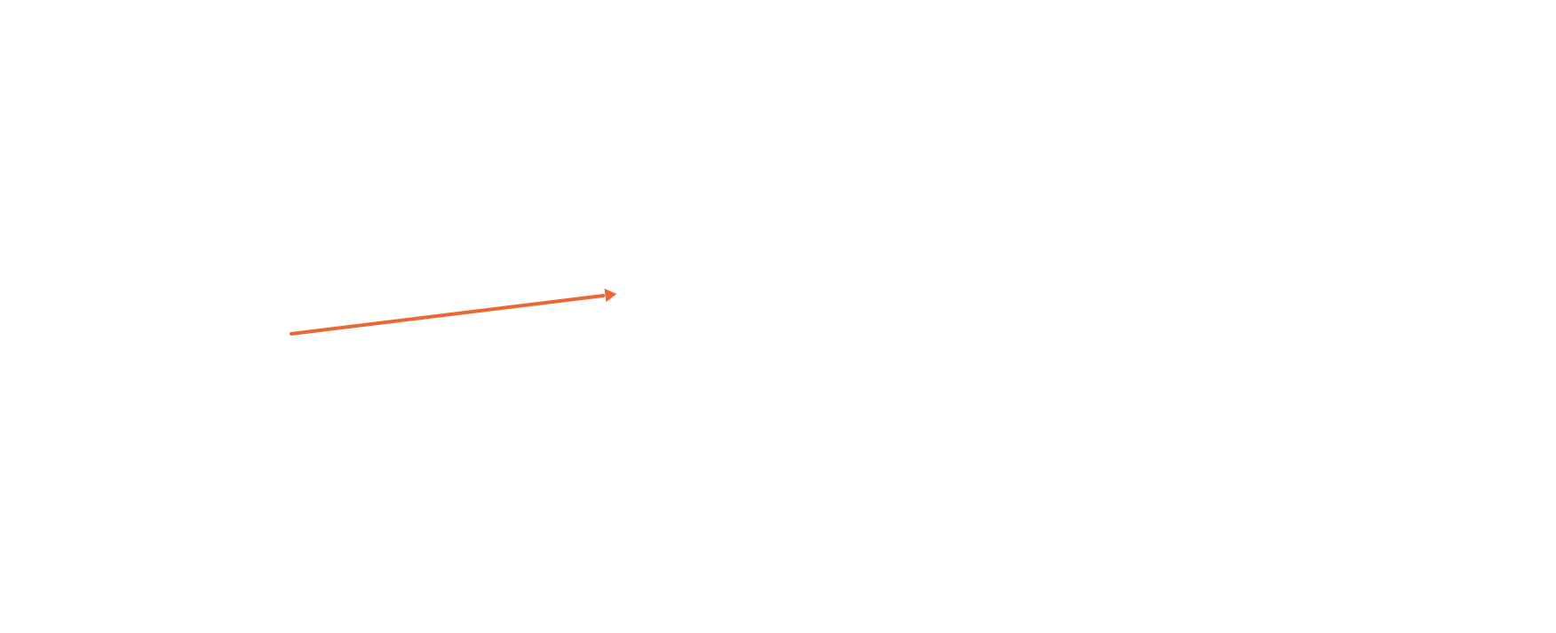
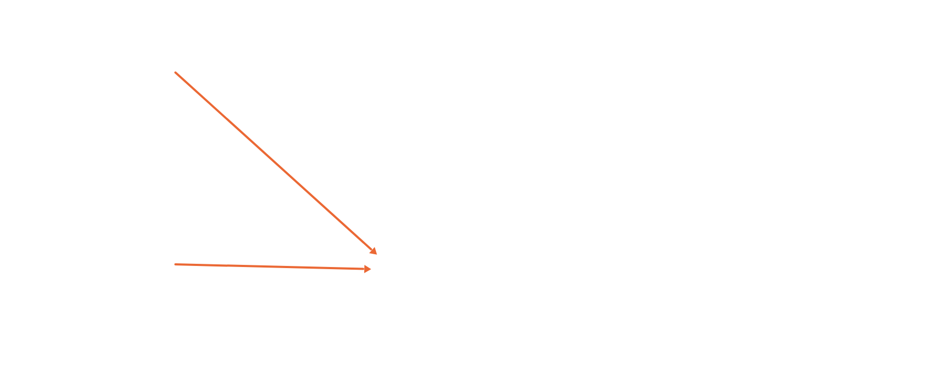
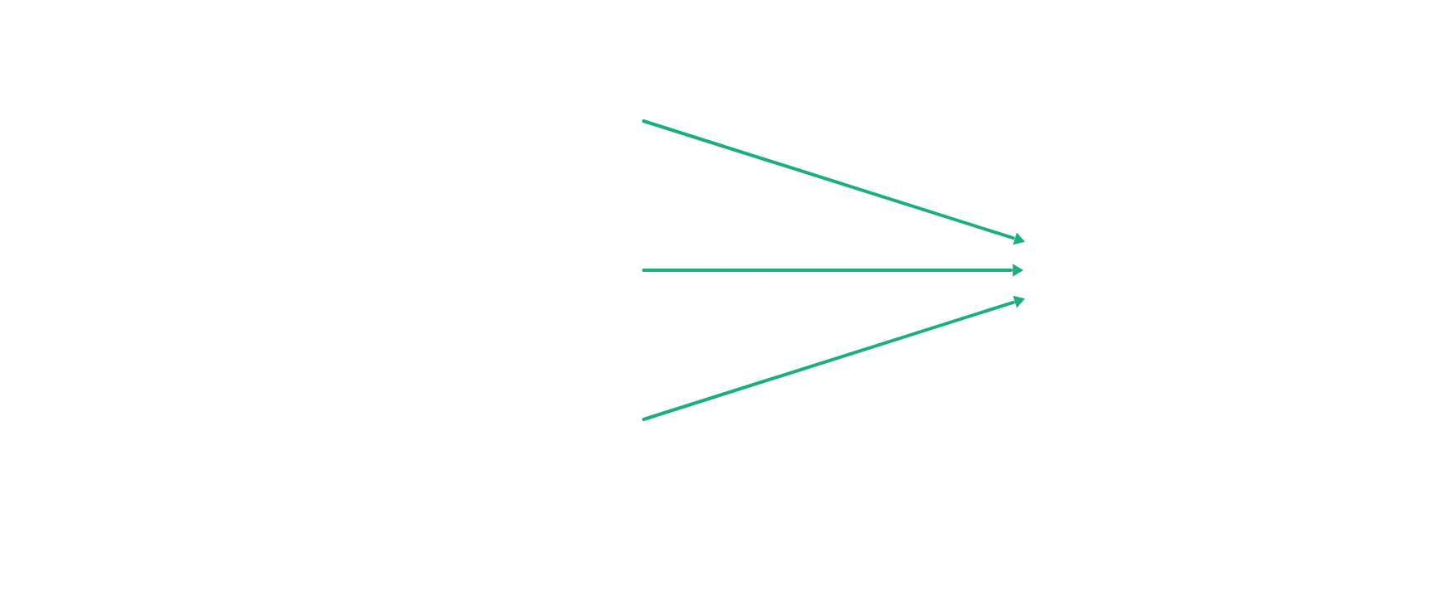
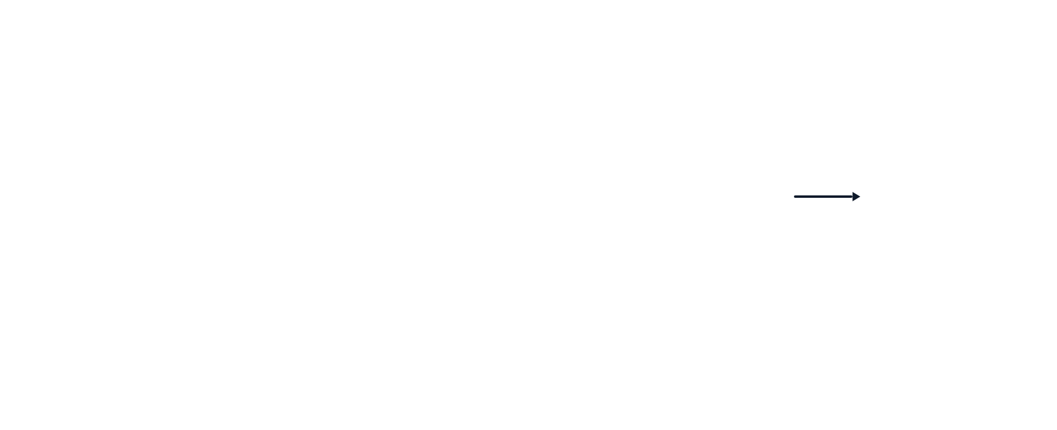
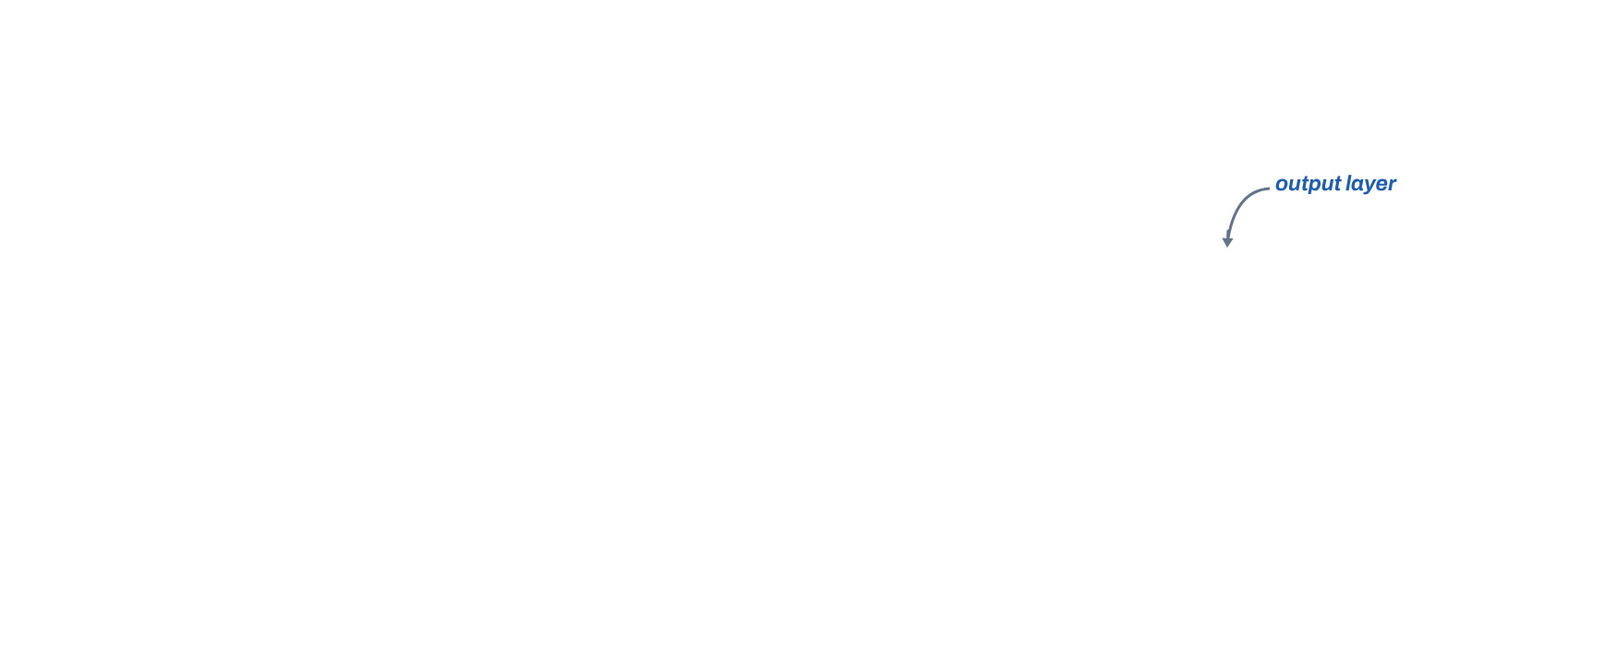
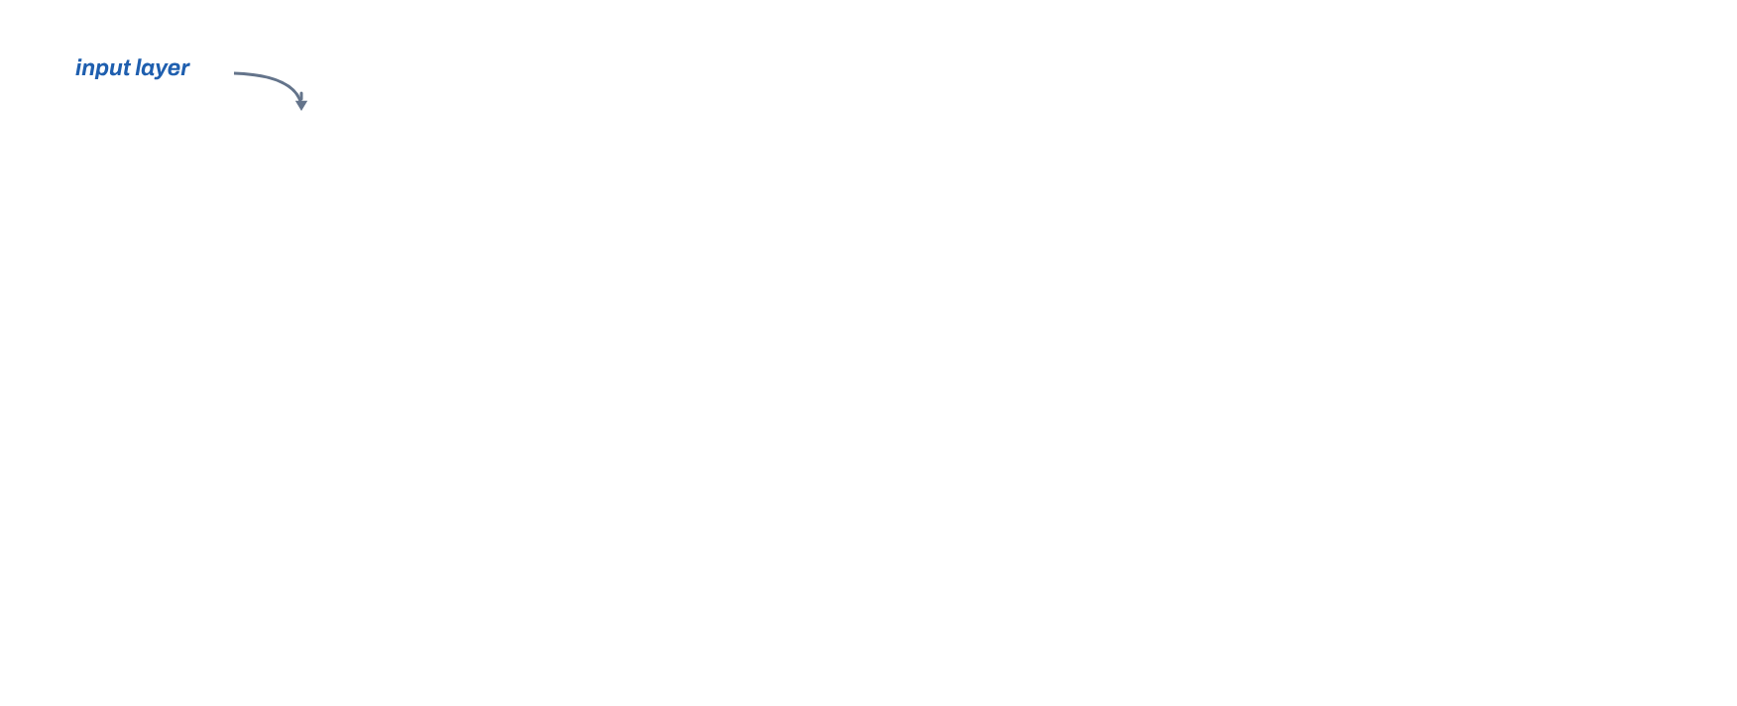

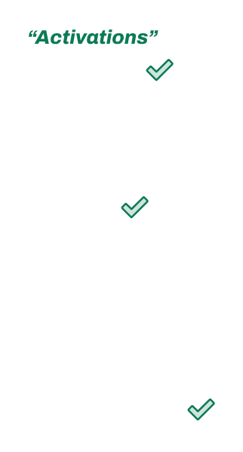







Notes:
Demand prediction, after Andrew Ng: will this T-shirt be a top seller? 19 clicks, in the draft's order. Click 1: the three intermediate quantities, affordability, awareness, perceived quality, and the output. Clicks 2 to 7: each neuron and the inputs that feed it: price and shipping cost give affordability; marketing gives awareness; price and material give perceived quality. Clicks 8 to 9: the output neuron and its inputs. Click 10: 4 numbers, 3 numbers, 1 number. Clicks 11 to 15: output arrow, the hidden layer, the output layer. Click 16: these are the activations. Click 17: each arrow carries an activation value. Clicks 18 and 19: output layer and input layer.
[Clicks on this slide: 19]

Slide 13
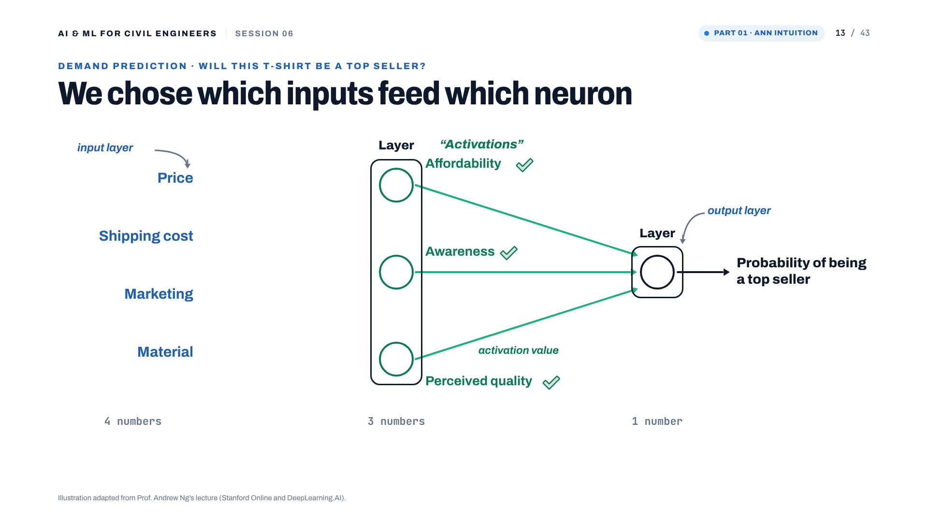
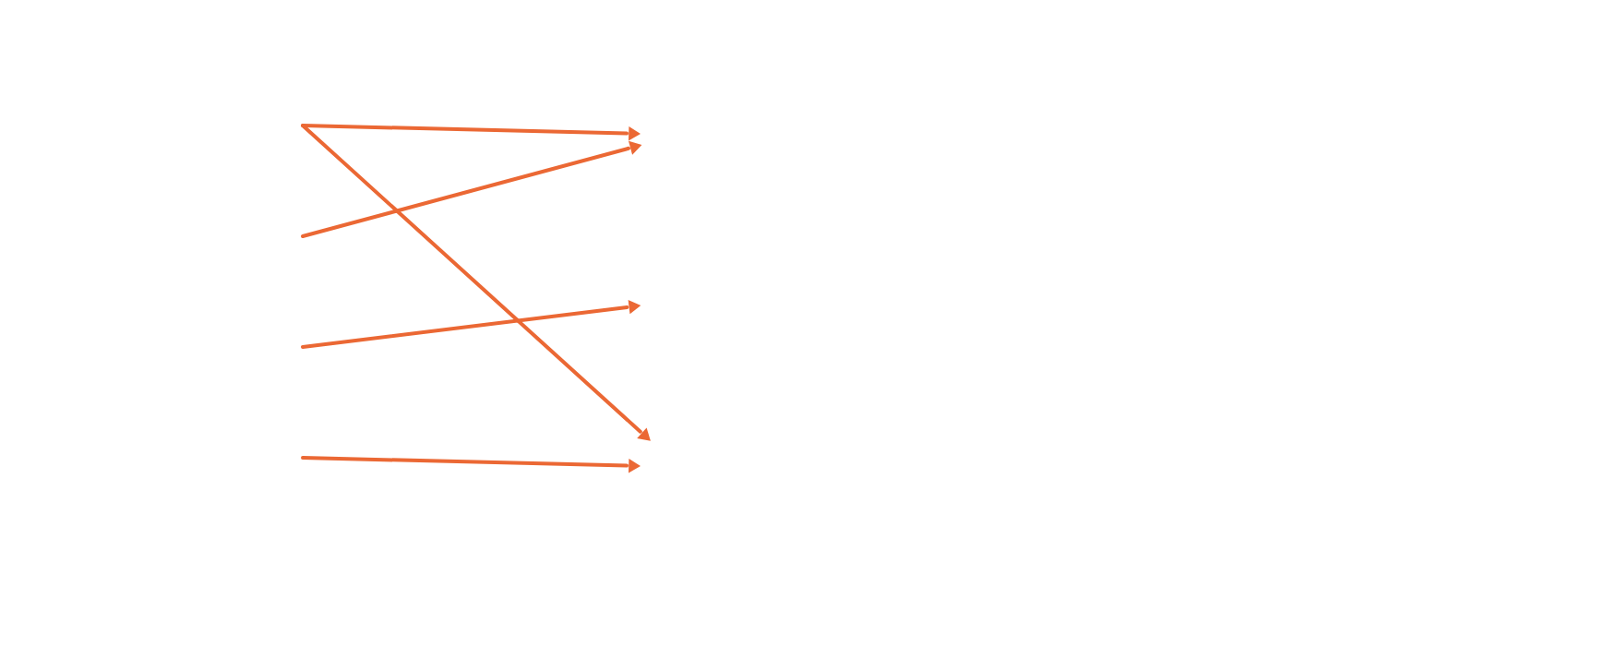
Notes:
So far we decided by hand which inputs feed which neuron. Click: those hand-picked connections go away.
[Clicks on this slide: 1]

Slide 14
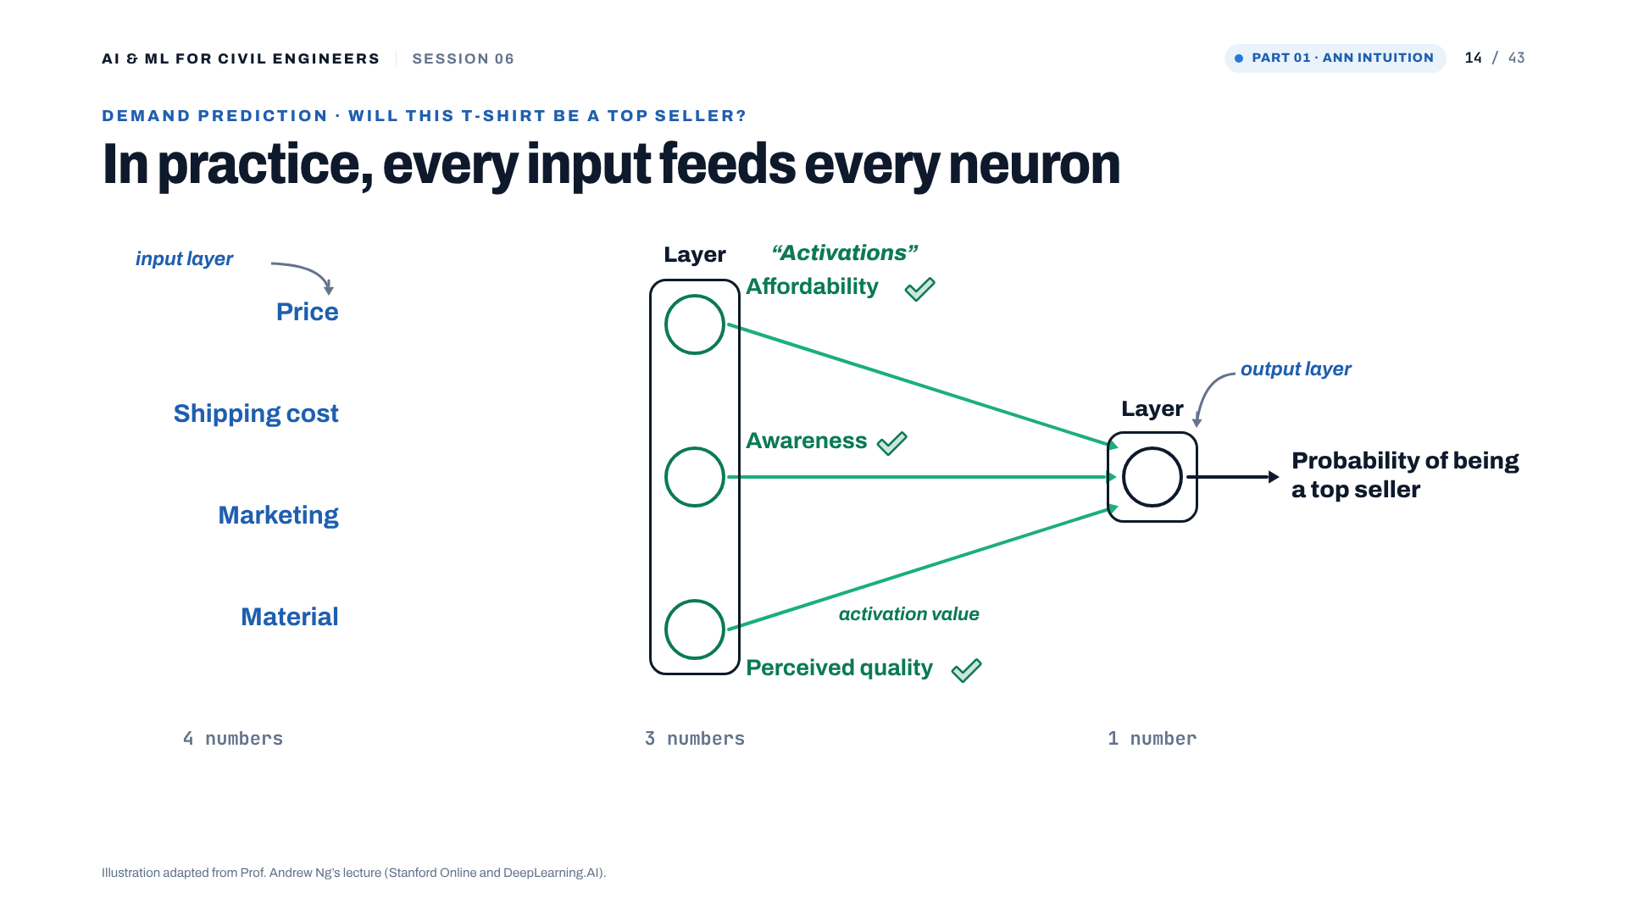
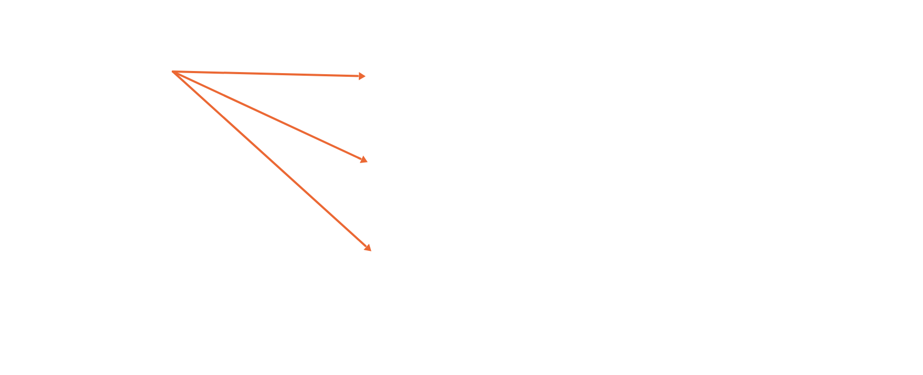
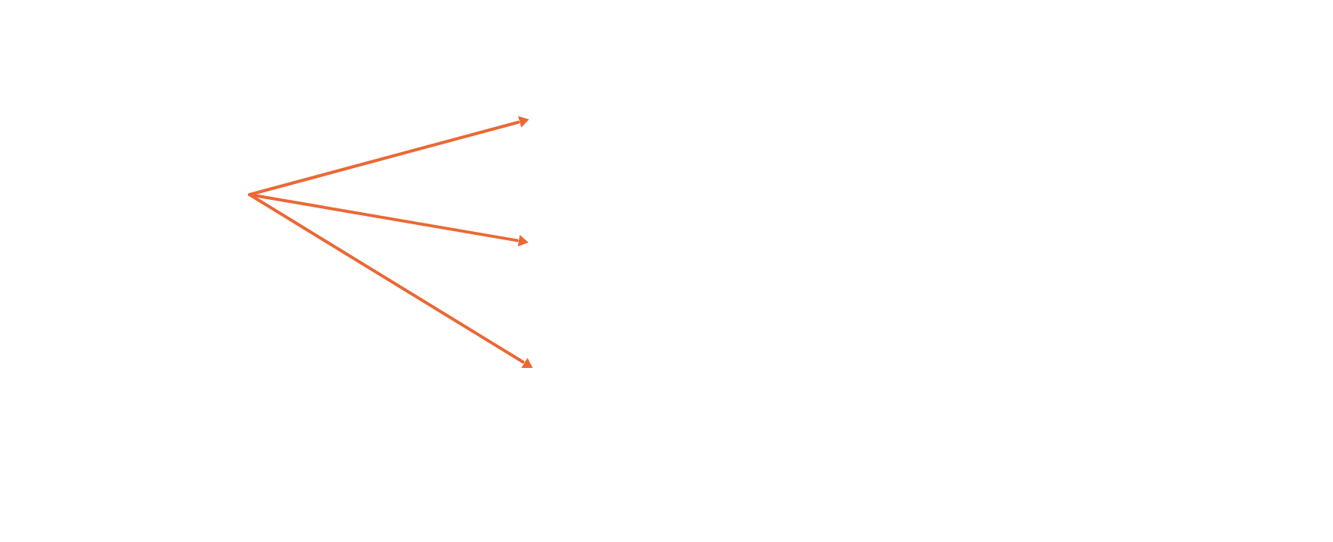
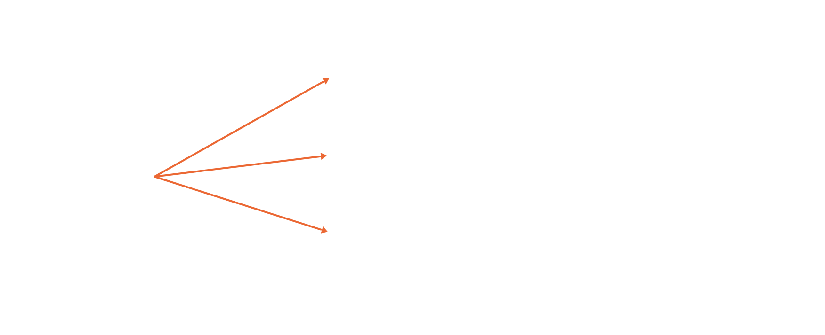
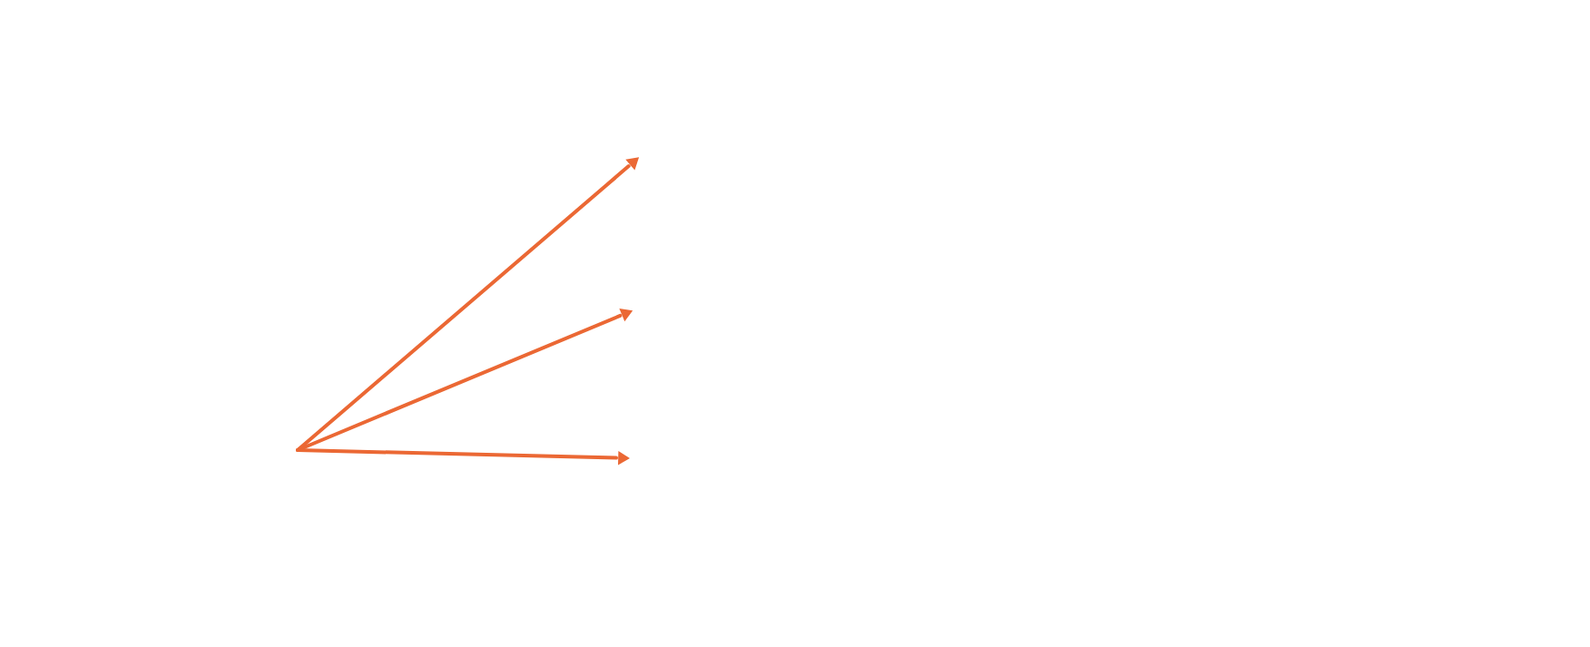
Notes:
In practice every neuron in a layer receives every input from the previous layer, and learns which ones matter through its weights. Four clicks, one input at a time: price, shipping cost, marketing, material.
[Clicks on this slide: 4]

Slide 15
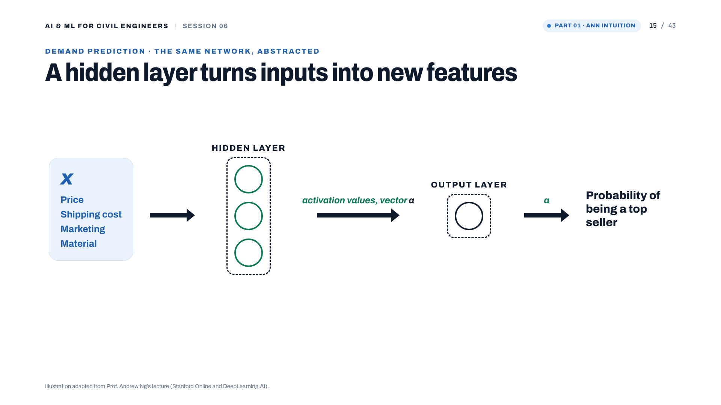
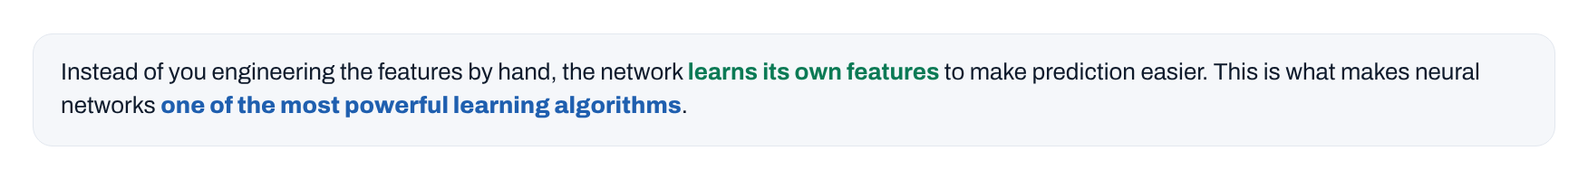
Notes:
The middle layer is called the hidden layer because the training set shows us x and y, the correct inputs and outputs, but not the correct values of affordability, awareness or perceived quality. We never see them in the data. One way to see this network: logistic regression, but a version that learns its own features, which makes it easier to predict accurately. Click: instead of engineering features by hand, the network learns them.
[Clicks on this slide: 1]

Slide 16
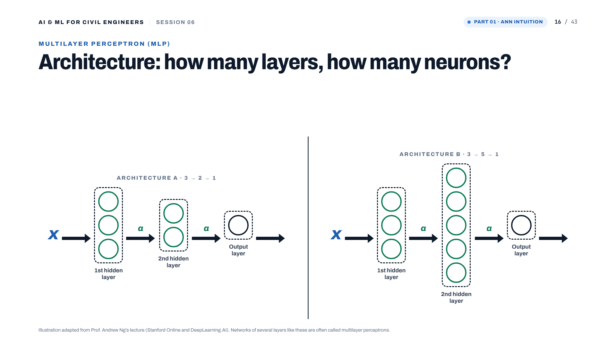
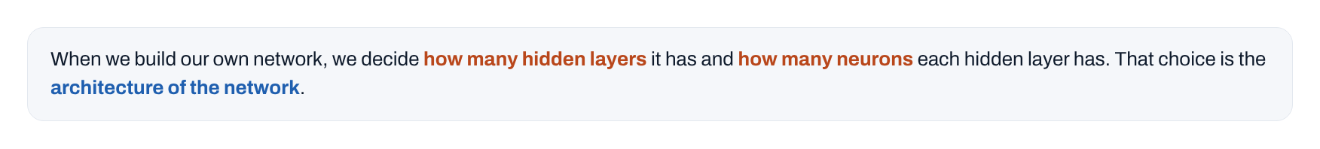
Notes:
Click: when building our own network we choose how many hidden layers and how many neurons per layer: the architecture. Two examples. Networks with several layers like these are called multilayer perceptrons in some literature.
[Clicks on this slide: 1]

Slide 17
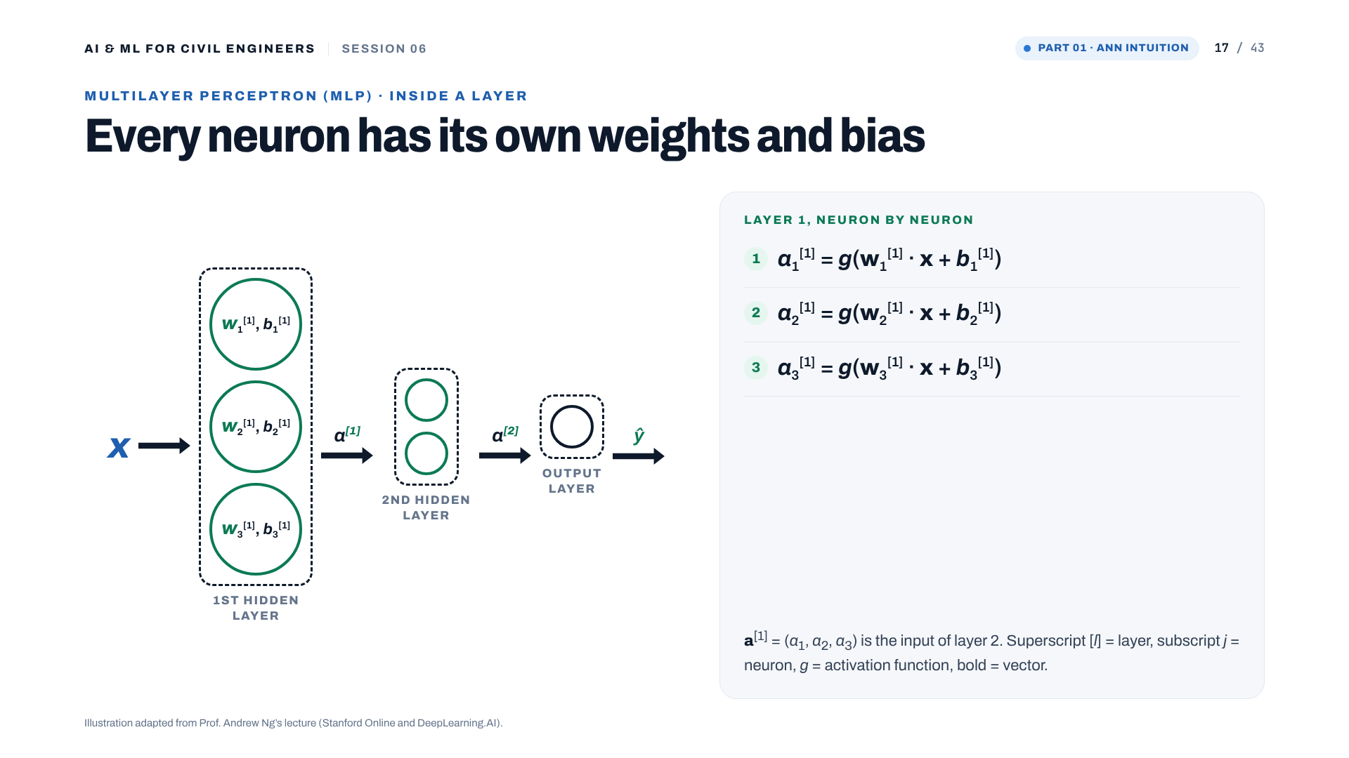
Notes:
Hidden layers transform the inputs nonlinearly; the number of layers and neurons are key hyperparameters. Each neuron j in layer 1 has its own weight vector and bias, and applies an activation g: a_j = g(w_j · x + b_j). The vector of activations a[1] is the input of layer 2. Forward propagation computes the prediction; the loss compares it with the label; backpropagation computes gradients, and an optimiser such as stochastic gradient descent or Adam adjusts weights and biases. For our concrete regressor the loss is squared error, not cross-entropy.

Slide 18

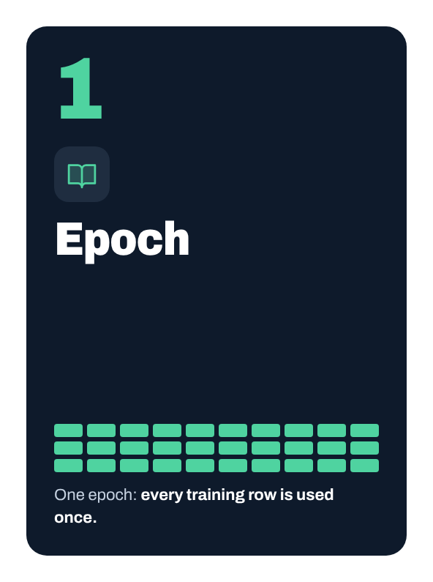
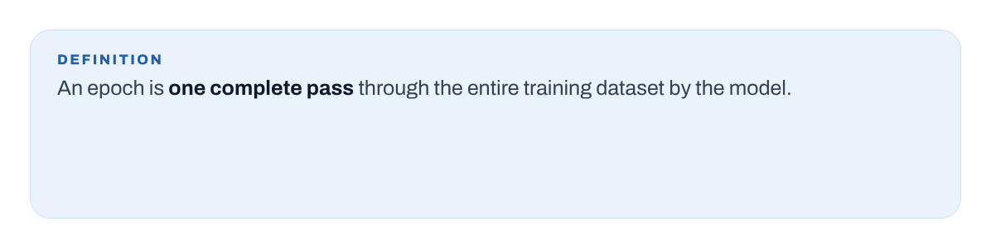
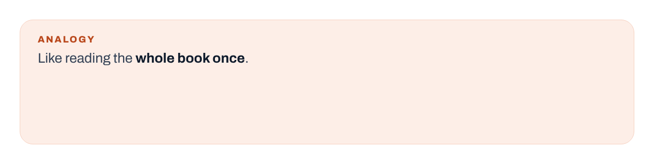

Notes:
Epoch: one complete pass through the training data, like reading the whole book once. We train for many epochs. Note: within an epoch the weights are updated once per batch, not once per epoch.
[Clicks on this slide: 4]

Slide 19





Notes:
Batch size: how many samples the model processes before one weight update. 800 rows with batch size 32 means 25 updates per epoch. Small batches: more, noisier updates; large batches: smoother updates, more memory. scikit-learn's default is min(200, number of rows).
[Clicks on this slide: 4]

Slide 20





Notes:
Learning rate: the step size. Too high overshoots and may not converge; too low is slow and may get stuck. The three small panels show the same bowl with three step sizes. Like your pace on a hike.
[Clicks on this slide: 4]

Slide 21

Notes:
Summary, with the matching scikit-learn MLPRegressor settings: max_iter is the maximum number of epochs for the adam and sgd solvers; batch_size 'auto' means min(200, n); learning_rate_init defaults to 0.001. These are hyperparameters: we choose them, on validation data.

Slide 22

Notes:
Part 02: building and training an ANN for concrete strength.

Slide 23



Notes:
An ANN is a parameterised function made of connected units: inputs, hidden layers of weighted sums and nonlinear activations, one output. It learns weights and biases from examples; nobody hands it a mix-design equation.
[Clicks on this slide: 3]

Slide 24




Notes:
Inside one neuron: z is a weighted sum plus a bias, then the activation g. Weights scale each input, the bias shifts z, and g bends the response. Training adjusts all of them. The same z was the logistic-regression score in Session 05.
[Clicks on this slide: 4]

Slide 25





Notes:
Our selected network is (32, 16): 32 neurons in the first hidden layer, 16 in the second. The notation counts neurons, not parameters. Clicks: 8 x 32 + 32 = 288, 32 x 16 + 16 = 528, 16 x 1 + 1 = 17, total 833 weights and biases, learned from 824 training mixes.
[Clicks on this slide: 4]

Slide 26



Notes:
Without nonlinear activations, two linear layers collapse into one linear map, so depth adds nothing. Our network uses ReLU in both hidden layers; the output is linear so it can predict any strength. Clicks show sigmoid and tanh for comparison only.
[Clicks on this slide: 2]

Slide 27


Notes:
The features live on very different scales: superplasticizer up to 32.2 kg/m³, coarse aggregate 801-1,145 kg/m³, age 1-365 days. Gradient-based training is better behaved after StandardScaler. The scaler is inside the Pipeline, so it learns means and standard deviations from the training data only.
[Clicks on this slide: 3]

Slide 28




Notes:
One training step: forward pass, loss (squared error for regression), backpropagation of gradients, an update by the optimiser (Adam is scikit-learn's default) with the learning rate as the step size. Repeat for every batch and epoch. This is optimisation, as in Session 03, not the discovery of a physical law.
[Clicks on this slide: 5]

Slide 29



Notes:
The notebook plots the fitted ANN's optimisation history. Training loss tracks the objective on training batches; it is not test RMSE. The internal validation R² is computed on a held-out part of the training data and drives early stopping. The chart here is a schematic of the typical shapes, not the notebook's run. Check whether training reached the iteration limit.
[Clicks on this slide: 2]

Slide 30



Notes:
Three roles. Training data (824 mixes) fits the parameters; a validation subset inside it monitors training and compares architectures; the test data (206 mixes) is used once at the end. The architecture is chosen on validation RMSE, never on the test set.
[Clicks on this slide: 3]

Slide 31




Notes:
Four candidates on the validation subset: (8,) 7.175, (16, 8) 6.390, (32, 16) 5.980, (32, 16, 8) 6.381 MPa RMSE. (32, 16) is selected. The deeper network did not help. Best of four tried, not proof of a global optimum.
[Clicks on this slide: 3]

Slide 32

Notes:
Part 03: results and judgement. Is the ANN worth its complexity?

Slide 33



Notes:
Three complementary metrics. MAE: average error size in MPa. RMSE: also MPa, but large errors count more. R²: compared with always predicting the mean, and can be negative. Residual = actual minus predicted: positive means underprediction, negative means overprediction.
[Clicks on this slide: 3]

Slide 34




Notes:
Test results on the same 206 mixes. Linear regression: MAE 7.75, RMSE 9.80. Random forest: MAE 3.79, RMSE 5.57, best in this run. ANN (32, 16): MAE 4.70, RMSE 6.04, competitive but not best. One split, one run: no general verdict on model families.
[Clicks on this slide: 4]

Slide 35


Notes:
R²: linear 0.628, random forest 0.880, ANN 0.858. Useful, but R² alone does not show error patterns, behaviour near critical thresholds, or validity outside the training domain.
[Clicks on this slide: 1]

Slide 36



Notes:
The actual-versus-predicted plot of the linear baseline, reproduced from the UCI data. Look for scatter around the 1:1 line, systematic bias, and changing spread. Then show the ANN and random-forest plots live in the notebook. Plots complement metrics; they do not prove physical validity.
[Clicks on this slide: 2]

Slide 37


Notes:
Residual plot of the linear baseline. Positive: underprediction; negative: overprediction; patterns suggest systematic error. Click: in this baseline, weak mixes are overpredicted and strong mixes underpredicted, on average. A good average score can hide weak performance in parts of the range. Compare with the ANN residual plot in the notebook.
[Clicks on this slide: 2]

Slide 38





Notes:
Does an ANN understand concrete? No: it learns a statistical mapping. Interpolation inside the training domain is reasonable; extrapolation is risky; a high test score does not establish physical validity; deployment needs representative validation, plausible behaviour and attention to error consequences. The table shows the training domain.
[Clicks on this slide: 4]

Slide 39


Notes:
The same idea transfers to geotechnical engineering, as illustrations, not trained models here: a slope-stability surrogate for the factor of safety, and surrogates of expensive numerical models, the topic of Session 08. A surrogate speeds up repeated predictions; it does not validate the numerical model or justify extrapolation.
[Clicks on this slide: 2]

Slide 40




Notes:
Take-home: understand the mapping; training is optimisation; validate correctly; compare honestly, here the random forest beat the selected ANN; keep claims proportional.
[Clicks on this slide: 3]

Slide 41

Notes:
After the session: work through the notebook with these five tasks. Dataset citation at the bottom right.

Slide 42

Notes:
Questions.

Slide 43

Notes:
Thank you. Next session: can we trust our ML model? Feature importance, SHAP and engineering judgement.

