Slide 1






Live online course
Cohort Fall 2026
AI & Machine
Learning for Civil
Engineers
Session 06 · Artificial neural networks
Artificial Neural Networks for Engineering
Prediction
From neurons to defensible predictions. How a network learns, how we validate it,
and when it is worth its complexity.
Data
Model
Validate
Decide
Dr. Abdul Waris
Research Associate · Universität Siegen, Germany
Technology partner
Notes:
Welcome to Session 06: artificial neural networks for engineering prediction. Today we go from a single neuron to a trained network, and then ask the engineering question: is the extra flexibility worth it on our concrete data?

Slide 2


AI & ML for Civil Engineers
Session 06
Course overview
02 / 43
Where are we?
Same concrete question, a more flexible model
Sessions 03–05
Today · Session 06
Linear models, trees, classification
An artificial neural network
ŷ = b₀ + Σ bⱼxⱼ
8 → 32 → 16 → 1
linear regression
random forest
MAE · RMSE · R²
neurons & layers
activations
training & validation
Concrete strength from mix and age, then slope stability as a
class.
Back to concrete strength: does the extra flexibility actually
help?
The ANN is one more candidate model. It has to earn its place against the baselines on the same test set.
Notes:
Bridge from Sessions 03 to 05. We predicted concrete strength with linear regression and trees, and last time classified slopes. Today: the same concrete regression problem with an ANN of 8 inputs, hidden layers of 32 and 16 neurons, and one output. It is one more candidate model and must earn its place on the same test set.
[Clicks on this slide: 2]

Slide 3


AI & ML for Civil Engineers
Session 06
Course overview
03 / 43
The course at a glance
Eight sessions. One engineering workflow.
Part 1 · Foundations
Part 2 · Prediction to decision
01
From Engineering Problems to Python
Done
05
From Prediction to Engineering Decision:
Classification
AI/ML basics, Google Colab, NumPy & pandas
Done
Logistic regression, confusion matrix, precision & recall
02
From Raw Engineering Data to an ML-Ready Dataset
Done
06
Artificial Neural Networks
Today
EDA, data quality, outliers, train/test split, leakage
Architecture, activations, training, overfitting
03
Your First Engineering Prediction Model
Done
07
Can We Trust Our ML Model?
Linear regression, error metrics, cross-validation
Feature importance, SHAP, engineering judgement
Instructor’s research area
04
Nonlinear Engineering Problems: Trees & Ensembles
Done
08
From Prediction to Probability
Decision trees, Random Forest, boosting
Monte Carlo, ML surrogates, probability of failure
Instructor’s research area
Notes:
Session 06 of 8, in Part 2: from prediction to decision.

Slide 4



AI & ML for Civil Engineers
Session 06
Course overview
04 / 43
Today · Session 06
One regression problem, three steps
What you should leave understanding
ANN intuition
Explain
Neurons, weights, biases, layers and
activations
01
Neurons · layers · activations · learning its own features · epoch, batch,
learning rate
Train
Scaling, loss, iterations and
parameter updates
Validate
Training, validation and test data, and
their roles
02
Build & train an ANN
One neuron · the (32, 16) architecture · scaling · training · validation
Compare
ANN predictions against simpler
baselines
Judge
Overfitting, extrapolation risk and
limitations
03
Results & judgement
MAE · RMSE · R² · residuals · ANN vs baselines · limits
Notes:
Three parts: the intuition behind neural networks, then building and training one for concrete strength, then reading the results honestly. On the right, the five things participants should leave understanding: explain, train, validate, compare, judge.

Slide 5



AI & ML for Civil Engineers
Session 06
Recap · concrete strength
05 / 43
Recap · start with an engineering question
Can mix and age predict concrete strength?
Inputs · X
Model
Output · ŷ
Eight variables
Learn the mapping
Compressive strength
cement
slag
fly ash
water
X → ŷ
42.7 MPa
superplasticizer
coarse agg.
fine agg.
age
Linear regression, random forest, or an
ANN.
Mix quantities in kg/m³, age in days.
One predicted number per mix.
This is regression: the target is a continuous number, not a category.
Notes:
Recap. Eight mix and age variables in, one continuous strength out: a regression problem.
[Clicks on this slide: 3]

Slide 6
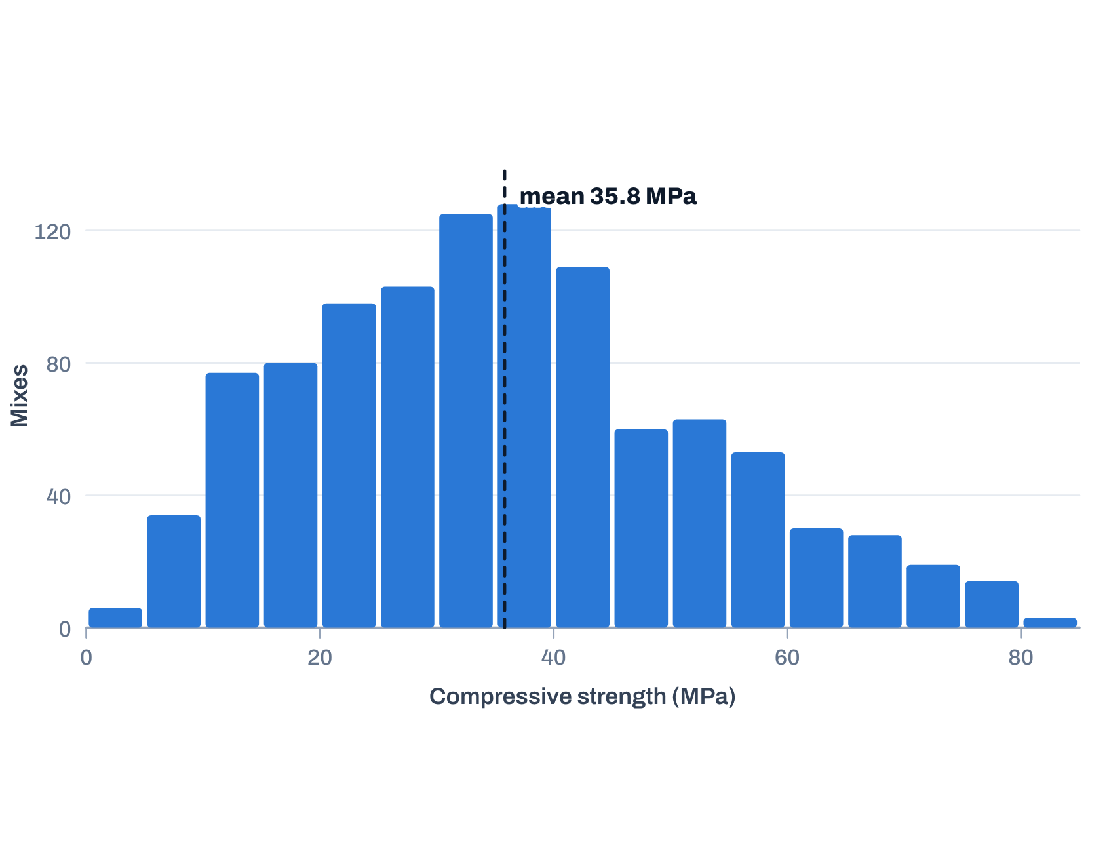
AI & ML for Civil Engineers
Session 06
Recap · concrete strength
06 / 43
Recap · the dataset and target
1,030 concrete mixes from the UCI repository
1,030
8
Strength of all 1,030 mixes
observations
predictor features
0
206
missing values
held-out test mixes (20%)
Target
Compressive strength in MPa, from 2.3 to 82.6 MPa.
Caution
The data support a prediction exercise. They are not, by themselves, a
physical model of concrete behaviour.
Yeh, I.-C. (1998). Concrete Compressive Strength. UCI Machine Learning Repository, CC BY 4.0. doi:10.24432/C5PK67. Original data, all 1,030 rows.
Notes:
Recap of the data: 1,030 mixes, 8 features, no missing values in the original UCI file. One fixed 80/20 split gives 824 training and 206 test mixes. Strength ranges from 2.3 to 82.6 MPa, mean 35.8. The data support a prediction exercise; they are not a physical model of concrete.
[Clicks on this slide: 2]

Slide 7




AI & ML for Civil Engineers
Session 06
Recap · concrete strength
07 / 43
Recap · why compare more than one model?
The ANN is one candidate, not the default winner
Multiple linear regression
Random forest
Artificial neural network
A simple baseline with an additive linear
form.
A nonlinear ensemble of trees that captures
complex patterns.
A flexible function approximator, trained
iteratively.
Session 03 · baseline
Session 04 · ensemble
Today
We compare fitted configurations on the same held-out test set. The baselines are not exhaustively tuned.
Notes:
Three candidates: linear regression as the baseline, random forest as the nonlinear ensemble from Session 04, and the ANN. All are compared on the same held-out test set. The baselines are not exhaustively tuned.
[Clicks on this slide: 3]

Slide 8

AI & ML for Civil Engineers
Session 06
Recap · concrete strength
08 / 43
Recap · the baseline
Multiple linear regression
A reference for asking whether extra flexibility is useful
ŷ = β₀ + β₁x₁ + β₂x₂ + ··· + β₈x₈
Strength
Limitation
Role
Simple to fit and to interpret as a baseline.
Without added nonlinear terms or
interactions, its functional form is restricted.
A reference against which to judge more
flexible models.
On today’s 206 test mixes the baseline reaches R² = 0.628 (RMSE 9.80 MPa). That is the bar to beat.
Notes:
The baseline: an additive linear form. Simple and interpretable, but restricted without interactions or nonlinear terms. On today's test mixes it reaches R² = 0.628, RMSE 9.80 MPa. That is the bar to beat.
[Clicks on this slide: 4]

Slide 9


AI & ML for Civil Engineers
Session 06
09 / 43
01
a
Where neural networks came from
b
From a brain neuron to a simple model
c
Demand prediction: layers and activations
d
A network learns its own features
e
Multilayer perceptrons
f
Epoch, batch size, learning rate
Done with the recap · Part 01 · ANN intuition
Here comes the ANN…
Notes:
Done with the recap. Here comes the ANN. Part 01 builds the intuition.

Slide 10






AI & ML for Civil Engineers
Session 06
Part 01 · ANN intuition
10 / 43
Artificial neural network intuition
Where neural networks came from
Origin
1980s – early 1990s
From around 2005
Algorithms that try to mimic the
brain
Widely used, then out of favour
Resurgence
Fell out of favour in the late 1990s.
More data, more computing power, better training
methods.
The first motivation was biological.
Speech recognition
Image recognition (computer vision)
Text (natural language processing)
…
Today neural networks are used in almost everything: climate change, medical imaging, online advertising, product recommendations. Many
application areas of machine learning now use them.
Today’s neural networks have almost nothing to do with how the brain learns. Mimicking the brain was only the early
motivation.
Notes:
Click through the history. Origin: algorithms that try to mimic the brain. Used in the 1980s and early 1990s, out of favour in the late 1990s. Resurgence from around 2005. Applications came in waves: speech recognition, then image recognition (computer vision), then text (natural language processing). Today: everything from climate change to medical imaging, advertising and product recommendations. Last click: today's networks have almost nothing to do with how the brain learns; the brain was only the early motivation.
[Clicks on this slide: 6]

Slide 11
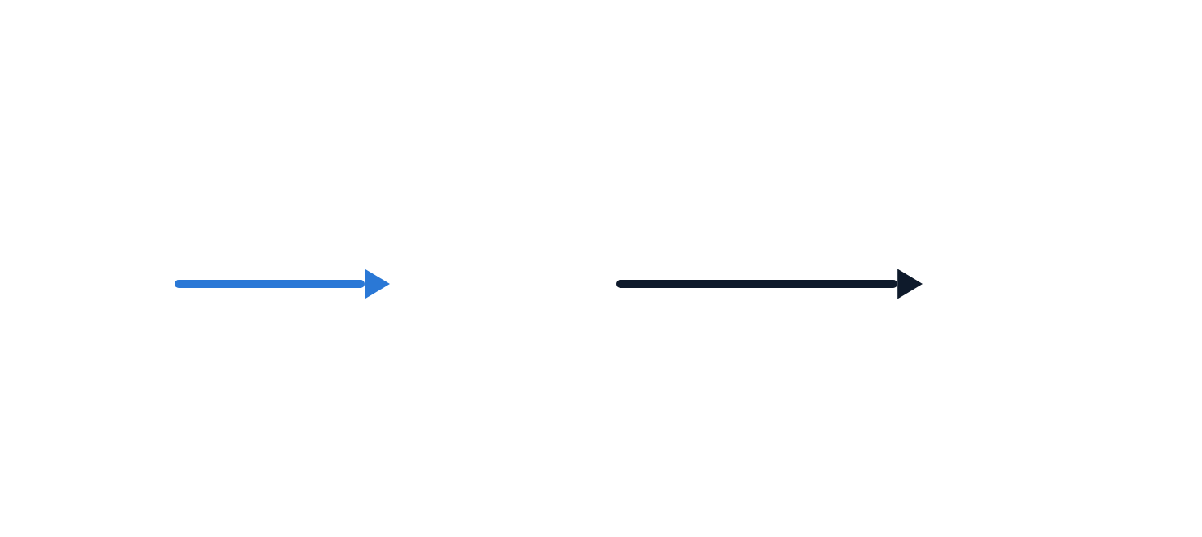
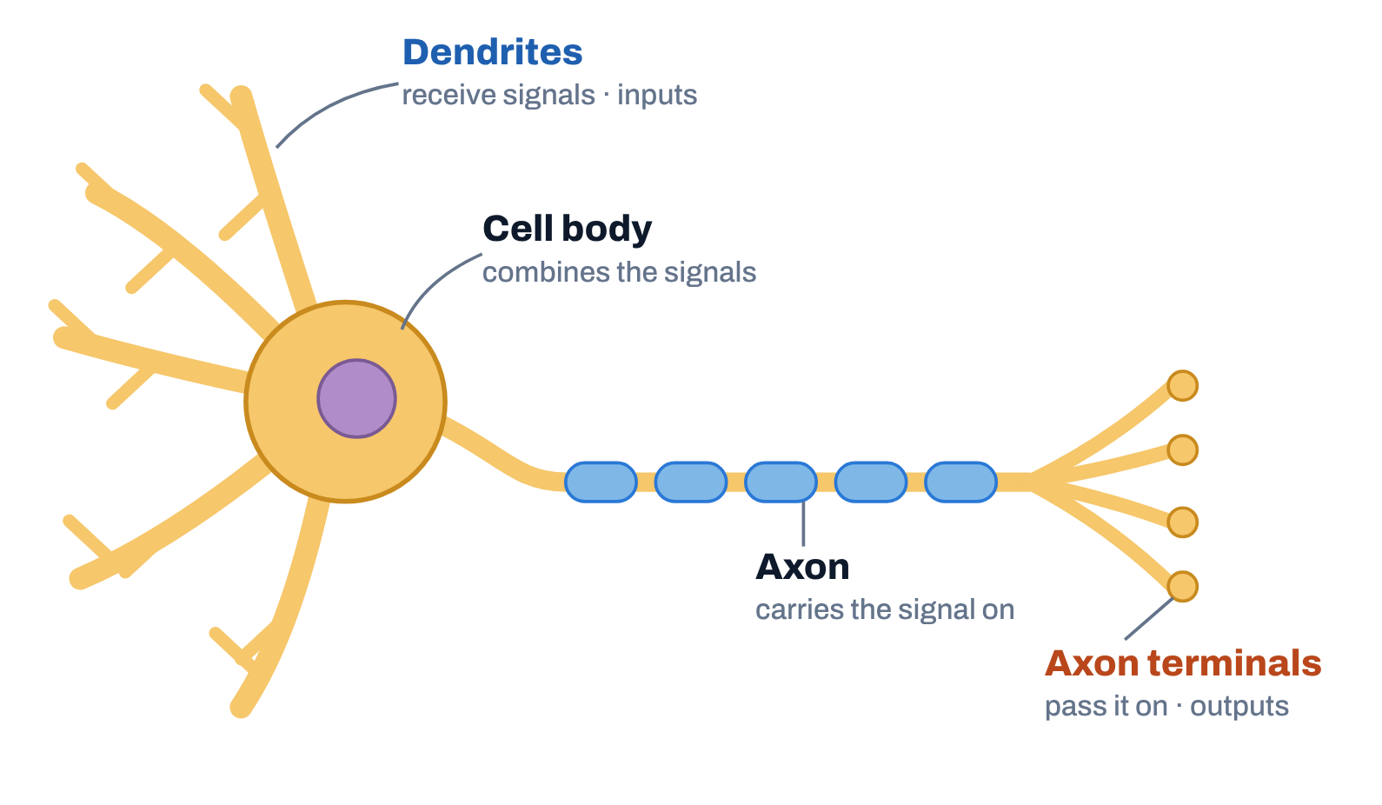
AI & ML for Civil Engineers
Session 06
Part 01 · ANN intuition
11 / 43
Artificial neural network intuition
From a brain neuron to a simple model
So how does the brain work? Here is a diagram of what a neuron
in the brain looks like.
Simplified mathematical model of a neuron
Neuron
Input
Output
0.7
2
With these extremely simplified models of a neuron we can build really
powerful deep-learning algorithms. The origins were biological, but don’t
take the biological motivation too seriously.
Neuron drawn schematically after the standard textbook diagram.
Notes:
All of human thought comes from neurons like this, sending electrical impulses and sometimes forming new connections with other neurons. Dendrites receive the inputs, the cell body combines them, the axon carries the signal, and the axon terminals pass it on. Click 2: the simplified mathematical model takes a number in, here 2, and outputs a number, here 0.7. With such extremely simplified models we build powerful algorithms. Don't take the biology too seriously.
[Clicks on this slide: 2]

Slide 12
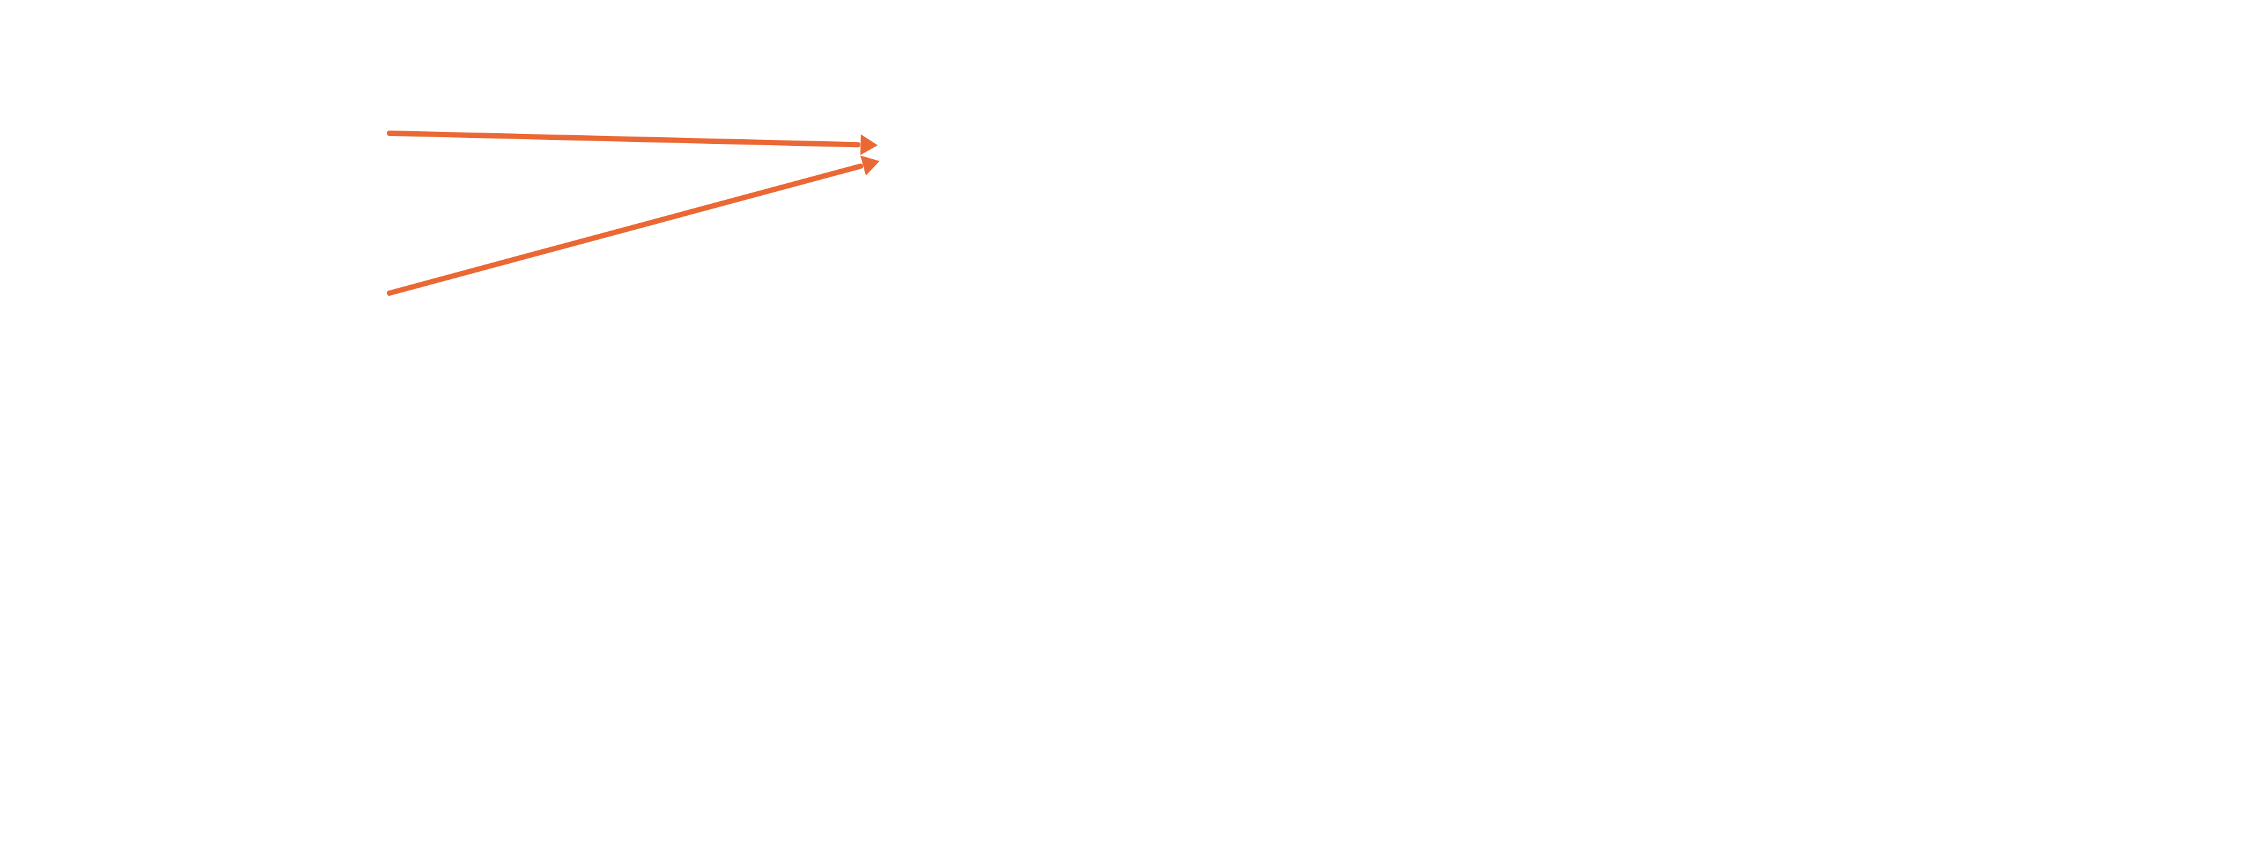
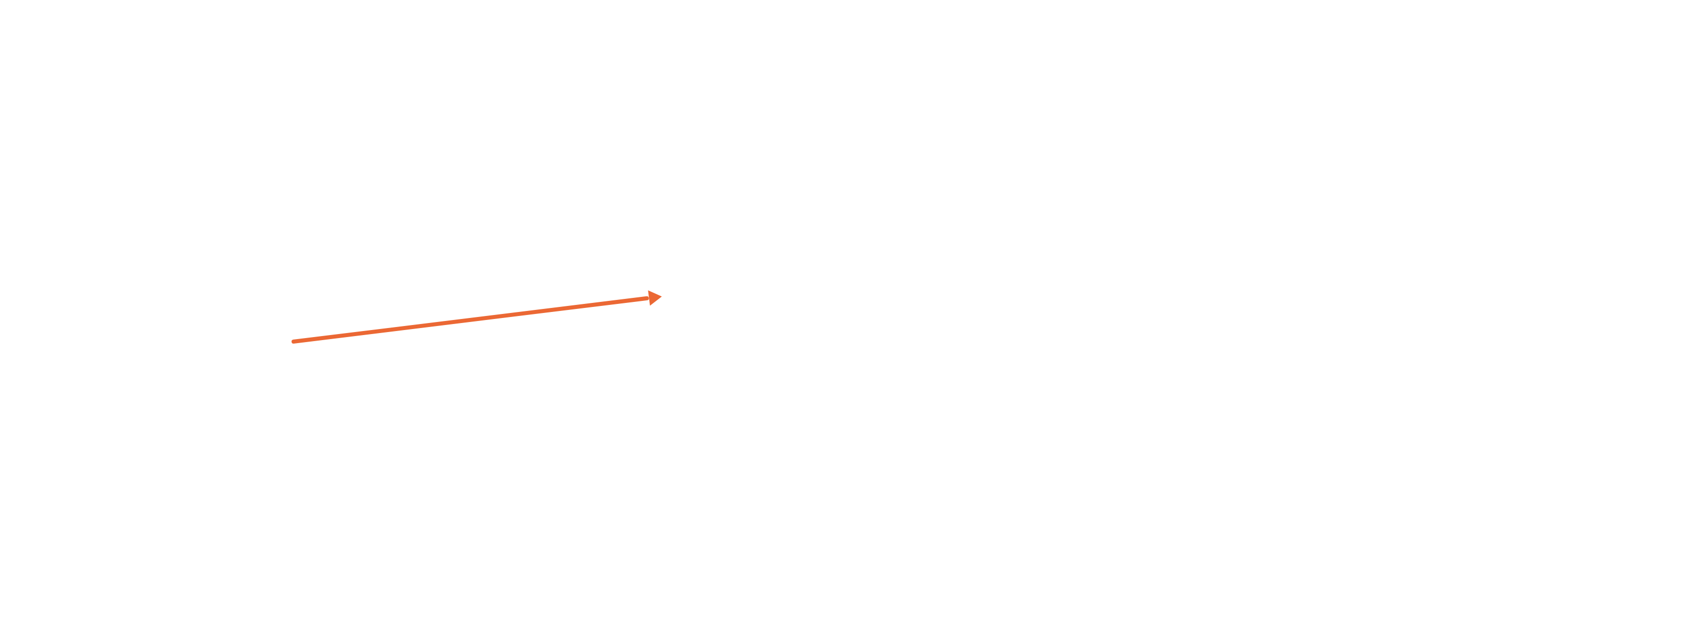
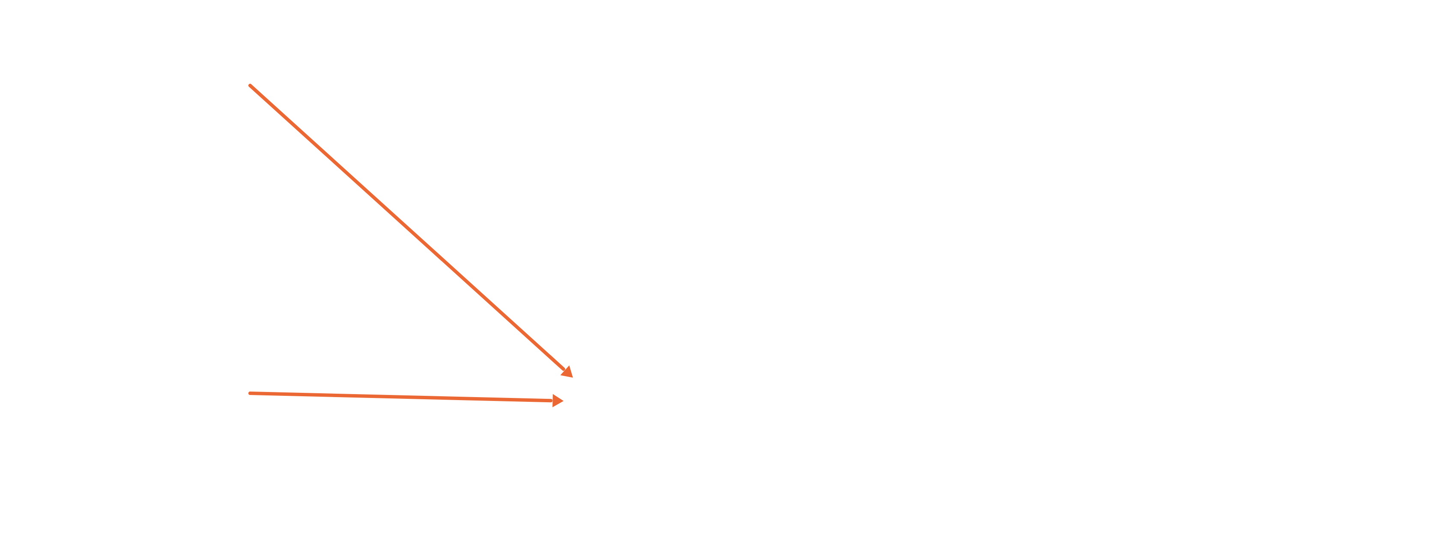
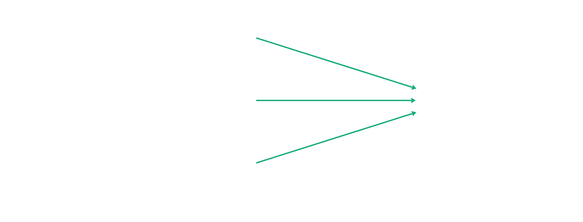
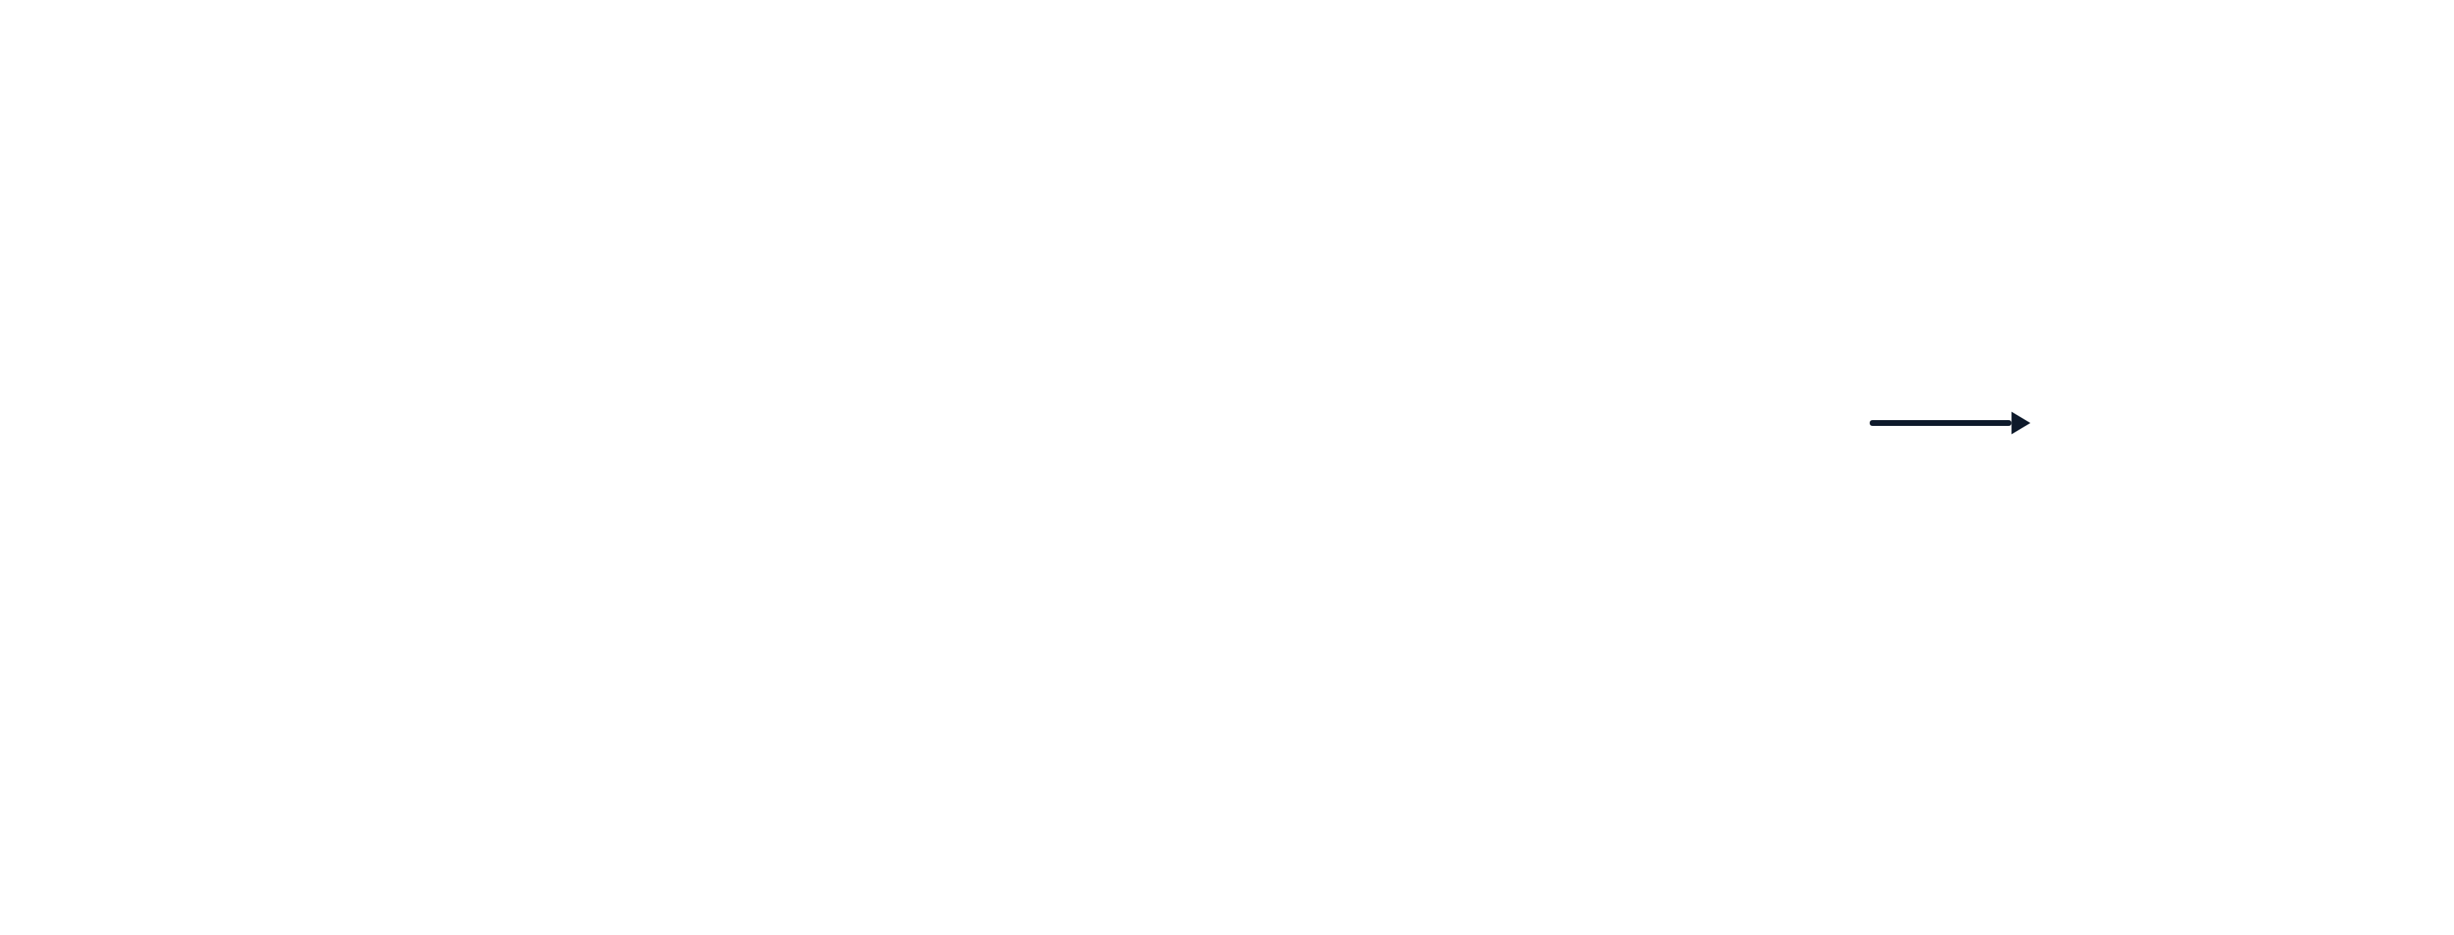




AI & ML for Civil Engineers
Session 06
Part 01 · ANN intuition
12 / 43
Demand prediction · will this T-shirt be a top seller?
Layers and activations, one step at a time
input layer
Layer
“Activations”
Affordability
Price
output layer
Shipping cost
Layer
Awareness
Probability of being
a top seller
Marketing
Material
activation value
Perceived quality
4 numbers
3 numbers
1 number
Illustration adapted from Prof. Andrew Ng’s lecture (Stanford Online and DeepLearning.AI).
Notes:
Demand prediction, after Andrew Ng: will this T-shirt be a top seller? 19 clicks, in the draft's order. Click 1: the three intermediate quantities, affordability, awareness, perceived quality, and the output. Clicks 2 to 7: each neuron and the inputs that feed it: price and shipping cost give affordability; marketing gives awareness; price and material give perceived quality. Clicks 8 to 9: the output neuron and its inputs. Click 10: 4 numbers, 3 numbers, 1 number. Clicks 11 to 15: output arrow, the hidden layer, the output layer. Click 16: these are the activations. Click 17: each arrow carries an activation value. Clicks 18 and 19: output layer and input layer.
[Clicks on this slide: 19]

Slide 13







AI & ML for Civil Engineers
Session 06
Part 01 · ANN intuition
13 / 43
Demand prediction · will this T-shirt be a top seller?
We chose which inputs feed which neuron
input layer
Layer
“Activations”
Affordability
Price
output layer
Shipping cost
Layer
Awareness
Probability of being
a top seller
Marketing
Material
activation value
Perceived quality
4 numbers
3 numbers
1 number
Illustration adapted from Prof. Andrew Ng’s lecture (Stanford Online and DeepLearning.AI).
Notes:
So far we decided by hand which inputs feed which neuron. Click: those hand-picked connections go away.
[Clicks on this slide: 1]

Slide 14
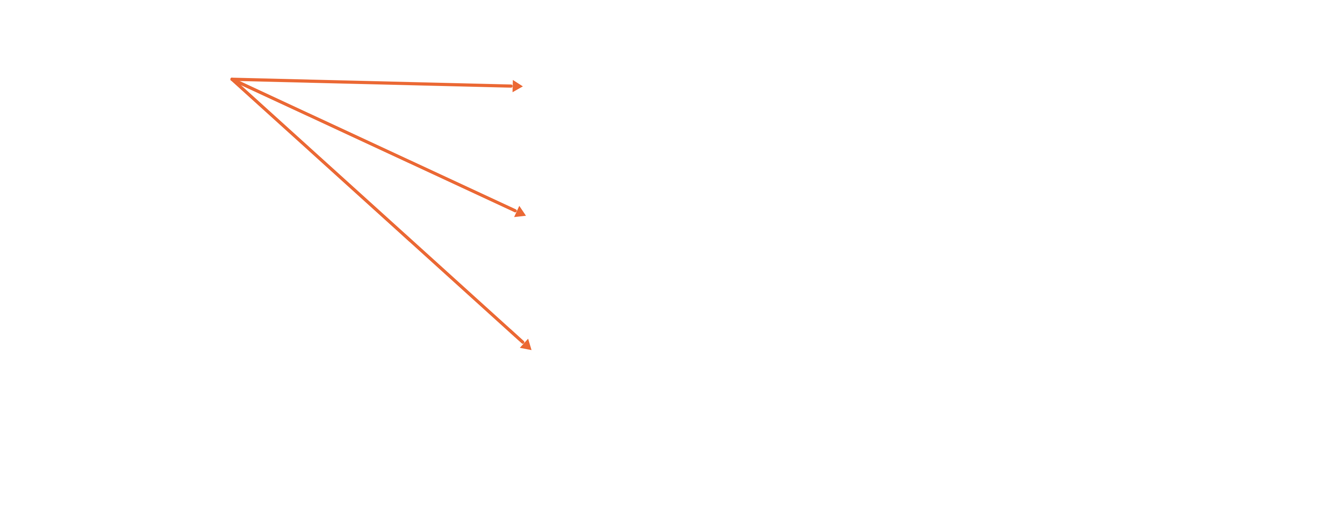
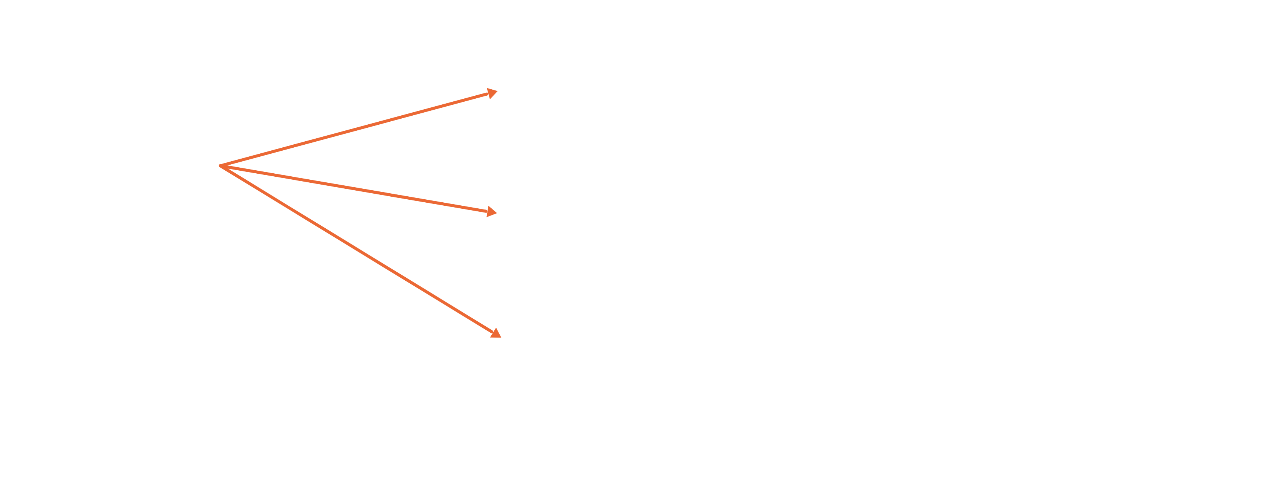
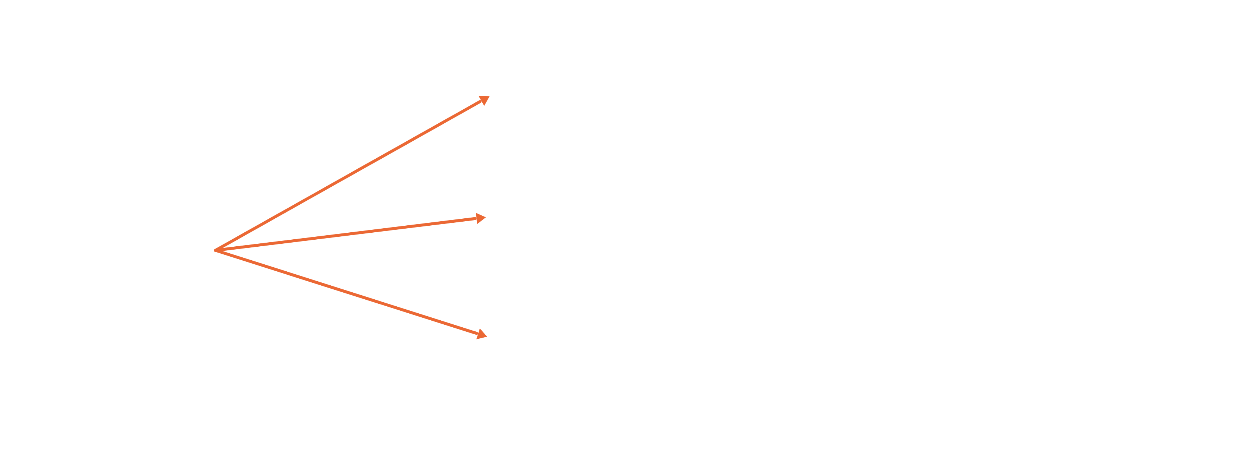
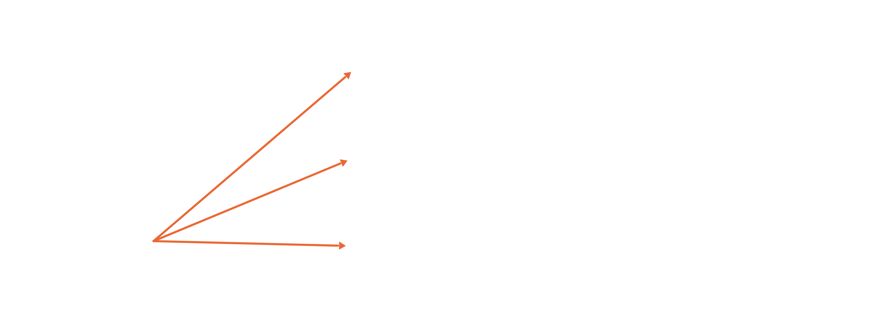



AI & ML for Civil Engineers
Session 06
Part 01 · ANN intuition
14 / 43
Demand prediction · will this T-shirt be a top seller?
In practice, every input feeds every neuron
input layer
Layer
“Activations”
Affordability
Price
output layer
Shipping cost
Layer
Awareness
Probability of being
a top seller
Marketing
Material
activation value
Perceived quality
4 numbers
3 numbers
1 number
Illustration adapted from Prof. Andrew Ng’s lecture (Stanford Online and DeepLearning.AI).
Notes:
In practice every neuron in a layer receives every input from the previous layer, and learns which ones matter through its weights. Four clicks, one input at a time: price, shipping cost, marketing, material.
[Clicks on this slide: 4]

Slide 15



AI & ML for Civil Engineers
Session 06
Part 01 · ANN intuition
15 / 43
Demand prediction · the same network, abstracted
A hidden layer turns inputs into new features
Hidden layer
x
Output layer
Price
activation values, vector a
a
Probability of
being a top
seller
Shipping cost
Marketing
Material
Instead of you engineering the features by hand, the network learns its own features to make prediction easier. This is what makes neural
networks one of the most powerful learning algorithms.
Illustration adapted from Prof. Andrew Ng’s lecture (Stanford Online and DeepLearning.AI).
Notes:
The middle layer is called the hidden layer because the training set shows us x and y, the correct inputs and outputs, but not the correct values of affordability, awareness or perceived quality. We never see them in the data. One way to see this network: logistic regression, but a version that learns its own features, which makes it easier to predict accurately. Click: instead of engineering features by hand, the network learns them.
[Clicks on this slide: 1]

Slide 16




AI & ML for Civil Engineers
Session 06
Part 01 · ANN intuition
16 / 43
Multilayer perceptron (MLP)
Architecture: how many layers, how many neurons?
When we build our own network, we decide how many hidden layers it has and how many neurons each hidden layer has. That choice is the
architecture of the network.
Architecture B · 3 → 5 → 1
Architecture A · 3 → 2 → 1
x
a
a
x
a
a
Output
layer
Output
layer
2nd hidden
layer
1st hidden
layer
1st hidden
layer
2nd hidden
layer
Illustration adapted from Prof. Andrew Ng’s lecture (Stanford Online and DeepLearning.AI). Networks of several layers like these are often called multilayer perceptrons.
Notes:
Click: when building our own network we choose how many hidden layers and how many neurons per layer: the architecture. Two examples. Networks with several layers like these are called multilayer perceptrons in some literature.
[Clicks on this slide: 1]

Slide 17



AI & ML for Civil Engineers
Session 06
Part 01 · ANN intuition
17 / 43
Multilayer perceptron (MLP) · inside a layer
Every neuron has its own weights and bias
Layer 1, neuron by neuron
1
a₁^{[1]} = g(w₁^{[1]} · x + b₁^{[1]})
w₁^{[1]}, b₁^{[1]}
2
a₂^{[1]} = g(w₂^{[1]} · x + b₂^{[1]})
3
a₃^{[1]} = g(w₃^{[1]} · x + b₃^{[1]})
x
w₂^{[1]}, b₂^{[1]}
a^{[1]}
a^{[2]}
ŷ
Output
layer
2nd hidden
layer
w₃^{[1]}, b₃^{[1]}
1st hidden
layer
a^{[1]} = (a₁, a₂, a₃) is the input of layer 2. Superscript [l] = layer, subscript j =
neuron, g = activation function, bold = vector.
Illustration adapted from Prof. Andrew Ng’s lecture (Stanford Online and DeepLearning.AI).
Notes:
Hidden layers transform the inputs nonlinearly; the number of layers and neurons are key hyperparameters. Each neuron j in layer 1 has its own weight vector and bias, and applies an activation g: a_j = g(w_j · x + b_j). The vector of activations a[1] is the input of layer 2. Forward propagation computes the prediction; the loss compares it with the label; backpropagation computes gradients, and an optimiser such as stochastic gradient descent or Adam adjusts weights and biases. For our concrete regressor the loss is squared error, not cross-entropy.

Slide 18

AI & ML for Civil Engineers
Session 06
Part 01 · ANN intuition
18 / 43
Key training terms in an ANN (MLP) · 1 of 3
How long do we train?
Definition
1
An epoch is one complete pass through the entire training dataset by the model.
Epoch
Analogy
Like reading the whole book once.
In practice
We train for many epochs (10, 50, 100, …) so the model keeps improving.
Within each epoch the weights are updated again and again, once per batch.
One epoch: every training row is used
once.
Notes:
Epoch: one complete pass through the training data, like reading the whole book once. We train for many epochs. Note: within an epoch the weights are updated once per batch, not once per epoch.
[Clicks on this slide: 4]

Slide 19

AI & ML for Civil Engineers
Session 06
Part 01 · ANN intuition
19 / 43
Key training terms in an ANN (MLP) · 2 of 3
How much data per update?
Definition
2
The number of training samples the model processes before updating the weights once.
Batch size
Why it matters
The model does not always look at the whole dataset at once.
It breaks the data into smaller batches. Common values: 32, 64, 128.
In practice
Small batch: more updates, noisier learning, but faster to start.
Large batch: smoother updates, more memory.
Example: 800 rows, batch size 32 → 25
weight updates per epoch.
Notes:
Batch size: how many samples the model processes before one weight update. 800 rows with batch size 32 means 25 updates per epoch. Small batches: more, noisier updates; large batches: smoother updates, more memory. scikit-learn's default is min(200, number of rows).
[Clicks on this slide: 4]

Slide 20


AI & ML for Civil Engineers
Session 06
Part 01 · ANN intuition
20 / 43
Key training terms in an ANN (MLP) · 3 of 3
How big is each step?
Definition
3
A small number that controls how big a step the model takes while updating the weights during
training.
Why it matters
Too high: the model may overshoot the optimum and not converge.
Learning rate
Too low: the model learns very slowly and may get stuck.
Each update moves the weights a step
downhill on the loss. The learning rate sets
the step size.
Analogy
Like your pace while hiking towards a goal: not too fast, not too slow.
Notes:
Learning rate: the step size. Too high overshoots and may not converge; too low is slow and may get stuck. The three small panels show the same bowl with three step sizes. Like your pace on a hike.
[Clicks on this slide: 4]

Slide 21

AI & ML for Civil Engineers
Session 06
Part 01 · ANN intuition
21 / 43
Key training terms · summary
Three settings that shape training
Term
What it means
Analogy
In scikit-learn’s MLPRegressor
Epoch
One full pass through the training data
Reading the whole book once
max_iter
maximum number of epochs (adam, sgd)
Batch size
Samples used in one weight update
Reading one chapter at a time
batch_size="auto"
min(200, number of rows)
Learning rate
Step size for updating the weights
How big a step you take
learning_rate_init=0.001
the default
These are hyperparameters: we choose them, the network does not learn them. Choose them on validation data.
Notes:
Summary, with the matching scikit-learn MLPRegressor settings: max_iter is the maximum number of epochs for the adam and sgd solvers; batch_size 'auto' means min(200, n); learning_rate_init defaults to 0.001. These are hyperparameters: we choose them, on validation data.

Slide 22




AI & ML for Civil Engineers
Session 06
22 / 43
02
a
What an ANN is, and one neuron
b
Reading the (32, 16) architecture
c
Why nonlinear activations matter
d
Scaling the inputs
e
How the network learns
f
Data roles and choosing the architecture
Part 02 · Build & train
An ANN for concrete
strength
Notes:
Part 02: building and training an ANN for concrete strength.

Slide 23




AI & ML for Civil Engineers
Session 06
Part 02 · Build & train
23 / 43
What is an artificial neural network?
A parameterised function built from connected units
Inputs
Hidden layers
Output
The measured features enter the
network.
Weighted combinations, then nonlinear
activations.
One predicted strength value.
8 mix and age variables
32 and 16 neurons
ŷ in MPa
The network learns its weights and biases from examples. It is not handed an explicit engineering equation.
Notes:
An ANN is a parameterised function made of connected units: inputs, hidden layers of weighted sums and nonlinear activations, one output. It learns weights and biases from examples; nobody hands it a mix-design equation.
[Clicks on this slide: 3]

Slide 24
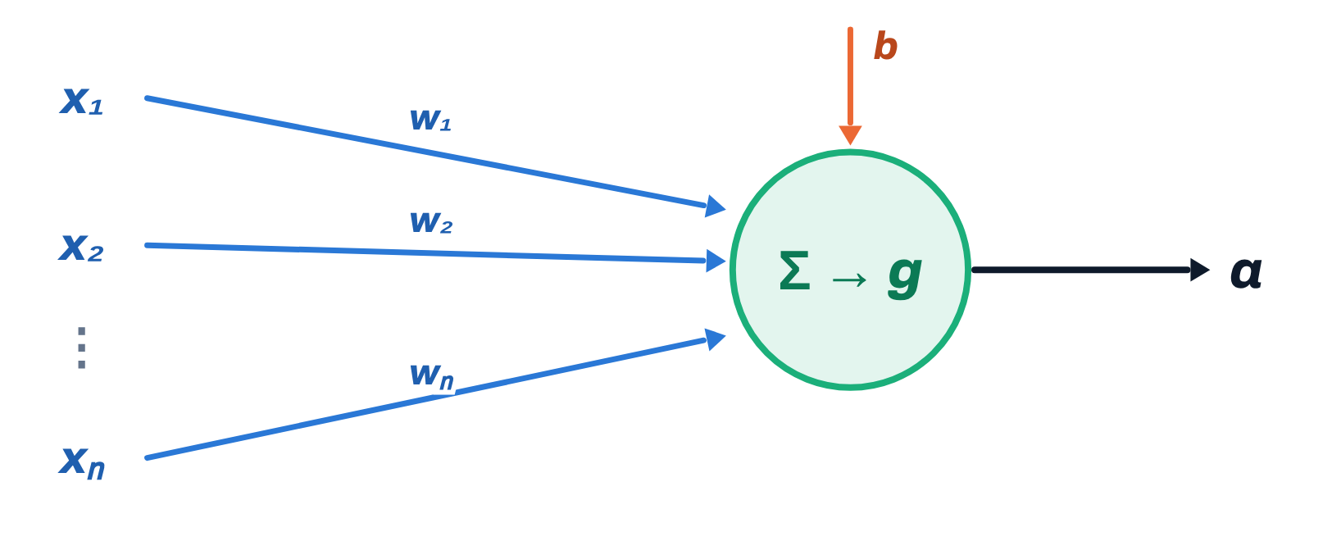
AI & ML for Civil Engineers
Session 06
Part 02 · Build & train
24 / 43
Inside one neuron
Combine the inputs, add a bias, apply an activation
Two steps
z = w₁x₁ + w₂x₂ + ··· + w_{n}x_{n} + b
a = g(z)
Weights w
Bias b
Activation g
Control how much each input contributes.
Shifts the pre-activation value z.
Bends the response, so layers can model curves.
Training adjusts every weight and every bias. The same z appeared in Session 05 as the logistic-regression score.
Notes:
Inside one neuron: z is a weighted sum plus a bias, then the activation g. Weights scale each input, the bias shifts z, and g bends the response. Training adjusts all of them. The same z was the logistic-regression score in Session 05.
[Clicks on this slide: 4]

Slide 25
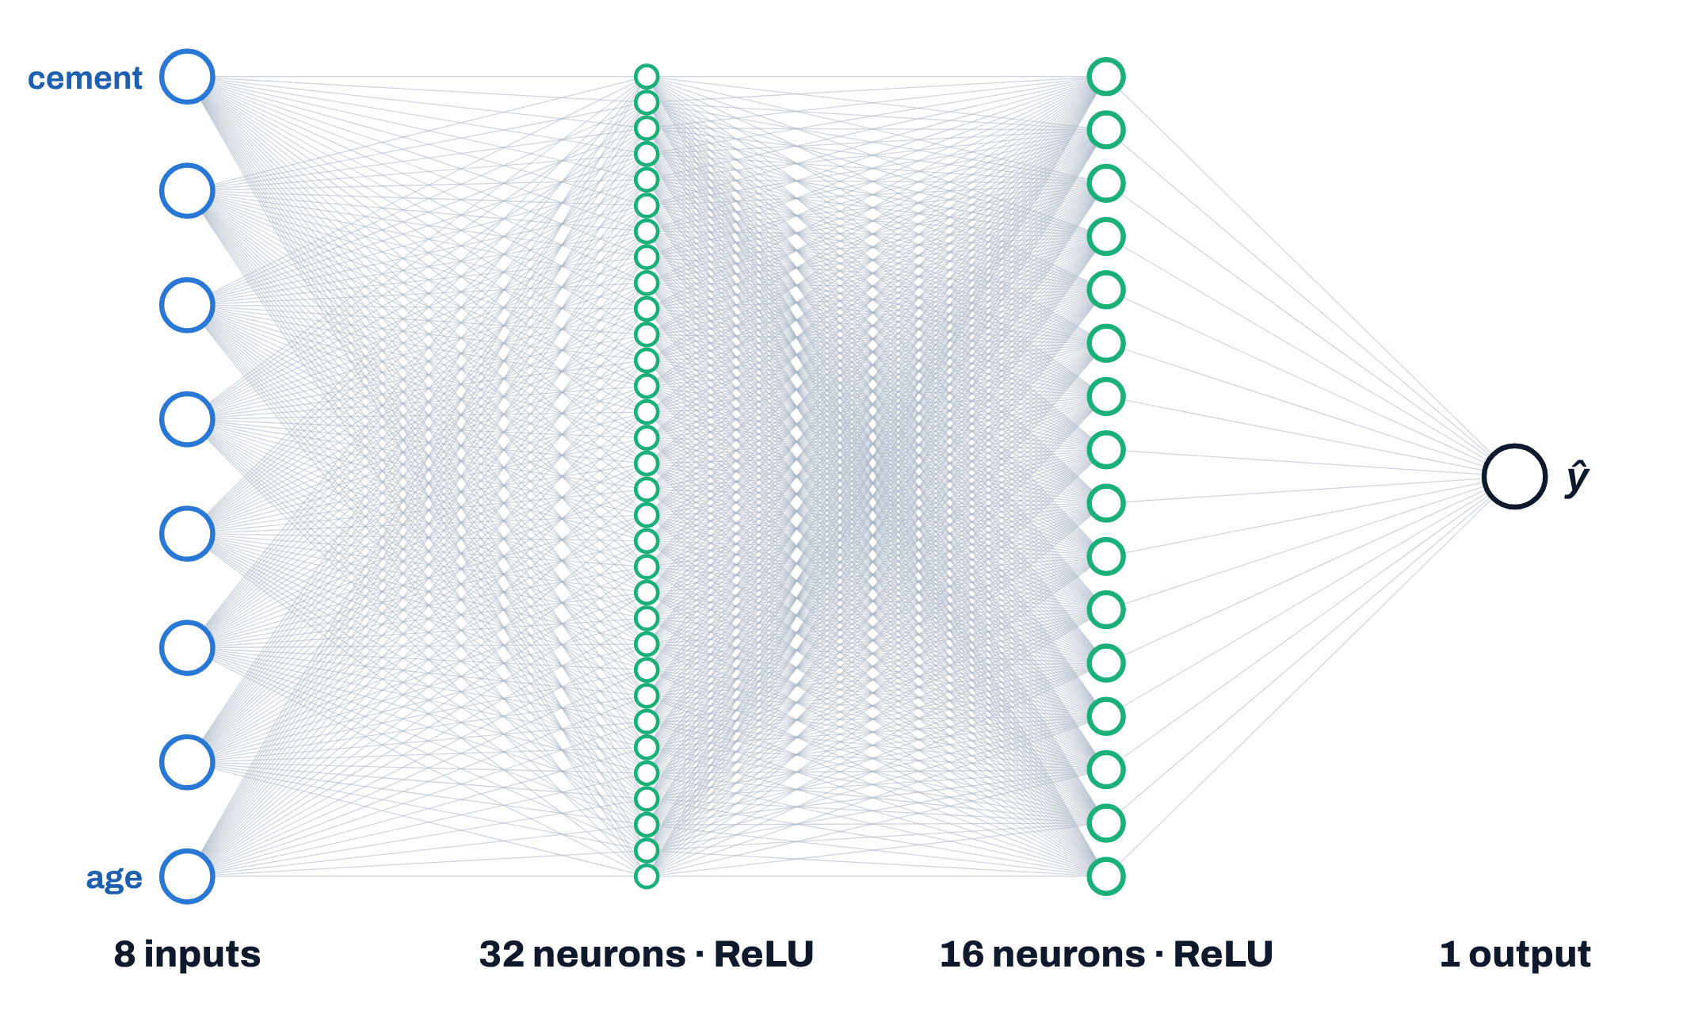
AI & ML for Civil Engineers
Session 06
Part 02 · Build & train
25 / 43
Reading an ANN architecture
Our selected network is (32, 16)
Weights and biases to learn
Inputs → 32 · 8 × 32 + 32
288
32 → 16 · 32 × 16 + 16
528
16 → output · 16 × 1 + 1
17
Total parameters
833
(32, 16) gives the neurons in each hidden layer,
not the number of parameters. Two hidden
layers here.
Notes:
Our selected network is (32, 16): 32 neurons in the first hidden layer, 16 in the second. The notation counts neurons, not parameters. Clicks: 8 x 32 + 32 = 288, 32 x 16 + 16 = 528, 16 x 1 + 1 = 17, total 833 weights and biases, learned from 824 training mixes.
[Clicks on this slide: 4]

Slide 26
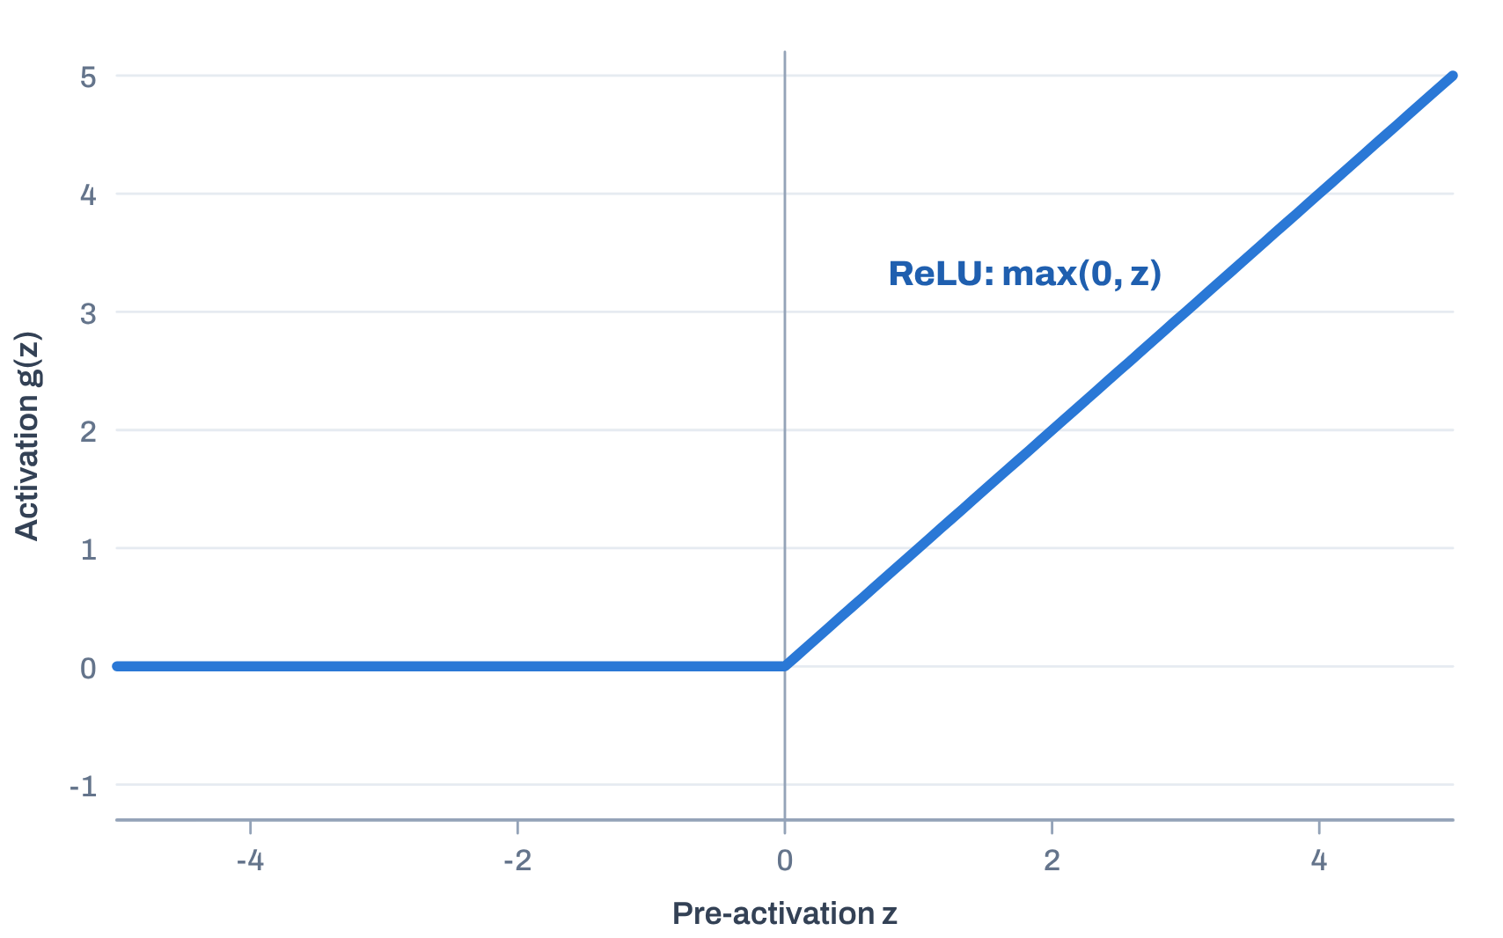
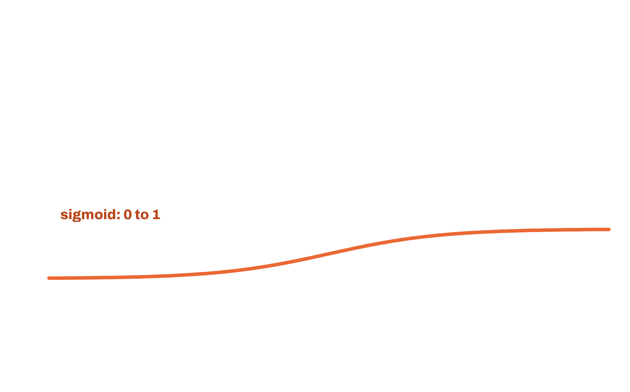
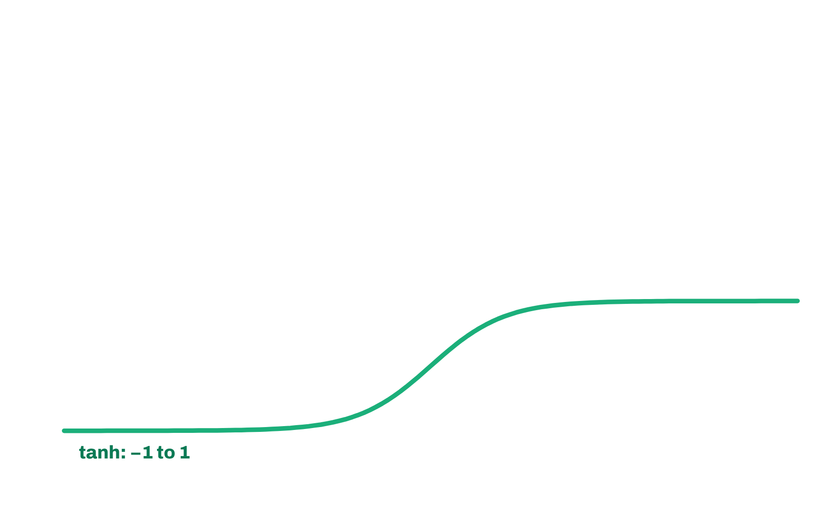
AI & ML for Civil Engineers
Session 06
Part 02 · Build & train
26 / 43
Why nonlinear activation functions matter
Without them, stacked layers stay linear
Three common activation functions
In our fitted ANN
Both hidden layers use ReLU. The output neuron is linear, so ŷ can
be any strength.
Why not linear everywhere?
W₂(W₁x + b₁) + b₂ = Wx + b
Two linear layers collapse into one linear model.
Sigmoid and tanh are shown for comparison; they are not used in
this fitted model.
Notes:
Without nonlinear activations, two linear layers collapse into one linear map, so depth adds nothing. Our network uses ReLU in both hidden layers; the output is linear so it can predict any strength. Clicks show sigmoid and tanh for comparison only.
[Clicks on this slide: 2]

Slide 27
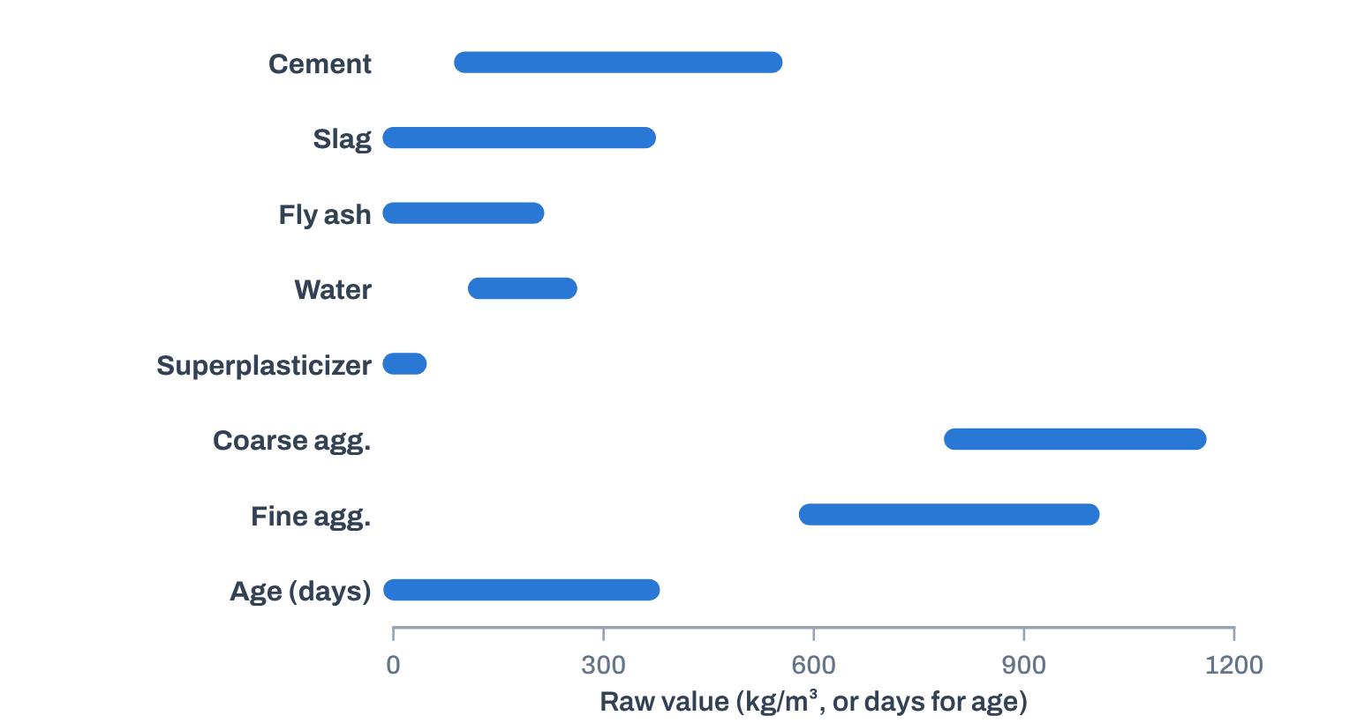
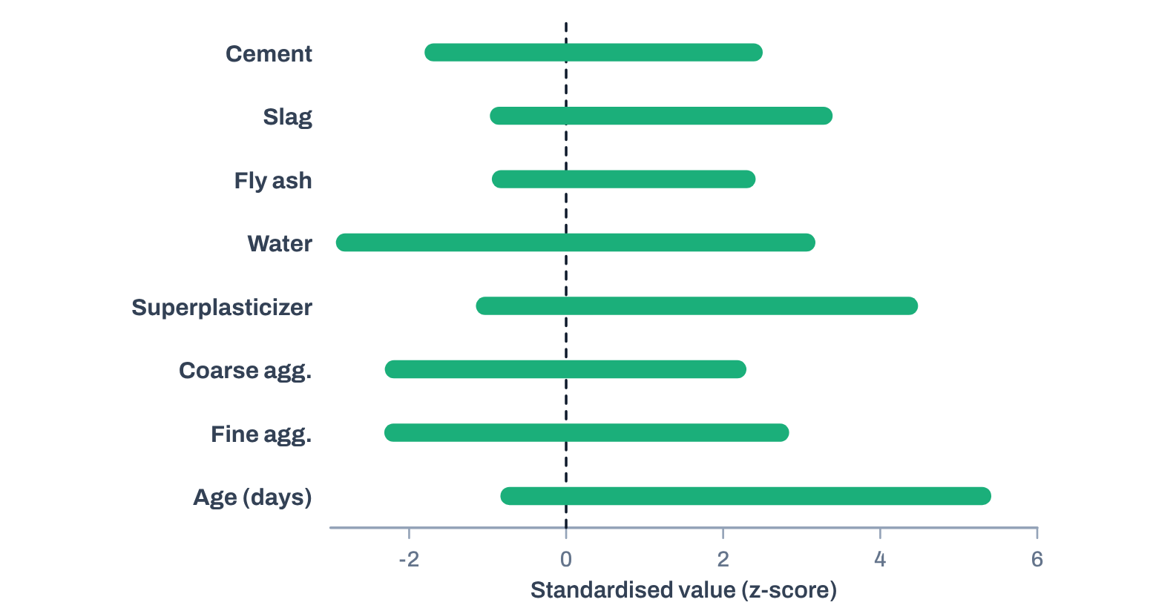


AI & ML for Civil Engineers
Session 06
Part 02 · Build & train
27 / 43
Why scale the inputs?
Our features use very different ranges and units
Raw inputs
After StandardScaler
Superplasticizer spans 0–32.2 kg/m³; coarse aggregate 801–1,145 kg/m³.
Each feature centred and scaled with the training mean and standard deviation.
Raw inputs
StandardScaler · fit on training data
ANN · optimisation better behaved
The scaler sits inside a Pipeline, so it is fitted on the training data, never on the held-out test set.
Notes:
The features live on very different scales: superplasticizer up to 32.2 kg/m³, coarse aggregate 801-1,145 kg/m³, age 1-365 days. Gradient-based training is better behaved after StandardScaler. The scaler is inside the Pipeline, so it learns means and standard deviations from the training data only.
[Clicks on this slide: 3]

Slide 28




AI & ML for Civil Engineers
Session 06
Part 02 · Build & train
28 / 43
How does an ANN learn?
Adjust weights and biases to reduce a loss
1
2
3
4
Forward pass
Calculate loss
Backpropagate
Update
Compare ŷ with the observed
strength y: squared error for
regression.
The optimiser (Adam by default)
takes a step of size set by the
learning rate.
The inputs flow through the layers
and produce a prediction ŷ.
Compute the gradient of the loss
for every weight and bias.
Repeat for every batch, epoch after epoch, until the loss stops improving.
This is optimisation, the same gradient descent as Session 03. It is not the discovery of a guaranteed physical law.
Notes:
One training step: forward pass, loss (squared error for regression), backpropagation of gradients, an update by the optimiser (Adam is scikit-learn's default) with the learning rate as the step size. Repeat for every batch and epoch. This is optimisation, as in Session 03, not the discovery of a physical law.
[Clicks on this slide: 5]

Slide 29
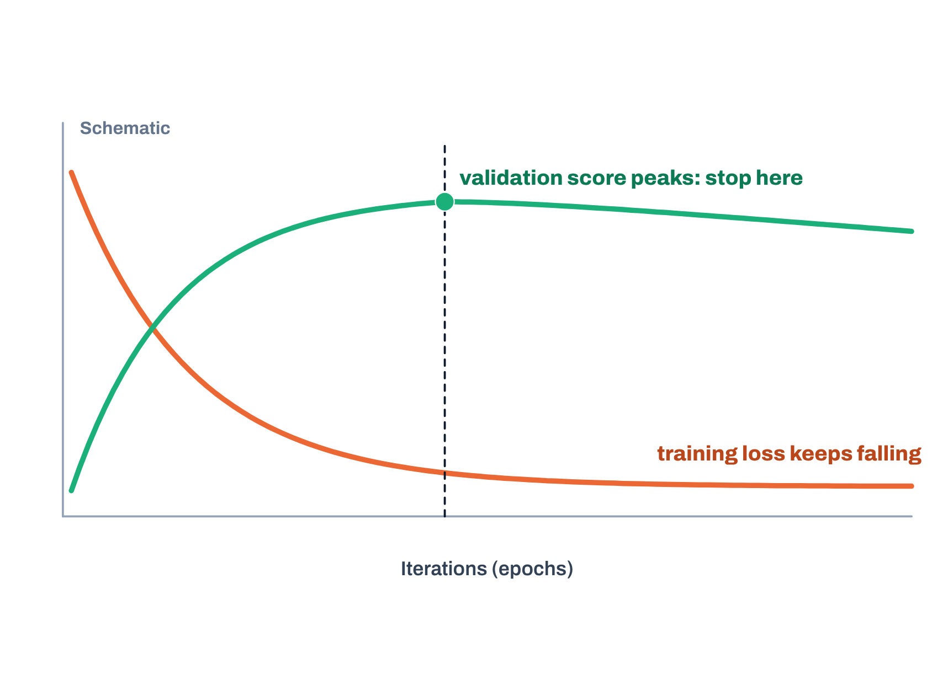
AI & ML for Civil Engineers
Session 06
Part 02 · Build & train
29 / 43
Training loss and validation score
They answer different questions
What the notebook’s training plot shows
Training loss
Early stopping keeps the iteration with the best validation score.
Tracks the optimisation objective on training batches. It is not the test
RMSE.
Internal validation R²
Performance on a held-out part of the training data, used by early
stopping.
A falling training loss is not evidence of generalisation.
Inspect both curves; note if training hit the iteration limit.
The internal validation subset is not the final test set.
Notes:
The notebook plots the fitted ANN's optimisation history. Training loss tracks the objective on training batches; it is not test RMSE. The internal validation R² is computed on a held-out part of the training data and drives early stopping. The chart here is a schematic of the typical shapes, not the notebook's run. Check whether training reached the iteration limit.
[Clicks on this slide: 2]

Slide 30

AI & ML for Civil Engineers
Session 06
Part 02 · Build & train
30 / 43
Three data roles · do not mix them up
Train, validate, then test once
Training · 824 mixes
validation subset
Test · 206
Training data
Validation data
Test data
Fit the parameters
Monitor and choose
Final evaluation
Weights and biases are learned here.
Early stopping, and comparing candidate
architectures.
Used once, after every choice is made.
The architecture is chosen on validation RMSE. The held-out test set plays no part in that choice.
Notes:
Three roles. Training data (824 mixes) fits the parameters; a validation subset inside it monitors training and compares architectures; the test data (206 mixes) is used once at the end. The architecture is chosen on validation RMSE, never on the test set.
[Clicks on this slide: 3]

Slide 31
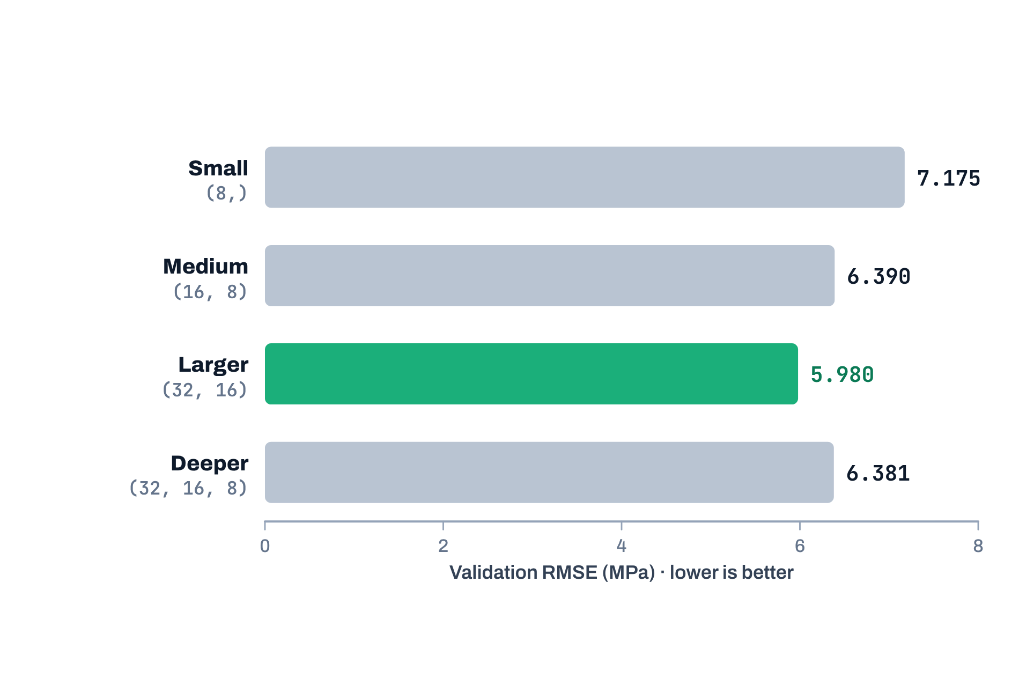
AI & ML for Civil Engineers
Session 06
Part 02 · Build & train
31 / 43
Candidate architectures, compared on validation data
Does a bigger ANN automatically do better?
Four architectures, one validation subset
Selected
(32, 16)
Lowest validation RMSE of the four candidates: 5.980 MPa.
Bigger is not always better
Adding a third layer, (32, 16, 8), gave 6.381 MPa: no
improvement.
Best of four tried. Not proof of a global optimum.
Notes:
Four candidates on the validation subset: (8,) 7.175, (16, 8) 6.390, (32, 16) 5.980, (32, 16, 8) 6.381 MPa RMSE. (32, 16) is selected. The deeper network did not help. Best of four tried, not proof of a global optimum.
[Clicks on this slide: 3]

Slide 32


AI & ML for Civil Engineers
Session 06
32 / 43
03
a
Measuring regression performance
b
Results on the held-out test set
c
What R² does and does not tell us
d
Actual vs predicted, and residuals
e
Does an ANN understand concrete?
f
Transfer to geotechnical problems
Part 03 · Results & judgement
Is the ANN worth its
complexity?
Notes:
Part 03: results and judgement. Is the ANN worth its complexity?

Slide 33
AI & ML for Civil Engineers
Session 06
Part 03 · Results & judgement
33 / 43
How do we measure regression performance?
Complementary metrics, not one number
Mean absolute error
Root mean squared error
Coefficient of determination
MAE
RMSE
R²
mean |y − ŷ|
√ mean (y − ŷ)²
1 − SS_{res} / SS_{tot}
Also in MPa; penalises large errors more
strongly.
Compared with always predicting the mean;
can be negative.
The average size of an error, in MPa.
e = y − ŷ
Residual > 0: actual above predicted, the model underpredicts.
Residual < 0: actual below predicted, the model overpredicts.
Notes:
Three complementary metrics. MAE: average error size in MPa. RMSE: also MPa, but large errors count more. R²: compared with always predicting the mean, and can be negative. Residual = actual minus predicted: positive means underprediction, negative means overprediction.
[Clicks on this slide: 3]

Slide 34
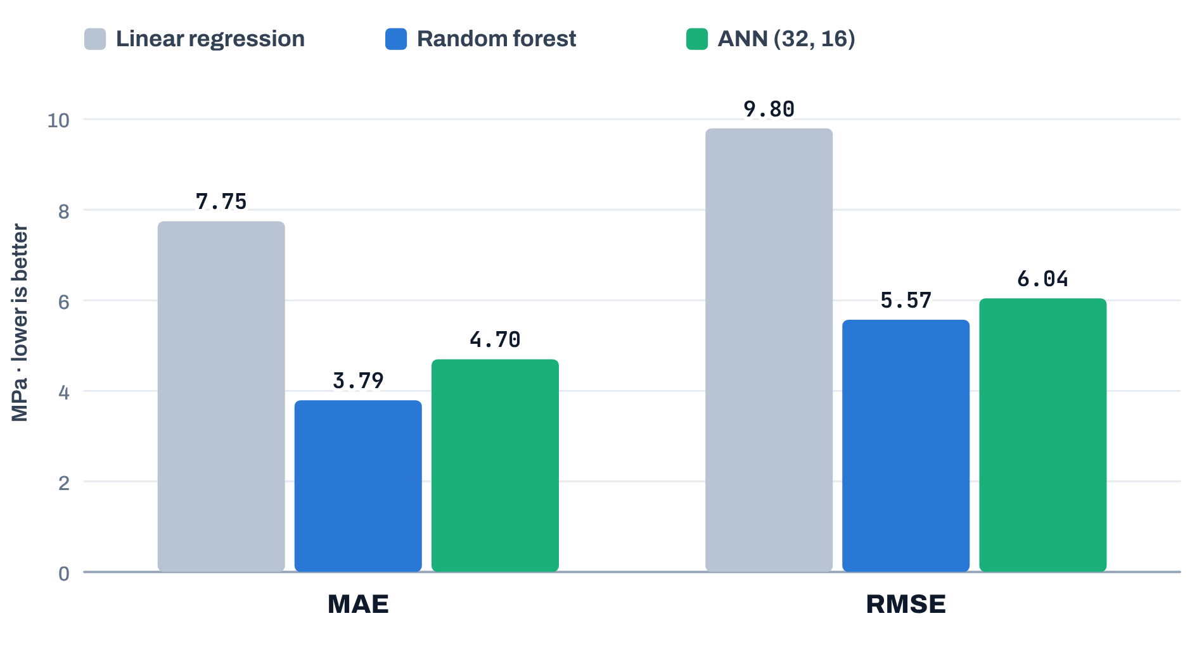
AI & ML for Civil Engineers
Session 06
Part 03 · Results & judgement
34 / 43
One fixed 80/20 split · the same 206 test mixes for all three models
Results on the held-out test set
Test errors
Random forest
MAE 3.79 · RMSE 5.57
Best of these configurations in this run.
ANN (32, 16)
MAE 4.70 · RMSE 6.04
Competitive, but not the best.
Linear regression
MAE 7.75 · RMSE 9.80
Both nonlinear models clearly improve on it.
One split, one run. These results do not prove which model family is best in general.
Notes:
Test results on the same 206 mixes. Linear regression: MAE 7.75, RMSE 9.80. Random forest: MAE 3.79, RMSE 5.57, best in this run. ANN (32, 16): MAE 4.70, RMSE 6.04, competitive but not best. One split, one run: no general verdict on model families.
[Clicks on this slide: 4]

Slide 35
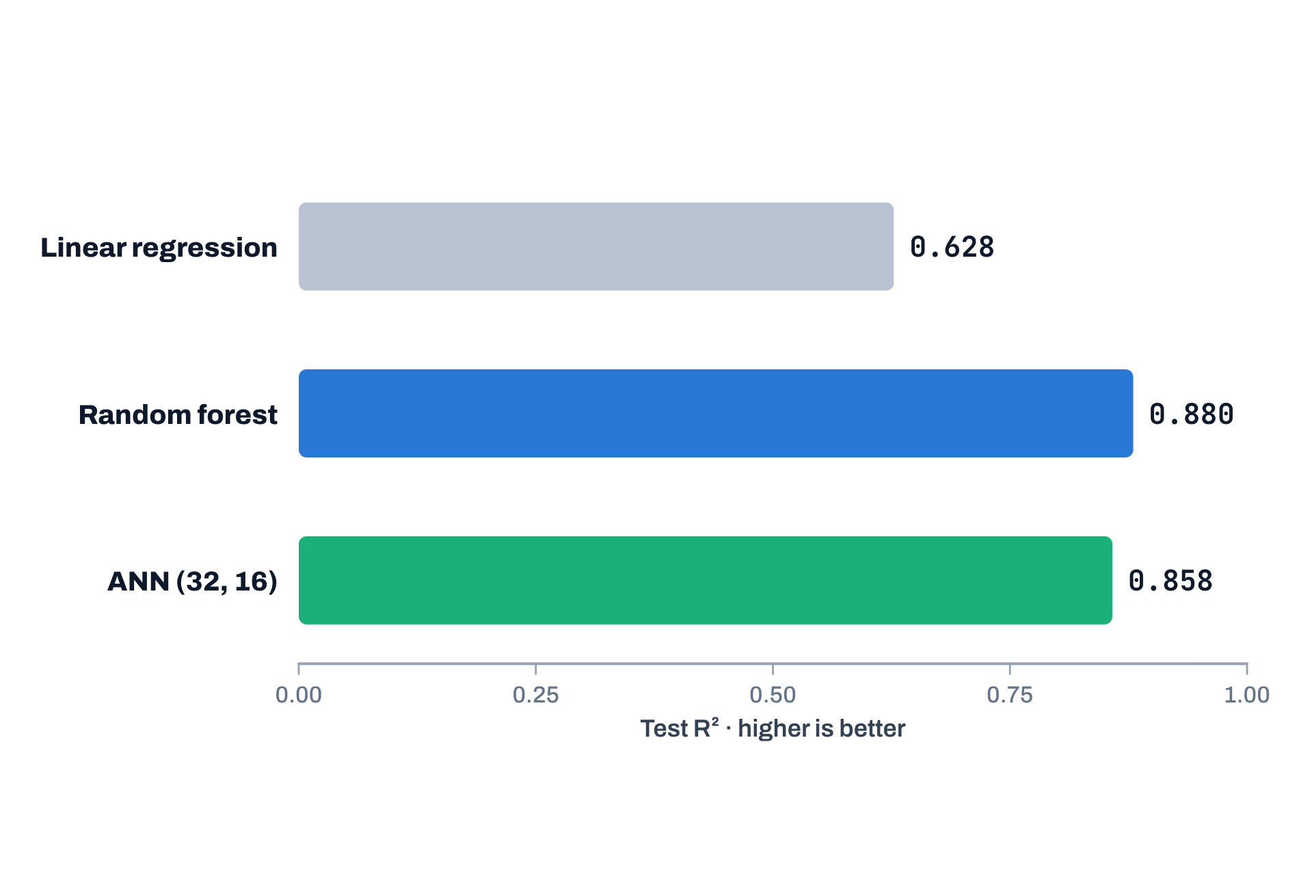
AI & ML for Civil Engineers
Session 06
Part 03 · Results & judgement
35 / 43
What does R² tell us here?
Useful, but not a complete measure of quality
Share of strength variance explained on the test mixes
Best observed R²
0.880
Random forest; the ANN reaches 0.858.
R² alone does not show
Error patterns
Performance near critical thresholds
Validity outside the training domain
Notes:
R²: linear 0.628, random forest 0.880, ANN 0.858. Useful, but R² alone does not show error patterns, behaviour near critical thresholds, or validity outside the training domain.
[Clicks on this slide: 1]

Slide 36
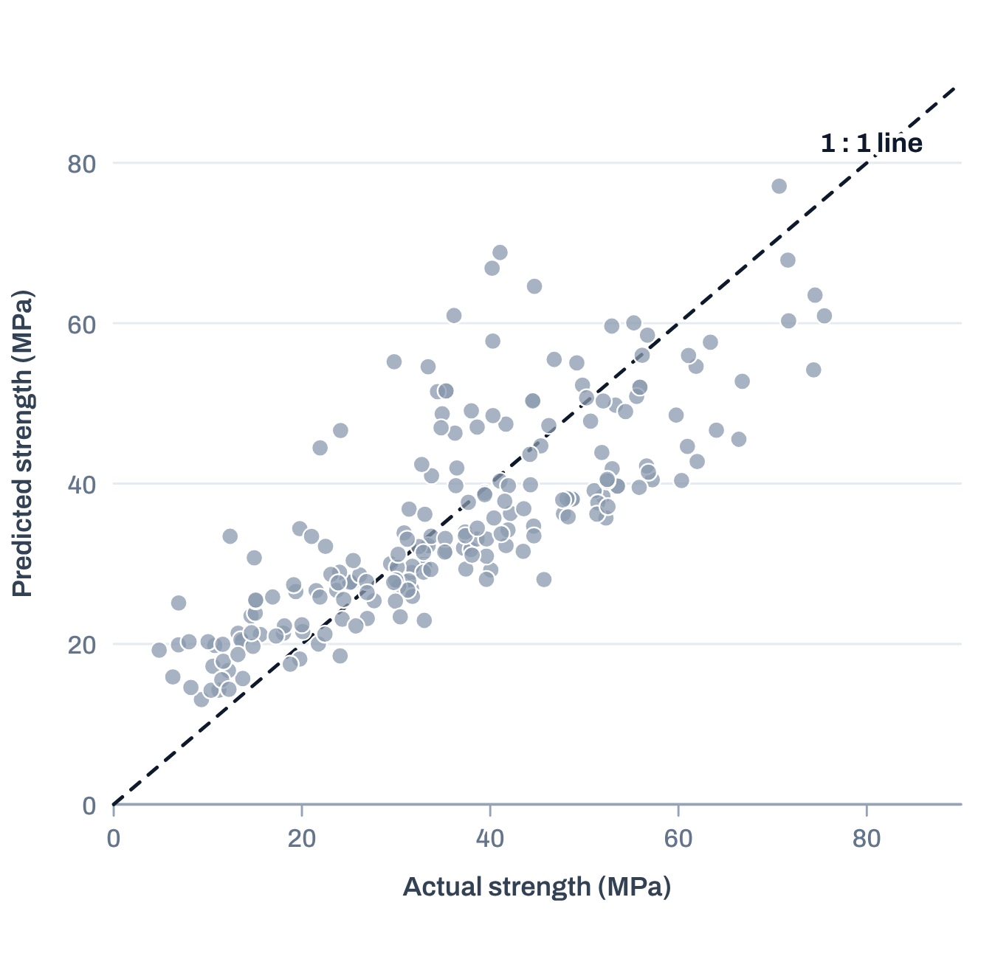

AI & ML for Civil Engineers
Session 06
Part 03 · Results & judgement
36 / 43
Actual versus predicted · inspect the pattern
Points near the dashed 1 : 1 line are accurate
Linear-regression baseline, 206 test mixes
Look for
Scatter around the 1 : 1 line
Systematic under- or overprediction
Different spread at low and high strength
Do not overread
Plots complement the metrics. They do not establish physical validity, or
generalisation to a new population.
Live: the ANN and random-forest plots in the notebook.
Notes:
The actual-versus-predicted plot of the linear baseline, reproduced from the UCI data. Look for scatter around the 1:1 line, systematic bias, and changing spread. Then show the ANN and random-forest plots live in the notebook. Plots complement metrics; they do not prove physical validity.
[Clicks on this slide: 2]

Slide 37
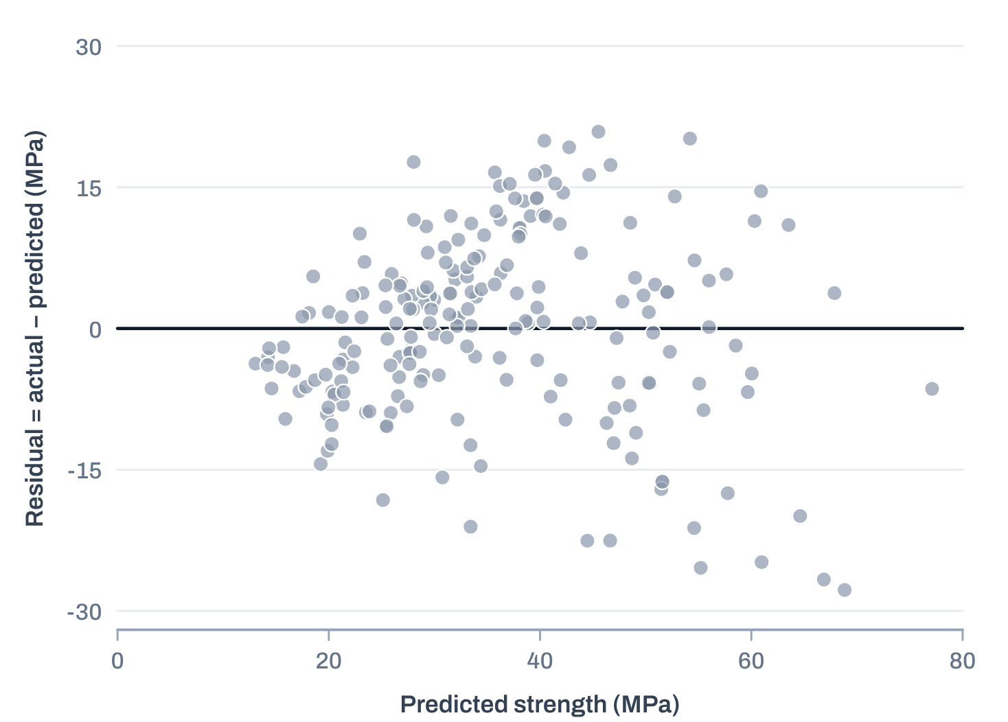

AI & ML for Civil Engineers
Session 06
Part 03 · Results & judgement
37 / 43
Residuals · actual minus predicted, for every test mix
Residuals reveal systematic errors
Linear-regression residuals, test mixes
Positive residual
Actual strength above predicted: underprediction.
Negative residual
Actual strength below predicted: overprediction.
Patterned residuals
May show systematic error, or unequal error spread.
In this baseline
Weak mixes (actual < 20 MPa) are overpredicted by 7.5 MPa on average; strong
mixes (≥ 60 MPa) underpredicted by 12.0 MPa.
A good average score can hide weak performance in parts of the strength range.
Notes:
Residual plot of the linear baseline. Positive: underprediction; negative: overprediction; patterns suggest systematic error. Click: in this baseline, weak mixes are overpredicted and strong mixes underpredicted, on average. A good average score can hide weak performance in parts of the range. Compare with the ANN residual plot in the notebook.
[Clicks on this slide: 2]

Slide 38
AI & ML for Civil Engineers
Session 06
Part 03 · Results & judgement
38 / 43
Does an ANN understand concrete?
No: it learns a statistical mapping from examples
Interpolation
Prediction in a region reasonably represented by the training data.
The training domain
Cement
102–540 kg/m³
Extrapolation
Prediction beyond the domain of the training data: particularly risky.
Water
122–247 kg/m³
Physical validity
Not established by a high test score alone.
Superplasticizer
0.0–32.2 kg/m³
Age
1–365 days
Deployment
Needs representative validation, plausible behaviour, and attention to
the consequences of errors.
Strength
2.3–82.6 MPa
A mix outside these ranges, or an unusual combination
inside them, is extrapolation.
Notes:
Does an ANN understand concrete? No: it learns a statistical mapping. Interpolation inside the training domain is reasonable; extrapolation is risky; a high test score does not establish physical validity; deployment needs representative validation, plausible behaviour and attention to error consequences. The table shows the training domain.
[Clicks on this slide: 4]

Slide 39


AI & ML for Civil Engineers
Session 06
Part 03 · Results & judgement
39 / 43
Illustrative applications · not trained or validated models
The same idea transfers to geotechnical engineering
Slope-stability surrogate
Expensive numerical model
Geometry + soil parameters + hydraulic conditions
Validated inputs
→ approximate factor of safety
→ rapid approximate response after training
Like the 616 Morgenstern–Price slopes of Session 05, as a regression on FOS.
The basis of the ML surrogates in Session 08.
A surrogate speeds up repeated predictions. It does not validate the underlying numerical model or justify extrapolation.
Notes:
The same idea transfers to geotechnical engineering, as illustrations, not trained models here: a slope-stability surrogate for the factor of safety, and surrogates of expensive numerical models, the topic of Session 08. A surrogate speeds up repeated predictions; it does not validate the numerical model or justify extrapolation.
[Clicks on this slide: 2]

Slide 40
AI & ML for Civil Engineers
Session 06
Course overview
40 / 43
Take-home messages
ANNs are useful tools, not automatic upgrades
1
2
3
4
5
Understand the
mapping
Training is
optimisation
Validate correctly
Compare honestly
Keep claims
proportional
Inputs → weighted
combinations → nonlinear
activations → output.
Loss, gradients and
parameter updates shape the
learned model.
Validation data for choices;
the test set only for the final
evaluation.
Here, the random forest beat
the selected ANN on the held-
out test set.
Scores do not establish
causation, physical validity or
safe extrapolation.
The central lesson
Choose the model the evidence supports, not the most sophisticated one.
Notes:
Take-home: understand the mapping; training is optimisation; validate correctly; compare honestly, here the random forest beat the selected ANN; keep claims proportional.
[Clicks on this slide: 3]

Slide 41

AI & ML for Civil Engineers
Session 06
Course overview
41 / 43
After the session · use the notebook to reinforce the workflow
Five things to do in the notebook
01
Compare the three fitted models using MAE, RMSE and R²
02
Inspect the actual-versus-predicted plots and the ANN residual plot
Session 06 notebook
03
Explain why (32, 16) was selected using validation RMSE
Link shared in the session chat
04
Discuss whether a more complex model is justified by its performance
05
Name two limitations before considering real engineering use
Dataset: Yeh, I.-C. (1998). Concrete Compressive Strength.
UCI Machine Learning Repository. doi:10.24432/C5PK67
Notes:
After the session: work through the notebook with these five tasks. Dataset citation at the bottom right.

Slide 42
AI & ML for Civil Engineers
Session 06
42 / 43
?
Questions
Unmute, or drop your question in the chat.
Neurons & layers
Activations
Training & validation
ANN vs baselines
Dr. Abdul Waris
Research Associate · Universität Siegen, Germany
Notes:
Questions.

Slide 43


End of session 06
Thank you.
See you in session 07: Can We Trust Our ML Model?
Dr. Abdul Waris
Research Associate · Universität Siegen, Germany
Course page
qudeltastudios.com/courses
Technology partner
Notes:
Thank you. Next session: can we trust our ML model? Feature importance, SHAP and engineering judgement.

