Slide 1







Live online course
Cohort Fall 2026
AI & Machine
Learning for Civil
Engineers
Session 05 · Binary classification for slope stability
From Prediction to Engineering Decision:
Classification
Stable or unstable? When the answer is a category, the model, the metrics and the
errors that matter all change.
Number
Probability
Class
Decision
Dr. Abdul Waris
Research Associate · Universität Siegen, Germany
Technology partner
Notes:
Welcome to Session 05. Today the answer is not a number but a category: is this slope stable or unstable? The first part builds the vocabulary of classification; then we apply it to 616 Morgenstern-Price slope cases; then we decide which model to use, from the cost of its errors.

Slide 2


AI & ML for Civil Engineers
Session 05
Course overview
02 / 50
Where are we?
From predicting a number to making a decision
Sessions 03–04 · regression
Today · Session 05 · classification
How strong will this concrete be?
Is this slope stable or unstable?
ŷ = 42.7 MPa
unstable · p = 0.88
linear regression
trees & forests
MAE · RMSE · R²
logistic regression
trees & forests
confusion matrix
The answer is a category, often with a probability, and the errors
are not equally costly.
The answer is a number on a continuous scale.
Same workflow as before. The target is now a class, so the model output and the metrics change.
Notes:
Bridge from Sessions 03 and 04: we predicted strength, a number, and judged it with MAE, RMSE and R². Today the target is a class, often with a probability attached. The workflow stays; the model output and the metrics change.
[Clicks on this slide: 2]

Slide 3


AI & ML for Civil Engineers
Session 05
Course overview
03 / 50
The course at a glance
Eight sessions. One engineering workflow.
Part 1 · Foundations
Part 2 · Prediction to decision
01
From Engineering Problems to Python
Done
05
From Prediction to Engineering Decision:
Classification
AI/ML basics, Google Colab, NumPy & pandas
Today
Logistic regression, confusion matrix, precision & recall
02
From Raw Engineering Data to an ML-Ready Dataset
Done
06
Artificial Neural Networks
EDA, data quality, outliers, train/test split, leakage
Architecture, activations, training, overfitting
03
Your First Engineering Prediction Model
Done
07
Can We Trust Our ML Model?
Linear regression, error metrics, cross-validation
Feature importance, SHAP, engineering judgement
Instructor’s research area
04
Nonlinear Engineering Problems: Trees & Ensembles
From Prediction to Probability
Done
08
Decision trees, Random Forest, boosting
Monte Carlo, ML surrogates, probability of failure
Instructor’s research area
Notes:
Session 05 of 8: the start of Part 2, from prediction to decision.

Slide 4









AI & ML for Civil Engineers
Session 05
Course overview
04 / 50
Today · Session 05
Classification, then slope stability
By the end of today you can
The language of classification
01
Terms · logistic vs linear regression · sigmoid · confusion matrix · recall
& precision
Explain how logistic regression turns
inputs into a probability and a class
Read a confusion matrix and choose
recall, precision or F1 for the task
The slope-stability problem
02
Define an engineering label and
handle class imbalance correctly
616 Morgenstern–Price cases · the FOS label · imbalance · three
models · stratified CV
Select a model from the cost of its
errors, not from accuracy alone
03
Results and the engineering decision
Test metrics · confusion matrices · thresholds · which model, and why
Notes:
Three parts. Part 01 is all concepts: terms, logistic vs linear regression, the sigmoid, the confusion matrix and its metrics. Part 02 applies them to the slope dataset. Part 03 reads the results and makes the engineering decision.
[Clicks on this slide: 4]

Slide 5


AI & ML for Civil Engineers
Session 05
05 / 50
01
a
Regression or classification?
b
The vocabulary of classification
c
From linear to logistic regression
d
Score → probability → class
e
The confusion matrix and its metrics
Part 01 · Classification fundamentals
The language of
classification
Notes:
Part 01: the language of classification.

Slide 6

AI & ML for Civil Engineers
Session 05
Part 01 · Classification basics
06 / 50
The target decides, every time
Same inputs, different question
1.37FOS
Stable
Unstable
Regression · Sessions 03–04
Classification · today
Predict a number
Predict a category
From infinitely many possible values.
From a small, fixed set of outcomes.
Factor of safety of a slope
1.37
Slope: FOS below 1.0?
unstable
Settlement of a footing
24 mm
Settlement within the limit?
acceptable
Concrete strength
42.7 MPa
Steel plate fault type
1 of 7
A continuous result can become a class through an engineering threshold, such as FOS < 1.0.
Notes:
Same inputs, different question. A factor of safety of 1.37 is a regression target; 'is FOS below 1.0?' is a classification target. A continuous result becomes a class through an engineering threshold.
[Clicks on this slide: 2]

Slide 7
AI & ML for Civil Engineers
Session 05
Part 01 · Classification basics
07 / 50
Words we will use all session
The vocabulary of classification
Class · label
Positive class
Binary · multiclass
One of the possible categories. The training
table stores it as y.
The class we want to detect. It defines what
recall and precision mean.
Two classes, or three and more mutually
exclusive classes.
stable = 0 · unstable = 1
positive = unstable
2 slope classes · 7 steel faults
Probability
Decision threshold
Class imbalance
The model’s estimate that a case belongs to the
positive class.
The probability above which we call a case
positive.
One class is much rarer than the other. It
changes which metrics matter.
predict_proba() → 0.88
p ≥ 0.50 → unstable
93 unstable of 616
Notes:
Six terms we use all session. Stress the positive class: we choose unstable as positive because that is the case we must not miss, and it defines what recall and precision mean.
[Clicks on this slide: 3]

Slide 8
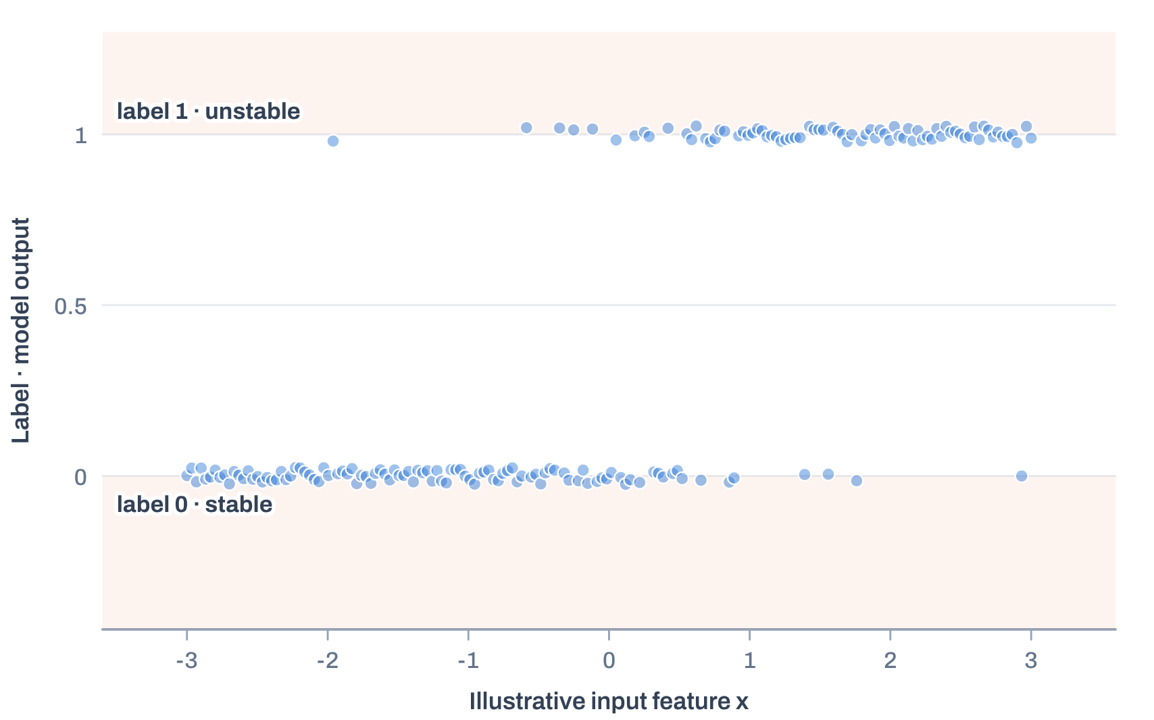
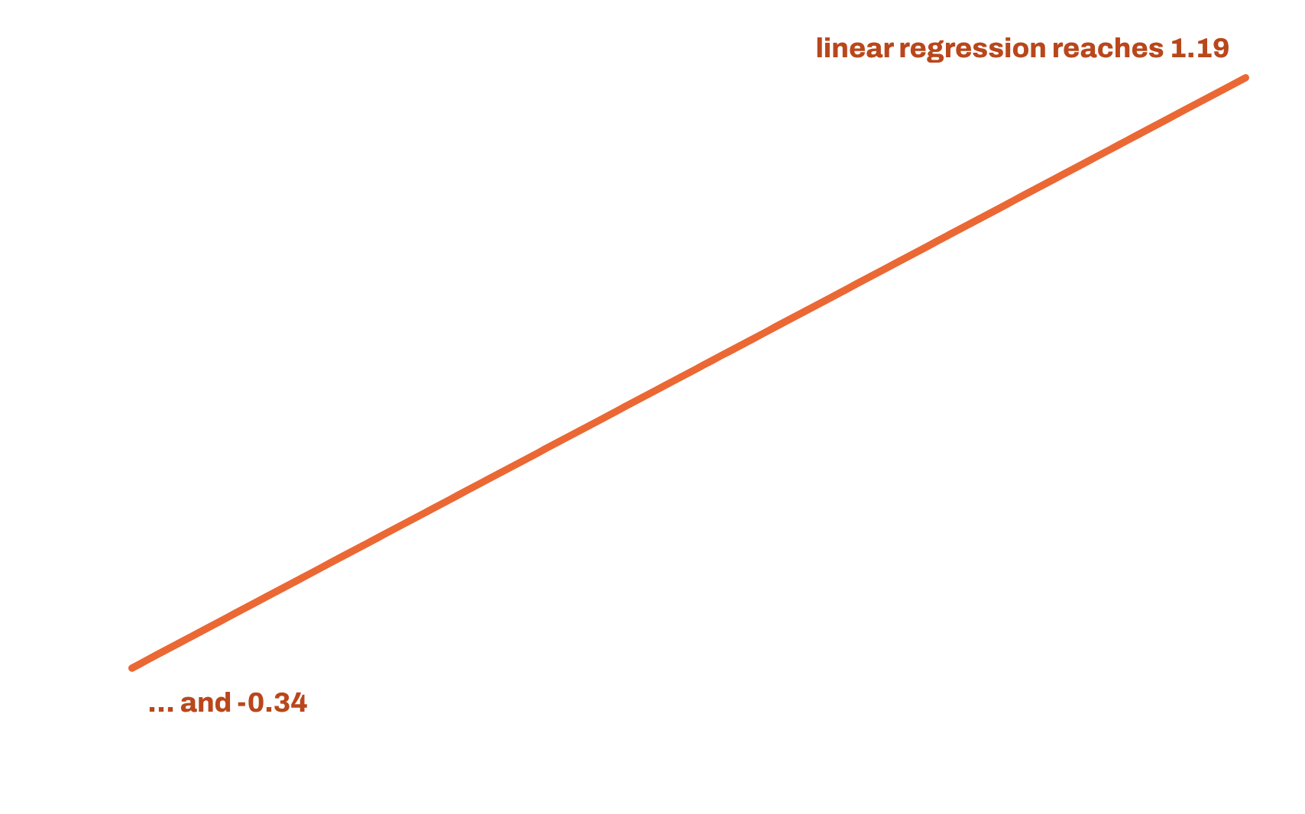
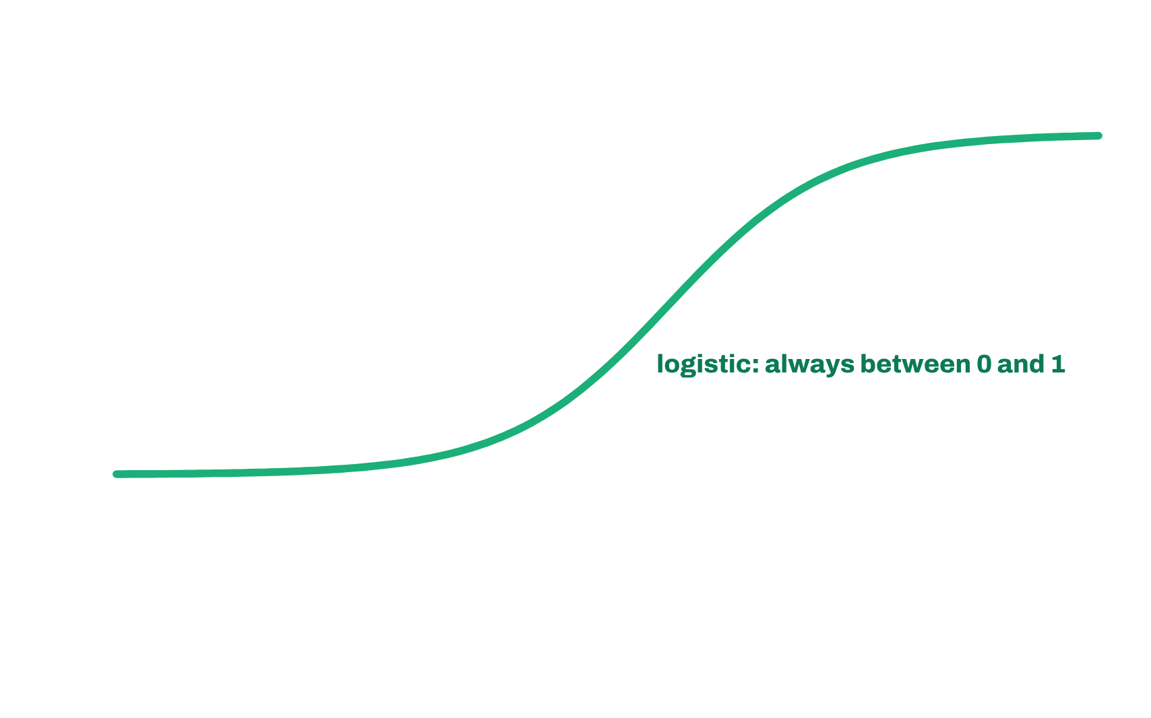
AI & ML for Civil Engineers
Session 05
Part 01 · Classification basics
08 / 50
Linear regression vs logistic regression · 1 of 2
Why not fit linear regression to 0/1 labels?
Same binary labels, two models
Linear regression
Predicts values from −0.34 to 1.19: not valid probabilities, and a
straight line ignores the S-shape.
Logistic regression
Squeezes the same linear score through the sigmoid: every output
lies between 0 and 1.
What we want
P(unstable | β, c/(γH), φ)
Illustrative one-feature data from the session notebook (180 points, random seed 42); the slope dataset has three inputs.
Notes:
Notebook Part A, cell 6. Same 0/1 labels, two models. Click 1: linear regression runs from -0.34 to 1.19, not valid probabilities. Click 2: logistic regression stays between 0 and 1 and follows the S-shape. What we want is the probability of unstable given the inputs.
[Clicks on this slide: 3]

Slide 9



AI & ML for Civil Engineers
Session 05
Part 01 · Classification basics
09 / 50
Logistic regression in four steps
Inputs → score → probability → class
1
2
3
4
Inputs
Linear score
Probability
Decision
β, c/(γH), φ
z = b₀ + Σ b_{j}x_{j}
p = 1 / (1 + e^{−z})
p ≥ threshold ?
Slope angle, cohesion term,
friction angle.
Any real number. Same form as
linear regression.
The sigmoid maps z into (0, 1).
Yes → unstable · No → stable.
“Regression” stays in the name because the model is linear on the log-odds scale. The class comes from the threshold.
Notes:
Logistic regression in four steps: inputs, a linear score, a probability, a decision. The word regression stays in the name because the model is linear on the log-odds scale; the class comes from the threshold.
[Clicks on this slide: 4]

Slide 10

AI & ML for Civil Engineers
Session 05
Part 01 · Classification basics
10 / 50
Step 1 · build a linear score
A weighted sum of the inputs, as in Session 03
For the slope-stability dataset
z = b₀ + b₁β + b₂[c/(γH)] + b₃φ
β
c/(γH)
φ
Slope angle
Cohesion term
Friction angle
Steepness of the slope face.
Dimensionless stability number: cohesion over
unit weight × height.
Shear-strength parameter of the soil.
15° – 65° · 11 levels
10° – 45° · 8 levels
0 – 0.30 · 7 levels
z can be any number. The coefficients b are learned from the training cases; their sizes depend on units and scaling.
Notes:
Step 1: the same weighted sum as Session 03, written for our three slope inputs. z is unrestricted. Coefficients are learned from training cases and depend on units and scaling.
[Clicks on this slide: 2]

Slide 11
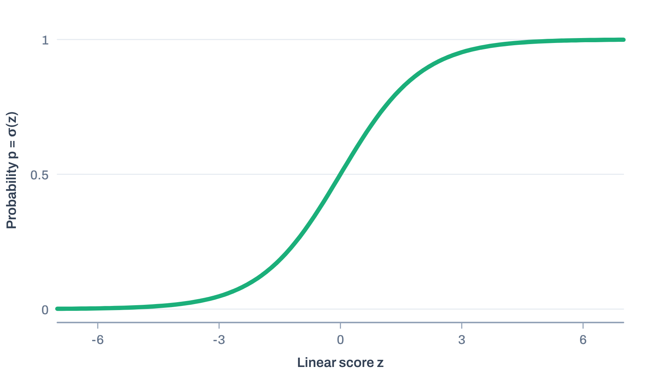
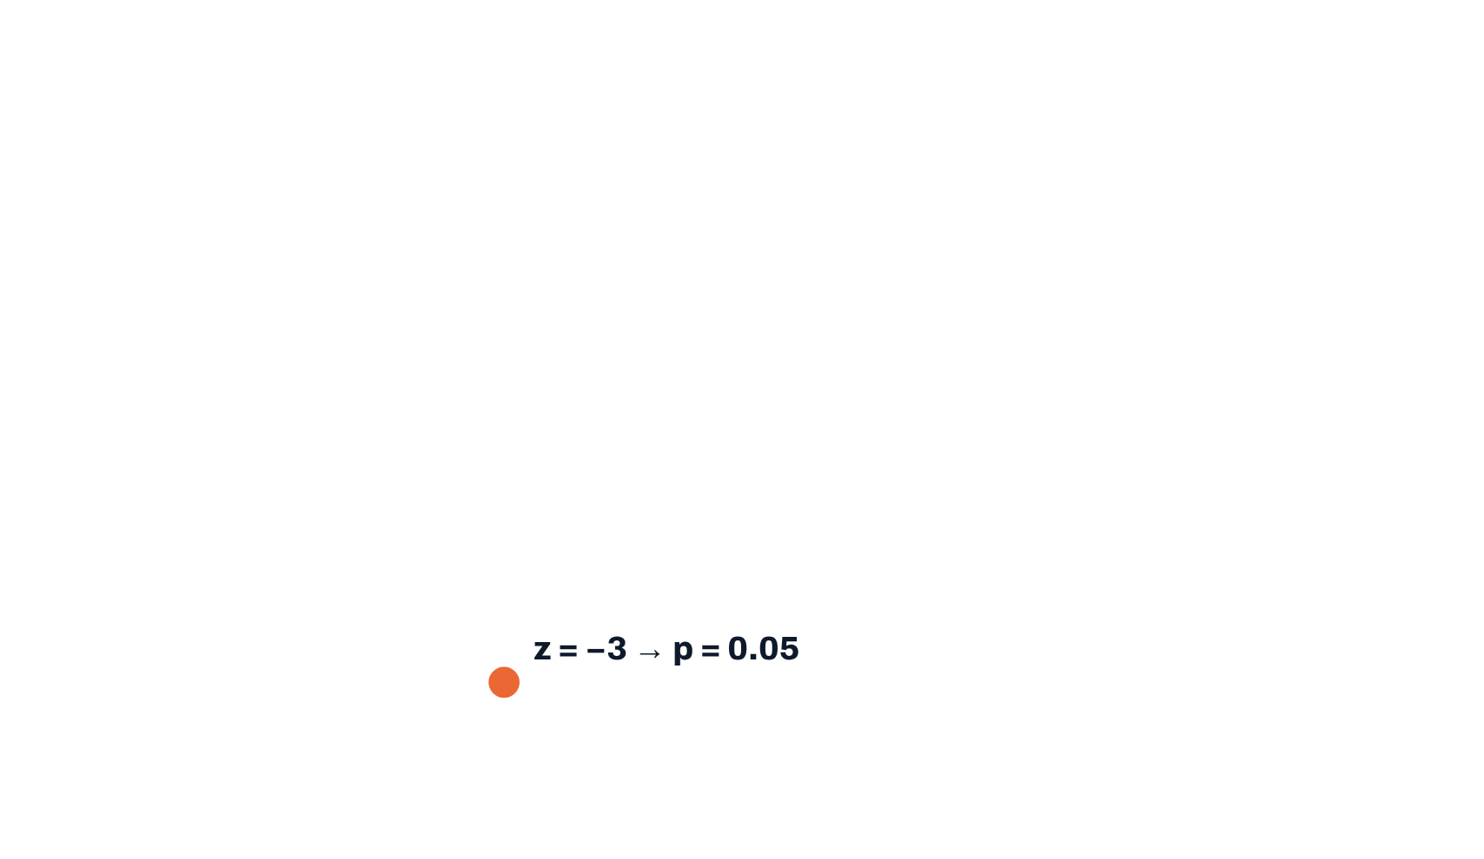
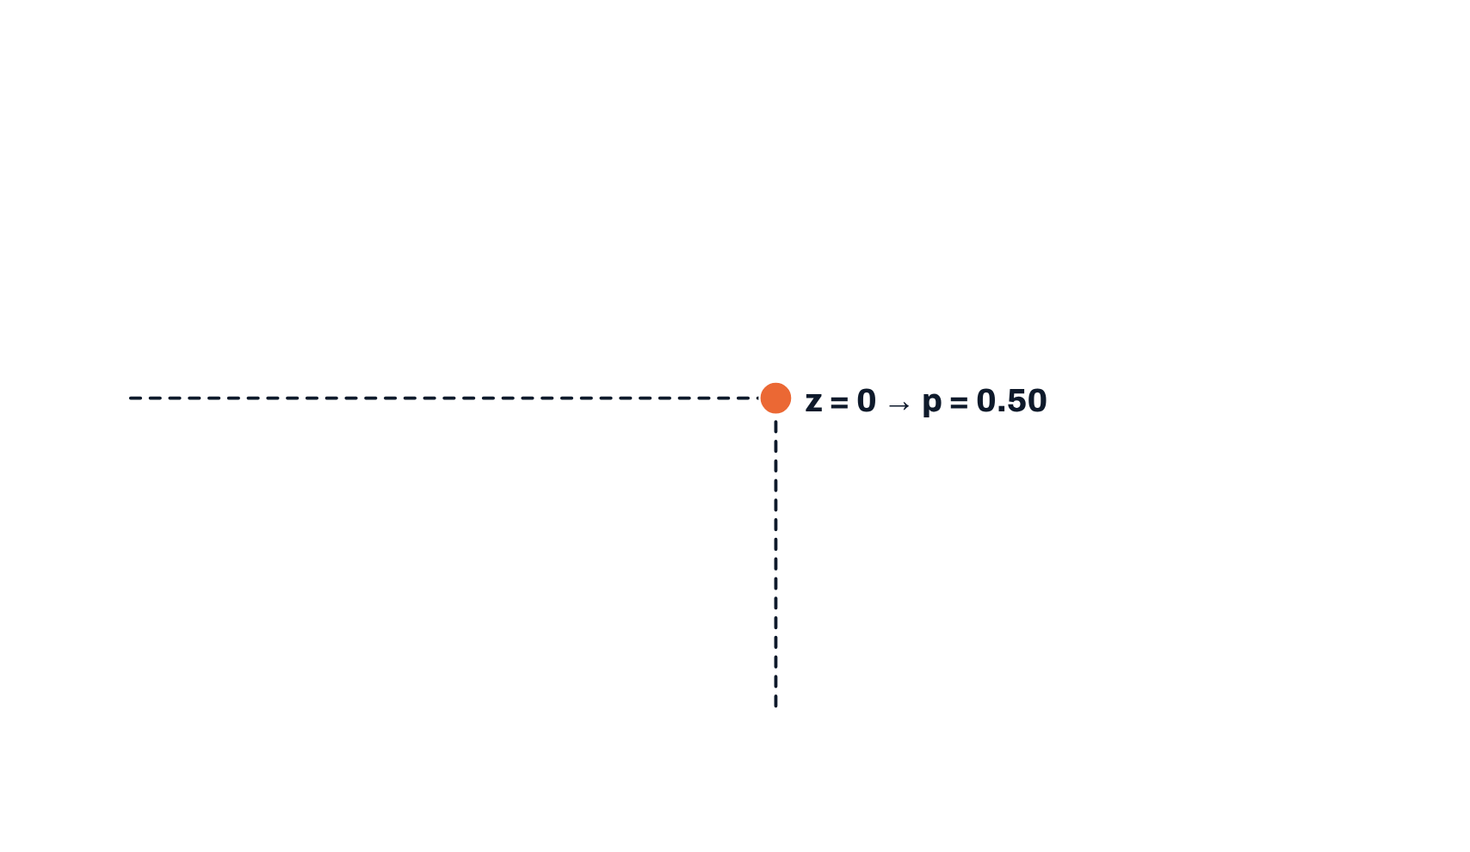
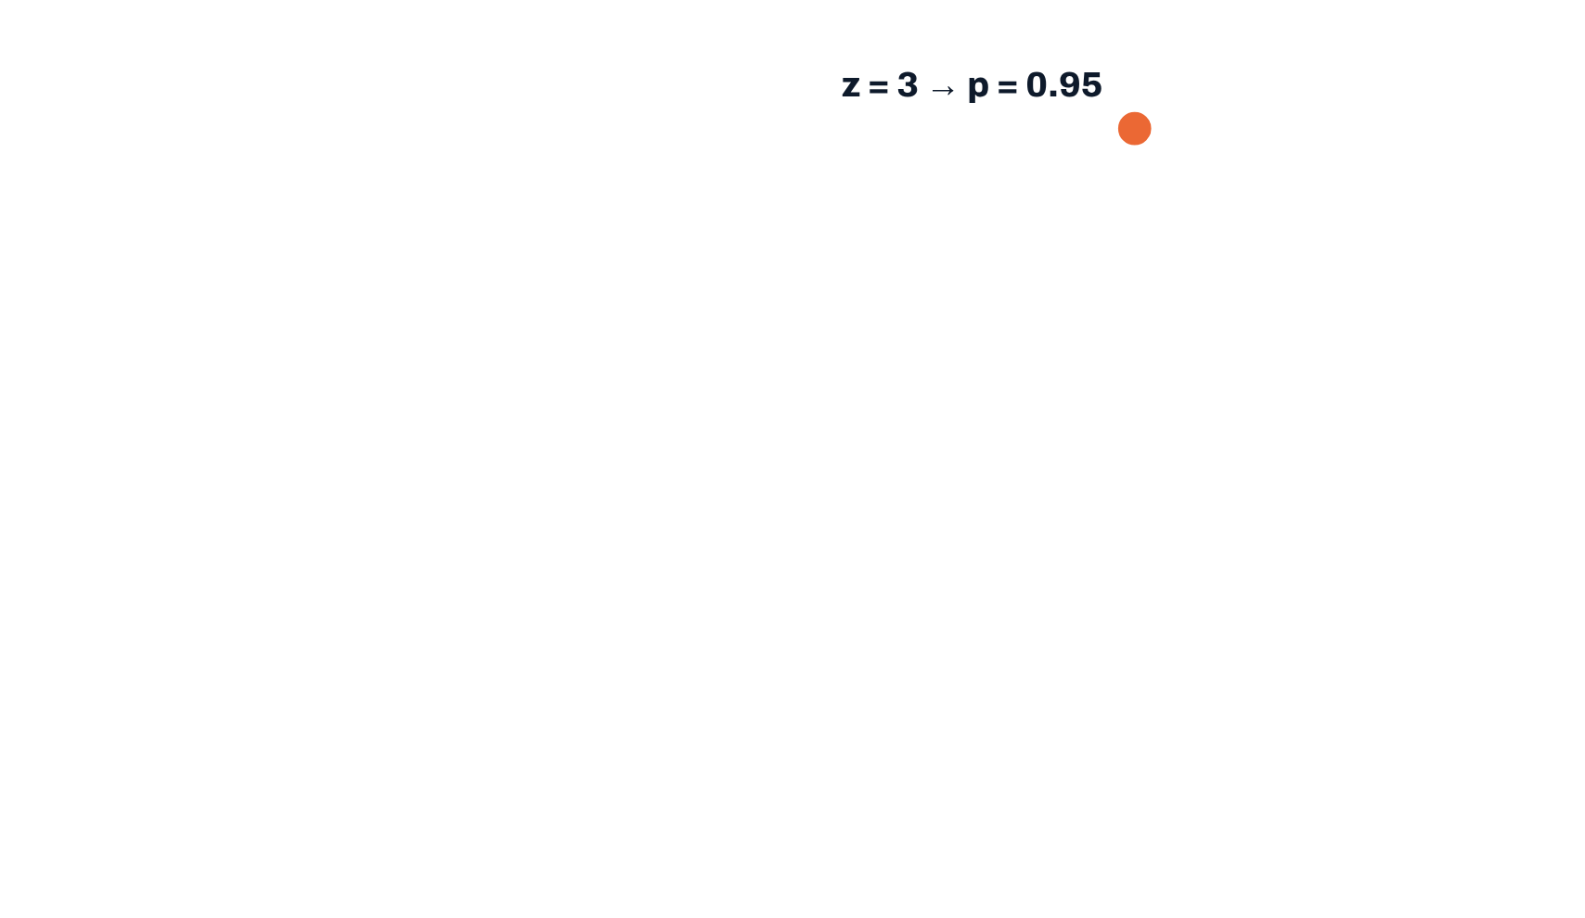
AI & ML for Civil Engineers
Session 05
Part 01 · Classification basics
11 / 50
Step 2 · map the score to a probability
The sigmoid squashes any score into (0, 1)
p = σ(z)
The sigmoid
p =
1
1 + e^{−z}
z < 0 → p < 0.5
z = 0 → p = 0.5
z > 0 → p > 0.5
A model probability is an estimate. It is not automatically calibrated,
and it is not a physical probability of failure.
Notes:
Step 2: the sigmoid. Clicks: z = -3 gives p = 0.05, z = 0 gives 0.50, z = 3 gives 0.95. These are model estimates, not automatically calibrated, and not a physical probability of failure.
[Clicks on this slide: 4]

Slide 12

AI & ML for Civil Engineers
Session 05
Part 01 · Classification basics
12 / 50
Step 3 · what the coefficients model
Linear in the log-odds
Probability
Odds
Log-odds · logit
p ∈ (0, 1)
p
∈ (0, ∞)
log
p
= z
p = 0.80
1 − p
1 − p
0.80 / 0.20 = 4 : 1
log 4 = 1.39
Bounded, so a straight line cannot model it
directly.
Unbounded in both directions, so a linear
model can describe it.
“Four times as likely to be unstable as stable.”
A coefficient is the change in log-odds per unit of an input, others held fixed. It is an association in this numerical dataset, not a
physical cause.
Notes:
Step 3: odds and log-odds. p = 0.8 means odds of 4 to 1; the log of the odds is unbounded, which is why a linear model can describe it. A coefficient is the change in log-odds per unit of an input, holding the others fixed.
[Clicks on this slide: 3]

Slide 13







AI & ML for Civil Engineers
Session 05
Part 01 · Classification basics
13 / 50
Step 4 · probability becomes a class
A threshold turns p into a decision
p < 0.50 → predict stable
p ≥ 0.50 → predict unstable
Lower the threshold
Raise the threshold
More cases flagged unstable: fewer missed unstable slopes, more false
alarms.
Fewer cases flagged: fewer false alarms, more missed unstable slopes.
0.50 is a software default, not a law of soil mechanics. Choose it on validation data, never on the test set.
Notes:
Step 4: a threshold turns the probability into a class. 0.50 is a software default. Lowering it flags more slopes (fewer misses, more false alarms); raising it does the opposite. Choose it on validation data.
[Clicks on this slide: 3]

Slide 14



AI & ML for Civil Engineers
Session 05
Part 01 · Classification basics
14 / 50
A worked prediction · the fitted model, a real test case
From inputs to decision, with real numbers
1 · Inputs
2 · Linear score
3 · Probability
4 · Decision
β
45°
z = 1.15 + 0.064·β − 24.5·c/(γH) −
0.087·φ
p = 0.88
unstable
c/(γH)
0.05
1 / (1 + e^{−1.95})
p ≥ 0.50
φ
10°
z = 1.95
Check
Morgenstern–Price gives FOS = 0.66 for this slope: truly unstable, and correctly flagged.
Coefficients of the tuned logistic regression (C = 0.1, class_weight = "balanced"), converted from the scaled model to original units. Class weighting shifts the probabilities: read them as scores, not calibrated chances of failure.
Notes:
A real worked prediction with the tuned model. beta = 45 degrees, c/(gamma H) = 0.05, phi = 10 degrees gives z = 1.95 and p = 0.88: predicted unstable. Morgenstern-Price gives FOS = 0.66, so the prediction is correct. Signs: steeper slopes raise z; more cohesion and friction lower it. Class weighting shifts these probabilities, so read them as scores.
[Clicks on this slide: 4]

Slide 15
AI & ML for Civil Engineers
Session 05
Part 01 · Classification basics
15 / 50
Linear regression vs logistic regression · 2 of 2
The essential distinction
Question
Linear regression · Session 03
Logistic regression · today
Typical target
Continuous quantity
Class label, often 0 / 1
The linear part
Predicts the response directly
A score on the log-odds scale
Output
Any real number
Probability in (0, 1), via the sigmoid
Fitting objective
Minimise squared errors
Maximise likelihood · minimise log loss
Threshold
Usually not needed
Turns a probability into a class
Evaluation
MAE · RMSE · R²
Confusion matrix · recall · precision · F1
With a fixed threshold, logistic regression draws a straight boundary in the input space, unless we transform the features.
Notes:
The essential distinction, from the notebook's table. With a fixed threshold, logistic regression draws a straight boundary in the input space unless features are transformed.
[Clicks on this slide: 3]

Slide 16
AI & ML for Civil Engineers
Session 05
Part 01 · Classification basics
16 / 50
Positive class = unstable (FOS < 1.0)
The confusion matrix: where every prediction lands
Predicted: stable
Predicted: unstable
How to read it
Rows are the truth, columns are the prediction. The diagonal is
correct.
TN
FP
True negative
False positive · false alarm
For safety screening
Stable, predicted stable. Correct.
Stable, flagged unstable. Costs an
unnecessary check.
Inspect the bottom-left cell first: unstable slopes the model
called stable.
FN
TP
False negative · missed warning
True positive
Unstable, predicted stable. Potentially
consequential.
Unstable, flagged unstable. Detected.
Notes:
The confusion matrix with unstable as the positive class. Click through TN, FP, FN, TP. A false positive costs an unnecessary check; a false negative is an unstable slope called stable. For safety screening, read FN first.
[Clicks on this slide: 5]

Slide 17

AI & ML for Civil Engineers
Session 05
Part 01 · Classification basics
17 / 50
Definitions before scores
Four metrics, four different questions
Recall (unstable) · sensitivity
Precision (unstable)
Recall =
TP
Precision =
TP
TP + FN
TP + FP
Of all unstable cases, what fraction did we detect?
Of all cases flagged unstable, what fraction really were?
F1 score
Balanced accuracy
F1 =
2 · P · R
BA =
Recall_{unstable} + Recall_{stable}
P + R
2
One number that balances precision and recall (harmonic mean).
Gives both classes equal weight, unlike ordinary accuracy.
Our priority today: do not miss unstable slopes. So recall for the unstable class comes first, with precision in view.
Notes:
Definitions before scores. Recall: of all unstable slopes, how many did we catch. Precision: of all slopes we flagged, how many were really unstable. F1 balances them. Balanced accuracy weights both classes equally.
[Clicks on this slide: 5]

Slide 18

AI & ML for Civil Engineers
Session 05
Part 01 · Classification basics
18 / 50
Why accuracy alone can mislead
A model that never warns can still look “accurate”
Always predict “stable” · 124 test slopes
Accuracy
Pred. stable
Pred. unstable
84.7%
105
0
TN
FP
It looks good, because 85% of slopes are stable anyway.
Recall for unstable
0 of 19
19
0
FN · all missed
TP
It detects none of the unstable slopes. Balanced accuracy is 0.50: no better than
chance.
With imbalanced classes, read the confusion matrix and the recall of the rare class, not accuracy alone.
Notes:
Why accuracy misleads: always predicting stable scores 84.7% accuracy on the 124 test slopes and detects none of the 19 unstable ones. Balanced accuracy is 0.50.
[Clicks on this slide: 3]

Slide 19




AI & ML for Civil Engineers
Session 05
19 / 50
02
a
The engineering question
b
616 Morgenstern–Price cases
c
The FOS label and class imbalance
d
The stability boundary
e
Three models, stratified CV
Part 02 · The slope-stability problem
From factor of safety to
a classification
Notes:
Part 02: from factor of safety to a classification.

Slide 20
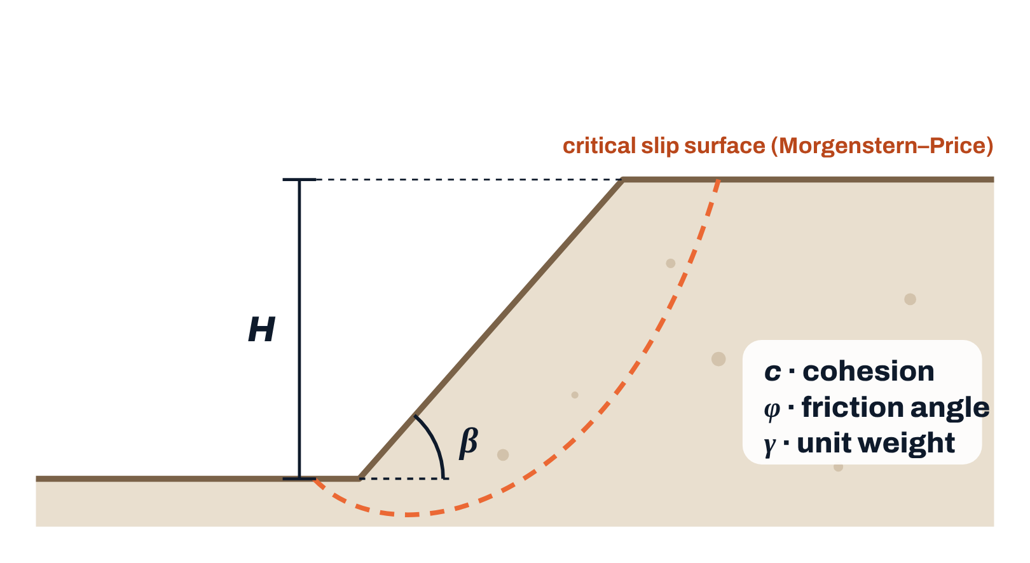
AI & ML for Civil Engineers
Session 05
Part 02 · Slope stability
20 / 50
The engineering question
Can three inputs classify a slope as stable or unstable?
Can β, c/(γH) and φ classify cases below
the limiting-equilibrium threshold?
Inputs X
Slope angle β (°), dimensionless c/(γH), friction angle φ (°).
The label y
From the factor of safety of a Morgenstern–Price analysis:
unstable = 1 · FOS < 1.0
stable = 0 · FOS ≥ 1.0
The labels reproduce a numerical analysis. They are not independent field
failures.
Data: Kenue, A.W., Alluri, H.R. & Munwar Basha, B. (2025). Prediction of the critical failure surface and factor of safety of finite slopes using machine learning algorithms. In: Application of Soft Computing Techniques in Geotechnical Engineering and Risk
Analysis (IGC 2023), LNCE 715, Springer. doi:10.1007/978-981-96-9529-4_3
Notes:
The engineering question. Inputs: slope angle, c/(gamma H), friction angle. The label comes from the Morgenstern-Price FOS: unstable when FOS < 1.0. These labels reproduce a numerical analysis; they are not field failures.
[Clicks on this slide: 3]

Slide 21

AI & ML for Civil Engineers
Session 05
Part 02 · Slope stability
21 / 50
The session dataset · first audit, as in Session 02
616 cases on a structured grid
616
11×7×8
0
0.17–7.43
slope cases, one Morgenstern–
Price analysis each
levels of β × c/(γH) × φ: every
combination once
missing values · 0 repeated input
combinations
range of the factor of safety
Data-quality decisions
Session_05_Integrated…Slope_Stability.ipynb
audit
itr is a row identifier: never a predictor
df = pd.read_excel("Simplified_static_dataset_616.xlsx")
df.shape, df.isna().sum().sum()
df.duplicated(["Beta", "CbygammaH", "phi"]).sum()
Only the five columns needed are distributed
The slip-surface results of the analysis are left out: as inputs they would leak the
answer
Output
A grid means test cases sit between familiar training levels
((616, 5), 0)
0
Data: Kenue, A.W., Alluri, H.R. & Munwar Basha, B. (2025). Prediction of the critical failure surface and factor of safety of finite slopes using machine learning algorithms. In: Application of Soft Computing Techniques in Geotechnical Engineering and Risk
Analysis (IGC 2023), LNCE 715, Springer. doi:10.1007/978-981-96-9529-4_3
Notes:
The dataset: 616 rows forming a complete grid, 11 slope angles x 7 cohesion levels x 8 friction angles. No missing values, no repeated input combinations. itr is an identifier. The slip-surface columns are outputs of the analysis and would leak the answer.
[Clicks on this slide: 2]

Slide 22
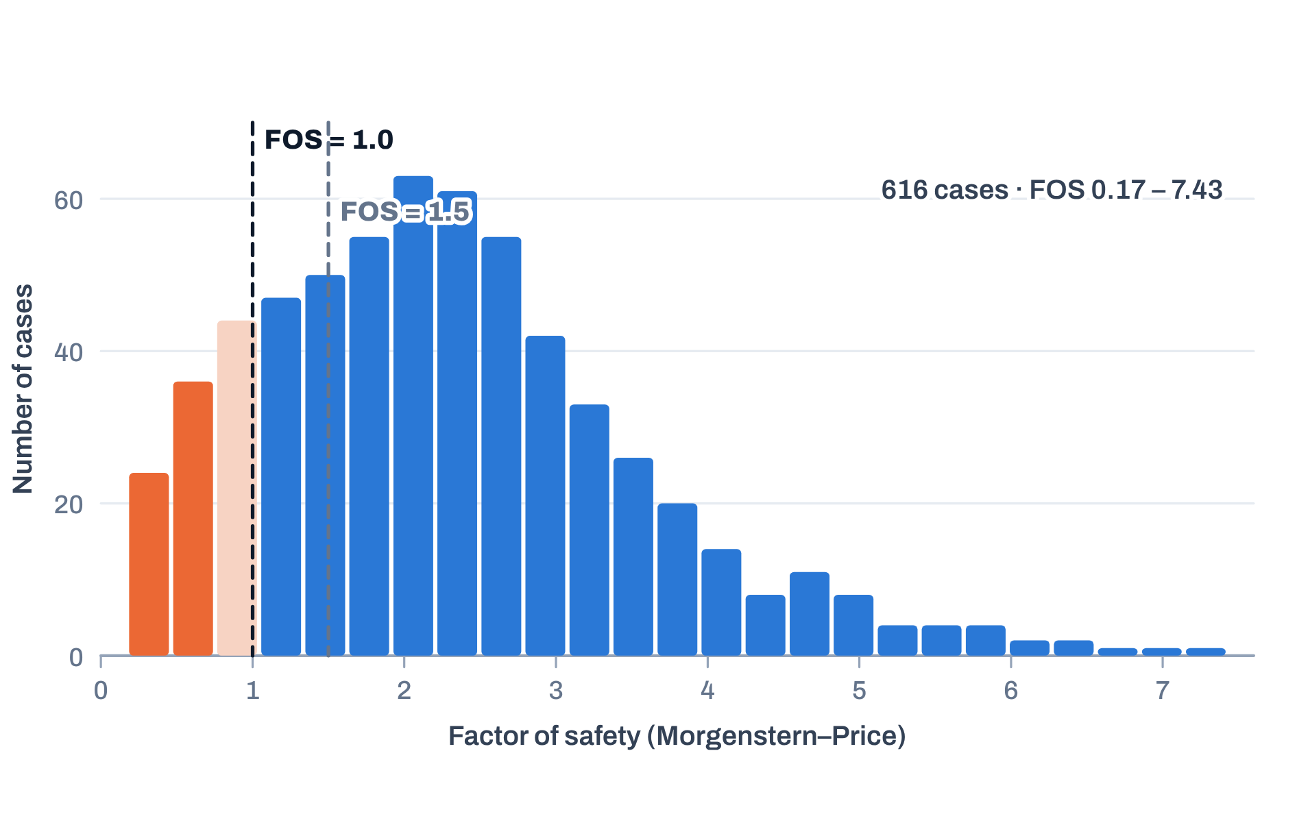
AI & ML for Civil Engineers
Session 05
Part 02 · Slope stability
22 / 50
The label is an engineering choice
Where we cut the factor of safety defines the problem
Factor of safety of all 616 cases
Label threshold
Below
At / above
Orange: below 1.0. No case has FOS exactly 1.0.
FOS < 1.0
93
523
FOS < 1.5
181
435
1.0 · our primary label
The limiting-equilibrium threshold.
1.5 · a different question
A design or screening threshold, not automatically physical
failure.
Notes:
The label is an engineering choice. FOS < 1.0: 93 unstable, 523 stable. FOS < 1.5: 181 below, a different design or screening question. No case has FOS exactly 1.0.
[Clicks on this slide: 3]

Slide 23
AI & ML for Civil Engineers
Session 05
Part 02 · Slope stability
23 / 50
Primary label: unstable = FOS < 1.0
Class imbalance: unstable slopes are the minority
Unstable cases at each friction angle
φ
Unstable of 77
10°
25
15°
19
Stable
523 · 84.9%
20°
14
25°
12
30°
9
Unstable
93 · 15.1%
35°
6
40°
5
Enough for a teaching exercise, but the minority-class metrics need careful
reading. Imbalance is not a data defect: it changes which metrics matter.
45°
3
Notes:
Imbalance: 523 stable (84.9%) and 93 unstable (15.1%). Unstable cases concentrate at low friction angles: 25 at phi = 10 degrees, 3 at 45 degrees. Imbalance is not a defect; it changes which metrics matter.
[Clicks on this slide: 3]

Slide 24
AI & ML for Civil Engineers
Session 05
Part 02 · Slope stability
24 / 50
Two different thresholds: do not confuse them
One defines the target. One defines the decision.
The FOS label threshold
The probability threshold
What “unstable” means
When the model says “unstable”
FOS < 1.0 → y = 1
p ≥ 0.50 → predict 1
Set before modelling, from engineering meaning
Set after modelling, on validation data
Changing it changes the target and the class balance
Changing it trades precision against recall for the same target
A slope with FOS = 0.95 is labelled unstable (y = 1). The model gives p = 0.42. At threshold 0.50 it predicts stable: a false
negative. At 0.30 it would be flagged.
Example
Notes:
Two thresholds. The FOS threshold defines the target before modelling. The probability threshold defines the decision after modelling. The example shows how a truly unstable slope becomes a false negative at 0.50.
[Clicks on this slide: 2]

Slide 25
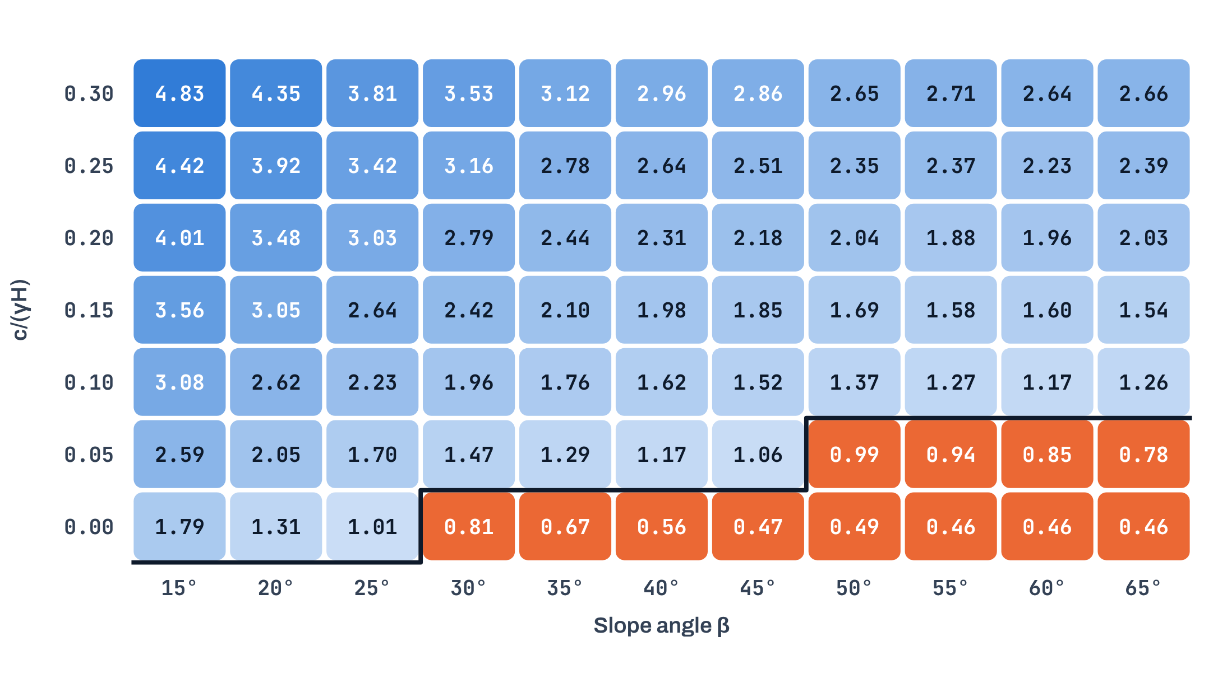
AI & ML for Civil Engineers
Session 05
Part 02 · Slope stability
25 / 50
The stability boundary is not a single cut-off
FOS on one slice of the grid: φ = 25°
Factor of safety for every β and c/(γH) at φ = 25°
Read it
Orange: FOS < 1.0 (unstable). The black line is the FOS = 1 boundary in this slice.
The boundary depends on β and c/(γH)
together: steeper slopes need more
cohesion.
Third input
φ shifts the whole surface: from 25 unstable
cases at φ = 10° to 3 at φ = 45°.
A slice is illustrative: the real boundary lives in
three dimensions.
Data: Kenue, A.W., Alluri, H.R. & Munwar Basha, B. (2025). Prediction of the critical failure surface and factor of safety of finite slopes using machine learning algorithms. In: Application of Soft Computing Techniques in Geotechnical Engineering and Risk
Analysis (IGC 2023), LNCE 715, Springer. doi:10.1007/978-981-96-9529-4_3
Notes:
One slice of the grid at phi = 25 degrees, with every FOS value. The boundary depends on slope angle and cohesion together, and phi shifts it. The real boundary is three-dimensional.
[Clicks on this slide: 3]

Slide 26
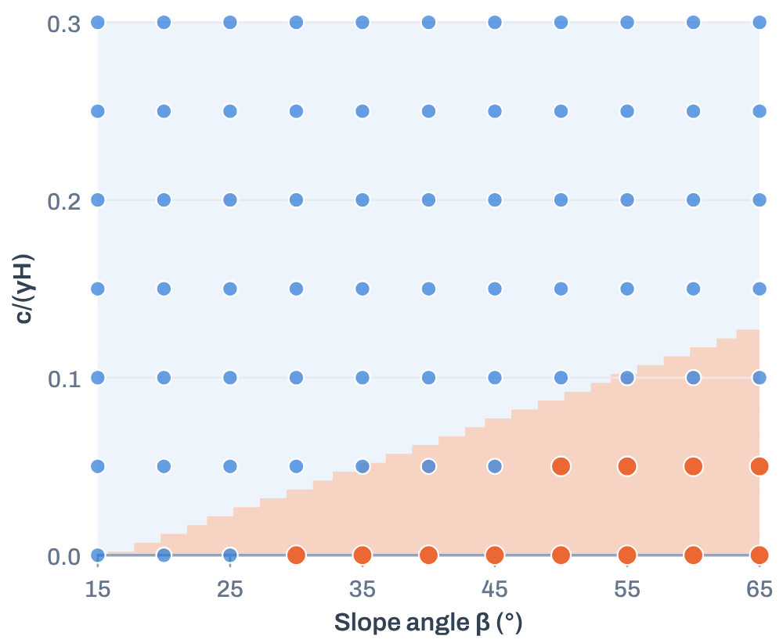
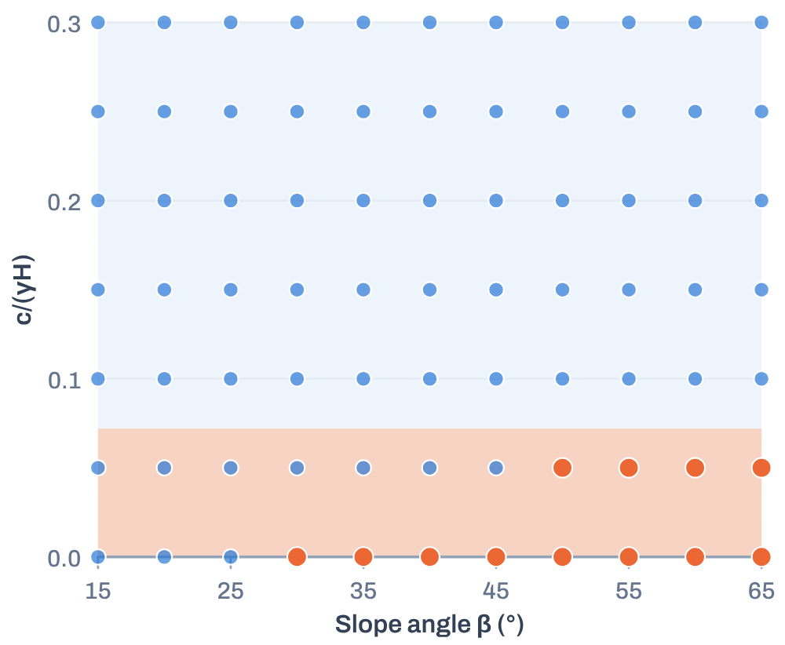
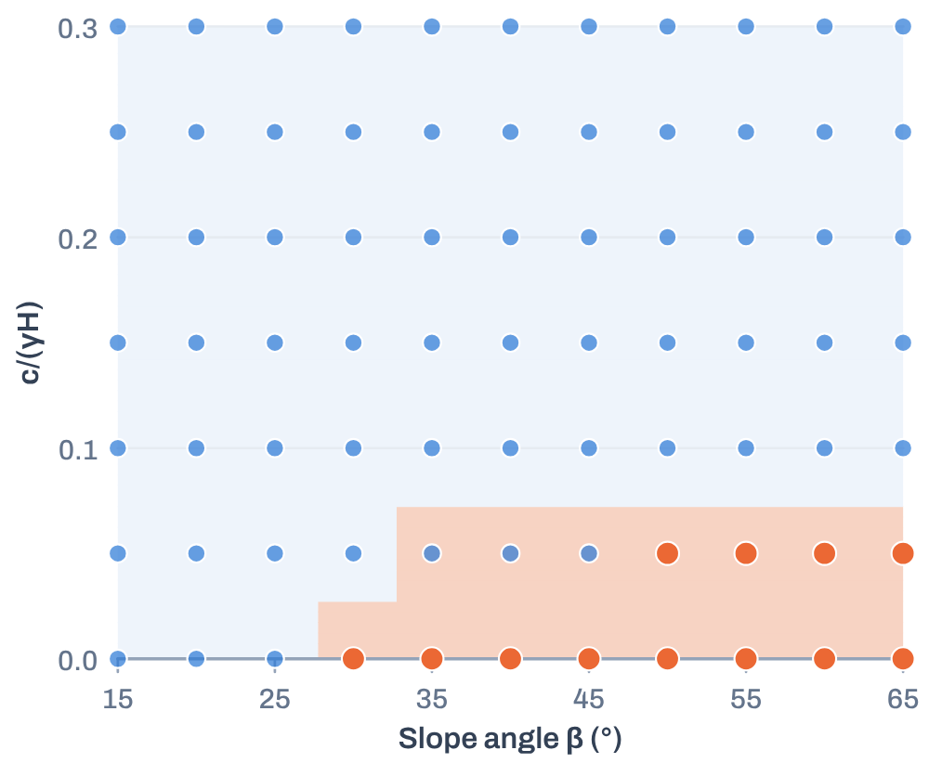

AI & ML for Civil Engineers
Session 05
Part 02 · Slope stability
26 / 50
Three models, three inductive biases · tuned models on the φ = 25° slice
Each model draws a different kind of boundary
unstable case
stable case
region predicted unstable
Logistic regression
Decision tree
Random forest
Probability-based; scaling in a pipeline.
Threshold rules; can overfit.
Many trees combined; lower variance.
A straight boundary
Axis-aligned steps
A flexible, stepped boundary
The orange regions reaching stable cases are the models’ false alarms. Class weighting makes all three cautious.
Notes:
The three tuned models on the same slice. Logistic regression: a straight edge, reaching into stable cases (false alarms). Decision tree: axis-aligned steps. Random forest: a tighter stepped region. All three use class weighting, so they lean towards caution.
[Clicks on this slide: 3]

Slide 27





AI & ML for Civil Engineers
Session 05
Part 02 · Slope stability
27 / 50
Ways to handle class imbalance
Make the rare class count, inside the training data
Stratify
Real effect of class weighting · logistic regression ·
5-fold CV, training set
Keep 15% unstable in the train/test split and in every CV fold.
No weighting · recall 0.61
Balanced · recall 1.00
Prioritise unstable recall
Pred. S
Pred. U
Pred. S
Pred. U
While watching precision and F1.
418
0
379
39
false alarms
class_weight="balanced"
29
Errors on the rare class cost more during fitting.
missed
45
0
74
Adjust the probability threshold
Weighting finds all 74 unstable training cases instead of 45, at the price of
39 false alarms.
On validation data, never on the test set.
Resampling, if needed
Only inside each CV training fold.
Notes:
Handling imbalance, with a real effect: logistic regression without weighting misses 29 of the 74 unstable training cases in CV; with class_weight='balanced' it misses none but raises 39 false alarms. Thresholds are tuned on validation data; resampling only inside CV folds.
[Clicks on this slide: 3]

Slide 28



AI & ML for Civil Engineers
Session 05
Part 02 · Slope stability
28 / 50
Same discipline as Session 03, now stratified
Stratified split, then CV on training data only
616 cases
Training 80% · 492
Test 20% · 124
93 unstable
418 stable · 74 unstable
105 · 19
Rules
Session_05_Integrated…Slope_Stability.ipynb
split · cv
stratify=y keeps 15% unstable in both parts
X_train, X_test, y_train, y_test = train_test_split(
X, y, test_size=0.20, random_state=42, stratify=y)
cv = StratifiedKFold(n_splits=5, shuffle=True, random_state=42)
gs = GridSearchCV(model, grid, scoring="recall", cv=cv)
gs.fit(X_train, y_train)
5-fold StratifiedKFold on the training set
GridSearchCV tunes each model on the folds
The test set stays locked until the final evaluation
# training data only
On a grid, a random split mostly tests interpolation
Notes:
Stratified 80/20 split: 492 training cases (74 unstable) and 124 test cases (19 unstable). Five-fold StratifiedKFold and GridSearchCV on the training data only. On a grid, a random split mostly tests interpolation.
[Clicks on this slide: 3]

Slide 29

AI & ML for Civil Engineers
Session 05
Part 02 · Slope stability
29 / 50
Tuning strategy · scoring = recall for the unstable class
What each model is allowed to try
Model
Hyperparameters searched
Why
Logistic regression
C ∈ {0.1, 1, 10}
class_weight ∈ {None, balanced}
C controls regularisation; scaling sits inside the pipeline
Decision tree
max_depth ∈ {2, 3, 4, 5, None}
min_samples_leaf ∈ {1, 3, 5, 10} · class_weight
Limits on depth and leaf size control overfitting
Random forest
max_depth ∈ {None, 4, 8} · min_samples_leaf ∈ {1, 3, 5}
max_features ∈ {sqrt, 1.0} · class_weight · 100 trees
Tree diversity and complexity
Recall-focused tuning can raise false alarms. Always look at precision and the confusion matrix too.
Notes:
The search grids from the notebook. Scoring is recall for the unstable class, so watch precision: recall-focused tuning can produce false alarms.
[Clicks on this slide: 4]

Slide 30




AI & ML for Civil Engineers
Session 05
30 / 50
03
a
Baseline and CV results
b
Held-out test performance
c
Confusion matrices
d
Thresholds: the precision–recall trade-off
e
Which model, and what the results do not
show
Part 03 · Results & decision
From scores to an
engineering decision
Notes:
Part 03: from scores to an engineering decision.

Slide 31

AI & ML for Civil Engineers
Session 05
Part 03 · Results & decision
31 / 50
Five-fold CV on the training set · used for model selection, not the final score
Baseline first, then the tuned models
Majority baseline
Logistic regression
Decision tree
Random forest
0.000
1.000
0.987
0.959
recall · always “stable”
best mean CV recall
best mean CV recall
best mean CV recall
max_depth = None
min_samples_leaf = 5
max_features = 1.0
class_weight = "balanced"
max_depth = 3
min_samples_leaf = 1
class_weight = "balanced"
DummyClassifier(
strategy="most_frequent")
C = 0.1
class_weight = "balanced"
All three tuned models chose class_weight = "balanced". CV picks the settings; only the test set gives the final score.
Notes:
Best mean CV recall: logistic regression 1.000, decision tree 0.987, random forest 0.959. All chose balanced class weights. CV selects settings; it is not the final score.
[Clicks on this slide: 4]

Slide 32
AI & ML for Civil Engineers
Session 05
Part 03 · Results & decision
32 / 50
Selected models evaluated once on the 124 held-out test slopes
Held-out test performance
Model
Accuracy
Balanced
accuracy
Precision
(unstable)
Recall
(unstable)
F1
(unstable)
ROC-AUC
Average
precision
Majority baseline
0.847
0.500
0.000
0.000
0.000
0.500
0.153
Logistic regression
0.895
0.938
0.594
1.000
0.745
0.995
0.975
Decision tree
0.871
0.924
0.543
1.000
0.704
0.940
0.680
Random forest
0.919
0.909
0.680
0.895
0.773
0.980
0.923
ROC-AUC and average precision judge how well a model ranks cases across all thresholds; the others use the 0.50 threshold.
Test set: 105 stable and 19 unstable slopes. With only 19 unstable cases, one slope changes recall by about 0.05.
Notes:
Held-out test results, evaluated once. Logistic regression: recall 1.000, precision 0.594. Tree: recall 1.000, precision 0.543. Forest: recall 0.895, precision 0.680, highest accuracy 0.919. With 19 unstable test slopes, one case moves recall by about 0.05.
[Clicks on this slide: 4]

Slide 33
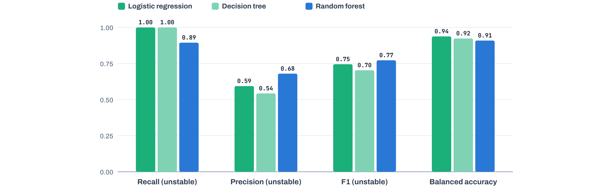

AI & ML for Civil Engineers
Session 05
Part 03 · Results & decision
33 / 50
Compare safety-relevant test metrics
No model wins on every metric
Test metrics of the three tuned models
Logistic regression and the tree catch every unstable slope; the forest raises fewer false alarms but misses 2.
Notes:
The safety-relevant metrics side by side. No model wins everywhere: logistic regression and the tree catch every unstable slope; the forest has better precision and F1 but misses two.
[Clicks on this slide: 1]

Slide 34







AI & ML for Civil Engineers
Session 05
Part 03 · Results & decision
34 / 50
Rows = actual · columns = predicted · test set
Confusion matrices reveal the error types
Logistic regression
Decision tree
Random forest
Pred. stable
Pred. unstable
Pred. stable
Pred. unstable
Pred. stable
Pred. unstable
92
13
89
16
97
8
TN
FP · false alarm
TN
FP · false alarm
TN
FP · false alarm
0
19
0
19
2
17
FN · missed
TP
FN · missed
TP
FN · missed
TP
recall 1.000 · precision 0.594
recall 1.000 · precision 0.543
recall 0.895 · precision 0.680
Focus on the orange cell: actual unstable slopes predicted stable. Random forest: 2. The others: 0.
Notes:
Confusion matrices on the test set. Logistic regression: 13 false alarms, 0 missed. Tree: 16 false alarms, 0 missed. Forest: 8 false alarms, 2 missed unstable slopes.
[Clicks on this slide: 4]

Slide 35

AI & ML for Civil Engineers
Session 05
Part 03 · Results & decision
35 / 50
Thresholds and probabilities · logistic regression · out-of-fold, training data
Moving the threshold trades recall for precision
Predicted probability of “unstable” for every training slope
Each case scored by a model that did not see it (5-fold CV). Dashed lines: thresholds 0.3 · 0.5 · 0.7.
Threshold
0.3
0.5
0.7
0.9
Recall (unstable)
1.00
1.00
0.93
0.30
Precision (unstable)
0.43
0.65
0.97
1.00
Missed · false alarms
0 · 98
0 · 39
5 · 2
52 · 0
Choose the threshold here, on validation data and from the cost of each error. Then evaluate once on the test set.
Notes:
Threshold trade-off on out-of-fold training probabilities, never the test set. At 0.3: recall 1.00, precision 0.43. At 0.5: 1.00 and 0.65. At 0.7: 0.93 and 0.97. At 0.9: 0.30 and 1.00. The notebook's draft note: the default 0.5 is a software convention, not an engineering law.
[Clicks on this slide: 2]

Slide 36
AI & ML for Civil Engineers
Session 05
Part 03 · Results & decision
36 / 50
The answer depends on the error we most want to avoid
Which model do we choose?
Provisional screening candidate
The alternative
Logistic regression
Random forest
1.000
0.594
0.745
0.938
0.895
0.680
0.773
0.909
recall
precision
F1
bal. acc.
recall
precision
F1
bal. acc.
Detected every unstable test slope, and is comparatively interpretable.
Cost: 13 false alarms.
Better precision and F1, but it missed 2 unstable slopes. Reasonable if
false alarms are costly.
Avoid missing unstable slopes → logistic regression, for this split. Not a universal winner: only 19 unstable test cases on a
structured grid.
Our stated priority
Notes:
Which model? It depends on the error we most want to avoid. Our stated priority is not missing unstable slopes, so logistic regression is the provisional screening candidate: it caught all 19, at the cost of 13 false alarms. Random forest is the alternative if false alarms are costly. Not a universal winner: one split, a structured grid.
[Clicks on this slide: 3]

Slide 37




AI & ML for Civil Engineers
Session 05
Part 03 · Results & decision
37 / 50
What these results do, and do not, show
A classifier of a numerical method, not of real slopes
They show
They do not show
How well classifiers reproduce labels from Morgenstern–Price
analyses
Independent validation against field failures
How imbalance, class weights and thresholds change the errors
Performance in unseen parameter regions: a random split of a grid
tests interpolation
A disciplined workflow: baseline, stratified CV, one final test
Real-world slope safety. Decisions still need proper analysis,
standards and judgement
A stronger follow-up test: hold out whole regions of the grid (for example all φ = 45° cases) and predict them.
Notes:
What the results do and do not show. They show how classifiers reproduce numerical-analysis labels. They do not validate field failures or performance in unseen parameter regions. Suggest a region holdout, e.g. all phi = 45 degree cases.
[Clicks on this slide: 2]

Slide 38
AI & ML for Civil Engineers
Session 05
Part 03 · Results & decision
38 / 50
Hands-on · in the notebook
Your turn: six questions to answer
01
02
03
Change the FOS label threshold to 1.5 and
recompute the class balance. What
question does it now answer?
Compare the majority baseline with the
tuned models. Why is accuracy
insufficient?
Which model detects the most unstable
test cases? What is its precision?
df.fos < 1.5
DummyClassifier
classification_report
04
05
06
Explain the false-negative cell of each
confusion matrix in engineering terms.
Turn class weighting off. What happens to
recall and to false alarms?
Design a grid-region holdout. Why is it
harder than a random split?
ConfusionMatrixDisplay
class_weight=None
X[df.phi_deg == 45]
Notes:
Six exercises from the notebook. Allow about 10 minutes; take answers to 4 and 5 aloud.
[Clicks on this slide: 3]

Slide 39
AI & ML for Civil Engineers
Session 05
Course overview
39 / 50
Key takeaways · carry this into every classification problem
A decision framework for classification
1
2
3
Define the engineering meaning of each
class
Inspect class balance before choosing
metrics
Start from a baseline; stratify; tune only
in training CV
4
5
6
Choose metrics from the consequences
of each error
Select the model from the stated priority,
not accuracy
Report limits and where the result can
generalise
The central lesson
High test accuracy is not proof of generalisation, or of engineering safety.
Notes:
The decision framework to carry into every classification problem. High test accuracy is not proof of generalisation or engineering safety.
[Clicks on this slide: 3]

Slide 40
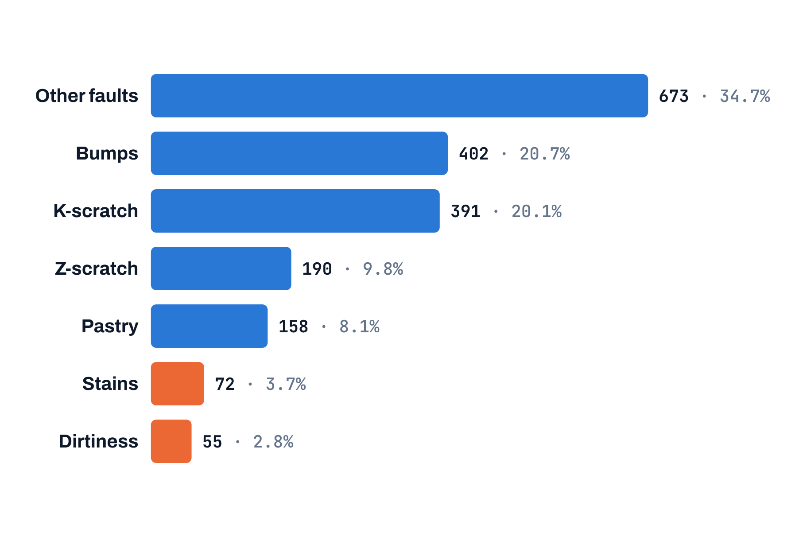
AI & ML for Civil Engineers
Session 05
Course overview
40 / 50
Extension · Appendix B notebook · UCI Steel Plates Faults
From binary to multiclass classification
1,941 steel plates, 7 mutually exclusive fault types
Binary
Multiclass
Orange: rare classes below 5%. The data we explored in Session 02.
stable vs unstable · 2 × 2 matrix
7 fault types · 7 × 7 matrix
New concepts
Per-class precision, recall and F1
Macro average: every class counts equally
Weighted average: common classes count more
Off-diagonal cells: which faults are confused
Same three model families, same stratified CV and test-set
discipline. The evaluation becomes class-specific.
UCI Machine Learning Repository: Steel Plates Faults (Buscema, Terzi & Tastle, 2010), CC BY 4.0. doi:10.24432/C5J88N.
Notes:
Extension: multiclass with the Steel Plates Faults data from Session 02, seven fault types, the rarest under 3%. Per-class metrics, macro and weighted averages. This is the Appendix B notebook and the homework.
[Clicks on this slide: 3]

Slide 41
AI & ML for Civil Engineers
Session 05
Course overview
41 / 50
Homework · steel plate fault classification
Apply today’s workflow to seven classes
01
Explore the data and plot the seven-class distribution
02
Make a stratified train/test split; keep the test set untouched
Deliverables
03
Fit a majority baseline, logistic regression, a decision tree and a random forest
A runnable notebook
04
Tune at least one model with stratified CV on the training data
A confusion-matrix plot
05
Report the confusion matrix, balanced accuracy, per-class P/R/F1, macro-F1 and weighted-F1
A comparison table
06
Explain which faults are confused, and choose a model with explicit criteria
A short engineering interpretation
Start from the Appendix B notebook. A high test score
alone does not make a model ready for production
inspection.
Notes:
Homework on the steel plates. Deliverables: notebook, confusion-matrix plot, comparison table, short interpretation.
[Clicks on this slide: 3]

Slide 42

AI & ML for Civil Engineers
Session 05
Course overview
42 / 50
Optional · for after the session
Two appendix notebooks
Appendix A
Appendix B
How trees and forests learn
Multiclass classification
Entropy, Gini impurity and information gain
Steel Plates Faults: 1,941 plates, 7 classes
A decision tree’s boundary, step by step
A 7 × 7 confusion matrix
Bootstrap samples, feature randomness, voting
Per-class, macro and weighted metrics
Out-of-bag estimates and feature importance
The starting point for the homework
Appendix_A_Trees_Entropy_Information_Gain_Random_Forest.ipynb
Appendix_Multiclass_Classification_Steel_Plates_Faults.ipynb
Reference slides for Appendix A follow after the closing slides.
Notes:
Two optional notebooks: Appendix A on how trees and forests learn; Appendix B on multiclass classification. The reference slides for Appendix A follow the closing slides.
[Clicks on this slide: 1]

Slide 43
AI & ML for Civil Engineers
Session 05
43 / 50
?
Questions
Unmute, or drop your question in the chat.
Logistic regression
Confusion matrix
Imbalance & thresholds
Slope stability
Dr. Abdul Waris
Research Associate · Universität Siegen, Germany
Notes:
Questions.

Slide 44



End of session 05
Thank you.
See you in session 06: Artificial Neural Networks.
Dr. Abdul Waris
Research Associate · Universität Siegen, Germany
Course page
qudeltastudios.com/courses
Technology partner
Notes:
Thank you. Session 06: artificial neural networks.

Slide 45
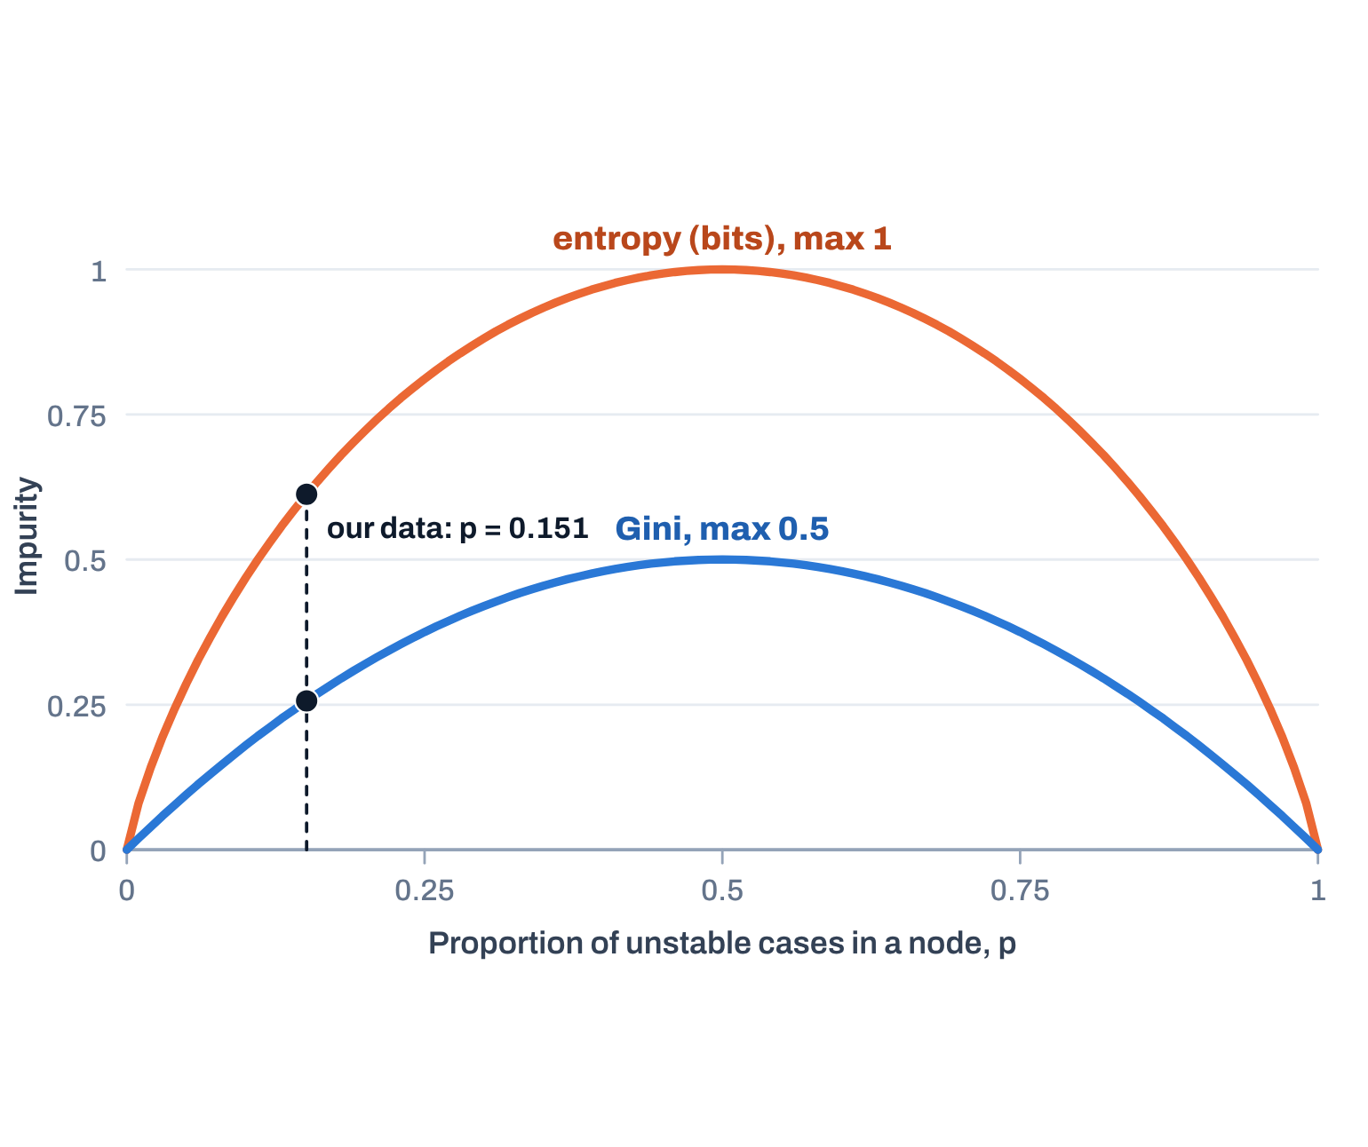
AI & ML for Civil Engineers
Session 05
Appendix A · Trees & forests
45 / 50
Appendix A1 · how mixed is a node?
Entropy and Gini measure class impurity
Both are 0 for a pure node, largest at 50 : 50
Entropy (bits)
H = −Σ_{k} p_{k} log₂ p_{k}
Gini impurity
G = 1 − Σ_{k} p_{k}² = 2p(1 − p)
Pure
Our data
50 : 50
H 0.000
G 0.000
H 0.612
G 0.256
H 1.000
G 0.500
Different scales: compare impurity reductions with the same criterion, not raw values.
Entropy describes a node’s label mix, not physical uncertainty.
Notes:
Appendix A1. Entropy and Gini both measure node impurity: zero for a pure node, largest at 50:50. For our data (15.1% unstable) entropy is about 0.61 bits and Gini about 0.26. Compare reductions, not raw values.
[Clicks on this slide: 2]

Slide 46
AI & ML for Civil Engineers
Session 05
Appendix A · Trees & forests
46 / 50
Appendix A2 · does a split reduce impurity?
Information gain compares candidate splits
Parent impurity minus size-weighted child impurity
IG = H(parent) − Σ_{j}
n_{j}
H(child_{j})
n
Parent node: 100 cases · 15 unstable / 85 stable · H = 0.610
Split A
Split B · preferred
50 cases
50 cases
50 cases
50 cases
10 / 40 · H 0.722
5 / 45 · H 0.469
12 / 38 · H 0.795
3 / 47 · H 0.327
IG = 0.0144 bits · ΔGini 0.0050
IG = 0.0486 bits · ΔGini 0.0162
Information gain scores one split at one node. Feature importance aggregates contributions across a whole model.
Illustrative counts from the Appendix A notebook, not measured from the 616-case dataset.
Notes:
Appendix A2. Information gain: parent impurity minus the size-weighted child impurity. Split B gains 0.0486 bits, split A 0.0144, so B is preferred. Counts are illustrative, from the Appendix A notebook.
[Clicks on this slide: 3]

Slide 47
AI & ML for Civil Engineers
Session 05
Appendix A · Trees & forests
47 / 50
Appendix A3 · match the explanation to the code
Entropy or Gini?
Criterion
Binary formula
Intuition
scikit-learn
Entropy
−p log₂p − (1−p) log₂(1−p)
Information-theoretic impurity
criterion="entropy"
Gini
2p(1 − p)
Chance of mislabelling a random case using the node’s proportions
criterion="gini" · default
Teaching rule
Today’s notebook uses the default Gini criterion. If you teach entropy, say so explicitly, or set criterion="entropy" and compare.
Notes:
Appendix A3. scikit-learn's DecisionTreeClassifier uses Gini by default, as in today's notebook. If you teach entropy, say so or set criterion='entropy'.
[Clicks on this slide: 1]

Slide 48
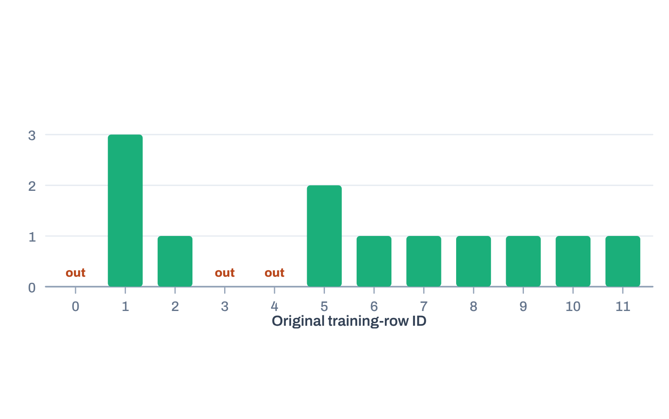

AI & ML for Civil Engineers
Session 05
Appendix A · Trees & forests
48 / 50
Appendix A4 · bagging plus random feature subsets
Random forest: many decorrelated trees
One bootstrap sample of 12 rows
drawn: [1, 9, 7, 5, 5, 10, 1, 8, 2, 1, 6, 11]
Bootstrap 1
Tree · random
features
Bootstrap 2
Tree · random
features
Aggregate
vote · average
probability
Training data
N rows
Bootstrap …
…
Bootstrap B
Tree · random
features
Different samples and feature randomness make trees less alike; averaging them reduces variance compared with one deep
tree.
Bootstrap draw reproduced from the Appendix A notebook (random seed 42). Rows marked “out” are out-of-bag for this tree.
Notes:
Appendix A4. Random forest: bootstrap samples plus random feature subsets give different trees; their votes are aggregated. The example draw shows rows 1 and 5 used several times and rows 0, 3, 4 left out (out-of-bag).
[Clicks on this slide: 2]

Slide 49
AI & ML for Civil Engineers
Session 05
Appendix A · Trees & forests
49 / 50
Appendix A5 · what each setting changes
Random forest mechanics
n_estimators
max_features
max_depth · min_samples_leaf
Number of trees. More trees stabilise predictions,
at more compute.
Features considered at each split. Controls how
different the trees are.
Limit tree complexity; can reduce overfitting.
class_weight
oob_score
Random forest is not automatically superior.
Compare on the same held-out data, with
metrics aligned to the application.
Gives the rare class more weight. Check recall
and precision, not accuracy.
Rows left out of a tree’s bootstrap give an internal
estimate. It does not replace a held-out test set.
Notes:
Appendix A5. The main settings and what they change. Random forest is not automatically better.

Slide 50
AI & ML for Civil Engineers
Session 05
Appendix A · Trees & forests
50 / 50
Appendix A6 · further reading and practical cautions
Where to go next
scikit-learn documentation
Slope-stability dataset caveat
Decision trees and impurity criteria
616 cases on a structured grid; labels from Morgenstern–Price FOS
scikit-learn.org/stable/modules/tree.html
A random split tests interpolation among grid points, not field-failure
prediction
Random forests
scikit-learn.org/stable/modules/ensemble.html#forest
Hold out a parameter region for a stronger test of generalisation
Classification metrics
scikit-learn.org/stable/modules/model_evaluation.html
Notes:
Appendix A6. Documentation links and the dataset caveat.

