Slide 1

Notes:
Welcome to Session 05. Today the answer is not a number but a category: is this slope stable or unstable? The first part builds the vocabulary of classification; then we apply it to 616 Morgenstern-Price slope cases; then we decide which model to use, from the cost of its errors.

Slide 2
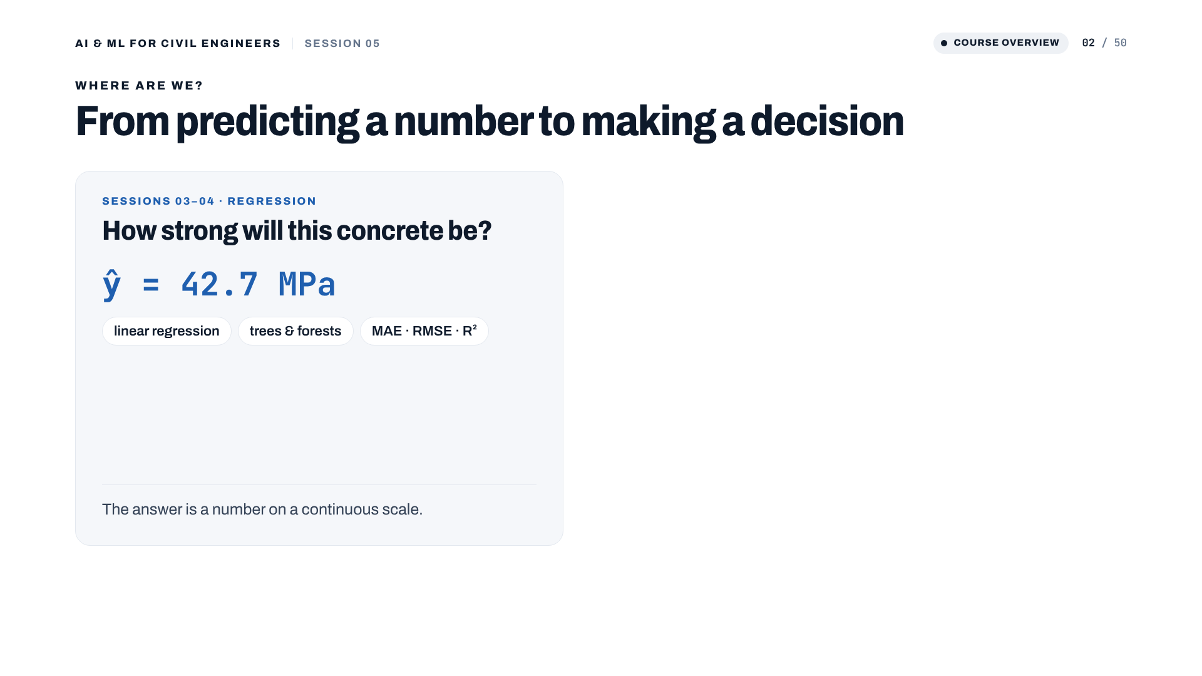
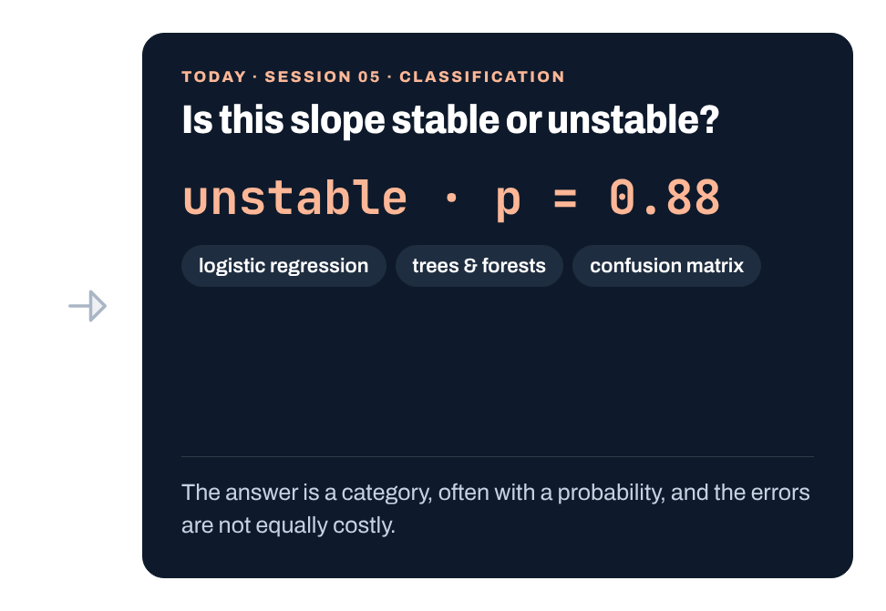
Notes:
Bridge from Sessions 03 and 04: we predicted strength, a number, and judged it with MAE, RMSE and R². Today the target is a class, often with a probability attached. The workflow stays; the model output and the metrics change.
[Clicks on this slide: 2]

Slide 3
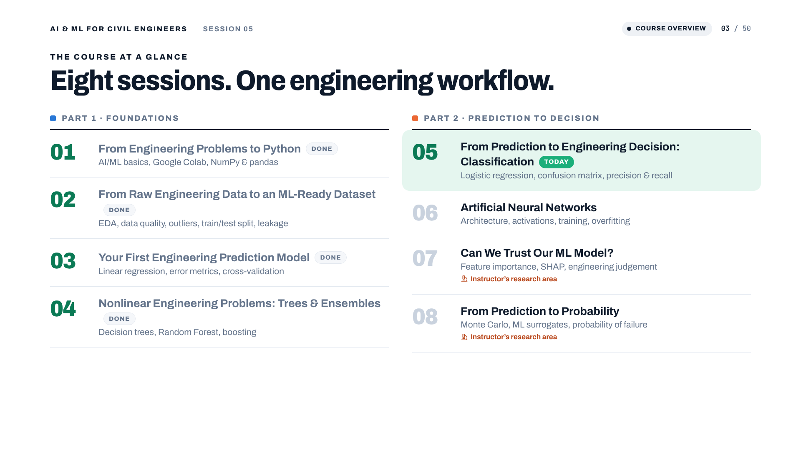
Notes:
Session 05 of 8: the start of Part 2, from prediction to decision.

Slide 4
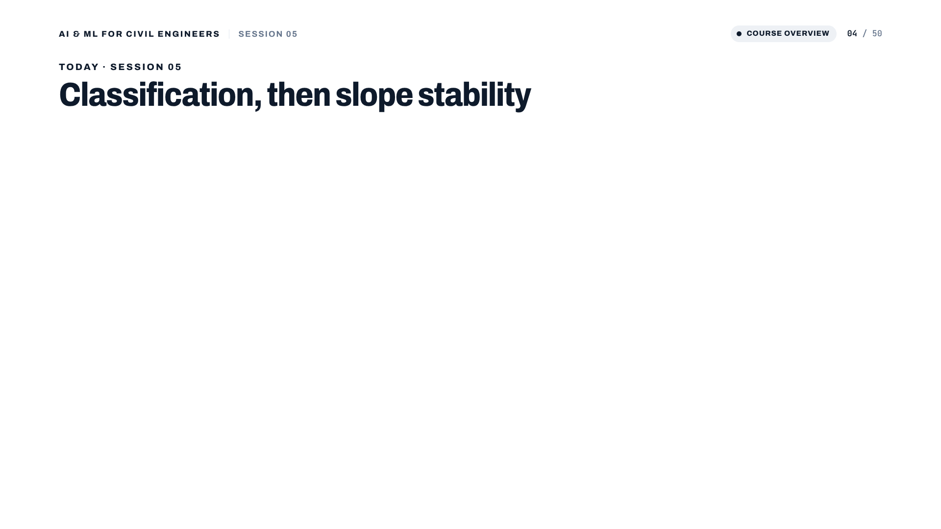
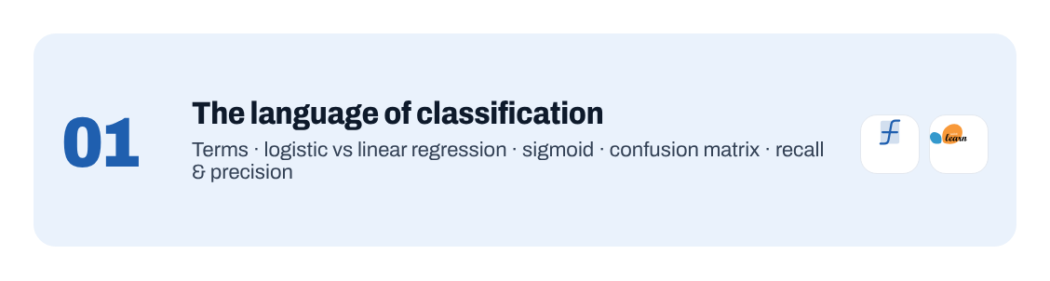
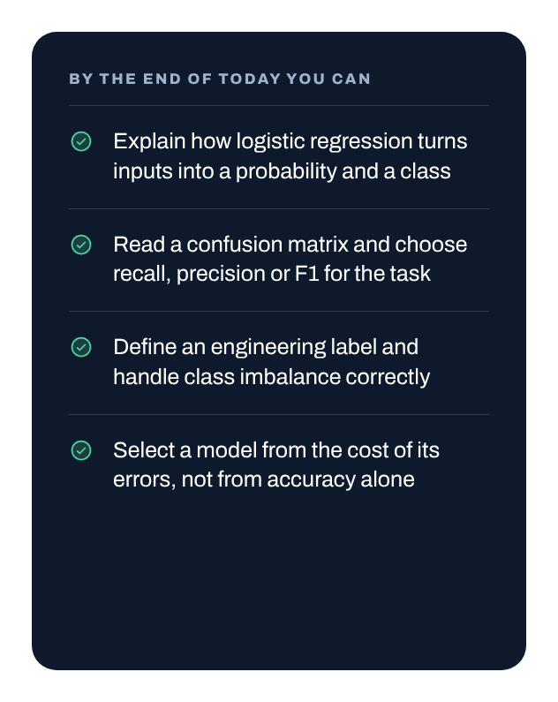
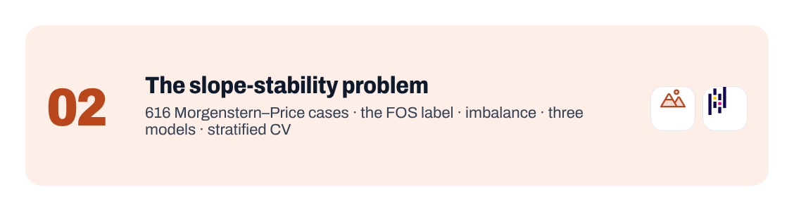
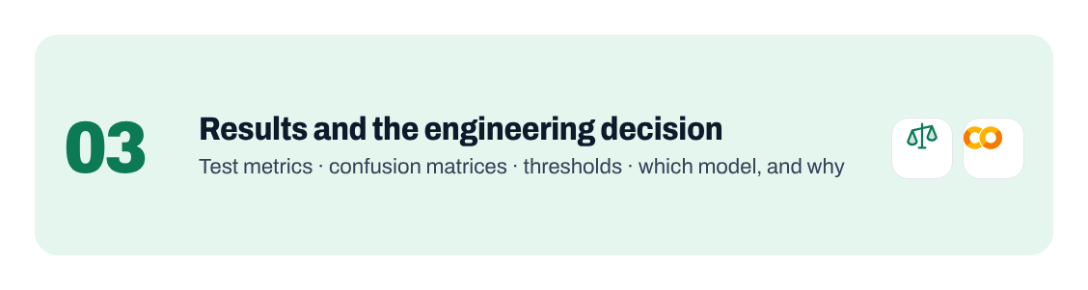
Notes:
Three parts. Part 01 is all concepts: terms, logistic vs linear regression, the sigmoid, the confusion matrix and its metrics. Part 02 applies them to the slope dataset. Part 03 reads the results and makes the engineering decision.
[Clicks on this slide: 4]

Slide 5

Notes:
Part 01: the language of classification.

Slide 6
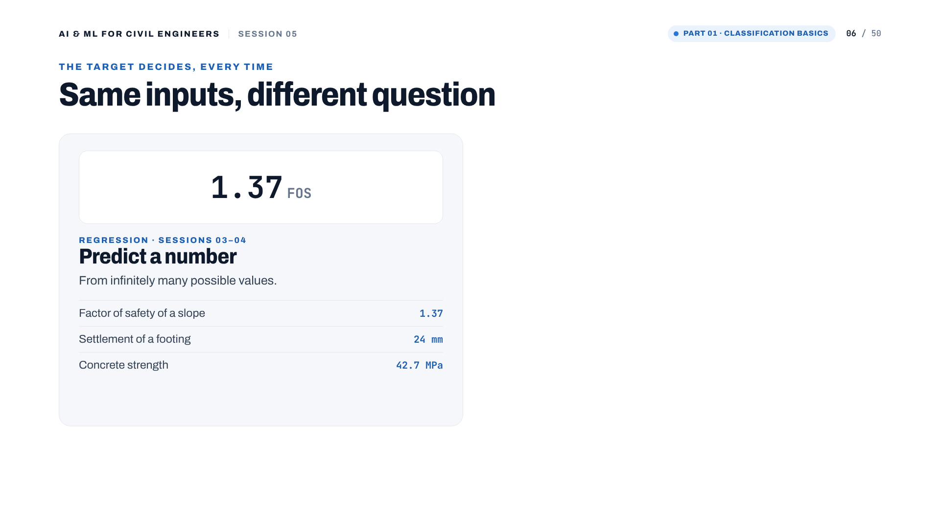
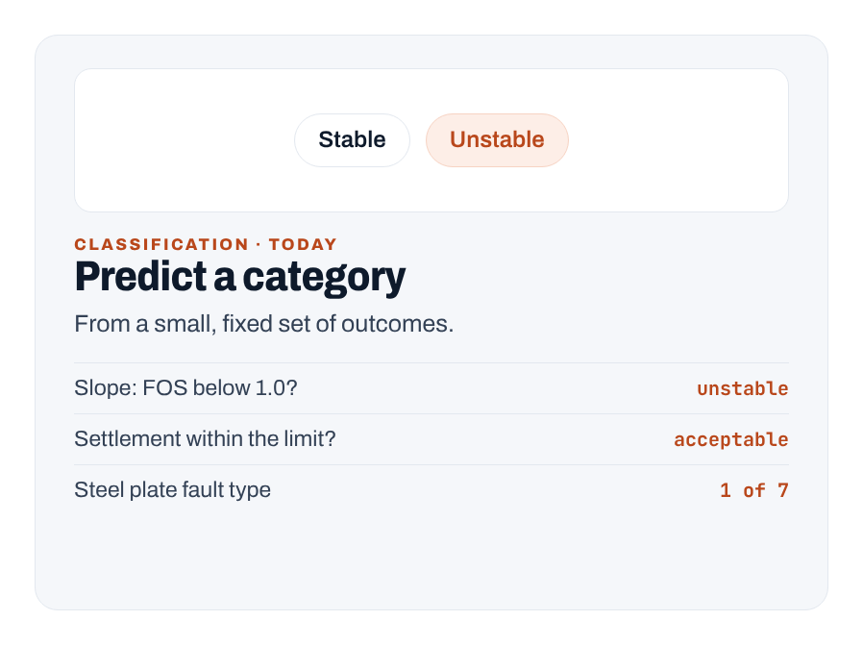
Notes:
Same inputs, different question. A factor of safety of 1.37 is a regression target; 'is FOS below 1.0?' is a classification target. A continuous result becomes a class through an engineering threshold.
[Clicks on this slide: 2]

Slide 7

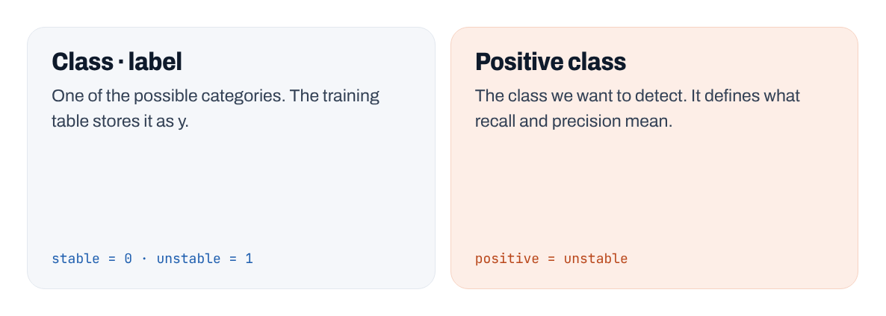
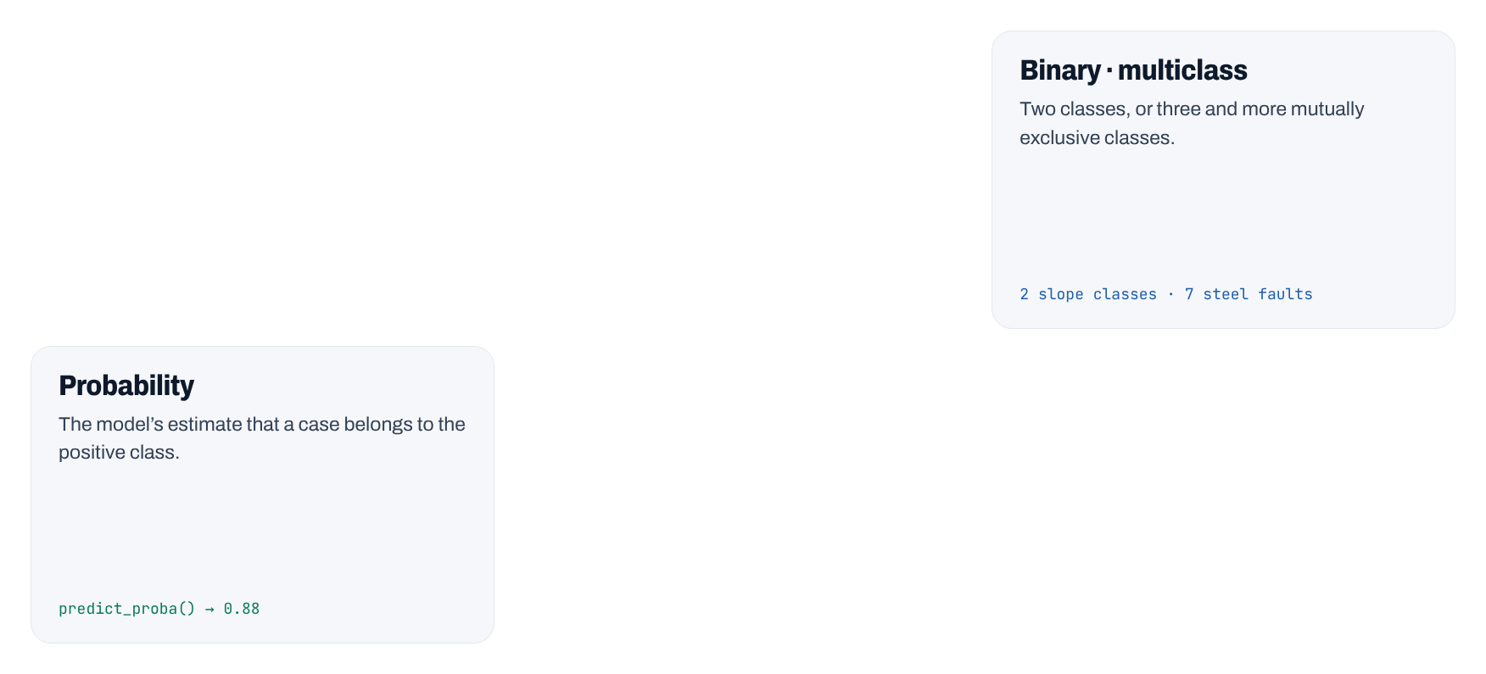
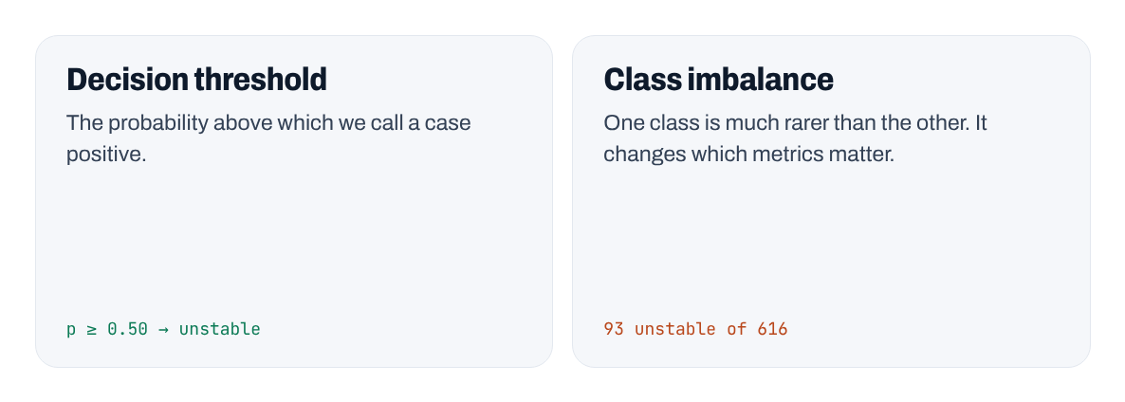
Notes:
Six terms we use all session. Stress the positive class: we choose unstable as positive because that is the case we must not miss, and it defines what recall and precision mean.
[Clicks on this slide: 3]

Slide 8
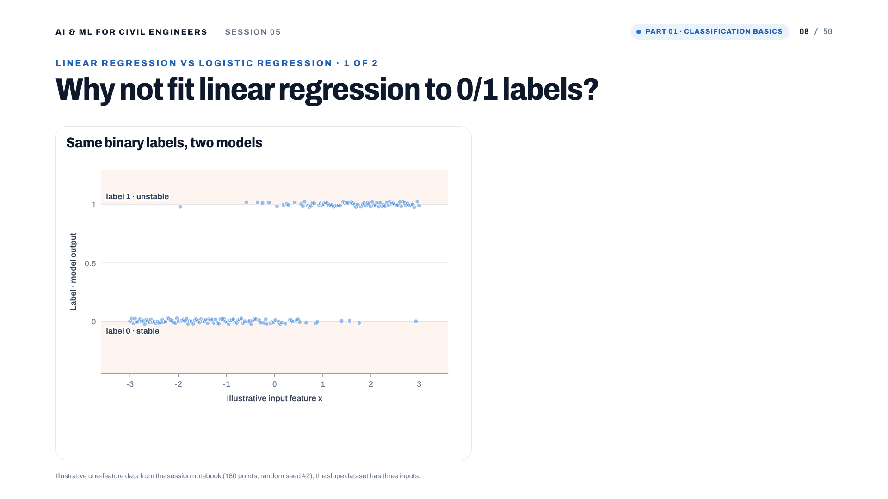
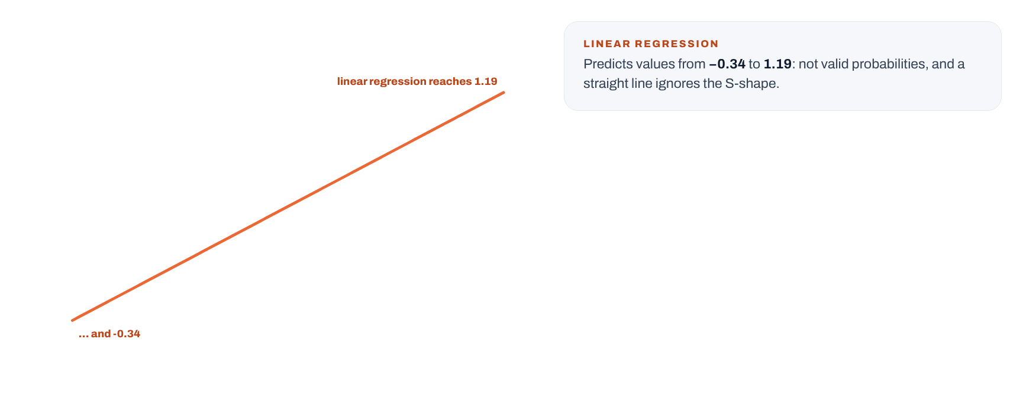
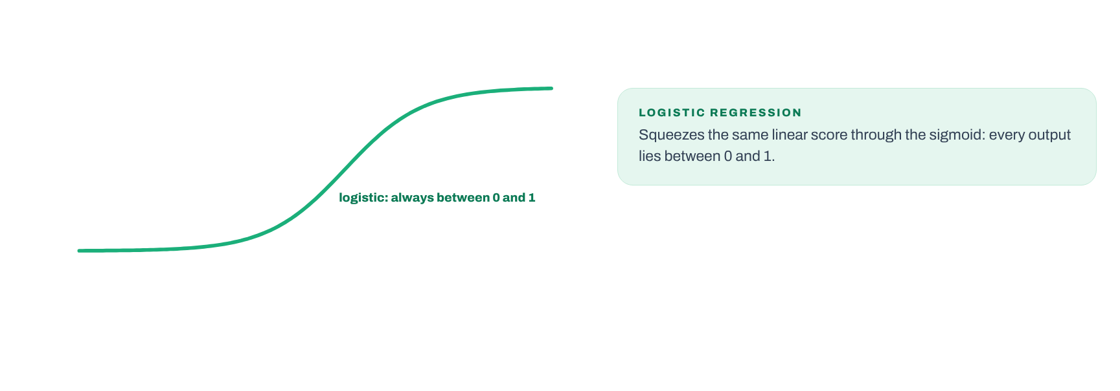

Notes:
Notebook Part A, cell 6. Same 0/1 labels, two models. Click 1: linear regression runs from -0.34 to 1.19, not valid probabilities. Click 2: logistic regression stays between 0 and 1 and follows the S-shape. What we want is the probability of unstable given the inputs.
[Clicks on this slide: 3]

Slide 9
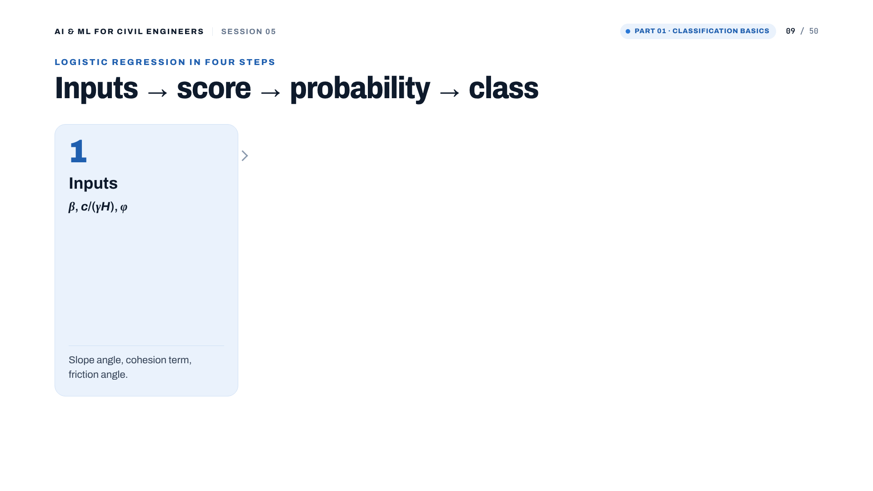
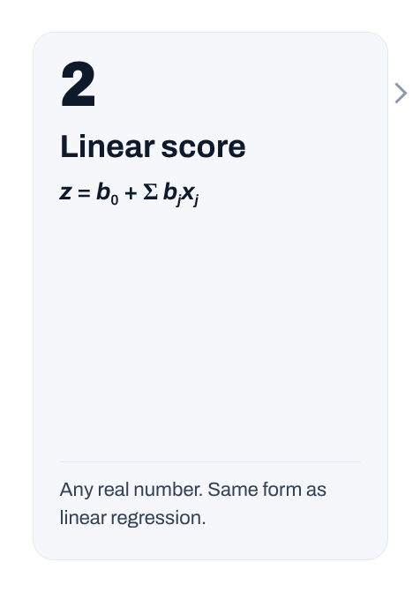
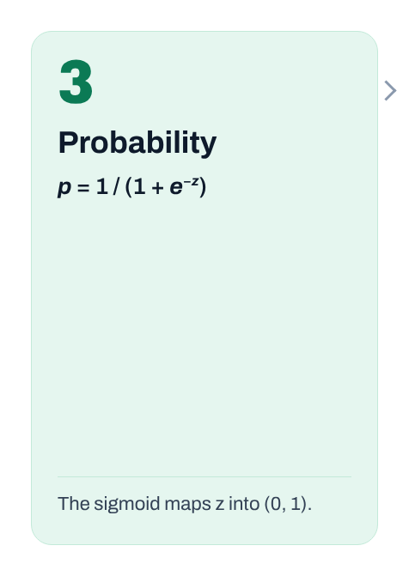
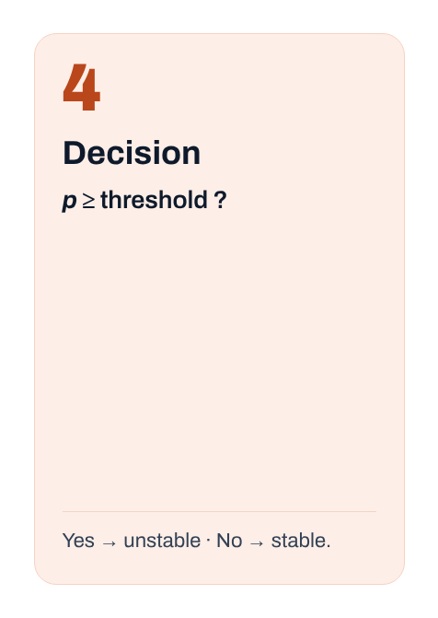
Notes:
Logistic regression in four steps: inputs, a linear score, a probability, a decision. The word regression stays in the name because the model is linear on the log-odds scale; the class comes from the threshold.
[Clicks on this slide: 4]

Slide 10
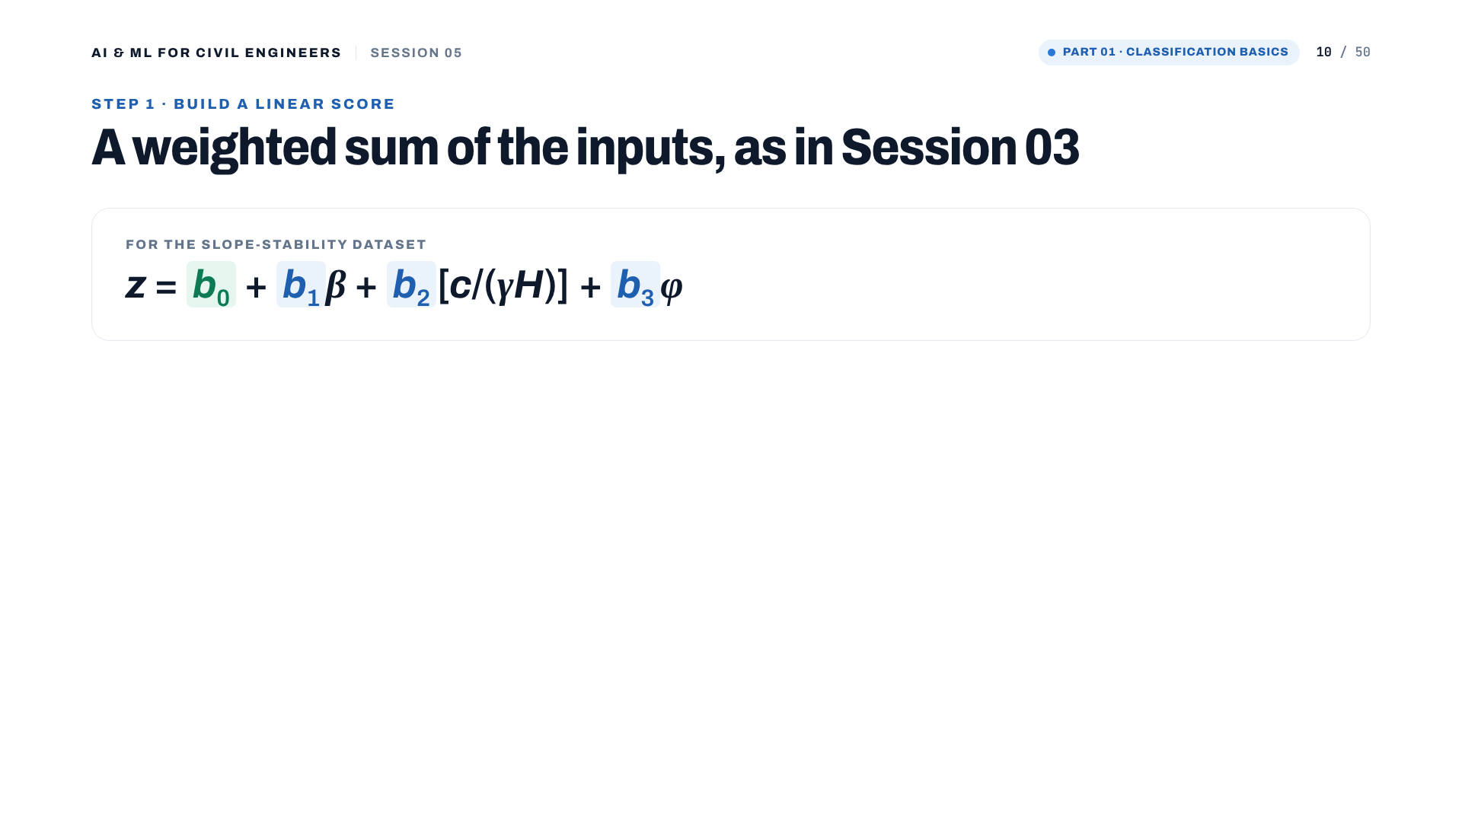
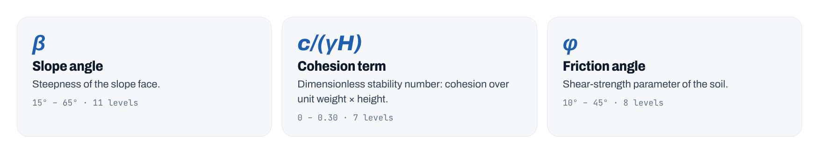
Notes:
Step 1: the same weighted sum as Session 03, written for our three slope inputs. z is unrestricted. Coefficients are learned from training cases and depend on units and scaling.
[Clicks on this slide: 2]

Slide 11
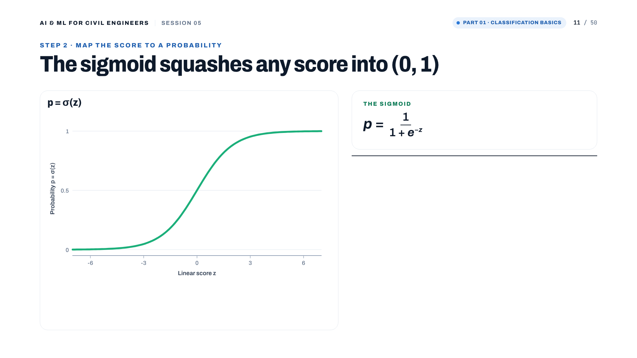
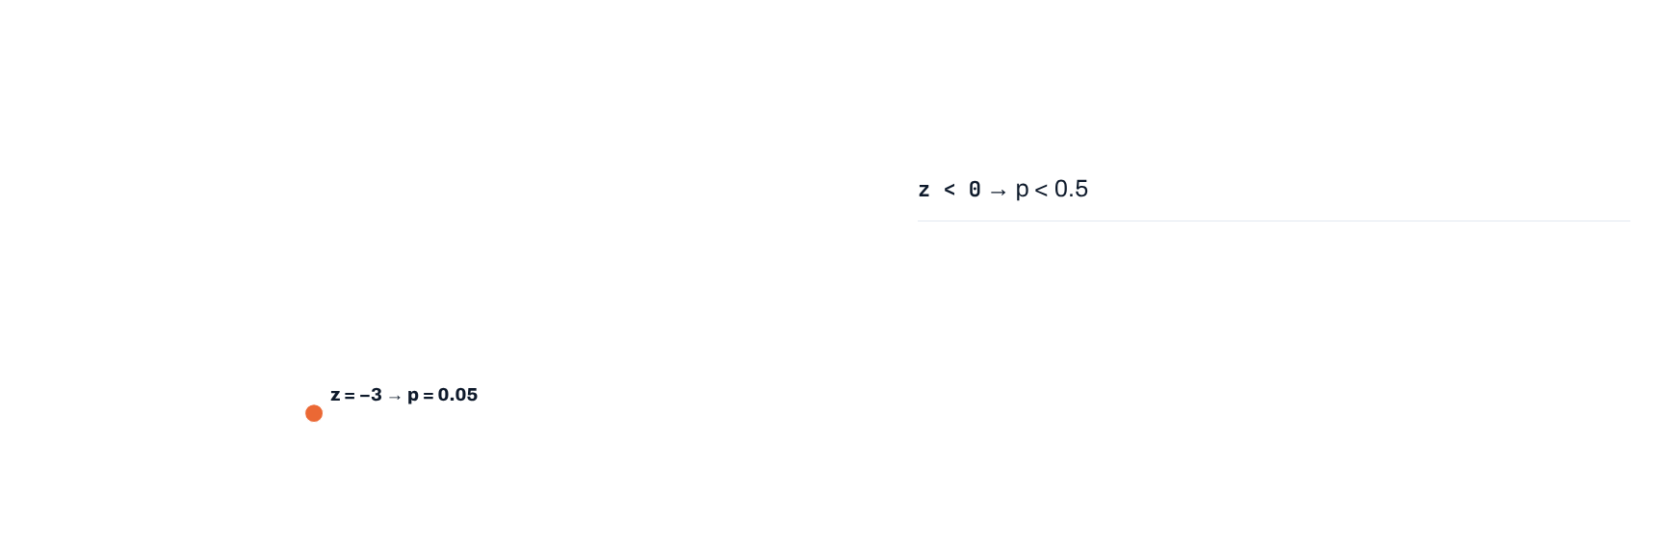
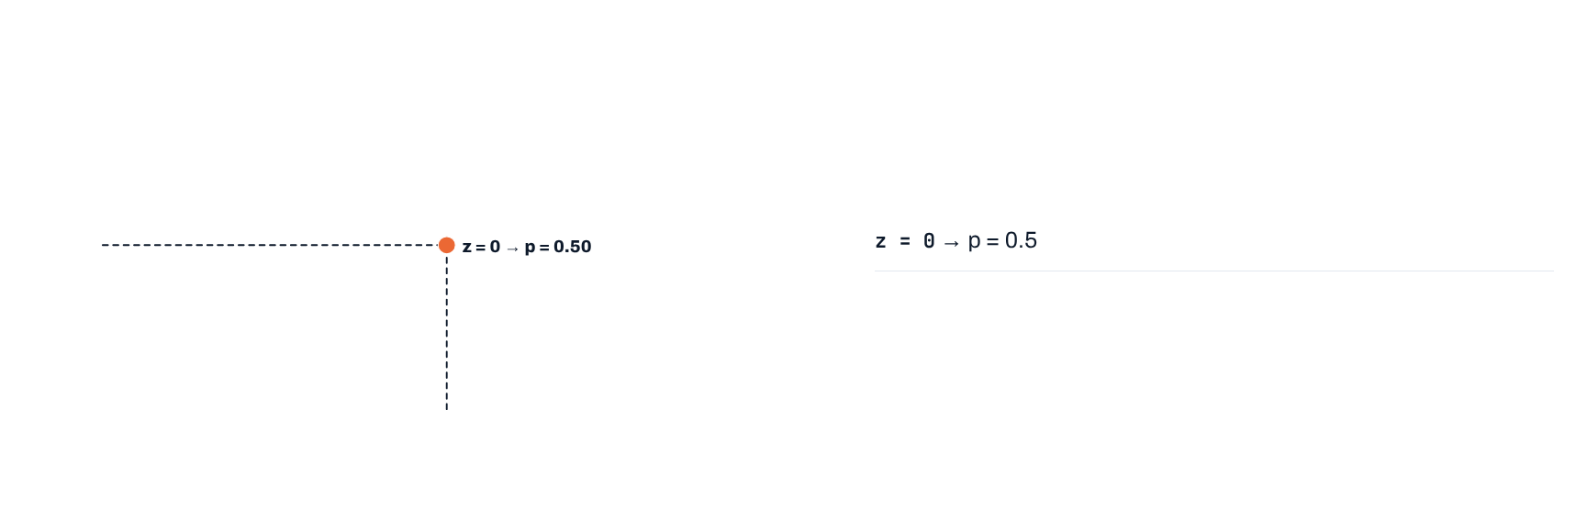
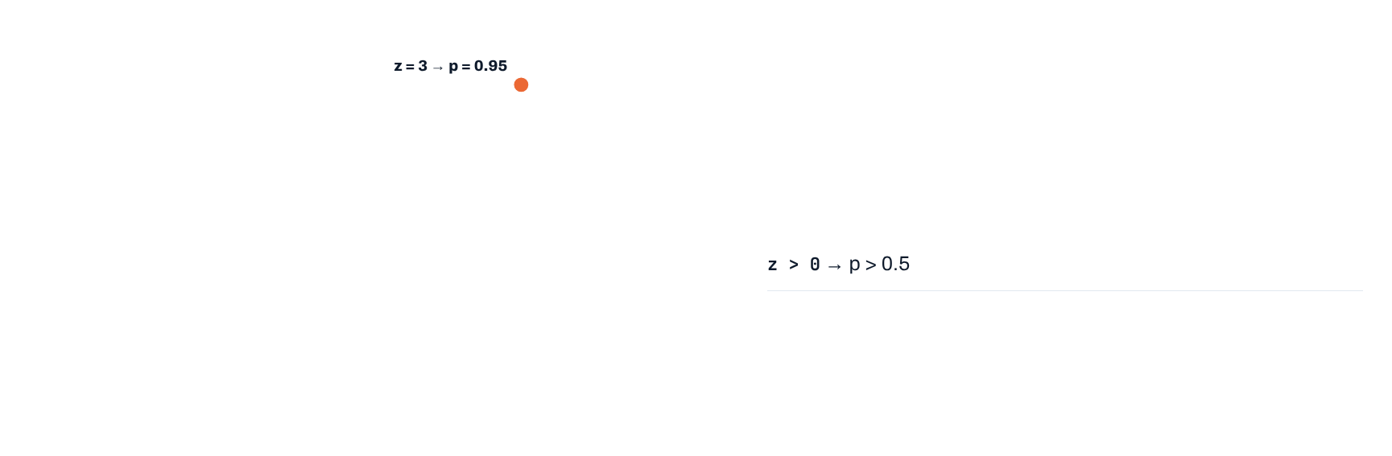
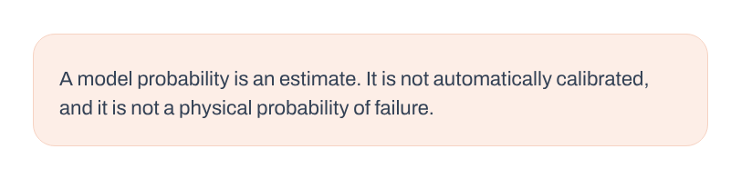
Notes:
Step 2: the sigmoid. Clicks: z = -3 gives p = 0.05, z = 0 gives 0.50, z = 3 gives 0.95. These are model estimates, not automatically calibrated, and not a physical probability of failure.
[Clicks on this slide: 4]

Slide 12
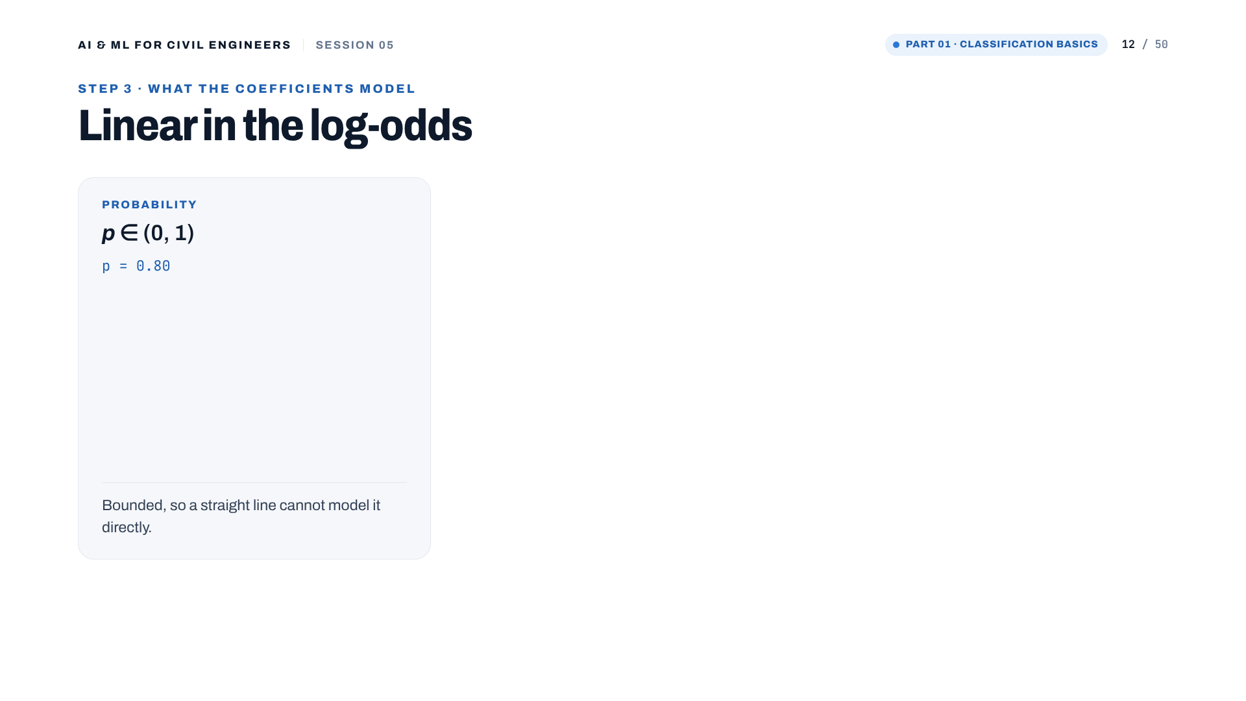
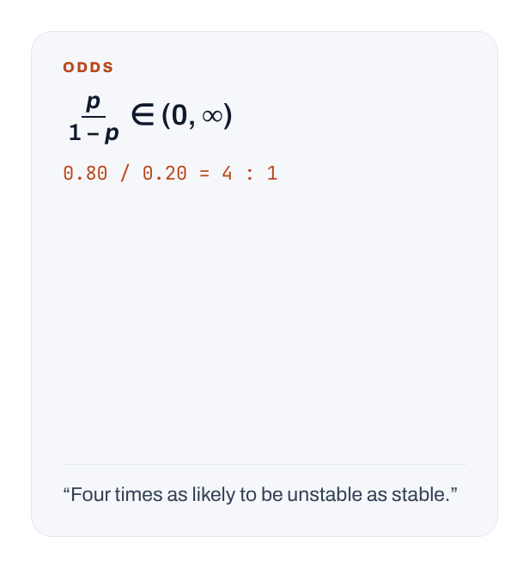
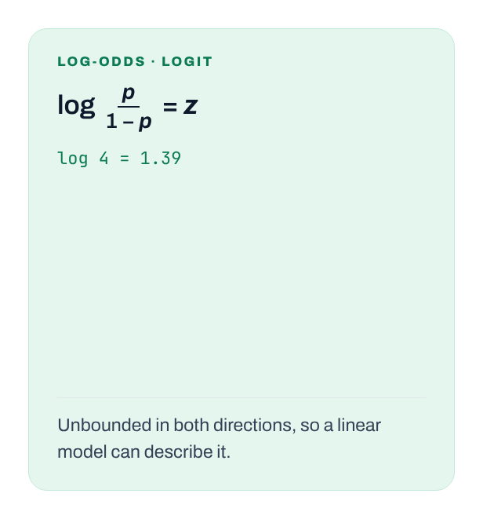
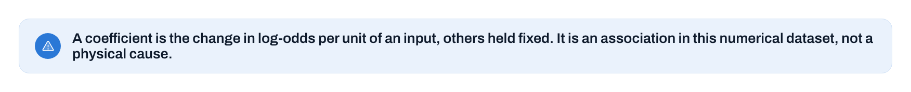
Notes:
Step 3: odds and log-odds. p = 0.8 means odds of 4 to 1; the log of the odds is unbounded, which is why a linear model can describe it. A coefficient is the change in log-odds per unit of an input, holding the others fixed.
[Clicks on this slide: 3]

Slide 13
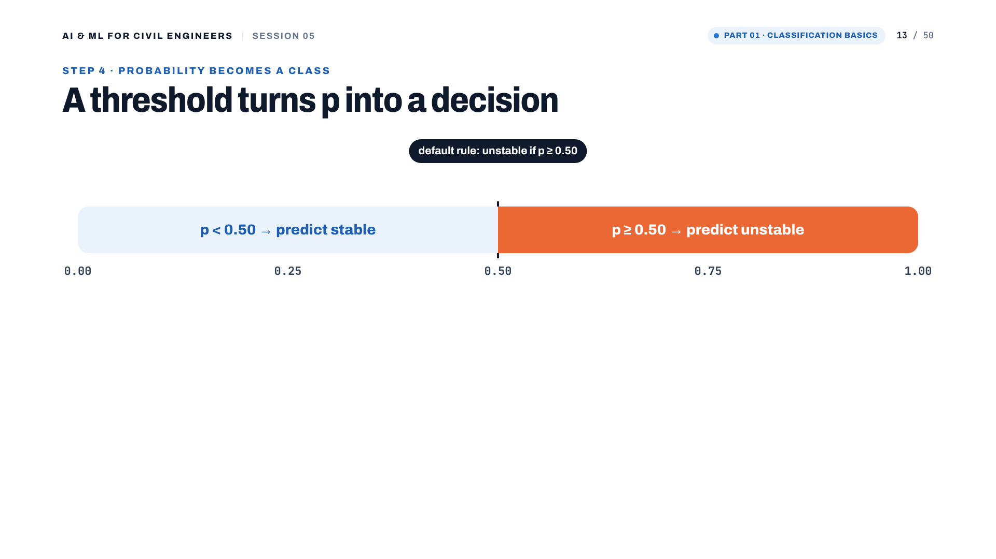
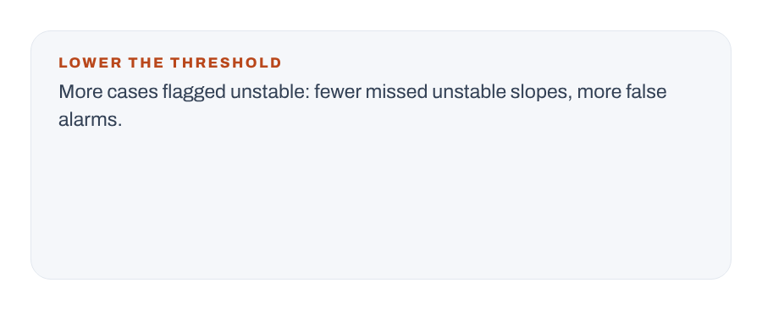
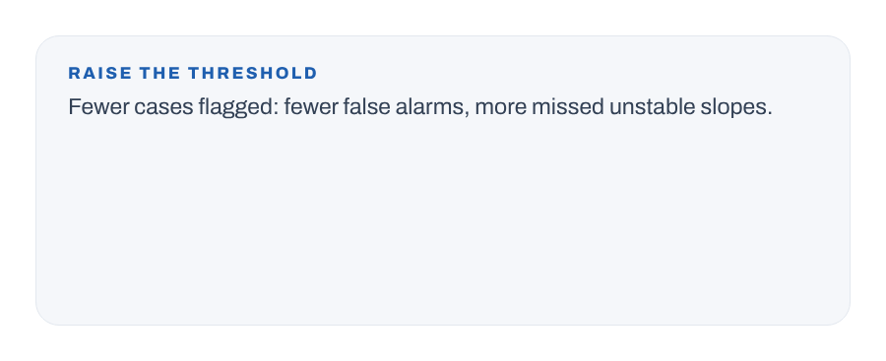
Notes:
Step 4: a threshold turns the probability into a class. 0.50 is a software default. Lowering it flags more slopes (fewer misses, more false alarms); raising it does the opposite. Choose it on validation data.
[Clicks on this slide: 3]

Slide 14
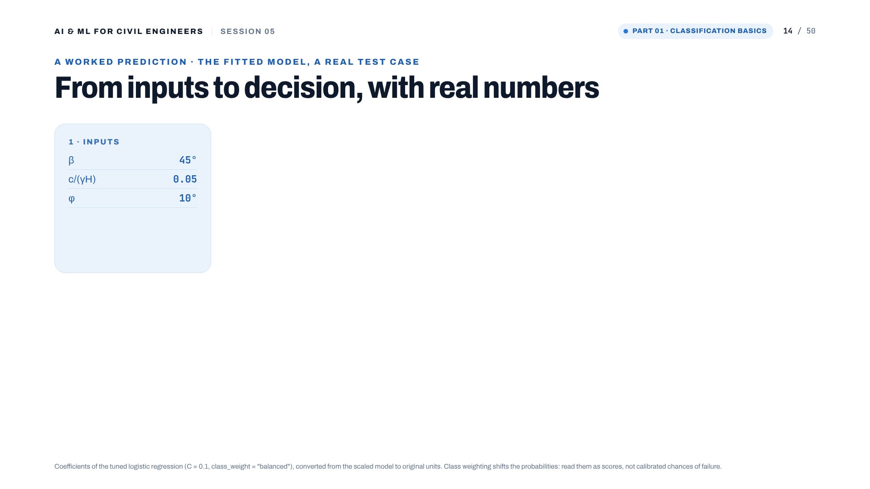
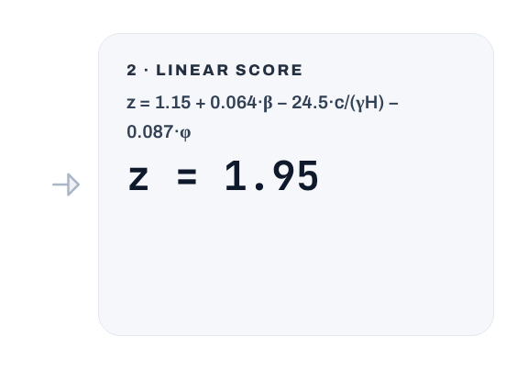
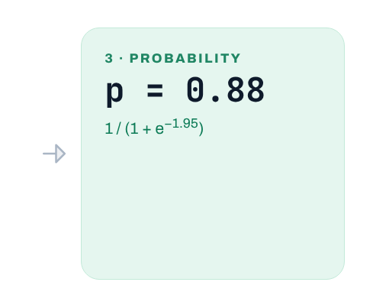
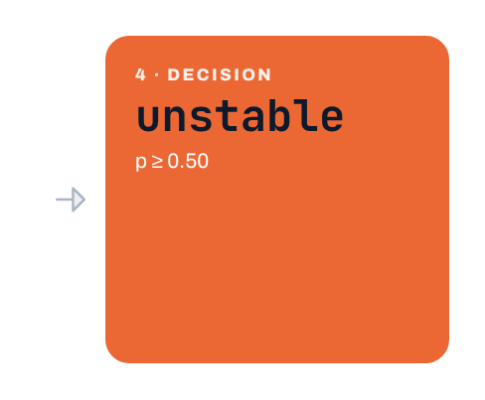
Notes:
A real worked prediction with the tuned model. beta = 45 degrees, c/(gamma H) = 0.05, phi = 10 degrees gives z = 1.95 and p = 0.88: predicted unstable. Morgenstern-Price gives FOS = 0.66, so the prediction is correct. Signs: steeper slopes raise z; more cohesion and friction lower it. Class weighting shifts these probabilities, so read them as scores.
[Clicks on this slide: 4]

Slide 15
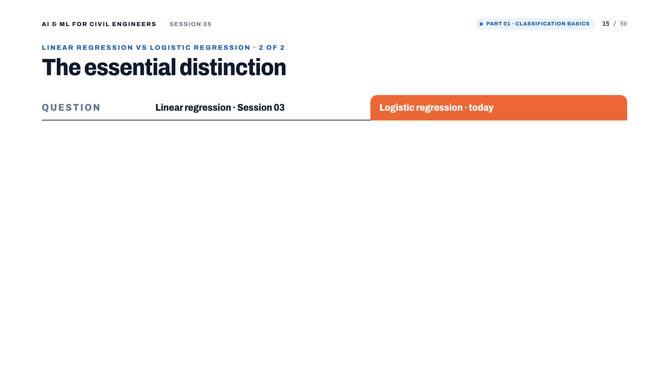
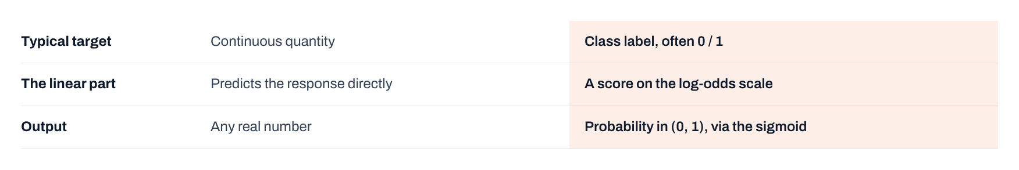
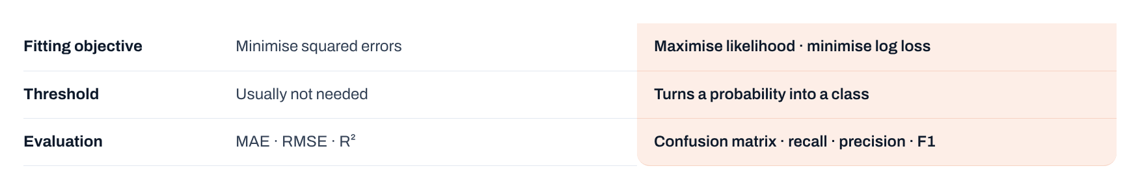
Notes:
The essential distinction, from the notebook's table. With a fixed threshold, logistic regression draws a straight boundary in the input space unless features are transformed.
[Clicks on this slide: 3]

Slide 16
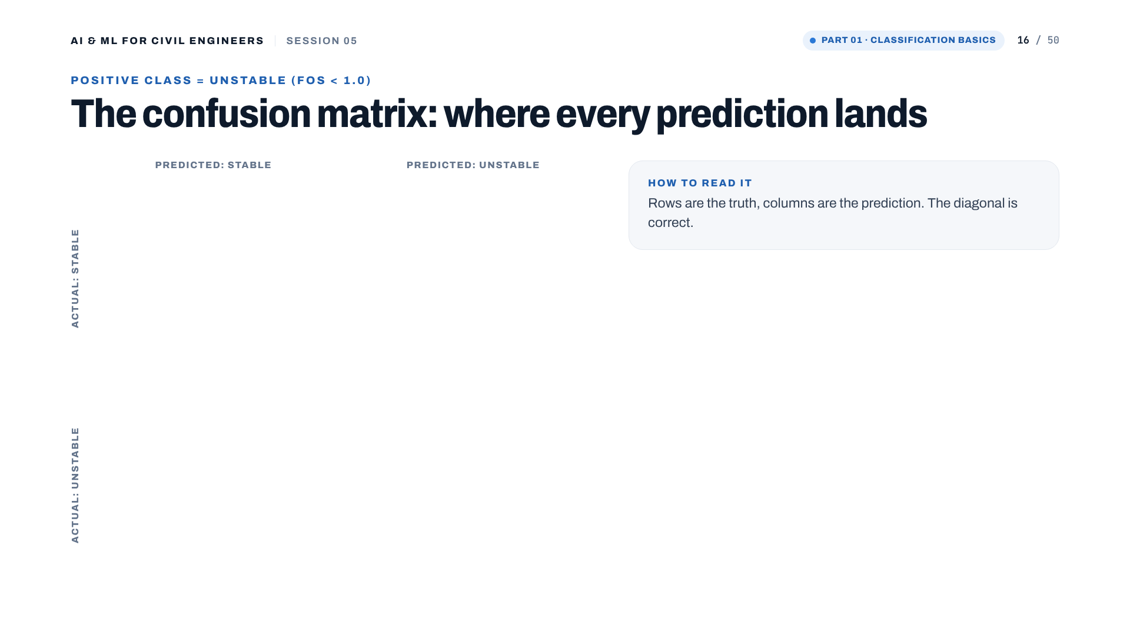
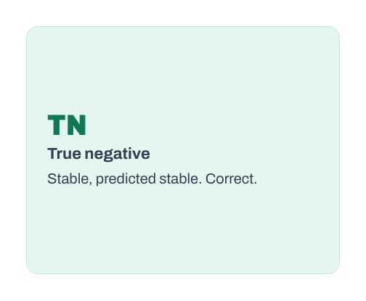
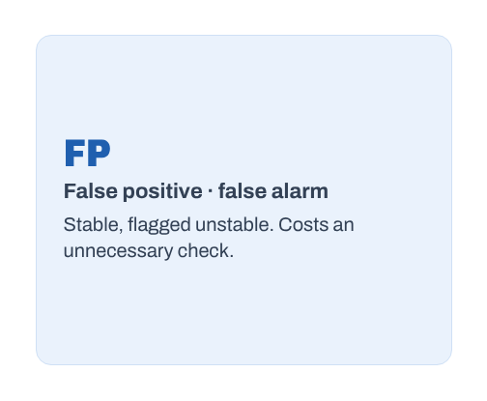
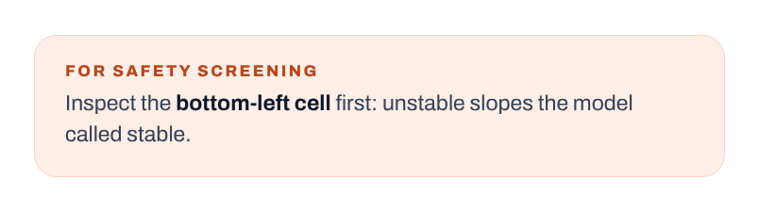
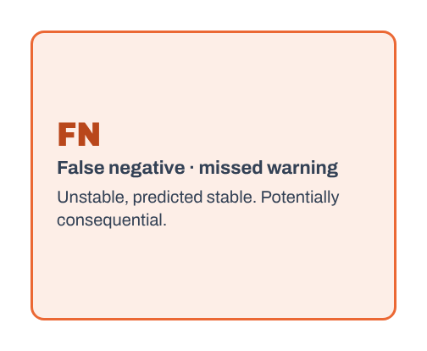
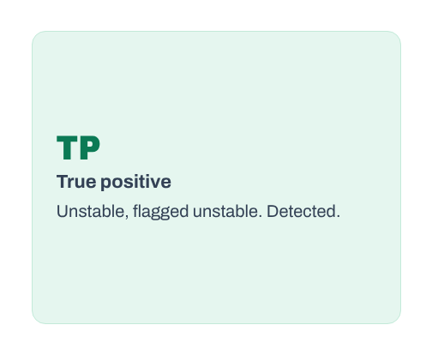
Notes:
The confusion matrix with unstable as the positive class. Click through TN, FP, FN, TP. A false positive costs an unnecessary check; a false negative is an unstable slope called stable. For safety screening, read FN first.
[Clicks on this slide: 5]

Slide 17
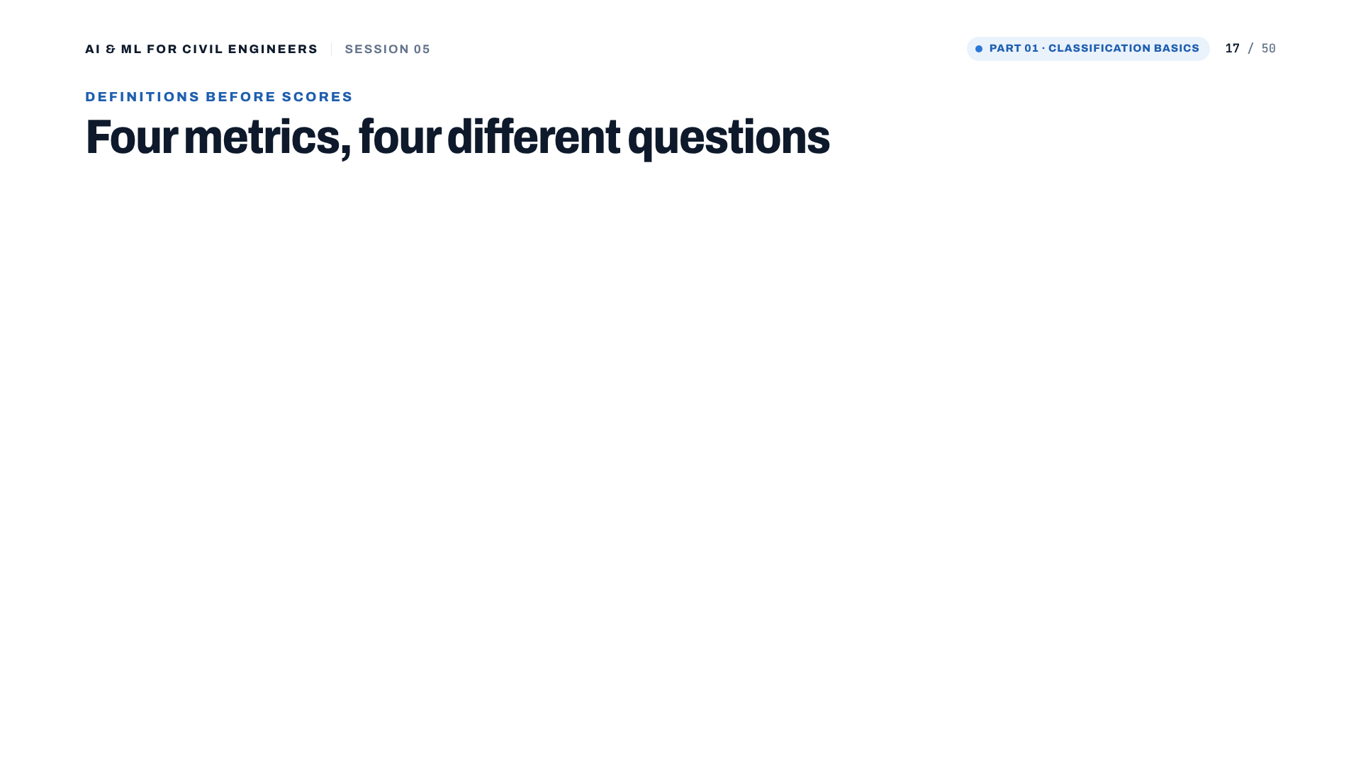
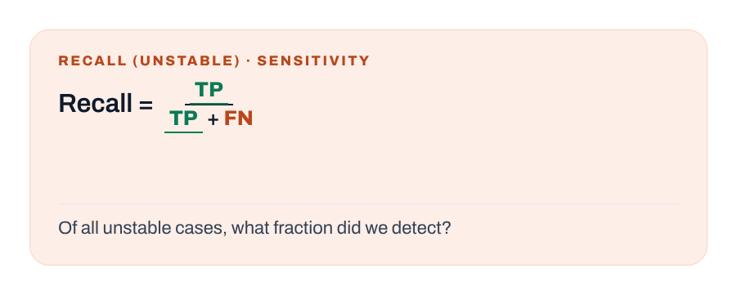
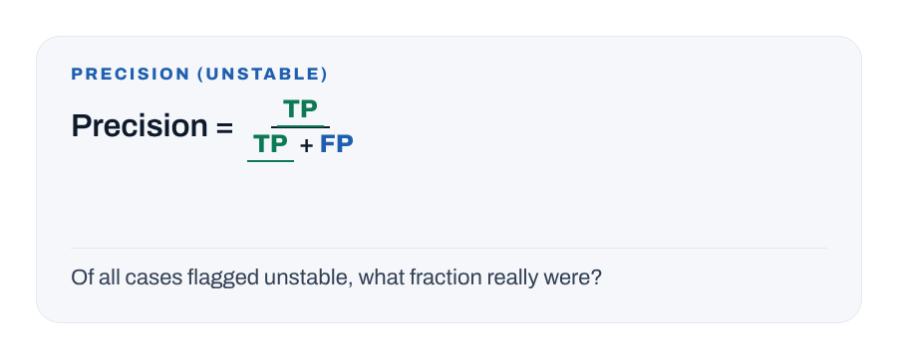


Notes:
Definitions before scores. Recall: of all unstable slopes, how many did we catch. Precision: of all slopes we flagged, how many were really unstable. F1 balances them. Balanced accuracy weights both classes equally.
[Clicks on this slide: 5]

Slide 18



Notes:
Why accuracy misleads: always predicting stable scores 84.7% accuracy on the 124 test slopes and detects none of the 19 unstable ones. Balanced accuracy is 0.50.
[Clicks on this slide: 3]

Slide 19

Notes:
Part 02: from factor of safety to a classification.

Slide 20




Notes:
The engineering question. Inputs: slope angle, c/(gamma H), friction angle. The label comes from the Morgenstern-Price FOS: unstable when FOS < 1.0. These labels reproduce a numerical analysis; they are not field failures.
[Clicks on this slide: 3]

Slide 21



Notes:
The dataset: 616 rows forming a complete grid, 11 slope angles x 7 cohesion levels x 8 friction angles. No missing values, no repeated input combinations. itr is an identifier. The slip-surface columns are outputs of the analysis and would leak the answer.
[Clicks on this slide: 2]

Slide 22




Notes:
The label is an engineering choice. FOS < 1.0: 93 unstable, 523 stable. FOS < 1.5: 181 below, a different design or screening question. No case has FOS exactly 1.0.
[Clicks on this slide: 3]

Slide 23




Notes:
Imbalance: 523 stable (84.9%) and 93 unstable (15.1%). Unstable cases concentrate at low friction angles: 25 at phi = 10 degrees, 3 at 45 degrees. Imbalance is not a defect; it changes which metrics matter.
[Clicks on this slide: 3]

Slide 24



Notes:
Two thresholds. The FOS threshold defines the target before modelling. The probability threshold defines the decision after modelling. The example shows how a truly unstable slope becomes a false negative at 0.50.
[Clicks on this slide: 2]

Slide 25




Notes:
One slice of the grid at phi = 25 degrees, with every FOS value. The boundary depends on slope angle and cohesion together, and phi shifts it. The real boundary is three-dimensional.
[Clicks on this slide: 3]

Slide 26



Notes:
The three tuned models on the same slice. Logistic regression: a straight edge, reaching into stable cases (false alarms). Decision tree: axis-aligned steps. Random forest: a tighter stepped region. All three use class weighting, so they lean towards caution.
[Clicks on this slide: 3]

Slide 27




Notes:
Handling imbalance, with a real effect: logistic regression without weighting misses 29 of the 74 unstable training cases in CV; with class_weight='balanced' it misses none but raises 39 false alarms. Thresholds are tuned on validation data; resampling only inside CV folds.
[Clicks on this slide: 3]

Slide 28




Notes:
Stratified 80/20 split: 492 training cases (74 unstable) and 124 test cases (19 unstable). Five-fold StratifiedKFold and GridSearchCV on the training data only. On a grid, a random split mostly tests interpolation.
[Clicks on this slide: 3]

Slide 29

Notes:
The search grids from the notebook. Scoring is recall for the unstable class, so watch precision: recall-focused tuning can produce false alarms.
[Clicks on this slide: 4]

Slide 30

Notes:
Part 03: from scores to an engineering decision.

Slide 31




Notes:
Best mean CV recall: logistic regression 1.000, decision tree 0.987, random forest 0.959. All chose balanced class weights. CV selects settings; it is not the final score.
[Clicks on this slide: 4]

Slide 32

Notes:
Held-out test results, evaluated once. Logistic regression: recall 1.000, precision 0.594. Tree: recall 1.000, precision 0.543. Forest: recall 0.895, precision 0.680, highest accuracy 0.919. With 19 unstable test slopes, one case moves recall by about 0.05.
[Clicks on this slide: 4]

Slide 33

Notes:
The safety-relevant metrics side by side. No model wins everywhere: logistic regression and the tree catch every unstable slope; the forest has better precision and F1 but misses two.
[Clicks on this slide: 1]

Slide 34




Notes:
Confusion matrices on the test set. Logistic regression: 13 false alarms, 0 missed. Tree: 16 false alarms, 0 missed. Forest: 8 false alarms, 2 missed unstable slopes.
[Clicks on this slide: 4]

Slide 35


Notes:
Threshold trade-off on out-of-fold training probabilities, never the test set. At 0.3: recall 1.00, precision 0.43. At 0.5: 1.00 and 0.65. At 0.7: 0.93 and 0.97. At 0.9: 0.30 and 1.00. The notebook's draft note: the default 0.5 is a software convention, not an engineering law.
[Clicks on this slide: 2]

Slide 36




Notes:
Which model? It depends on the error we most want to avoid. Our stated priority is not missing unstable slopes, so logistic regression is the provisional screening candidate: it caught all 19, at the cost of 13 false alarms. Random forest is the alternative if false alarms are costly. Not a universal winner: one split, a structured grid.
[Clicks on this slide: 3]

Slide 37


Notes:
What the results do and do not show. They show how classifiers reproduce numerical-analysis labels. They do not validate field failures or performance in unseen parameter regions. Suggest a region holdout, e.g. all phi = 45 degree cases.
[Clicks on this slide: 2]

Slide 38




Notes:
Six exercises from the notebook. Allow about 10 minutes; take answers to 4 and 5 aloud.
[Clicks on this slide: 3]

Slide 39




Notes:
The decision framework to carry into every classification problem. High test accuracy is not proof of generalisation or engineering safety.
[Clicks on this slide: 3]

Slide 40




Notes:
Extension: multiclass with the Steel Plates Faults data from Session 02, seven fault types, the rarest under 3%. Per-class metrics, macro and weighted averages. This is the Appendix B notebook and the homework.
[Clicks on this slide: 3]

Slide 41




Notes:
Homework on the steel plates. Deliverables: notebook, confusion-matrix plot, comparison table, short interpretation.
[Clicks on this slide: 3]

Slide 42


Notes:
Two optional notebooks: Appendix A on how trees and forests learn; Appendix B on multiclass classification. The reference slides for Appendix A follow the closing slides.
[Clicks on this slide: 1]

Slide 43

Notes:
Questions.

Slide 44

Notes:
Thank you. Session 06: artificial neural networks.

Slide 45



Notes:
Appendix A1. Entropy and Gini both measure node impurity: zero for a pure node, largest at 50:50. For our data (15.1% unstable) entropy is about 0.61 bits and Gini about 0.26. Compare reductions, not raw values.
[Clicks on this slide: 2]

Slide 46



Notes:
Appendix A2. Information gain: parent impurity minus the size-weighted child impurity. Split B gains 0.0486 bits, split A 0.0144, so B is preferred. Counts are illustrative, from the Appendix A notebook.
[Clicks on this slide: 3]

Slide 47

Notes:
Appendix A3. scikit-learn's DecisionTreeClassifier uses Gini by default, as in today's notebook. If you teach entropy, say so or set criterion='entropy'.
[Clicks on this slide: 1]

Slide 48



Notes:
Appendix A4. Random forest: bootstrap samples plus random feature subsets give different trees; their votes are aggregated. The example draw shows rows 1 and 5 used several times and rows 0, 3, 4 left out (out-of-bag).
[Clicks on this slide: 2]

Slide 49

Notes:
Appendix A5. The main settings and what they change. Random forest is not automatically better.

Slide 50

Notes:
Appendix A6. Documentation links and the dataset caveat.

