Slide 1


Slide 2
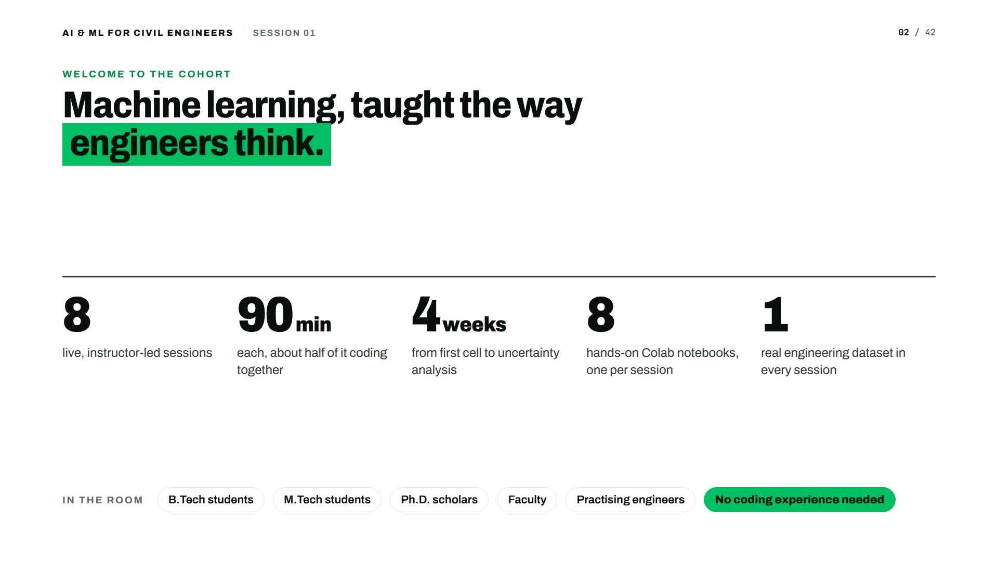

Slide 3


Slide 4
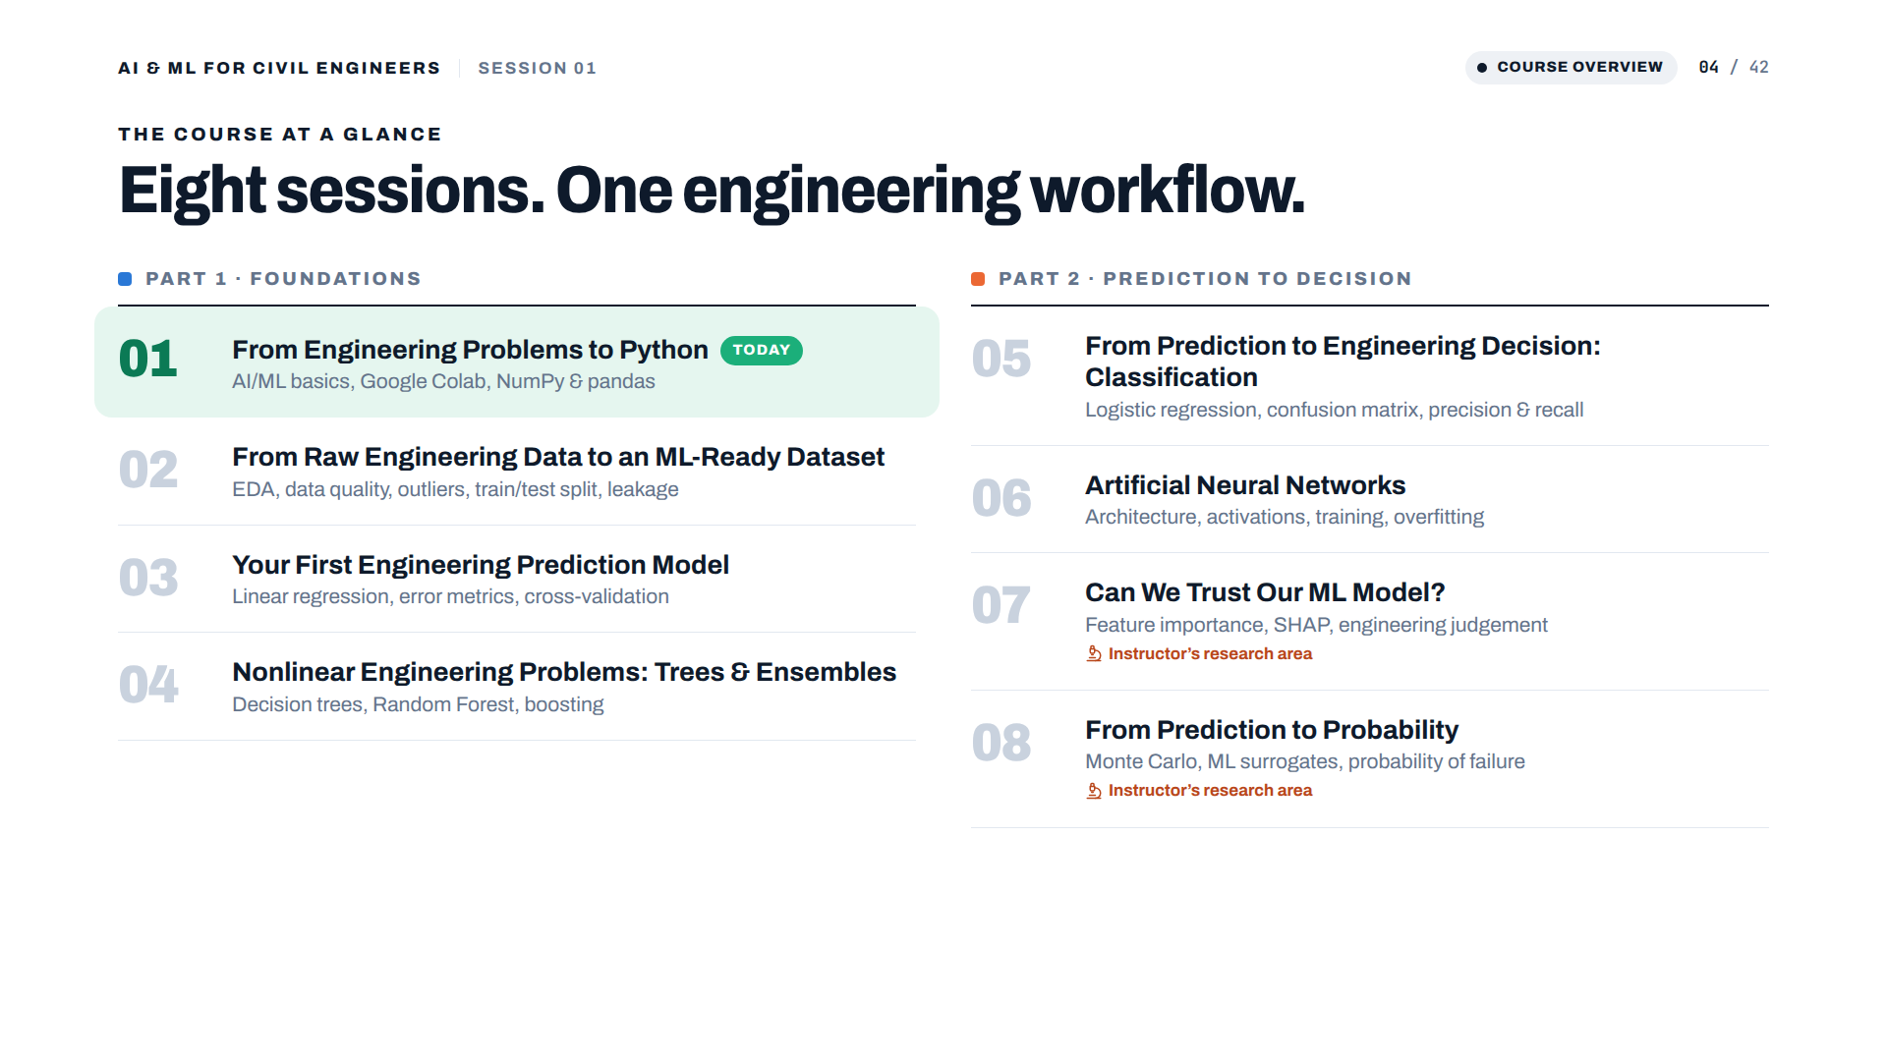

Slide 5
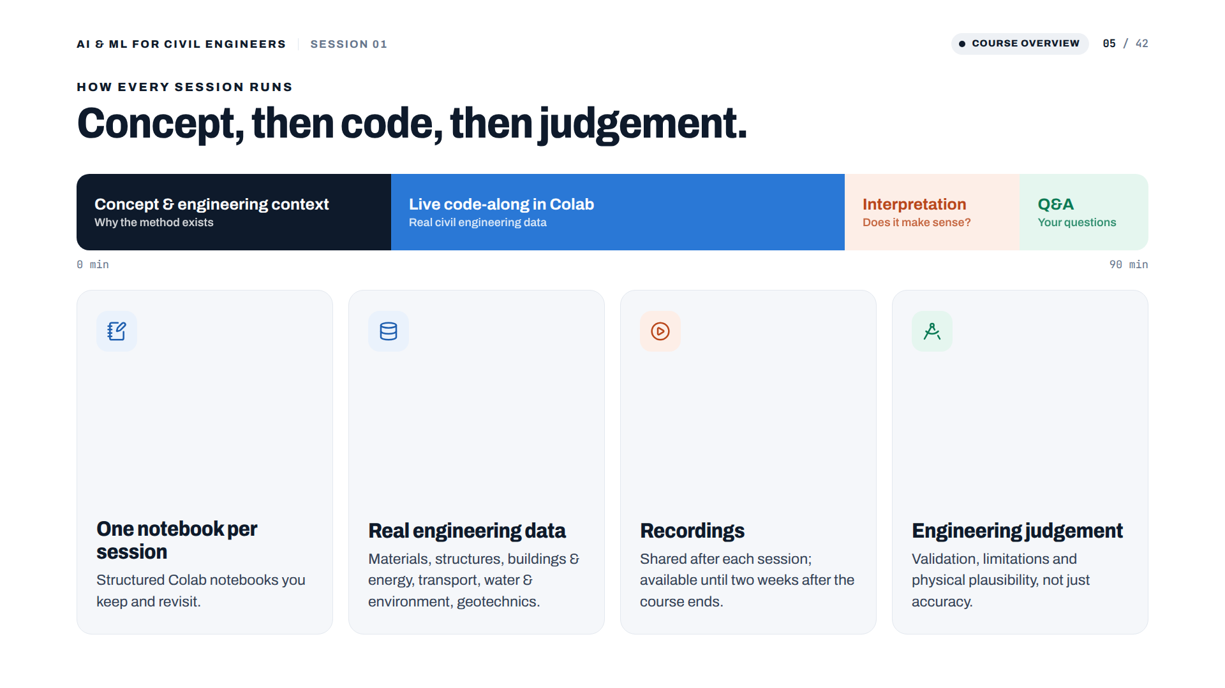

Slide 6
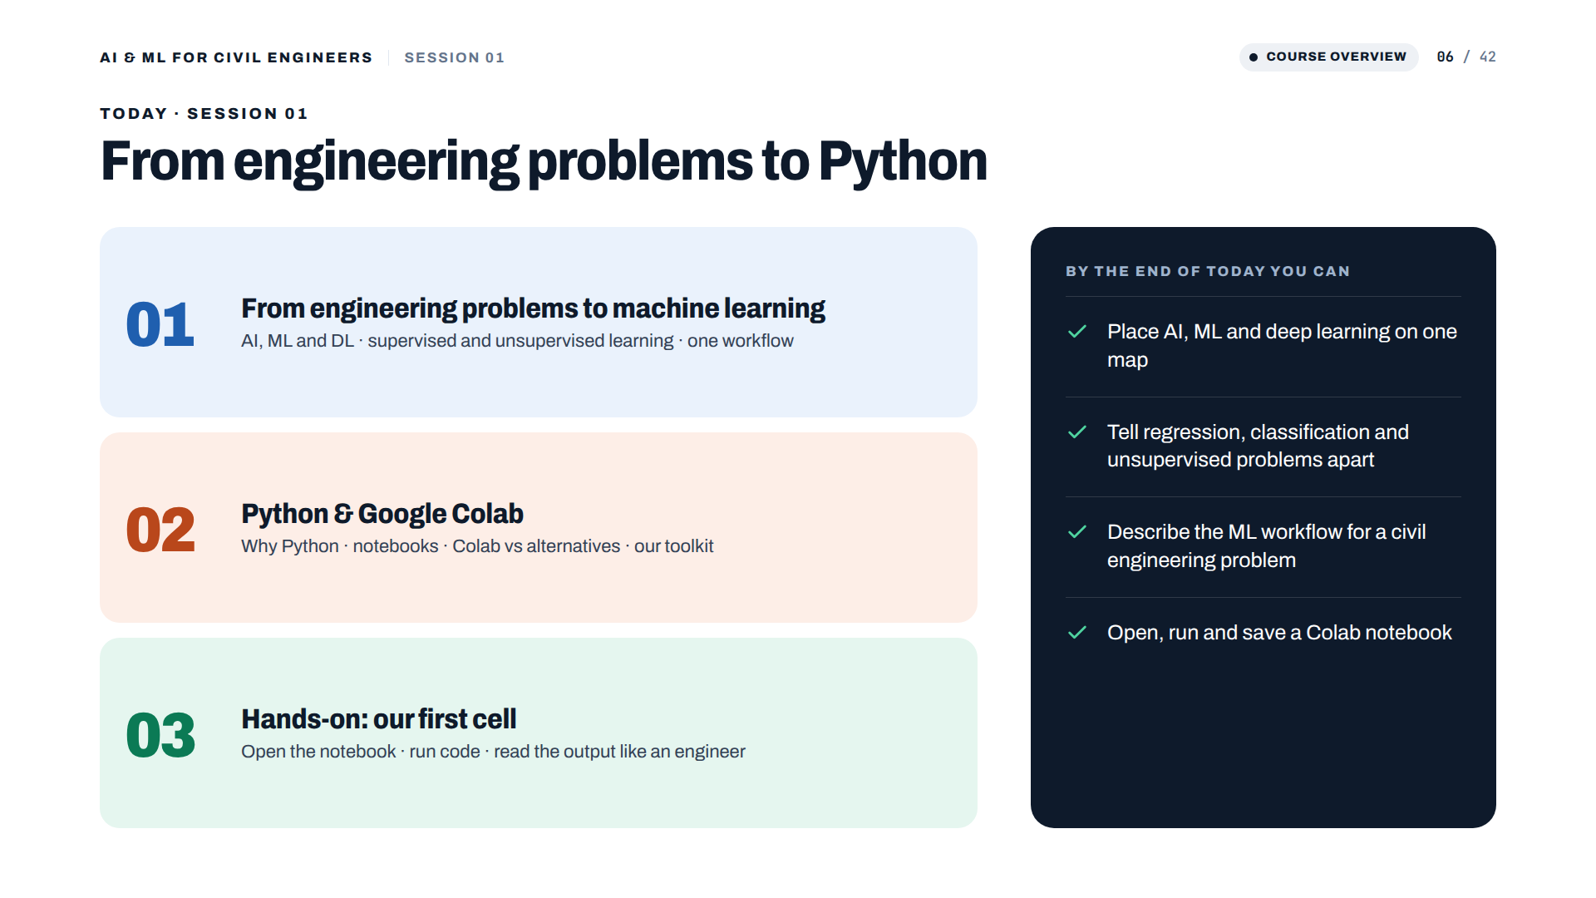

Slide 7
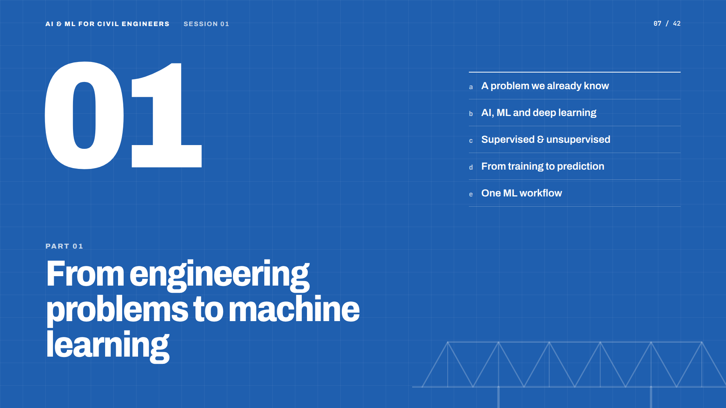

Slide 8
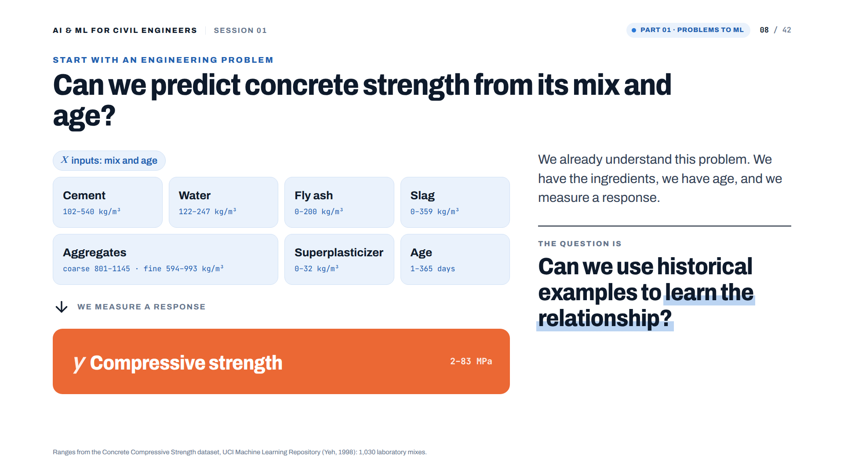
Notes:
Slide 2 — Start with an engineering problem
They are not learning an alien computer problem.
They are solving an engineering problem with another tool.

Slide 9
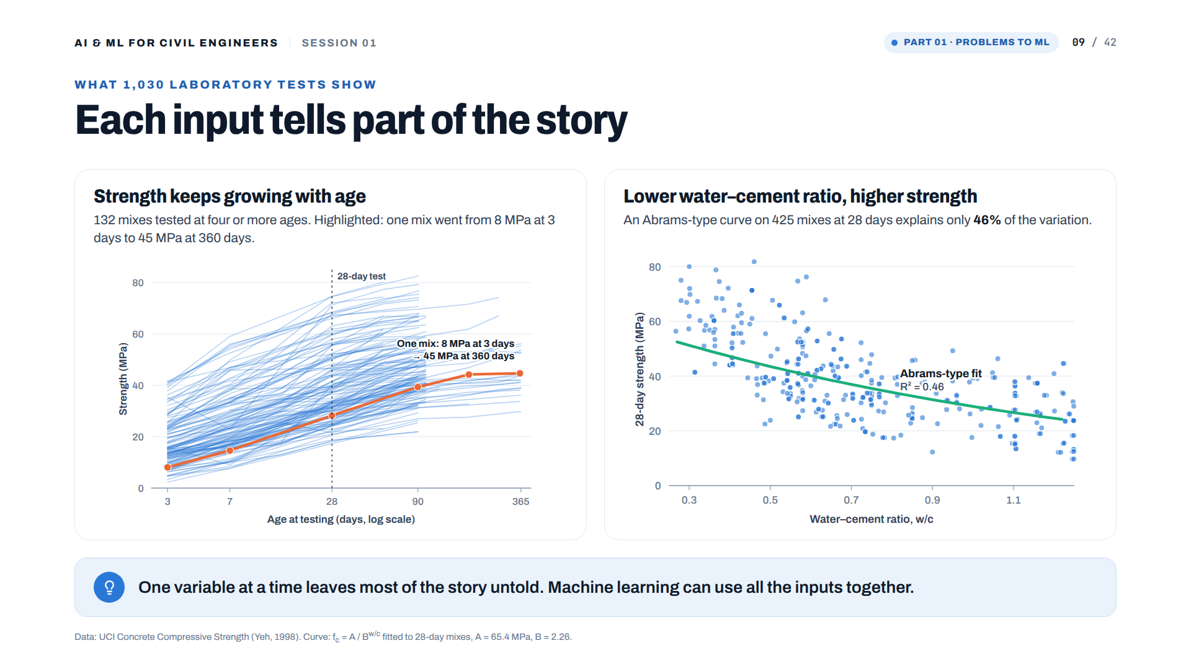
Notes:
[Added] Real data: 1,030 laboratory mixes (UCI Concrete Compressive Strength, Yeh 1998). Left: 132 mixes tested at four or more ages; one slag mix went from 8 MPa at 3 days to 45 MPa at 360 days. Right: an Abrams-type curve fitted to 425 mixes at 28 days explains only 46% of the variation (R² = 0.46). Message: one input at a time leaves much unexplained; ML can use all the inputs together.

Slide 10
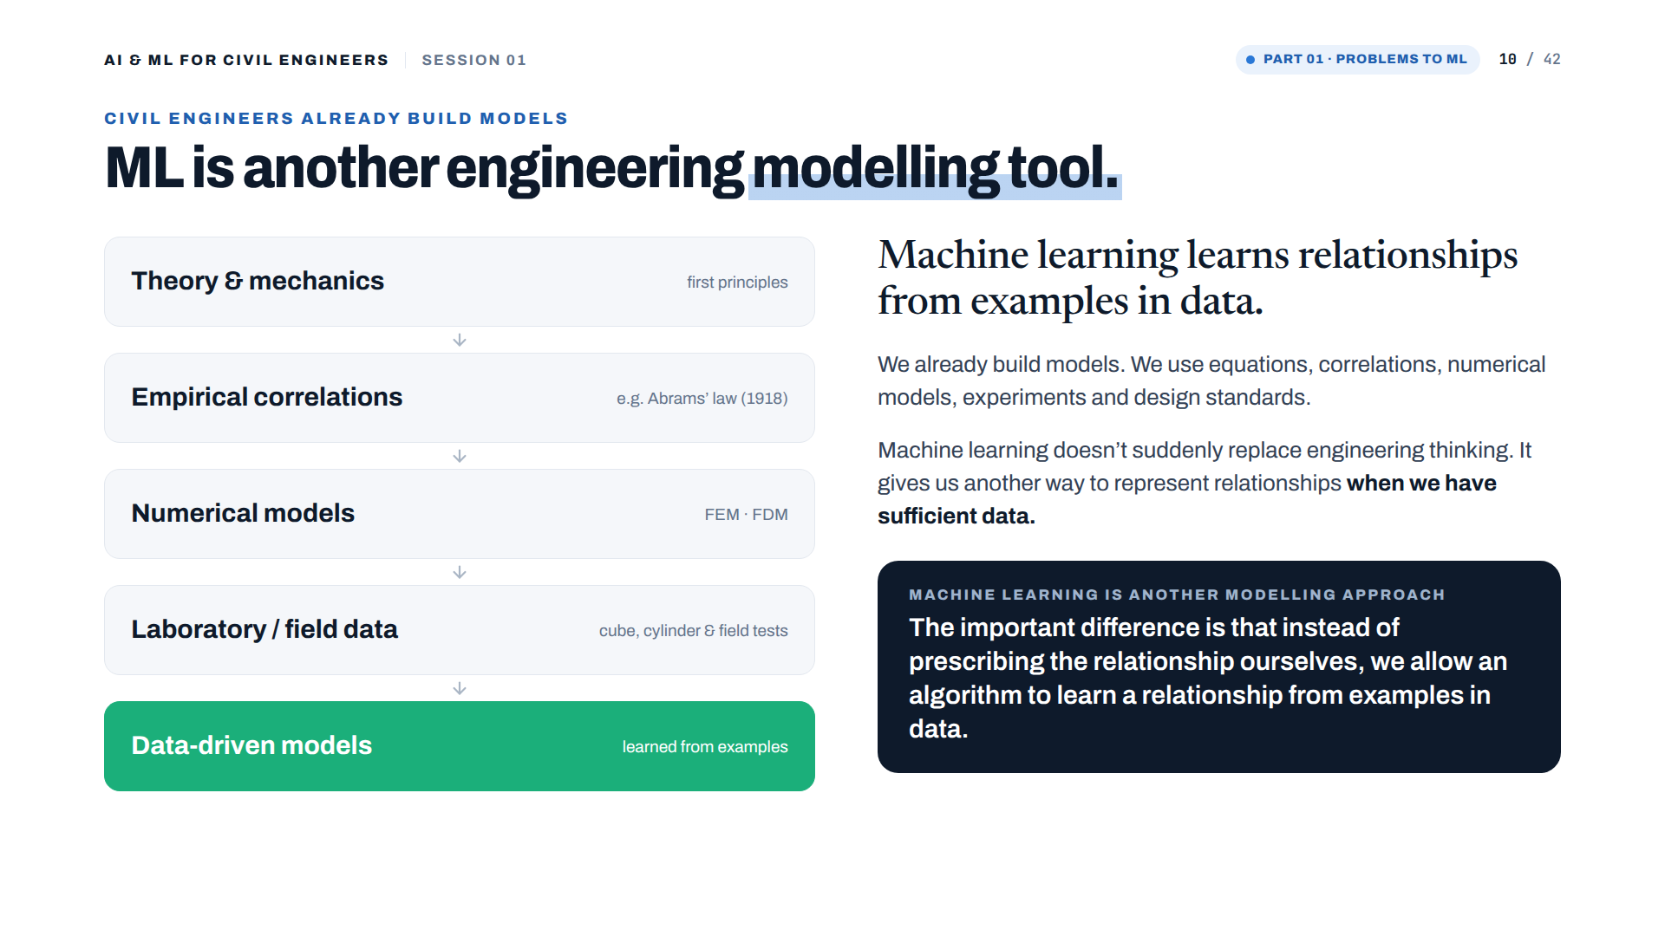
Notes:
Slide 3 — Civil Engineers already use models
Speaker point
"We already build models. We use equations, correlations, numerical models, experiments and design standards. Machine learning doesn't suddenly replace engineering thinking. It gives us another way to represent relationships when we have sufficient data."

Slide 11
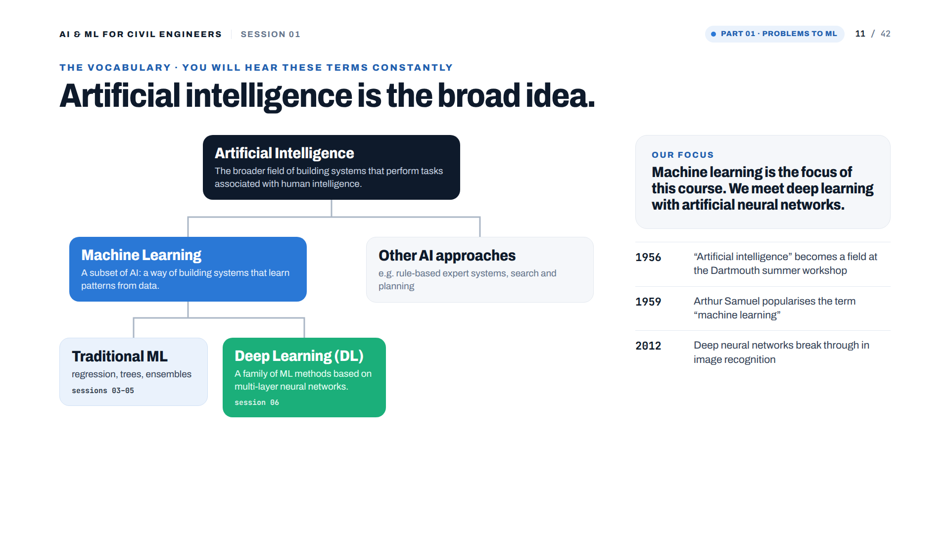
Notes:
Slide — Why are we talking about AI?
What you say
"You will hear these three terms constantly, so let's establish the vocabulary first.
Artificial Intelligence is the broadest term.
Machine Learning is one approach within AI, where algorithms learn patterns from data.
Deep Learning is a family of machine-learning methods based on neural networks with multiple layers."
Then immediately:
"For this workshop, ML is our main focus. We will touch deep learning later when we reach Artificial Neural Networks."
That is enough.

Slide 12
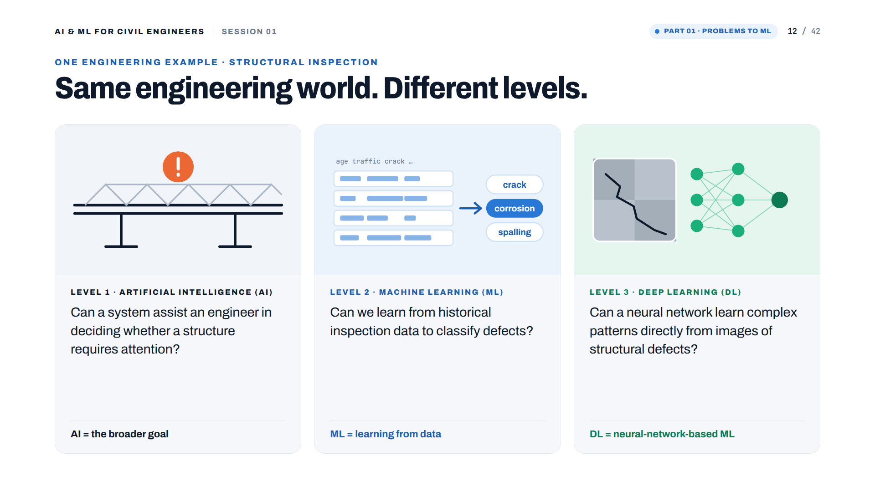
Notes:
Slide — AI, ML and DL: one engineering example

Slide 13
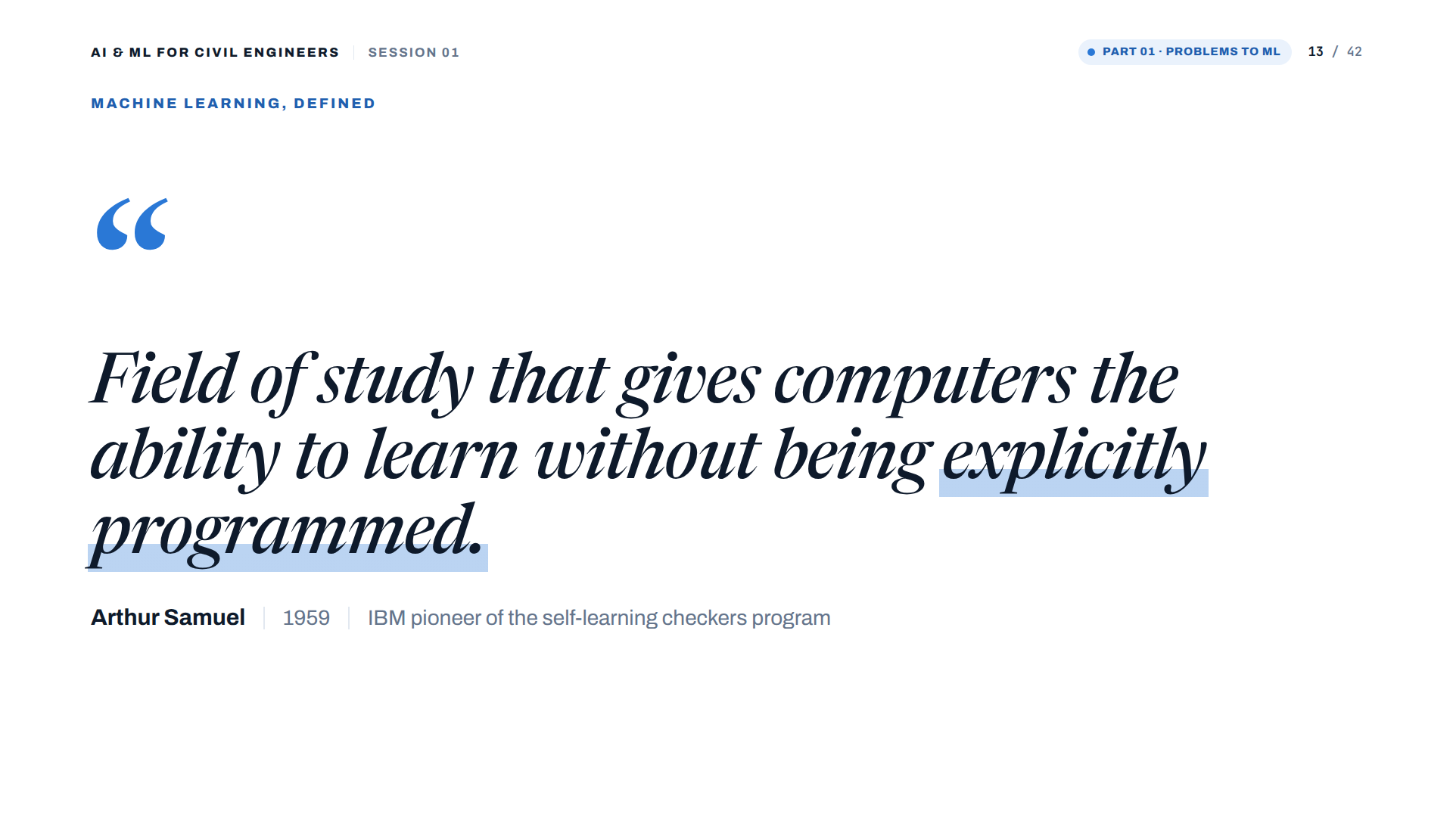
Notes:
Arthur Samuel's 1959 definition. Samuel worked at IBM; his checkers program improved by playing against itself.

Slide 14
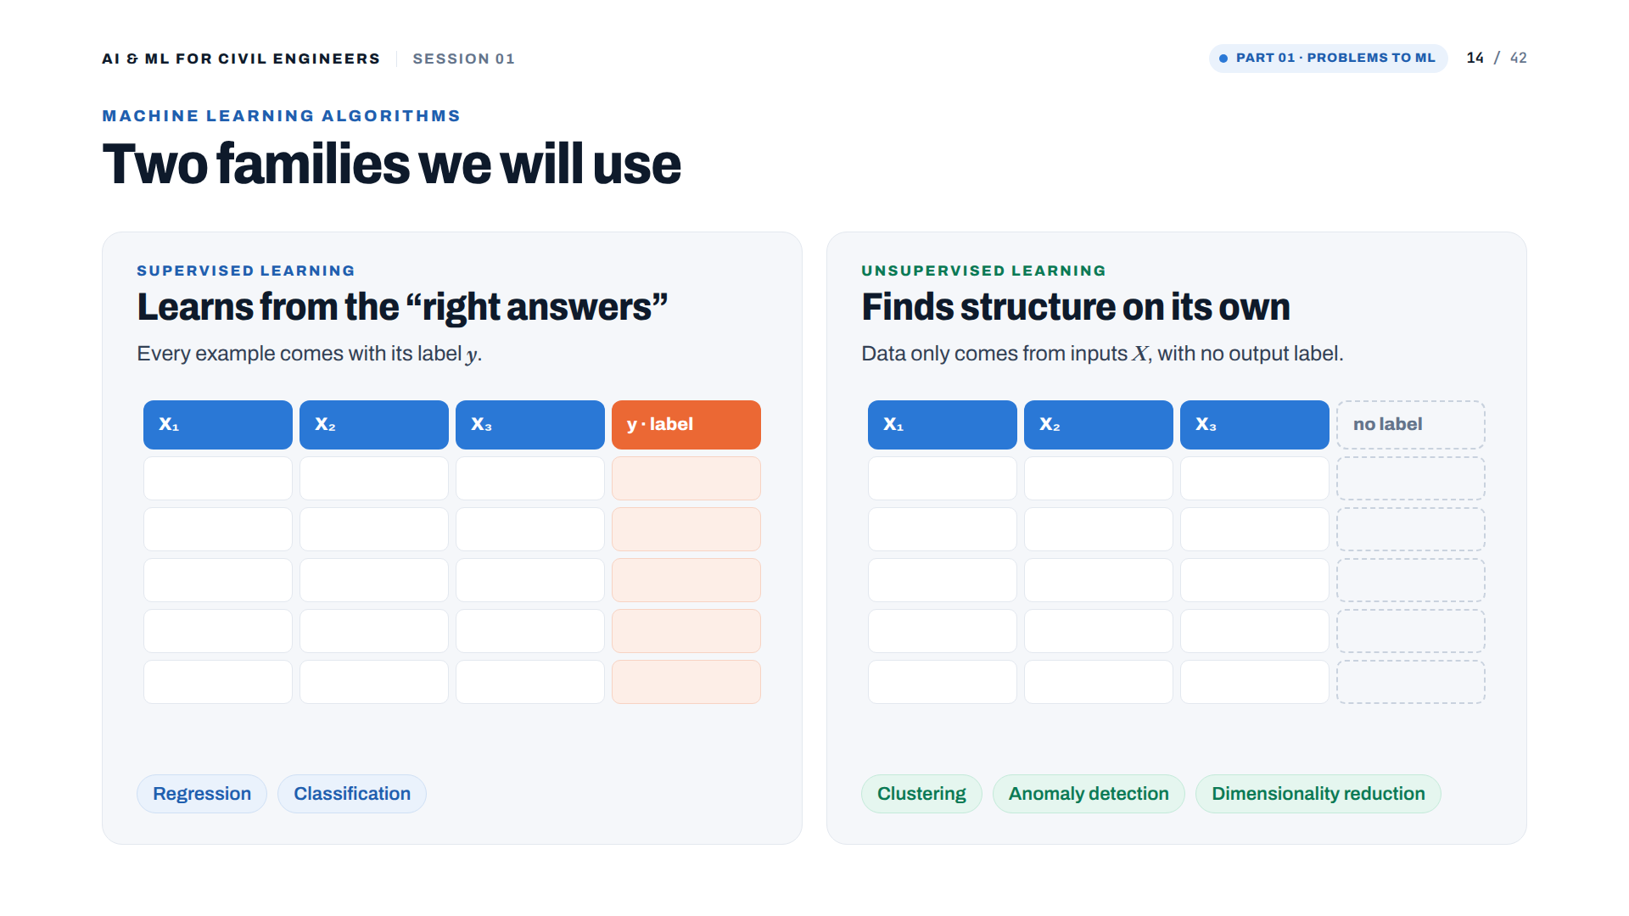
Notes:
[Layout added] From the original slide 6: 'Machine learning algorithms: Supervised / Unsupervised'. Supervised: every example has its label y. Unsupervised: only X, no label.

Slide 15
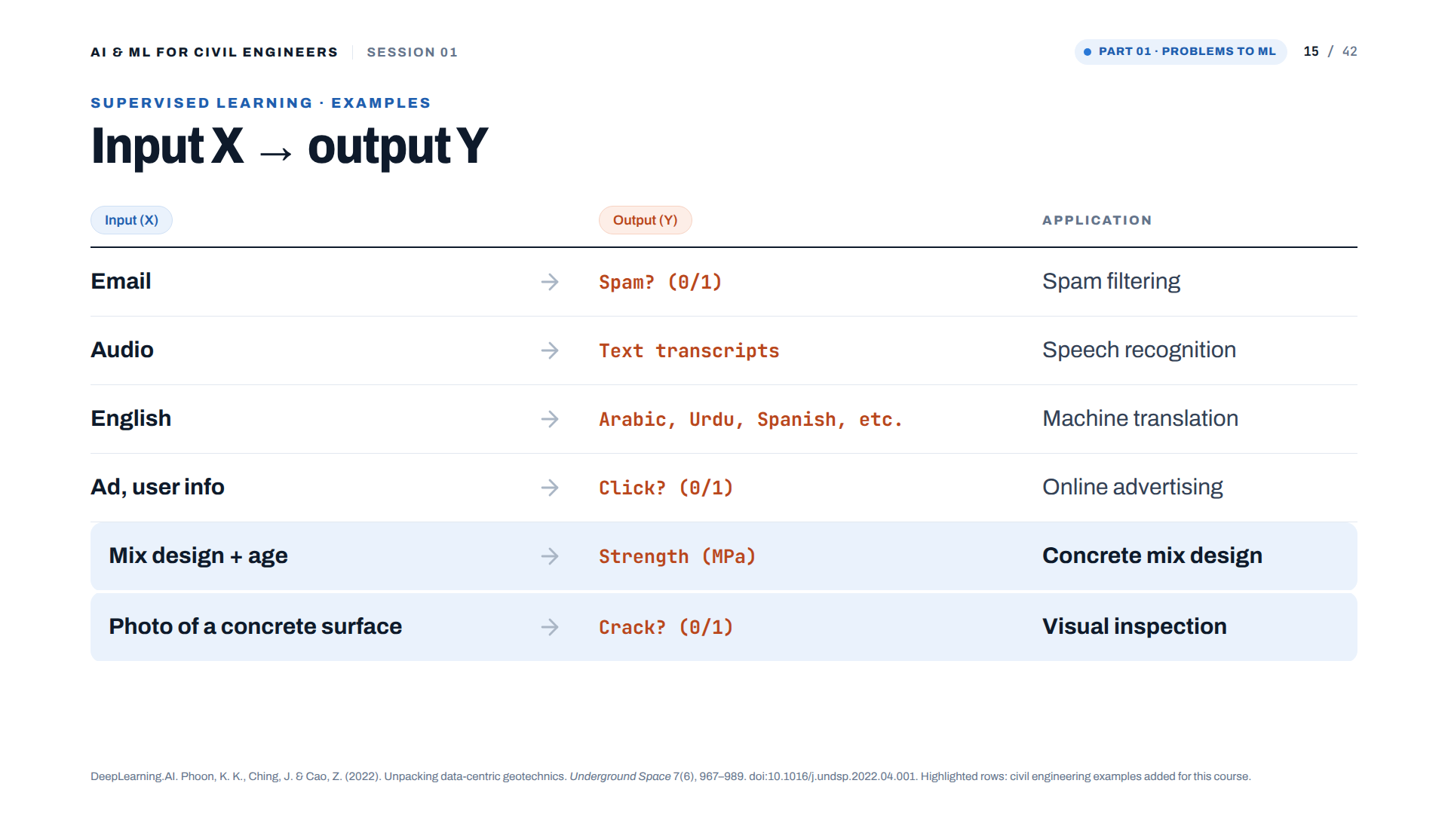
Notes:
Table from the original slide 6. Two civil engineering rows added at the bottom for this course.

Slide 16
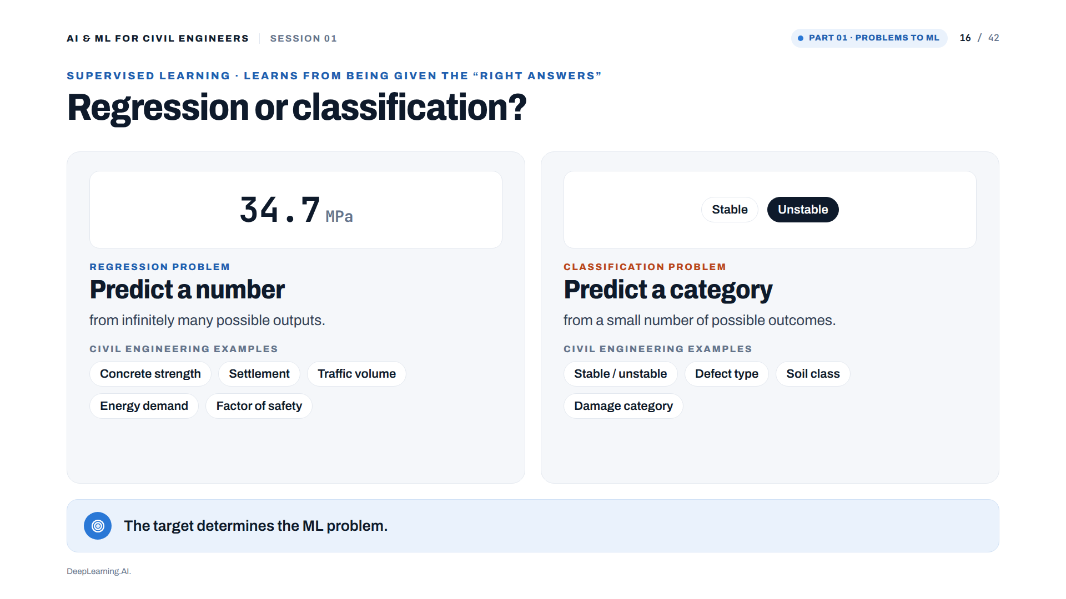

Slide 17
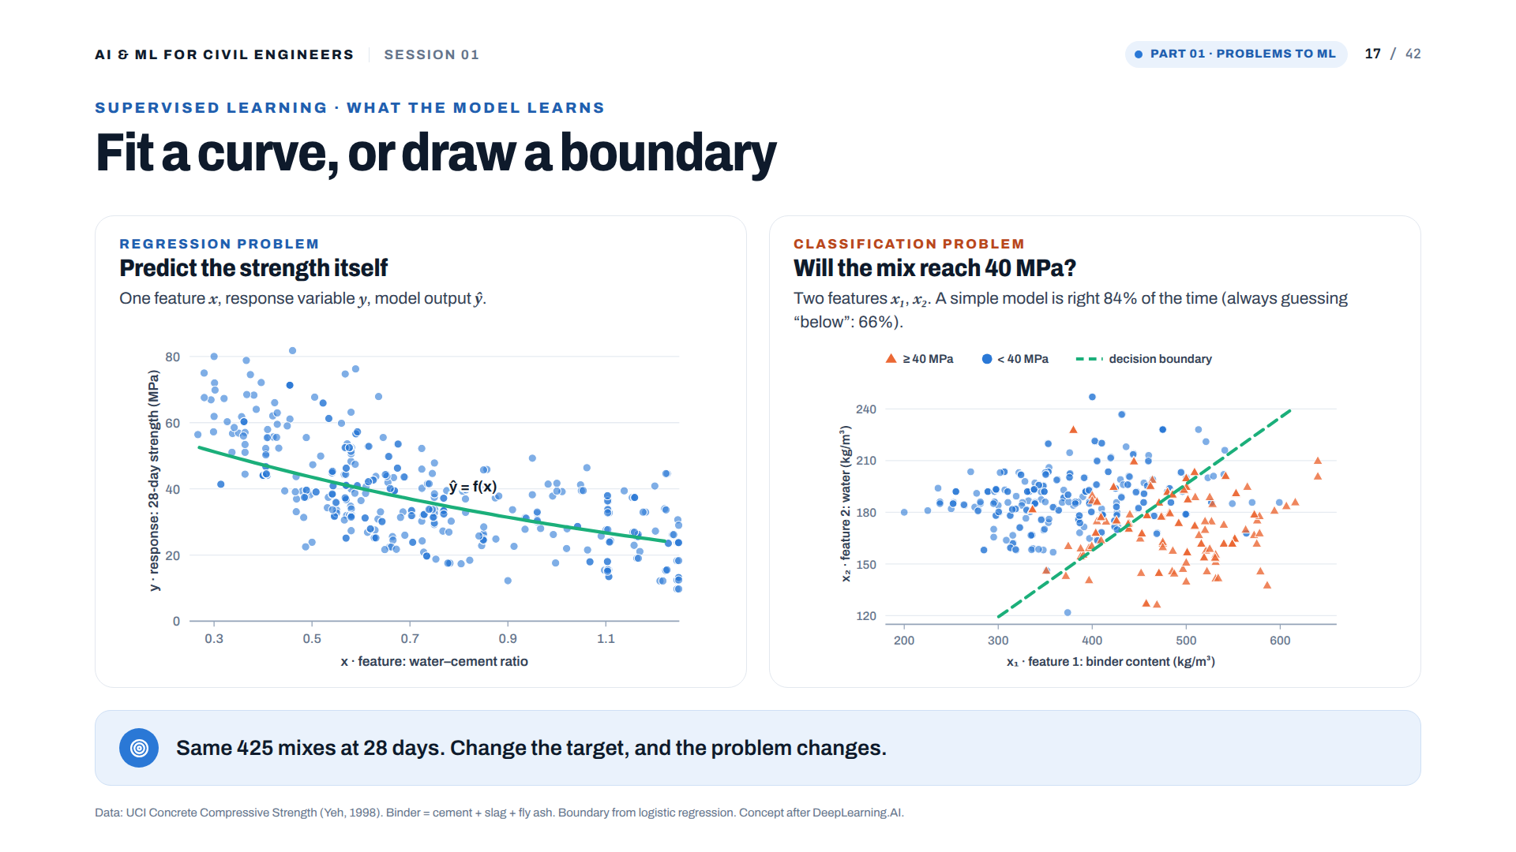
Notes:
[Real data] Left: regression, 28-day strength against water-cement ratio with the Abrams-type fit. Right: the same 425 mixes with the target changed to 'does the mix reach 40 MPa?'. A logistic regression on binder content and water is right 84% of the time, against 66% for always guessing 'below 40'. The boundary roughly follows a constant water-binder ratio: engineering knowledge is visible in the model.

Slide 18
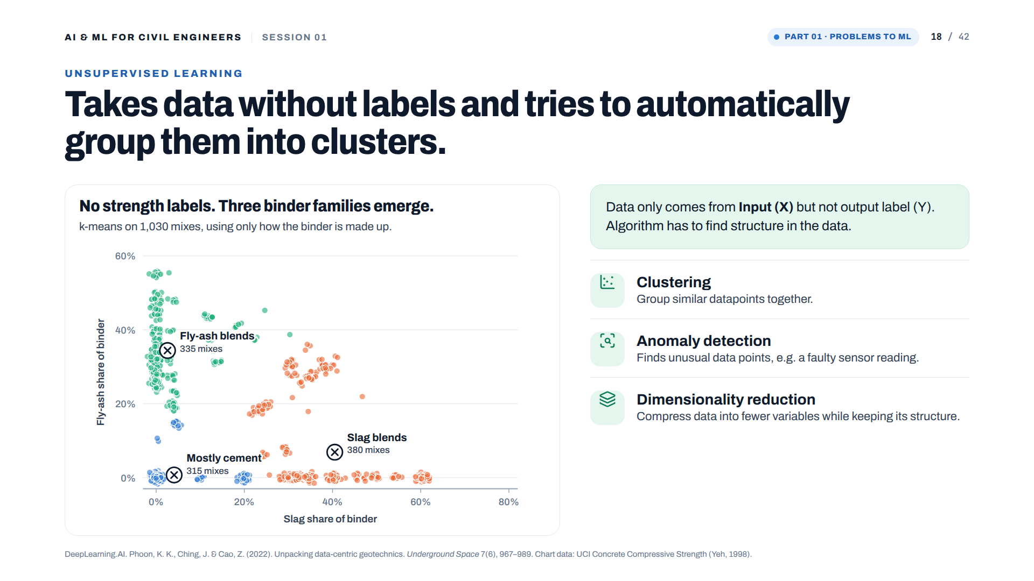
Notes:
[Real data] k-means with three groups on the slag share and fly-ash share of the binder; no strength labels used. Groups found: Mostly cement 315 mixes, Slag blends 380 mixes, Fly-ash blends 335 mixes. Dimensionality reduction compresses data into fewer variables (dimensions).

Slide 19
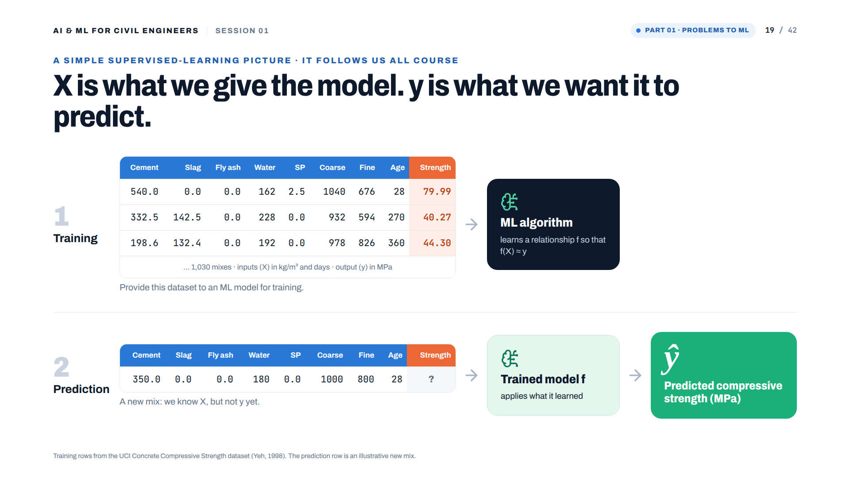
Notes:
Speaker point
"This little diagram is going to follow us throughout the course. X is the information we give the model. y is what we want it to predict."
Then give the Energy and Steel examples verbally.

Slide 20
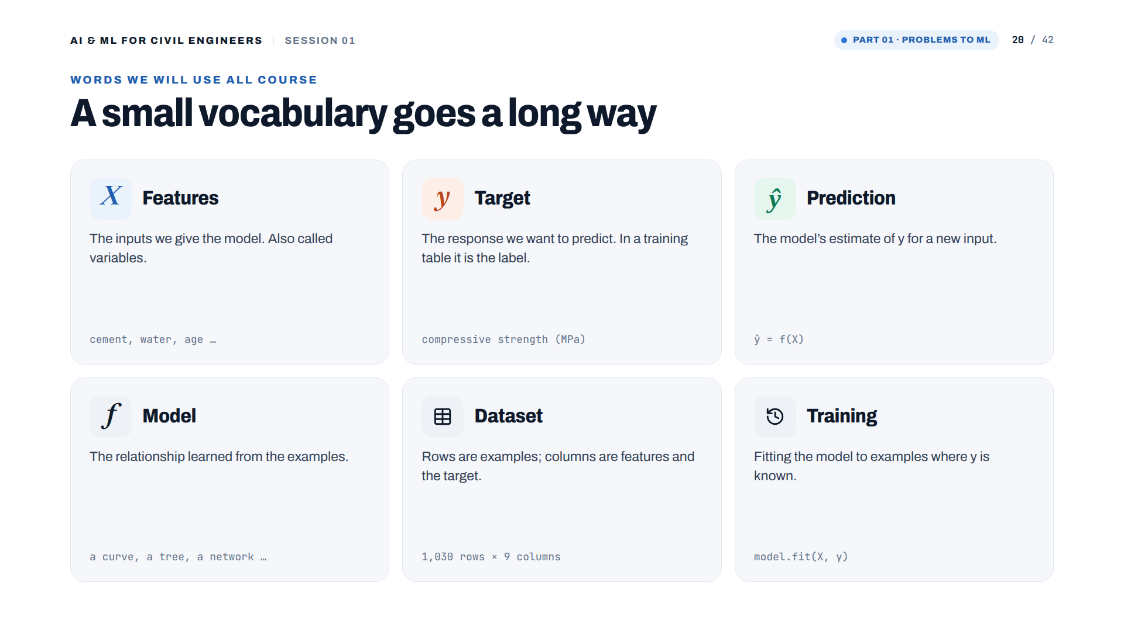
Notes:
[Added] Vocabulary for the whole course: X features, y target/label, ŷ prediction, f model, dataset, training.

Slide 21
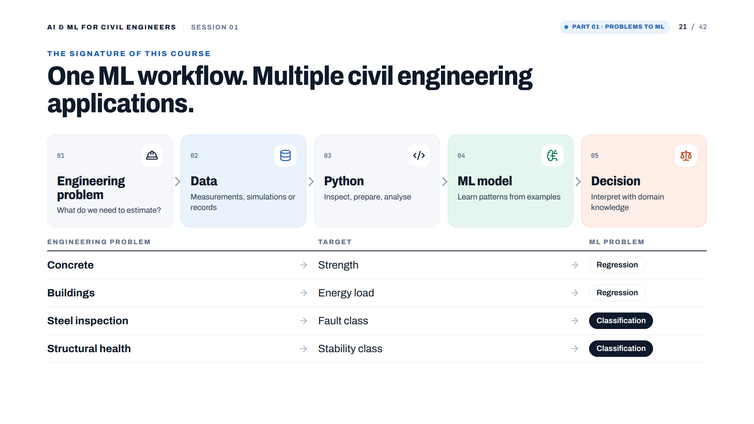
Notes:
Slide 6 — One workflow. Many engineering problems.
This should be one of the signature slides of the course.
The engineering problem changes. The dataset changes. The target changes. But the basic workflow survives.

Slide 22
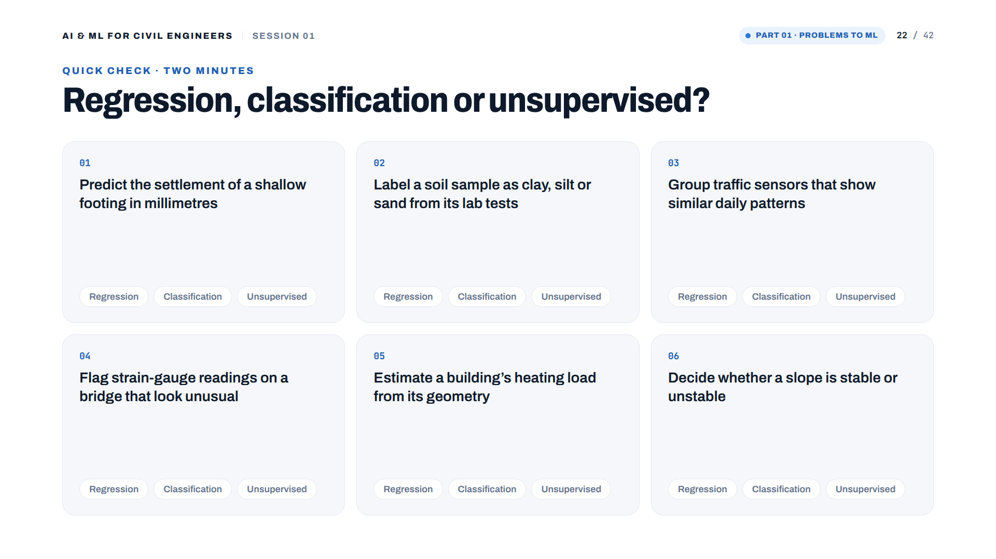
Notes:
[Added] Give the cohort two minutes and ask them to vote in the chat. Answers on the next slide.

Slide 23
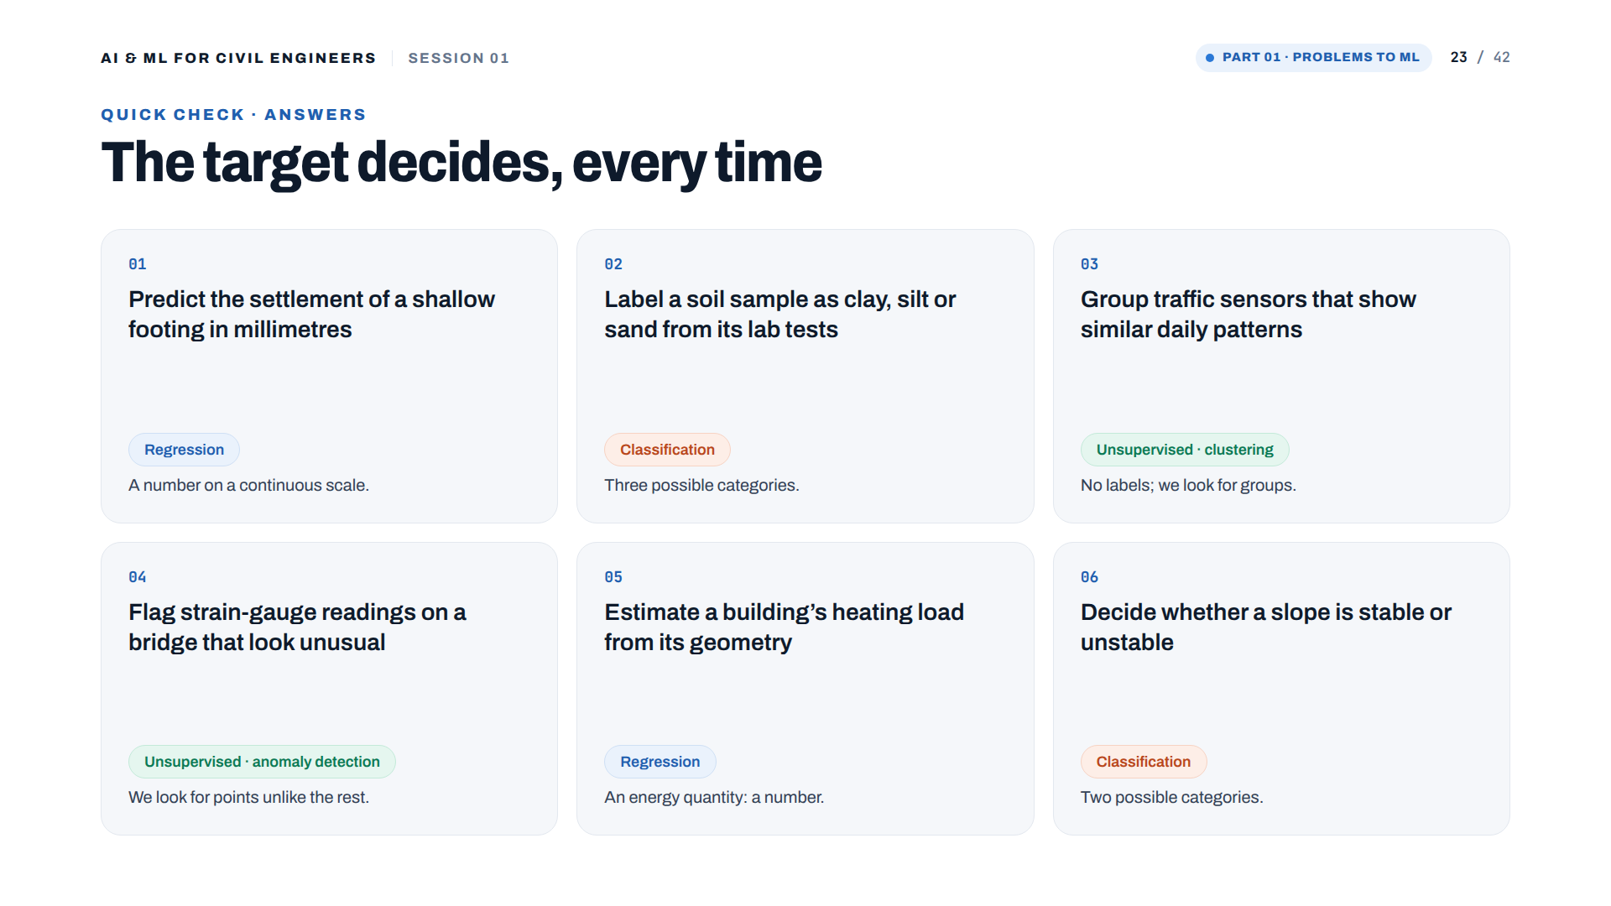
Notes:
[Added] Answers: 1 regression, 2 classification, 3 clustering (unsupervised), 4 anomaly detection (unsupervised), 5 regression, 6 classification.

Slide 24


Slide 25


Slide 26


Slide 27
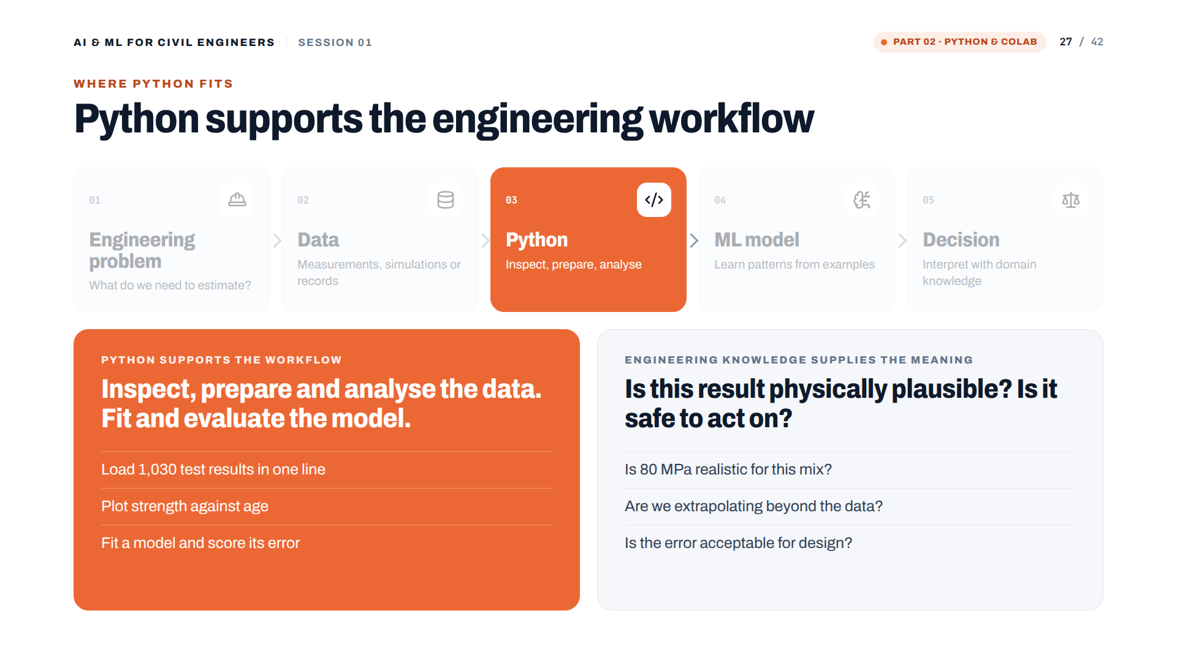
Notes:
Python supports the workflow; engineering knowledge supplies the meaning.

Slide 28
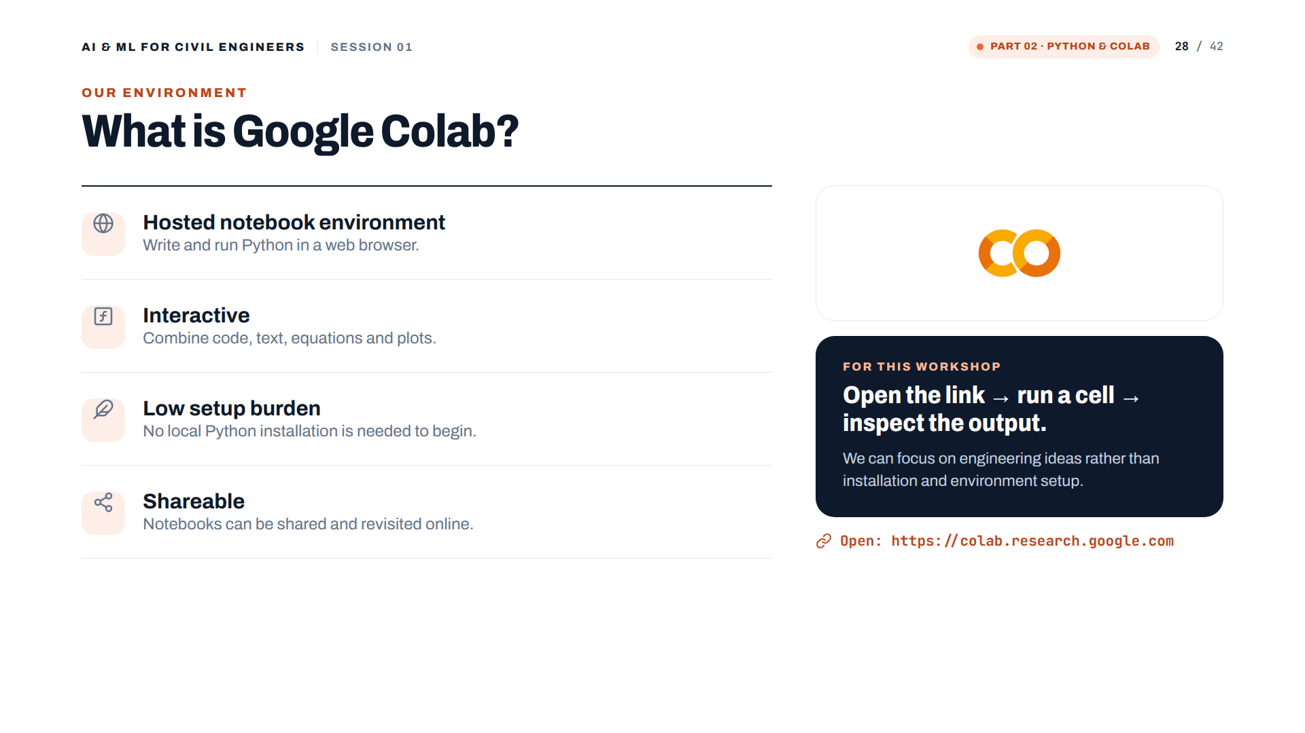

Slide 29
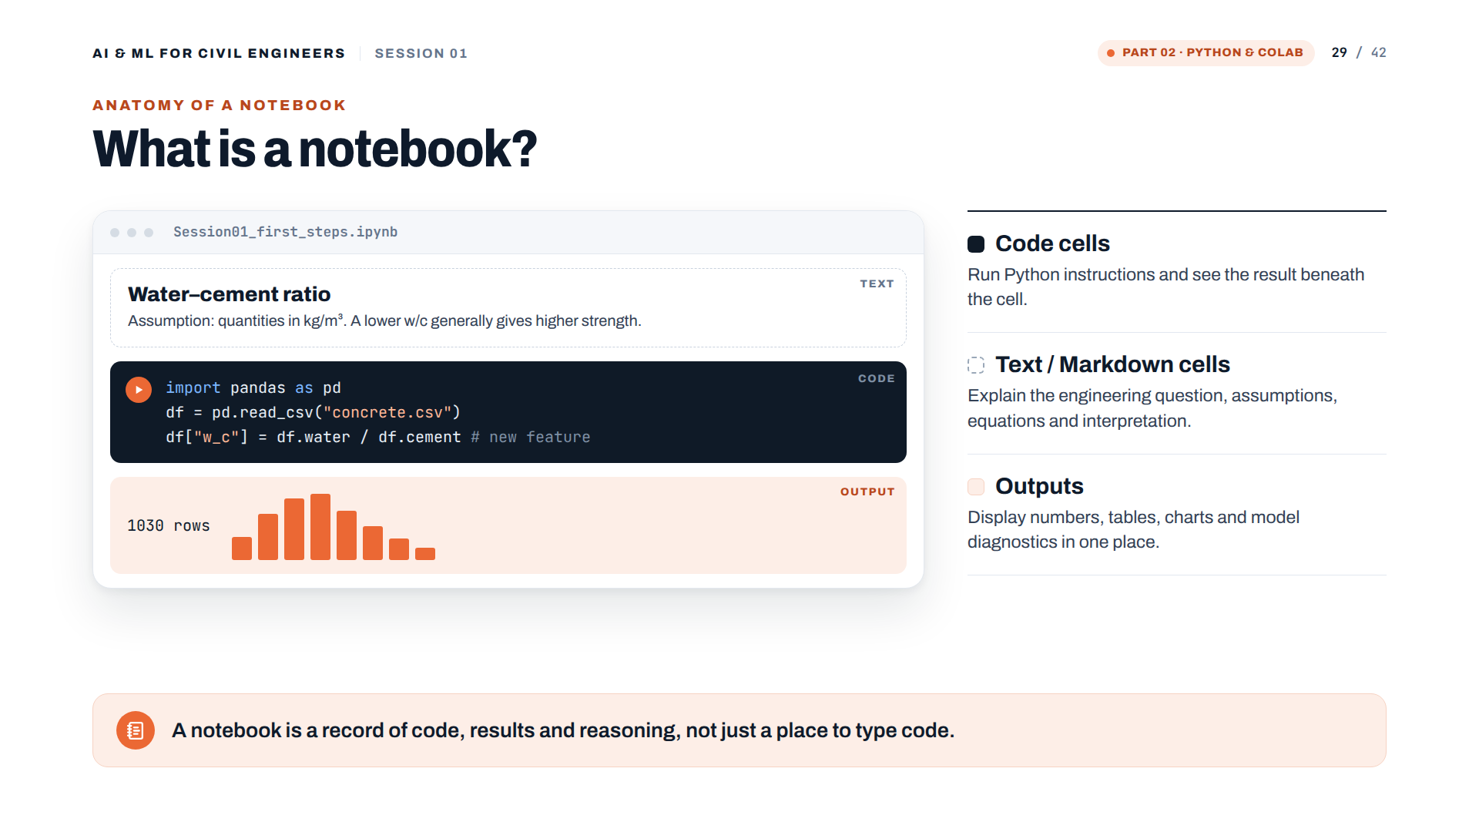

Slide 30
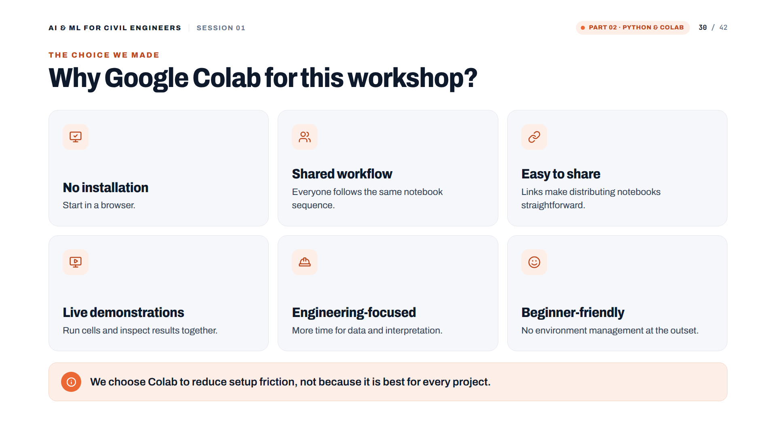

Slide 31
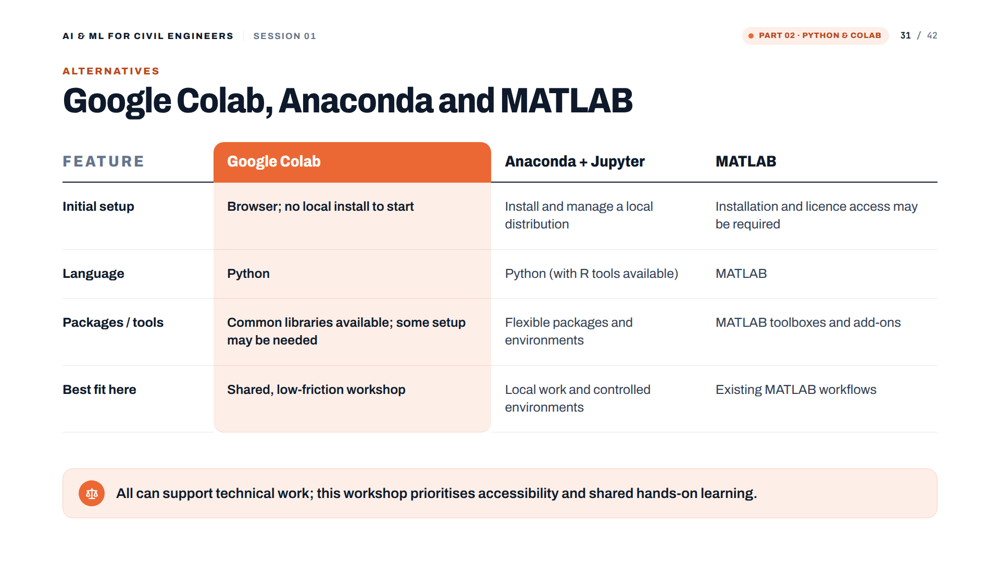

Slide 32
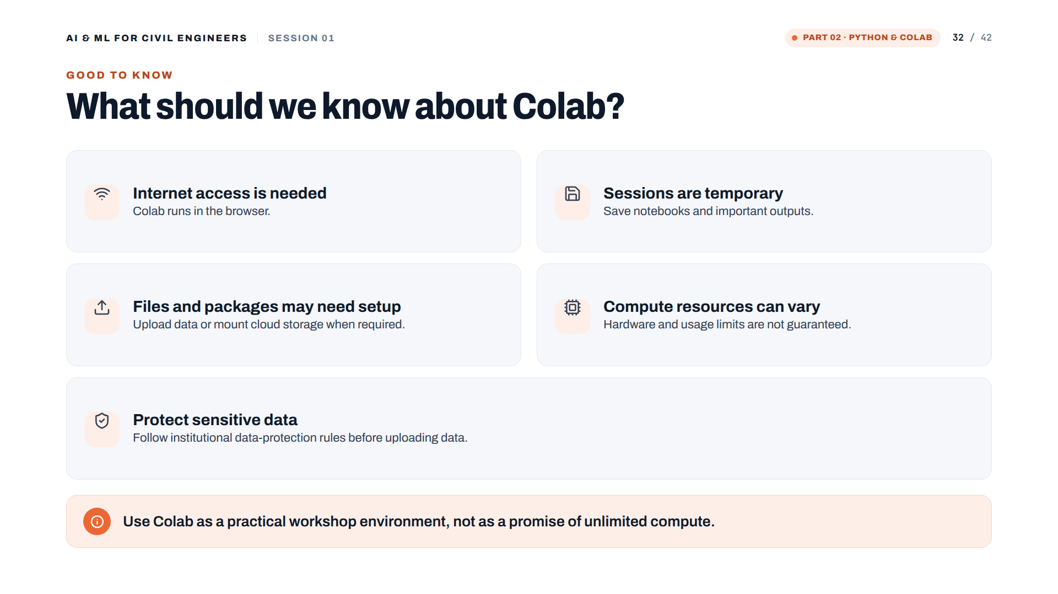

Slide 33
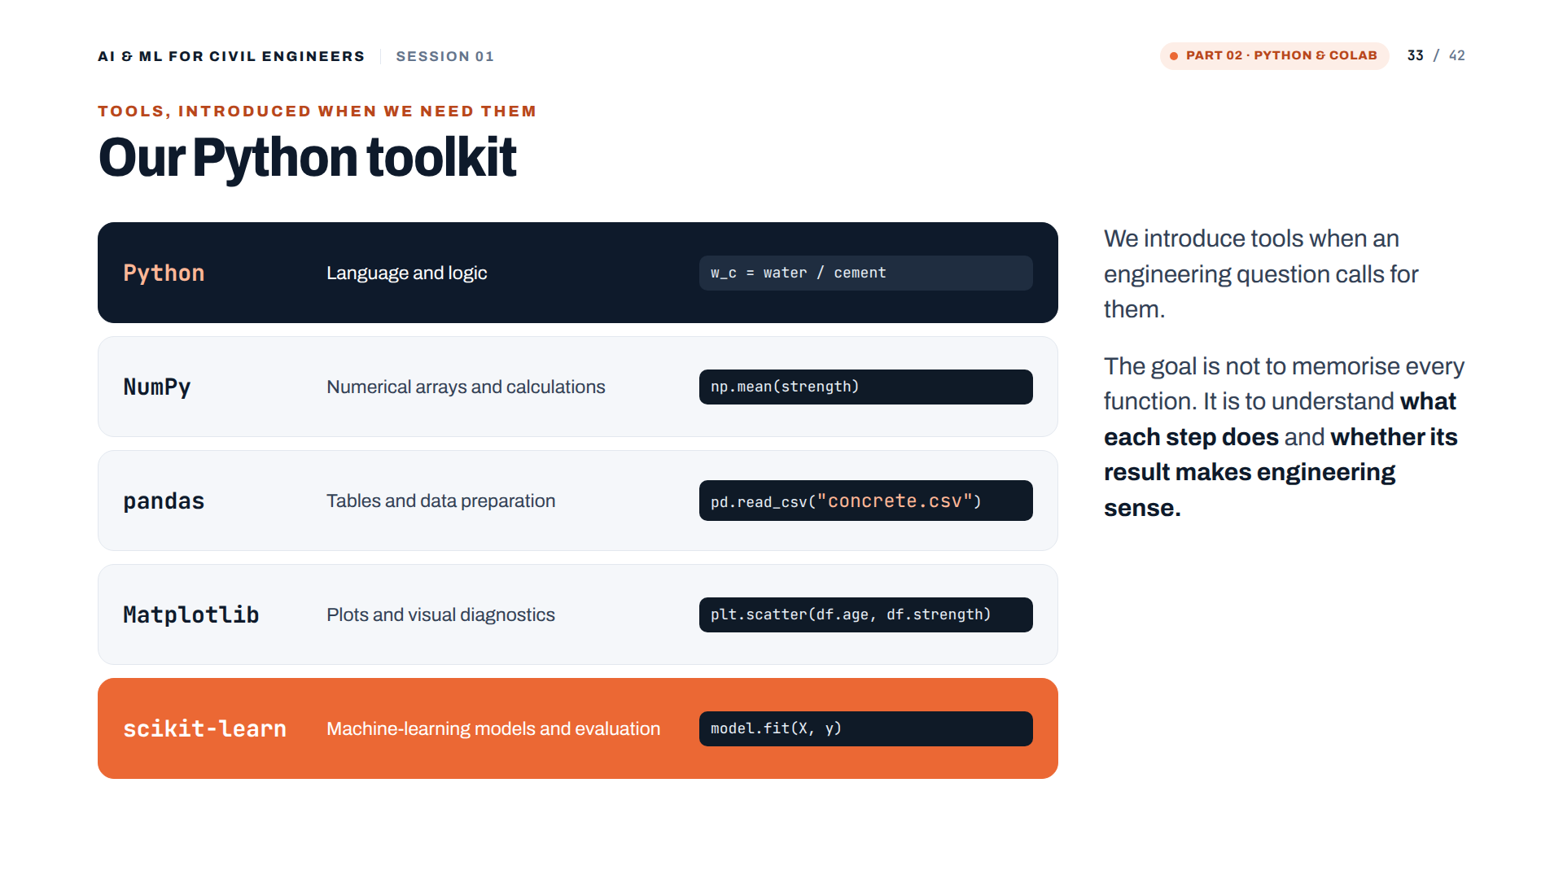

Slide 34


Slide 35
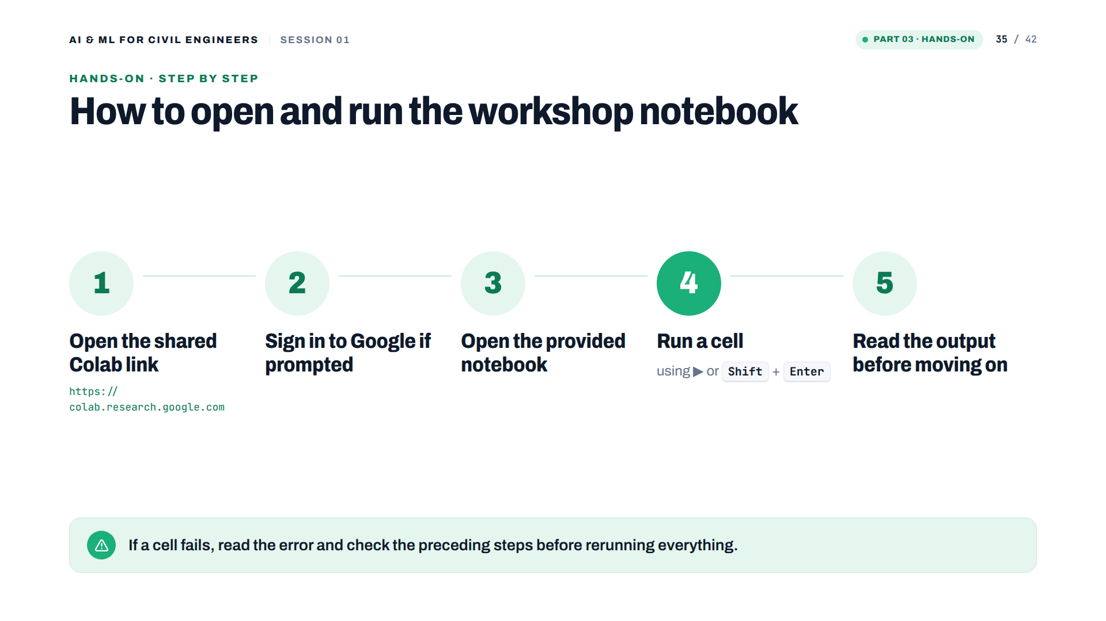

Slide 36
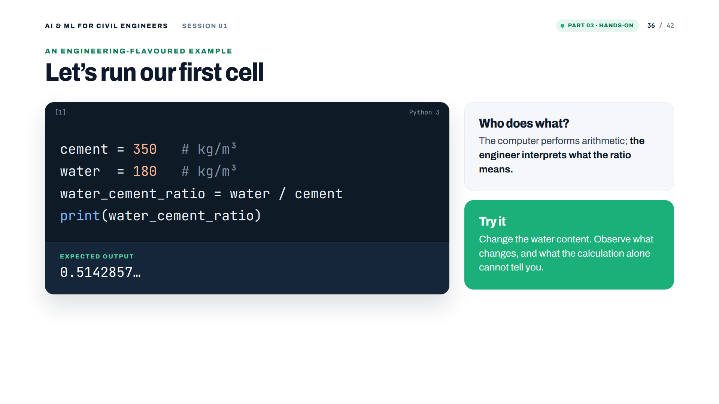

Slide 37
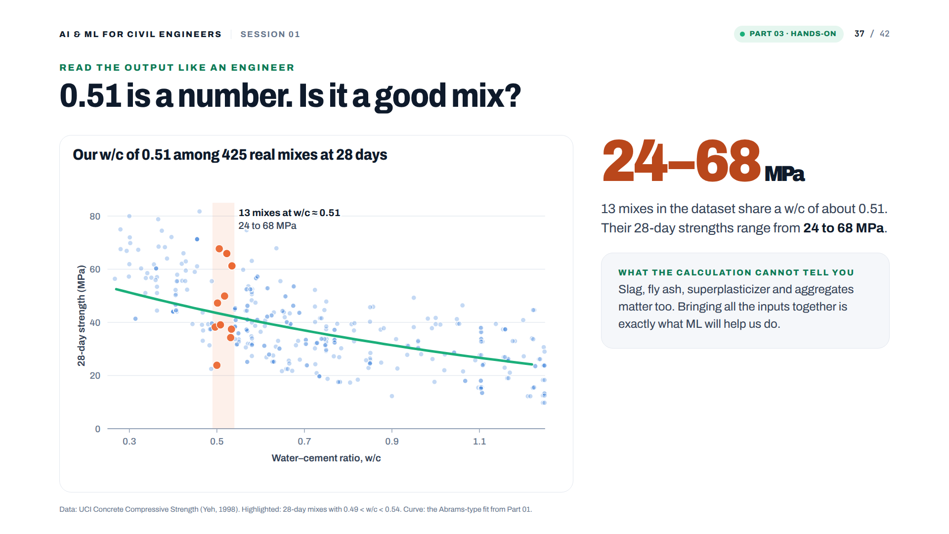
Notes:
[Added, real data] After the first cell. 13 mixes at 28 days have a w/c between 0.49 and 0.54; their strengths range from 24 to 68 MPa. The ratio alone does not fix the strength: slag, fly ash, superplasticizer and aggregates matter too. That is why we bring all the inputs together with ML.

Slide 38
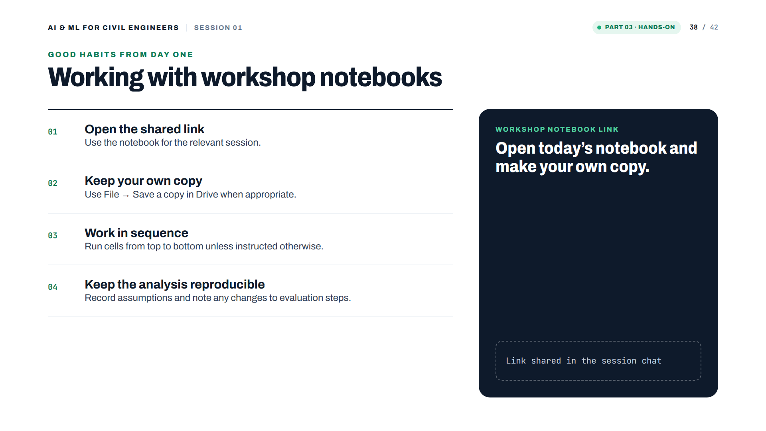
Notes:
Replace 'Link shared in the session chat' with the real notebook link if you want it on the slide.

Slide 39
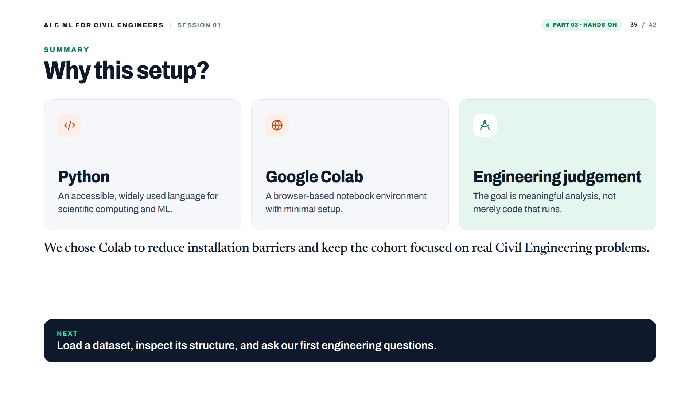

Slide 40
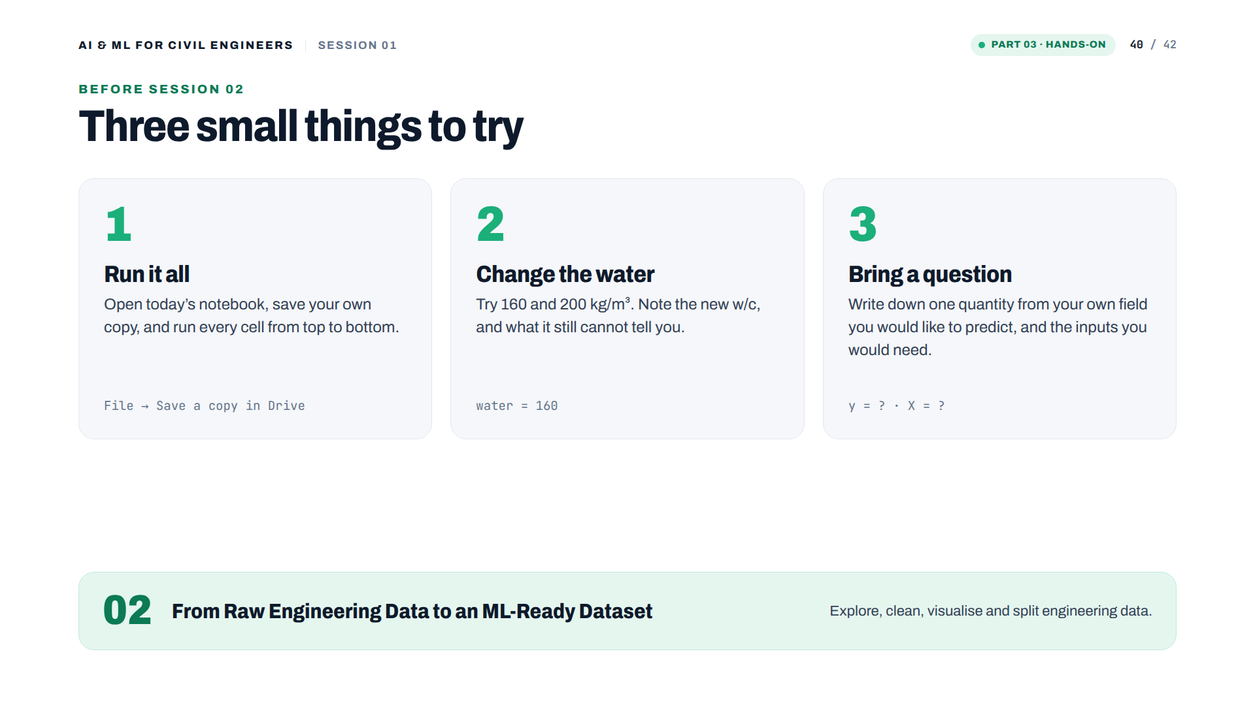
Notes:
[Added] Optional practice before session 02.

Slide 41


Slide 42


