Slide 1

Notes:
Welcome back. Session 02 is about the step before any model: turning raw engineering records into a dataset we can trust. Read the question on the slide aloud: can we trust our engineering data before giving it to a model? The four labels are the arc of today: data quality, exploration, preparation, and setting up a fair evaluation.

Slide 2
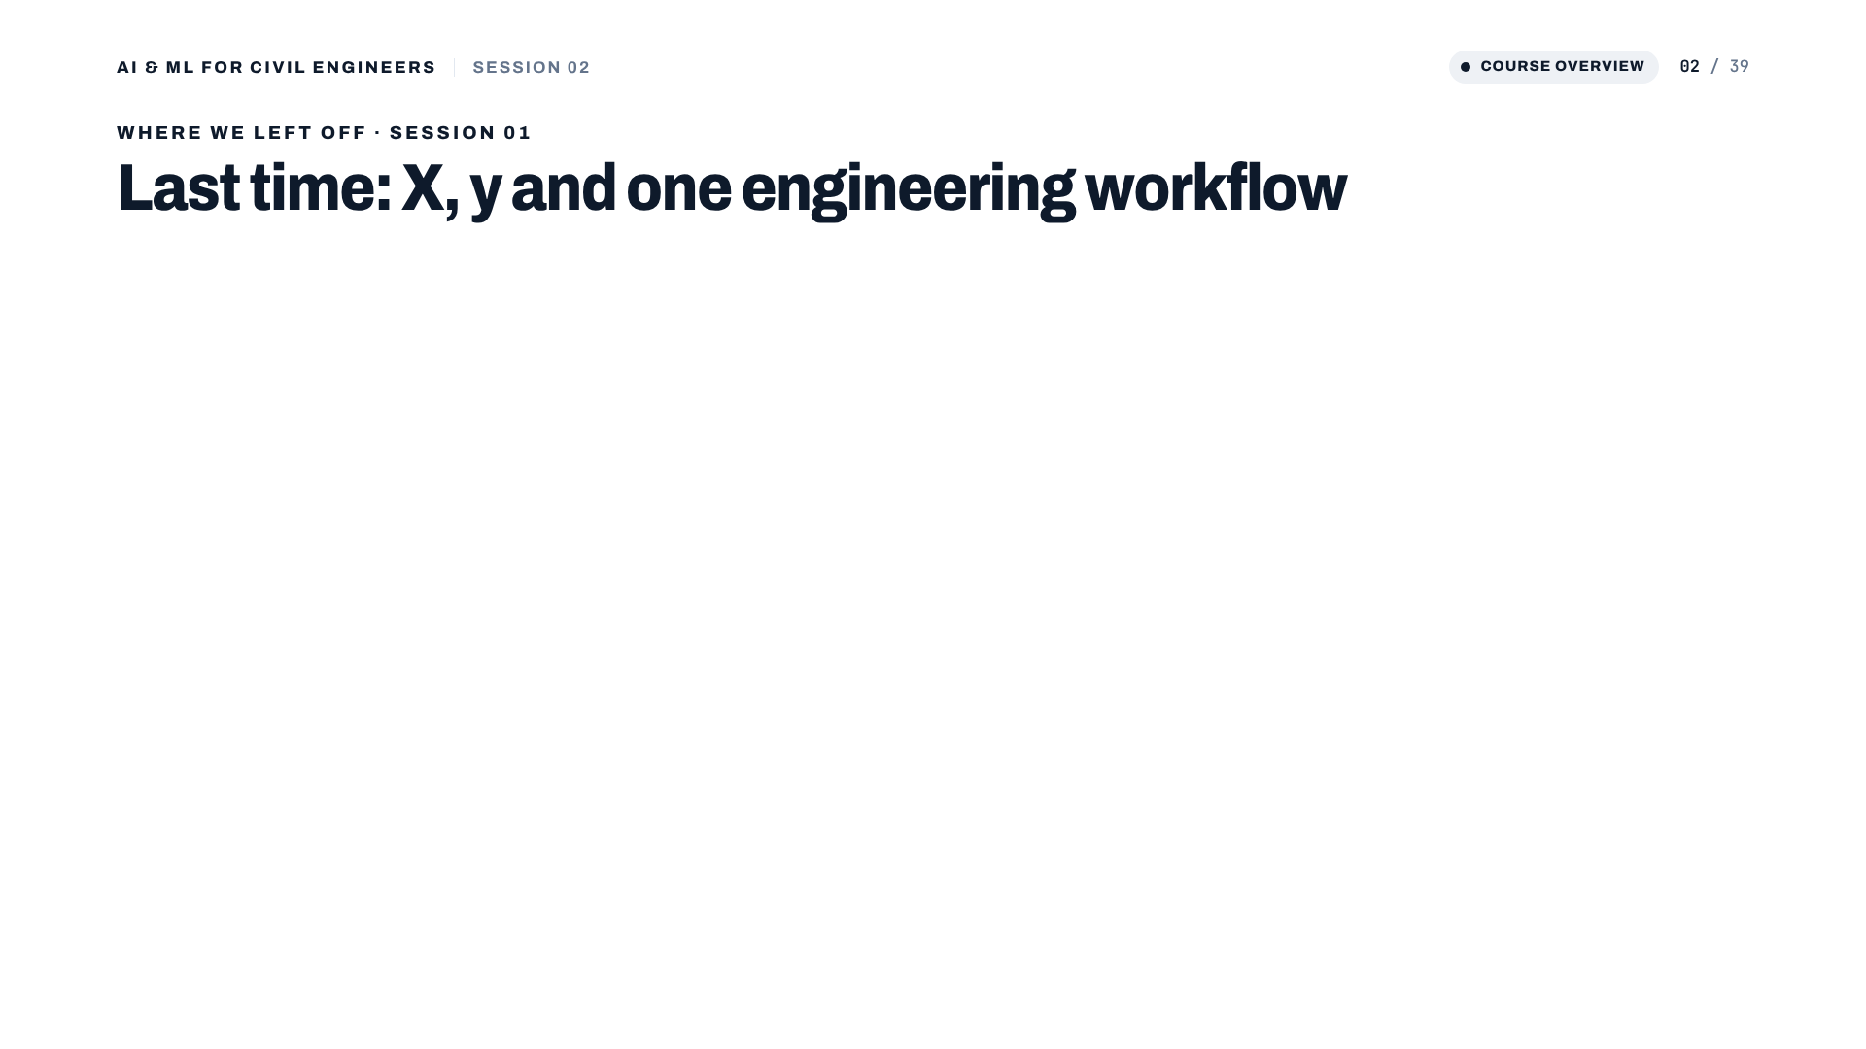
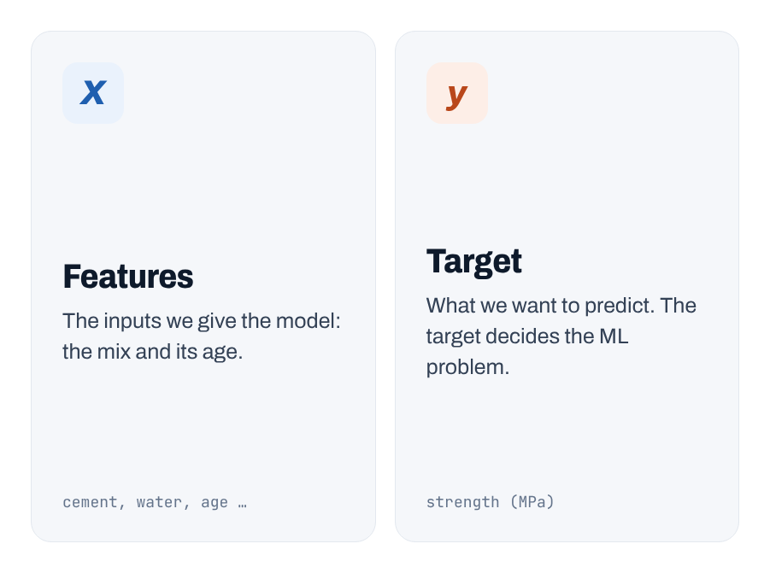
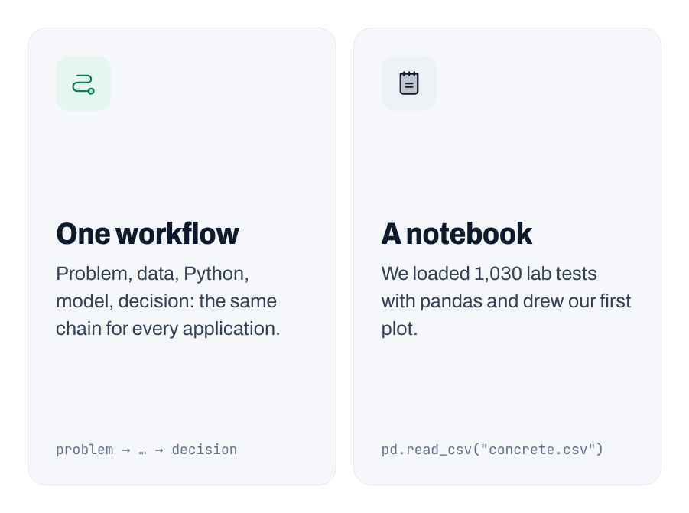
Notes:
Two-minute recap. X = the inputs, y = what we predict, and the target decides whether it is regression or classification. We used one workflow for every problem, and we loaded 1,030 concrete tests with pandas. Last time we assumed the table was ready. Today we question that assumption.
[Clicks on this slide: 3]

Slide 3
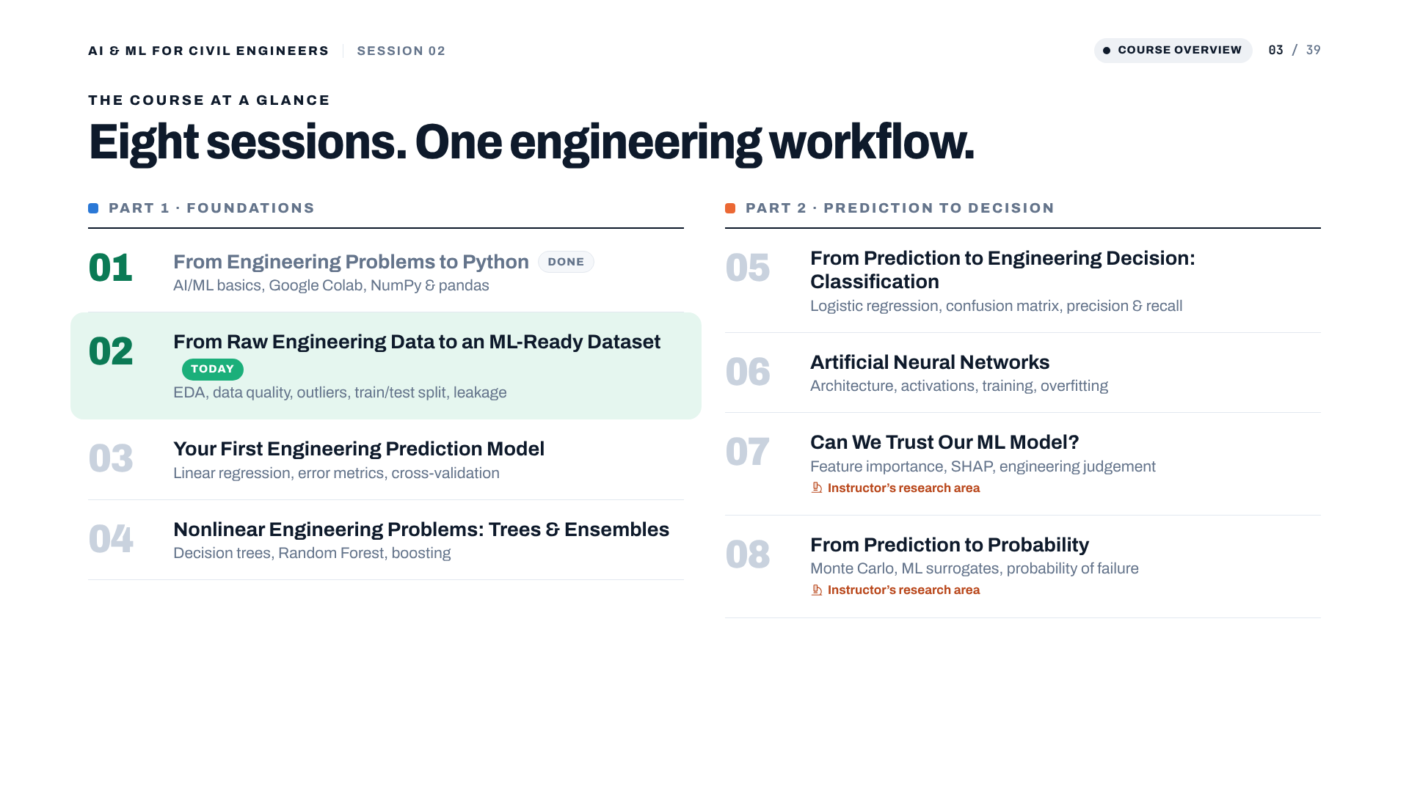
Notes:
Where we are in the course: session 01 done, session 02 today. Everything in sessions 03 to 08 depends on today: a model can only be as good as the dataset we prepare now.

Slide 4
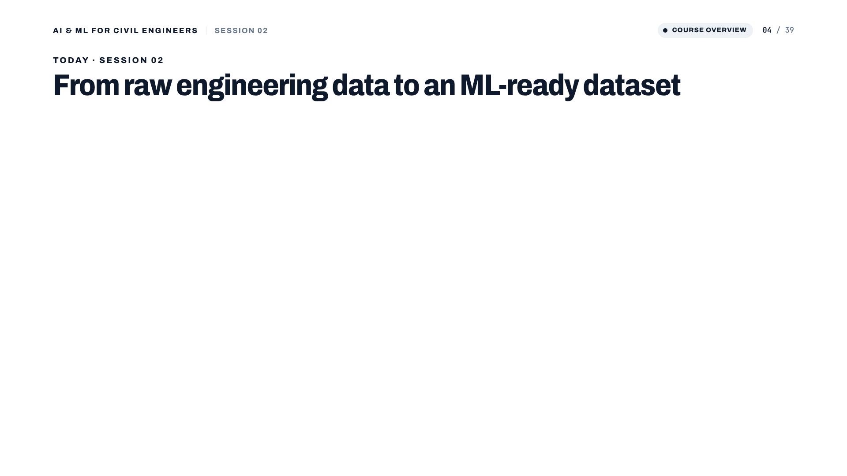
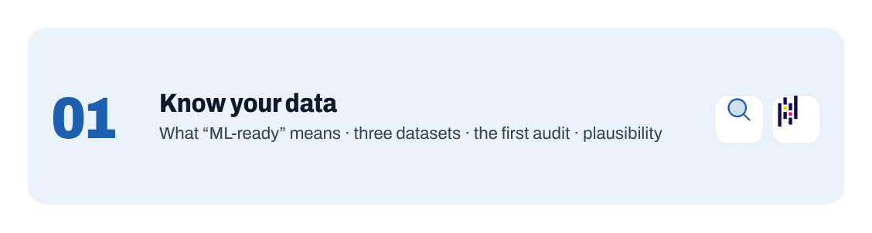

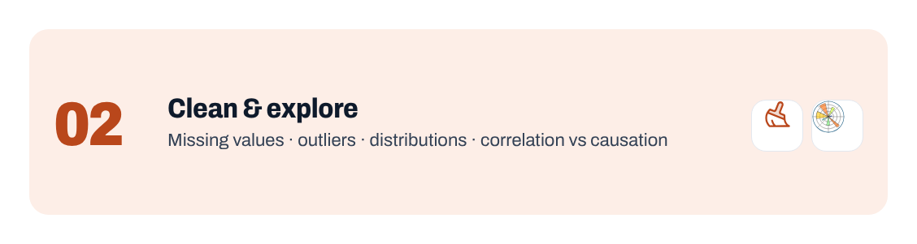
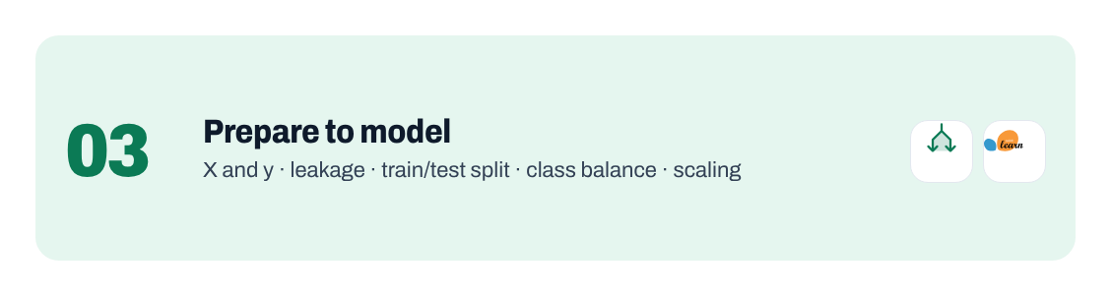
Notes:
Three parts. Part 01: know your data (what ML-ready means, three real datasets, the first audit, plausibility). Part 02: clean and explore (missing values, outliers, distributions, correlation). Part 03: prepare to model (X and y, leakage, train/test split, class balance, scaling). Read the four outcomes; we come back to them at the end.
[Clicks on this slide: 4]

Slide 5
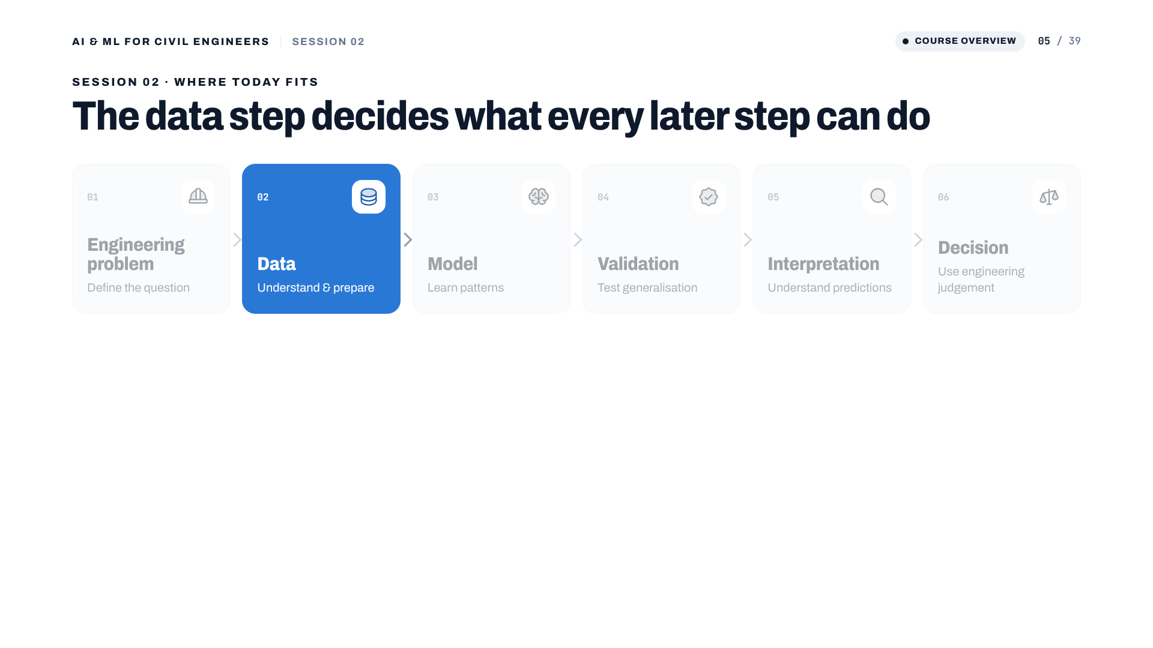
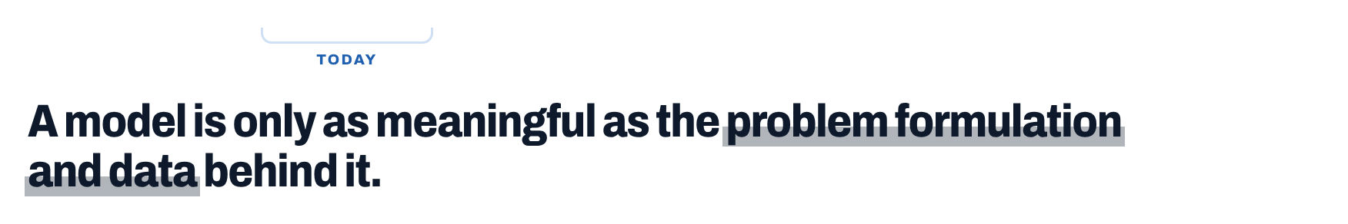
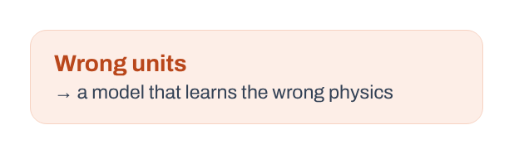
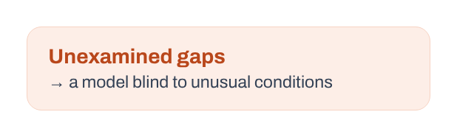
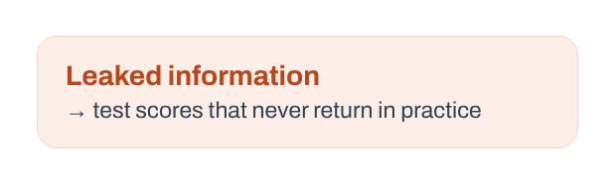
Notes:
The six-step workflow from the original deck. Today is step 02, Data. Message: a model is only as meaningful as the problem formulation and the data behind it. The three orange boxes preview what goes wrong if we skip this step.
[Clicks on this slide: 4]

Slide 6

Notes:
Part 01: know your data before you trust it.

Slide 7
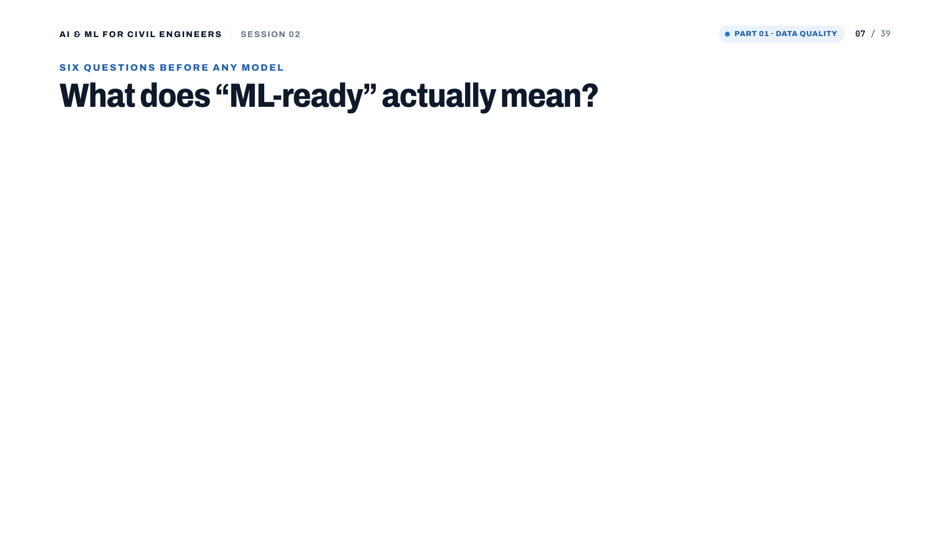
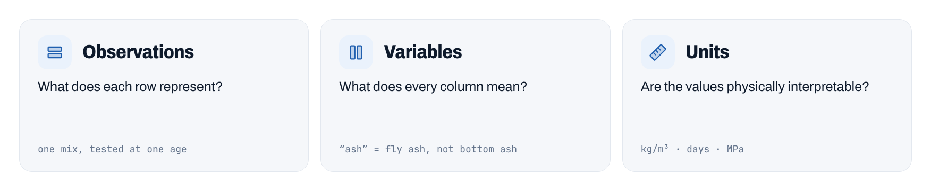
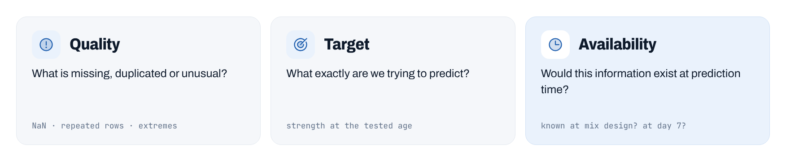
Notes:
Six questions to ask of any dataset before modelling. The examples at the bottom of each card are from the concrete data. Stress the last one, Availability: it comes back as leakage in Part 03. ML-ready is not the same as clean.
[Clicks on this slide: 3]

Slide 8
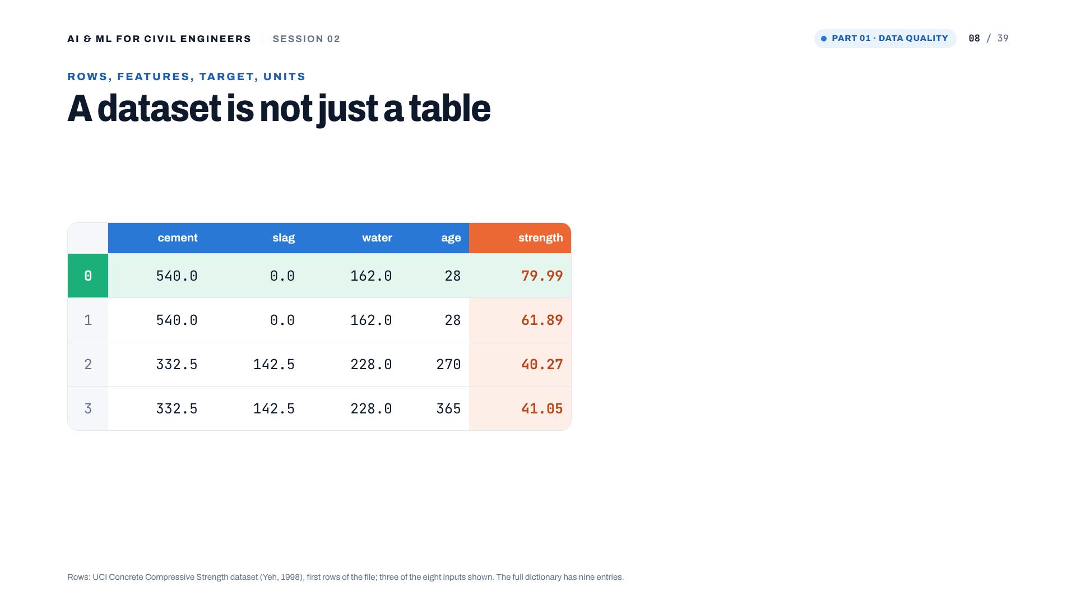
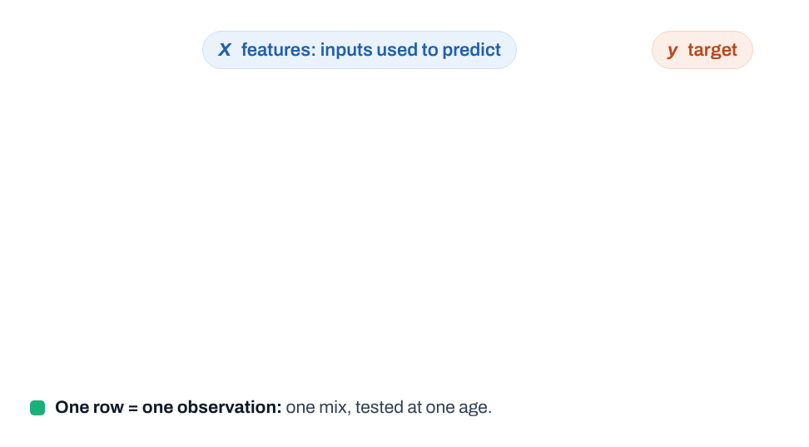
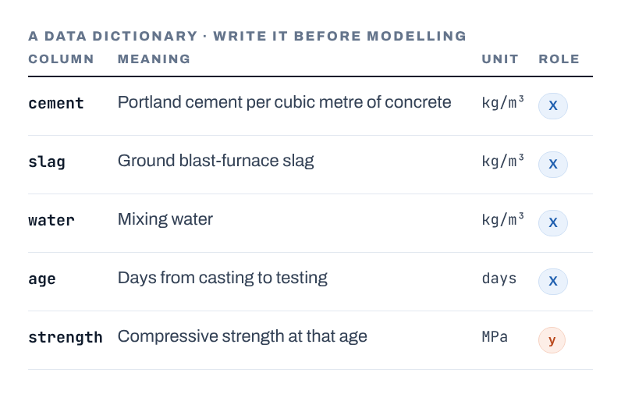
Notes:
A dataset is more than a table. One row = one mix tested at one age (the same mix appears several times at different ages). X are the inputs, y the target. The data dictionary on the right is something every project should have: meaning, unit and role of every column. Ask the cohort to write the full nine-row version as homework.
[Clicks on this slide: 3]

Slide 9

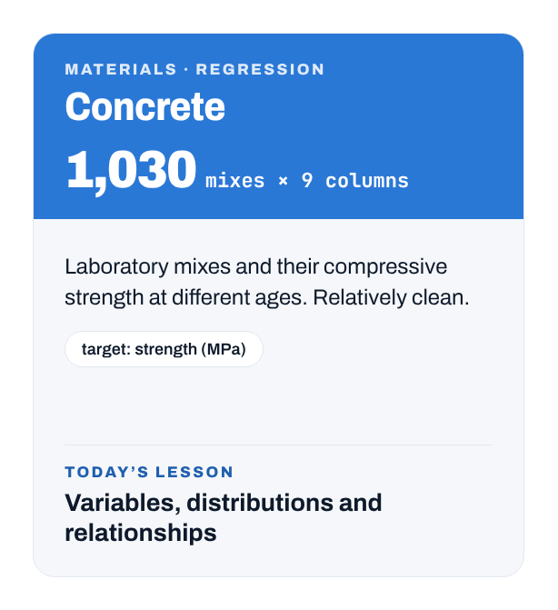


Notes:
Our three real datasets today, all from the UCI Machine Learning Repository. Concrete: 1,030 mixes, clean, used for distributions and relationships. Water treatment: 527 daily records of an urban wastewater plant in Spain, 38 variables, 591 values recorded as '?': our missing-values case. Steel plates: 1941 plates, 27 features, 7 fault classes: our target and class-balance case. Different problems, same preparation questions.
[Clicks on this slide: 4]

Slide 10
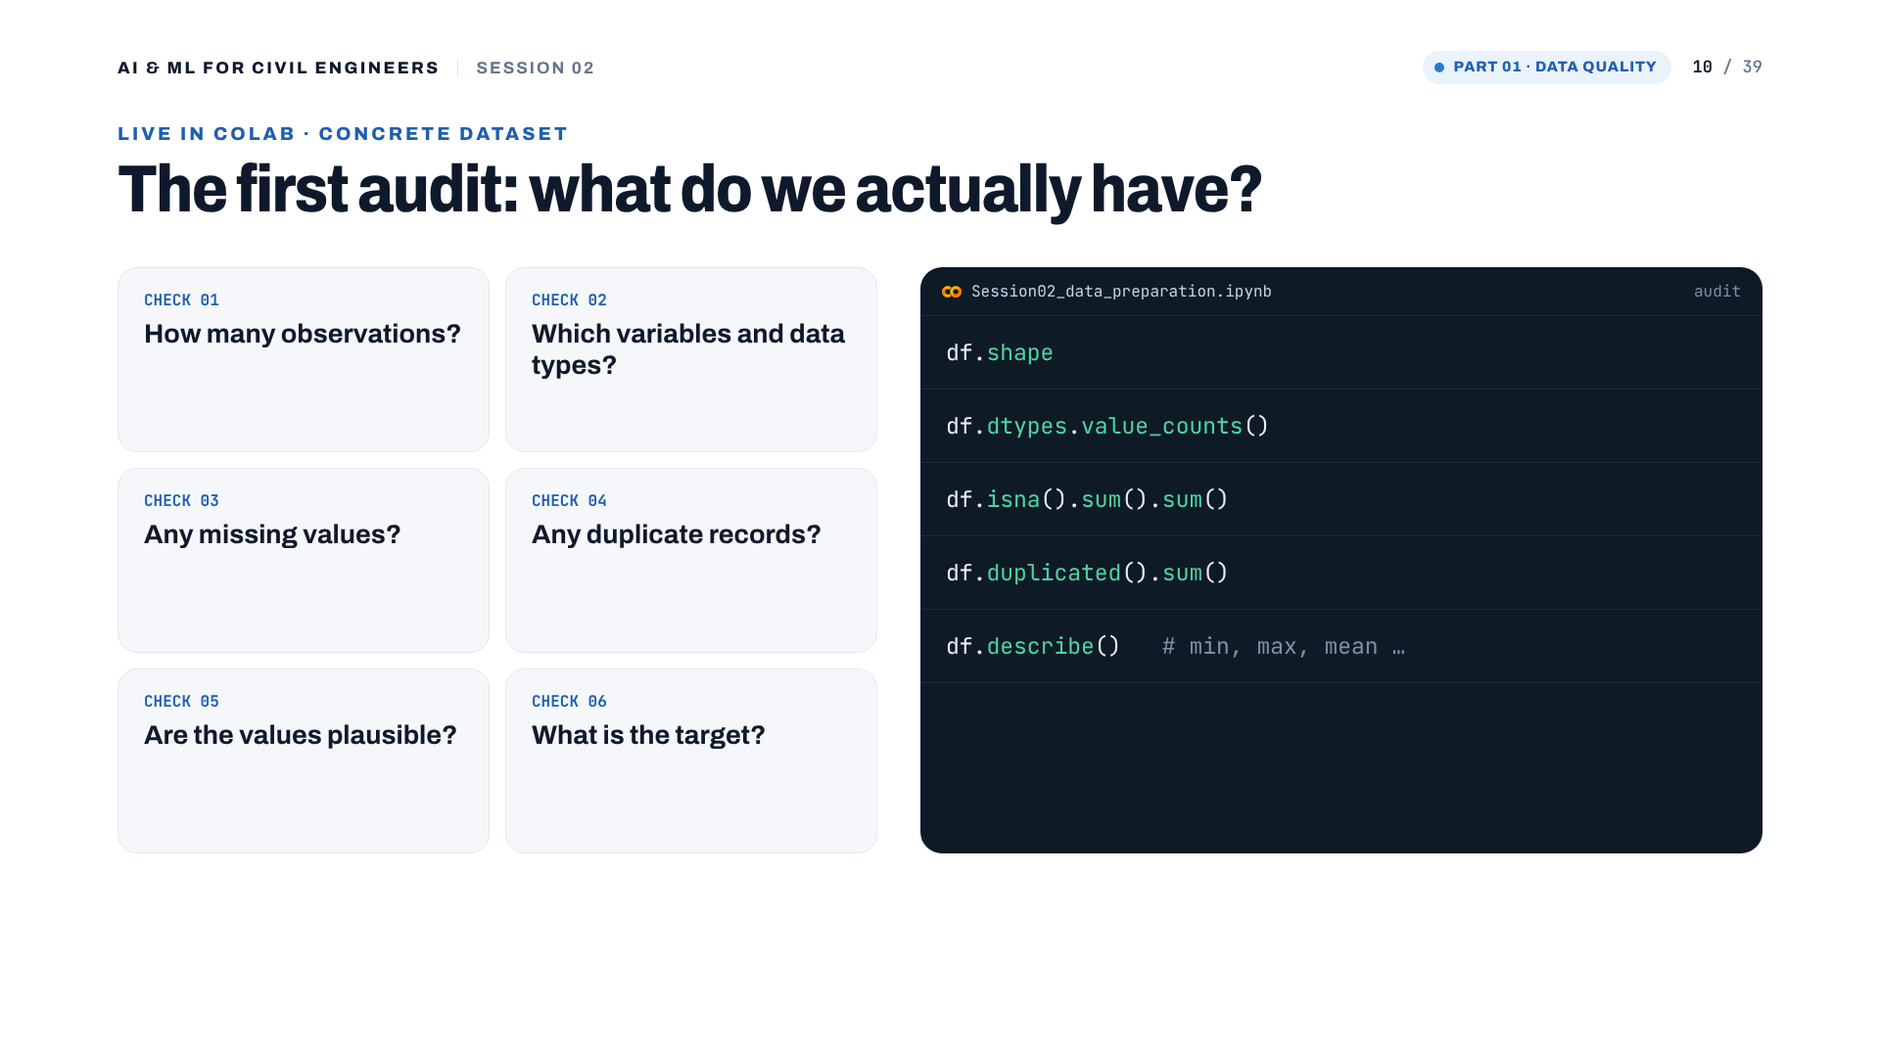
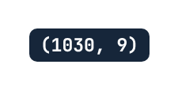
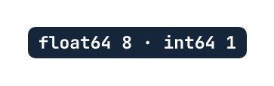


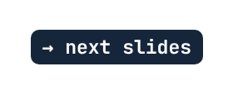
Notes:
Live in Colab. Run the five lines and reveal each output. Shape (1030, 9). Eight float columns and one integer (age). No missing values. But 25 duplicated rows: 11 mixes appear two to four times with the same inputs, the same age and the same strength. They may be repeated records rather than independent tests; we deal with them before the split (slide 28). describe() leads to the plausibility check.
[Clicks on this slide: 6]

Slide 11
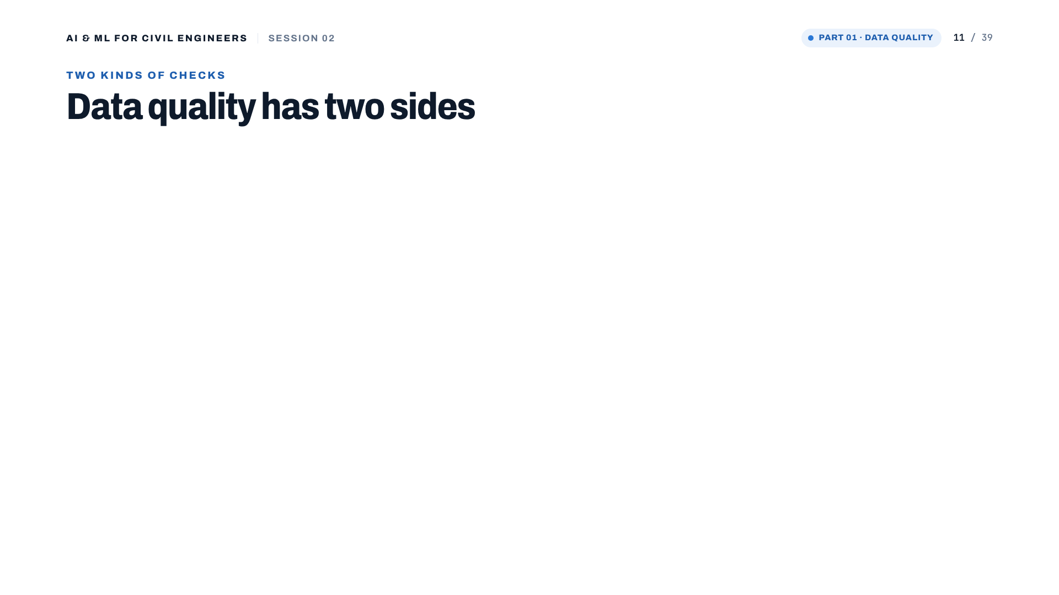
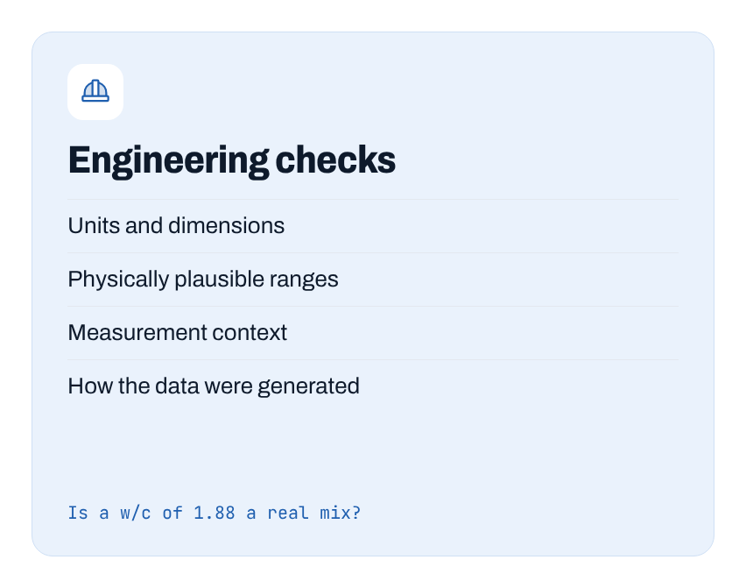
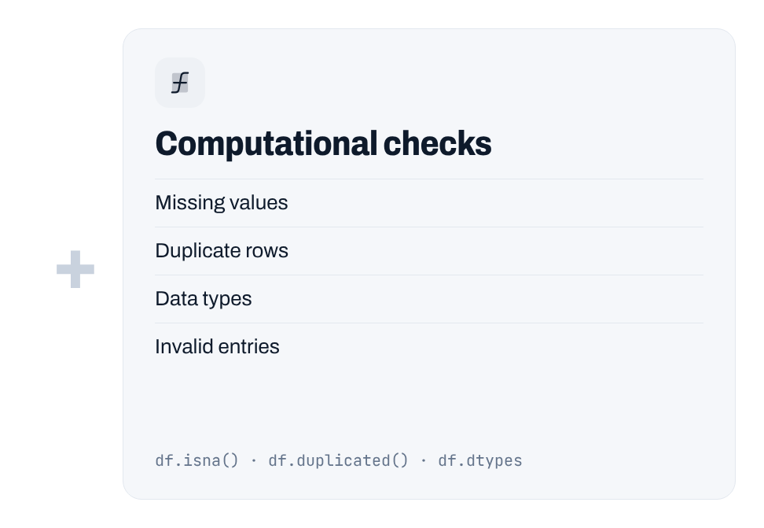
Notes:
Two sides of data quality. Computational checks are what pandas can do for us. Engineering checks need us: units, plausible ranges, how and where the data were measured. A dataset can pass every computational check and still be physically wrong.
[Clicks on this slide: 3]

Slide 12
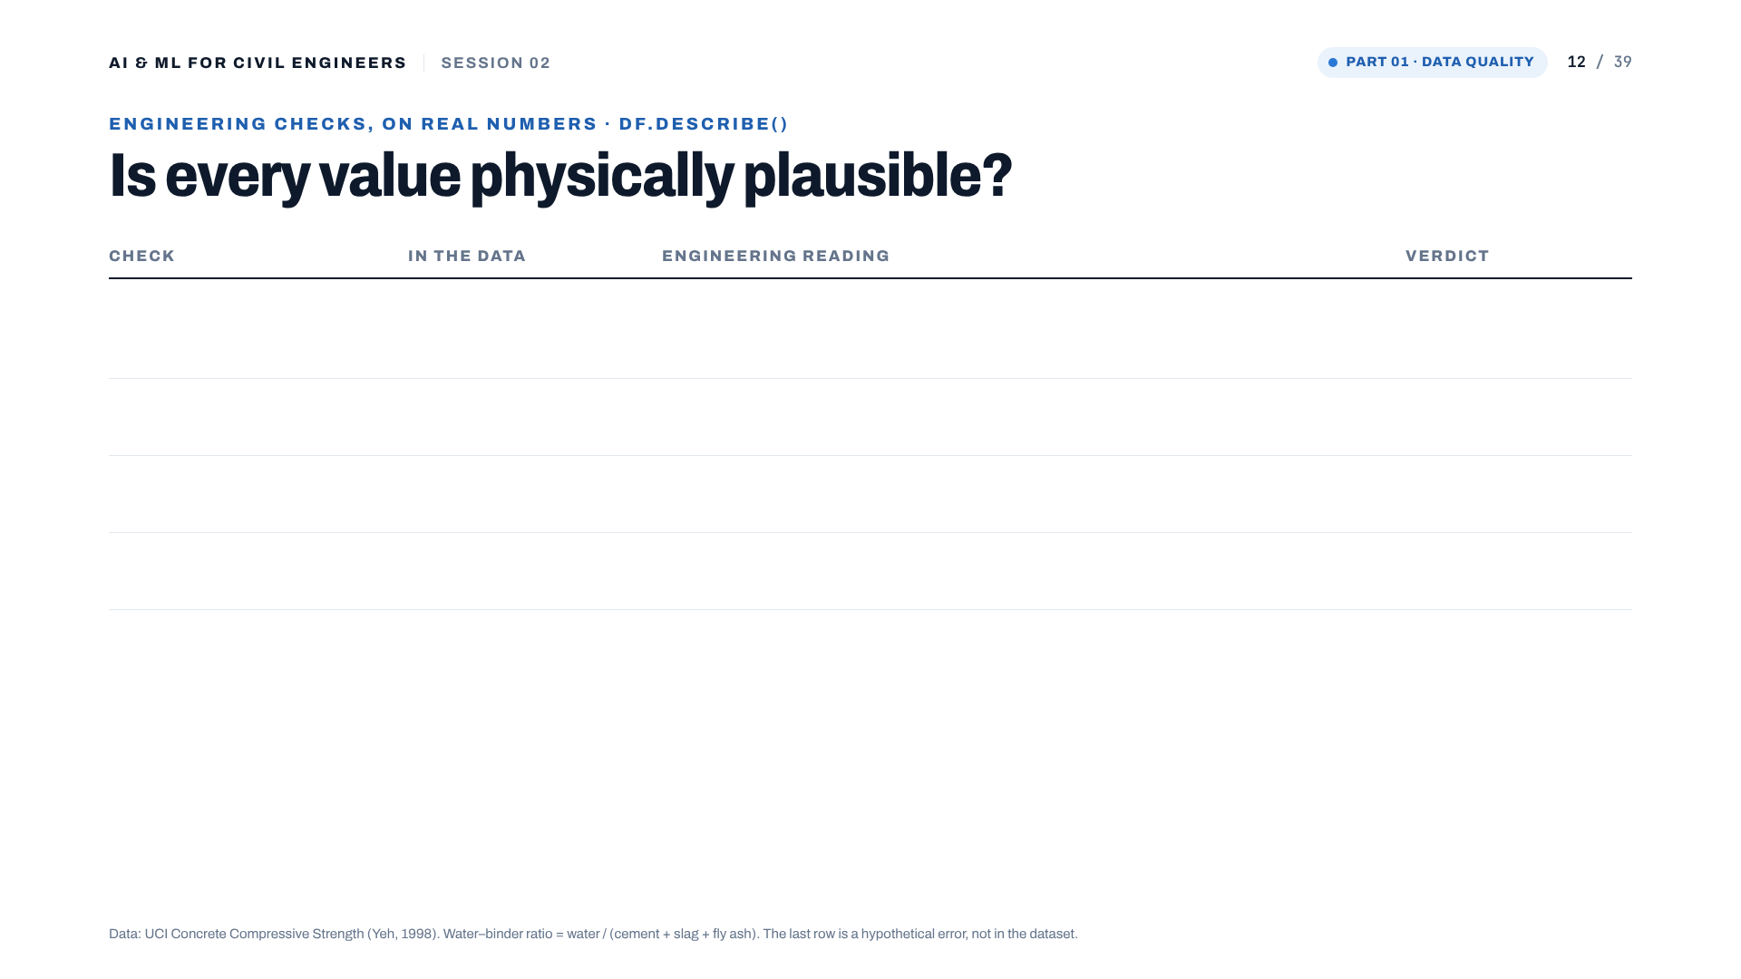
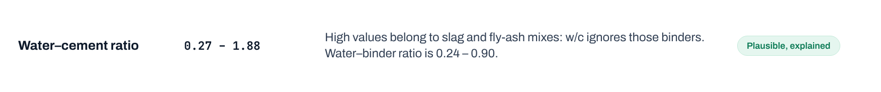
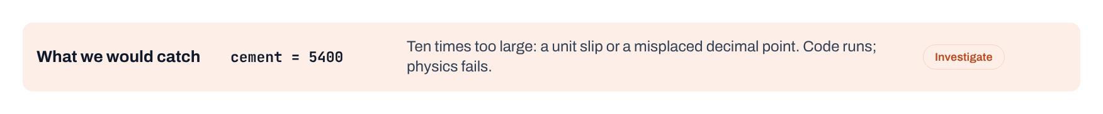
Notes:
Plausibility on real numbers. w/c goes from 0.27 to 1.88; 198 mixes are above 1.0, which looks alarming until you notice they contain slag and fly ash: water-to-total-binder stays between 0.24 and 0.90. The sum of ingredients (2,195 to 2,551 kg/m3) is close to the unit weight of normal concrete. The last row is hypothetical: a unit slip that code would never flag.
[Clicks on this slide: 6]

Slide 13

Notes:
Part 02: clean and explore, with engineering eyes.

Slide 14

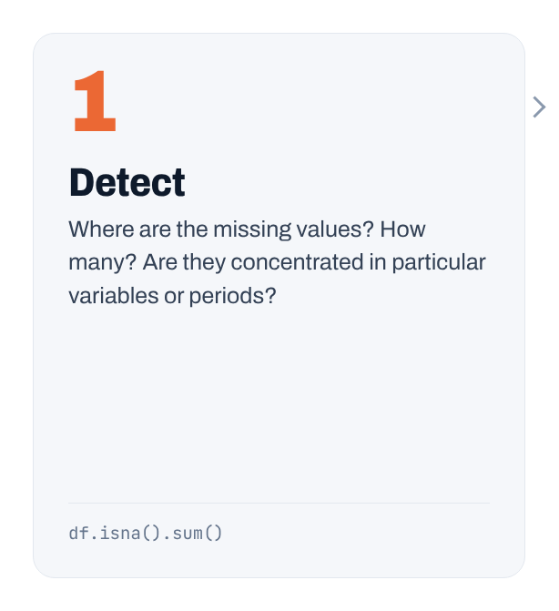
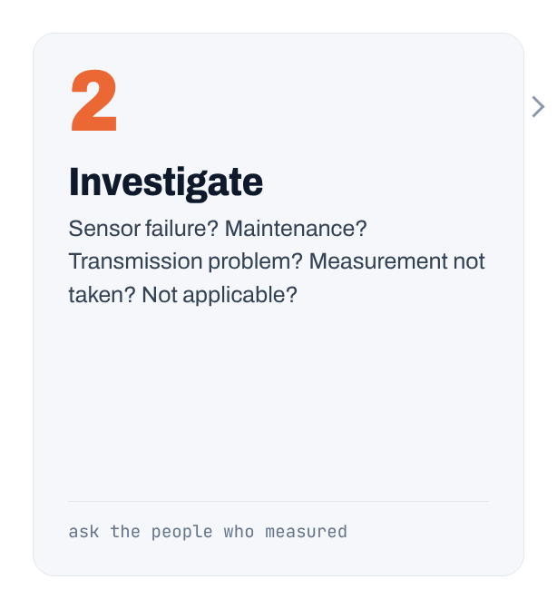
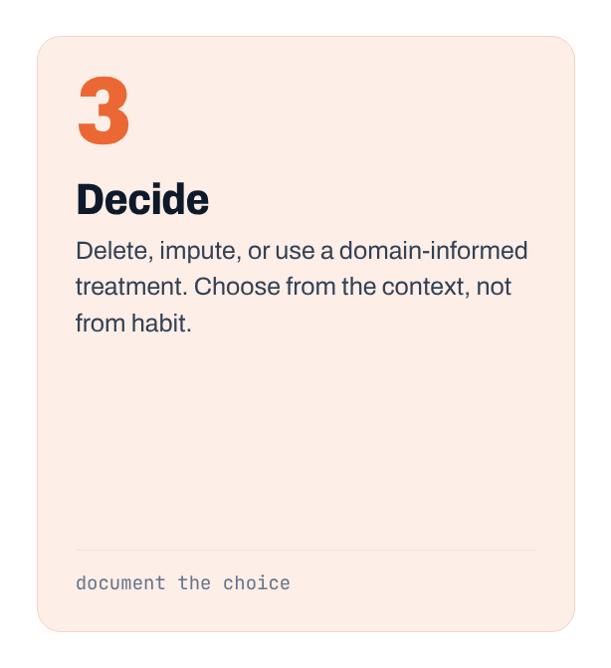
Notes:
Missing data in three steps. Detect: where, how many, concentrated where. Investigate: why. Decide: delete, impute or a domain-informed treatment, and document it. There is no universal rule.
[Clicks on this slide: 4]

Slide 15
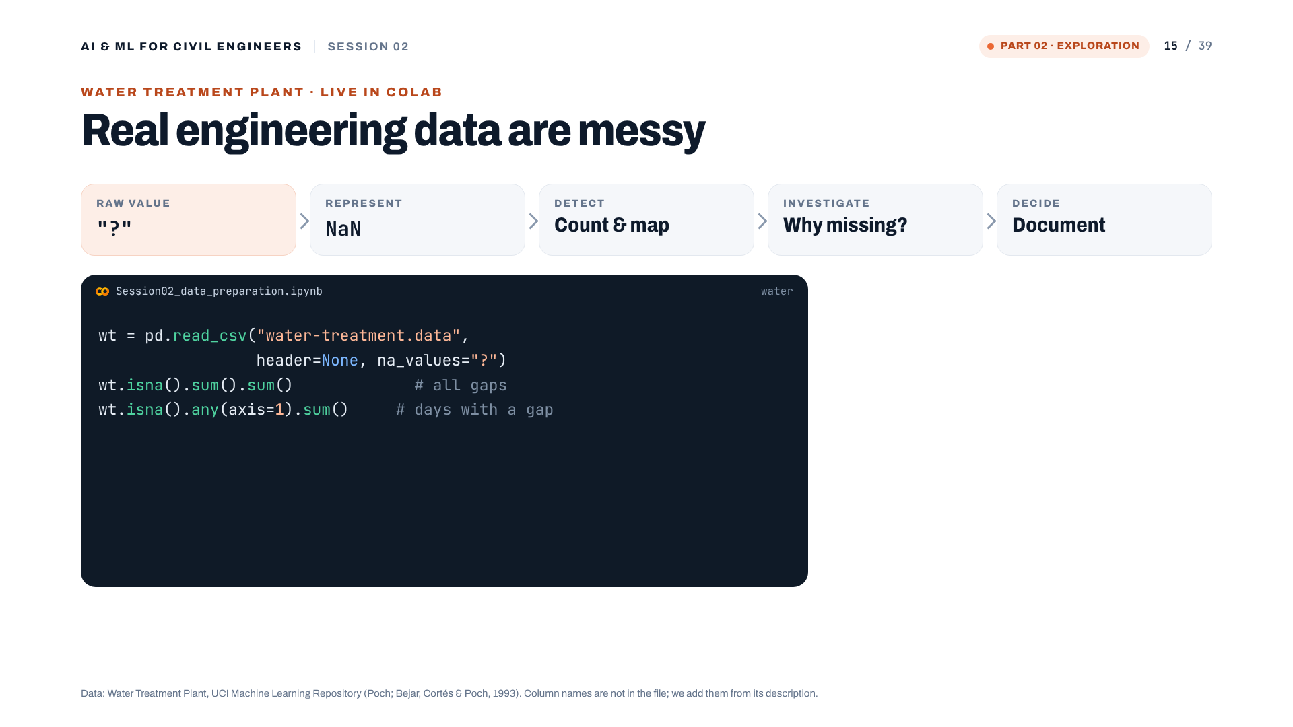
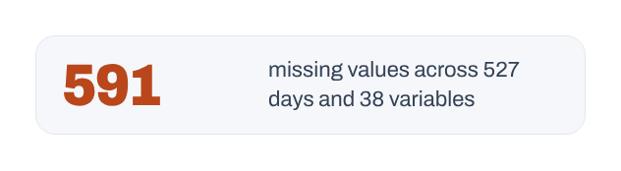
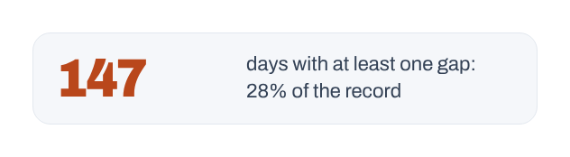
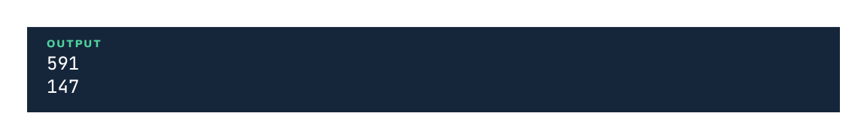
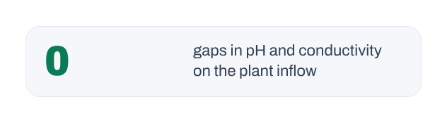
Notes:
Live in Colab with the water-treatment file. The file writes missing values as '?'. Without na_values='?', pandas reads those columns as text. With it: 591 missing values, and 147 of 527 days (28%) have at least one gap. pH and conductivity at the plant inflow have none.
[Clicks on this slide: 5]

Slide 16
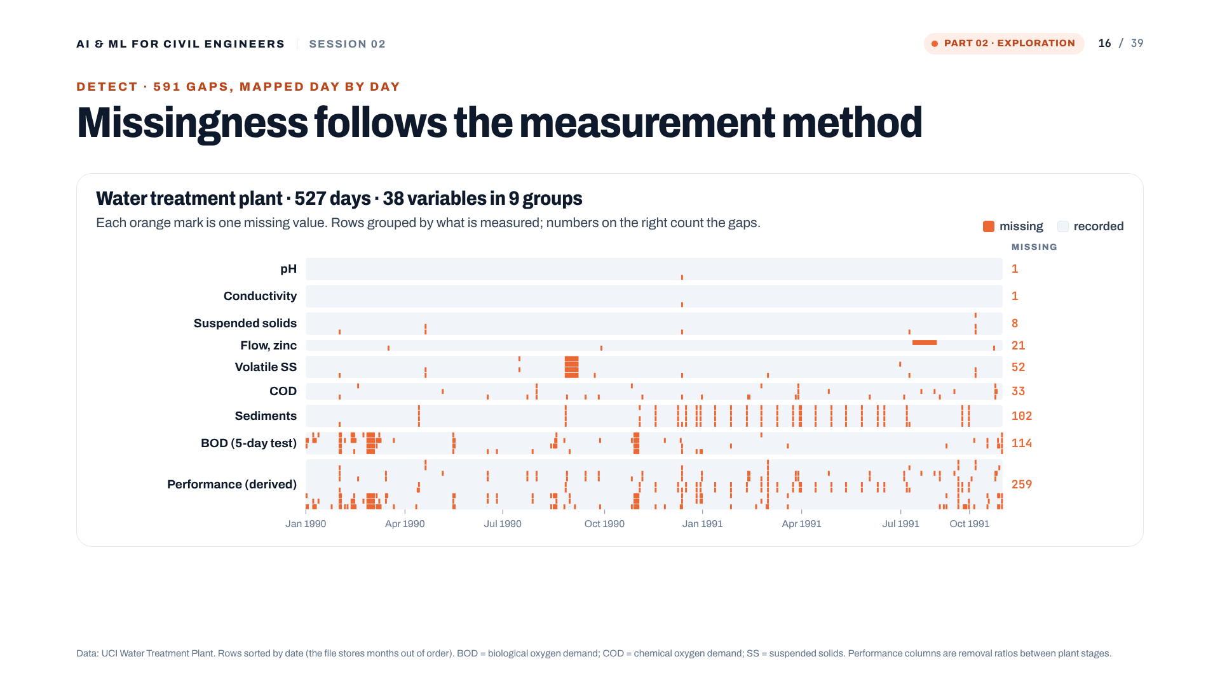
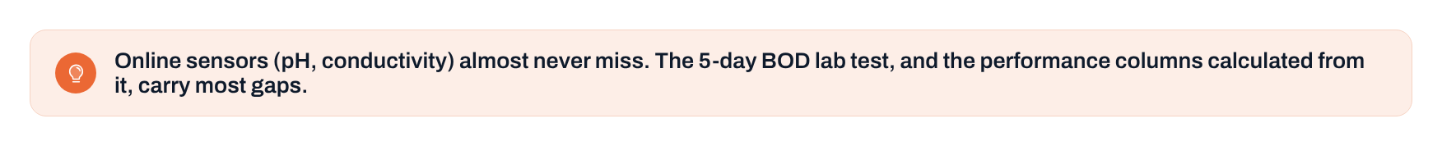
Notes:
The missing-value map: one orange mark per gap, rows grouped by what is measured. Online sensors (pH, conductivity) almost never miss. Sediments and BOD, laboratory tests (BOD takes five days), carry most gaps. The performance columns are calculated from those lab values, so they inherit the gaps. Missingness follows the measurement method. Note: the file stores months out of order; we sorted by date first.
[Clicks on this slide: 1]

Slide 17
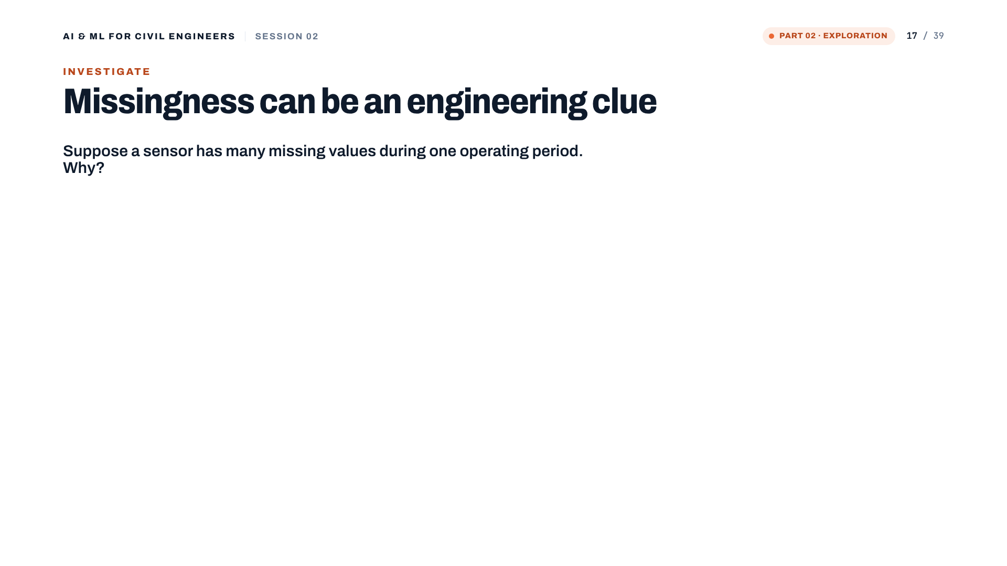

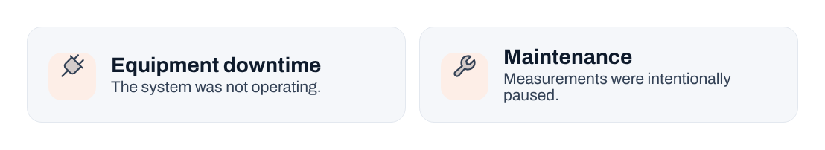
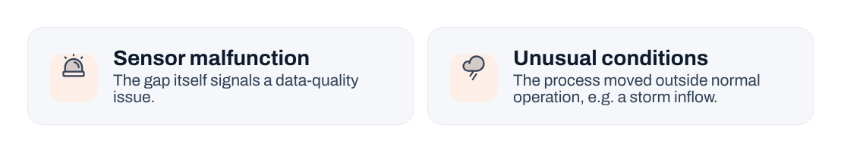
Notes:
Ask the cohort: why might a sensor go silent? Four typical reasons. Then the real clue: only 5 of 527 records fall on a Saturday. Whole days are missing because of a sampling schedule. A missing day in the calendar and a '?' in a cell are different kinds of missing, and both carry information.
[Clicks on this slide: 4]

Slide 18
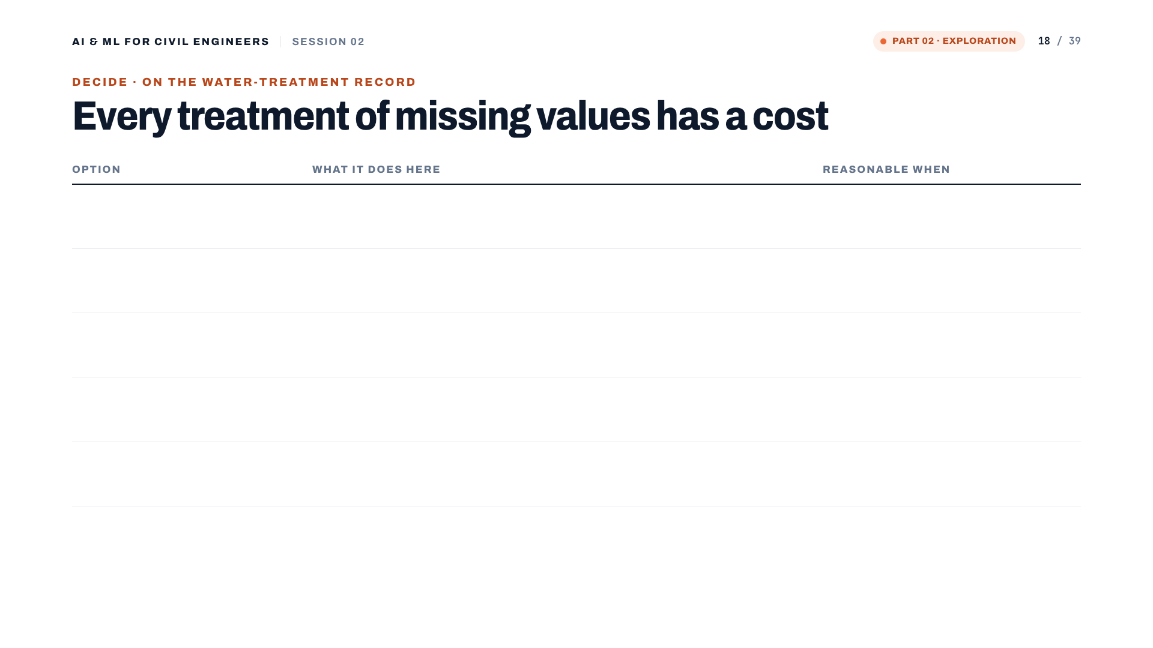
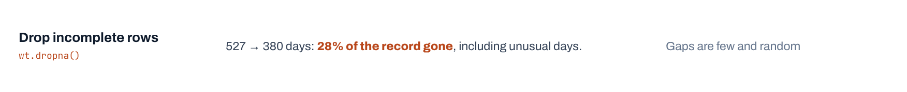
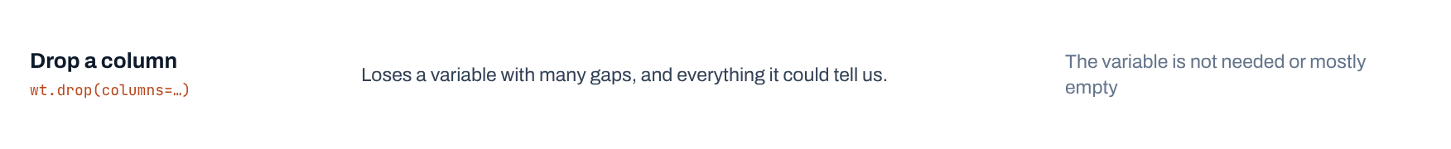
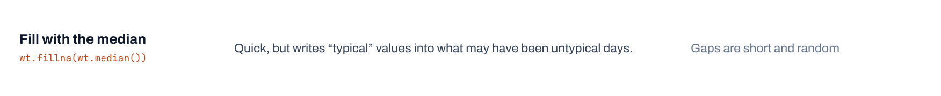
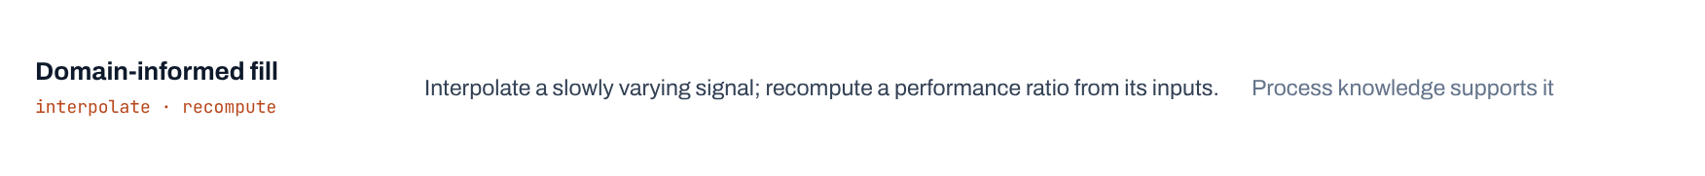
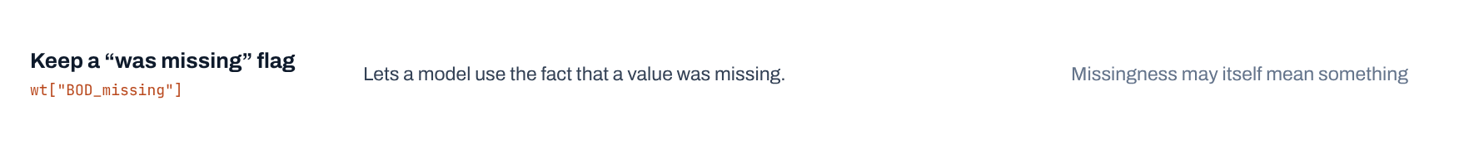
Notes:
Every option has a cost. Dropping incomplete rows keeps 380 of 527 days and loses 28% of the record, probably the unusual days we care most about. Median filling invents typical values. Domain-informed filling uses process knowledge. A 'was missing' flag keeps the information. Whatever you choose, write it down, and learn fill values from the training data only (link to leakage).
[Clicks on this slide: 6]

Slide 19
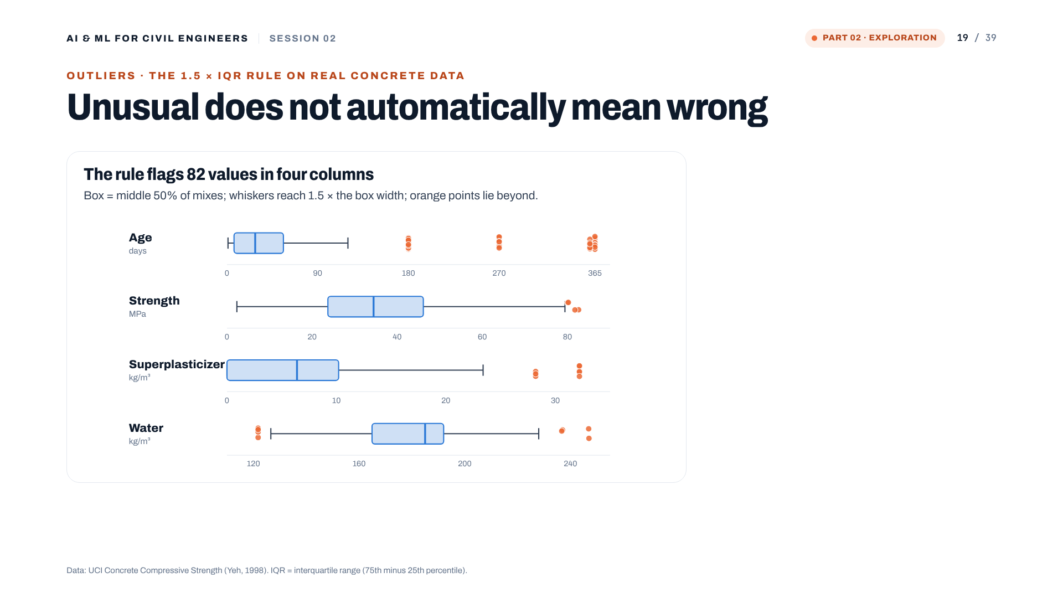


Notes:
The 1.5 x IQR rule on four concrete columns flags 82 values. Look at age: all 59 flags are real 180-, 270-, 360- and 365-day tests. The four 'strength outliers' are high-strength mixes near 80 MPa. Superplasticizer flags are two mix families. Nothing here is provably wrong. Flag, investigate, decide.
[Clicks on this slide: 3]

Slide 20





Notes:
df.hist() on four columns. Cement: wide spread, no typical mix. Water: spikes at 192 kg/m3 (118 mixes) and 228 kg/m3: repeated designs. Age: a handful of test ages, 425 at 28 days. Strength: roughly bell-shaped around 35 MPa with a tail to 83 MPa. Ask the cohort what they would note before fitting a model.
[Clicks on this slide: 5]

Slide 21


Notes:
Correlation with strength: cement +0.50, superplasticizer +0.37, age +0.33, water -0.29. Age looks weak by r, yet strength clearly depends on age: it rises fast and then levels off. Pearson r measures straight-line association only. And no correlation proves causation.
[Clicks on this slide: 2]

Slide 22




Notes:
The road example from the original deck, drawn as a cause diagram. Bigger puddles go with deeper potholes, but the puddle does not cause the pothole. Traffic, cracked asphalt and poor drainage shape both. Engineering action should target the cause.
[Clicks on this slide: 4]

Slide 23




Notes:
A memorable coincidence: U.S. mozzarella consumption and civil-engineering doctorates rose together 2000-2009 (r about 0.95, Tyler Vigen's Spurious Correlations). The chart is a schematic of the shape, not the published values. Use it to remember the principle, not as evidence.
[Clicks on this slide: 4]

Slide 24

Notes:
Part 03: prepare the data for an honest model.

Slide 25





Notes:
Formulate the learning problem: 8 features, one target. In code, X = df.drop(columns='strength') and y = df['strength']. Read the shapes aloud: (1030, 8) is a table; (1030,) is one value per row.
[Clicks on this slide: 5]

Slide 26






Notes:
Four roles a column can play. Identifiers such as the water-treatment date code label a row; they rarely carry meaning. Leaked information would not exist when the prediction is made. Three questions before using any column.
[Clicks on this slide: 6]

Slide 27






Notes:
Data leakage, the silent killer. Information unavailable at prediction time sneaks into training or preprocessing; test scores look excellent; reality disappoints. Two forms: a leaking column (56-day strength or an acceptance test when predicting 28-day strength at the design stage) and leaking preprocessing (statistics computed on the full dataset before the split).
[Clicks on this slide: 6]

Slide 28




Notes:
Split before fitting. test_size=0.2 on 1,030 mixes gives 824 for training and 206 for testing. Remember the 25 duplicates: if one copy lands in train and its twin in test, the test becomes easier than reality. Remove them before splitting.
[Clicks on this slide: 3]

Slide 29



Notes:
Why a separate test set? The exam analogy: memorising last year's paper gives full marks on that paper and says little about understanding. In session 03 we fit on train, predict the test rows, and compare with their true y.
[Clicks on this slide: 4]

Slide 30



Notes:
random_state: without a fixed seed each run puts different rows in the test set, so results move between runs. With random_state=42 the split is identical every time. 42 has no meaning; any number works if it is recorded.
[Clicks on this slide: 3]

Slide 31




Notes:
Steel plates: 7 fault classes, very unequal. A model that always answers 'Other faults' is right 34.7% of the time without learning anything. Dirtiness has only 55 plates, about 11 in a 20% test set. stratify=y keeps the class proportions in train and test. We return to this in session 05.
[Clicks on this slide: 4]

Slide 32




Notes:
Scaling preview. Aggregates are in the hundreds of kg/m3, superplasticizer in the tens, age in days. Distance- and gradient-based methods care about this; tree methods much less. The rule: fit the scaler on training data, then apply it to the test data.
[Clicks on this slide: 3]

Slide 33



Notes:
The complete journey in eight steps, coloured by today's three parts. Good ML begins before the algorithm.
[Clicks on this slide: 3]

Slide 34






Notes:
Hands-on: open the notebook, save a copy, work through the four sections. Replace 'Link shared in the session chat' with the real link if you want it on the slide.
[Clicks on this slide: 5]

Slide 35

Notes:
The final takeaway. Two questions to ask before choosing any algorithm. Then the order: understand the data, formulate the problem, protect the evaluation, then model.
[Clicks on this slide: 3]

Slide 36


Notes:
Bridge to session 03: a linear-regression model for concrete strength, trained on today's training set, judged on the test set with MAE, RMSE, R-squared, residuals and cross-validation.
[Clicks on this slide: 1]

Slide 37





Notes:
Optional practice before session 03.
[Clicks on this slide: 4]

Slide 38

Notes:
Questions.

Slide 39

Notes:
Thank you. See you in session 03.

