Slide 1




Live online course
Cohort Fall 2026
AI & Machine
Learning for Civil
Engineers
Session 02 · Data before algorithms
From Raw Engineering Data to an
ML-Ready Dataset
Can we trust our engineering data before giving it to a model?
Data quality
Exploration
Preparation
Evaluation setup
Dr. Abdul Waris
Research Associate · Universität Siegen, Germany
Technology partner
Notes:
Welcome back. Session 02 is about the step before any model: turning raw engineering records into a dataset we can trust. Read the question on the slide aloud: can we trust our engineering data before giving it to a model? The four labels are the arc of today: data quality, exploration, preparation, and setting up a fair evaluation.

Slide 2



AI & ML for Civil Engineers
Session 02
Course overview
02 / 39
Where we left off · Session 01
Last time: X, y and one engineering workflow
X
y
Features
Target
One workflow
A notebook
The inputs we give the model:
the mix and its age.
What we want to predict. The
target decides the ML
problem.
Problem, data, Python,
model, decision: the same
chain for every application.
We loaded 1,030 lab tests
with pandas and drew our first
plot.
cement, water, age …
strength (MPa)
problem → … → decision
pd.read_csv("concrete.csv")
Today we stop assuming the table is ready. We ask whether it deserves a model.
Notes:
Two-minute recap. X = the inputs, y = what we predict, and the target decides whether it is regression or classification. We used one workflow for every problem, and we loaded 1,030 concrete tests with pandas. Last time we assumed the table was ready. Today we question that assumption.
[Clicks on this slide: 3]

Slide 3


AI & ML for Civil Engineers
Session 02
Course overview
03 / 39
The course at a glance
Eight sessions. One engineering workflow.
Part 1 · Foundations
Part 2 · Prediction to decision
01
From Engineering Problems to Python
Done
05
From Prediction to Engineering Decision:
Classification
AI/ML basics, Google Colab, NumPy & pandas
Logistic regression, confusion matrix, precision & recall
02
From Raw Engineering Data to an ML-Ready Dataset
Today
06
Artificial Neural Networks
EDA, data quality, outliers, train/test split, leakage
Architecture, activations, training, overfitting
Your First Engineering Prediction Model
07
Can We Trust Our ML Model?
03
Feature importance, SHAP, engineering judgement
Linear regression, error metrics, cross-validation
Instructor’s research area
04
Nonlinear Engineering Problems: Trees & Ensembles
From Prediction to Probability
Decision trees, Random Forest, boosting
08
Monte Carlo, ML surrogates, probability of failure
Instructor’s research area
Notes:
Where we are in the course: session 01 done, session 02 today. Everything in sessions 03 to 08 depends on today: a model can only be as good as the dataset we prepare now.

Slide 4









AI & ML for Civil Engineers
Session 02
Course overview
04 / 39
Today · Session 02
From raw engineering data to an ML-ready dataset
By the end of today you can
01
Know your data
What “ML-ready” means · three datasets · the first audit · plausibility
Audit a dataset: size, types, missing
values, duplicates and plausible
ranges
Decide what to do with missing values
and outliers, and say why
02
Clean & explore
Missing values · outliers · distributions · correlation vs causation
Read distributions and correlations
without over-reading them
Choose X and y, spot leakage, and
split train and test reproducibly
03
Prepare to model
X and y · leakage · train/test split · class balance · scaling
Notes:
Three parts. Part 01: know your data (what ML-ready means, three real datasets, the first audit, plausibility). Part 02: clean and explore (missing values, outliers, distributions, correlation). Part 03: prepare to model (X and y, leakage, train/test split, class balance, scaling). Read the four outcomes; we come back to them at the end.
[Clicks on this slide: 4]

Slide 5









AI & ML for Civil Engineers
Session 02
Course overview
05 / 39
Session 02 · where today fits
The data step decides what every later step can do
01
02
03
04
05
06
Engineering
problem
Decision
Data
Model
Validation
Interpre­tation
Use engineering
judgement
Define the question
Understand & prepare
Learn patterns
Test generalisation
Understand predictions
Today
A model is only as meaningful as the problem formulation
and data behind it.
Wrong units
Unexamined gaps
Leaked information
→ a model that learns the wrong physics
→ a model blind to unusual conditions
→ test scores that never return in practice
Notes:
The six-step workflow from the original deck. Today is step 02, Data. Message: a model is only as meaningful as the problem formulation and the data behind it. The three orange boxes preview what goes wrong if we skip this step.
[Clicks on this slide: 4]

Slide 6


AI & ML for Civil Engineers
Session 02
06 / 39
01
a
What “ML-ready” means
b
A dataset is more than a table
c
Three datasets, three lessons
d
The first audit
e
Is it physically plausible?
Part 01 · Data quality
Know your data before
you trust it
Notes:
Part 01: know your data before you trust it.

Slide 7







AI & ML for Civil Engineers
Session 02
Part 01 · Data quality
07 / 39
Six questions before any model
What does “ML-ready” actually mean?
Observations
Variables
Units
What does each row represent?
What does every column mean?
Are the values physically interpretable?
one mix, tested at one age
“ash” = fly ash, not bottom ash
kg/m³ · days · MPa
Quality
Target
Availability
What is missing, duplicated or unusual?
What exactly are we trying to predict?
Would this information exist at prediction
time?
NaN · repeated rows · extremes
strength at the tested age
known at mix design? at day 7?
ML-ready ≠ merely clean. Clean means no errors; ML-ready means every column is understood.
Notes:
Six questions to ask of any dataset before modelling. The examples at the bottom of each card are from the concrete data. Stress the last one, Availability: it comes back as leakage in Part 03. ML-ready is not the same as clean.
[Clicks on this slide: 3]

Slide 8

AI & ML for Civil Engineers
Session 02
Part 01 · Data quality
08 / 39
Rows, features, target, units
A dataset is not just a table
X
features: inputs used to predict
y
target
A data dictionary · write it before modelling
Column
Meaning
Unit
Role
cement
slag
water
age
strength
cement
Portland cement per cubic metre of concrete
kg/m³
X
0
540.0
0.0
162.0
28
79.99
Ground blast-furnace slag
slag
kg/m³
X
1
540.0
0.0
162.0
28
61.89
water
Mixing water
kg/m³
X
2
332.5
142.5
228.0
270
40.27
age
Days from casting to testing
days
X
3
332.5
142.5
228.0
365
41.05
strength
Compressive strength at that age
MPa
y
One row = one observation: one mix, tested at one age.
Before modelling, understand what every column represents, and document its unit and role.
Rows: UCI Concrete Compressive Strength dataset (Yeh, 1998), first rows of the file; three of the eight inputs shown. The full dictionary has nine entries.
Notes:
A dataset is more than a table. One row = one mix tested at one age (the same mix appears several times at different ages). X are the inputs, y the target. The data dictionary on the right is something every project should have: meaning, unit and role of every column. Ask the cohort to write the full nine-row version as homework.
[Clicks on this slide: 3]

Slide 9

AI & ML for Civil Engineers
Session 02
Part 01 · Data quality
09 / 39
Real data, all session · UCI Machine Learning Repository
Three datasets, three lessons
Materials · regression
Water & environment · plant records
Steel · quality inspection
Concrete
Water treatment
Steel plates
1,030
mixes × 9 columns
527
days × 38 variables
1,941
plates × 27 features
Laboratory mixes and their compressive
strength at different ages. Relatively clean.
Daily sensor and laboratory readings from an
urban wastewater plant. Messy, like most
real records.
Geometry and luminosity measurements of
surface faults on steel plates, each labelled
with one of 7 fault types.
target: strength (MPa)
591 values written as “?”
target: fault class (7)
Today’s lesson
Today’s lesson
Today’s lesson
Variables, distributions and
relationships
Missing values and how to
investigate them
What the target means, and class
balance
The engineering problem changes. The data-preparation questions remain.
UCI Machine Learning Repository: Concrete Compressive Strength (Yeh, 1998); Water Treatment Plant (Poch; Bejar, Cortés & Poch, 1993); Steel Plates Faults (Buscema, Terzi & Tastle, 2010).
Notes:
Our three real datasets today, all from the UCI Machine Learning Repository. Concrete: 1,030 mixes, clean, used for distributions and relationships. Water treatment: 527 daily records of an urban wastewater plant in Spain, 38 variables, 591 values recorded as '?': our missing-values case. Steel plates: 1941 plates, 27 features, 7 fault classes: our target and class-balance case. Different problems, same preparation questions.
[Clicks on this slide: 4]

Slide 10


AI & ML for Civil Engineers
Session 02
Part 01 · Data quality
10 / 39
Live in Colab · concrete dataset
The first audit: what do we actually have?
CHECK 01
CHECK 02
Session02_data_preparation.ipynb
audit
How many observations?
Which variables and data
types?
df.shape
(1030, 9)
df.dtypes.value_counts()
float64 8 · int64 1
CHECK 03
CHECK 04
df.isna().sum().sum()
0
Any missing values?
Any duplicate records?
df.duplicated().sum()
25
df.describe() # min, max, mean …
→ next slides
CHECK 05
CHECK 06
Are the values plausible?
What is the target?
Even our “clean” dataset holds 25 repeated rows: 11 mixes appear two to four times with identical strengths.
Notes:
Live in Colab. Run the five lines and reveal each output. Shape (1030, 9). Eight float columns and one integer (age). No missing values. But 25 duplicated rows: 11 mixes appear two to four times with the same inputs, the same age and the same strength. They may be repeated records rather than independent tests; we deal with them before the split (slide 28). describe() leads to the plausibility check.
[Clicks on this slide: 6]

Slide 11



AI & ML for Civil Engineers
Session 02
Part 01 · Data quality
11 / 39
Two kinds of checks
Data quality has two sides
Engineering checks
Computational checks
Units and dimensions
Missing values
+
Physically plausible ranges
Duplicate rows
Measurement context
Data types
How the data were generated
Invalid entries
Is a w/c of 1.88 a real mix?
df.isna() · df.duplicated() · df.dtypes
A dataset can be computationally clean and physically wrong.
Notes:
Two sides of data quality. Computational checks are what pandas can do for us. Engineering checks need us: units, plausible ranges, how and where the data were measured. A dataset can pass every computational check and still be physically wrong.
[Clicks on this slide: 3]

Slide 12

AI & ML for Civil Engineers
Session 02
Part 01 · Data quality
12 / 39
Engineering checks, on real numbers · df.describe()
Is every value physically plausible?
Check
In the data
Engineering reading
Verdict
Water–cement ratio
0.27 – 1.88
High values belong to slag and fly-ash mixes: w/c ignores those binders.
Water–binder ratio is 0.24 – 0.90.
Plausible, explained
Sum of ingredients
2,195 – 2,551
In kg/m³: close to the unit weight expected of normal-weight concrete.
Plausible
Age at testing
1 – 365 days
Standard test ages: 3, 7, 28, 56, 90 days and long-term tests.
Plausible
Compressive strength
2.3 – 82.6 MPa
From very young concrete to high-strength mixes.
Plausible
What we would catch
cement = 5400
Ten times too large: a unit slip or a misplaced decimal point. Code runs;
physics fails.
Investigate
Computers check types. Engineers check physics.
Data: UCI Concrete Compressive Strength (Yeh, 1998). Water–binder ratio = water / (cement + slag + fly ash). The last row is a hypothetical error, not in the dataset.
Notes:
Plausibility on real numbers. w/c goes from 0.27 to 1.88; 198 mixes are above 1.0, which looks alarming until you notice they contain slag and fly ash: water-to-total-binder stays between 0.24 and 0.90. The sum of ingredients (2,195 to 2,551 kg/m3) is close to the unit weight of normal concrete. The last row is hypothetical: a unit slip that code would never flag.
[Clicks on this slide: 6]

Slide 13





AI & ML for Civil Engineers
Session 02
13 / 39
02
a
Missing values: detect, investigate, decide
b
Missingness as an engineering clue
c
Outliers: unusual is not wrong
d
Explore distributions
e
Correlation is not causation
Part 02 · Exploration
Clean and explore, with
engineering eyes
Notes:
Part 02: clean and explore, with engineering eyes.

Slide 14

AI & ML for Civil Engineers
Session 02
Part 02 · Exploration
14 / 39
Missing data
“What is missing?” is not enough
1
2
3
Detect
Investigate
Decide
Where are the missing values? How
many? Are they concentrated in particular
variables or periods?
Sensor failure? Maintenance?
Transmission problem? Measurement not
taken? Not applicable?
Delete, impute, or use a domain-informed
treatment. Choose from the context, not
from habit.
df.isna().sum()
ask the people who measured
document the choice
There is no universal “remove missing values” rule.
Notes:
Missing data in three steps. Detect: where, how many, concentrated where. Investigate: why. Decide: delete, impute or a domain-informed treatment, and document it. There is no universal rule.
[Clicks on this slide: 4]

Slide 15

AI & ML for Civil Engineers
Session 02
Part 02 · Exploration
15 / 39
Water treatment plant · live in Colab
Real engineering data are messy
Raw value
Represent
Detect
Investigate
Decide
"?"
NaN
Count & map
Why missing?
Document
Session02_data_preparation.ipynb
water
591
missing values across 527
days and 38 variables
wt = pd.read_csv("water-treatment.data",
header=None, na_values="?")
wt.isna().sum().sum() # all gaps
wt.isna().any(axis=1).sum() # days with a gap
147
days with at least one gap:
28% of the record
Output
0
gaps in pH and conductivity
on the plant inflow
591
147
Tell pandas what “missing” looks like in this file. Otherwise “?” is read as text and the column stops being numeric.
Data: Water Treatment Plant, UCI Machine Learning Repository (Poch; Bejar, Cortés & Poch, 1993). Column names are not in the file; we add them from its description.
Notes:
Live in Colab with the water-treatment file. The file writes missing values as '?'. Without na_values='?', pandas reads those columns as text. With it: 591 missing values, and 147 of 527 days (28%) have at least one gap. pH and conductivity at the plant inflow have none.
[Clicks on this slide: 5]

Slide 16
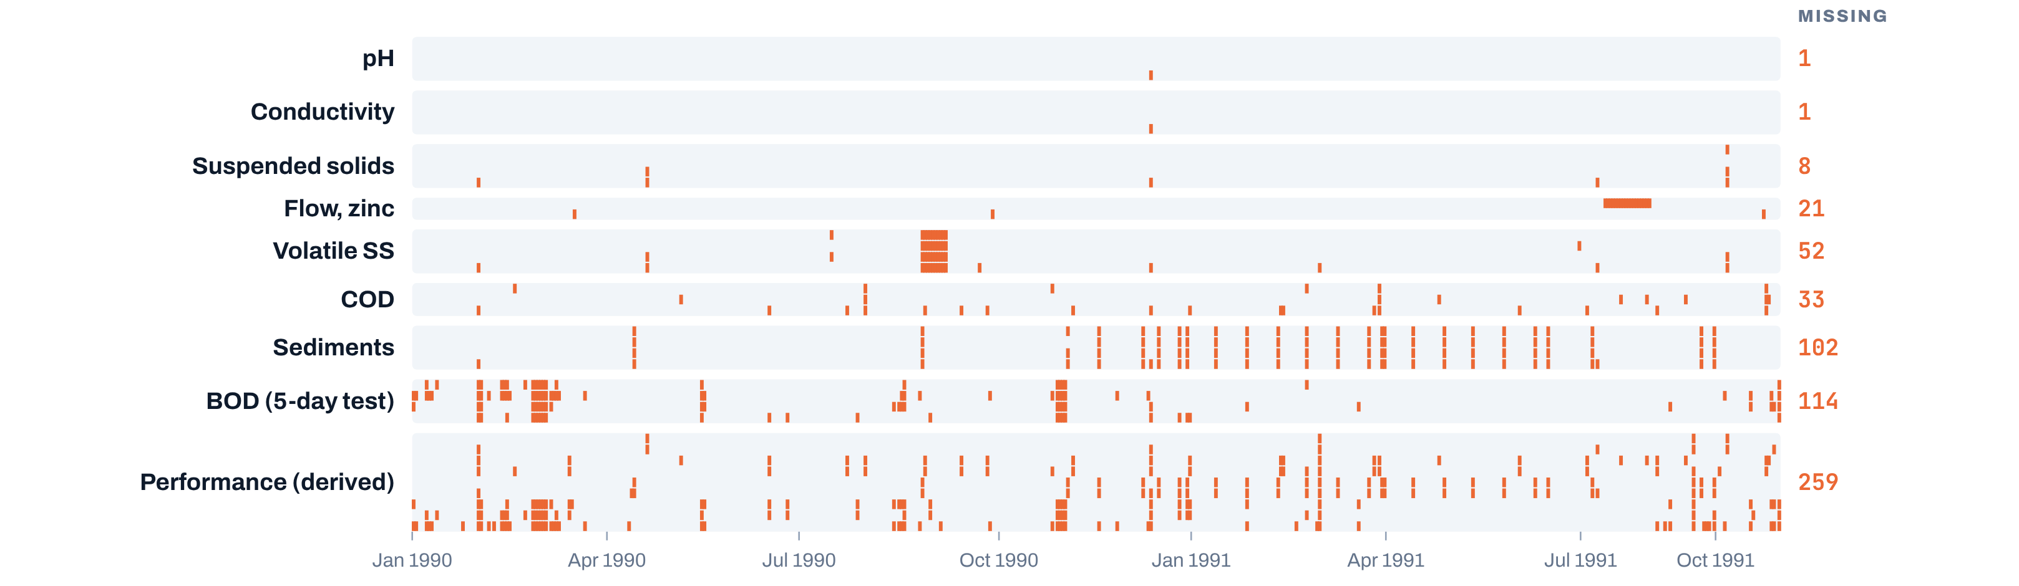

AI & ML for Civil Engineers
Session 02
Part 02 · Exploration
16 / 39
Detect · 591 gaps, mapped day by day
Missingness follows the measurement method
Water treatment plant · 527 days · 38 variables in 9 groups
Each orange mark is one missing value. Rows grouped by what is measured; numbers on the right count the gaps.
missing
recorded
Online sensors (pH, conductivity) almost never miss. The 5-day BOD lab test, and the performance columns calculated from
it, carry most gaps.
Data: UCI Water Treatment Plant. Rows sorted by date (the file stores months out of order). BOD = biological oxygen demand; COD = chemical oxygen demand; SS = suspended solids. Performance columns are removal ratios between plant stages.
Notes:
The missing-value map: one orange mark per gap, rows grouped by what is measured. Online sensors (pH, conductivity) almost never miss. Sediments and BOD, laboratory tests (BOD takes five days), carry most gaps. The performance columns are calculated from those lab values, so they inherit the gaps. Missingness follows the measurement method. Note: the file stores months out of order; we sorted by date first.
[Clicks on this slide: 1]

Slide 17





AI & ML for Civil Engineers
Session 02
Part 02 · Exploration
17 / 39
Investigate
Missingness can be an engineering clue
Suppose a sensor has many missing values during one operating period.
Why?
A real clue in this dataset
5of 527 days
Equipment downtime
Maintenance
The system was not operating.
Measurements were intentionally
paused.
fall on a Saturday. Whole days are absent from
the calendar because of a sampling schedule,
not a fault.
Sensor malfunction
Unusual conditions
The gap itself signals a data-quality
issue.
The process moved outside normal
operation, e.g. a storm inflow.
A gap in the calendar and a “?” in a cell are different
kinds of missing. Both carry information.
Don’t erase information before understanding it.
Notes:
Ask the cohort: why might a sensor go silent? Four typical reasons. Then the real clue: only 5 of 527 records fall on a Saturday. Whole days are missing because of a sampling schedule. A missing day in the calendar and a '?' in a cell are different kinds of missing, and both carry information.
[Clicks on this slide: 4]

Slide 18

AI & ML for Civil Engineers
Session 02
Part 02 · Exploration
18 / 39
Decide · on the water-treatment record
Every treatment of missing values has a cost
Option
What it does here
Reasonable when
Drop incomplete rows
527 → 380 days: 28% of the record gone, including unusual days.
Gaps are few and random
wt.dropna()
Drop a column
Loses a variable with many gaps, and everything it could tell us.
The variable is not needed or mostly
empty
wt.drop(columns=…)
Fill with the median
Quick, but writes “typical” values into what may have been untypical days.
Gaps are short and random
wt.fillna(wt.median())
Domain-informed fill
Interpolate a slowly varying signal; recompute a performance ratio from its inputs.
Process knowledge supports it
interpolate · recompute
Keep a “was missing” flag
Lets a model use the fact that a value was missing.
Missingness may itself mean something
wt["BOD_missing"]
Whatever you choose, write it down: the treatment is part of the model. Learn fill values from training data only.
Notes:
Every option has a cost. Dropping incomplete rows keeps 380 of 527 days and loses 28% of the record, probably the unusual days we care most about. Median filling invents typical values. Domain-informed filling uses process knowledge. A 'was missing' flag keeps the information. Whatever you choose, write it down, and learn fill values from the training data only (link to leakage).
[Clicks on this slide: 6]

Slide 19
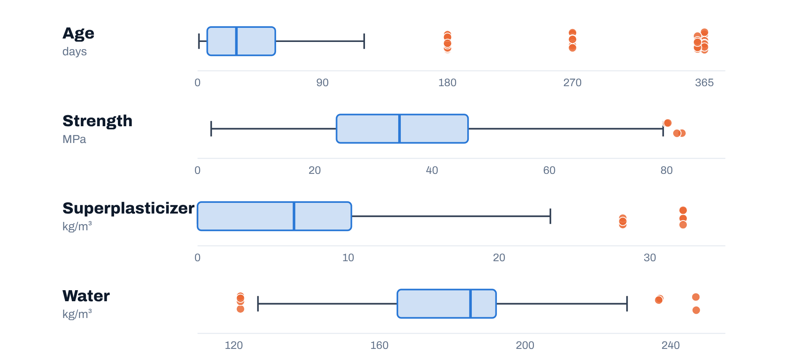

AI & ML for Civil Engineers
Session 02
Part 02 · Exploration
19 / 39
Outliers · the 1.5 × IQR rule on real concrete data
Unusual does not automatically mean wrong
The rule flags 82 values in four columns
Investigate each flag
Box = middle 50% of mixes; whiskers reach 1.5 × the box width; orange points lie beyond.
Measurement error
Data-entry error
Rare but legitimate condition
Extreme engineering case
Here
All 59 “outlier” ages are real 180- to 365-day
tests. Delete them and the model never
learns long-term strength.
Flag → investigate → decide. Avoid deleting observations just because they are extreme.
Data: UCI Concrete Compressive Strength (Yeh, 1998). IQR = interquartile range (75th minus 25th percentile).
Notes:
The 1.5 x IQR rule on four concrete columns flags 82 values. Look at age: all 59 flags are real 180-, 270-, 360- and 365-day tests. The four 'strength outliers' are high-strength mixes near 80 MPa. Superplasticizer flags are two mix families. Nothing here is provably wrong. Flag, investigate, decide.
[Clicks on this slide: 3]

Slide 20
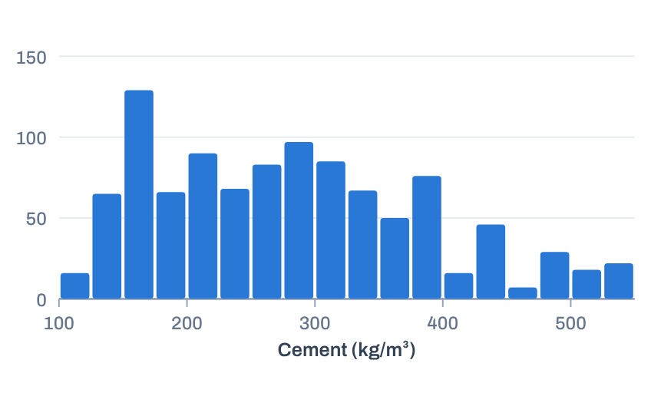
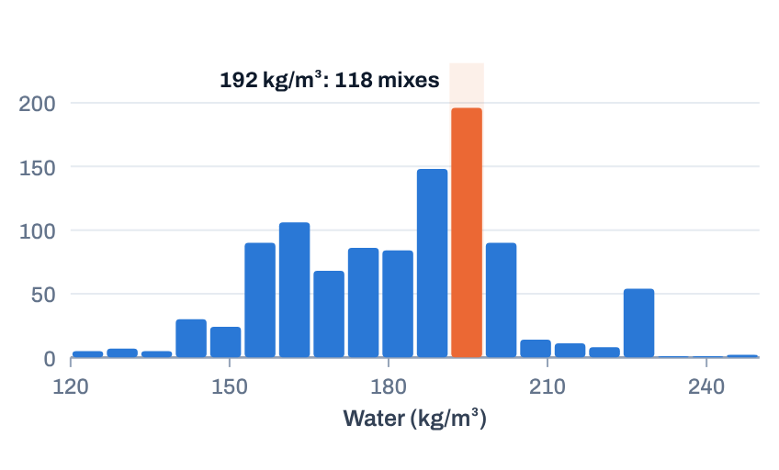
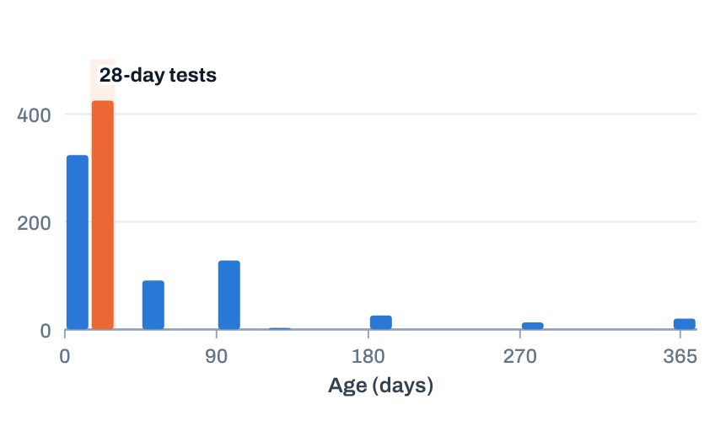
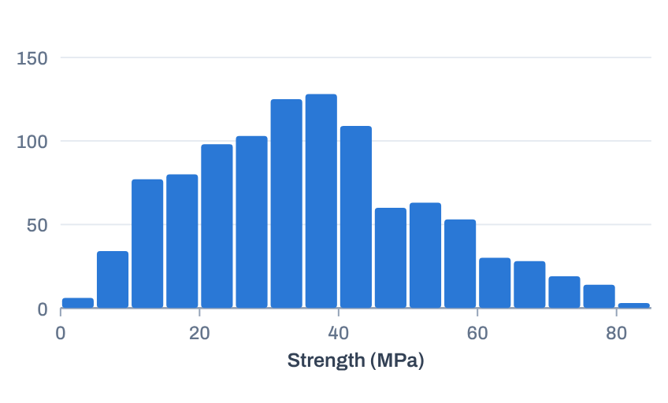

AI & ML for Civil Engineers
Session 02
Part 02 · Exploration
20 / 39
Look before you model · df.hist()
Explore before you model
Cement
Water
Spread from 102 to 540 kg/m³. No
single “typical” mix.
Spikes at 192 and 228 kg/m³:
repeated mix designs, not a
natural spread.
Age
Strength
A few fixed test ages, 425 of them
at 28 days. Not a smooth,
continuous variable.
Centred near 35 MPa with a long
tail to 83 MPa: the target we will
predict.
Ask: what would you notice before fitting a model? The plots are part of understanding, not decoration.
Notes:
df.hist() on four columns. Cement: wide spread, no typical mix. Water: spikes at 192 kg/m3 (118 mixes) and 228 kg/m3: repeated designs. Age: a handful of test ages, 425 at 28 days. Strength: roughly bell-shaped around 35 MPa with a tail to 83 MPa. Ask the cohort what they would note before fitting a model.
[Clicks on this slide: 5]

Slide 21
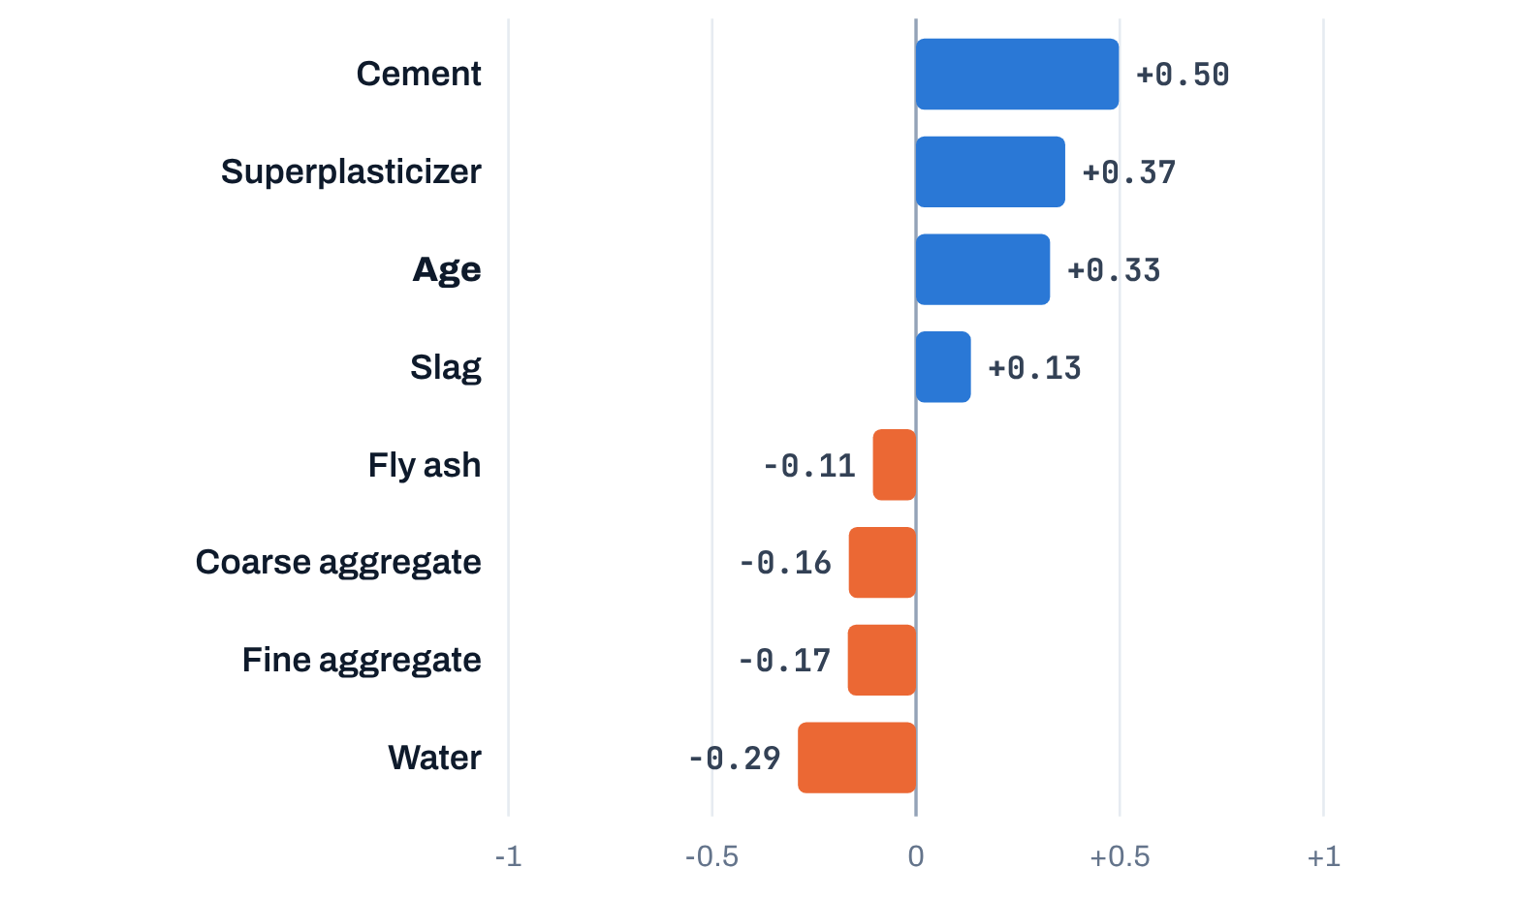
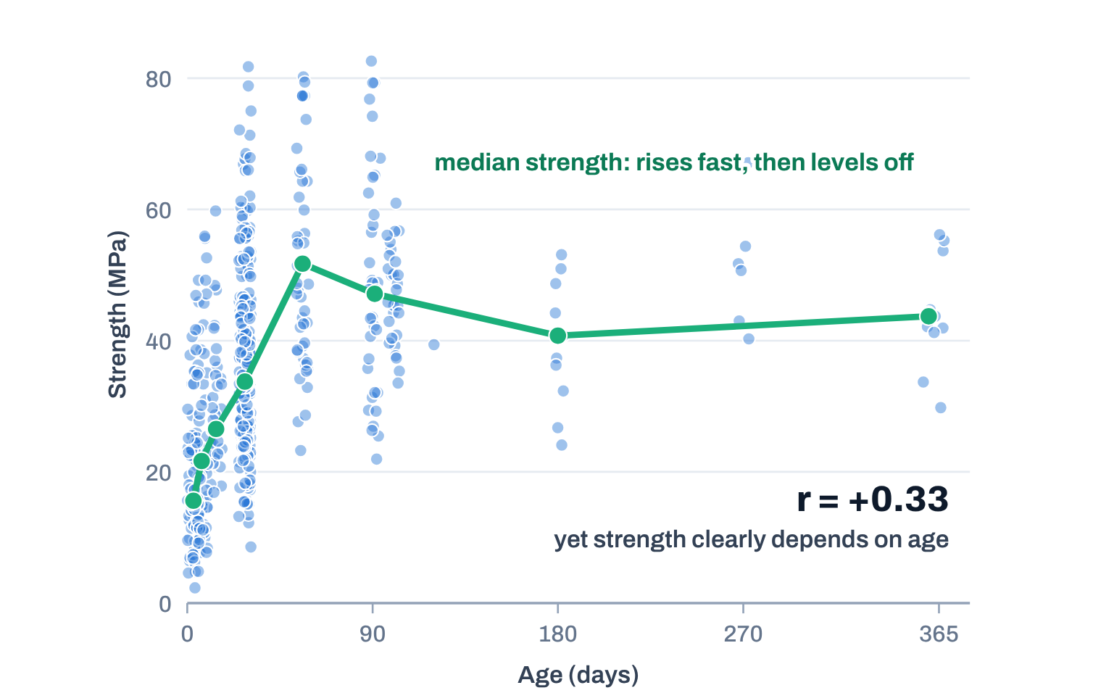

AI & ML for Civil Engineers
Session 02
Part 02 · Exploration
21 / 39
Pearson correlation with strength · 1,030 mixes · df.corr()
Correlation is a clue, not an answer
Linear association of each input with strength
Age: r = +0.33, yet it matters a lot
−1 strong negative
0 no linear association
+1 strong positive
Strength rises quickly, then levels off. A straight-line measure misses that shape.
Correlation measures linear association: nonlinear relationships can be missed. And correlation ≠ causation.
Data: UCI Concrete Compressive Strength (Yeh, 1998). Right: 520 of the 1,030 mixes shown, jittered by ±3 days; green line = median strength per group of test ages.
Notes:
Correlation with strength: cement +0.50, superplasticizer +0.37, age +0.33, water -0.29. Age looks weak by r, yet strength clearly depends on age: it rises fast and then levels off. Pearson r measures straight-line association only. And no correlation proves causation.
[Clicks on this slide: 2]

Slide 22
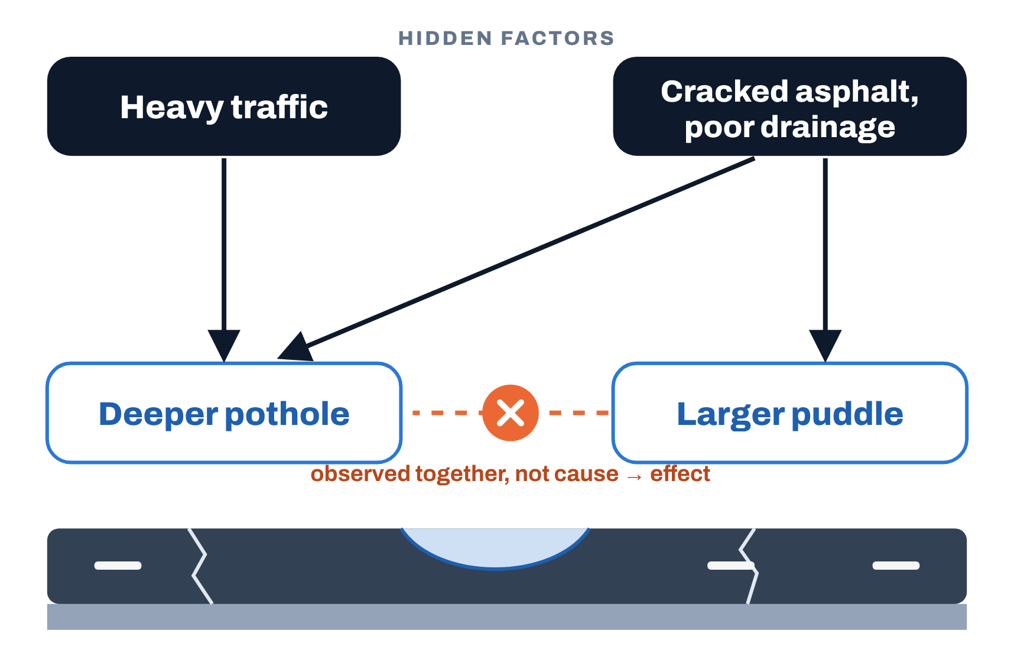

AI & ML for Civil Engineers
Session 02
Part 02 · Exploration
22 / 39
Correlation ≠ causation · a road-engineering example
Do puddles cause potholes?
Observed pattern
Larger puddles go with deeper potholes.
Tempting conclusion
“The puddle caused the pothole.”
Possible hidden factors
Traffic, cracked asphalt and depressions shape
both.
A correlation points us toward a question. It does not establish the
mechanism.
Engineering action should target the underlying cause, not merely the visible association.
Notes:
The road example from the original deck, drawn as a cause diagram. Bigger puddles go with deeper potholes, but the puddle does not cause the pothole. Traffic, cracked asphalt and poor drainage shape both. Engineering action should target the cause.
[Clicks on this slide: 4]

Slide 23
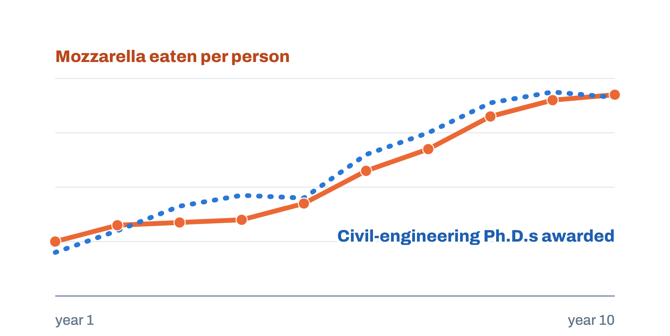

AI & ML for Civil Engineers
Session 02
Part 02 · Exploration
23 / 39
A memorable coincidence
Mozzarella and civil-engineering Ph.D.s
Two U.S. series that rose together, 2000–2009
The pattern
Published correlation: r ≈ 0.95.
Per-capita mozzarella consumption and civil-engineering
doctorates awarded moved together for a decade.
Schematic: shape only, not the published values
The lesson
Strong association can arise by coincidence, or because both
follow unrelated upward trends.
Cheese does not cause Ph.D.s.
Use the example to remember the principle, not as evidence of a causal relationship.
Vigen, T. Spurious Correlations (tylervigen.com), from U.S. Department of Agriculture and National Science Foundation data. See also Science News Explores, “Correlation, causation, coincidence and more”.
Notes:
A memorable coincidence: U.S. mozzarella consumption and civil-engineering doctorates rose together 2000-2009 (r about 0.95, Tyler Vigen's Spurious Correlations). The chart is a schematic of the shape, not the published values. Use it to remember the principle, not as evidence.
[Clicks on this slide: 4]

Slide 24




AI & ML for Civil Engineers
Session 02
24 / 39
03
a
Features X and target y
b
Not every column is a feature
c
Data leakage
d
Train ≠ test, and random_state
e
Class balance
f
Scaling: a preview
Part 03 · Preparation & evaluation setup
Prepare the data for an
honest model
Notes:
Part 03: prepare the data for an honest model.

Slide 25



AI & ML for Civil Engineers
Session 02
Part 03 · Preparation
25 / 39
Formulate the learning problem
What exactly are we asking the model to learn?
Features · X
Target · y
8 inputs
y
Model
Cement
Slag
Fly ash
Water
Superplasticizer
Learns a relationship from
examples
Concrete compressive strength
(MPa)
Coarse agg.
Fine agg.
Age
Session02_data_preparation.ipynb
X, y
Read the output
X = df.drop(columns="strength") # features
y = df["strength"] # target
X.shape, y.shape
(1030, 8)
1,030 rows, 8 feature columns: the table X
(1030,)
one strength value per row: the vector y
Output
((1030, 8), (1030,))
Features are the information we use. The target is the quantity we want to predict.
Notes:
Formulate the learning problem: 8 features, one target. In code, X = df.drop(columns='strength') and y = df['strength']. Read the shapes aloud: (1030, 8) is a table; (1030,) is one value per row.
[Clicks on this slide: 5]

Slide 26

AI & ML for Civil Engineers
Session 02
Part 03 · Preparation
26 / 39
Column roles
Not every column should become a feature
Feature
Target
Before using a column, ask
Known at prediction time
What we predict
Information we will genuinely have.
One column, chosen deliberately.
01
What does it represent?
02
When would it be known?
cement, water, age
strength · fault class
03
Could it reveal the answer
indirectly?
Identifier
Leaked information
Names, IDs, dates
Not available in time
Labels for a row; often no predictive
meaning.
Would not exist when the prediction is
made.
"D-1/3/90" · specimen no.
56-day strength → 28-day
“I have a column” does not mean “I should give it to the model.”
Notes:
Four roles a column can play. Identifiers such as the water-treatment date code label a row; they rarely carry meaning. Leaked information would not exist when the prediction is made. Three questions before using any column.
[Clicks on this slide: 6]

Slide 27



AI & ML for Civil Engineers
Session 02
Part 03 · Preparation
27 / 39
The silent killer
Data leakage: excellent tests, disappointing reality
01
Information unavailable at prediction time
Leak through a column
Predicting 28-day strength at the mix-design stage
…with the 56-day result or an acceptance-test pass/fail as an input. Neither exists when
the mix is designed.
02
Influences training or preprocessing
03
Test performance looks excellent
Leak through preprocessing
04
Real-world performance disappoints
Filling or scaling with the full dataset
Medians or scales computed before the split let the test rows quietly shape training.
split first → fit on train → apply to test
Ask: would this information genuinely be available when I make the prediction?
Notes:
Data leakage, the silent killer. Information unavailable at prediction time sneaks into training or preprocessing; test scores look excellent; reality disappoints. Two forms: a leaking column (56-day strength or an acceptance test when predicting 28-day strength at the design stage) and leaking preprocessing (statistics computed on the full dataset before the split).
[Clicks on this slide: 6]

Slide 28

AI & ML for Civil Engineers
Session 02
Part 03 · Preparation
28 / 39
Evaluation setup · split before you fit
Train ≠ Test
Full dataset · all available observations
1,030 mixes
Split the data before fitting the model
TRAIN · 80%
TEST · 20%
The model learns from these observations.
Kept aside for unseen data.
824 mixes
206 mixes
Session02_data_preparation.ipynb
split
Remember the 25 duplicates?
from sklearn.model_selection import train_test_split
X_train, X_test, y_train, y_test = train_test_split(
X, y, test_size=0.2, random_state=42)
Remove them before splitting.
A row in train with its twin in test makes the test look
easier than reality.
X_train.shape, X_test.shape
((824, 8), (206, 8))
Notes:
Split before fitting. test_size=0.2 on 1,030 mixes gives 824 for training and 206 for testing. Remember the 25 duplicates: if one copy lands in train and its twin in test, the test becomes easier than reality. Remove them before splitting.
[Clicks on this slide: 3]

Slide 29




AI & ML for Civil Engineers
Session 02
Part 03 · Preparation
29 / 39
Why keep a test set at all?
Why not evaluate on the data the model has seen?
Seen data
Unseen data
A model may perform well on examples it has already learned
from, even by memorising them.
We need an honest estimate of how it may perform on new
observations: the next mix, the next plate.
Like a student scoring full marks on last year’s paper after
memorising its answers.
Like a new paper: it shows what was understood, not what was
remembered.
In Session 03
Fit
on train
Predict
the test rows
Compare
with their true
y
An honest error estimate
Training performance ≠ generalisation performance.
Notes:
Why a separate test set? The exam analogy: memorising last year's paper gives full marks on that paper and says little about understanding. In session 03 we fit on train, predict the test rows, and compare with their true y.
[Clicks on this slide: 4]

Slide 30

AI & ML for Civil Engineers
Session 02
Part 03 · Preparation
30 / 39
Reproducibility · which 8 of 40 rows land in the test set?
Why random_state = 42?
train row
test row
No fixed seed
Results may vary because the samples differ.
run 1
run 2
random_state=42
Same split every time: easier to reproduce and compare.
run 1
run 2
42 has no engineering meaning. It is simply a fixed random seed. Any number works, as long as it is recorded.
Notes:
random_state: without a fixed seed each run puts different rows in the test set, so results move between runs. With random_state=42 the split is identical every time. 42 has no meaning; any number works if it is recorded.
[Clicks on this slide: 3]

Slide 31
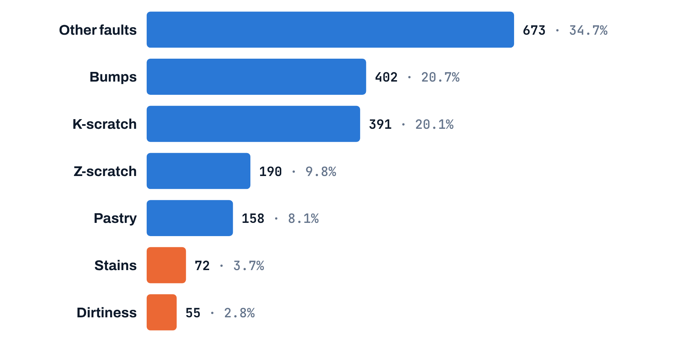

AI & ML for Civil Engineers
Session 02
Part 03 · Preparation
31 / 39
Steel plates · what does the target look like?
Class balance changes what “good” means
1,941 plates, 7 fault classes
34.7%
y = fault type. Orange: classes below 5% of the plates.
accuracy of a useless model that always answers “Other
faults”.
Rare classes
A random 20% test set holds only about 11 Dirtiness plates.
Keep the proportions
Stratify the split by the target:
train_test_split(…, stratify=y)
Before building a classifier, look at the target. Balance decides which accuracy is impressive. (Session 05)
Data: Steel Plates Faults, UCI Machine Learning Repository (Buscema, Terzi & Tastle, 2010). Every plate carries exactly one fault label.
Notes:
Steel plates: 7 fault classes, very unequal. A model that always answers 'Other faults' is right 34.7% of the time without learning anything. Dirtiness has only 55 plates, about 11 in a 20% test set. stratify=y keeps the class proportions in train and test. We return to this in session 05.
[Clicks on this slide: 4]

Slide 32
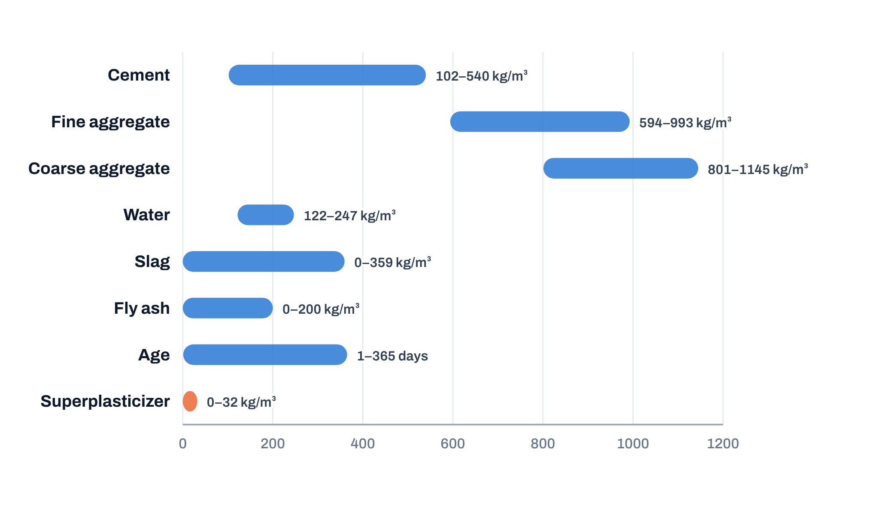
AI & ML for Civil Engineers
Session 02
Part 03 · Preparation
32 / 39
An important preview
Scaling: same data, very different numbers
Range of each concrete input, on one axis
Sensitive to scale
Aggregates sit in the hundreds of kg/m³; superplasticizer in the tens; age in days.
Distance- and gradient-based methods: k-nearest
neighbours, SVMs, neural networks.
Less sensitive
Tree-based methods: decision trees, random
forests (Session 04).
The rule
Fit preprocessing on training data,
not on the full dataset.
scaler.fit(X_train) # learn
scaler.transform(X_test) # apply
Data: UCI Concrete Compressive Strength (Yeh, 1998). Bars run from the minimum to the maximum in the dataset.
Notes:
Scaling preview. Aggregates are in the hundreds of kg/m3, superplasticizer in the tens, age in days. Distance- and gradient-based methods care about this; tree methods much less. The rule: fit the scaler on training data, then apply it to the test data.
[Clicks on this slide: 3]

Slide 33
AI & ML for Civil Engineers
Session 02
Course overview
33 / 39
Summary · today’s workflow
The complete journey
01
02
03
04
Investigate missing
values & duplicates
Check physical
plausibility
Understand the variables
Check data quality
data dictionary
shape · dtypes
isna · duplicated
describe
05
06
07
08
Explore distributions &
relationships
Define features X and
target y
Prevent leakage
Split train / test
hist · corr
drop · select
known in time?
train_test_split
Good ML begins before the algorithm.
Notes:
The complete journey in eight steps, coloured by today's three parts. Good ML begins before the algorithm.
[Clicks on this slide: 3]

Slide 34

AI & ML for Civil Engineers
Session 02
Part 03 · Preparation
34 / 39
Hands-on · in Colab
Today’s notebook, section by section
Audit the concrete data
01
Size, types, missing values, duplicates, ranges
df.describe()
Read the water-treatment file
Workshop notebook link
02
Turn “?” into NaN, then count and map the gaps
na_values="?"
Open today’s notebook and
save your own copy.
Explore the concrete data
Run the cells in order. Read every output before
moving on.
03
Histograms, box plots, correlation with strength
df.hist()
Prepare the steel-plate data
04
Class counts, X and y, a stratified train/test split
stratify=y
Link shared in the session chat
Notes:
Hands-on: open the notebook, save a copy, work through the four sections. Replace 'Link shared in the session chat' with the real link if you want it on the slide.
[Clicks on this slide: 5]

Slide 35


AI & ML for Civil Engineers
Session 02
Course overview
35 / 39
The final takeaway
Before asking “Which ML algorithm should I use?”
“Do I understand my data?”
Ask
“Would this be available at prediction time?”
And
Understand the data
Formulate the problem
Protect the evaluation
Then model
Notes:
The final takeaway. Two questions to ask before choosing any algorithm. Then the order: understand the data, formulate the problem, protect the evaluation, then model.
[Clicks on this slide: 3]

Slide 36



AI & ML for Civil Engineers
Session 02
Course overview
36 / 39
Today → next time
Are we ready to build the model?
Today · Session 02
Next · Session 03 · Your First Engineering Prediction
Model
We learned to inspect, question and
prepare engineering data.
Can linear regression predict concrete
strength well? How will we judge it?
Audit, check plausibility, map missing values
Fit a model on the training set we made today
Investigate outliers before deleting anything
Judge it on the test set it has never seen
Choose X and y, prevent leakage, split train/test
MAE
RMSE
R²
residuals
cross-validation
Notes:
Bridge to session 03: a linear-regression model for concrete strength, trained on today's training set, judged on the test set with MAE, RMSE, R-squared, residuals and cross-validation.
[Clicks on this slide: 1]

Slide 37
AI & ML for Civil Engineers
Session 02
Part 03 · Preparation
37 / 39
Before session 03
Three small things to try
1
2
3
Finish the audit
Write a dictionary
Hunt for one leak
Run today’s notebook end to end. Remove
the duplicates and note how many rows
remain.
For a dataset from your own field: meaning,
unit and role (X, y, ID) of every column.
Name a column in your field that would look
predictive but is only known after the fact.
df.drop_duplicates()
column · meaning · unit · role
known at prediction time?
03
Your First Engineering Prediction Model
Linear regression, error metrics and cross-validation on
concrete.
Notes:
Optional practice before session 03.
[Clicks on this slide: 4]

Slide 38
AI & ML for Civil Engineers
Session 02
38 / 39
?
Questions
Unmute, or drop your question in the chat.
Data quality
Missing values & outliers
Leakage & splitting
Your own engineering data
Dr. Abdul Waris
Research Associate · Universität Siegen, Germany
Notes:
Questions.

Slide 39



End of session 02
Thank you.
See you in session 03: Your First Engineering Prediction
Model.
Dr. Abdul Waris
Research Associate · Universität Siegen, Germany
Course page
qudeltastudios.com/courses
Technology partner
Notes:
Thank you. See you in session 03.

