Slide 1
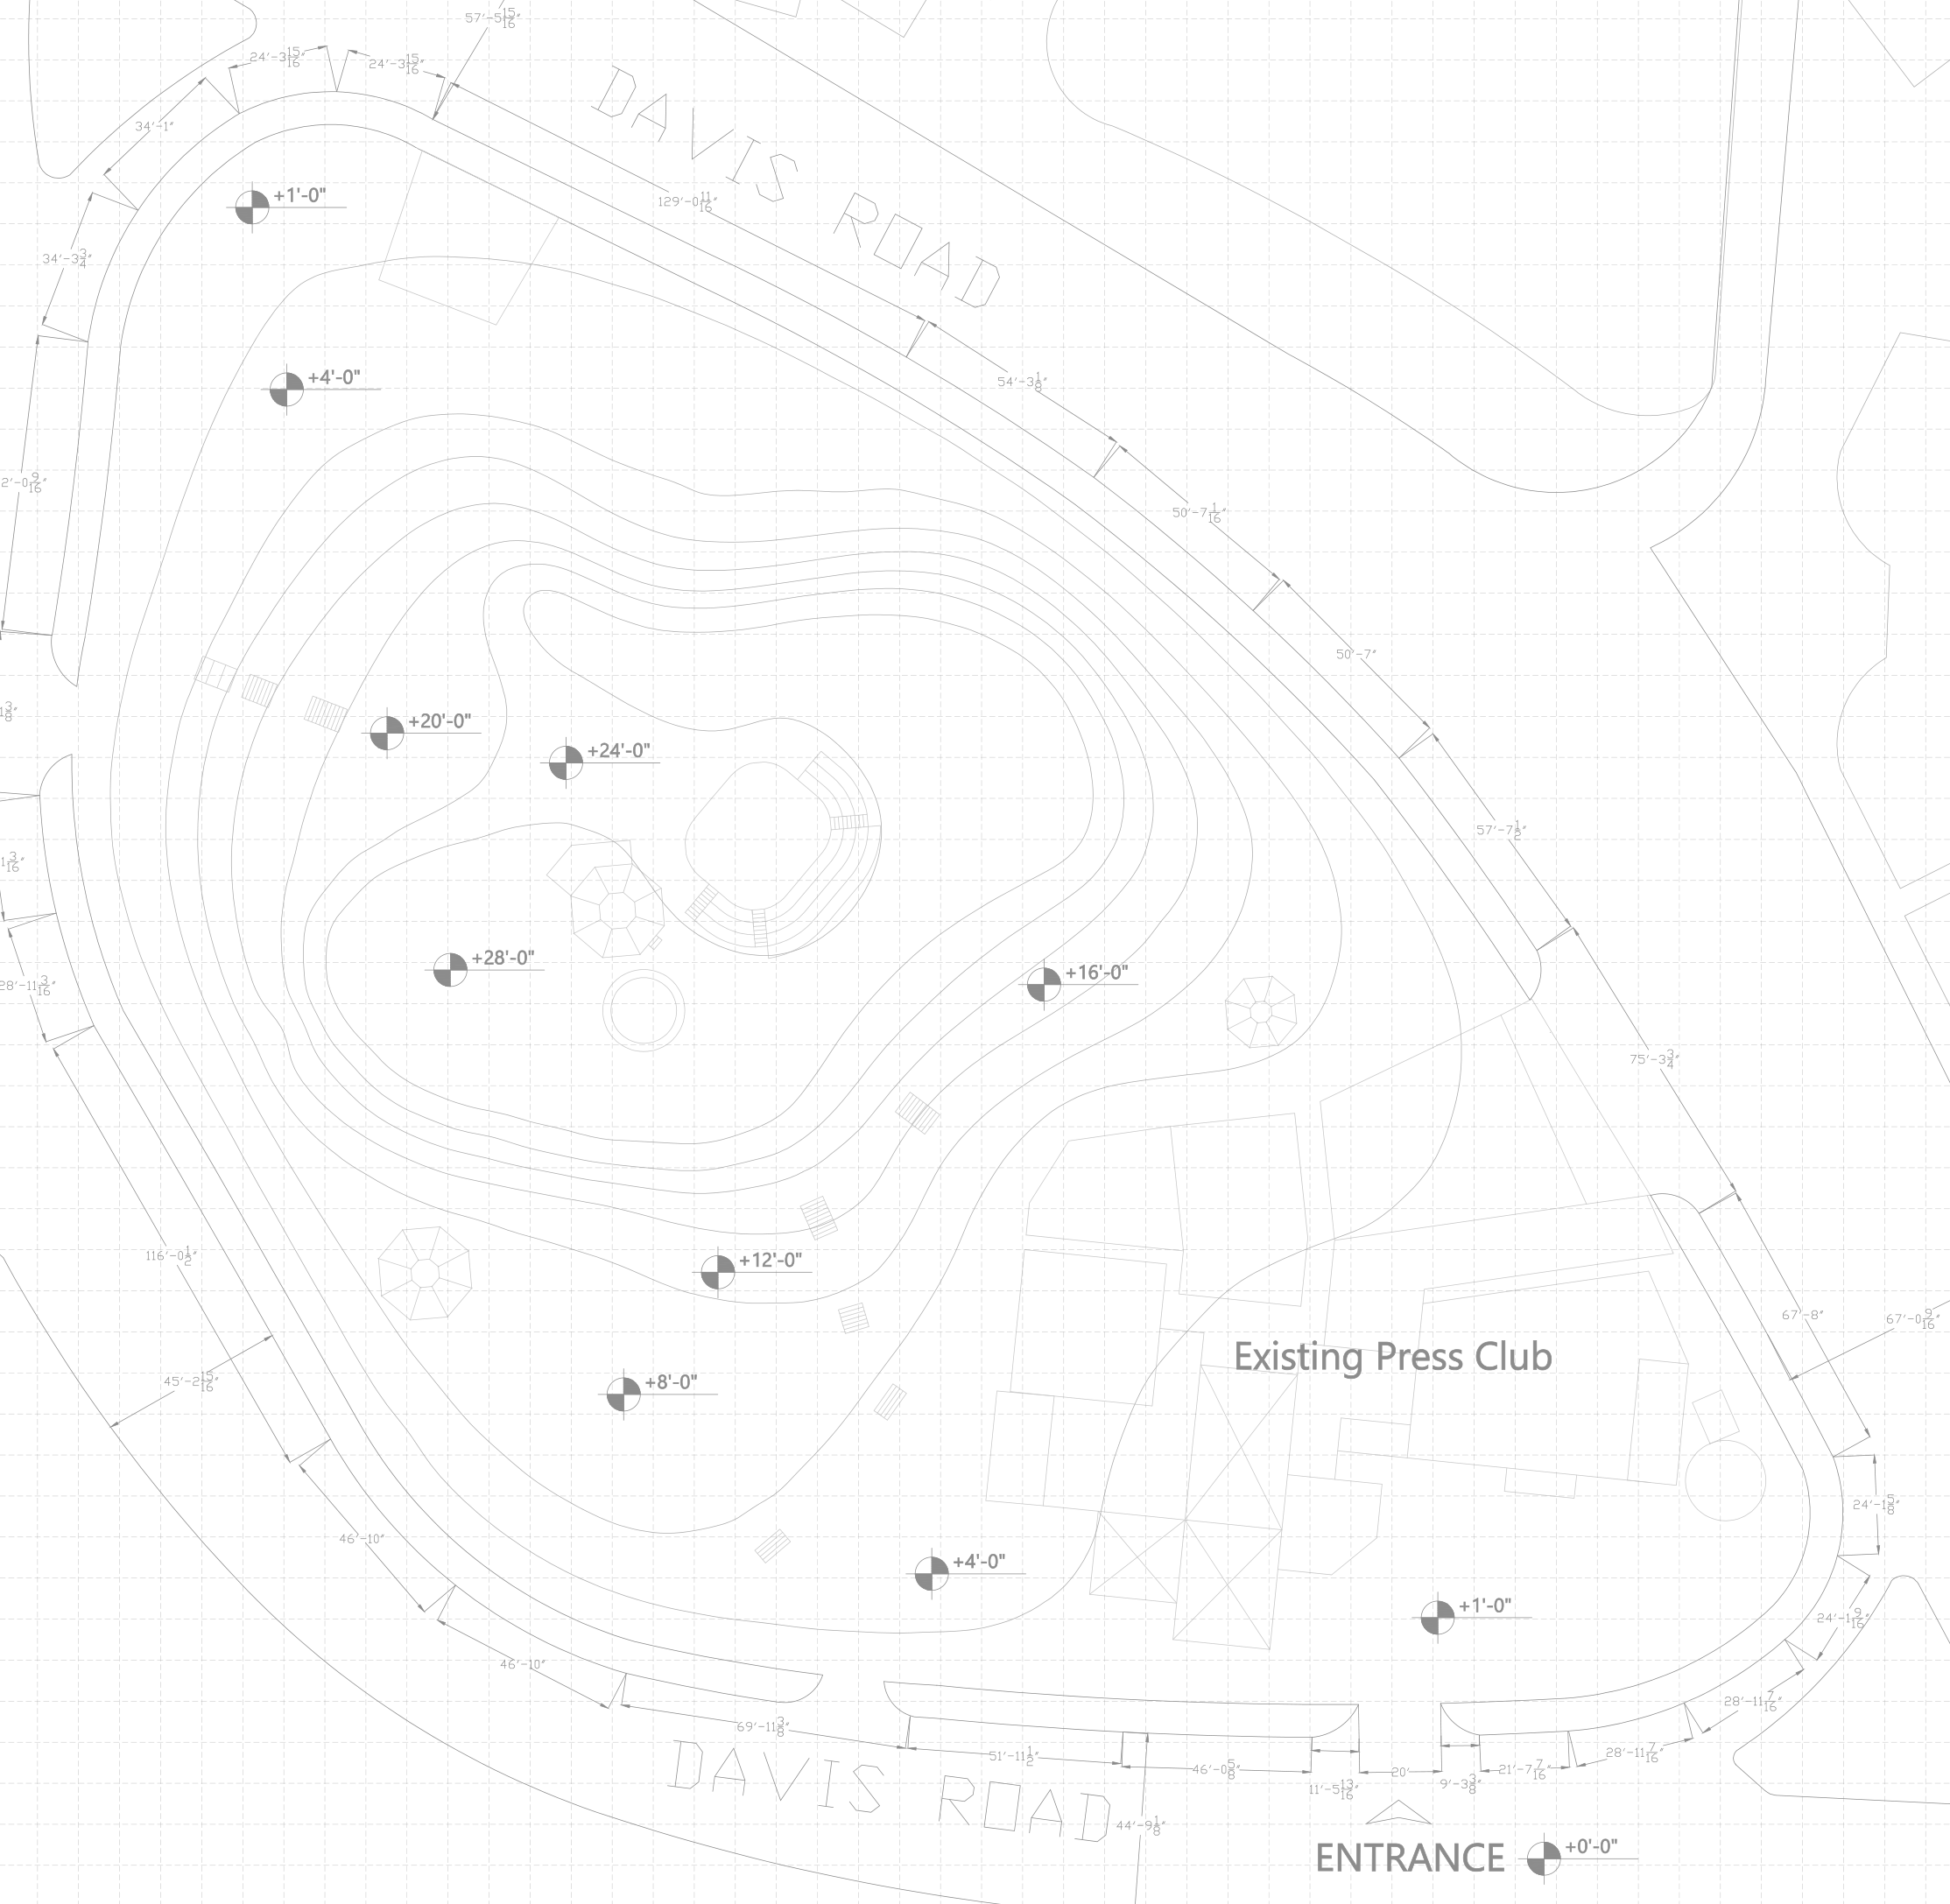
SITES OF REPRESENTATION · THE CONTEMPORARY PUBLISHING HOUSE · DETAILED SITE ZONING
01
SURVEY READING — LEVELS
Contours from the survey (+4' … +28'), grouped into four bands. Everything below is measured off the drawing.
A'
FOUR BANDS (ground area inside the traced site edge)
0' → +4' base ≈31,700 sq ft — flattest: NW pocket, S edge, Press Club
+4' → +12' lower slope ≈35,800 sq ft — gentle on the S, a steep bank on the NE
+12' → +28' flanks ≈17,200 sq ft — contours 4' apart at ~10–15' spacing: steep
+28' summit ≈20,000 sq ft — a broad plateau with existing structures
NE bank: +4' at the boundary
WHAT THIS MEANS FOR ZONING
existing summit structures
Build low most built program on the 0'–4' base and the gentle S slope — no cutting.
Keep the flanks the +12'–+28' band is too steep to build on without regrading.
Open the top the summit is already a public place — keep it open.
NE edge the ground reaches +4' at the boundary: only a thin bar, stepping.
0'–4' base (white = below +4')
+12'–+28' flanks
existing stairs
+28' summit
existing Press Club (outline approx.)
Traced site edge ≈ 105k sq ft (inner boundary line). Handout: 136,530 sq ft, probably to the outer line. Scale read from dimension strings (≈2.68 px/ft at 2000 px width).
A
ENTRANCE ±0'

Slide 2
SITES OF REPRESENTATION · THE CONTEMPORARY PUBLISHING HOUSE · DETAILED SITE ZONING
02
DETAILED PROGRAM ZONING
Every program group placed on the band that can take it. Figures = ground available in each zone (not building area).
public / civic
knowledge
media / production
archive (protected)
PRINT · DISPATCH
≈2,900 sq ft ground
learning
admin / service
ARCHIVE
≈2,700 sq ft ground
landscape / slopes
open summit
existing (retained)
RESEARCH
≈1,100 sq ft ground
PLACEMENT LOGIC
S base (0'–4') entry forum at the survey's ENTRANCE; exhibition + press conference along Davis Rd S, beside the Press Club.
S slope (+4'–+12') auditorium raked on the SW slope; library + reading on the existing stair route.
NW pocket (+1') print + dispatch with a service yard — the only flat ground away from the entrance.
NE bank archive + research at the NW end, media + editorial at the SE end, next to the Press Club.
E of Press Club workshops (N side) and admin + staff entry (E side).
Flanks + summit no new building: landscape, existing stairs, open forum at +28'.
OPEN FORUM (summit)
≈20,000 sq ft ground
MEDIA · EDITORIAL
≈3,800 sq ft ground
SLOPES
≈17,200 sq ft ground
WORKSHOPS
≈1,800 sq ft ground
AUDITORIUM
≈6,400 sq ft ground
LIBRARY + READING
≈5,400 sq ft ground
ADMIN
≈2,100 sq ft ground
Existing Press Club retained (outline approximated from the survey's grey linework). NW existing structure kept — use to be decided.
EXHIBITION · PRESS CONF.
≈6,000 sq ft ground
ENTRY FORUM
≈6,700 sq ft ground

Slide 3
SITES OF REPRESENTATION · THE CONTEMPORARY PUBLISHING HOUSE · DETAILED SITE ZONING
03
ACCESS + CIRCULATION
Public enters at the surveyed ENTRANCE (+0'); service and staff kept off the public route.
public — entrance → forum → stairs → summit
staff · journalists — E edge → NE bars
PRINT · DISPATCH
service — Davis Rd (N end), proposed
ARCHIVE
ROUTES
RESEARCH
Public entrance → entry forum → exhibition foyer → existing S stairs → library → summit. Branches to the auditorium and the W stairs.
Staff + journalists from the entrance past the Press Club's E side → admin → workshops → media → research → archive.
Press Club journalists move directly N into media and W onto the forum.
Service one yard at the NW pocket (+1'); vehicles never enter the S forum. Access point is proposed — not on the survey.
OPEN FORUM (summit)
MEDIA · EDITORIAL
SLOPES
WORKSHOPS
CONFLICTS AVOIDED
Forum staff route peels off E before the crowd.
Summit public only; working bars sit below it on the NE bank.
AUDITORIUM
LIBRARY + READING
ADMIN
EXHIBITION · PRESS CONF.
ENTRY FORUM

Slide 4
SITES OF REPRESENTATION · THE CONTEMPORARY PUBLISHING HOUSE · DETAILED SITE ZONING
04
SECTION A–A' · ENTRANCE SIDE → SUMMIT → DAVIS ROAD N
Profile read from the survey contours along line A–A' (slide 01). Vertical scale ×3.
OPEN FORUM
+28'
+24'
+20'
+16'
LIBRARY + READING
ARCHIVE
+12'
steep flank — landscape + existing stairs
+8'
EXHIBITION · PRESS CONF.
public route
+4'
+0'
ENTRANCE SIDE (S)
DAVIS ROAD (N)
READING THE SECTION
Built program sits where the ground is low or gentle (left: exhibition, library; right: archive on the NE bank). The steep flanks stay landscape; the summit plateau stays an open public forum. Floors step with the ground on piers; nothing is cut or filled.

Slide 5
SITES OF REPRESENTATION · THE CONTEMPORARY PUBLISHING HOUSE · DETAILED SITE ZONING
05
PROGRAM PLACEMENT SCHEDULE
Where every program item goes, on which level, and why. Areas are ground available — building areas still to be set.
PROGRAM ITEM | ZONE | LEVEL | ACCESS | WHY HERE
Entry forum · arrival · protest edge | S base, at ENTRANCE | ±0' – +1' | public | the survey's only marked entrance; Davis Rd S frontage
Exhibition · press conference · forum hall · foyer | S base / lower slope, W of Press Club | +1' – +8' | public | faces the forum and road; next to the Press Club
Auditorium | SW slope | +4' – +12' | semi-public | rake follows the existing slope; foyer at the low end
Public library + reading room | S slope on the existing stairs | +4' – +12' | semi-public | on the public route up; reading terrace faces the summit
Open forum · viewing | summit plateau | +28' | public | already a public top with structures; nothing new built
Archive stores · conservation · consultation | NE bank, NW end | +1' – +12' | private / controlled | beside the service yard; away from the crowd
Research studios · seminar | NE bank, next to archive | +4' – +12' | semi-private | research ↔ archive
Media: newsroom · editorial · recording · broadcast · editing | NE bank, SE end | +4' – +12' | working | next to the Press Club (journalists)
Print · paper store · dispatch · service yard | NW pocket | +1' | private | only flat ground away from the public entrance
Workshops · education | N of Press Club | +4' – +12' | semi-public | between media (skills) and the public side
Admin · staff entry · security | E of Press Club | +1' – +4' | private | on the staff route, close to the entrance
Slopes (+12' – +28') | flanks | — | public landscape | too steep to build without regrading
Existing Press Club | SE | +1' – +8' | existing | retained; linked W to forum, N to media

Slide 6
