Slide 1
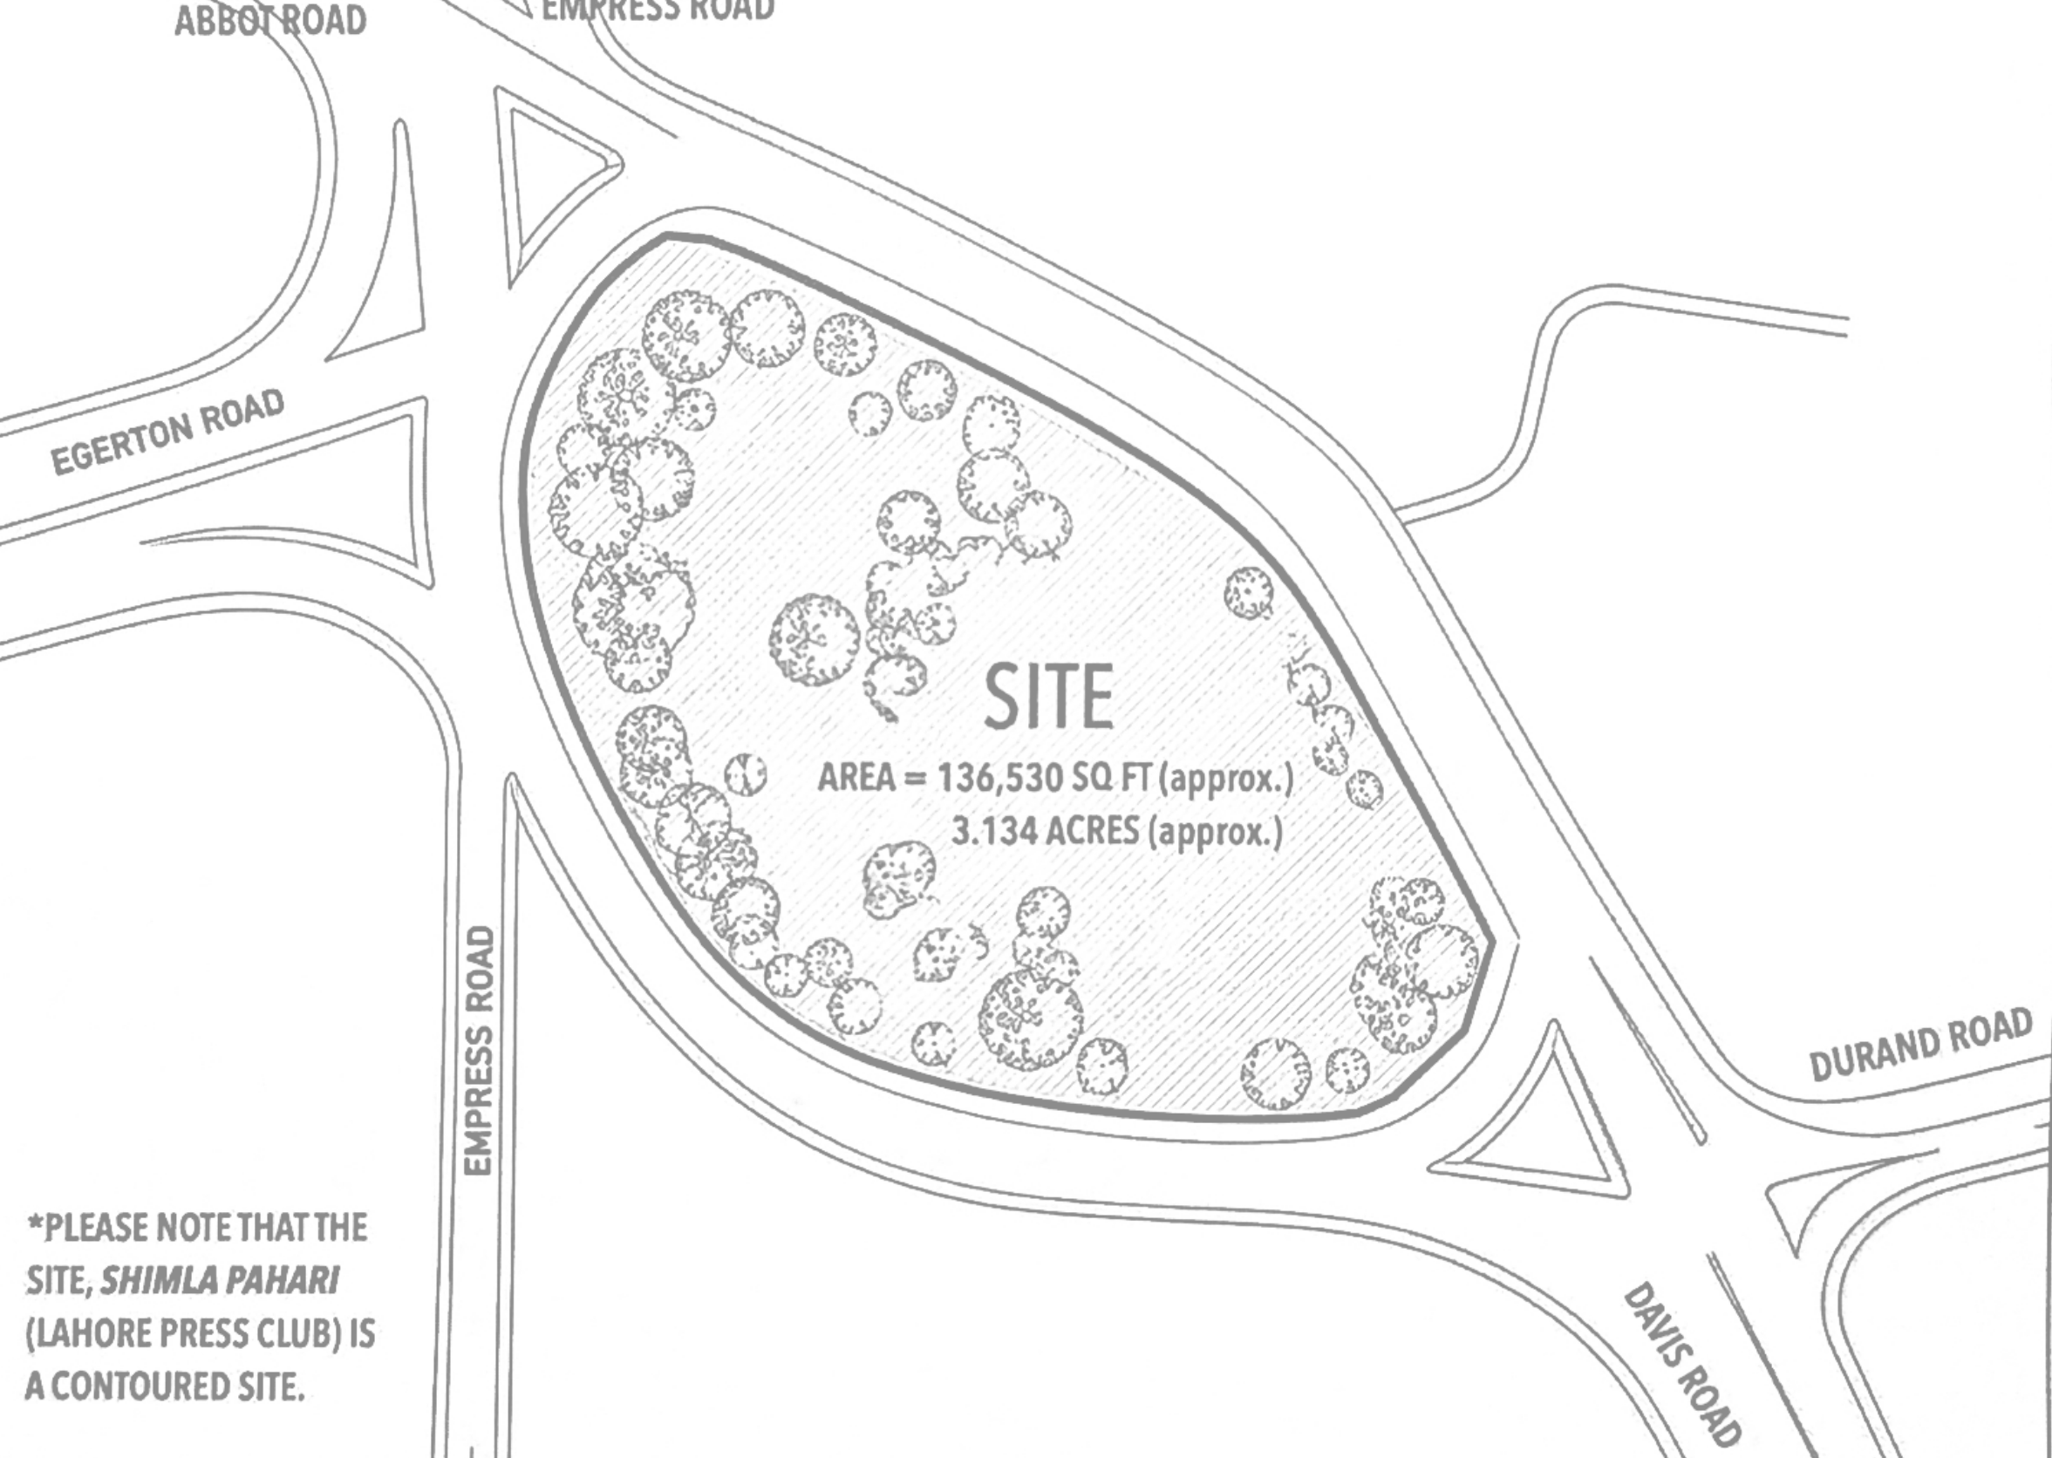
SITES OF REPRESENTATION · THE CONTEMPORARY PUBLISHING HOUSE · SITE ZONING
01
SITE ANALYSIS
Base: the site plan provided in the project handout (p.4), unaltered, shown in light grey. Highlights are overlays.
IDENTIFIED ON THE PLAN
Boundary ≈136,530 sq ft · 3.134 ac, oval island
Roads Empress · Egerton · Abbot (NW) · Davis · Durand (SE)
Junctions two, one at each tip, with traffic islands
Trees dense at W end + perimeter; least cover centre-east
NW JUNCTION
NOT IDENTIFIABLE FROM PROVIDED SITE PLAN
Press Club no footprint or entrances drawn
Contours site noted as contoured, no levels
Existing access no gates / paths drawn
North · scale not shown
Views · noise · protest spot not shown
Names of the two long-side roads not labelled
DENSE TREES (as drawn)
SHIMLA PAHARI · contoured (plan note) · levels not shown
LEAST TREE COVER (as drawn)
SE EDGE → Davis / Durand
FROM THE HANDOUT (TEXT)
Davis Rd historically a media street
Mound artificial, brick-kiln origin
Rule topography not to be altered
SE JUNCTION
site boundary
SE public edge / Davis Rd
dense trees (as drawn)
least tree cover (as drawn)
DAVIS RD · media street (handout)
road junction

Slide 2
SITES OF REPRESENTATION · THE CONTEMPORARY PUBLISHING HOUSE · SITE ZONING
02
OPPORTUNITIES + CONSTRAINTS
What the drawn site offers, and what limits it.
OPPORTUNITIES
1 SE tip faces the Davis / Durand junction: the handout's media street — the public, civic end.
2 Centre-east has the least tree cover as drawn: the most buildable ground.
3 Dense W-end trees: keep as a landscape the public can walk through.
4 NE long edge has a thin stretch of trees: possible service entry.
C
4
3
CONSTRAINTS
A Topography must not be altered — levels unknown: building placement to be checked against a survey.
B Tree ring along almost the whole perimeter: entries must thread between trees.
C Roads on every side: all edges exposed to traffic (volumes not shown).
D Press Club position unknown: zoning must stay flexible around it.
A
2
B
D
1
opportunity (numbered)
constraint (lettered)

Slide 3
SITES OF REPRESENTATION · THE CONTEMPORARY PUBLISHING HOUSE · SITE ZONING
03
PUBLIC / PRIVATE ZONING
Not a straight line: public at the SE edge AND an open top; working parts split to face the service edge.
WHY EACH SITS WHERE IT DOES
Public the SE tip meets the junction and the media street — where crowds, cameras and speech already arrive.
Semi-public next ring in: reached through the public zone, never directly from the road.
Semi-private SW side of the centre, away from the service edge: research + archive reading.
Private NE side of the centre, next to the only thin tree stretch: loading reaches it without crossing public ground.
Public landscape + top the wooded W end and the open top stay public: the gradient reverses as you reach them.
service edge → private side
PUBLIC LANDSCAPE
PRIVATE
PUBLIC TOP
SEMI-PUBLIC
SEMI-PRIVATE
public
PUBLIC
semi-public
semi-private
private
public landscape (preserved)
city arrives here
Gradient is my design interpretation; zone lines are diagrammatic, to be checked against levels + Press Club position.

Slide 4
SITES OF REPRESENTATION · THE CONTEMPORARY PUBLISHING HOUSE · SITE ZONING
04
PROGRAM ZONING
Large program clusters on the site — no rooms, no areas yet.
A · G PUBLIC / CIVIC — forum, auditorium, exhibition, gathering
B KNOWLEDGE — library, reading, archive, research
C/D PRODUCTION — editorial, publishing, media
E LEARNING — workshops, education
F ADMIN · SERVICE
F ADMIN / SERVICE
H LANDSCAPE — preserved, walkable
C/D MEDIA · EDITORIAL · PUBLISHING
READING ORDER (SE → NW)
1 road + junction → forum under trees (G)
2 civic halls facing it (A)
3 library + learning, side by side (B, E)
4 archive + research | media + publishing (B, C/D)
5 open top → wooded W end (H)
OPEN TOP
H PRESERVED LANDSCAPE
B LIBRARY + READING
A EXHIBITION · FORUM · AUDITORIUM · PRESS
WHY THIS ORDER
Public program sits where the public already arrives; knowledge sits between the public and production so both reach it; production sits on the service edge; the most wooded ground stays unbuilt.
Program from handout: required = library + reading, archive, research + studios, media + recording, publishing. ‘May include’ = exhibition, forum, auditorium, workshops, education.
B ARCHIVE + RESEARCH
E WORKSHOPS · EDUCATION
G FORUM UNDER TREES · PROTEST EDGE

Slide 5
SITES OF REPRESENTATION · THE CONTEMPORARY PUBLISHING HOUSE · SITE ZONING
05
ACCESS + USER CIRCULATION
Three separate systems. Entry points are PROPOSED — existing gates are not shown on the plan.
GENERAL PUBLIC — junction → forum → halls → library → open top
JOURNALISTS · RESEARCHERS · STAFF — own entry + route
SERVICE / DELIVERY — NE edge only
public path through the wooded W end
SERVICE ENTRY (proposed)
CONFLICT POINTS → ZONING ANSWER
!
SE tip protest crowds + staff arriving together → staff get a second door off the SE route, beside the press room, not through the forum.
NE edge delivery vehicles cross the footpath → one short service bay only, next to production, trees kept either side.
Centre public route passes research → research on the SW side, route on the NE of it; windows, not doors, face the path.
service vs pedestrians
!
public route vs research
RESTRICTED
archive stores · production floor · loading · admin
!
crowd vs staff arrival
PUBLIC ARRIVAL

Slide 6
SITES OF REPRESENTATION · THE CONTEMPORARY PUBLISHING HOUSE · SITE ZONING
06
THREE ZONING OPTIONS
Same site, same program, three priorities. Not ranked.
A PUBLIC-CENTRIC
B KNOWLEDGE / PRODUCTION
C SITE / TOPOGRAPHY
A public street crosses the whole site, junction to junction; civic halls at both ends.
One compact knowledge + production core on the least-wooded ground; small public front at the SE tip.
Rings follow the mound: public along the toe, knowledge mid-slope, open top; W end kept.
+ strongest public presence; links both junctions · − cuts the wooded W end; production split by the street; many entries to secure
+ efficient, easy to service and secure; smallest disturbance · − public limited to one edge; weakest civic engagement
+ reads the mound; open top; route climbs · − depends on real levels (not on plan); ring along the toe faces traffic
PRESS CLUB shares the SE civic end, or sits on the street
ROAD both junctions open
TOPOGRAPHY street must cross levels
PRESS CLUB stands as the core's public face
ROAD one public edge (SE)
TOPOGRAPHY built area smallest
PRESS CLUB joins the outer public ring
ROAD whole toe faces the road
TOPOGRAPHY zoning follows levels
public / civic
knowledge
production
landscape

Slide 7
SITES OF REPRESENTATION · THE CONTEMPORARY PUBLISHING HOUSE · SITE ZONING
07
FINAL ZONING
Draws on all three: B's compact core, C's reading of the mound, A's public arrival.
WHY IT WORKS
SITE public where the junction and media street are; building on the least-wooded ground; the W woods stay.
PROGRAM knowledge in the middle, reachable from both the public and the working side.
USERS three separate entries; they meet in the forum, library and on the route.
VISION the public reaches the top of the landmark; production is next to the route, not hidden.
TOPOGRAPHY zones follow the mound in plan; no flattening. Levels to be surveyed.
F ADMIN · SERVICE
C/D MEDIA · EDITORIAL · PUBLISHING
OPEN TOP
H PRESERVED LANDSCAPE
B LIBRARY + READING
PRESS CLUB OPTIONS (not on plan)
A EXHIBITION · FORUM · AUDITORIUM · PRESS
If near the SE tip keep it; it becomes the press face of the civic zone A, sharing the forum G.
If mid-site keep it; the public route passes it; link at ground level.
If in the W woods keep it as a pavilion in the landscape; connect by path.
public / civic
public
B ARCHIVE + RESEARCH
knowledge
staff
production
service
E WORKSHOPS · EDUCATION
learning
G FORUM UNDER TREES · PROTEST EDGE
landscape

Slide 8
ZONING BOARD (A1 landscape, scaled)
SITE ZONING — SHIMLA PAHARI
SITE → CONDITIONS → OPPORTUNITIES / CONSTRAINTS → ACCESS → USERS → PROGRAM → OPTIONS → FINAL
01 SITE CONDITIONS
02 PUBLIC / PRIVATE
03 ACCESS + USERS
07 FINAL ZONING
04 OPTION A
05 OPTION B
06 OPTION C
public / civic
public
knowledge
staff
production
service
learning
Public where the city arrives · knowledge in the middle · production on the service edge · woods and top stay open.
landscape
Base: handout site plan (p.4). Press Club footprint, levels and existing gates are not shown on it and must be added from a survey.

