Slide 1
SITES OF REPRESENTATION · THE CONTEMPORARY PUBLISHING HOUSE · ARCH 4201 · SEMESTER 8 · PROJECT 01
01
WHAT IS THE PROJECT?
What? · Why? · Vision — Lahore Press Club, Shimla Pahari
A
WHY? THE ISSUE
B
THE CORE IDEA
C
WHAT? PROJECT BRIEF
Who decides what is accepted as truth?
ARCHITECTURE
decides who enters, who is seen, who speaks
PRODUCE
research · studios
An integrated complex at the Lahore Press Club where researchers, journalists, writers, academics, artists, intellectuals, civic organisations and the public meet to produce, communicate and negotiate public knowledge.
01
INFORMATION = POWER
NEGOTIATE
citizen · institution · state
RECORD
archive · media
DESIGN BRIEF · MUST INCLUDE
Whoever controls how information is produced, reached and circulated decides whose version counts.
Research + studio areas
Public library + reading room
PUBLIC
KNOWLEDGE
PUBLIC
KNOWLEDGE
Archive facilities
Media + recording
02
SPACE IS NOT NEUTRAL
Publishing infrastructure
Formal + informal debate
How institutions, streets and public spaces are arranged decides what is seen, what is hidden and who is left out.
MAY INCLUDE
Exhibition
Public forum
Auditorium
03
A FRAGMENTED PRESENT
QUESTION
forum · debate
PUBLISH
to publish is to mediate
Workshops
Education
State TV, newspapers, digital and social media now carry competing accounts of Pakistan's past and present.
SITE RULE existing topography must not be altered
STANCE take a clear personal position
CENTRAL QUESTION
How is truth produced in the contemporary city, and why does it matter between the citizen and the state?
VISION
A shared civic institution where the city's knowledge is produced, questioned and shared — and where citizens take part alongside professionals.
CITIZEN
STATE
the institution sits between — its stance is my personal position
TRUTH
REPRESENTATION
PUBLIC KNOWLEDGE
NEGOTIATION
Notes:
WHAT: A contemporary publishing house on Shimla Pahari at the Lahore Press Club: an integrated complex where researchers, journalists, writers, academics, artists, intellectuals, civic organisations and the general public produce, communicate and negotiate public knowledge.
WHY: The handout starts from the question "who decides what is accepted as truth?" Control of information is tied to power (who produces it, who can reach it, whose version is given authority). Space is not neutral (Lefebvre): the arrangement of institutions and streets decides visibility, access and exclusion. In Pakistan, PTV once shaped national narratives; today media is fragmented.
CORE DIAGRAM: knowledge is produced, recorded, published (the handout: "to publish is to mediate"), questioned and negotiated; architecture frames the whole cycle. The institution sits between citizen and state; the handout asks me to define that relationship through a personal position.
DESIGN BRIEF (handout): must include research/studio areas, public library + reading room, archive, media + recording, publishing infrastructure; formal + informal environments for debate; may include exhibition, forums, auditoriums, workshops, education. Topography must not be altered.
VISION (my interpretation): a shared civic institution where citizens take part in producing and questioning knowledge alongside professionals.

Slide 2
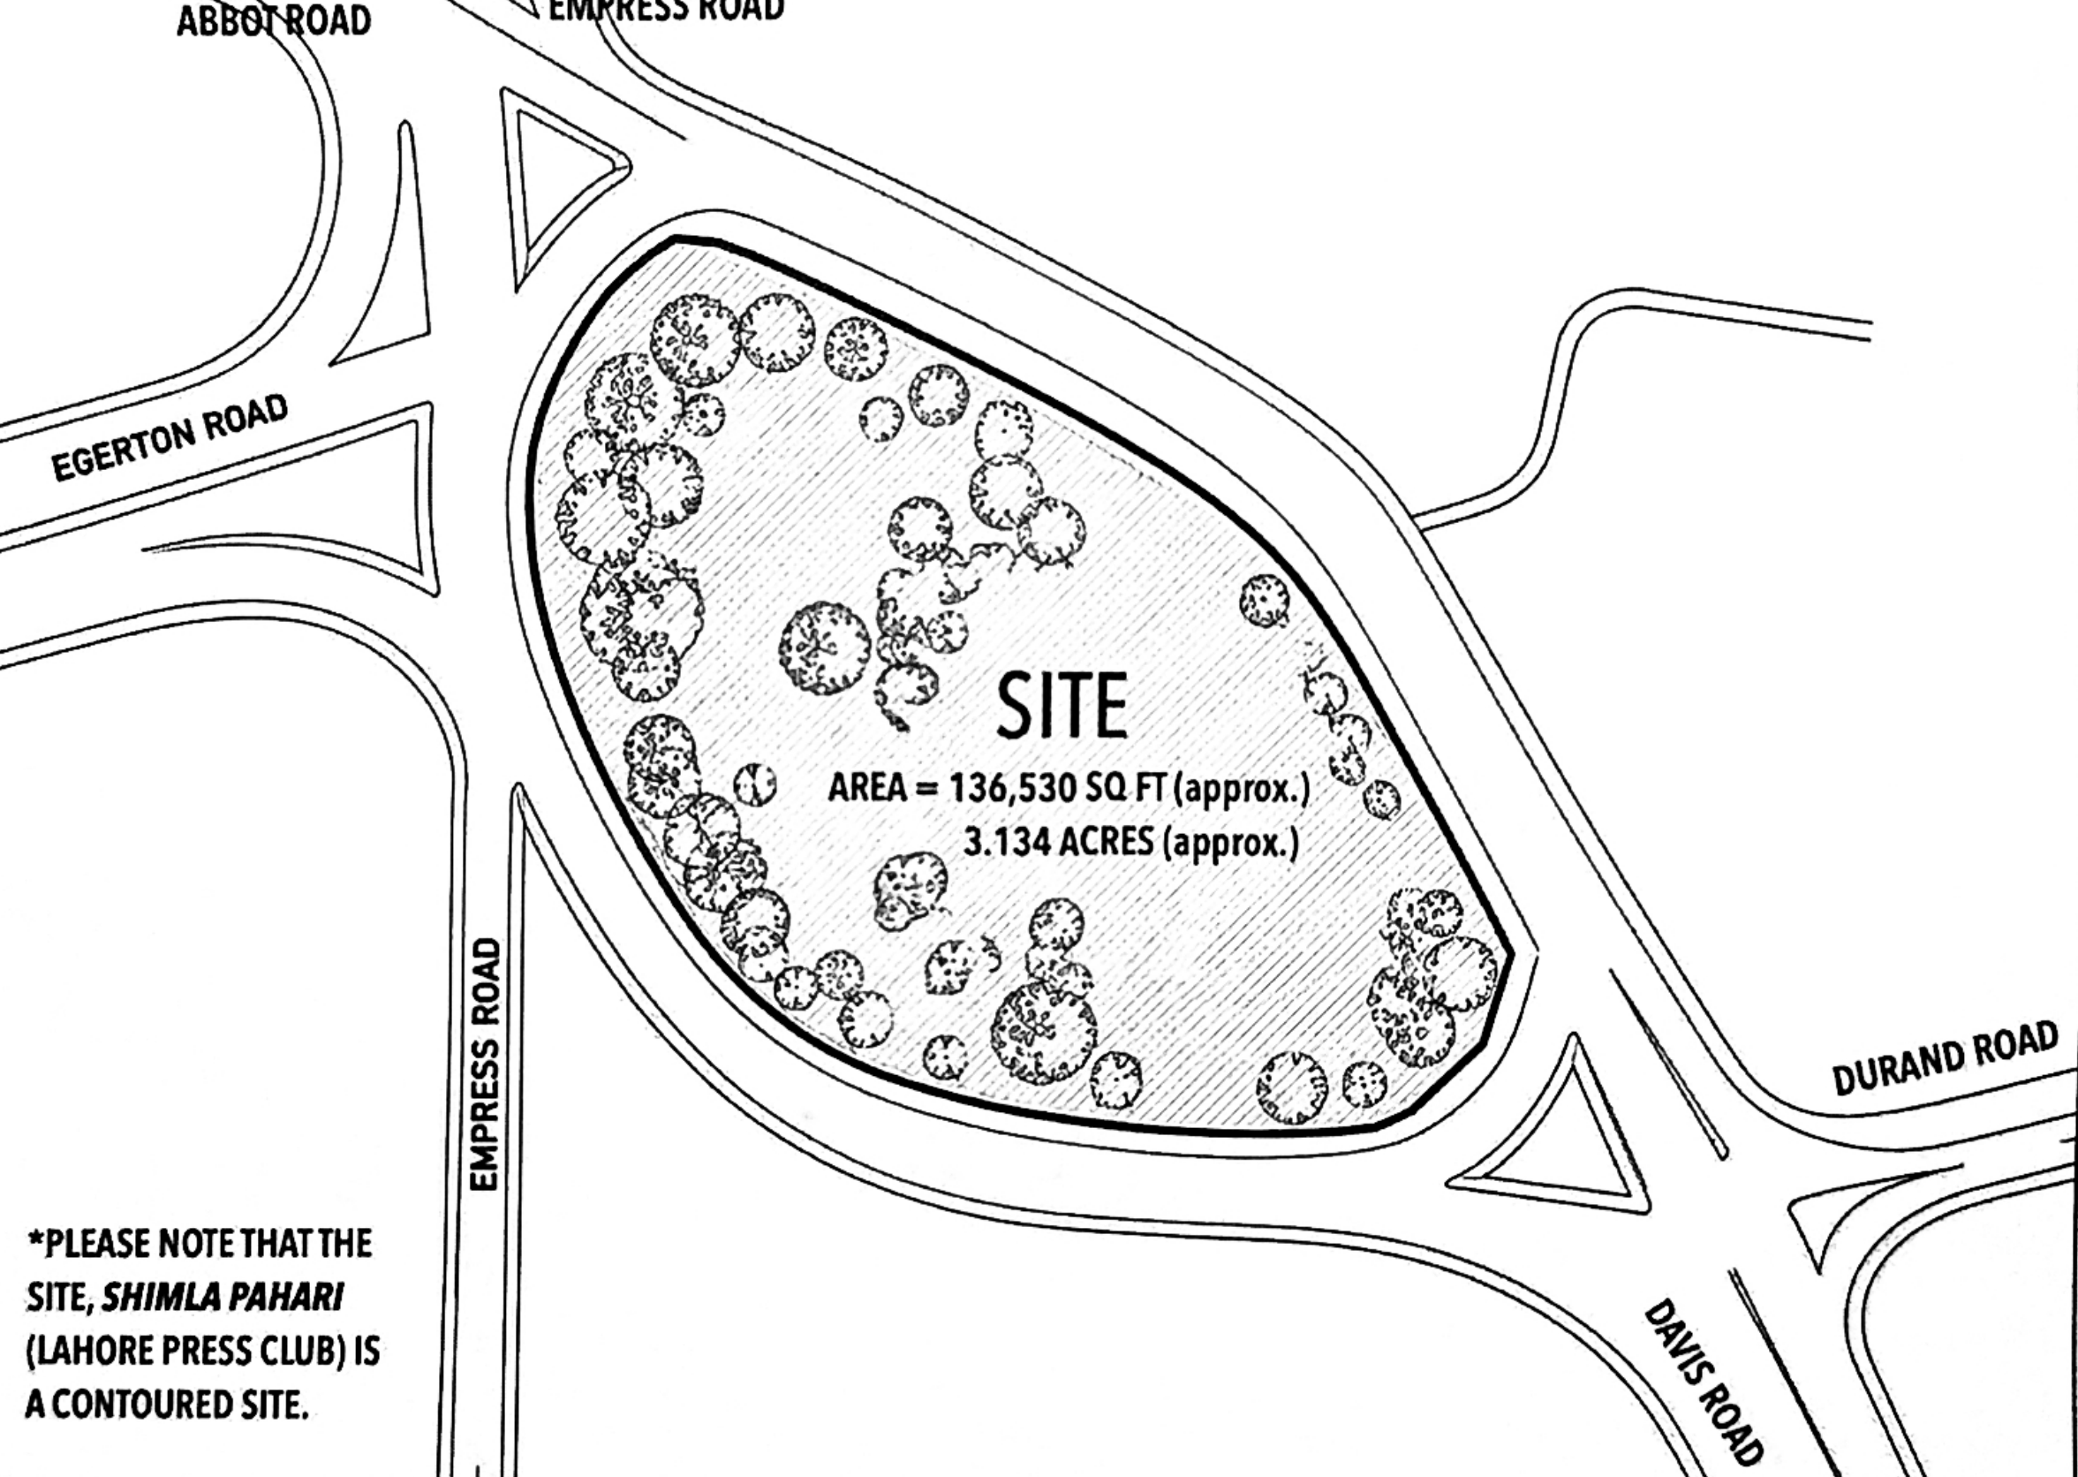
SITES OF REPRESENTATION · THE CONTEMPORARY PUBLISHING HOUSE · ARCH 4201 · SEMESTER 8 · PROJECT 01
02
WHERE? FOR WHOM? WHAT CAN WE LEARN?
Site · Users · Precedents
A
SITE · LAHORE PRESS CLUB · SHIMLA PAHARI
B
USERS · WHO TAKES PART?
C
PRECEDENTS · LESSONS
WHO RESEARCHES?
researchers · academics
Oodi Helsinki Central Library
ALA Architects · Helsinki · 2018
Faces Parliament across a public square. Floors move from busy (events) to working (studios, makers) to quiet (reading).
LESSON Sort activities by noise + publicness; let the citizens' institution face the state.
quiet
READ
PARL.
MAKE
WHO PRODUCES?
writers · artists · intellectuals
WHO PUBLISHES?
journalists · media practitioners
busy
MEET
square
PUBLISHING
HOUSE
Sendai Mediatheque
Toyo Ito · Sendai · 2001
Library, gallery and media centre stacked on open floor plates held by tube structures.
LESSON Mix reading, media and exhibition so different users see and meet each other.
WHO PARTICIPATES?
civic organisations · the public
WHO READS?
the general public
open floors + tubes
Site plan reproduced from the project handout (not to scale)
Centre Pompidou
Piano + Rogers · Paris · 1977
A sloping public piazza in front of an open cultural institution with a free public library.
LESSON Treat the public forecourt as program: where the city gathers before it enters.
3.134 ac
CONTOURED
3 PARTS
WHO DISCUSSES?
public representatives · communities
≈ 136,530 sq ft (approx.)
topography to stay unaltered
Press Club + Shimla Pahari + protest interface
HISTORY man-made mound linked to a brick kiln; slopes + greenery; Press Club later built on part of the hill
CONTEXT Davis Road: historic media street; roads lead to Punjab Assembly · Railway Station · Canal Bank
━ direct relation to the institution ┅ exchange between groups
STATE + PUBLIC BODIES “may engage” — the relationship comes from my own position
piazza
HILL
landmark
PROJECT
amplifier
ROAD
audience
CITY
distribution
Diagrams redrawn by author
Notes:
SITE (all from the handout): Lahore Press Club on Shimla Pahari; approx. 136,530 sq ft / 3.134 acres; a contoured site whose topography must not be altered. The site deliberately includes the Press Club, Shimla Pahari and the immediate public/protest interface. Shimla Pahari was originally a large artificial mound associated with a brick kiln; the Press Club was later built on part of the hill. Davis Road has historically been associated with media activity; surrounding roads lead to the Punjab Assembly, Railway Station and Canal Bank. The handout's own diagram: hill = landmark, project = amplifier, road = audience, to publish is to mediate, city = distribution network.
USERS (named in the handout): researchers, academics, journalists, media practitioners, writers, artists, intellectuals, civic organisations, communities, public representatives, the general public. The state and public bodies "may" be engaged; that relationship is left to my position. The grouping into researches / produces / publishes / reads / discusses / participates is my interpretation.
PRECEDENTS (my selection): Oodi (ALA, 2018) for grading activities from busy to quiet and facing Parliament across a square; Sendai Mediatheque (Toyo Ito, 2001) for mixing library, media and gallery in one open system; Centre Pompidou (Piano + Rogers, 1977) for the public piazza as part of the institution, relevant to the protest interface.

Slide 3
SITES OF REPRESENTATION · THE CONTEMPORARY PUBLISHING HOUSE · ARCH 4201 · SEMESTER 8 · PROJECT 01
03
HOW DOES THE PROJECT WORK?
Program · Access · Process · Design drivers
A
PROGRAM · RELATIONSHIPS
B
ACCESS · PUBLIC → PRIVATE
C
PROCESS
RESEARCH + STUDIOS
ARCHIVE
PUBLIC
protest interface · landscape · exhibition · public forum · library
OPEN
01
ISSUE
who decides what is true?
PUBLISHING
02
BRIEF
a publishing house at the Press Club
SEMI-PUBLIC
reading room · auditorium · workshops · education · archive consultation
03
VISION
citizens take part in public knowledge
LIBRARY + READING ROOM
EXHIBITION
MEDIA + RECORDING
04
USERS
producers ↔ public ↔ state
WORKING
research studios · media + recording · publishing
05
PROGRAM
5 core spaces + debate
06
SPATIAL RELATIONS
public → controlled
PUBLIC FORUM
WORKSHOPS
AUDITORIUM
EDUCATION
PROTECTED
archive stores · production back-of-house
07
DESIGN DRIVERS
see below
08
CONCEPT
next stage
PUBLIC / PROTEST INTERFACE + SHIMLA PAHARI LANDSCAPE (site)
CONTROLLED
My interpretation — the handout asks who has access and who is excluded
● required ○ “may include” ━ strong link ━ link (my reading) · Areas: to be determined in design development
DESIGN
DRIVERS
01 Unaltered topography
02 The protest edge
03 Visible / hidden
04 Degrees of access
05 Protect + share the archive
06 Meeting across users
07 Formal + informal debate
08 Links to city + state
Notes:
PROGRAM (handout): the design must include research and studio areas, a public library and reading room, archive facilities, media and recording spaces, and publishing infrastructure (filled bubbles). To support debate it should integrate formal and informal environments, which may include exhibition spaces, public forums, auditoriums, workshops and educational spaces (outlined bubbles). The program is open-ended and can be expanded. No areas are given in the handout; areas will be set in design development.
RELATIONSHIPS (my reading): research-archive-library form a knowledge chain; media-publishing-workshops form a production chain; forum, exhibition, auditorium and media face the public/protest interface.
ACCESS (my interpretation, not stated in the handout): public, semi-public, working and protected levels, based on the handout's question of who has access and who is excluded.
PROCESS: issue > brief > vision > users > program > spatial relationships > design drivers > concept (next stage).
DESIGN DRIVERS: unaltered topography (handout), the protest edge (handout site), visible/hidden (handout), degrees of access, protecting and sharing the archive, meeting across user groups, formal + informal debate (handout), links to the city and state (handout context).

