Slide 1
WHY THE PROGRAMS NOW CONNECT
Before: 12 separate boxes, each at its own angle, joined only by paths. After: ONE building that follows the hill.
ONE BUILDING
All program sits in a single ring at the foot of Shimla Pahari, following the surveyed +8' contour — so the form comes from the hill, not from boxes.
ARCHIVE
RESEARCH
NE bank: gallery as boardwalk
ONE PUBLIC GALLERY
A 12 ft colonnaded gallery runs the full loop on the hill side. Every room opens onto it, so anyone can walk from the cafe to the library, archive, newsroom and back.
LIBRARY
CHAINS OF RELATED ROOMS
Knowledge: library → archive consultation → archive stores → research. Production: research → (boardwalk) → newsroom → editorial → recording → editing → print. Public: forum → entry hall + cafe → bookshop → exhibition → press conference → auditorium → workshops.
OPEN FORUM
+28' summit
MEDIA
THE HILL IS SHARED
Three stairs climb from the gallery to the open summit forum. The auditorium's seats rake up the existing slope (+8' → +16'), with the stage on the gallery line — no cutting.
LEARN
PUBLIC GALLERY (continuous loop)
CLUB
ENTRY + CAFE
ARMS REACH THE CITY
Press conference, games and print push out from the ring toward Davis Road and frame the entry forum, the protest edge.
AUDITORIUM
EXHIBITION
FORUM · ENTRANCE

Slide 2
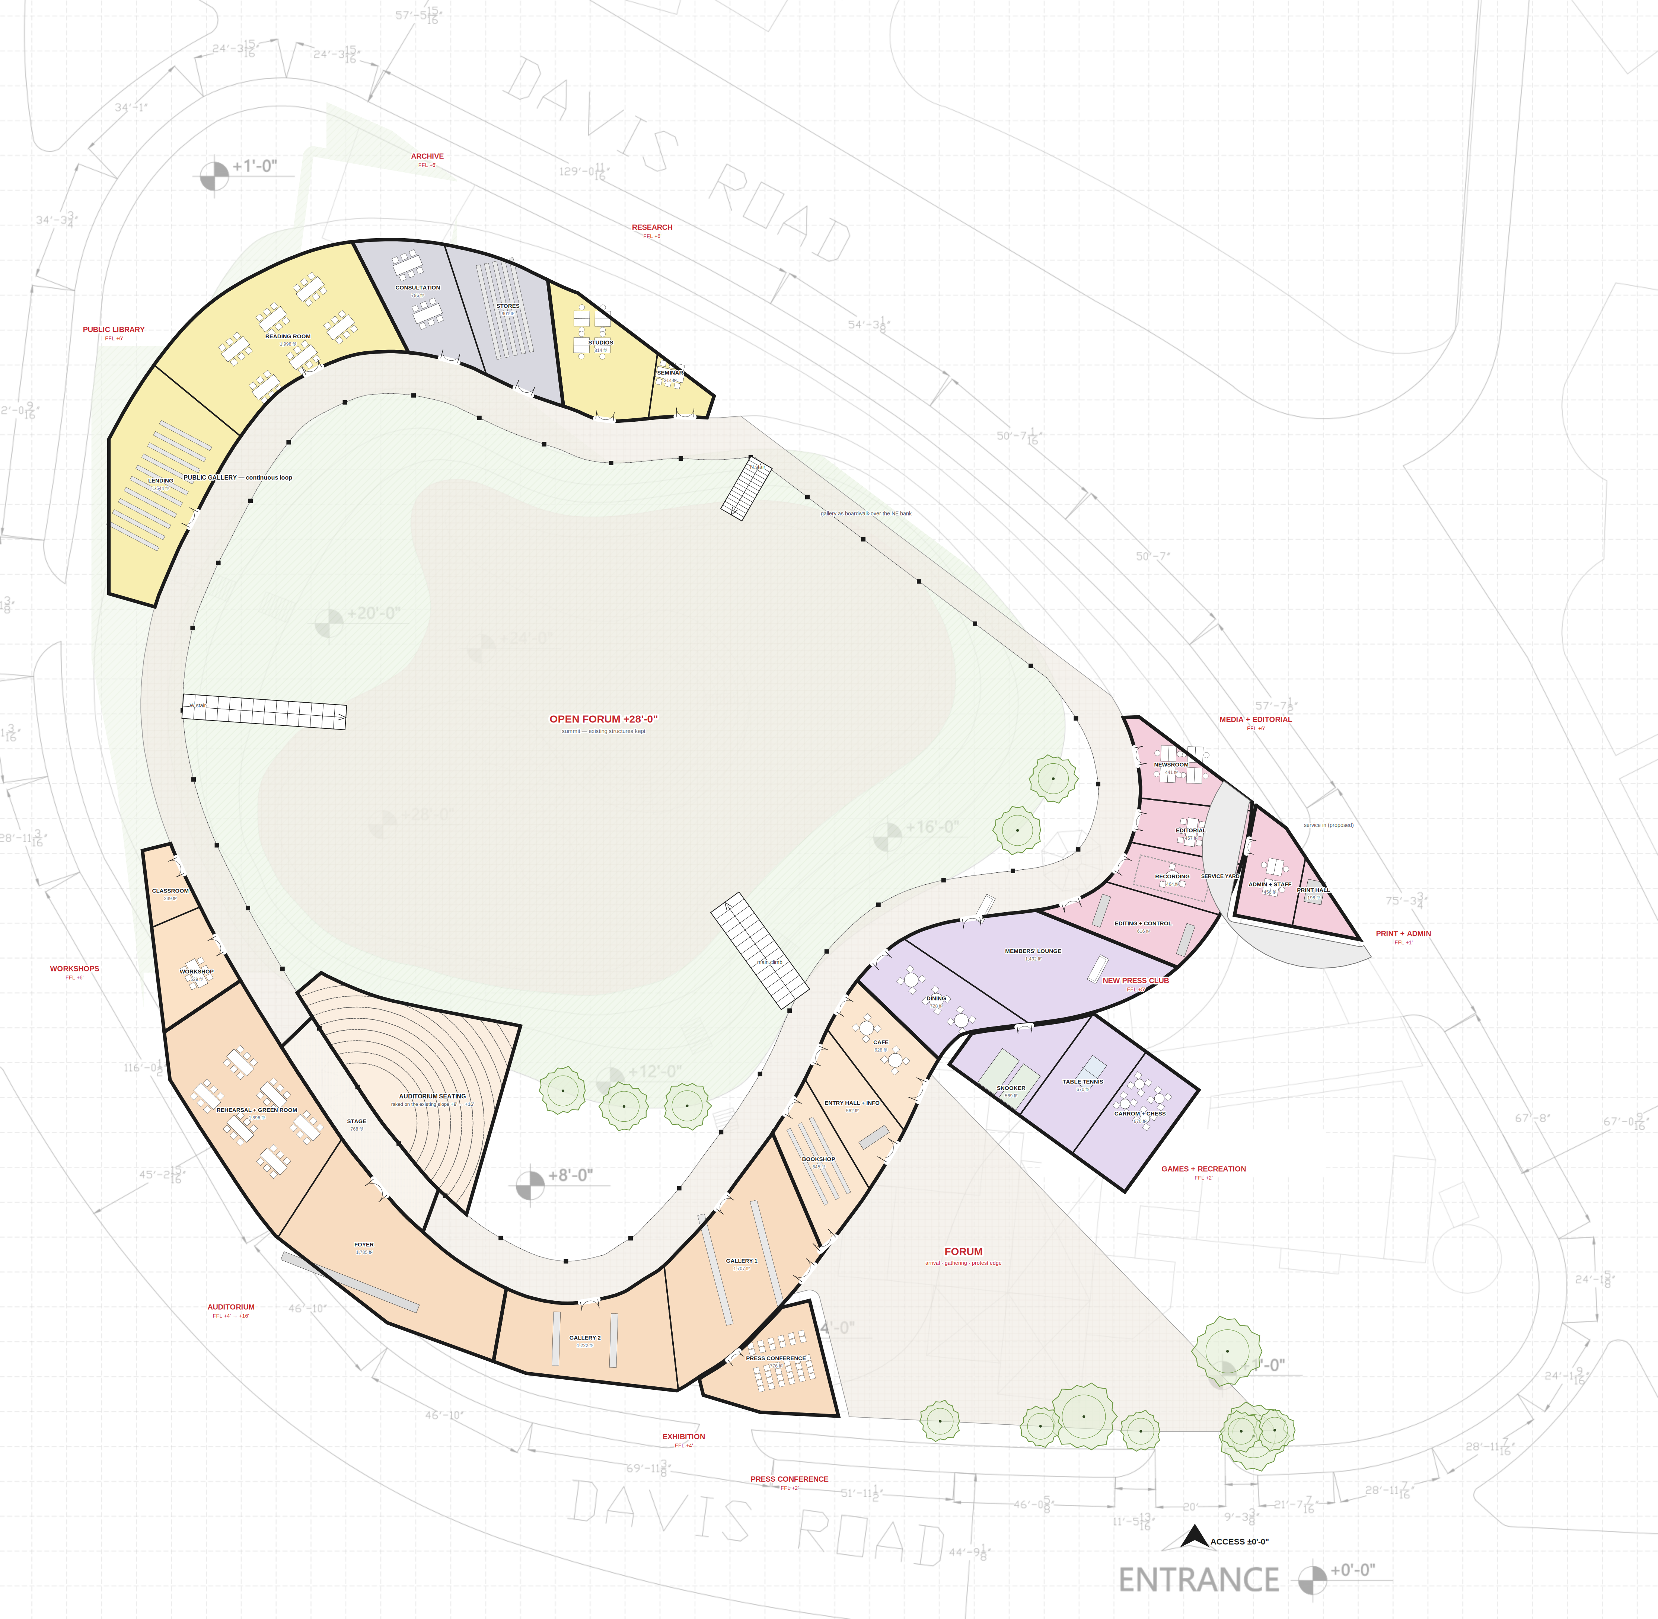
GROUND FLOOR PLAN — THE RING (whole site)
0
25
50
75
100
feet · north not shown on survey
Black walls = one continuous building
■ columns = gallery colonnade (hill side)
Arcs = doors; every room opens to the gallery
Stairs = three climbs to the summit forum
FFL = floor level above entrance ±0'
Base: Shimla Pahari survey. Ring follows the surveyed +8' contour; no regrading. Old Press Club removed. Sizes, rooms, furniture and the service entry are design proposals.

Slide 3
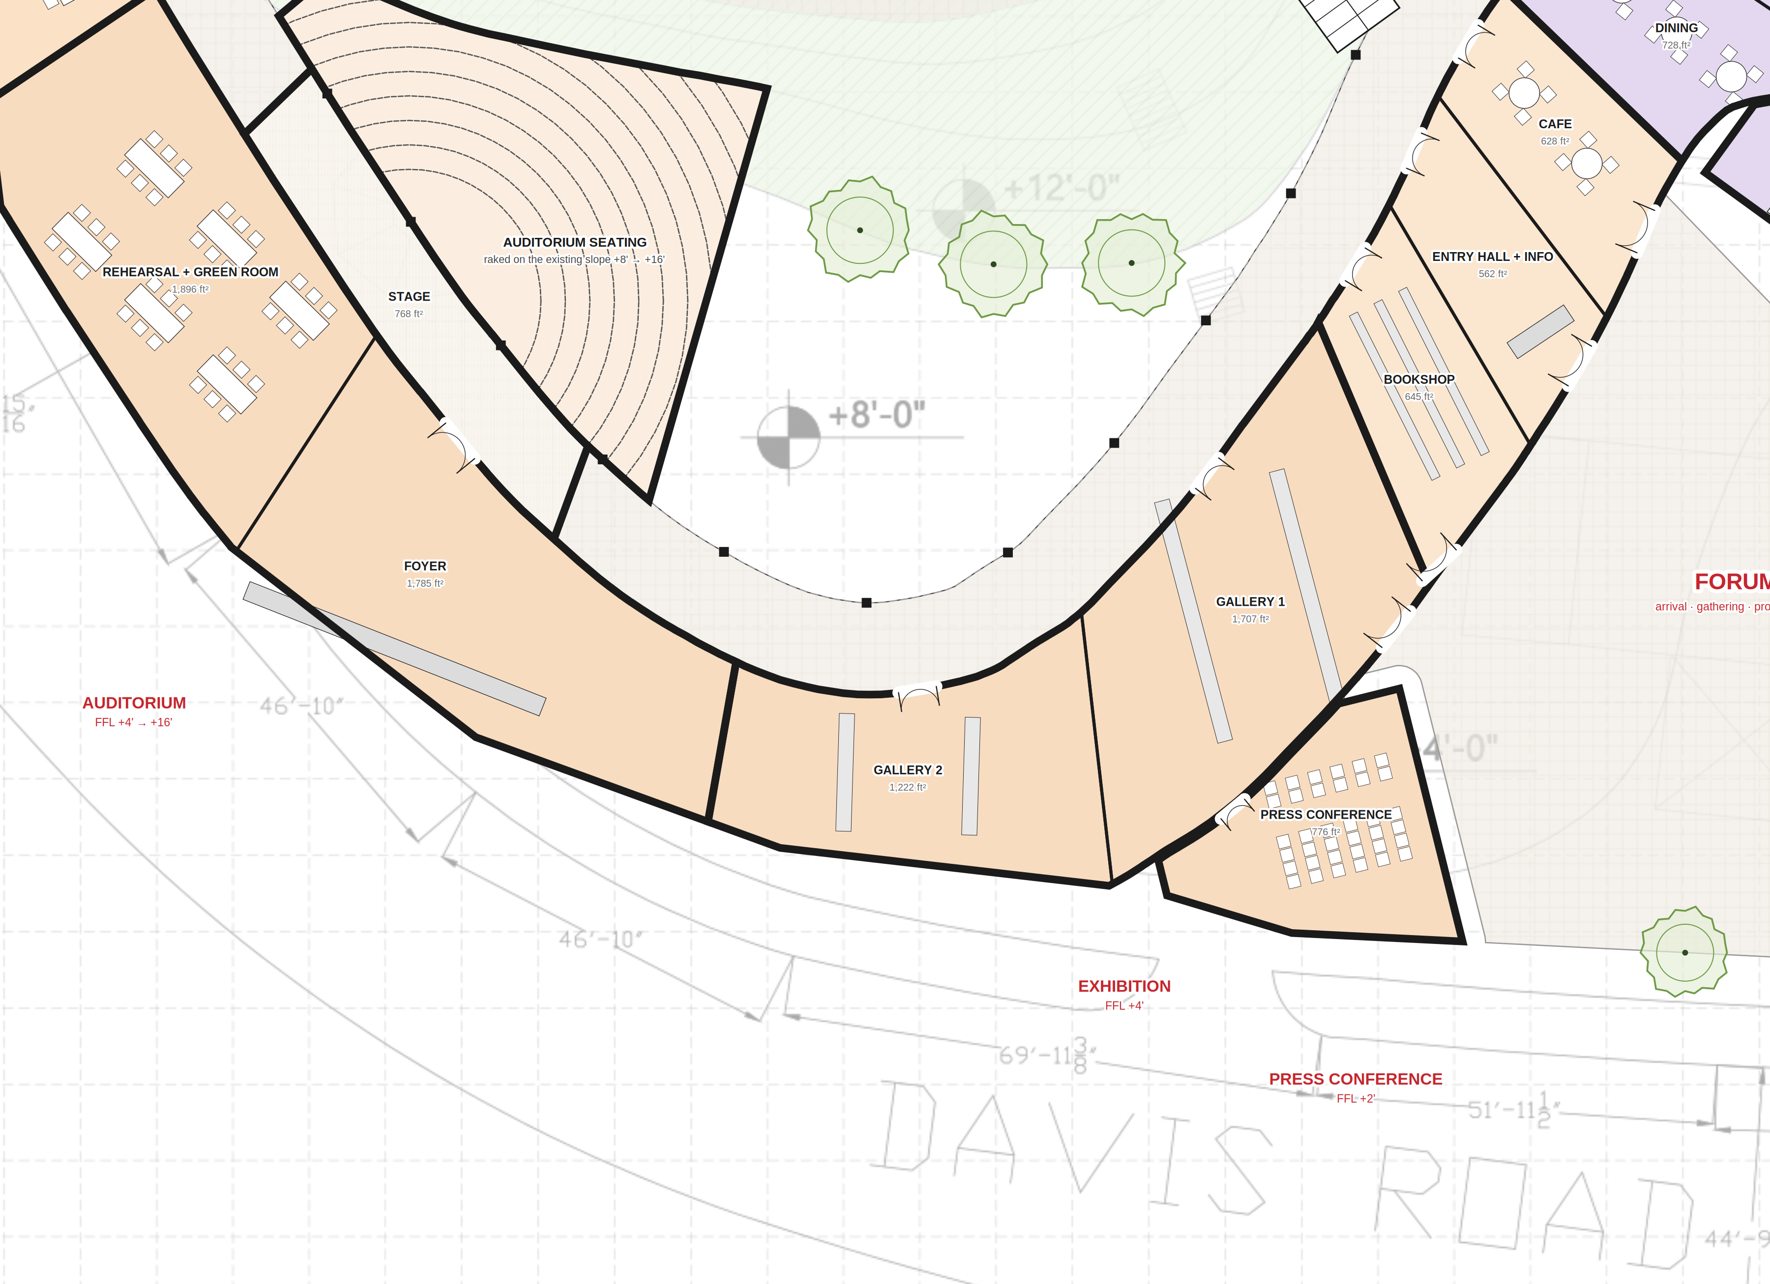
ENLARGED — SOUTH: forum · entry hall · exhibition · press conference · auditorium
0
10
20
30
40
feet · north not shown on survey
Black walls = one continuous building
■ columns = gallery colonnade (hill side)
Arcs = doors; every room opens to the gallery
Stairs = three climbs to the summit forum
FFL = floor level above entrance ±0'
Base: Shimla Pahari survey. Ring follows the surveyed +8' contour; no regrading. Old Press Club removed. Sizes, rooms, furniture and the service entry are design proposals.

Slide 4
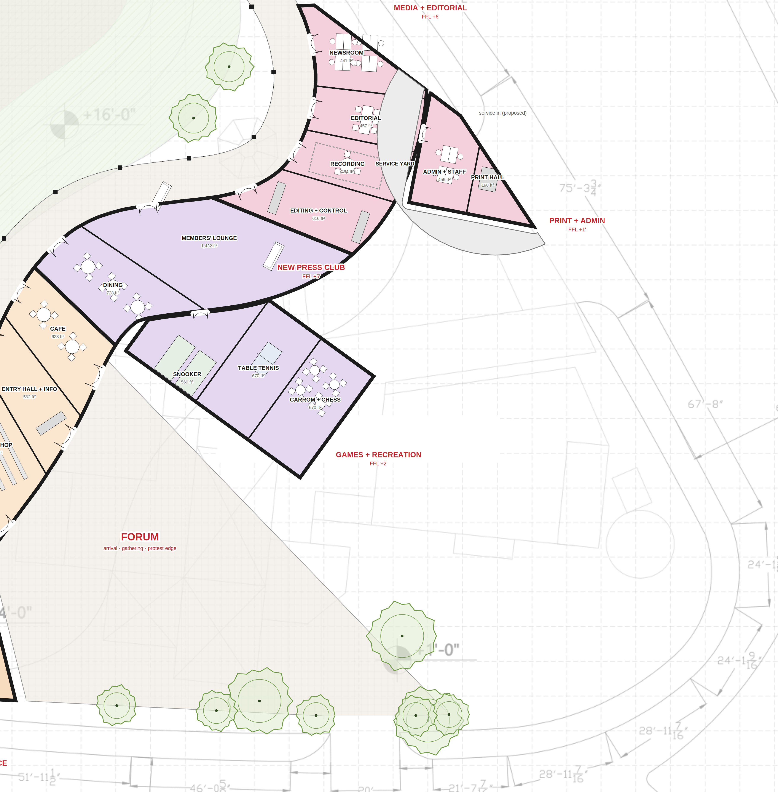
ENLARGED — SOUTH-EAST: press club · games · media + editorial · print + admin
0
10
20
30
40
feet · north not shown on survey
Black walls = one continuous building
■ columns = gallery colonnade (hill side)
Arcs = doors; every room opens to the gallery
Stairs = three climbs to the summit forum
FFL = floor level above entrance ±0'
Base: Shimla Pahari survey. Ring follows the surveyed +8' contour; no regrading. Old Press Club removed. Sizes, rooms, furniture and the service entry are design proposals.

Slide 5
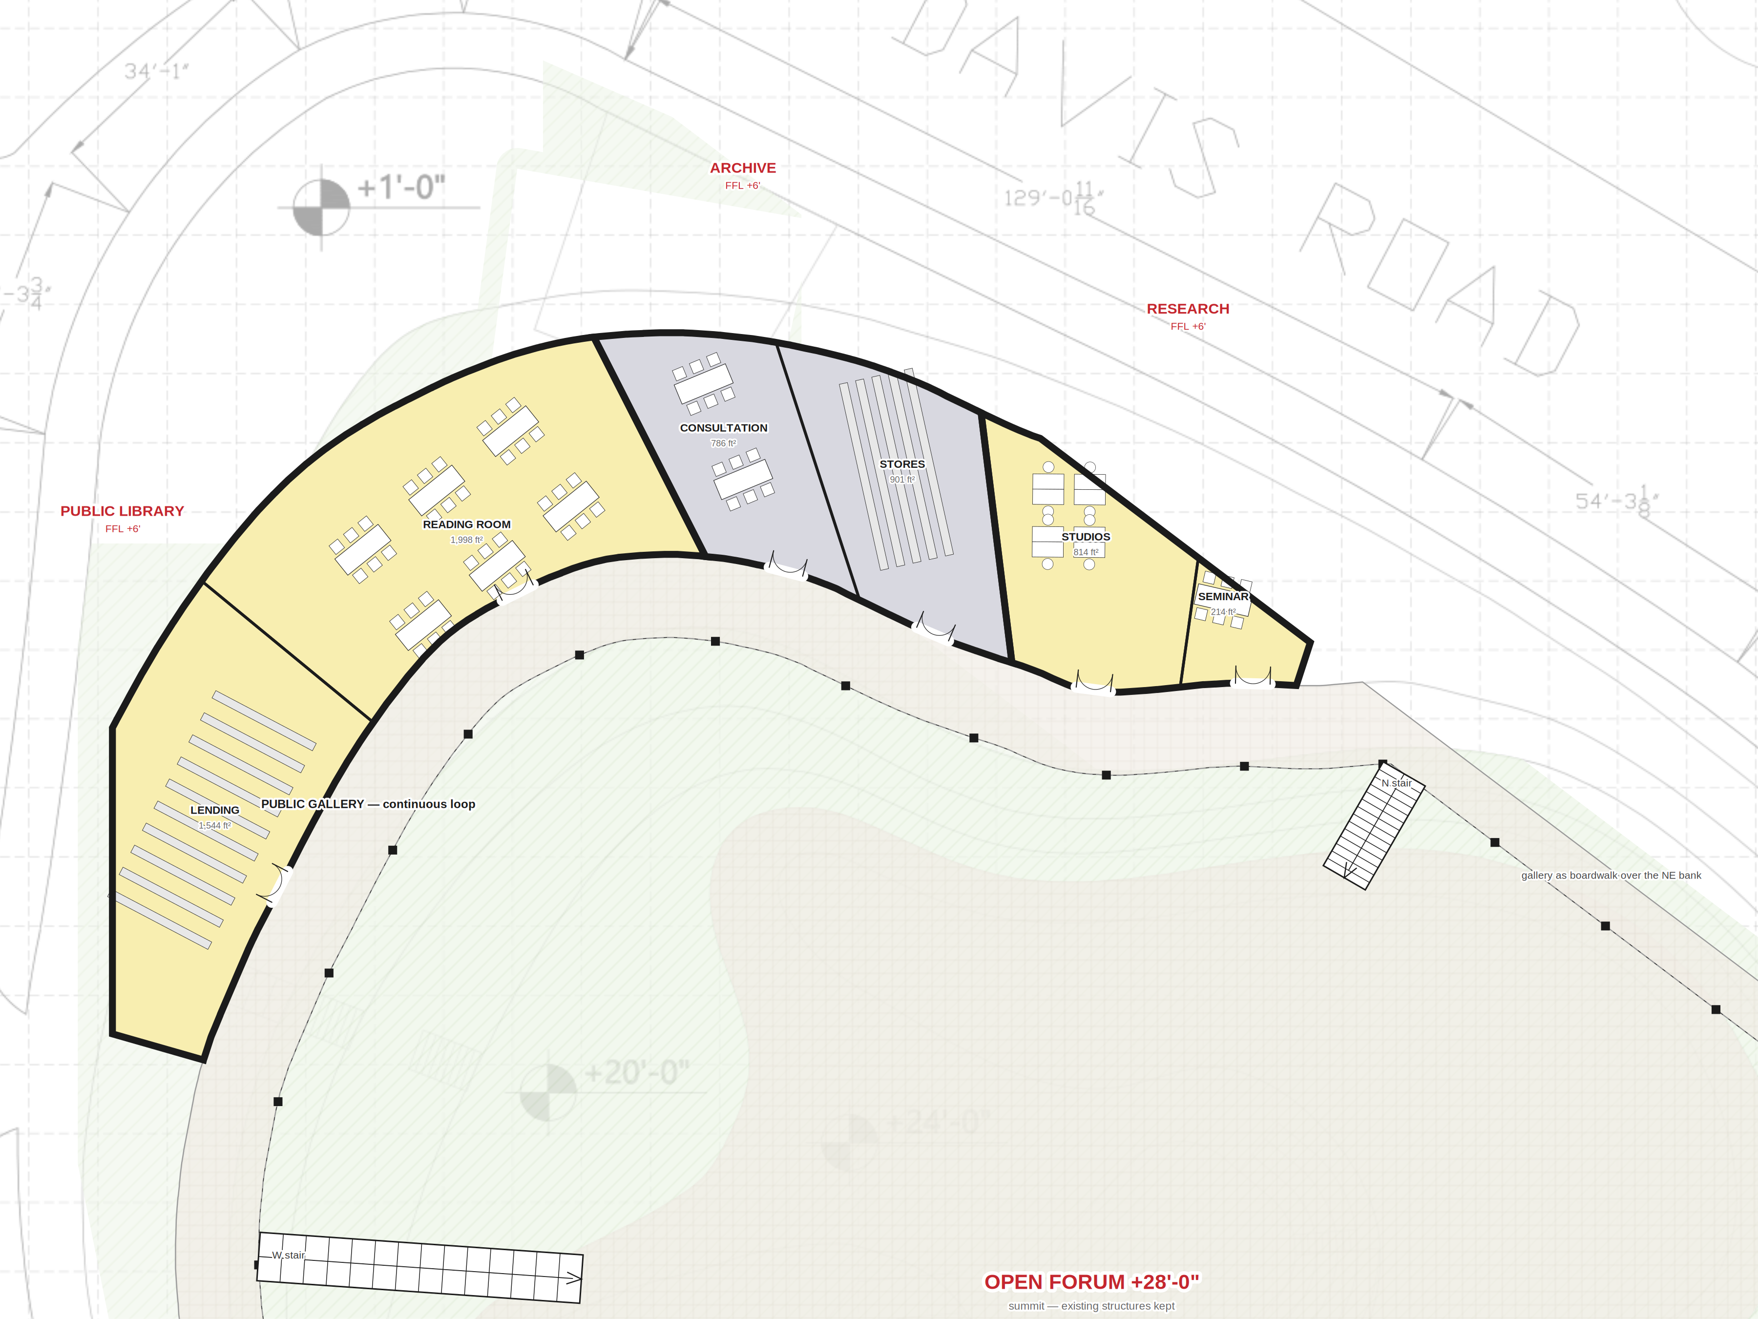
ENLARGED — NORTH: library · archive · research
0
10
20
30
40
feet · north not shown on survey
Black walls = one continuous building
■ columns = gallery colonnade (hill side)
Arcs = doors; every room opens to the gallery
Stairs = three climbs to the summit forum
FFL = floor level above entrance ±0'
Base: Shimla Pahari survey. Ring follows the surveyed +8' contour; no regrading. Old Press Club removed. Sizes, rooms, furniture and the service entry are design proposals.

